Slide 1
Micro-Aggression
Video Vignettes
Client: Dr. Karen DePauw
April 28, 2016
CS 4624-Virginia Tech
Blacksburg, VA
Laxmi Patha
Divya Sharma
Gurkiran Sethi
Pranavi Kotagiri
Notes:
Harsha

Slide 2
What is Micro-Aggression?
Verbal, nonverbal, and environmental slights, snubs, or insults
-Intentional or unintentional
Communicate hostile, derogatory, or negative messages to target persons
  -Based solely upon their marginalized group membership
Notes:
Harsha

Slide 3
What is our objective?
Try to garner attention and awareness regarding everyday micro-aggression
Educate the public with the help of:
  YouTube
  Dean DePauw (Dean of Graduate Education)
  Website - Microaggressions @ VT - http://microaggressions.cs.vt.edu/index.php
Notes:
Kiran

Slide 4
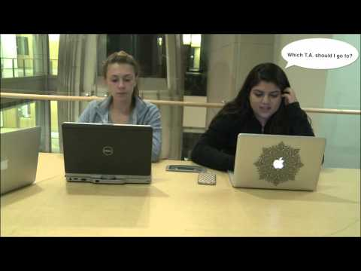
Sexism + Ascription to Intelligence
Notes:
Divya

Slide 5
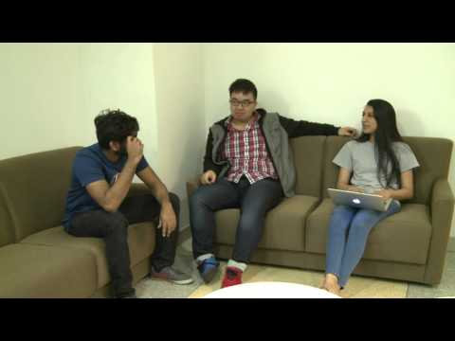
Pathologizing Cultural Values/ Communication Styles
Notes:
Divya

Slide 6
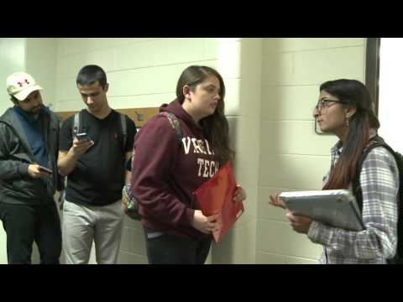
Foreigner in Your Own Country
Notes:
Kiran

Slide 7
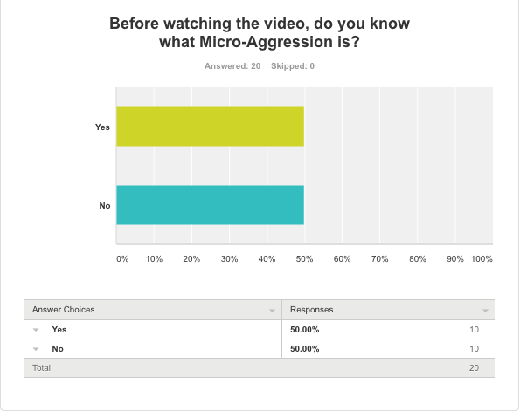
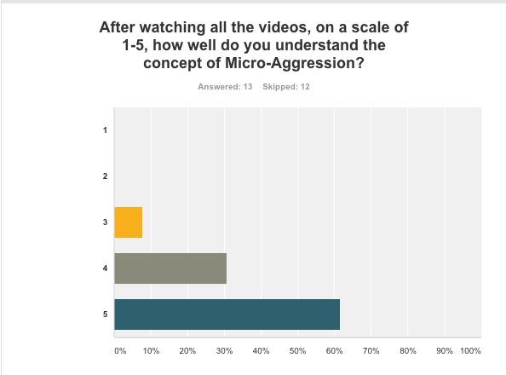
Evaluation
Notes:
Divya

Slide 8
Acknowledgements
Dr. Karen DePauw
Dr. Edward Fox
Innovation Space Center Faculty
Foreigner in Your Own Country Video Actors/Extras:
Abi Subramanian, David Pickle, Pratishtha Puri,
Ahmed Zuwawa, Shabaan Rana
Notes:
Pranavi

Slide 9
Sources
Tool Recognizing Microaggressions. (n.d.). Retrieved from <http://academicaffairs.ucsc.edu/events/documents/Microaggressions_Examples_Arial_2014_11_12.pdf>
N.p., n.d. Web. Retrieved 30 Mar. 2016>. <https://www.aja.com/assets/news/img/226/524dbb37919a4.jpg>.
"Cinematic Terms - A FilmMaking Glossary." Cinematic Terms - A FilmMaking Glossary. N.p., n.d. Web. Retrieved 25 Mar. 2016. <http://www.filmsite.org/filmterms19.html>.
PMW-EX1. N.p., n.d. Web. Retrieved 15 Mar. 2016. <http://www.pro.sony.eu/pro/lang/en/eu/product/broadcast-products-camcorders-xdcam/pmw-ex1/overview/>.
"Azden 330LT." N.p., n.d. Web. Retrieved 21 Mar. 2016. <http%3A%2F%2Fwww.bhphotovideo.com%2Fc%2Fproduct%2F733909-REG%2FAzden_330ULT_330LT_UHF_On_Camera_Dual.html>.
"Final Cut Pro X Transition Effects: Dissolves Start and Finish on Edit."Alex4D Old Blog. N.p., 02 July 2011. Web. 19 Apr. 2016. <https://blog.alex4d.com/2011/07/02/final-cut-pro-x-transitions-dissolves-start-and-finish-on-edit/>.
"Final Cut Pro X: Cut Clips with the Blade Tool." Final Cut Pro X: Cut Clips with the Blade Tool. N.p., n.d. Web. 19 Apr. 2016. <https://support.apple.com/kb/PH12549?locale=en_US&viewlocale=en_US>
Notes:
Pranavi

Slide 10
Questions?
Notes:
All

