Slide 1
Vocalization Detection
Team: Dat Bui, Amr Aboelnaga
Client: Dr. Michael Bowers
Course: CS4624 Multimedia, Hypertext and Information Access Capstone
Instructor: Dr. Edward Fox
Virginia Tech, Blacksburg 24061
4/29/20

Slide 2
Outline
Technology used
Timeline
Overview
Phases of Work
Progress
Deliverables
Roles
Future Work
Lessons Learned
Acknowledgements / References

Slide 3


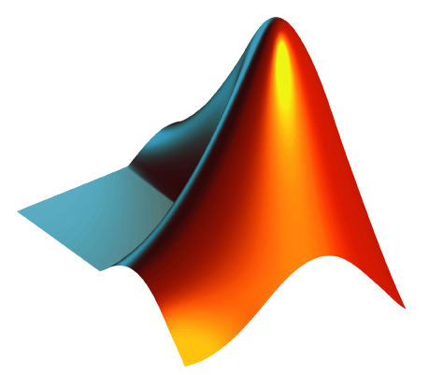

Technology used
Github
Kaggle
MATLAB
PyWinAuto
Ghidra
Python
NumPy
Pandas

Slide 4
Timeline
2/3 - Milestone: Receive kaggle data
2/17 - Milestone: Process data
4/4 - Interim Report
4/7 - Milestone: Model refined
4/13 - Begin Data Matching
4/17 - Milestone: Application is developed and ready to use
4/26 - VTechWorks

Slide 5
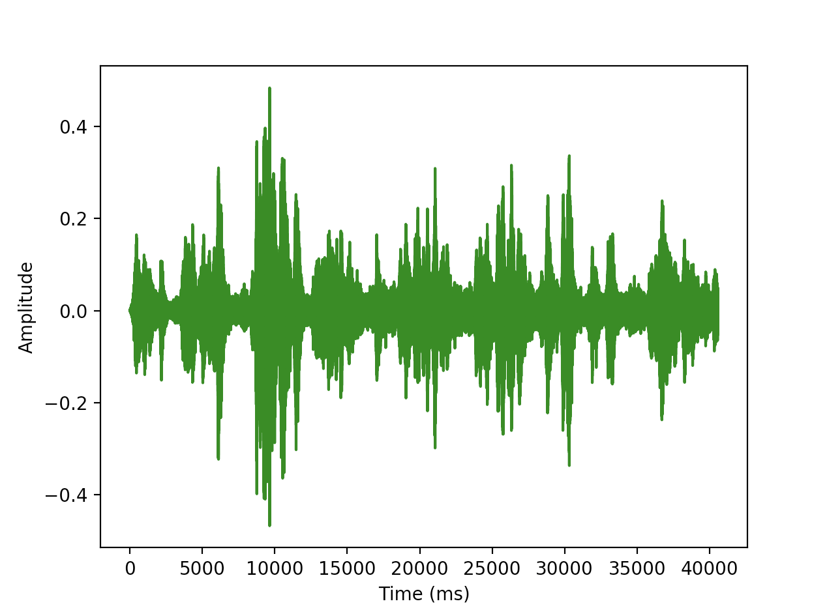
Overview
Goal is to facilitate Dr. Bower’s research
Attempts have been made to automate AviSoft
  Automation with Python was not practical
  Reverse engineering proved to be nearly impossible
DeepSqueak
  Transforming wav files into spectrograms for image processing
  Detection
  Classifications
    Clustering
    K-means clustering
    Supervised classification
    Wright Classifier Network

Slide 6
Phases of Work
Pipelining and integration of DeepSqueak data with AviSoft
  At the beginning
Automation of AviSoft
  Did not work
Data matching between DeepSqueak and AviSoft
  Current stage

Slide 7



Phases of Work
Pipelining and Integration of AviSoft and DeepSqueak
  Original plan
  AWS, PostgresSQL, Python
  Was not what Amr had in mind

Slide 8
Phases of Work
Automation of AviSoft
  Attempts were made to automate functionality of AviSoft
  PyWinAuto
    Would have been counterintuitive
  Ghidra
    Reverse engineering tool
    Disassembly of source code
    Not practical

Slide 9
Phases of Work
Data matching
  Python script that takes in AviSoft file and DeepSqueak classifications file
  Syncs up classifications between the two
  Checks for correlations between AviSoft data and DeepSqueak data

Slide 10
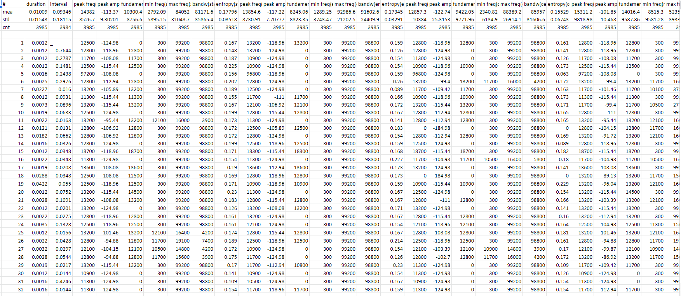
AviSoft data

Slide 11
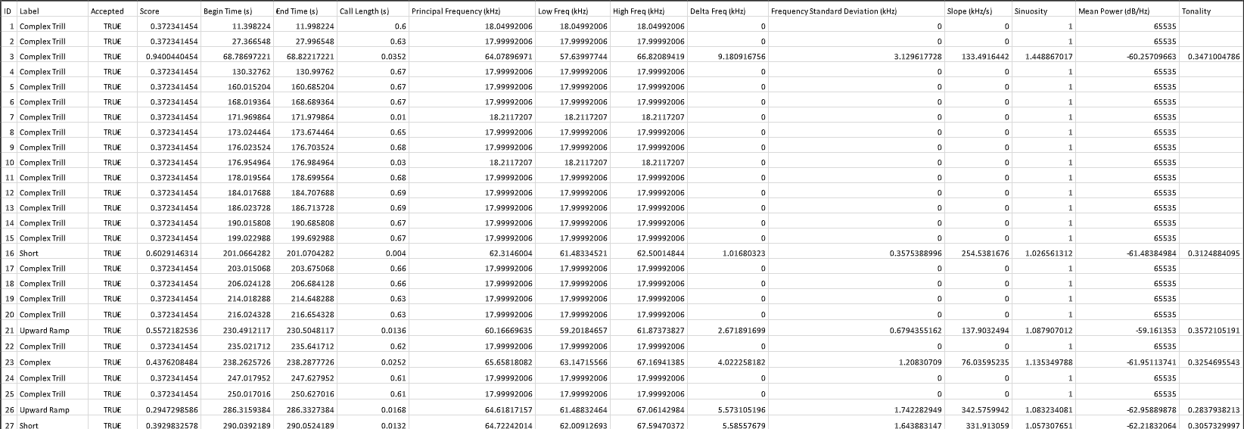
DeepSqueak Output

Slide 12
Progress - Detection
Faster R-CNN
State of the art detection model
We only want to detect Ultrasonic Vocalizations

Slide 13
Progress - Classifications
Wright Classifier Network
Accuracy up to 75% from a baseline of ~30%
Training with Dr. Bowers’ data
Data augmentation

Slide 14
Roles
Dat Bui
  Automation
  Learning DeepSqueak MATLAB library
  Data matching
  Note-taking
Amr Aboelnaga
  Development and improvement of Machine Learning model
  Graduate Student
Mike Bowers, PhD
  Collection and categorization of vocalization data from rats

Slide 15
Future Work
Improved Classifier Network
Standalone application

Slide 16
Lessons Learned
Communication
COVID-19
Linear Progression

Slide 17
Acknowledgement
Client
  Dr. Mike Bowers
Graduate Student Correspondent
  Amr Aboelnaga
Instructor
  Edward Fox
DeepSqueak
  https://www.researchgate.net/publication/330143833_DeepSqueak_a_deep_learning-based_system_for_detection_and_analysis_of_ultrasonic_vocalizations

