Slide 1

The information, data, or work presented herein was funded in part by the Advanced Research Projects Agency-Energy (ARPA-E), U.S. Department of Energy, under Award Number DE-AR0000293.
Sensitivity of Wind Turbine Airfoil Sections to Geometry Variations Inherent in
Modular Blades
Photo: http://www.windpowerengineering.com/
Ken Brown, Nick Molinaro, Tim Meyers, Mike Nelson, Aurelien Borgoltz, Nanya Intaratep, William Devenport
  Virginia Tech, Blacksburg, VA, U.S.A.
Jonathan Luedke, David Pesetsky
  GE Power and Water, Greenville, SC, U.S.A.
June 9, 2015
NAWEA Symposium

Slide 2
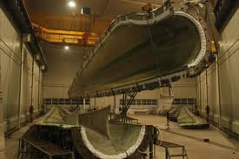
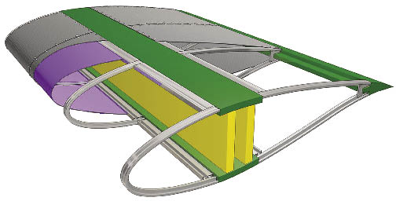
Motivation
Wind turbine blades need to grow longer to lower the cost of electricity
Conventional
2-piece mold shell manufacturing
Transportation difficulties
Low stiffness/weight ratio
Fixed outer mold line
Modular
Modular manufacturing
Build on-site
Tailor-able stiffness/weight ratio
Misaligned/flexible outer mold line
Photo: http://www.frpinchina.com/
Photo: courtesy of GE Power and Water
Dutton et al. (2000), Vionis et al. (2006), Saenz et al. (2014)
Notes:
Because the power-generating capacity of a wind turbine is proportional to the swept area of its rotors, there is an ever-present push to build longer and longer blades to increase the output per turbine and lower the cost of electricity.
The conventional way to build a blade is from composite laminate material that is molded into 2 halves and joined together to form a full-length blade in the factory.
The concept of the modular blade is to build reasonably sized segments that are easier to both manufacture and transport and then assemble the segments into the full span at the wind farm site. Modular blade designs may have several chordwise sections as shown here: a nose module, two center spars, an aft section, and a trailing edge stiffener. One proposed design, such as the one here, uses a fabric section in the aft region for weight/cost saving. One of the challenges of the concept is that the outer-mold line is made from multiple materials, so there is the possibility for misalignments in the 2D blade profile (such as this section being displaced up or down), as well as for varying variable profile due to flexible materials such as the fabric in the aft section.
The aim of this research is to experimentally measure the aerodynamic impact of such misaligned/flexible outer mold lines.
%Current standard: 50-100m for onshore applications
%Newest designs: 110-130m “ “

Slide 3
Outline
Modular wind turbine blades
Misaligned sections
  Literature
  Configuration
  Test setup
  Results
Fabric sections
  Literature
  Configuration
  Test setup
  Results
Summary
Notes:
The order of this talk will be first to discuss the impacts of misaligned sections in the 2D profile of a turbine blade, and second the impacts of having fabric sections in the aft region of the model. Sort of a two-segment talk.

Slide 4



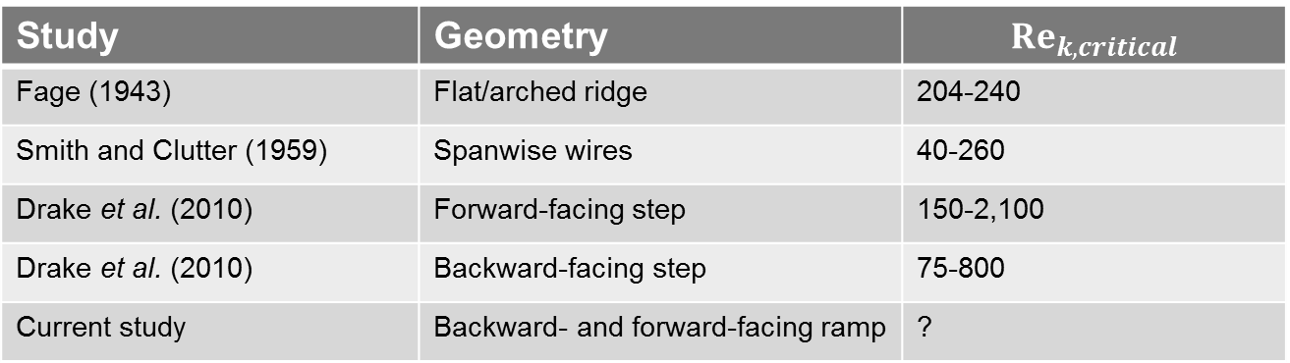
Misaligned sections: literature
Transition behavior
2D disturbances thought to contribute to Tollmein-Schlichting type transition (Braslow, 1960)
Roughness Reynolds number: ${\text{Re}}_{k} \text{=}\frac{μ_{k}k}{ν_{k}}$
${\text{Re}}_{k,critical}$ may be influenced by length of preceding laminar boundary layer, width of geometric feature, type of the geometric feature, and pressure gradient in boundary layer
$μ_{k}$ - flow velocity at top of roughness in undisturbed case
$k$ - roughness height
$v_{k}$ - kinematic viscosity at roughness location
Study | Geometry | $$Re_{k,critical}$$
Fage (1943) | Flat/arched ridge | 204-240
Smith and Clutter (1959) | Spanwise wires | 40-260
Drake et al. (2010) | Forward-facing step | 150-2,100
Drake et al. (2010) | Backward-facing step | 75-800
Current study | Backward- and forward-facing ramp | ?
Notes:
The dominant concern with misaligned sections is premature transition caused by discontinuity in the profile surface that can increase drag and decrease lift.
2D disturbances contribute to the amplification of Tollmein-Schlichting type transition % and are generally more severe in this sense than 3D roughness of the same height.
The severity of the disturbance can be non-dimensionalized by the so-called roughness Reynolds number and the critical roughness Reynolds number is that at which the transition point starts to move forward relative to the undisturbed case.
Studies in the past on a variety of configurations have predicted a range of Re_k values. The studies shown here range from as low as 40 to as high as 2,100. The variability is due to two main reasons: shape of the geometry (for instance the variation between Drake et al.’s configurations is due to the step facing backwards or forwards, and it is true that the backward-facing geometries have lower Re_k’s and require tighter manufacturing tolerances) and the pressure gradient in the boundary layer (for instance the variation within each of Drake et al.’s configurations is due to pressure gradient with more favorable pressure gradient having a stabilizing effect on BL and allowing larger Re_k).

Slide 5
Misaligned sections: configuration
DU00-W-212 profile
Flow
0.6-mm (0.075%c)
Backward-facing ramp
Camber line
Forward-facing ramp
Flow
0.6-mm (0.075%c)
Offset results in an effective increase in camber
and, more importantly, produce discontinuities in the profile
Notes:
The test developed to measure the effect of misaligned sections on a wind turbine profile was centered around the DU00-W-212 profile which is a 21.2% thick section designed at Delft University.
A thickness-wise misalignment in the nose region might occur up or down, and it was selected in this study to move it up since this puts the more critical backward-facing step on the suction surface.
…such an offset increases slightly the camber of the profile, but more importantly, it creates discontinuities in the profile…such as a backwards facing ramp on the suction side…and a forward-facing ramp on the pressure side. Ramps were selected for this study because of certain manufacturing processes foreseen for modular blades by the sponsors.
Two different offset levels were selected corresponding to a typical misalignment and a worst-case misalignment based on predicted manufacturing tolerances and scaled for wind tunnel testing using the ratio of the wind tunnel model's chord to the full-scale chord. The scaled worst-case is shown here which is 0.6-mm, and the typical case is half that.
%The $Re_{k}$ values of these offsets on the suction side at the design angle of attack equate to roughly 1,400 and 4,400, respectively, which are on the upper end of the Re_k,crits of the previous slide.

Slide 6
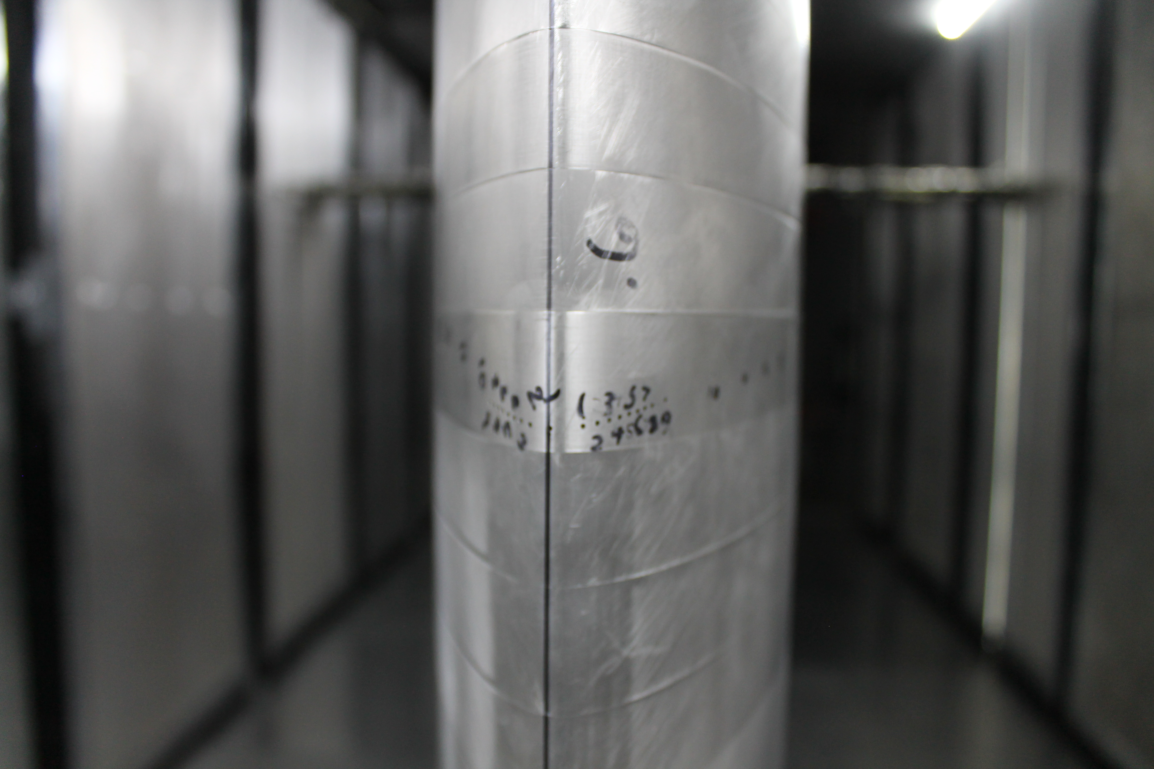
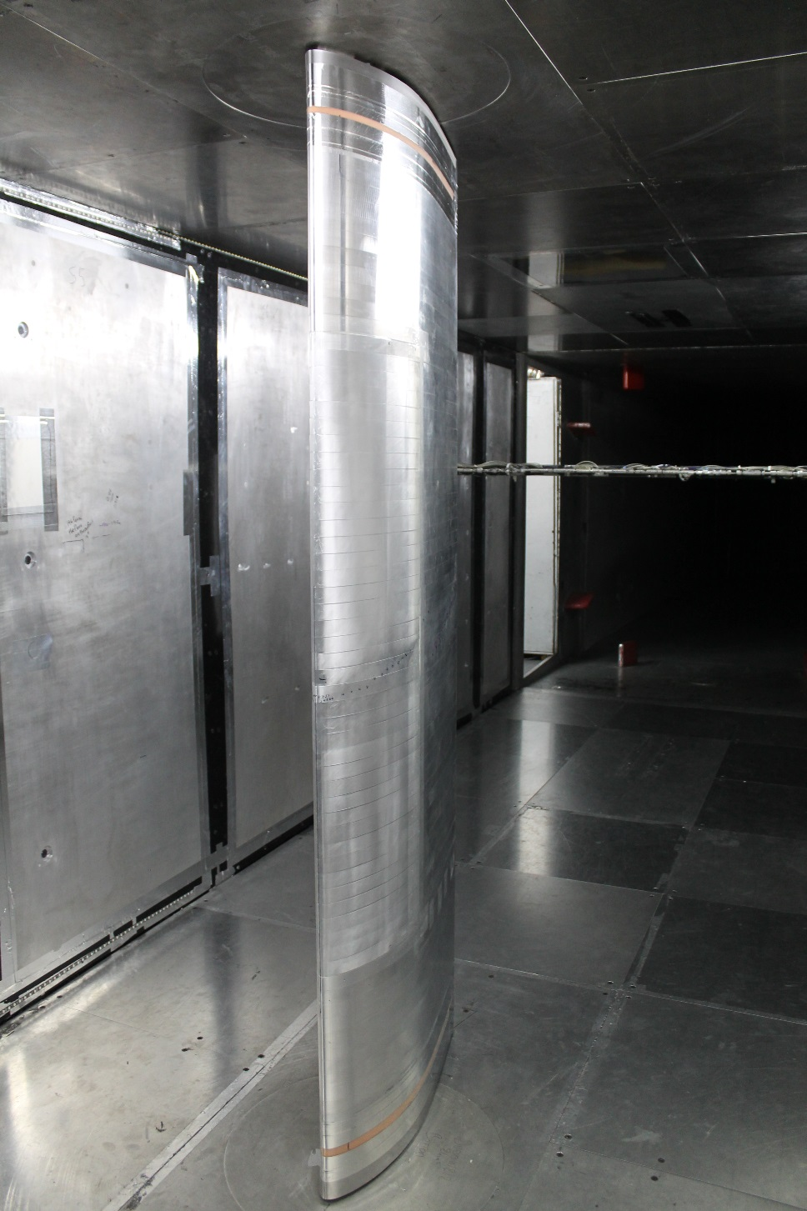
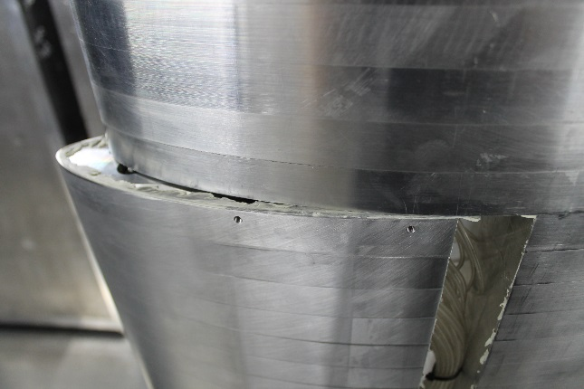
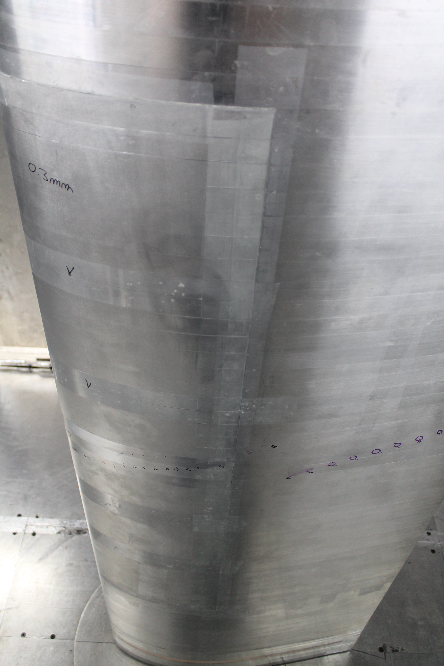
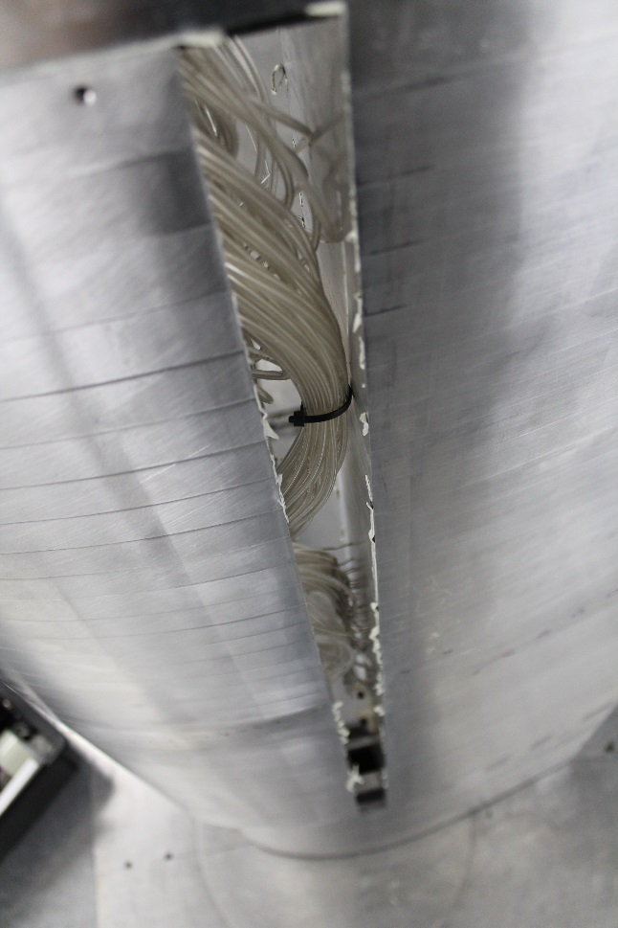
Misaligned sections: test setup
Model:
DU00-W-212
0.6-m chord
64 aluminum laminates
73 pressure taps
3 nose modules: baseline, 0.3-, and 0.6-mm offsets
Endwall suction on
Measurements:
Mean surface pressure
Wake profiles
Test Conditions:
Re = 2.5x10⁶
Ma = 0.21
0.24 m
Sealing putty
Set-screw holes
Internal pressure tubing
1.85 m
1.01 m
Endwall suction inlets
0.61 m
Flow
Notes:
Model in the SWT. We have full-span models that span the entire 6-ft. height of the test section, and the model is mounted vertically, half-way between each walls. What is unique about this particular model is it has a removable leading-edge module that spans 55% of the span and is 40% chordwise. We had three different nose modules machined: a baseline, 0.3-mm offset, and 0.6-mm offset. The offset ramp is shown in the top right photo, hardly discernable. (The joint between the leading edge module and the main airfoil DID some slight steps in the flow surface due to poor manufacturing that were on average ~8 mil (0.2mm) but these were over 15% downstream of the designed ramps and are not believed to have significant effect on the final conclusions of this study.) It should be stated that due to unexpected torsional twist in the angle of attack mounting system with wind loading, the angle of attack uncertainty is higher than typical and the following polar data have been aligned in angle of attack using shifts that are derived from XFOIL predictions, within the estimated 0.5 deg. absolute angle of attack uncertainty.

Slide 7






Misaligned sections: results
$$C_{l,min}$$
$${{(C}_{l}/C_{d})}_{min}$$
$${{(C}_{l}/C_{d})}_{max}$$
$$C_{l,max}$$
Re = 2.5x10⁶
Ma = 0.21
Re = 2.5x10⁶
Ma = 0.21
Re = 2.5x10⁶
Ma = 0.21
${\text{Re}}_{k,crit} ≈$ 4,000
${\text{Re}}_{k,crit} ≈$ 1,400
5%
17%
Notes:
Here are some results of the testing. This is a typical lift versus angle of attack curve and the three data sets correspond to the baseline, 0.3-mm offset, and 0.6-mm offset cases.
For the lift result, we see that the lift is similar between all models within the linear range. To magnify the small differences between the models, we subtract out the baseline lift from the two offset cases and get this relationship…here we see the experimental data again in symbols, as well as XFOIL predictions in lines. The trend is that the lift difference is flat throughout most of the linear range and may be slightly increased for the offset models which would be a result of the increased camber of the offsets (although the effect isn’t linear apparently). Near the design angle of attack, there is a dip in the lift for the 0.6-mm offset which is hypothesized to be the result of premature transition due to the offsets. %(+/- 0.012 uncertainty from Tests of Trailing Edge Modifications to a G.E. Wind Turbine Blade Section)
For the drag, we also see a blip at the same location in the polar in the 0.6-mm model which is understandable given the decreased laminar flow fraction and thus higher drag caused by premature transition. The onset of the increased drag relative to the baseline is between 3,960 and 4,070. Similarly, the 0.3-mm offset model sees a spike in drag though smaller and more delayed. The drag increase for this model indicates $Re_{k,t}$ is between 1,300 and 1,420. The lower $Re_{k,t}$ for the 0.3-mm model is explained by the presence of an adverse rather than favorable pressure gradient for the 0.6-mm model over the suction side ramp location for the angles of attack found to be critical.
For the lift over drag case, we see the L/D goes down for the offset model. The decrease is due to both the lift and drag terms, however, the drag term dominates. The maximum dips in performance for the experimental data here correspond to 17\% and 5\% of the total Cl/Cd for the 0.6-mm and 0.3-mm offset, respectively.
To gain a better understanding of the phenomenon causing the performance drop, XFOIL’s transition results were examined more closely…

Slide 8
Misaligned sections: results
XFOIL transition prediction
Suction Side
0.3-mm offset: 5.5% jump in transition location at design angle
0.6-mm offset: 12.1% jump in transition location at design angle
Boundary layer predictions from XFOIL support premature transition hypothesis
Notes:
This plot shows the angle of attack versus the suction side location along the chord of transition as predicted by XFOIL. The gray bar shows the ramp location in the profile. Right near 6 degrees angle of attack, there are jumps in the transition locations for both offset models as they suddenly move forward along the chord till just behind the ramp. These are consistent with the drag results of the previous slide as we see the 0.6-mm offset causes transition both stronger and at early angles.
The XFOIL predictions are thus confirming this idea of premature transition caused by the misalignments which cause the performance degradation seen on the previous slide. So these results offer us, as designers, a notion of what kind of manufacturing tolerances will be acceptable or unacceptable for modular blades.

Slide 9
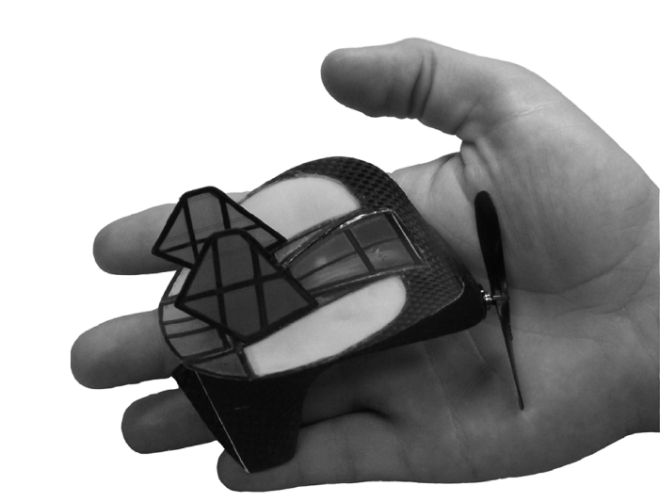
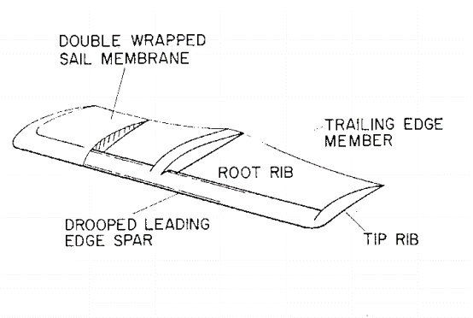
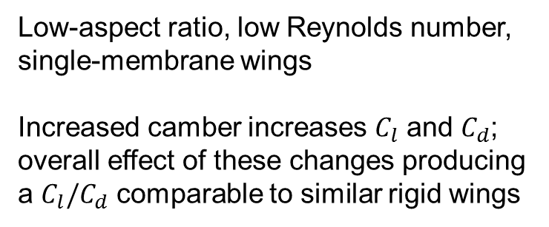
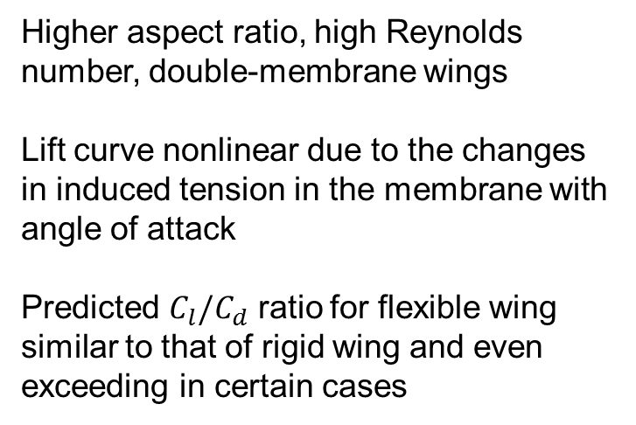
Fabric sections: literature
Micro-aerial vehicle wings:
Low-aspect ratio, low Reynolds number, single-membrane wings
Increased camber increases $C_{l}$ and $C_{d}$; overall effect of these changes producing a $C_{l}/C_{d}$ comparable to similar rigid wings
Stanford et al. (2007)
Princeton sailwing:
Higher aspect ratio, high Reynolds number, double-membrane wings
Lift curve nonlinear due to the changes in induced tension in the membrane with angle of attack
Predicted $C_{l}/C_{d}$ ratio for flexible wing similar to that of rigid wing and even exceeding in certain cases
Ormiston (1971)
Notes:
Now, moving on to the second segment of the presentation, there are a number of examples in literature of flexible wings for applications such as sailing, full-scale gliding/flying, and micro-aerial vehicles. Here are two of such applications that give a flavor of what we might expect from a wing with a flexible surface.
Micro-aerial vehicles use a single membrane wing due to weight savings as well as aeroelastic tailoring. Generally, the literature finds the Cl/Cd of these wings is comparable to those of rigid wings of the same geometry.
The Princeton sailwing was developed in the 1960-70’s with both aeronautical and wind-energy applications in-mind. This design has a fabric stretched around a rigid LE nose and held at the TE by a tensioning cable. So this is a double-membrane wing which is more similar to the proposed modular blade design. The lift curve is nonlinear due to variation in the camber of the profile as the loading on the membrane, and again the predicted Cl/Cd_max ratios are comparable to rigid wings though occurring at higher Cl and Cd than rigid wings because of increased camber.
In contrast to the Princeton sailwing, the model designed for the current study has considerably lower percent of the chord covered by fabric than our model which is shown…

Slide 10
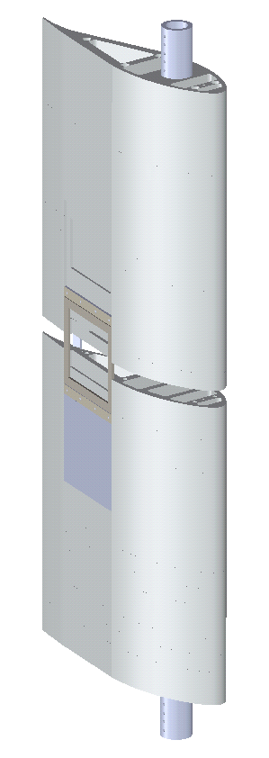
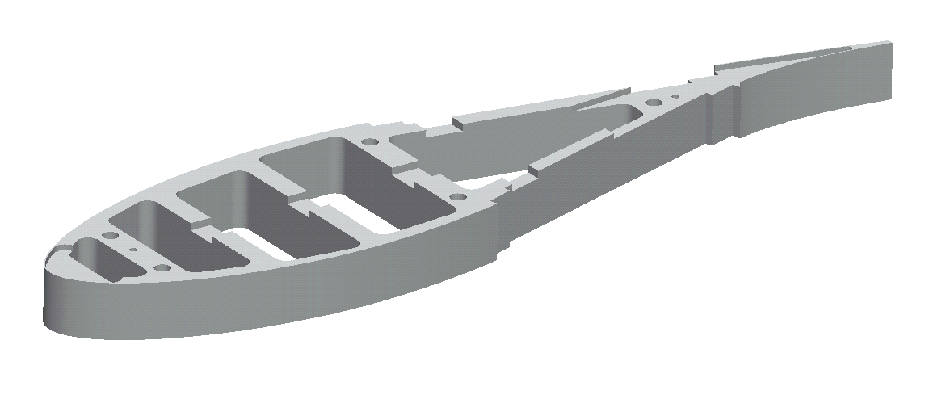
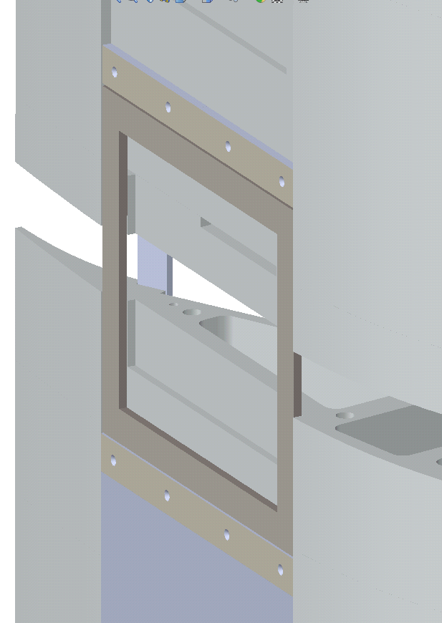
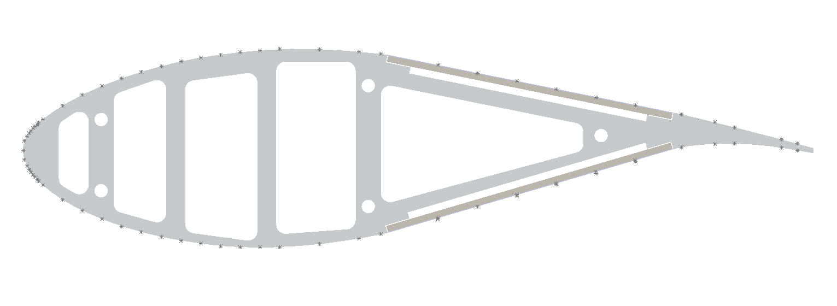


Fabric section: configuration
$0.446 x/c$
$$0.850 x/c$$
Top panel
Middle panel
Bottom panel
Tube routing channel
6.4-mm
25.4-mm
Notes:
The DU91-W2-250 profile was selected for the fabric section study and the original profile is in black. The modifications are shown in blue and include a nose offset as before (however, this will not be a focus of the following analysis) and a straightening of the profile between the x/c locations indicated here).
The reason for the straightening is to allow for the placement of fabric panels shown in this figure…there are 3 spanwise positions for the fabric panels (as well as three more on the opposite side of the model) and, going from bottom to top here, they are shown with increasing amounts of cut-away. Each cavity is hollowed out so that the fabric has ample room to deflect into the model, if necessary. Each panel is made from a steel frame shown here in brown with an impervious, glass fiber reinforced fabric stretched over top of it. The panel is then bolted to the main body of the model and the final outcome looks like…

Slide 11
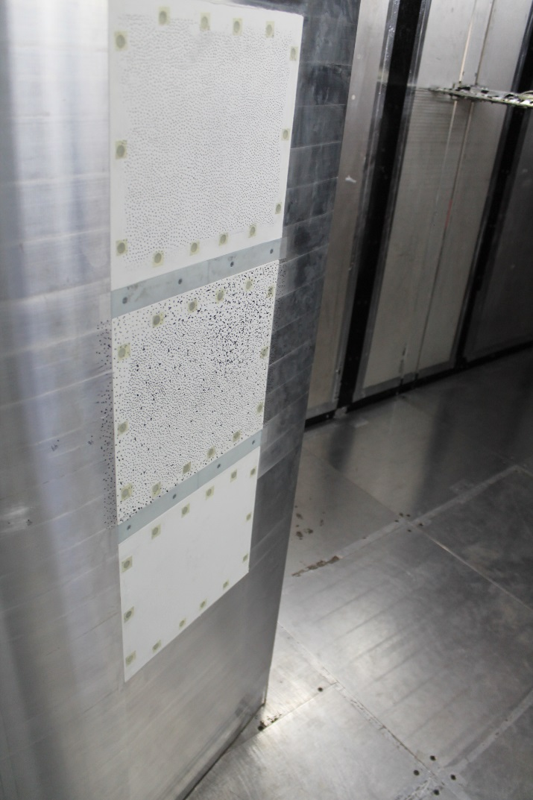
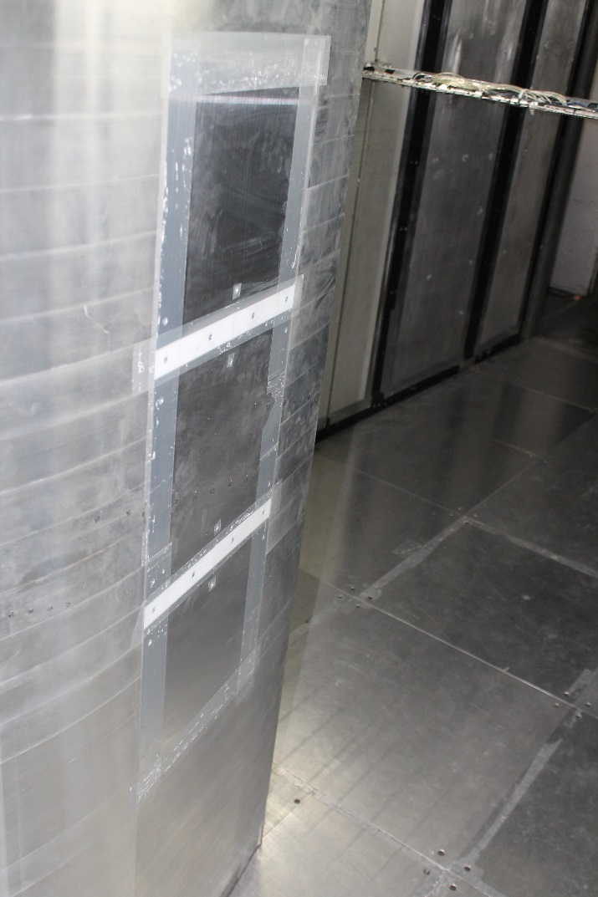
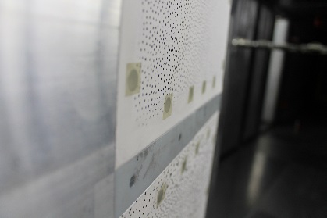
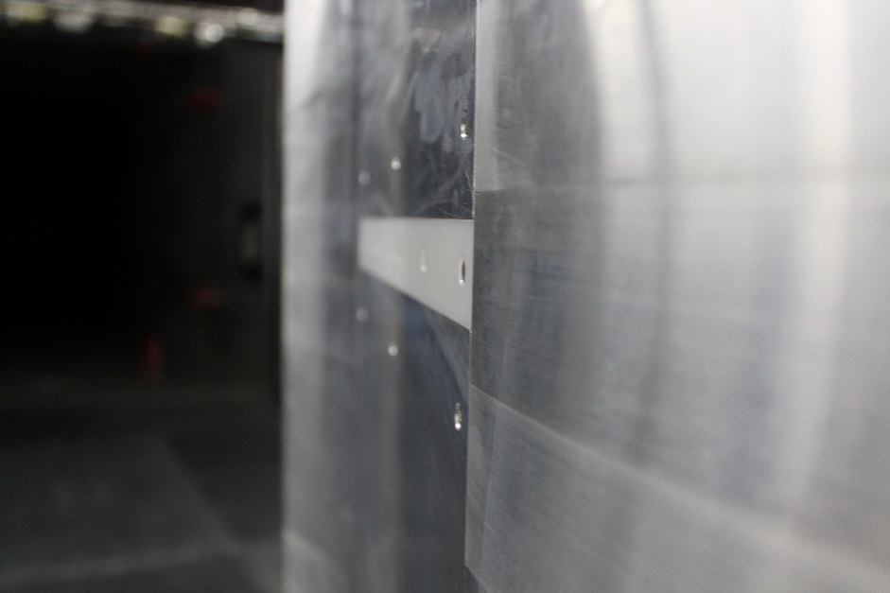
Fabric section: test setup
Fabric panel model
Rigid panel model
Model:
Modified DU91-W2-250
0.8-m chord
34 aluminum laminates
64 pressure taps
6 removable panels (3 suction side, 3 pressure side)
No endwall suction
Measurements:
Mean surface pressure
Wake profiles
Fabric deflection (DIC)
Test Conditions:
Re = 2.5 - 3.0x10⁶
Ma = 0.15 - 0.19
Flow
Flow
Bolt countersink
Bolt countersink
(covered)
Fabric panel
Rigid panel
Rigid panel
Transition piece
Transition piece
Notes:
…as shown here. We see three spanewise panels and small non-flexible transitions between each panel. Also, the fabric panels of the center cavities on each side of the model were instrumented for pressure tubes from the backside of the fabric.
You may notice the speckled pattern on the panels which is due to the use of a digital image correlation system to measure the fabric deflections.
To act as a control for the fabric testing, a rigid-paneled model was also tested which had aluminum frames installed.

Slide 12
Fabric sections: results
Re = 3.0x10⁶
Ma = 0.19
Re = 3.0x10⁶
Ma = 0.19
0.8% higher $C_{l}$ at design angle of attack
19% variation in spanwise drag
Notes:
These results are at the Reynolds = 3M case and we see the lift and drag polars here on top, as well as the baseline-subtracted polars on the bottom. They symbols are for the experimental data, and the dashed lines are for an aeroelastic simulation that iterates until convergence is reached between a strip-theory aerodynamic solution from XFOIL and a structural membrane solution from a finite difference algorithm. In this case, two different spanwise solutions of the simulation are shown.
For the lift comparison, we do see in the linear range small changes due to the fabric which are generally increasing moving into the positive linear range and reaching a maximum around the design angle of attack at about 6 degrees. Such variation is consistent with the literature that predicts non-linear lift curves for flexible models and is physically understood by the fact that increased load on the fabric panels increases their deflection and thus camber.
The drag comparison is shown on the right with two different pieces of experimental data: polar sweeps at each angle of attack and wake cross-sections at 3 selected angles of attack. The wake cross-sections produced a range of drag values corresponding to different spanwise locations and these ranges are plotted using error bars as shown here, here, and here. The main message to take away from this plot is the immense amount of spanwise variation in the drag. This is seen even more dramatically in the wake cross-sections…

Slide 13
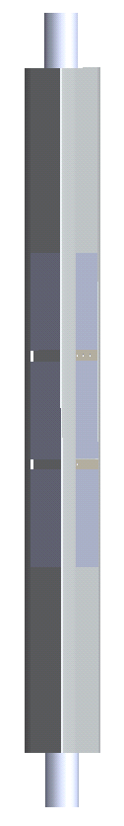
Fabric sections: results
2.0 deg.
6.6 deg.
8.5 deg.
C_{p}
8.5 deg.
2.0 deg.
6.6 deg.
Panel
Panel
Panel
Distance across test-section, m
C_{d}
Fabric flexibility produces spanwise drag variation
Notes:
This figure shows three wake cross-sections at the given angles of attack. We are looking up at the TE of the model which is in this orientation. The contours here represent the Cp. The spanwise locations of the cross-sections are indicated by the black lines tracing from the full-span view of the model on the left. For the 8.5 deg case and lesser so for the 6.6 degree case, we see spanwise periodicity in the wake width; the width bulges at the center of the panels and narrows at the transitions between panels. While not confirmed with flow separation measurements, it is suspected that the increased camber and resulting three-dimensional effects over the fabric panels causes separation to initiate first at the highly deflected span locations of each panel.
Plotting the traces of the drag for each of these cases, we see the spanwise periodicity with clear dips in-between panels for the two higher AoA cases.
What we can take away from these plots is that the drag performance and thus lift/drag of the fabric model varies greatly with spanwise location, and as with the DU00-W-212, the observed variation in $C_l/C_d$ between models is primarily due to the drag term. In order to have an accurate picture of the aero performance of fabric models, therefore, it is believed that future testing of modular blade designs with flexible surfaces should include significant consideration towards how to accurately represent the average drag across the span and how to appropriately scale this spanwise variation from the full-scale wind turbine blade to the wind tunnel.

Slide 14
Fabric sections: results
(b) Pressure Side
Lead-in ramp
Lead-out ramp
Lead-in ramp
Lead-out ramp
Panel region
Panel region
Fabric sections: results
(i)
Suction side deflection
Original profile has similar camber to fabric profile
(i)
(ii)
Panel
mid-span
Panel quarter-span
Fabric panel deflection increases flow velocity
Notes:
Finally, we will look more closely at the fluid-structure interaction over the fabric, and specifically, this region of the suction side shown here.
I plotted here the fabric deflection in red which includes experimental data from the DIC and simulated data from the aeroelastic simulation. Overlaid on the graph for reference are the chordwise locations of machined ramps that lead into and out of the fabric region.
To get a clearer picture of what is happening, we can subtract out the rigid profile shape from the DIC measurements which yields…the loading on the panels clearly produces deflection out of the model on the suction side panels as measured and predicted for two different spanwise locations along the panel. At the midspan of the panel, the deflection is greatest at almost 5-mm and at the quarter-span it is roughly half that. There is good agreement of the experiment and simulation.
We can also see how the shape changes affect the pressure distribution…Here you can see jaggedness in the lead-in and lead-out ramps due to abrupt changes in surface slope. Furthermore, the velocity of flow over the fabric region is faster than that over the rigid aluminum panels; the deflection into the flow causes the flow to accelerate which lowers the pressure and appears to be the reason for the slightly increased lift of the fabric model at the design angle of attack.
Finally, it is interesting to see what happens if we superimpose the ORIGINAL unmodified DU91 profile on the fabric deflection which is shown in the second plot as…it is clear that the deflection of the fabric is bringing its profile close to that of the original, carefully designed DU91 profile. So this suggests that fabric models have the potential, if they are tuned properly in the elastic modulus and pretension of the fabric, to have similar aero performance to standard wind turbine sections.

Slide 15
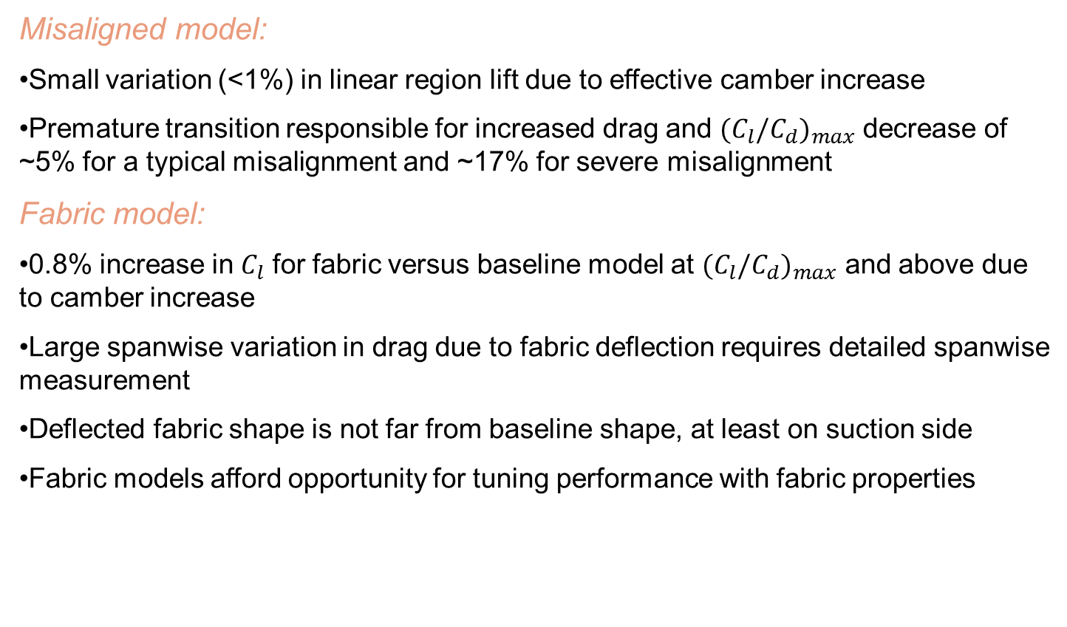
Summary/Conclusions
Misaligned model:
Small variation (<1%) in linear region lift due to effective camber increase
Premature transition responsible for increased drag and ${{(C}_{l}/C_{d})}_{max}$ decrease of ~5% for a typical misalignment and ~17% for severe misalignment
Fabric model:
0.8% increase in $C_{l}$ for fabric versus baseline model at ${{(C}_{l}/C_{d})}_{max}$ and above due to camber increase
Large spanwise variation in drag due to fabric deflection requires detailed spanwise measurement
Deflected fabric shape is not far from baseline shape, at least on suction side
Fabric models afford opportunity for tuning performance with fabric properties
Thank you!
Notes:
To conclude…repeat the bullet points
This gives us a preliminary quantification of the risk and design considerations associated with modular blades.

Slide 16
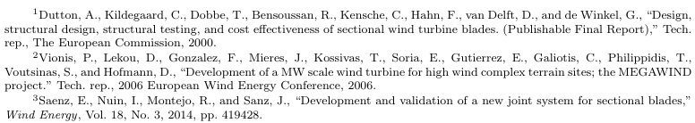
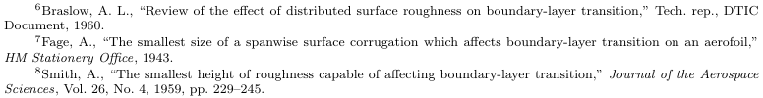
References

Slide 18
DU00

Slide 19
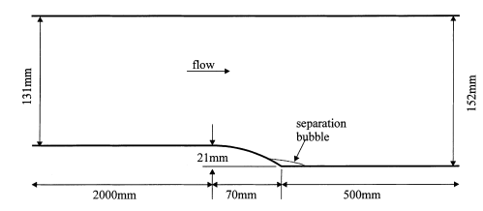
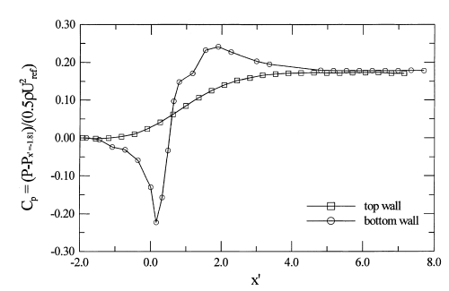
Misaligned sections: literature
Song et al. (2000)*
*Song et al. (2000) - Experimental study of a separating, reattaching, and redeveloping flow over a smoothly contoured ramp
Notes:
$Re_{k}≈3,400$ for 0.6mm
$Re_{k}≈1,700$ for 0.3mm
This is quite APPLIED work, but first it is useful to get a glimpse of the underlying physics behind flow over a step or ramp

Slide 20
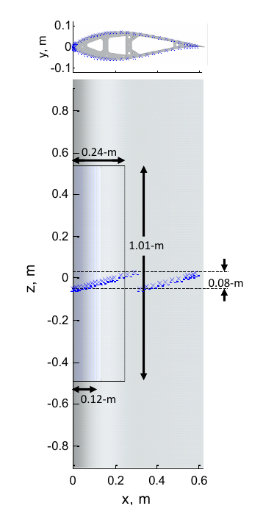
Misaligned sections: setup

Slide 21
Effective Angle of Attack Increase
Offset profile looks as if at higher angle of attack
Lowering the angle of attack by 0.06 deg. makes differences minimal
Offset
Offset effect predominantly at nose
Notes:
Y:\GeneralElectric\Wind Turbine TE Modifications\Tunnel Entries\2014 - Summer\Data Reduction\Fabric Airfoils Reprocessing and Analysis - Ken\Analysis\Final Plotting Codes\plotClCp_kab_xfoilaoa_v2.m
Y:\GeneralElectric\Wind Turbine TE Modifications\Tunnel Entries\2014 - Summer\Data Reduction\Fabric Airfoils Reprocessing and Analysis - Ken\Analysis\Final Plotting Codes\ClCpPlot_kab_vnew_v2_Xfoilaoa_split2.m
To make AoA offset plot…
Uncomment the code around line 242:
if n==2||n==5||n==8
alphaWC = alphaWC+0.04; % this value found by trial and error
elseif n==3||n==6||n==9
alphaWC = alphaWC+0.06; % this value found by trial and error
end

Slide 22
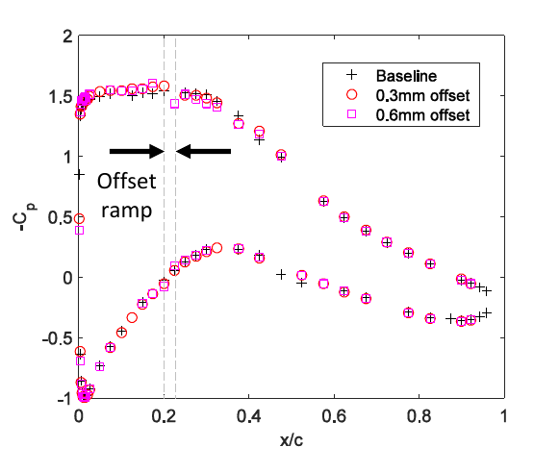
Misaligned sections: results
Notes:
Reynolds = 2.5M?

Slide 23
Misaligned sections: results
Suction side
6 degrees
3 degrees
0 degrees
Notes:
XFOIL gradations help the eye follow the trends and give a little bit more resolution to the ramp region. As for the experimental data, the trend for XFOIL is the offsets are producing higher –Cp’s, which we associate with higher lift
>> axis([0 0.325 0 2])

Slide 24
Misaligned sections: results
Pressure side
0 degrees
3 degrees
6 degrees
Notes:
>> axis([0 0.325 -1 1])

Slide 25
Boundary layer comparison at 6 deg.
(from XFOIL)
Transition
Notes:
Y:\GeneralElectric\Wind Turbine TE Modifications\Tunnel Entries\2014 - Summer\Data Reduction\Fabric Airfoils Reprocessing and Analysis - Ken\Analysis\Final Plotting Codes\Xfoil\XFOIL_foilBLplotter.m

Slide 26
Boundary layer comparison at 7 deg.
(from XFOIL)
Transition
Notes:
Y:\GeneralElectric\Wind Turbine TE Modifications\Tunnel Entries\2014 - Summer\Data Reduction\Fabric Airfoils Reprocessing and Analysis - Ken\Analysis\Final Plotting Codes\Xfoil\XFOIL_foilBLplotter.m

Slide 27
Boundary layer comparison at 8 deg.
(from XFOIL)
Transition
Notes:
Y:\GeneralElectric\Wind Turbine TE Modifications\Tunnel Entries\2014 - Summer\Data Reduction\Fabric Airfoils Reprocessing and Analysis - Ken\Analysis\Final Plotting Codes\Xfoil\XFOIL_foilBLplotter.m

Slide 28
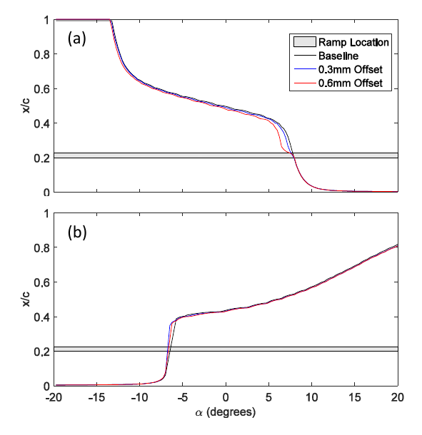
Misaligned sections: results

Slide 29
DU91

Slide 30
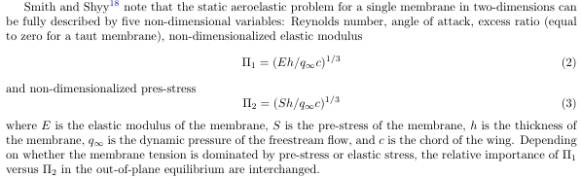
Fabric sections: literature

Slide 31
Fabric sections: configuration
0.6-mm
0.850 x/c
0.250 x/c
0.425 x/c
DU91-W2-250 profile

Slide 32
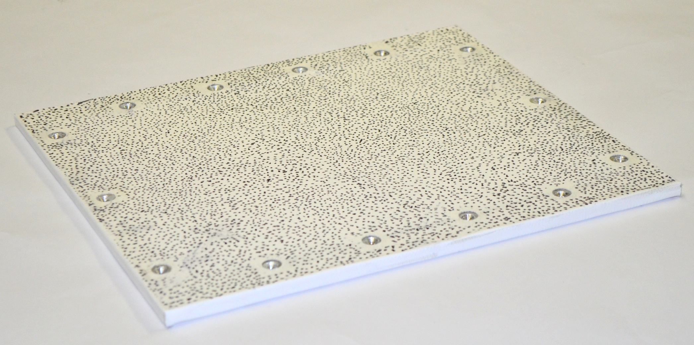
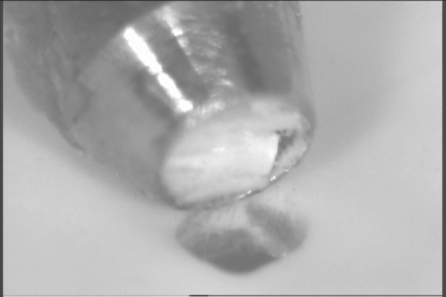
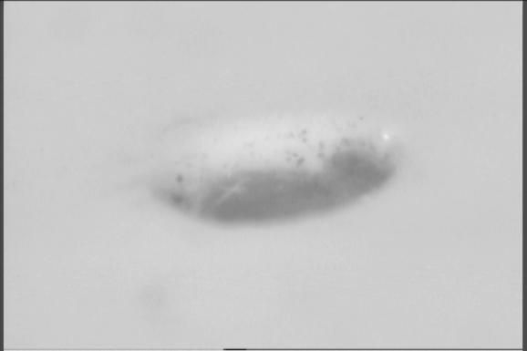
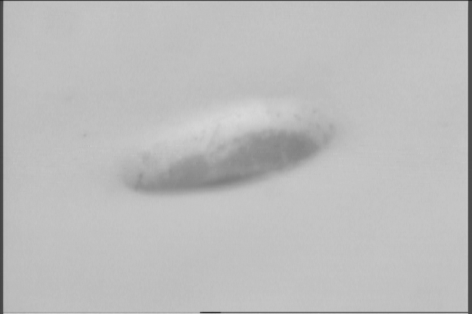
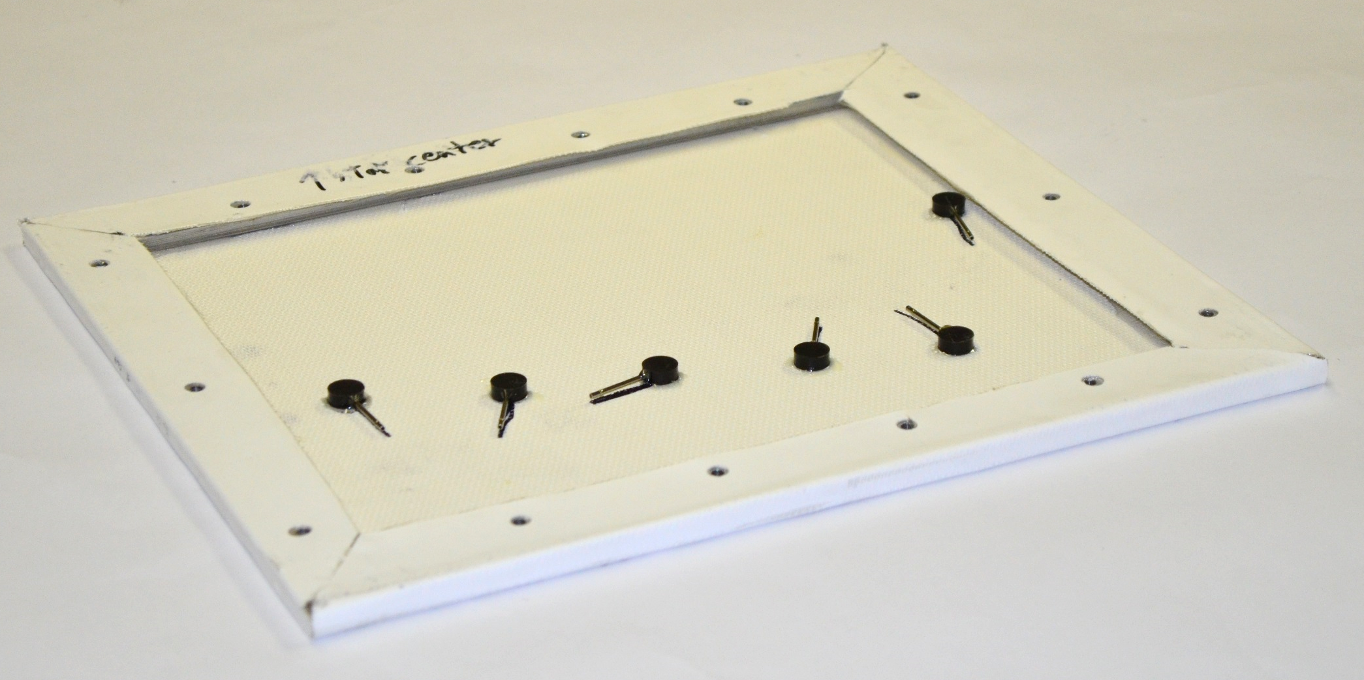
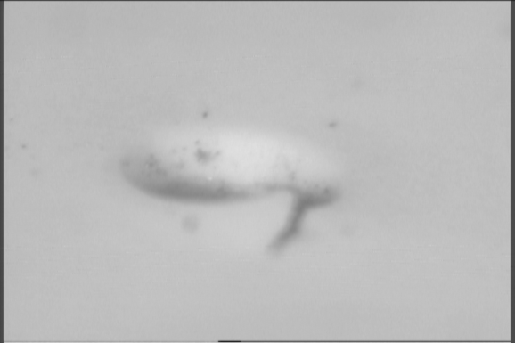
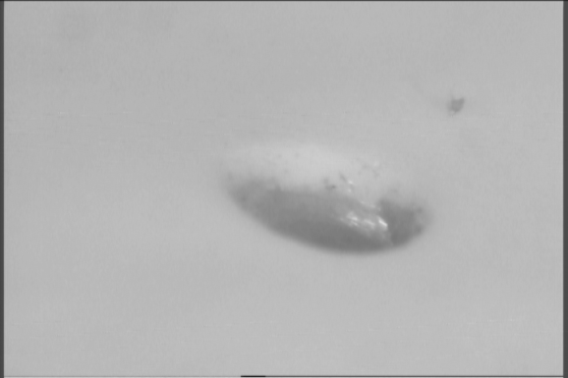
Fabric sections: configuration
Flow side
0.29-m
0.26-m
0.03-m
Back side
0.08-m
Notes:
Total spanwise variation of pressure tap locations is 8cm or 31% of the panel span. The maximum deviation from the midspan is 6cm or 24% of the panel span

Slide 33
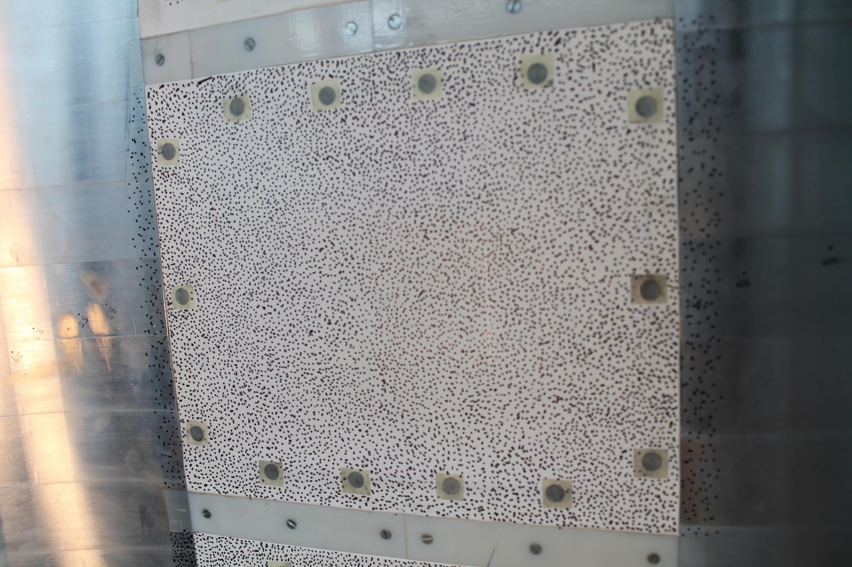
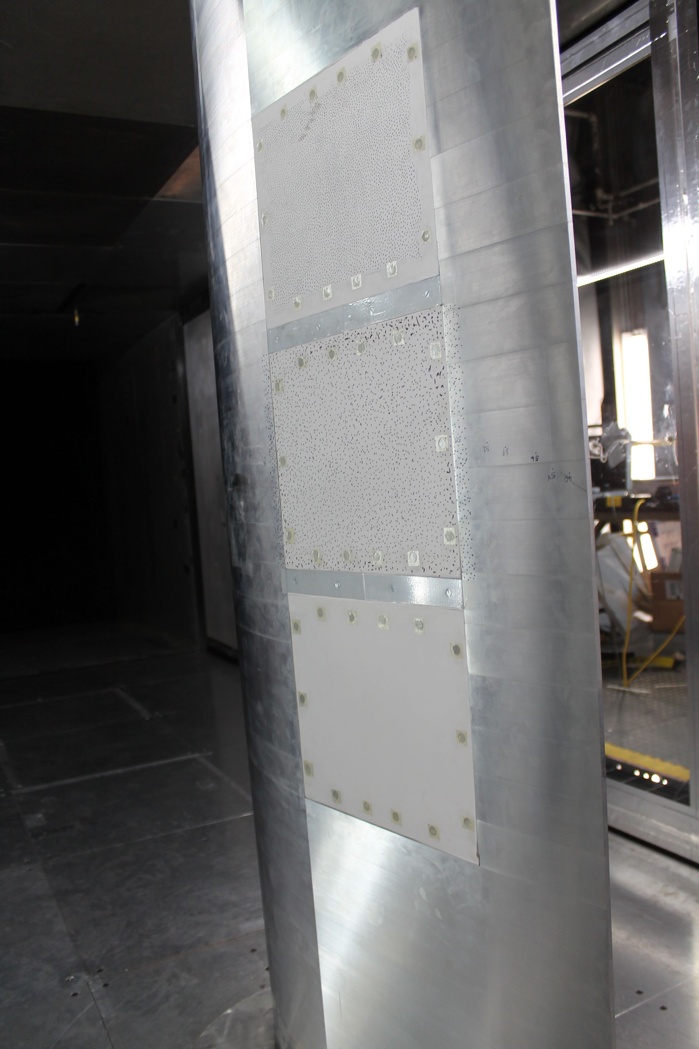
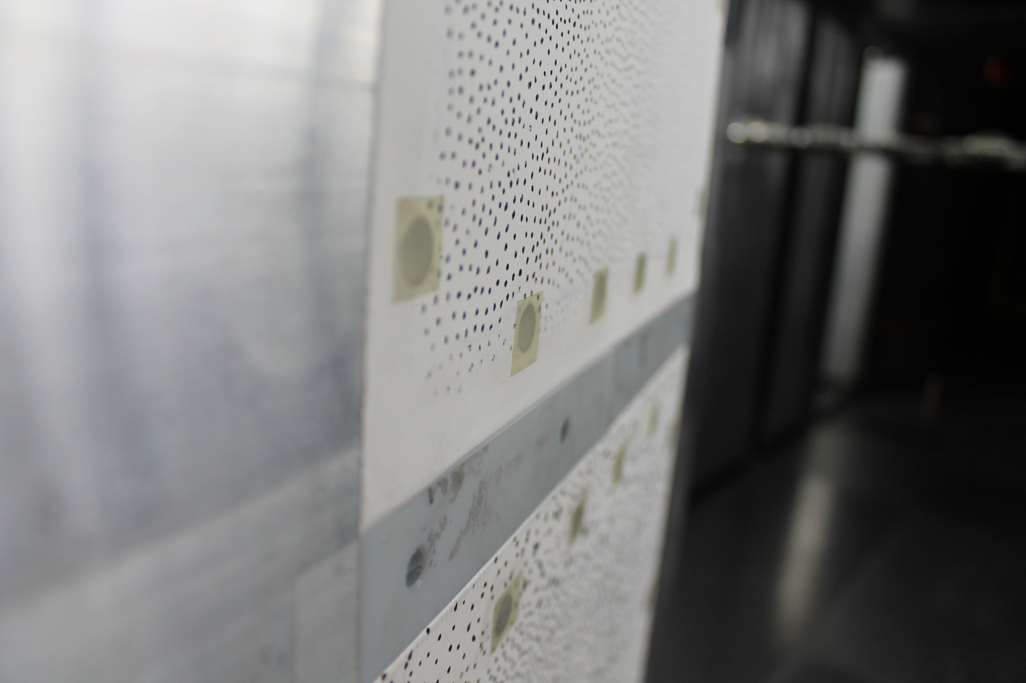
Fabric sections: setup
Nominally 5 psi/in tension
Tape covering bolt holes (3M #9731)
Tape covering transitions (40 micron)
No taping on leading or trailing edges of fabric panels

Slide 34
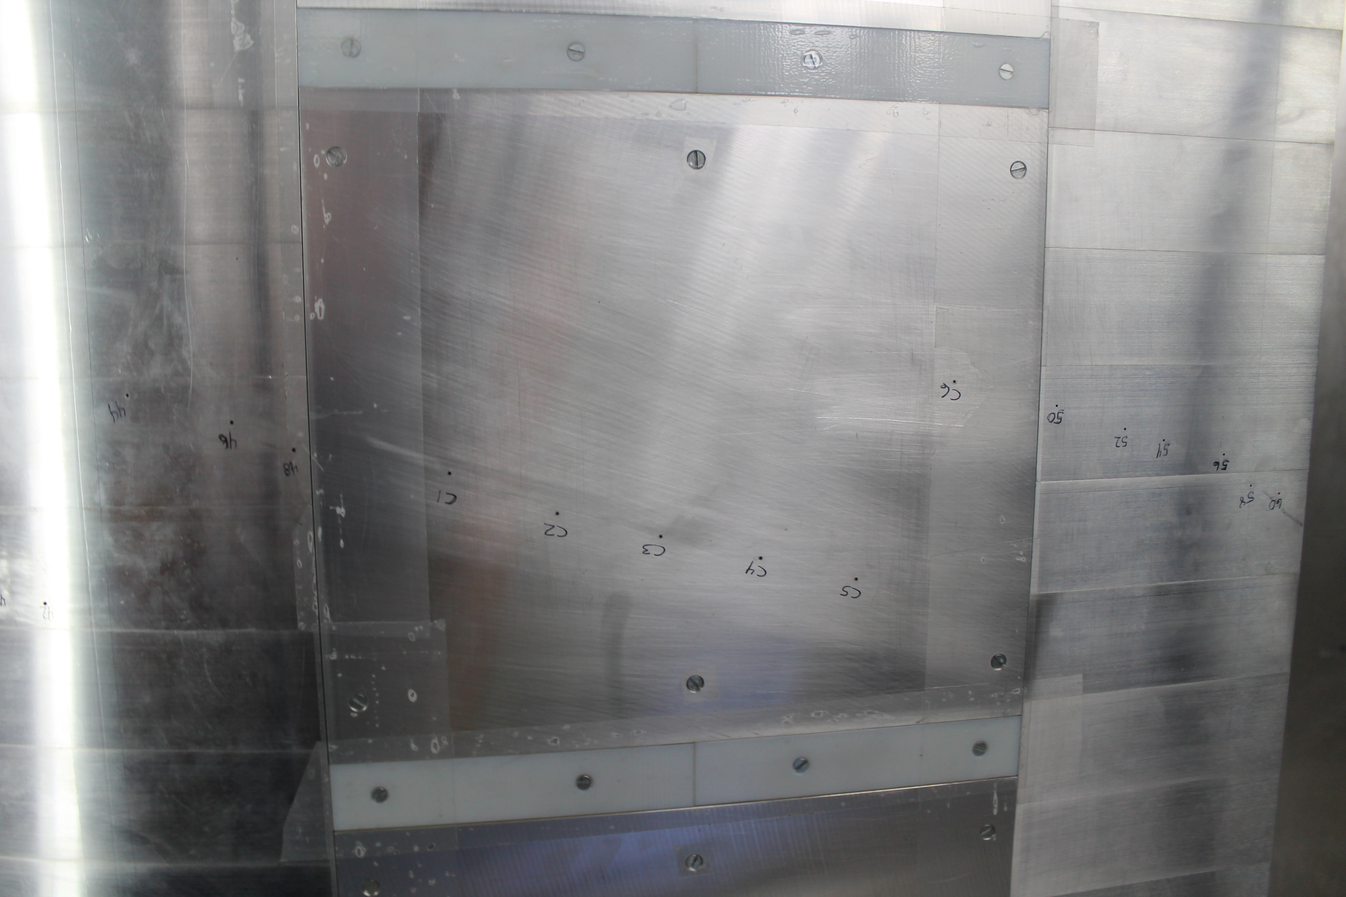

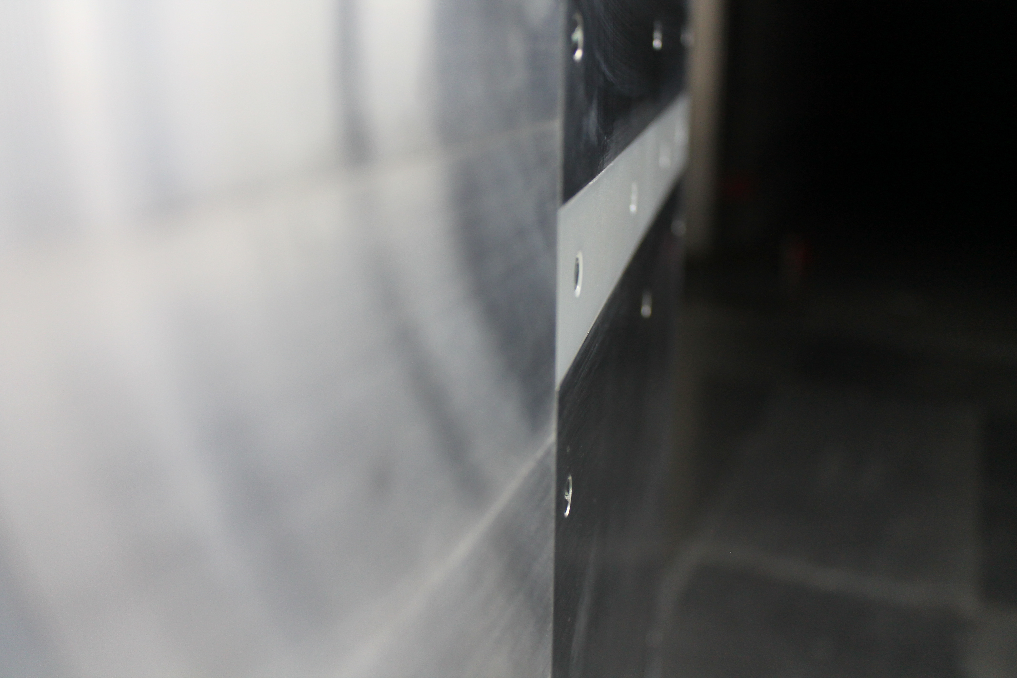
Fabric sections: setup
Actual run had tape over bolt holes
All panel joints covered with 40 micron tape

Slide 35
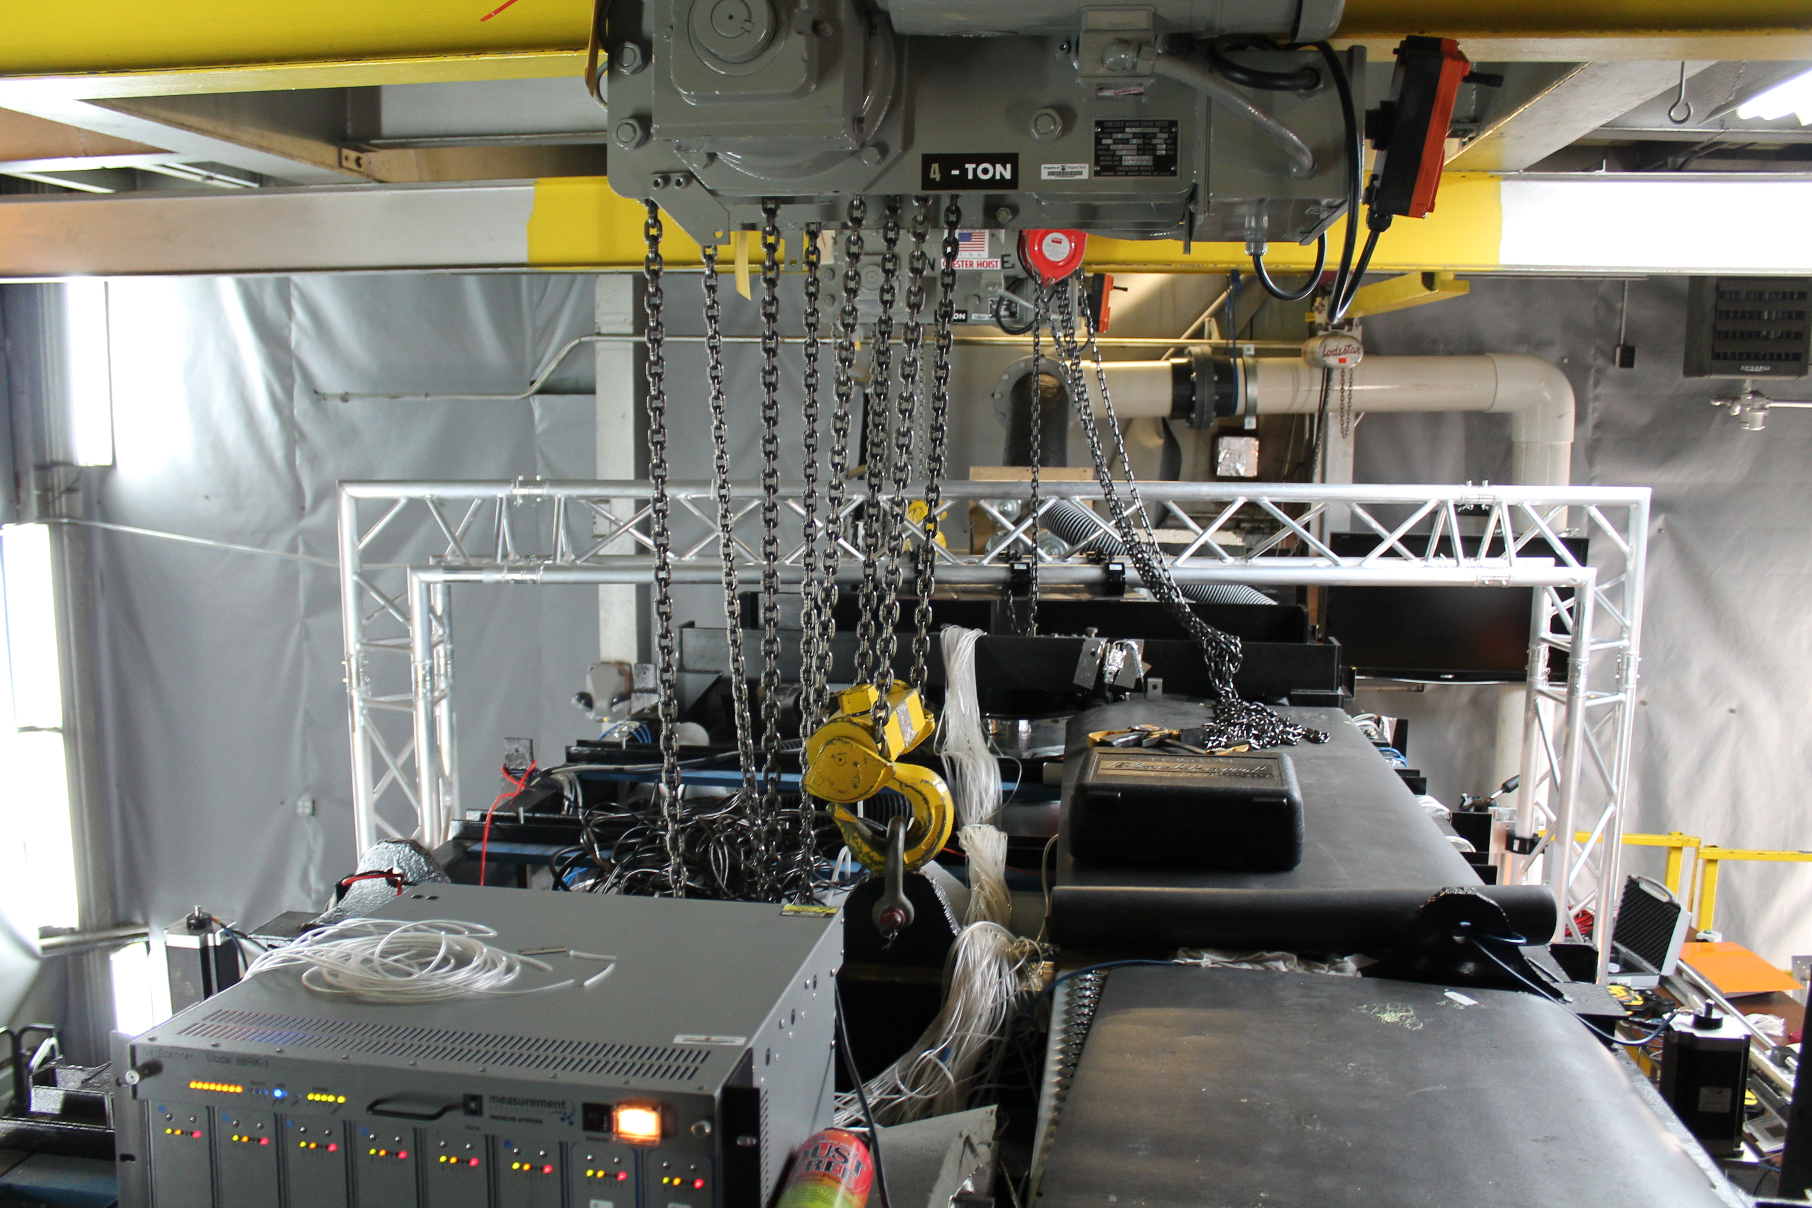
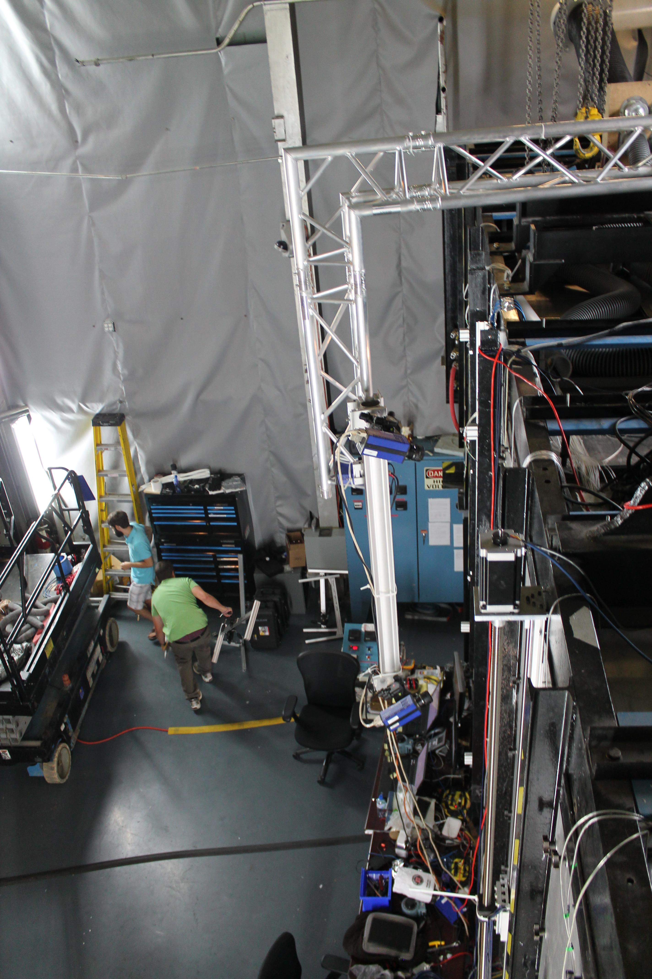
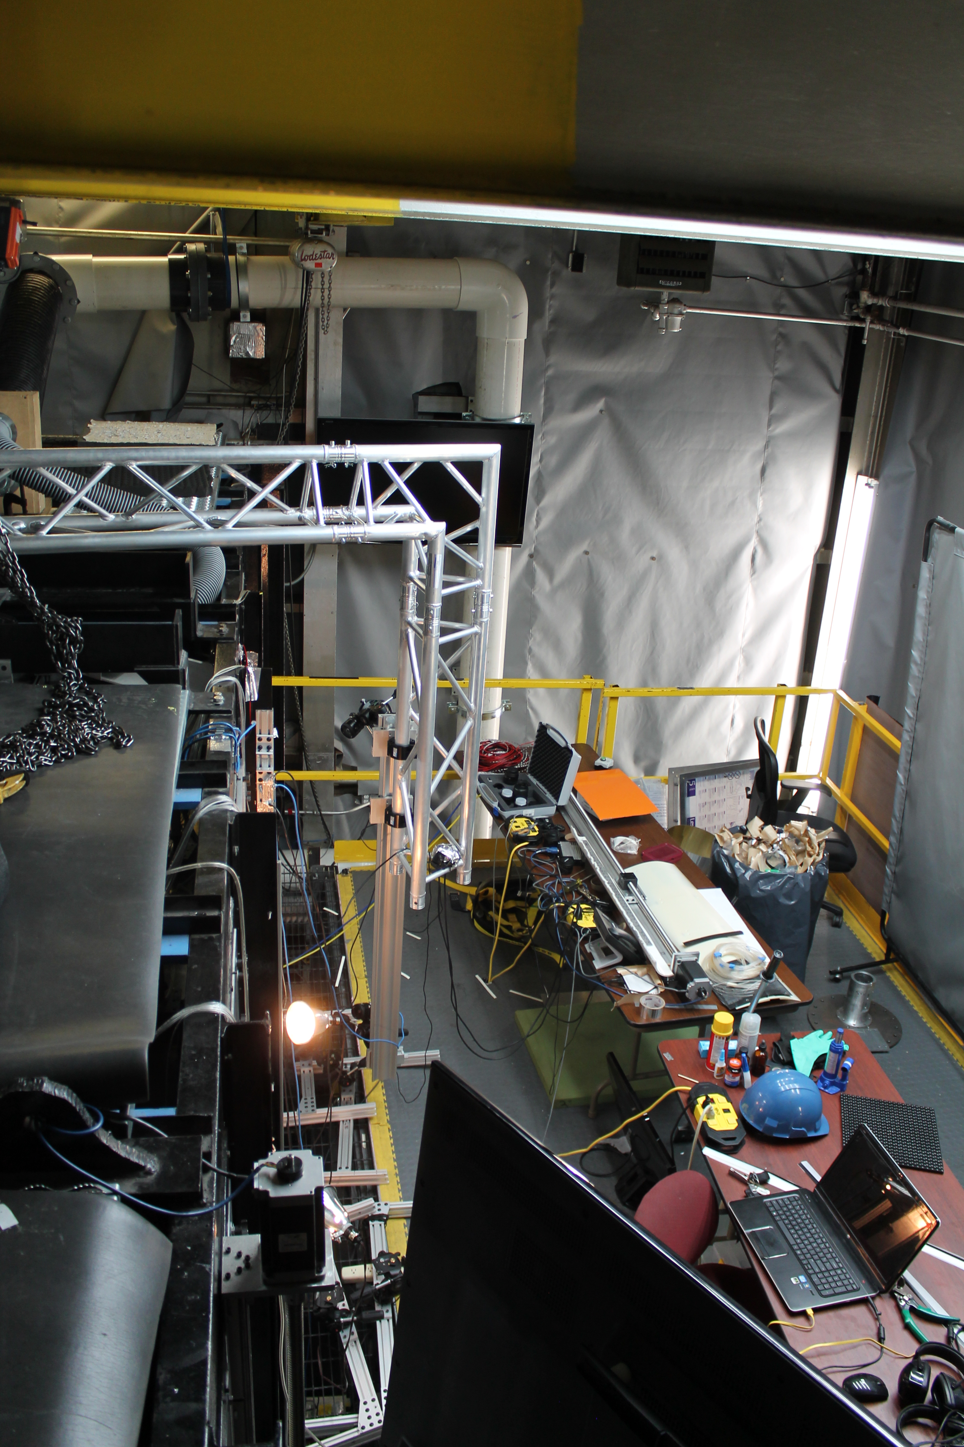
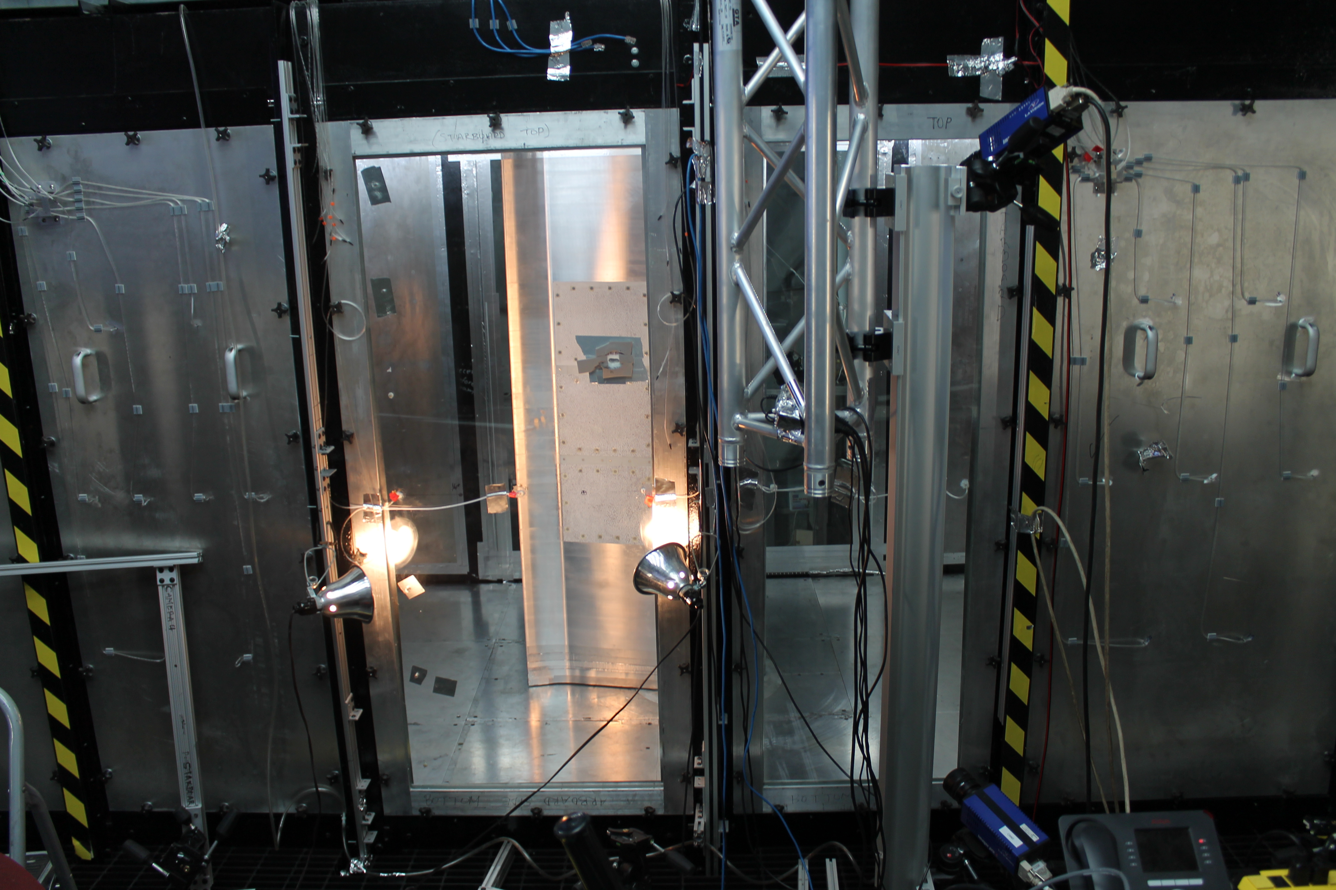
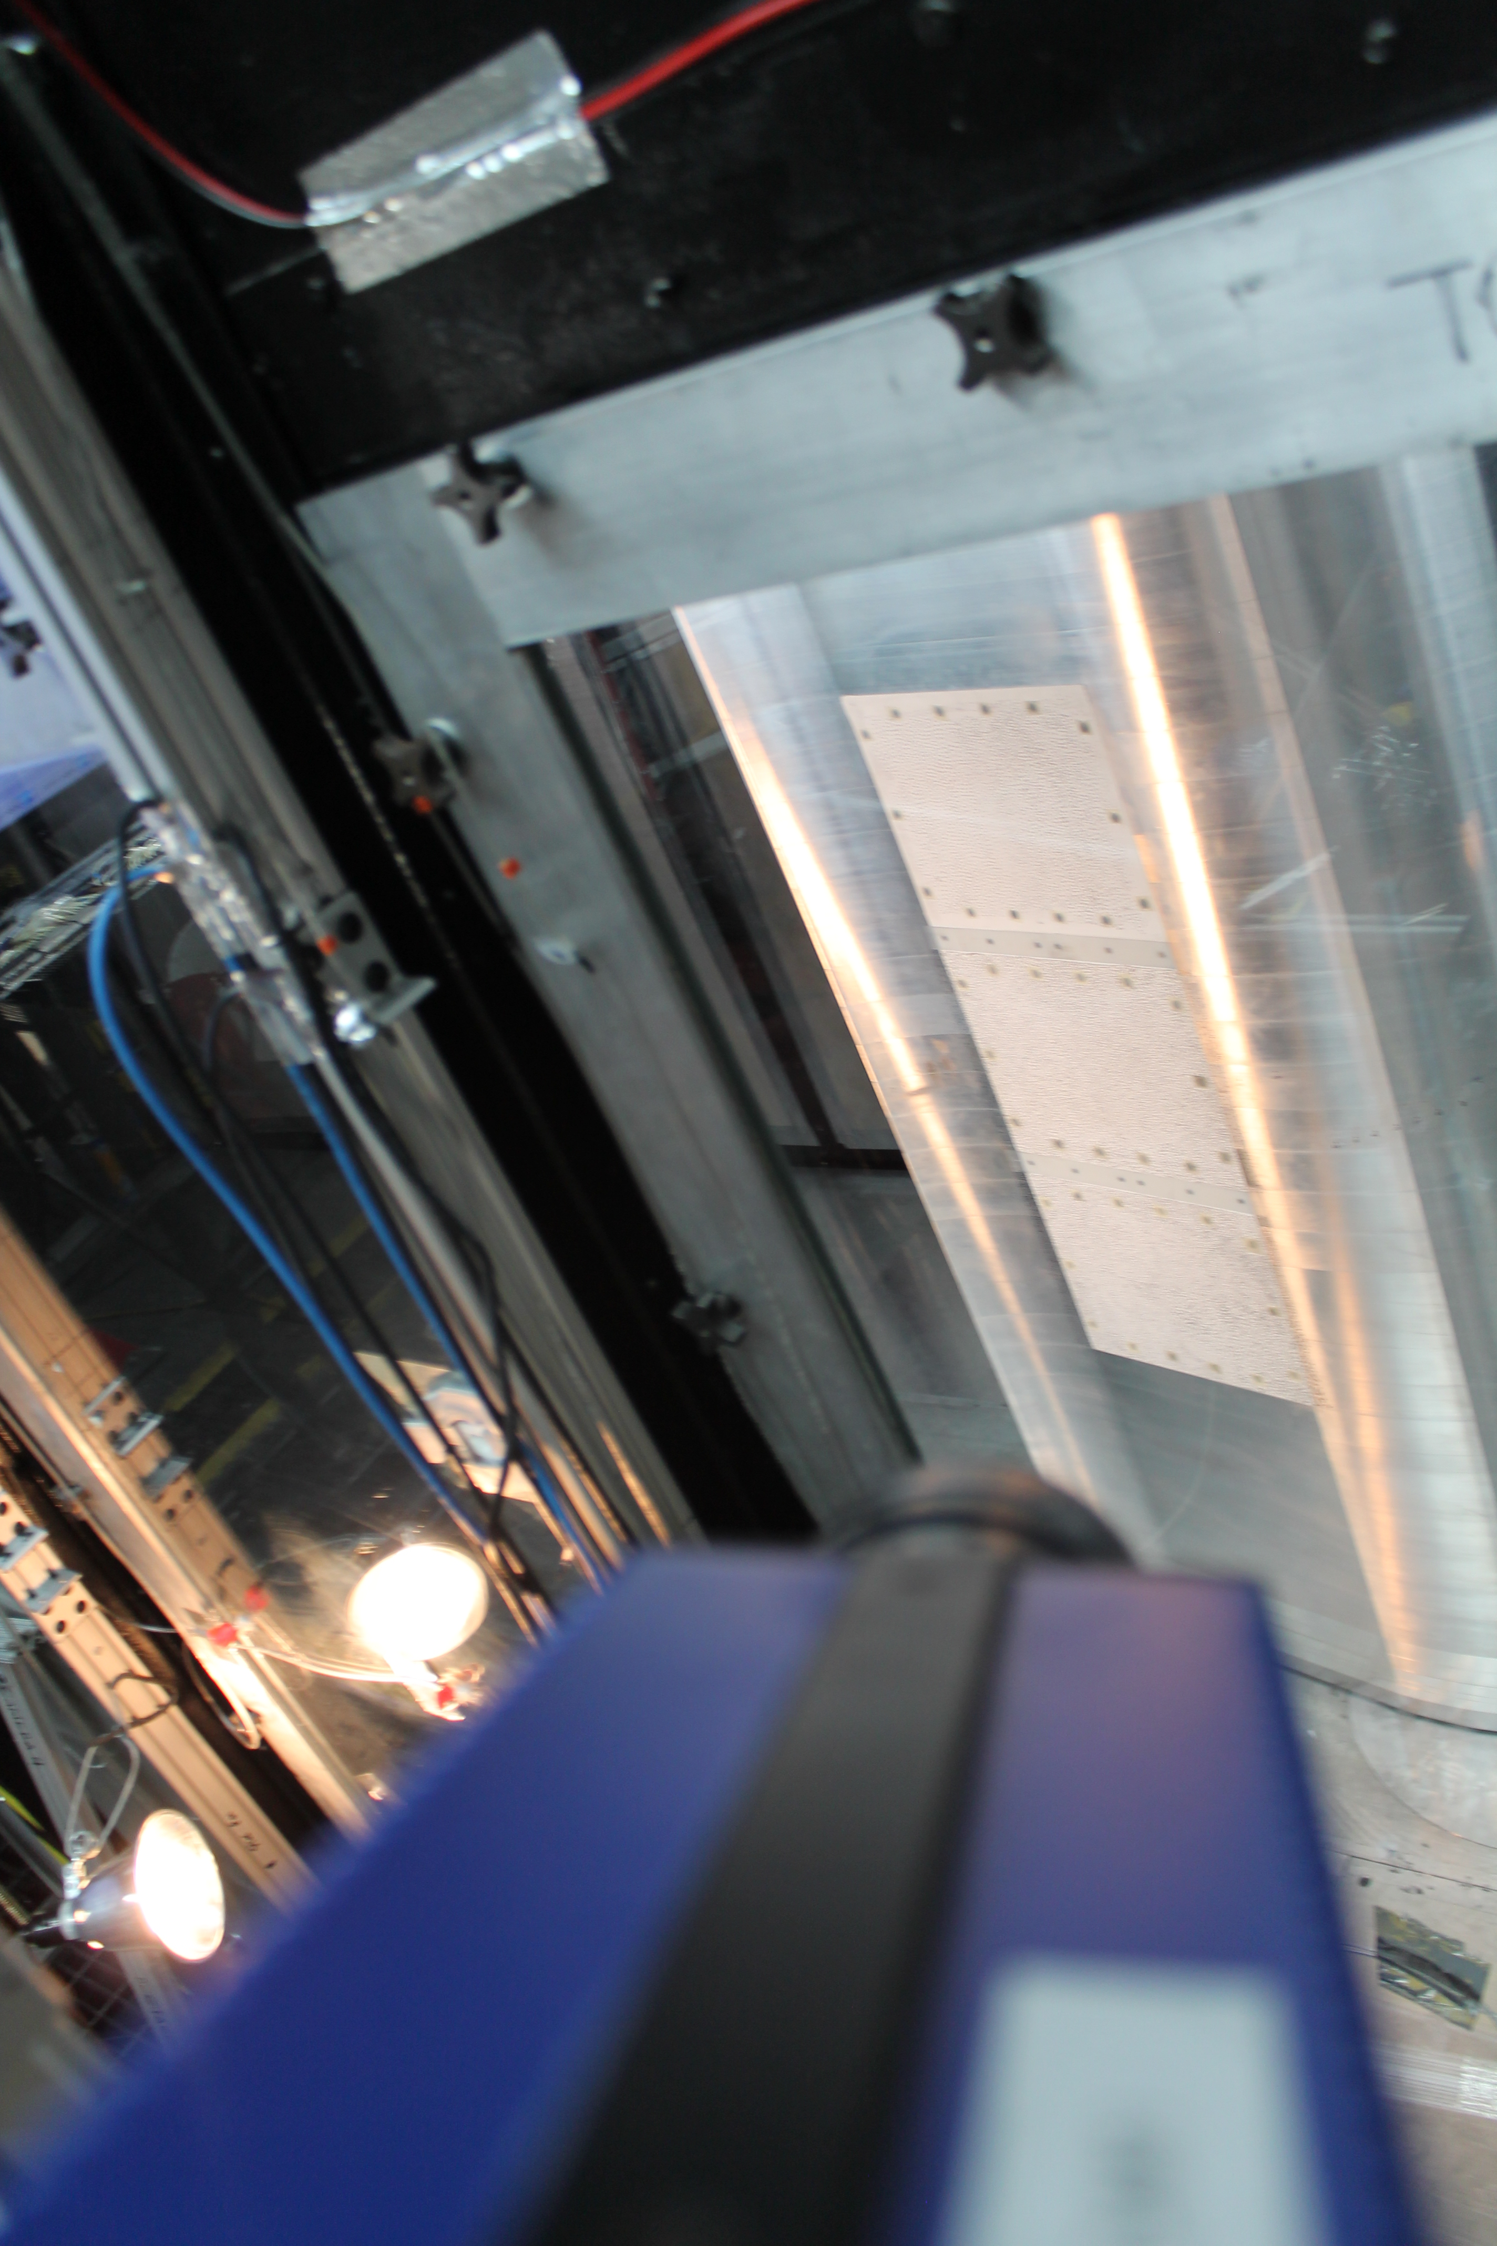
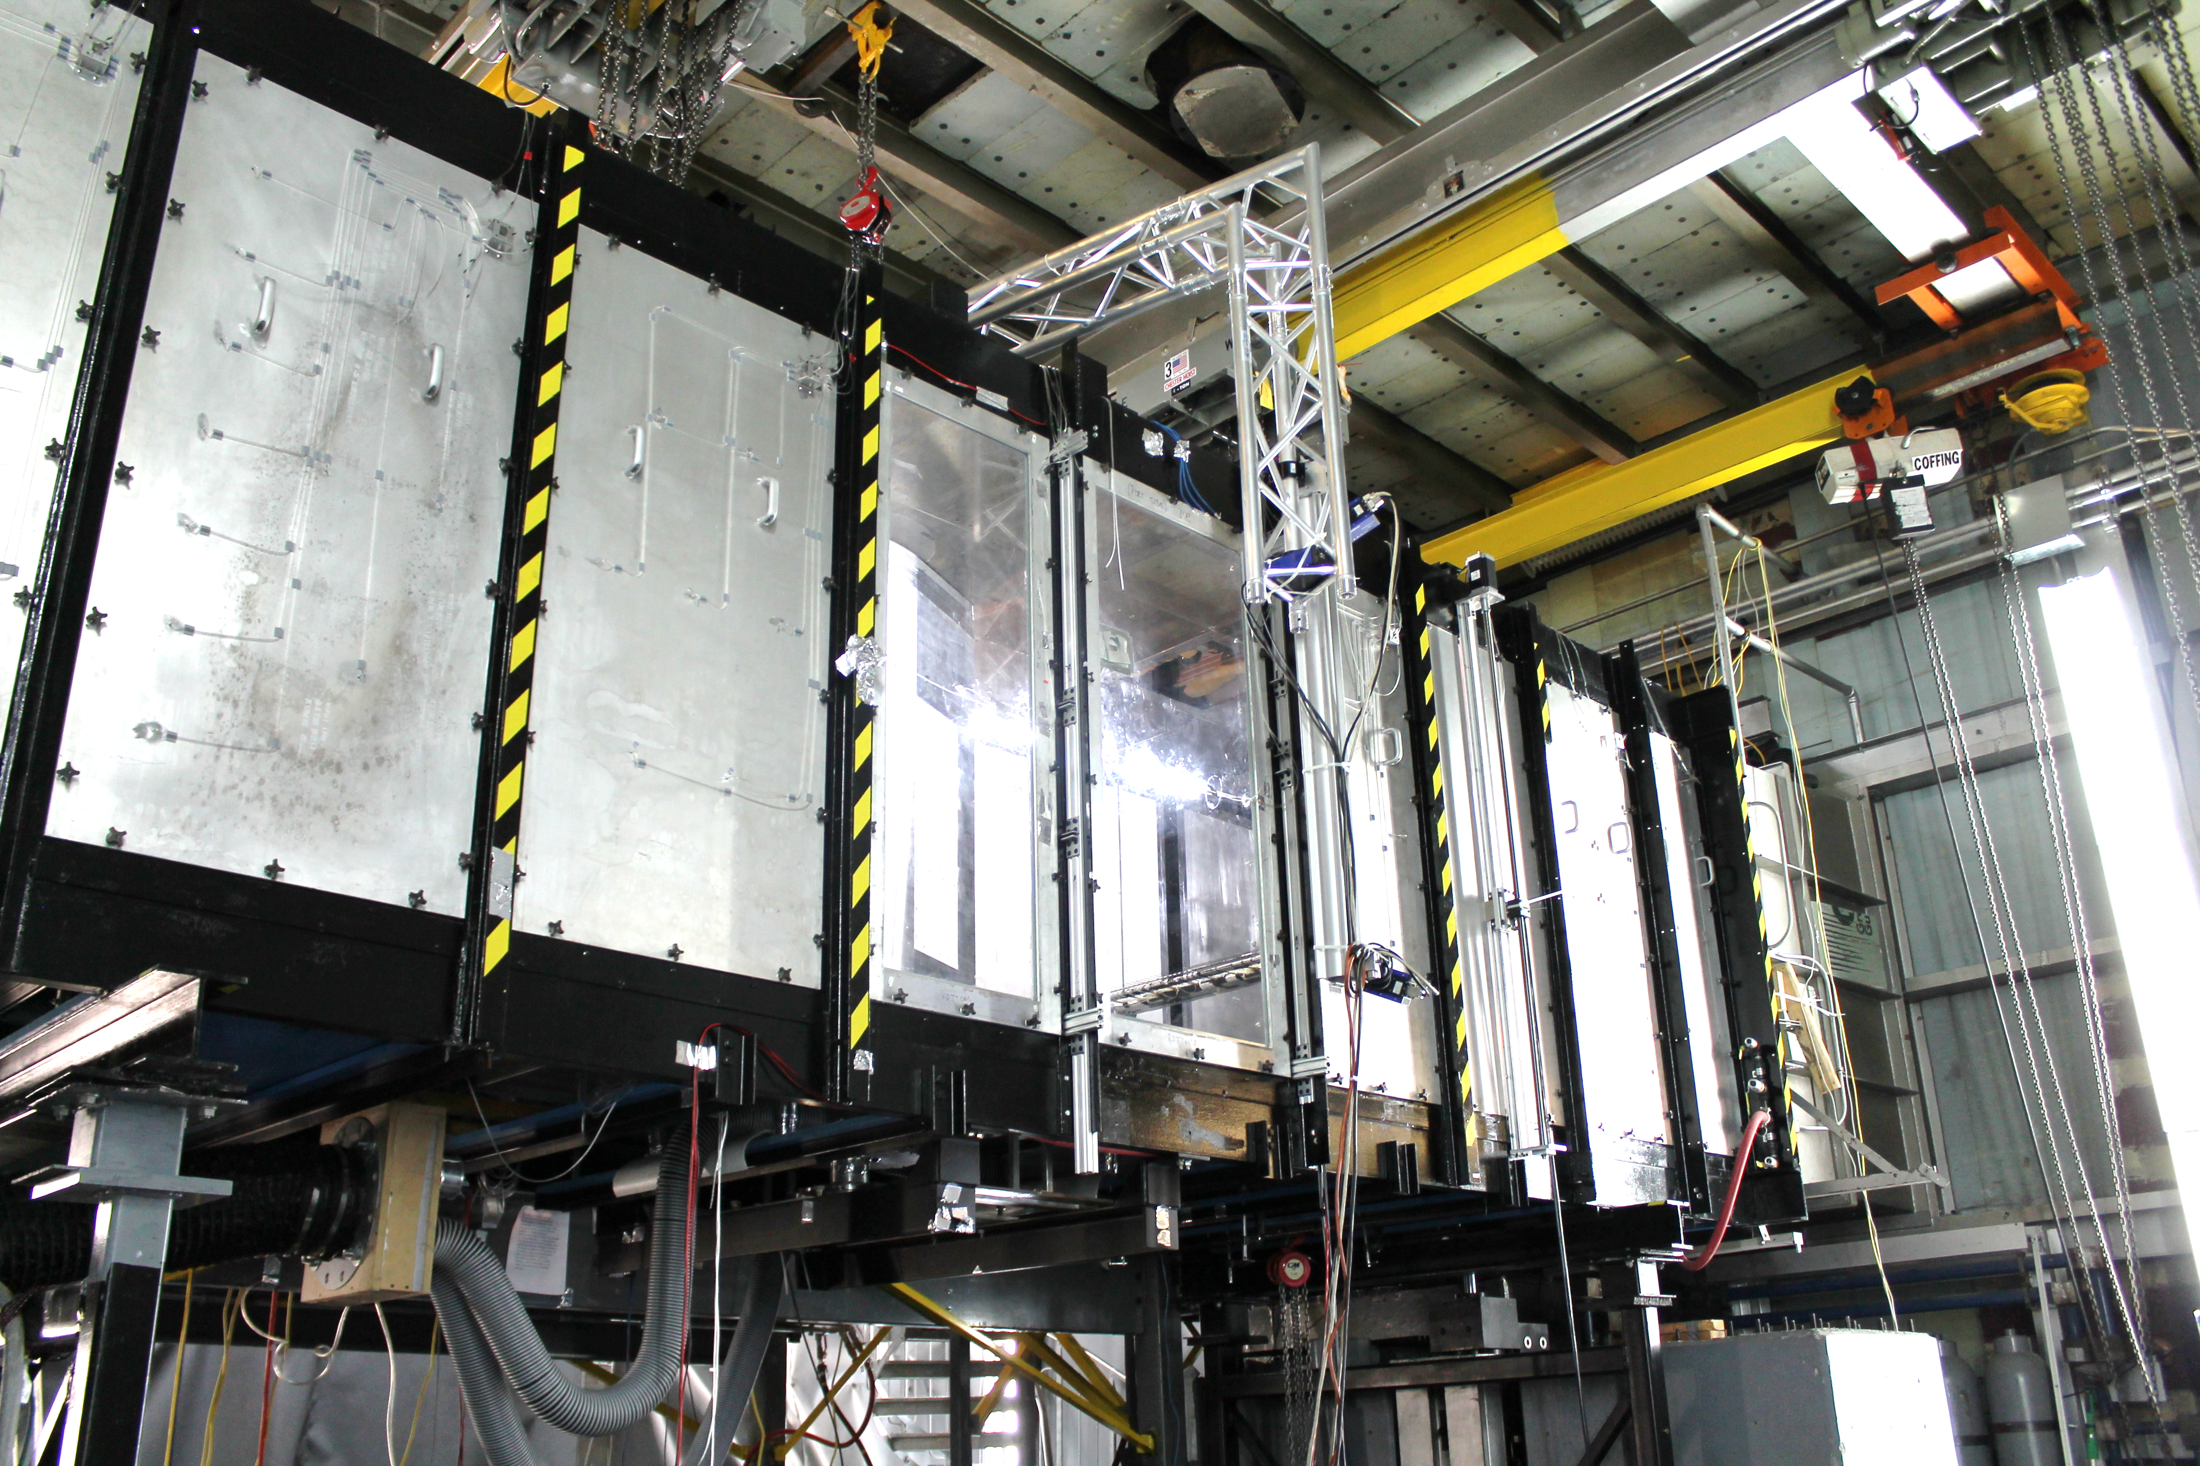
Fabric sections: setup
Starboard side cameras
Successful Digital Image Correlation measurements

Slide 36
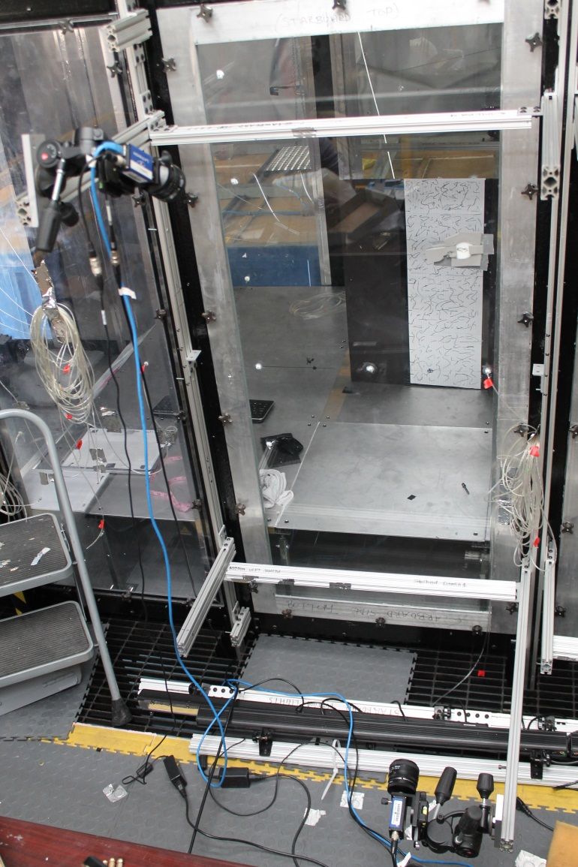





Design of DIC System
Experimental setup variables:
$b$ – baseline separation of cameras
$z$ – depth to measurement space
$f$ – lens’ focal length
$m$ = magnification
$N$ – f-stop number ($f/aperture$)
$Δd$ – physical pixel spacing
$h$ –number of pixels in 1D
$FOV$ (field-of-view) –extent of measurement space in 1D
$DOF$ (depth-of-field) – out-of-plane distance in-focus
Post-processing variables:
$H$ – circle of confusion diameter
LaVision StrainMaster 2D/3D DIC system:
2 Imager Pro X 4M
4 MP cameras
52-mm lenses
2,048-by-2,048 resolution
7.4-by-7.4 $μ$m pixel spacing
14 Hz sampling
14 bit digital output
Starboard-side
Rotation Axis
FOV=0.311m
b=1.4 m
z=1.8m
Image Acquisition
Trigger
$$Δz=−\frac{z^{2}\left(Δd\right)}{\left(bf+z\left(Δd\right)\right)}⇒0.26 mm$$
$$DOF=−\frac{2HN\left(m+1\right)}{m^{2}}⇒0.42 m$$

Slide 37


Iteration on Design
for Rotating Truss-Mounted Cameras
$$f=\frac{hz\left(Δd\right)}{FOV+h(Δd)}⇒24.03 mm$$
Rotation Axis
$$Δz=−\frac{z^{2}\left(Δd\right)}{\left(bf+z\left(Δd\right)\right)}⇒0.66 mm$$
$DOF=−\frac{2HN\left(m+1\right)}{m^{2}}>10 cm$ (if aperture $< 6mm$)
b=0.787 m
z=1.295m
Flow

Slide 38

Iteration on Design
for Rotating Truss-Mounted Cameras
$$f=\frac{hz\left(Δd\right)}{FOV+h(Δd)}⇒24.03 mm$$
$$Δz=−\frac{z^{2}\left(Δd\right)}{\left(bf+z\left(Δd\right)\right)}⇒0.66 mm$$
$DOF=−\frac{2HN\left(m+1\right)}{m^{2}}>10 cm$ (if aperture $< 6mm$)
New Side Windows (½” thick laminated glass)
Uncertainty due to glass refraction:
  Sutton and McFadden (2000): water tunnel experiment, rotation of the cameras of 12 degrees relative to viewing window induced a strain error of 10,000 $μ$strain or 0.01 m/m
Structural integrity of glass:
  Viewing angle requirement on dimensions: 1.42 m streamwise by 1.60 m spanwise (as measured by Tim Meyers)
Flow

Slide 39

Fabric sections: results
Re = 3.5M -> 0 (70 m/s ->0)
$$AoA =12 deg., speed sweep$$

Slide 40
Fabric sections: results
Camber lines at 6 deg., Re = 3M
Notes:
Reynolds = 2.5M?

Slide 41

Fabric sections: results
Notes:
Reynolds = 2.5M?

Slide 42

Fabric sections: results
Notes:
Reynolds = 2.5M?

Slide 43

Fabric sections: results
Notes:
Reynolds = 2.5M?

Slide 44

Fabric sections: results
Notes:
Reynolds = 2.5M?

Slide 45

Fabric sections: results
Notes:
Reynolds = 2.5M?

Slide 46

Fabric sections: results
Notes:
Reynolds = 2.5M?

Slide 47

Fabric sections: results
Notes:
Reynolds = 2.5M?

Slide 48

http://www.thonline.com/news/breaking/article_fe7deb6c-c8d5-11e0-9ab6-001a4bcf6878.html
Notes:
Good afternoon. My name is Ken Brown and I will be speaking today about the Sensitivity of Wind Turbine Airfoil Sections to Geometry Variations Inherent in Modular Blades.
To motivate this talk, this photo is actually a picture of exactly what a modular blade ISN’T and shows one of the problems with conventional fiber glass blades which is transportation. The modular blade concept proposes to reduce the transportation problem as well as help in other ways to lower the cost of wind energy.
I would like to thank the co-authors on this paper as well as our colleagues from GE Power and Water.
This work comes out of a collaborative project between Virginia Tech and GE Power and Water titled Understanding The Aerodynamics And Aeroacoustics Of Fabric-Covered Wind Turbine Blades that was sponsored by the ARPA-e grant listed here.

