Slide 1



A Tale of Two (Open) Textbooks
Anita Walz, Open Education, Copyright & Scholarly Communication Librarian
Corinne Guimont, Digital Publishing Specialist
University Libraries at Virginia Tech
October 2, 2018
Open Education Southern Symposium, Fayetteville, AR
© Books gema.pc, ES CC BY https://thenounproject.com/term/books/48671

Slide 2
It was the best of times;
It was the worst of times.
Charles Dickens

Slide 3
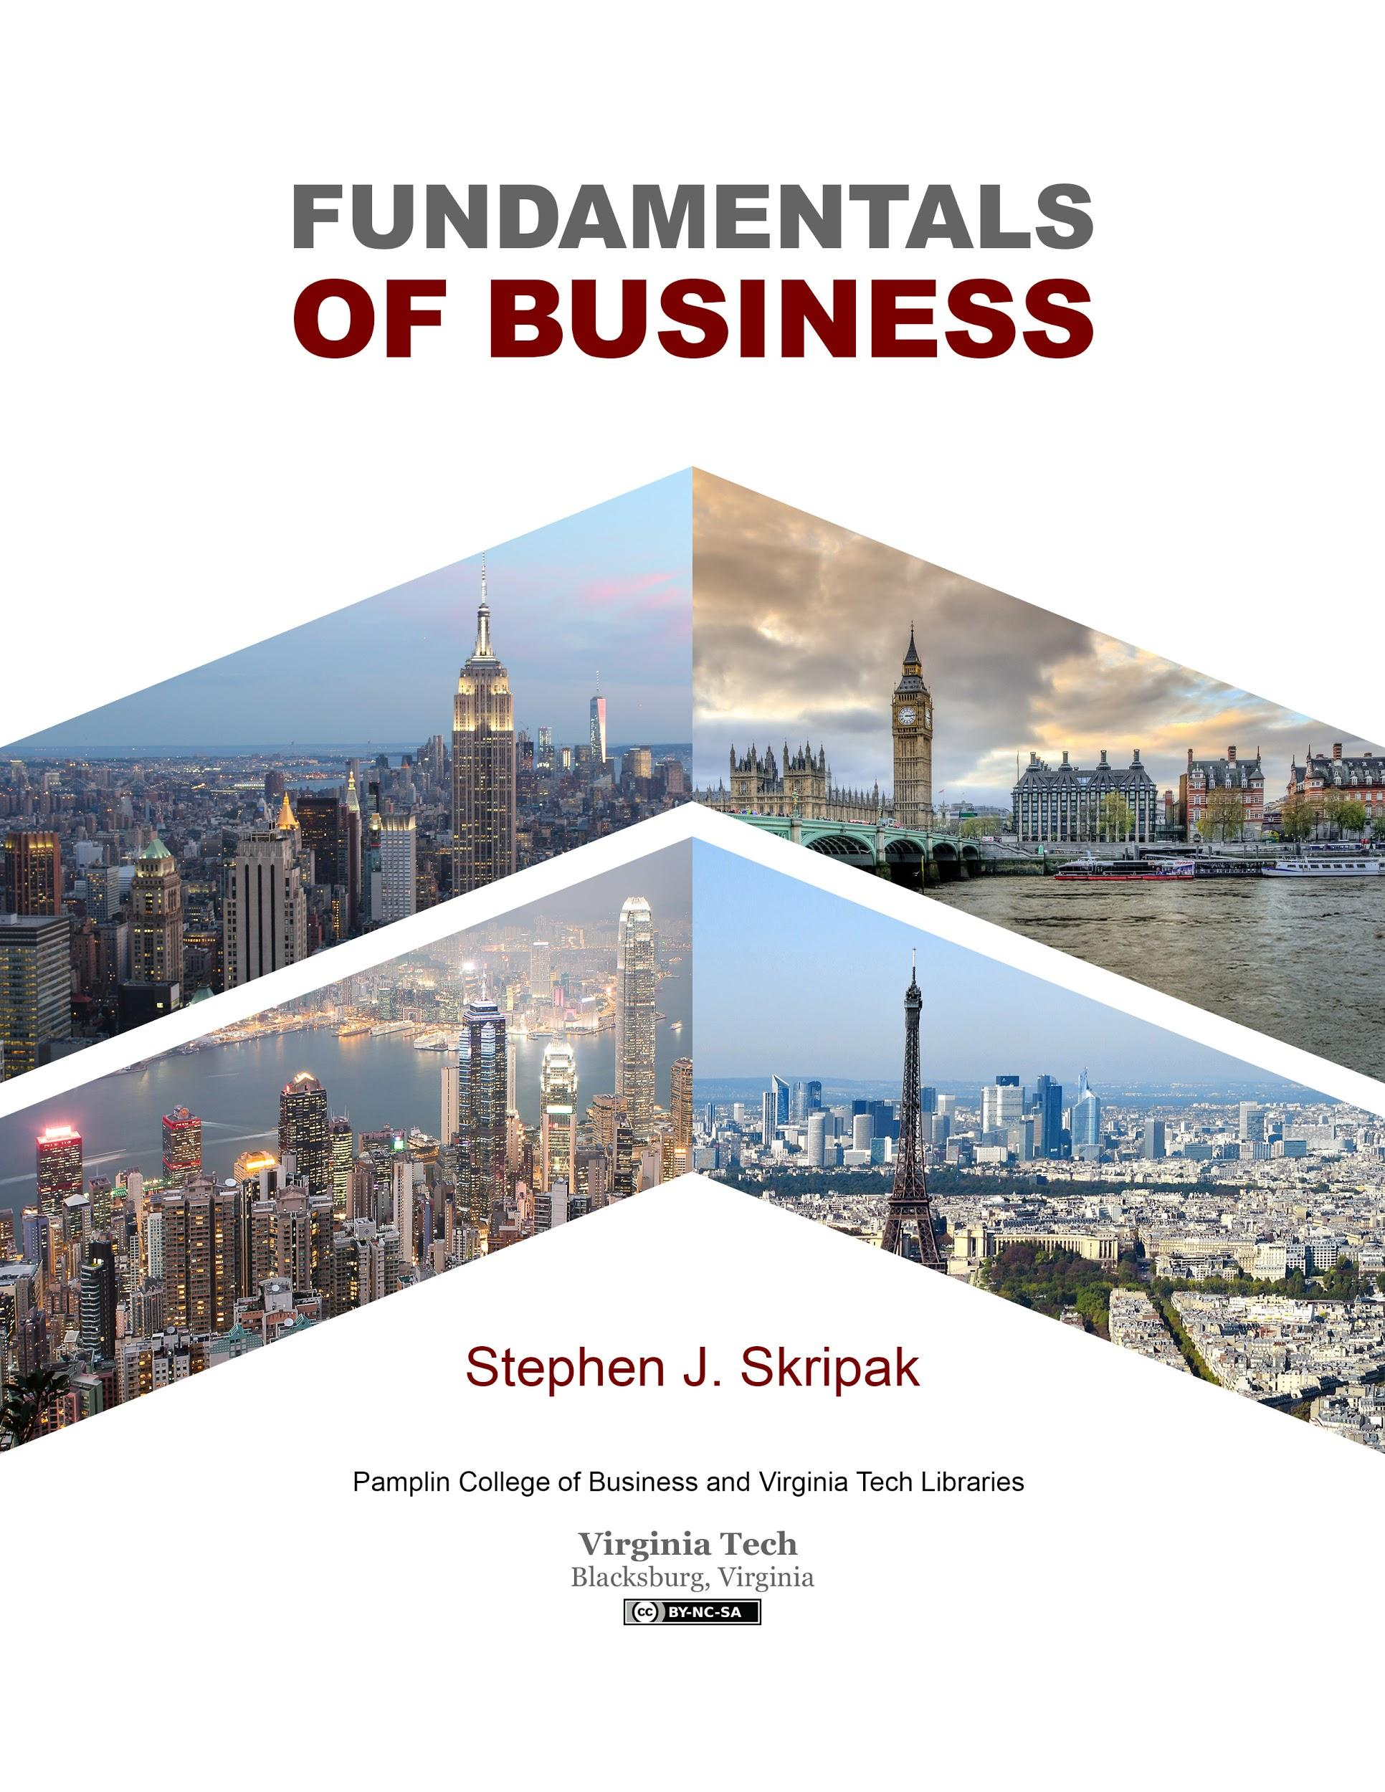

Fundamentals of Business (2016)
Type: Adaptation
Start to finish: 14 months
License:
Authored in: MSWord; Layout: MSWord
Features: Student-reviewed
Available: PDF, MSWord, Print on demand (Lulu)
Notes:
Anita

Slide 4
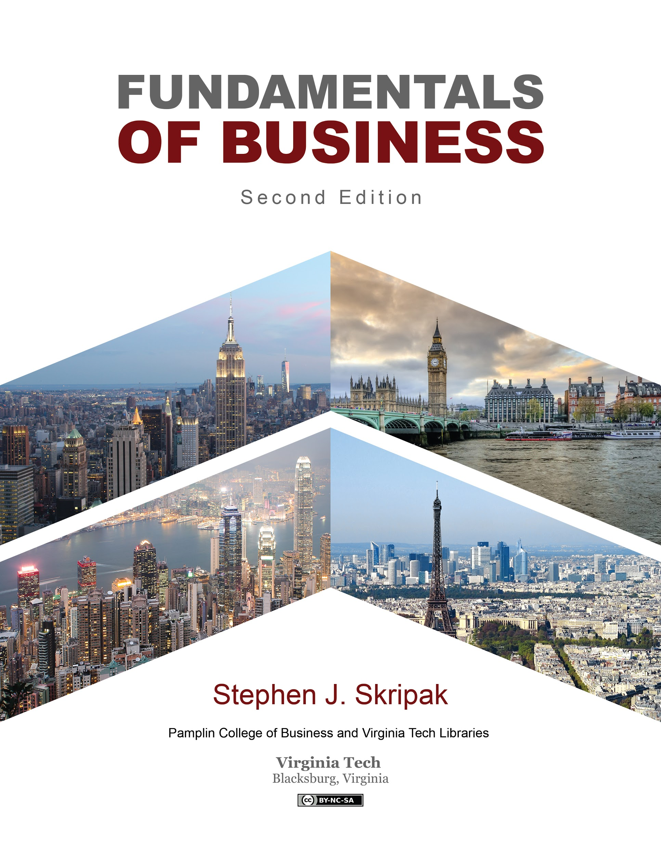
Fundamentals of Business, Second Edition (2018)
Type: Adaptation
Start to finish: 6 months
License:
Authored in: MSWord and PressBooks
Layout: PressBooks and Adobe Acrobat
Features: Student-reviewed, Accessible, Interactive Quizzes, Videos
Available: PressBooks, ePub, HTML, Open Document, PDF, Print on demand (CreateSpace/Amazon)
Notes:
Corinne

Slide 5
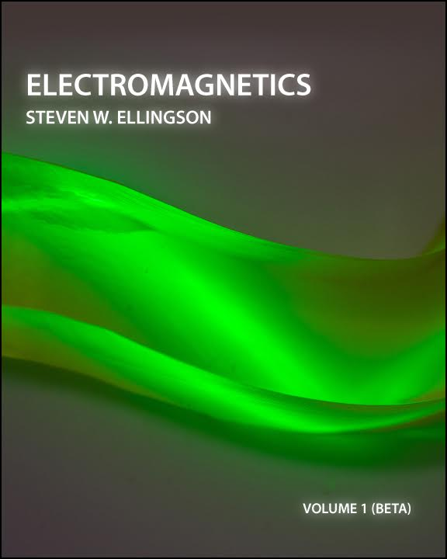

Electromagnetics v1, Beta (2018)
Type: Original work
Start to finish: 11 months
License:
Authored in: LaTeX; Layout: LaTeX
Features: Peer review, feedback loops
Available: PDF, Print on demand (CreateSpace/Amazon)
Notes:
Anita - full process
Corinne - Accessibility

Slide 6

Electromagnetics v1, Beta (2018)
Linking new & old:
Amazon
Bowker / ISBN
Repository landing page
Front cover
Open Textbook Library
Internet search (LibGuides, .coms)
Notes:
Anita

Slide 7

Electromagnetics Volume 1 (2018)
Type: Revision of original work
Start to finish: 8 months (+11 from Beta)
License:
Authored in: LaTeX; Layout: LaTeX
Features: Accessibility, problem sets + solutions, copyediting + technical review, field testing, index, LaTeX sourcefiles, remixable modules, community portal & listserv
Available: LaTeX, PDF, Print on demand (CreateSpace/Amazon)
Notes:
Anita - full process
Corinne - Accessibility and sharing LaTex source files

Slide 8

Lessons Learned
Author agency
Shared goals & author agreements
Copyright and Open Licensing
Large impacts
Workflow
Layout & print on demand
Accessibility
© Maxim Kulikov CC BY https://thenounproject.com/search/?q=lightbulb&i=1263016
Notes:
Anita - author agency, shared goals & author agreements, copyright and open licensing, impacts, ?workflow
Corinne - Workflow, Layout and print on demand, Accessibility, Workflow

Slide 9

Moving Forward
Post production (publicity, user/adapter community, development of ancillaries)
Author recruitment
Assessment and research
Set Workflow
  Continue to explore tools
Author agreements
Site maintenance (PressBooks)
© Rose Alice Design CC BY https://thenounproject.com/search/?q=arrow&i=1947952
Notes:
Anita - Post production, author recruitment, assessment and research
Corinne - Set Workflow, Author agreements, Site maintenance

Slide 10

Thank you and discussion
Cover Art attribution:
Fundamentals of Business
“Hong Kong Skyscrapers” by Estial, CC BY-SA 4.0
“Paris vue d’ensemble tour Eiffel” by Taxiarchos228, cropped and modified by Poke2001 CC BY 3.0;
“London Bridge” by Skitterphoto, Public Domain;
“New York” by Mscamilaalmeida, Public Domain.
All images cropped and modified by T. Finney
Electromagnetics
(C) Michelle Yost. Total Internal Reflection. (Cropped by R.Browder) CC BY-SA 2.0
FIND OUR BOOKS HERE
https://guides.lib.vt.edu/oer/grantees
Anita Walz arwalz@vt.edu
Corinne Guimont gcorinne@vt.edu
University Libraries at Virginia Tech

