Slide 1

Playpal
Team
Kirtan Desai
Kahan Ghadiya
Tanvi Khosla

Slide 2
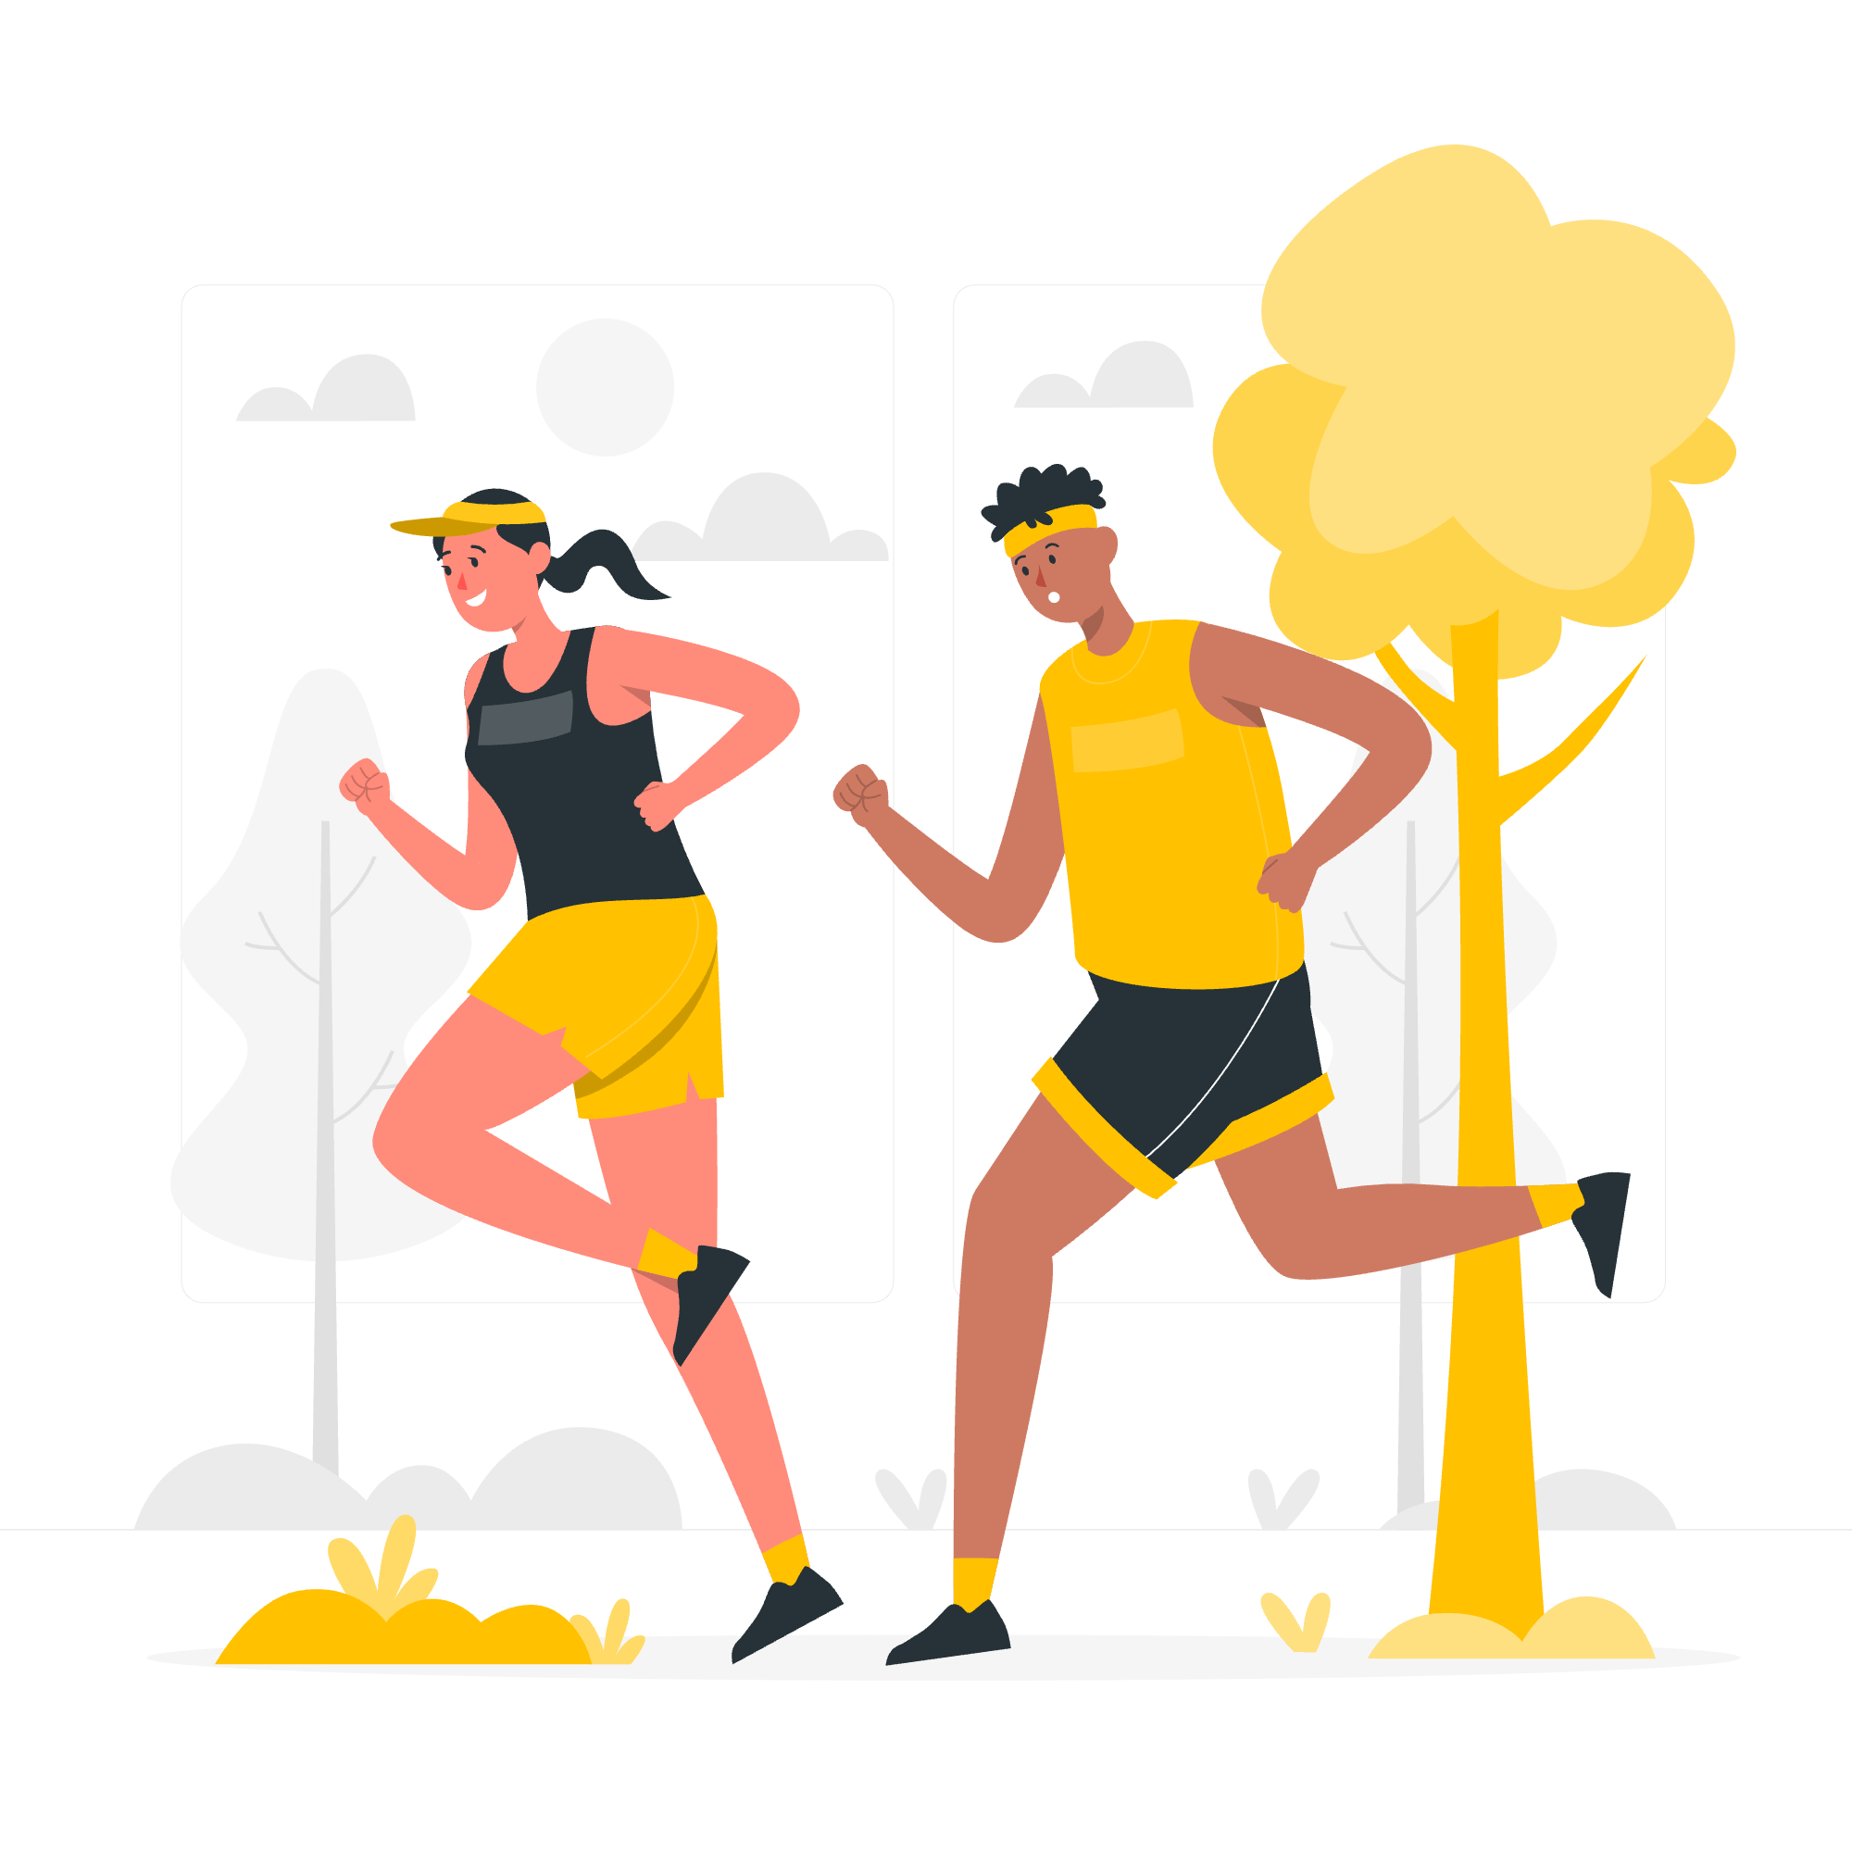
Purpose
Playing sports is associated with reduction in chronic diseases as well as stress reduction.
Playing sports is also a great way to make social connections and be more active in general.
Playpal helps you find a sports partner to play sports with by providing an interface that helps you see people living in the same town with the same sports interests.
Notes:
So why do we need Playpal?
We all know, playing sports has major health benefits such as reducing the risk of many chronic diseases. It also aids in stress reduction and helps people make social connections.
However, nowadays most people find it difficult to find the time to play sports, and when they do, finding a sports partner to play that sport with is even more difficult.
Additionally, since most people have shifted to working as well as getting an education remotely, it adds to the problem of not meeting new people who enjoy playing the sports you enjoy or even making social connections.
Playpal solves these problems by providing an interface to meet people with similar sports interests and capabilities to play your favourite sports with.
So Playpal is essentially a web application that helps people looking for a sports partner to play their favourite sports with.

Slide 3
Features
Login : Google Sign-on for seamless logging in and easy access to all.
Registration : Providing personal details and preferences to aid Playpal matching as well as to provide information to other users.
Playpal matching : Customised suggestions as well as the ability to filter based on multiple criteria to find the perfect playpal.
Messaging : Messaging exclusively for matched playpals to arrange meeting and playing their favourite sports.
Game History : Ability to add a history of sports played with details to track as well as to allow other users to make an informed decision.
Rating : You can rate a Playpal based on your interaction and experience so other PlayPal users can make an informed decision.
Notes:
I’ll take ya’ll through the features of Playpal in the flow that a new user would when they land on the Playpal web application. And in the further slides we will display the designs and even a demo of the features we have completed working on
So, the first feature is the login button. To keep users from having to remember a distinct id and password for the Playpal app we integrated Google Sign-in into our web application, so a user can directly log in using a google email address of their preference.
Now coming to registration or completing one’s profile information. Once a new user logs in using their google email address, the user will be directed to two pages that take the user’s information (such as the sports they are interested in playing, their competency at the sport, etc) to help them find a sports partner as well as so other users can see relevant details about the user when looking for a sports partner.
Now that the user has completed their profile, they can access the dashboard where they can match with their playpal and proceed to enjoy playing their favourite sports. Based on the primary sport chosen by the user, the user’s dashboard will display one profile at a time of users’ who also have that sport as their primary sport. We help the user match specifically according to their criteria. We provide a filter to allow a user to see profiles only that match parameters set by them. These can vary from age ranges and gender to the venues they want to play the sport at. Once a user sets these filter values, they will only be suggested playpal users who match those criteria. If a user wants, they can send a playpal request to a user that matches these criteria and can contact that user only if that user accepts the former user as playpal as well.
Coming to our messaging feature, when both users accept each other as a playpal, they are both given access to message each other on the Playpal messaging. Using our messaging feature which we have created using the Chat Engine api, the users can arrange to play sports at their convenience.
Lastly, we have a game history and score board feature displayed on every user’s profile. When a user finds a playpal, both playpals can then add the sport they played, the playpal the played it with as well as the scores of the games or matches they played with each other. This history will be visible to other user’s and can help them gauge if they think the other user is a suitable playpal.

Slide 4
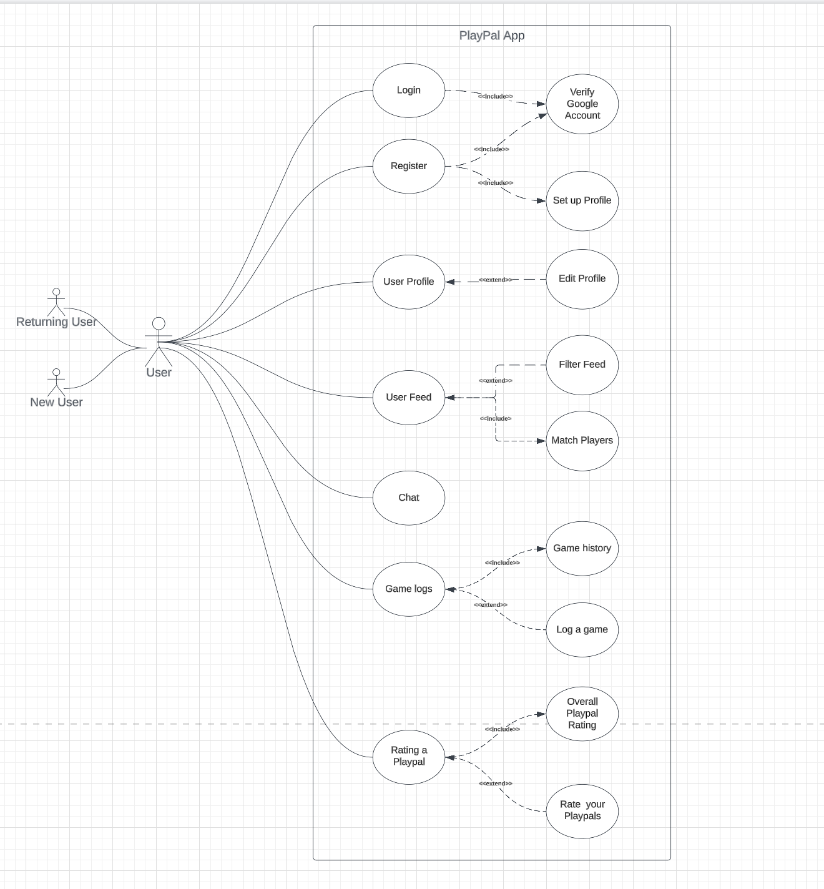
Use Case Diagram

Slide 5
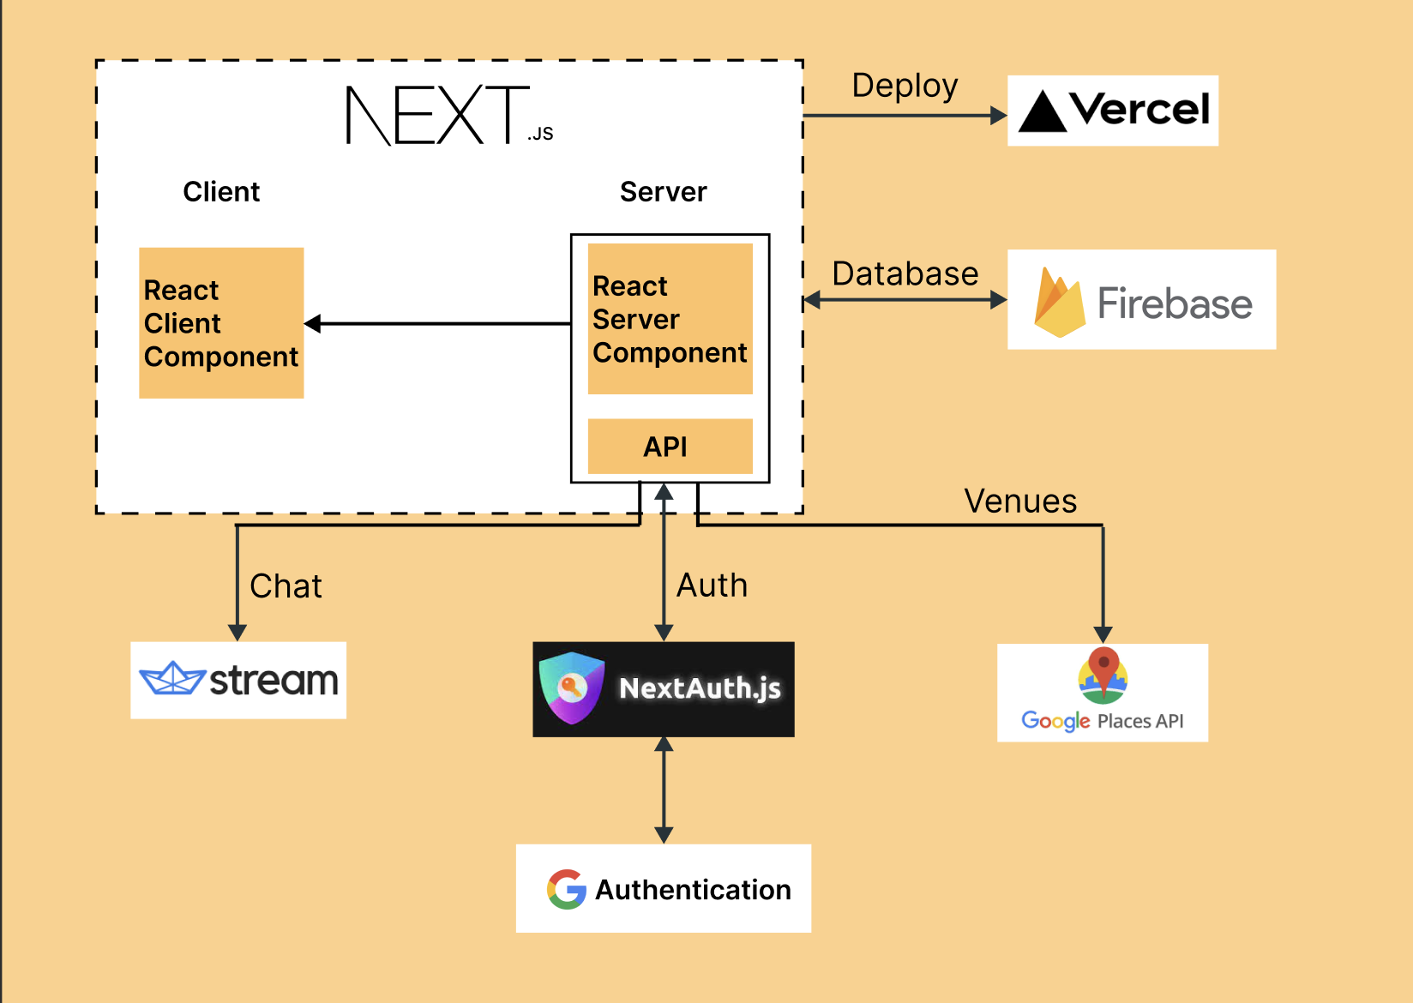
High level architecture

Slide 6
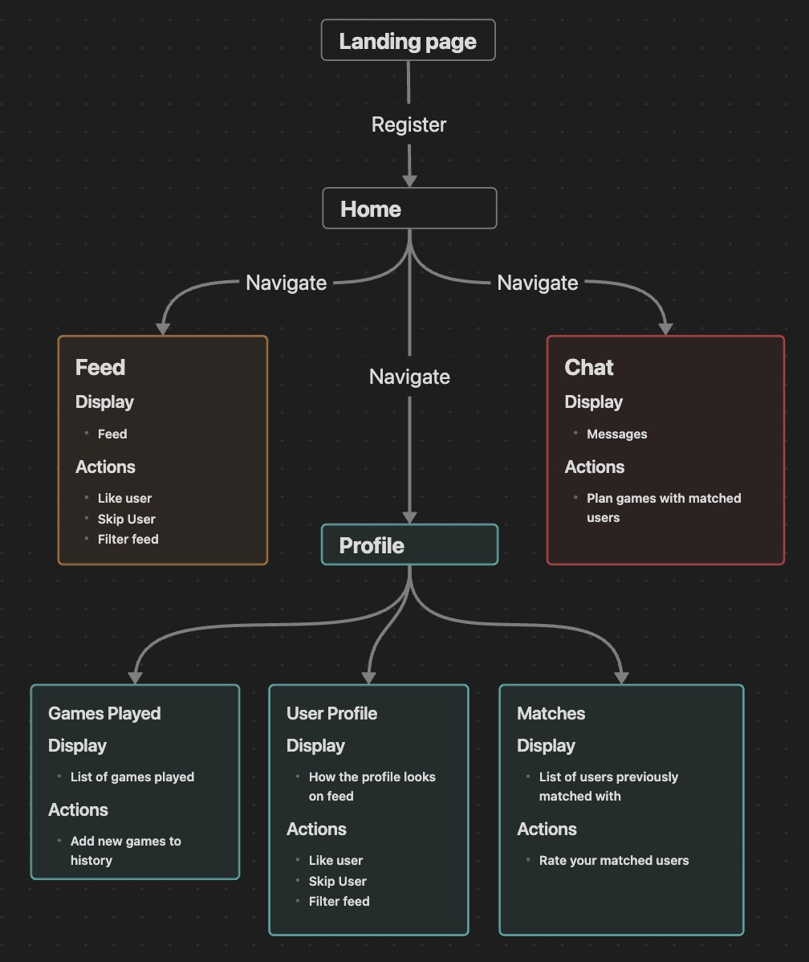
Subsystem architecture

Slide 7
Demo

Slide 8

Questions?

