Slide 1
Save The Penguins
Joey Avant + David Merryman
Notes:
This template can be used as a starter file for a photo album.

Slide 2
What is “Save the Penguins”?

Slide 3

What is Save the Penguins?
Studio STEM
The organization behind “Save the Penguins”
Challenges students to creatively solve real-world issues related to energy and the environment.
Funded by a $1.3 million grant to implement Studio STEM from Spring 2012 through Fall 2014

Slide 4
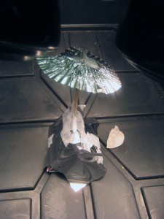
What is Save the Penguins?
Diving Deeper:
After school program for middle school boys and girls
Develop model penguin houses from different materials and test to see if the properties are ideal.

Slide 5
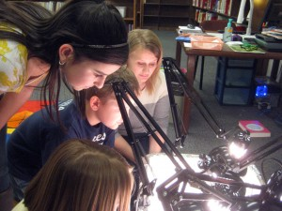
What is Save the Penguins?
How It Works:
Place the penguin houses under heat lamps and find how the materials react.
Test temperature and weigh ice cubes to see which penguin house’s are the best at keeping the heat out

Slide 6
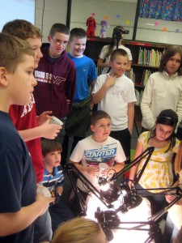
Separation of Roles
David
  Took on the role of managing database and organizing footage.
Joey
  Final video management and editing.

Slide 7
Initial Problem
We have more than 25GB of random footage and hundreds of photos that must be organized.
So we decided to create a database containing the names of each video based on specific criteria.

Slide 8
Datasheet Challenges
An incredible amount of videos, with relatively little time to sift through the footage.
A useful rating system must be created.
An easy solution to sharing the data in real-time
Was this something that we needed for the final video or the client needed.

Slide 9
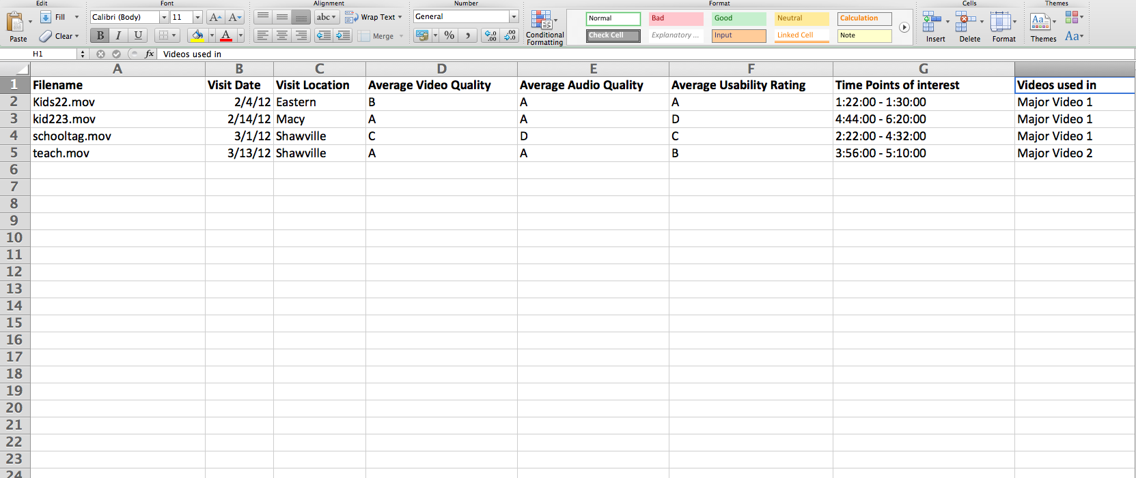
Penguins Videos Datasheet Solution
We decided to base the videos on Filename, Visit Date, Average Video Quality, Average Usability Rating and Time Points of Interest

Slide 10
Datasheet Importance
Client realized it was something needed for organization of the videos.
Became extremely useful when creating the video to differentiate which videos were useful and which were useless.
Sharing over Google Docs for real-time updates

Slide 11
Save the Penguins Video…

Slide 12
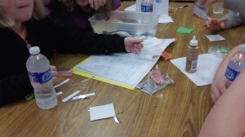
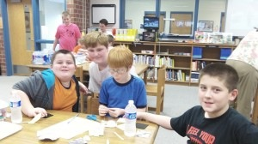
Save the Penguins Video
More Details:
3 to 5 Minute Edits
Mainly consist of footage of the children talking about the program, working on the penguin dwellings, and having fun all at the same time.

Slide 13
Purpose…

Slide 14
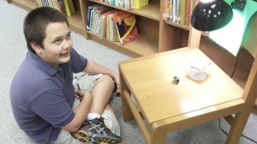
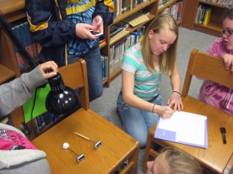
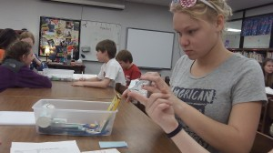
Save the Penguins Video Purpose
What is it we hope to accomplish?
Videos are aimed at parents of children who live in areas where the program is being done
Raise awareness of the Save the Penguins program
Gain an understanding of the program’s goals and and why parents should get their children involved

Slide 15
More on the Save the Penguins Video
The video will answer these questions…
Why should your child take part in this?
Will the children have fun?
How will the activities be educational?
How will the program enrich your child’s life?
The effect of this video can take the program to new heights.

Slide 16
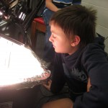
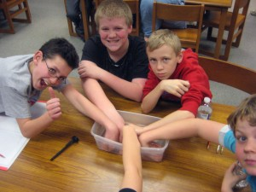
More on the Save the Penguins Video
A majority of the video will be edited with
Final Cut Pro X and Adobe Photoshop

Slide 17
Video Challenges
We had twelve year olds as our camera crew.
Watching for who signed waivers and who didn’t.
How to create and connect a narrative to our footage?

Slide 18
Plan for the Future
More videos to come
  Specialized video content answering specific questions.
  Video for Save the Penguins that is on an assignment specific level.

Slide 19
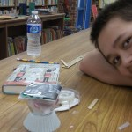
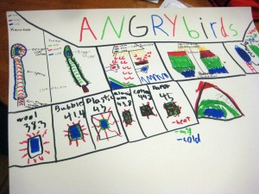
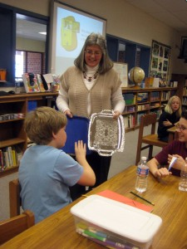
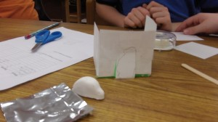
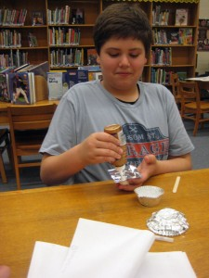
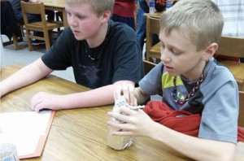
PROFESSIONAL
DYNAMIC
QUESTIONS?
ABSTRACT
SOPHISTICATED
CREATIVE
MODERN

