Slide 1


Boundary Spanners:
Bridging Gaps Between Higher Education and PreK12
Anita Walz, Associate Professor, Assistant Director of Open Education and Scholarly Communication Librarian, University Libraries at Virginia Tech
Julee Farley, Work completed as: University-PreK12 Liaison, Center for Educational Networks and Impacts, Institute for Creativity, Arts, and Technology at Virginia Tech
2021 Open Education Conference ~ October 19, 2021 ~ online
http://hdl.handle.net/10919/105384
at Virginia Tech

Slide 2
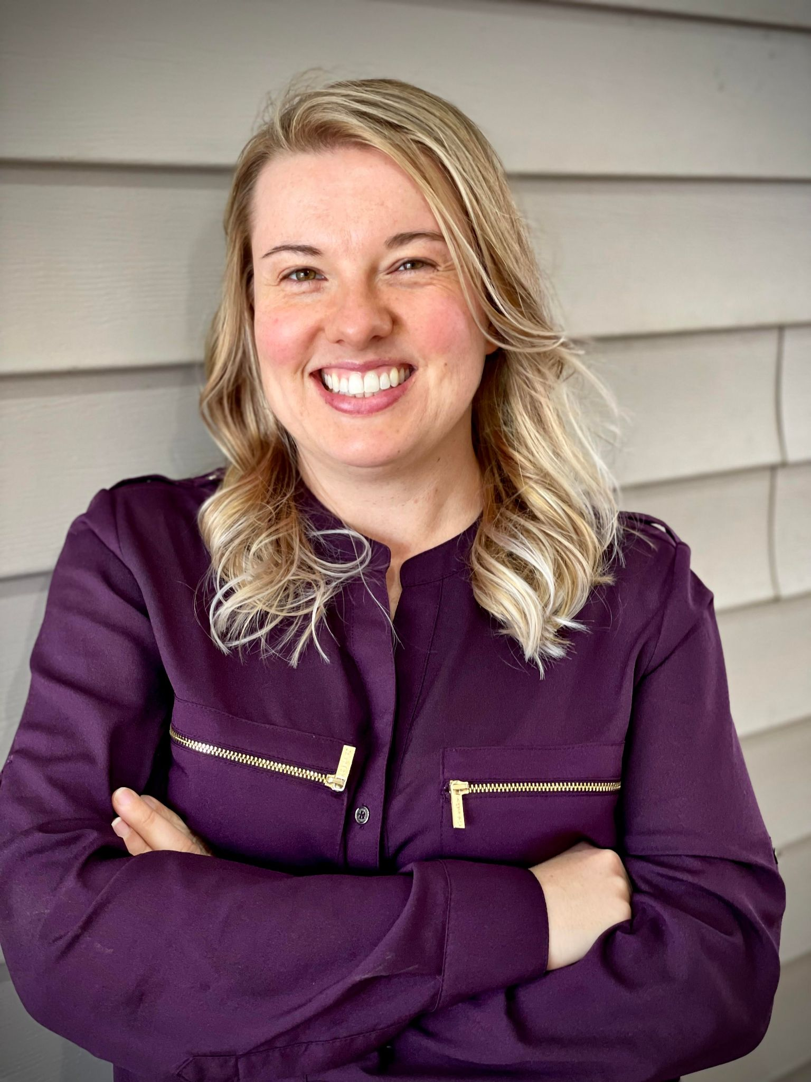
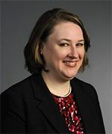
Introductions
Julee Farley, Ph.D.
[formerly] University-PreK12 Liaison, Center for Educational Networks and Impacts, Institute for Creativity, Arts, and Technology at Virginia Tech
farleyjp@vt.edu
Anita Walz, M.S.
Associate Professor, Assistant Director
of Open Education and Scholarly Communication
Librarian at Virginia Tech arwalz@vt.edu
Twitter: @arwalz

Slide 3
About this presentation
Discuss the problem of expectations, usefulness, and communication in sharing between higher education and PreK12.
  Misconceptions by both sides
  Implementation issues
Introducing Boundary Spanners and Boundary Objects
Project overview
  Getting started
  Accomplishments
  Findings and observations
Discussion

Slide 4
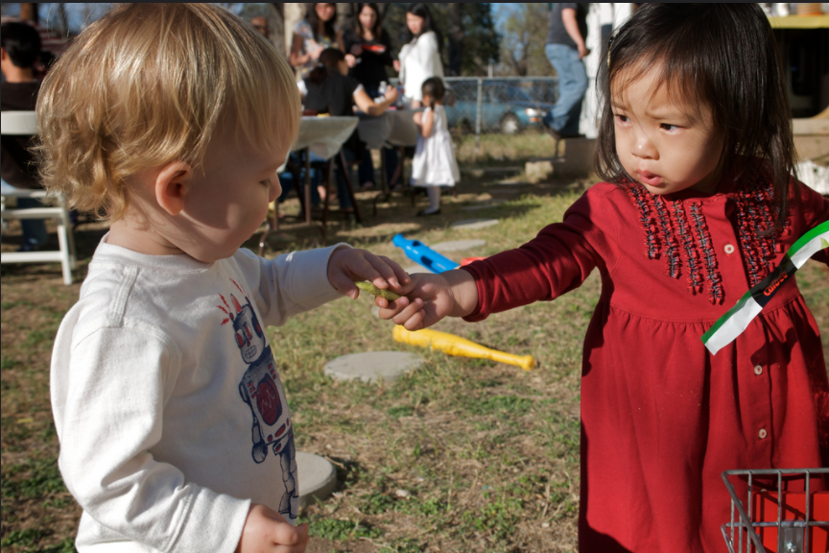
Context: Sharing between Higher Ed & PreK12
© Enoch Lai “Sharing is Caring” CC BY NC ND
© Enoch Lai “Sharing is Caring” CC BY NC ND

Slide 5

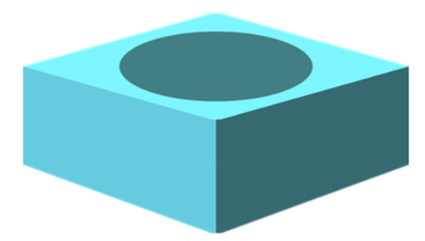
Some in Higher Education want to share.
Expert authored materials are valued by many in PreK12.
BUT . . . there are significant implementation issues

Slide 6



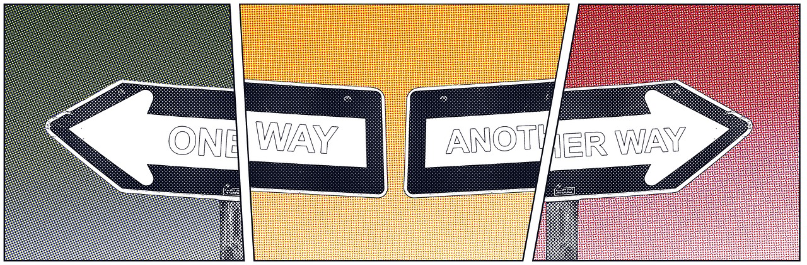
Implementation Issues
One-Directional Flow of information
Not grasping others’ needs
https://pixabay.com/photos/woman-poses-elearning-female-girl-1447067/
https://www.pexels.com/photo/man-in-red-polo-shirt-sitting-near-chalkboard-3779448/
https://www.pexels.com/photo/woman-in-teal-dress-shirt-sits-near-wall-1181426

Slide 7

On the importance of “fit”
Couch (public domain): https://commons.wikimedia.org/wiki/File:Orange_couch.png
Room is CC BY NC 2.0: https://flic.kr/p/2aXMEnj

Slide 8

Implementation Issues - Misconceptions by PreK12
Teachers . . .
Make assumptions about outreach
Assume dramatically different timelines
Image source: https://pixabay.com/illustrations/misunderstanding-black-men-2421389

Slide 9
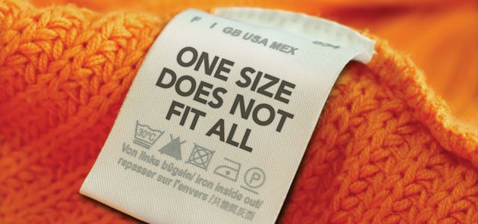
Implementation Issues- Misconceptions by HigherEd
Higher Ed faculty and staff may ...
Not know what PreK12 teachers need
Lack classroom knowledge regarding standards, time constraints, level of detail in lesson plans, differentiation
Not recognize that PreK12 teachers are experts in teaching their grade and differentiating for their students
Think they they cannot / should not ask PreK12 teachers for guidance
Not realize that PreK12 is not required to bring outreach into the classroom

Slide 10
Implementation Issues - for creators
Guidance needed regarding inclusion/sharing of:
  Undergrad/Grad Student creations
  Third-party graphics, elements, etc.
Format matters (for others to customize)
Accessibility (ADA compliance) matters -- and how

Slide 11

https://pixabay.com/photos/canyon-gorge-perspective-nature-5552326/
Notes:
https://pixabay.com/photos/canyon-gorge-perspective-nature-5552326/

Slide 12
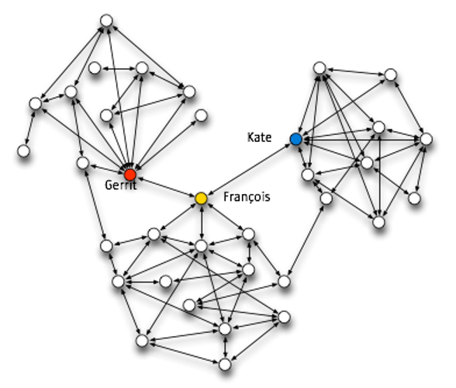
Boundary Spanners & Boundary Objects
Boundary spanners link organizations or groups to share knowledge and resources (Jesiek et. al, 2018; Johri, 2008)
Boundary objects are any object that is part of multiple groups that facilitates communication between them
(Hawkins & Rezazade, 2012)
© Aardrock CC BY NC SA “Spotting Boundary Spanners” https://www.pngfind.com/mpng/bTmwxJ_boundary-spanner-hd-png-download/ (Removed border and text)

Slide 13

Who are boundary spanners?
We are!
https://www.pexels.com/photo/woman-sharing-her-presentation-with-her-colleagues-3153198/

Slide 14
What are the roles of the boundary spanner?
Goal: bring together diverse communities in productive ways
Formal or informal
Links organizations or spans holes in networks
© Aardrock CC BY NC SA “Spotting Boundary Spanners” https://www.pngfind.com/mpng/bTmwxJ_boundary-spanner-hd-png-download/ (Removed border and text)

Slide 15
How our project started
Consultation re: copyright and open licenses
Development of instructional documents and forms
1a. Higher ed students own their own work
1b. Faculty must have (non coerced) permission to share student work
2. Further instruction needed regarding use of in-copyright third-party works, preferred file formats, and document accessibility
3. Process-management checklists (for authors and CENI)
4. CENI needs permission to “publish” works

Slide 16

What we’ve accomplished (and why it matters)
Faculty/grad students can share more easily
We have documentation!
We learned some things
Higher Ed learned a lot more about PreK12 context
PreK12 learned more about ©, open licensing, and accessibility
This framework does not exist elsewhere (and if it did, it was not easy to find) . . . also working on a publication about the project.
https://pixabay.com/vectors/superhero-comic-speech-bubbles-4376197

Slide 17
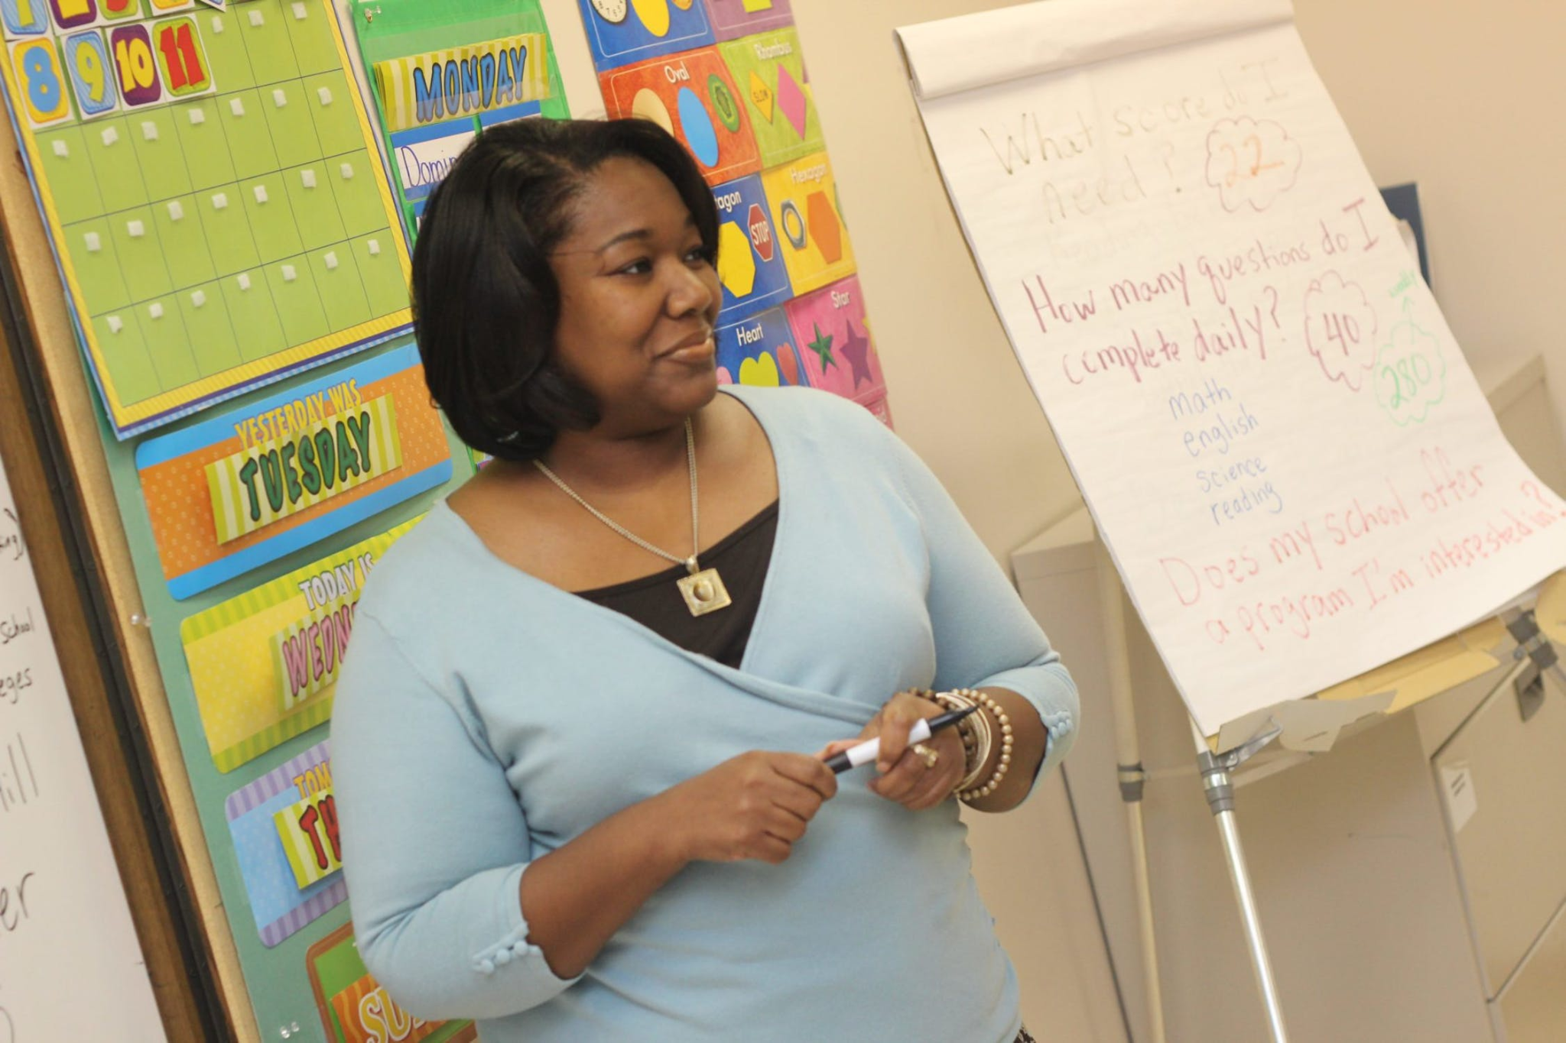
Additional Findings / Observations
Messages to Higher Education
PreK12 teachers are EXPERTS at teaching
Creating generalizable lesson plans (to share) is not a small, effortless, nor easy task
PreK12 are generally paid when collaboratively creating resources to share beyond their classroom
Questions to ask:
What standards are your students struggling with?
How much time can you/do you plan to spend teaching this specific concept, topic, task or project?
Is there specific terminology that should be included (or not included) to which you want students to be exposed?
What would make it easy for you to actually use the material?
When do you plan to teach the material? How far in advance would you like to receive it?
https://www.pexels.com/photo/photo-of-woman-teaching-935943

Slide 18
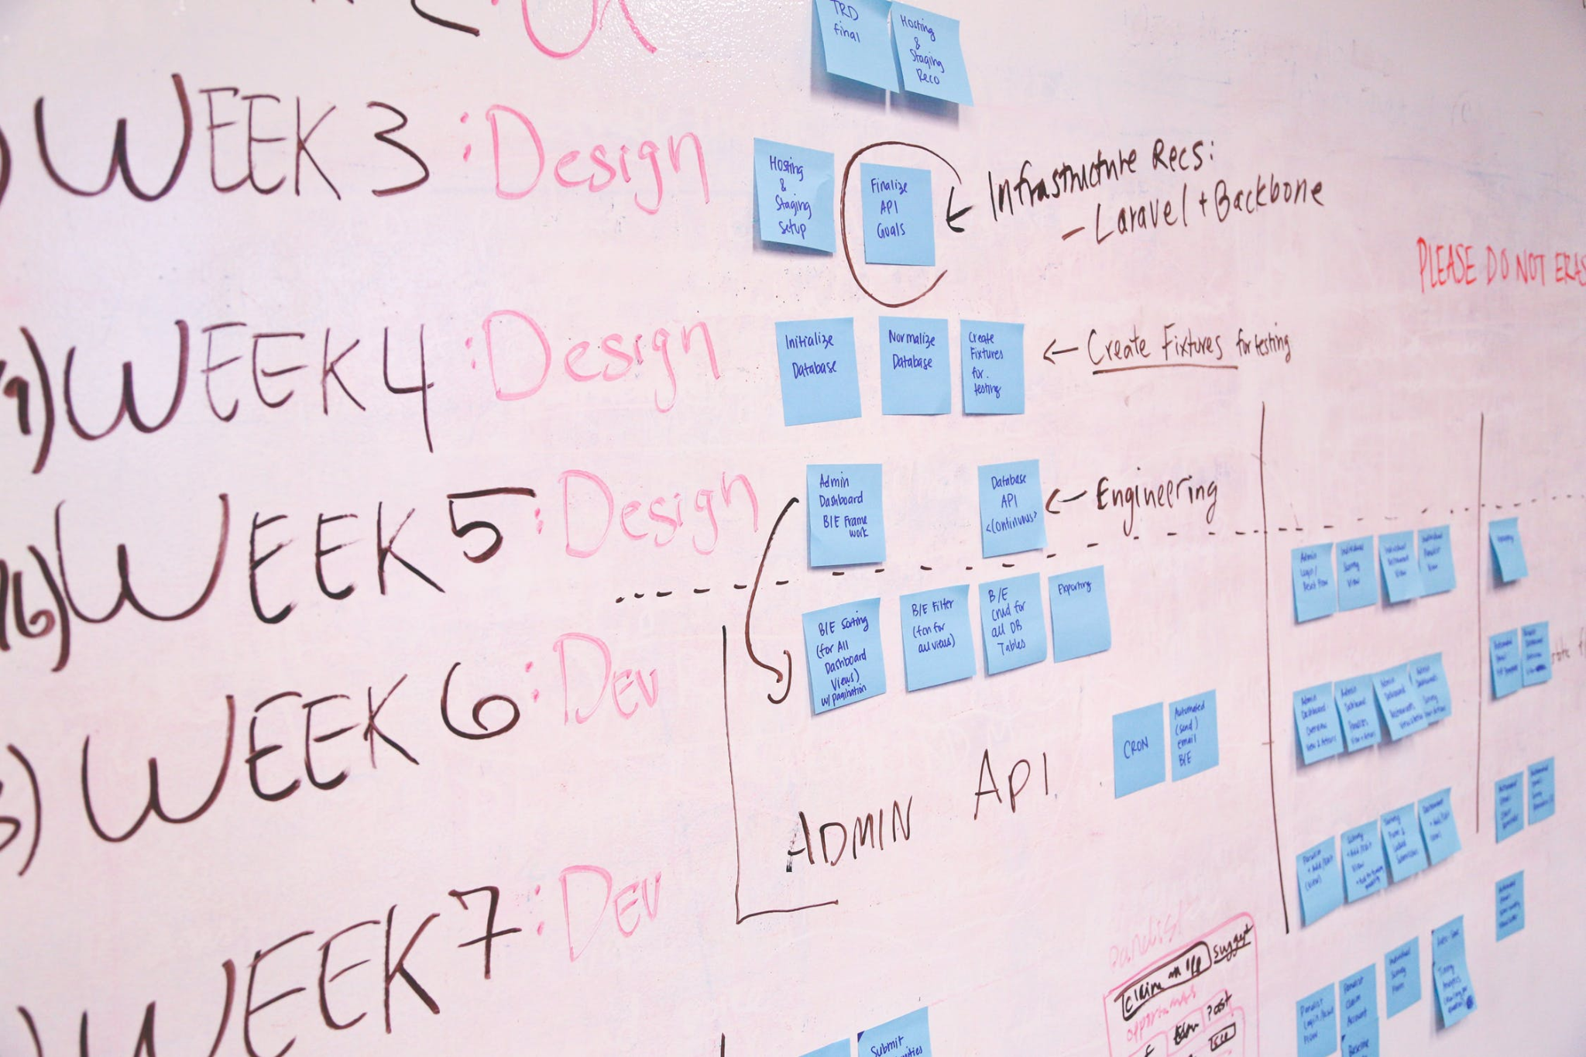
Additional Findings / Observations
Messages to PreK12 Education
Project timelines in Higher Education are much longer than in PreK12
Higher Education projects have a higher degree of uncertainty
Without funding, HE faculty and students may not have an obligation (or opportunity) to conduct outreach. (Outreach is generally not rewarded by the tenure process.)
https://www.pexels.com/photo/blue-printer-paper-7376/

Slide 19
References
Hawkins, M. A., & Rezazade M. H. (2012). Knowledge boundary spanning process: synthesizing four spanning mechanisms. Management Decision, 50(10), 1800 - 1815. doi: 10.1108/00251741211279611
Jesiek, B. K., Mazzurco, A., Buswell, N. T., & Thompson, J. D. (2018). Boundary spanning and engineering: A qualitative systematic review. Journal of Engineering Education, 107(3), 380–413. doi: 10.1002/jee.20219
Johri, A. (2008). Boundary spanning knowledge broker: An emerging role in global engineering firms. In 2008 38th Annual Frontiers in Education Conference, S2E-7. IEEE. doi: 10.1109/FIE.2008.4720407
Walz, A., & Farley, J. P. (2021). Slides and supporting documentation/forms from Boundary Spanners: Bridging Gaps Between Higher Education and PreK12. Presented at the 2021 Open Education Conference. http://hdl.handle.net/10919/105384

Slide 20

Discussion
Anita Walz, M.S.
University Libraries, Virginia Tech
arwalz@vt.edu
Julee Farley, Ph.D.
farleyjp@vt.edu
https://www.pexels.com/photo/marketing-sign-shopping-business-7564224/
Notes:
https://www.pexels.com/photo/marketing-sign-shopping-business-7564224/

