Slide 1

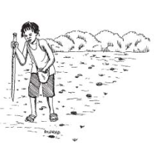




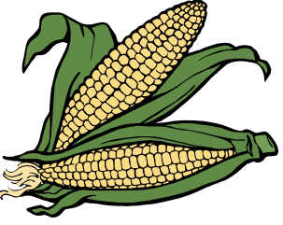
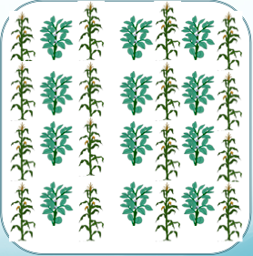
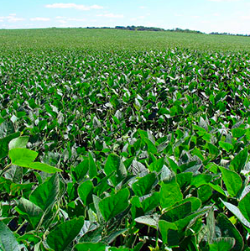


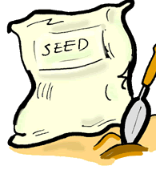
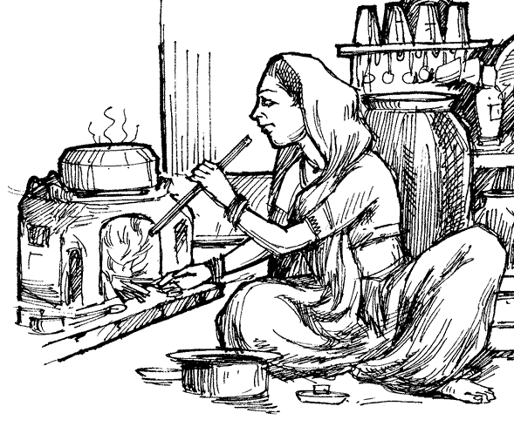
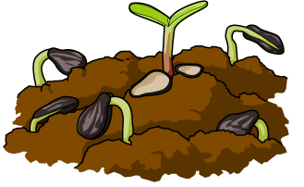


Conservation Agriculture Production Systems (CAPS)
SANREM
Short term BENEFITS:
Decreased labor for land preparation
Increased water absorption
Short term COSTS:
Increased labor for planting & weeding
Decreased yields
Dibble planting reduces soil disturbance during land preparation
Improves crop yields
Increases soil nutrients
Improves water absorption
Planting beans or legumes with maize improves soil health
Improves crop yields
Increases soil nutrients
Increases soil cover
Improves water absorption
Decreases erosion
Planting cover crops after harvest promotes healthy soil
Controls weeds
Increases soil nutrients
Increases soil cover
Improves water absorption
Decreases erosion
CAPS
Short term BENEFITS:
Decreased labor for weeding
Additional yield & income from beans
Improved household nutrition
Increased water absorption
Short term COSTS:
Increased labor for planting
Cost of beans or legumes
Short term COSTS:
Increased labor for planting cover crop
Cost of cover crop seed
Cost of additional herding
Overall Long Term Effects of CAPS
BENEFITS:
Increased yields
Increased income
Improved household nutrition
Improved soil conditions
Decreased erosion
COSTS:
Increased labor
A University of Hawaii/OUAT Collaboration
prepared by Jacqueline Halbrendt, MS
J. Halbrendt, T. Idol, C. Chan-Halbrendt, C. Lai. 2011. University of Hawaii, Dept. of Natural Resources & Environmental Management

