Slide 1
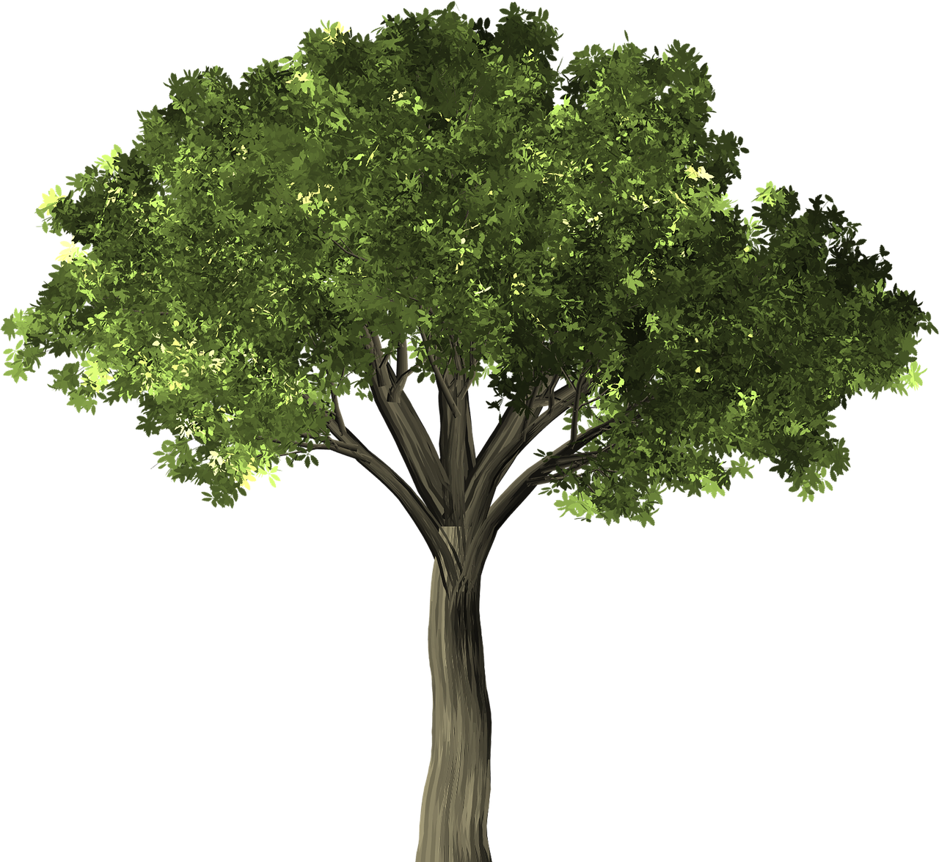
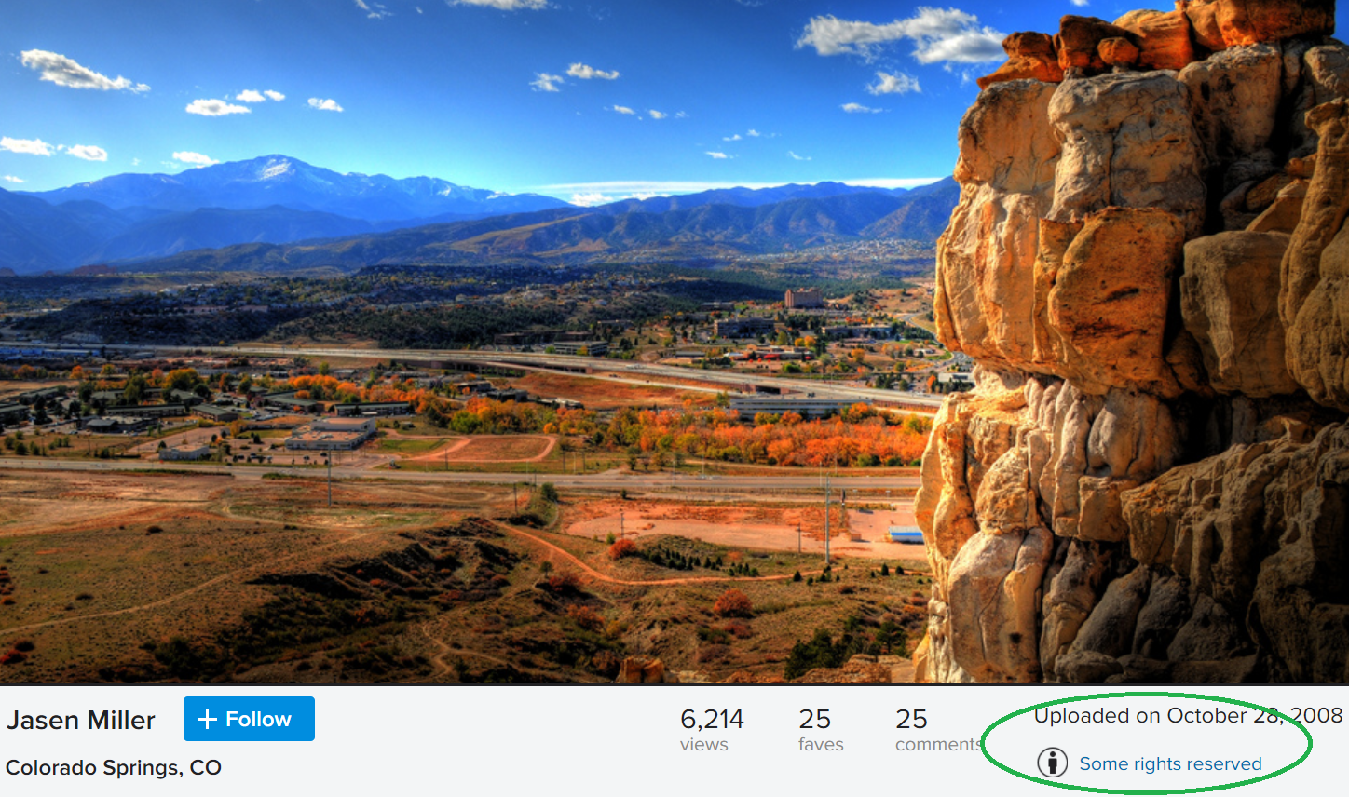

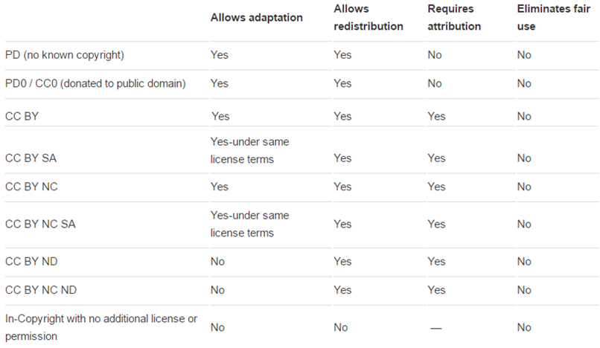
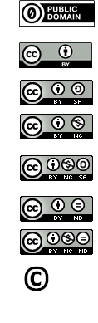

Remix and Share: Teaching Others to Navigate Copyright Issues in Open Education & Open Licensing Contexts
Anita R. Walz, Open Education, Copyright & Scholarly Communication Librarian, University Libraries, Virginia Tech
Kraemer Copyright Conference, June 5, 2018, Colorado Springs, CO
Abstract: Faculty and students creating or adapting openly licensed resources face
numerous barriers in understanding how to appropriately handle third party works.
To address these issues I developed the EMLS (Evaluate, Mark, License, Share) model and
presentation “Creative Commons and OER in 30 Minutes” [1] for non-copyright expert
colleagues who needed an efficient, clear, and memorable way to teach students, staff, and faculty who want to remix, openly license, and share content from multiple sources. This poster is based in part but will go beyond the presentation.
Your feedback and questions are very welcome!
The EMLS Model
Evaluate – Can you integrate the third party work? Under what terms? [2]
Mark – Mark the terms under which the 3rd party work is used.
License – Put an open license your overall work.
Share – Publically share your overall work.
Topical Summary
The 10,000 Foot View: Threshold Concepts in Open Education & Open Licensing
1. Educators of all types are in the business of sharing information and methods with others.
2. Educators love to recycle, reuse, and improve upon others’ works.
3. Creative Commons and other open licenses allow anyone to more broadly share their original work while indicating what kinds of uses are permitted.
4. Even if they are free online, original, fixed creative works are automatically in-Copyright in the U.S.
There are several ways to incorporate works (remix works) in your own: [2]
Create it yourself and retain the rights to meet your sharing and remix needs
Use public domain materials
Apply a relevant exemption from U.S. Copyright law
Leverage existing permission (license terms including Creative Commons licenses)
Request and obtain permission for your particular use
Conduct an informed fair use analysis
Link or point to a (legal) copy rather than copying, hosting, or redistributing
6. When one wants to incorporate third-part works in their own, terms of use are important
Free online works are most often under Copyright unless otherwise noted.
Educational uses are not automatically considered Fair Use
7. Copyright is complex. Educators are less likely to remix and share their work under an open license (or at all) if they are uncertain regarding navigating copyright issues.
Applying the EMLS Model
Evaluate [2]: Did I create (and still own) rights necessary to use the content in the way I want to use it?
If not, do I have permission for my use of third party content?
Is it Creative-Commons licensed content which requires attribution? [3]
Is it public domain content (© expired, U.S. Government content, donated to the Public Domain)
Do I have written permission from the copyright holder for your use
Can I assert Fair use, with (or without) transformative use for world-wide sharing?**
Discussion/Questions
What level of knowledge would a copyright non-expert need to master to be able to accurately and confidently teach this topic?
How can more nuanced discussions of the Public Domain and Fair Use be facilitated without overwhelming some levels of learners?
Could a discussion about plagiarism vs. copyright infringement vs. violation of terms of an agreement fit in here? To which audiences would that be most helpful and how could that be best presented?
_______________________________________
Is there a good model for obtaining transferable permission to use 3rd party works for your use and in continued uses under an open license?
Out of concern regarding “downstream” uses and users (future users and adapters) some OER referatories refuse content that contains 3rd party material not released under an open license (e.g. no Fair Use or content or all-rights-reserved “used with permission” content). When is this appropriate? Are there other best practices?
What are some examples of a valid non-transformative Fair Use argument if in-copyright, non-openly licensed content is freely shared with the world?
________________________________________
What suggestions, criticisms, observations, or additions do you have to the model and method of teaching? These would need to meet the needs of non-copyright expert colleagues who need an efficient, clear, and memorable way to teach students, staff, and faculty that want to remix, openly license, and share content from multiple sources?
Mark (see format suggestions below*)
If used under a Creative Commons license [3]:
(c) Jason Miller. Colorado Springs. CC BY 2.0
If public domain content [4]:
Elm Tree by Deedster [Public domain] https://pixabay.com/en/tree-elm-elm-tree-leaf-green-1484370
If written permission was granted for your specific use.
© Year, Author. Used with Permission. URL if any.
If fair use is asserted on the basis of an informed Fair Use Analysis:
© Year, Author. Reproduced under Fair Use. URL if any.
What are Open Licenses?
The most prominent, but not the only open licenses are Creative Commons licenses. Open licenses are intellectual property licenses which allow no-cost redistribution and adaptation with attribution.
Most open
License:
Apply the license of your choice to your compilation:
©MyName, Publication Year. Unless otherwise noted, licensed with a Creative Commons Attribution License 4.0
Make your CC-licensed works machine readable: http://wiki.creativecommons.org/wiki/Marking_Works_Technical
Open Educational Resources (OER)
Share:
Share in the places of your intended use: in print or on your website
Share in URL-stable repositories and places where people might look for your work
Institutional repository
Disciplinary repository
OER Commons
Open Textbook Library (if all content is openly licensed)
MERLOT
Tell people about your work via social media
Not OER
Disclaimer: The author is not a lawyer. Information presented here in should not be construed as legal advice.
*Suggestion: Use http://rightsstatements.org formats or those discussed at http://blog.apastyle.org/apastyle/2016/01/navigating-copyright-overview.html
Suggested citation: Walz, A. (2018) Remix and Share: Teaching Others to Navigate Copyright Issues in Open Education & Open Licensing Contexts. Kraemer Copyright Conference, Colorado Springs, CO. June 4-6, 2018. Released under a CC BY 4.0 International License.
References
[1] Walz, A. (2017) Creative Commons and OER in 30 minutes http://hdl.handle.net/10919/78393
[2] Walz, A. (2015) A Framework for Analyzing any U.S. Copyright Problem. http://hdl.handle.net/10919/56505 CC BY SA. Adapted from © 2014 Kevin Smith and Lisa Macklin.
[3] Best Practices for Attribution https://wiki.creativecommons.org/wiki/Best_practices_for_attribution
[4] Copyright term and the Public Domain in the United States https://copyright.cornell.edu/publicdomain
Least open
Attach a copy of the presentation: Walz, A. (2017) “Creative Commons and OER in 30 Minutes” here http://hdl.handle.net/10919/78393
Please note the 2017 presentation has an older version of the EMLS model and very restrictive suggestions regarding Fair Use.
© Anita Walz, 2018. Except where otherwise indicated, this poster is licensed with a Creative Commons Attribution 4.0 License.

