Slide 1

Revising the Bottom Line:
Advocacy & Adding Value for Students
Anita Walz @arwalz
Open Education, Copyright & Scholarly Communication Librarian
Virginia Tech
April 28, 2016 - Textbook Affordability Conference - Davis, CA
This presentation is licensed with a Creative Commons Attribution 4.0 license.

Slide 2
Open Education Librarian perspective:
The ethos of Open
How libraries approach affordability, access & student success
Collaborative opportunities

Slide 3

Getting to know you: I’m a…
Bookstore/campus store manager
Vendor
Faculty member
Librarian
Administrator
Student
Image: Public Domain

Slide 4
What is Open Education anyway?

Slide 5
The nature of knowledge & information
A non-rivalrous good

Slide 6
Education is sharing.

Slide 7

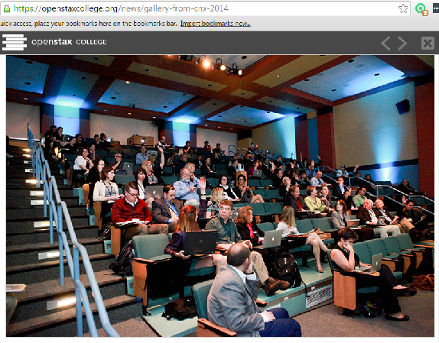


CNX 2014
Image Credit: OpenStax College. Used with permission.
https://openstaxcollege.org/news/gallery-from-cnx-2014

Slide 8
5 R permissions
Retain
Reuse
Revise
Remix
Redistribute

Slide 9

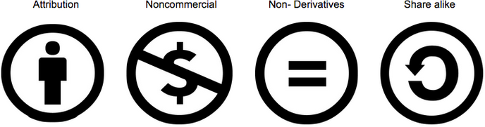



Slide 10


Slide 11


Slide 12
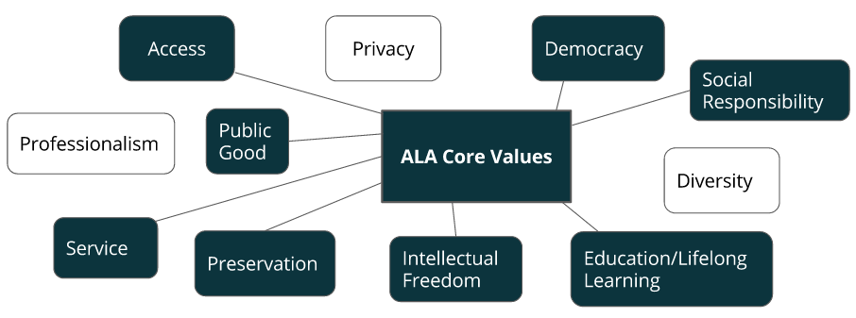
Library core values
ALA “Core Values of Librarianship”

Slide 13

© SparkCBC https://flic.kr/p/61VWme CC BY SA

Slide 14
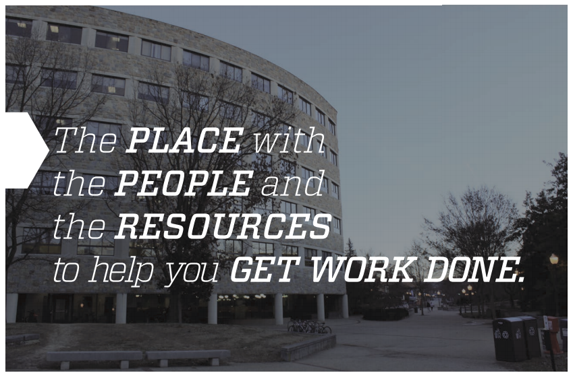

Slide 15
Virginia Tech
No institutional mandate
.6 Library FTE exploration of Open Education
Building knowledge of campus needs, partners, teaching, events, and raising awareness.
Supporting faculty: Revising an OER textbook, consulting on OER development projects

Slide 16
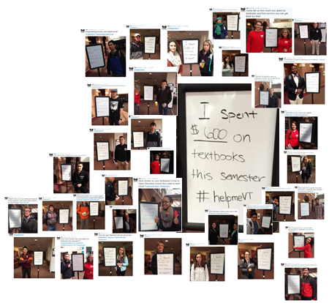
Source: @AAffairs_VTSGA 2/23/2015
Notes:
[students] are not buying books
anymore.
People are going to spend the money on the textbook the professor selected.
I don’t want to have to work twenty hours a week to afford my textbook.
I had to spend $90 to rent an eBook in order to get a required software code to submit homework. I did not even get to keep the book.
I don’t think professors know that $250 is a lot of money for [students].
I just want faculty to be aware that there is a problem.

Slide 17
Anticipated vs. Reported Spending
 | Anticipated | Reported
Total Respondents | $187,200 | $97,250
Individuals (average) | $600 / semester | $325 / semester
WHY did students spend only 54% of what was anticipated?
N=312
Notes:
Population: all VT students
Sample: 3,100 currently-enrolled undergrad and grad students representative sample. Selected and provided by VT’s Office of Institutional Research
Respondents: 362 (11.6% response rate)
Online survey: Jan 29-Feb 29, 2016

Slide 18
Library roles
Consulting
Collaborative teaching
Pilot projects
  Advising on grant-funded OER creation
  Updating an openly licensed textbook
  Mini-grant program with collaborative support

Slide 19
Library roles: OER Programs
University of Massachusetts – Amherst
Temple University
Others
+ many in the works

Slide 20
Library Roles: Publishing
OpenSuny Textbooks
LEVER Press
Humboldt State University Press
University of Nebraska
Other OER notables:
Open Textbook Library and BC Open Campus
Library Publishing Coalition

Slide 21
Getting practical

Slide 22
Faculty roles:
Students at the center
Experiments are ok
Explore options (and implications on students and institutions)

Slide 23
Faculty roles:
Options (and implications on students and institutions)
  OER
  Openly license & share your original work
  Library-subscribed resources
  Negotiate / Lower-cost
  Older edition
  Library Reserves

Slide 24
Faculty roles:
Experiment with pedagogy
  Student agency & real-world activities
  What can you do with Open?
  Higher-order skills: apply, analyze, evaluate, create
Repeat! Or continuous improvement

Slide 25
Or, guiding questions for reflection:
How can I make my course more open?
- more accessible?
- more engaging?
- more connected to the real world?

Slide 26
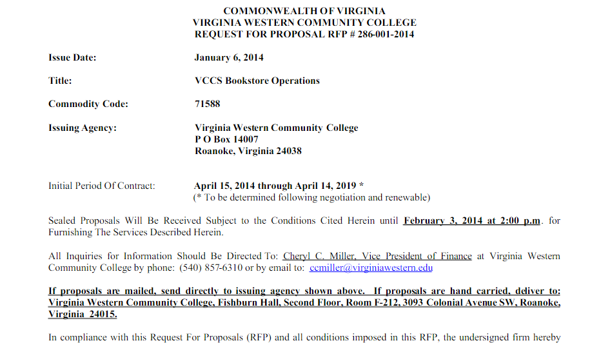
Procurement Suggestions

Slide 27
Library & Bookstore Suggestions

Slide 28
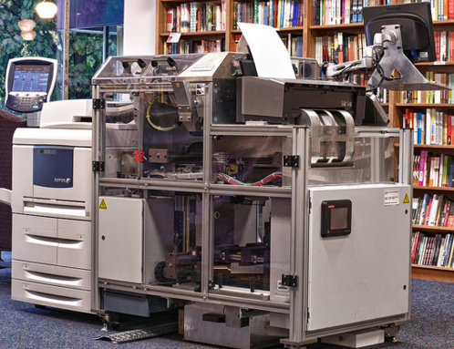
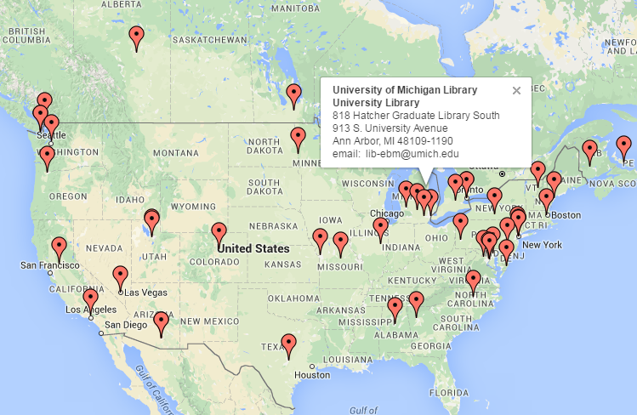
Print on Demand
Espresso Book Machine (EMB) http://www.ondemandbooks.com
© Politics & Prose https://flic.kr/p/awRg8j CC BY SA

Slide 29
Collect & share data!
Bookstore Prints PDFs of OER on Demand
“More students are going thru the bookstore now than before.”
→ Bookstore is losing LESS money.
→ Students are saving MORE money.

Slide 30
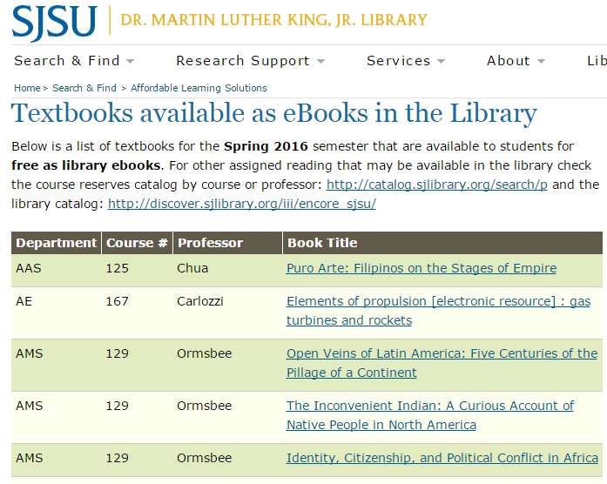
Share data to promote access

Slide 31
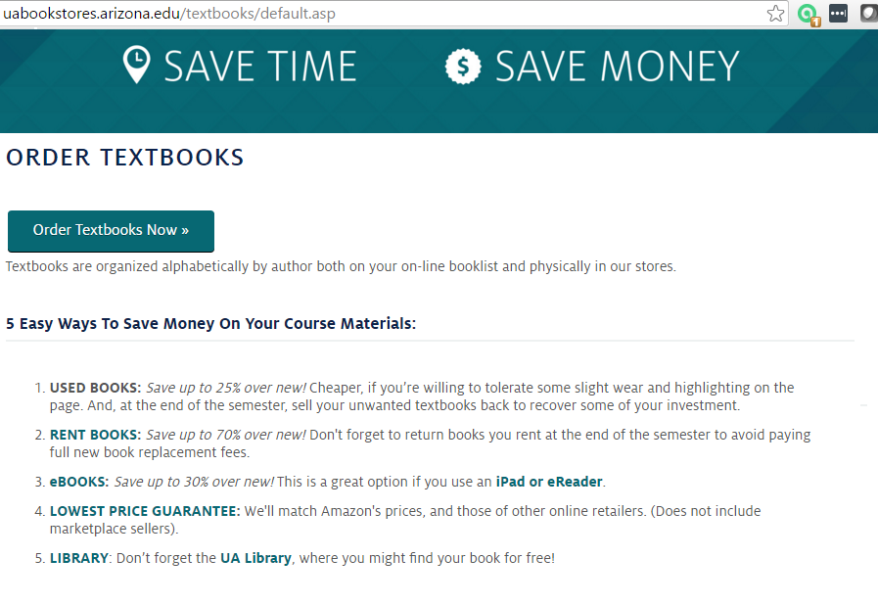
Mention the Library

Slide 32
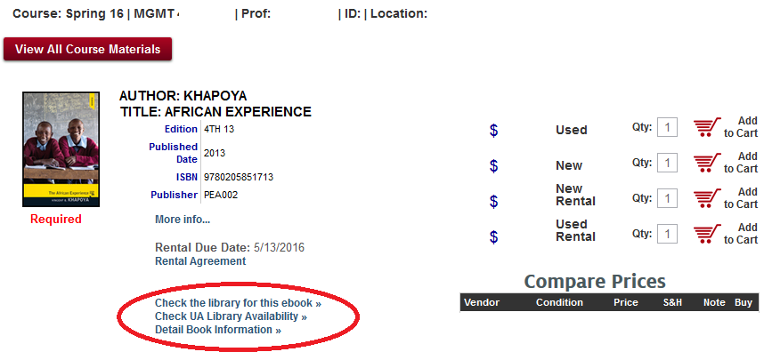

Mention the Library

Slide 33
Overall Suggestions
Ask “How can we be more open?”
Pilot projects
Reinvent; avoid merely shifting costs
Your spending is an investment
Promote sharing that leads to greater access (data, systems, content etc.)

Slide 34
Reading & Resources
Bell, S. (2015) “Bookstore or College Store: Building a Relationship” Library Journal http://lj.libraryjournal.com/2015/12/opinion/steven-bell/bookstore-or-college-store-building-a-relationship-from-the-bell-tower
Billings M., Hutton S., Shafer J, Schweik C., Sheridan, M. (2012) “Open Educational Resources as Learning Materials: Prospects and Strategies for University Libraries” Research Library Issues 280. http://publications.arl.org/rli280/2
National Association of College Stores (2015) Mapping the Learning Content Ecosystem http://ecosystem.nacs.org/
National Association of College Stores (2015) OER Cram Session https://www.nacs.org/educationevents/OERCramSession/tabid/4777/pageID/746/Default.aspx
Sebastian, R. (2015) [Virginia Community College System Bookstore RFP]
http://edtech.vccs.edu/bookstore-contracts-oer-and-textbook-affordability/
Wiley, D. (2014) “On OER and College Bookstores” Iterating Toward Openness http://opencontent.org/blog/archives/3168
- Online Bookstore as Competitive Edge University Business https://www.universitybusiness.com/article/online-bookstore-competitive-edge
SPARC Libraries & OER Forum
Open Textbook Network
BCOER Librarians
CCCOER

