Slide 1
Anti Poaching Drone Control
Matthew Hudson, Matthew Lyman, Cory Bishop
CS 4624: Multimedia, Hypertext, and Information Access
Instructor: Dr. Edward Fox
Virginia Tech, Blacksburg, VA 24061
5/11/2022

Slide 2
Outline
Project Overview
Our Deliverables
Scope Changes
Challenges
Lessons Learned
Acknowledgements
References
Notes:
Matthew H

Slide 3
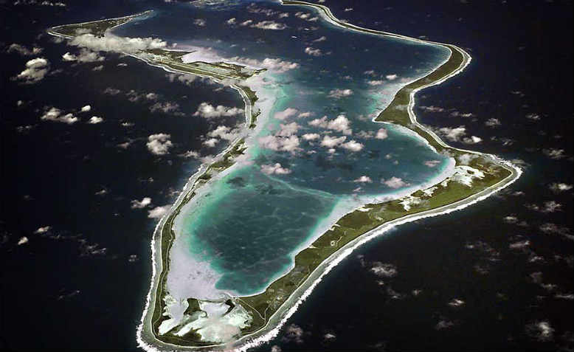
Project Overview
Project Aim:
Autonomous drone system to monitor shark poaching and illegal fishing around Chagos Archipelago
Notes:
Matthew H

Slide 4
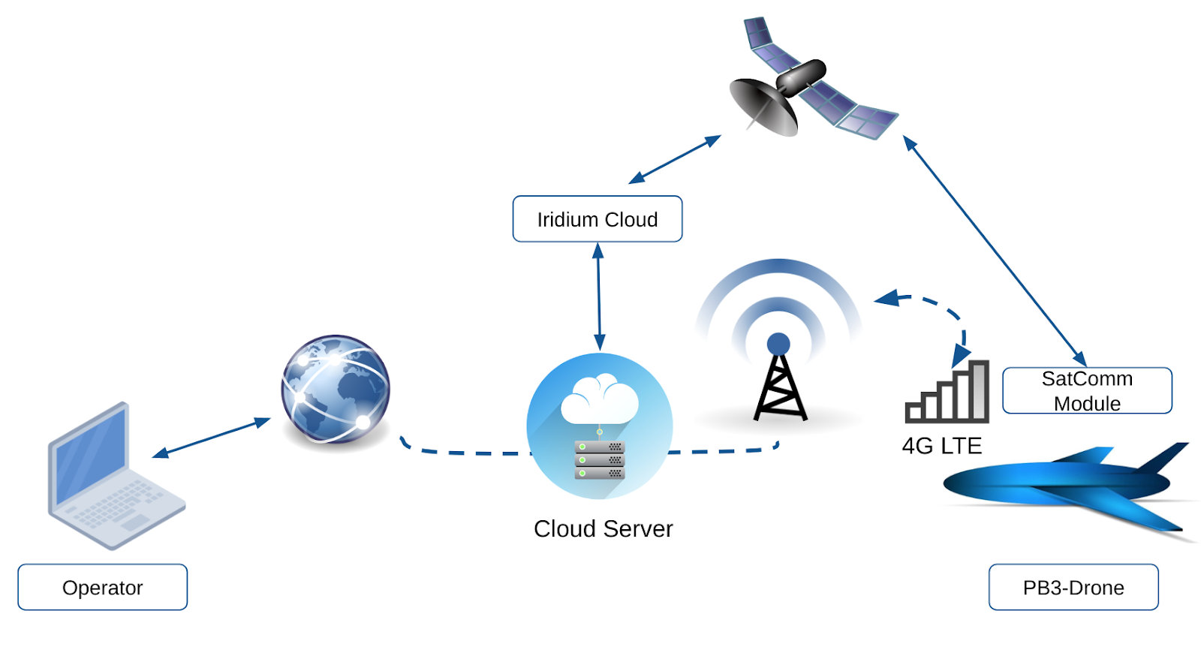
Project Overview
Project Tasks:
Wireless video streaming over 4G
AI Boat Detection Algorithm
Hand-built drones w/ cellular control
Server dashboard for monitoring and control
Notes:
Matthew H

Slide 5
Our Deliverables
Cameras calibrated and recording video through Robotic Operating System (ROS)
Repairing Frankenstein drone
Assisting hexacopter build from scratch
Describe work in report for client
Alternative drone cameras researched
Having two cameras recording at the same time
4G module startup script
Notes:
Matthew H

Slide 6
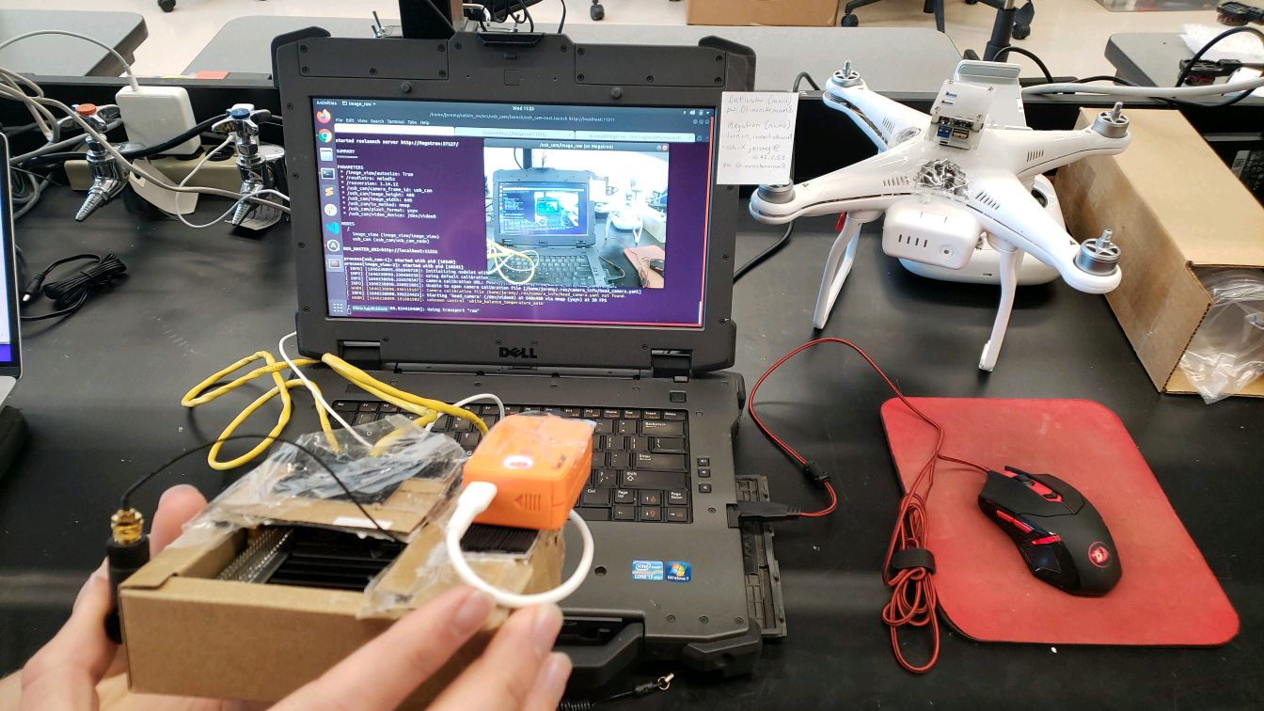
Camera Setup
Runcam Camera
Notes:
Matthew L

Slide 7
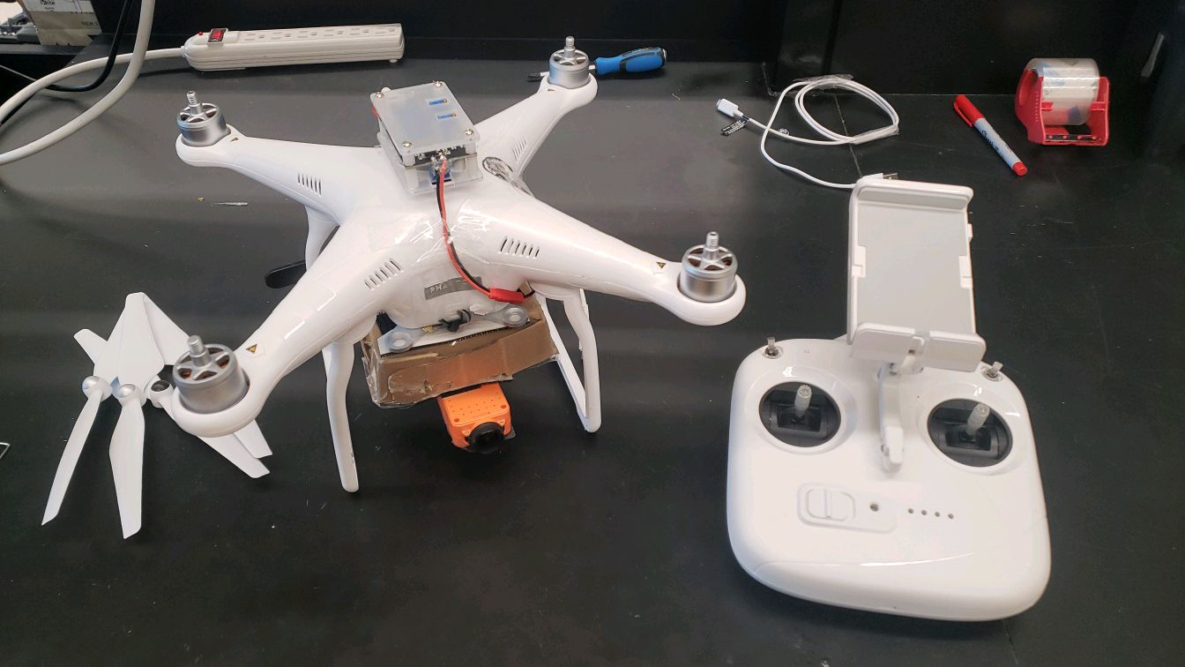
(Abandoned) Frankenstein Drone
Notes:
Matthew L

Slide 8
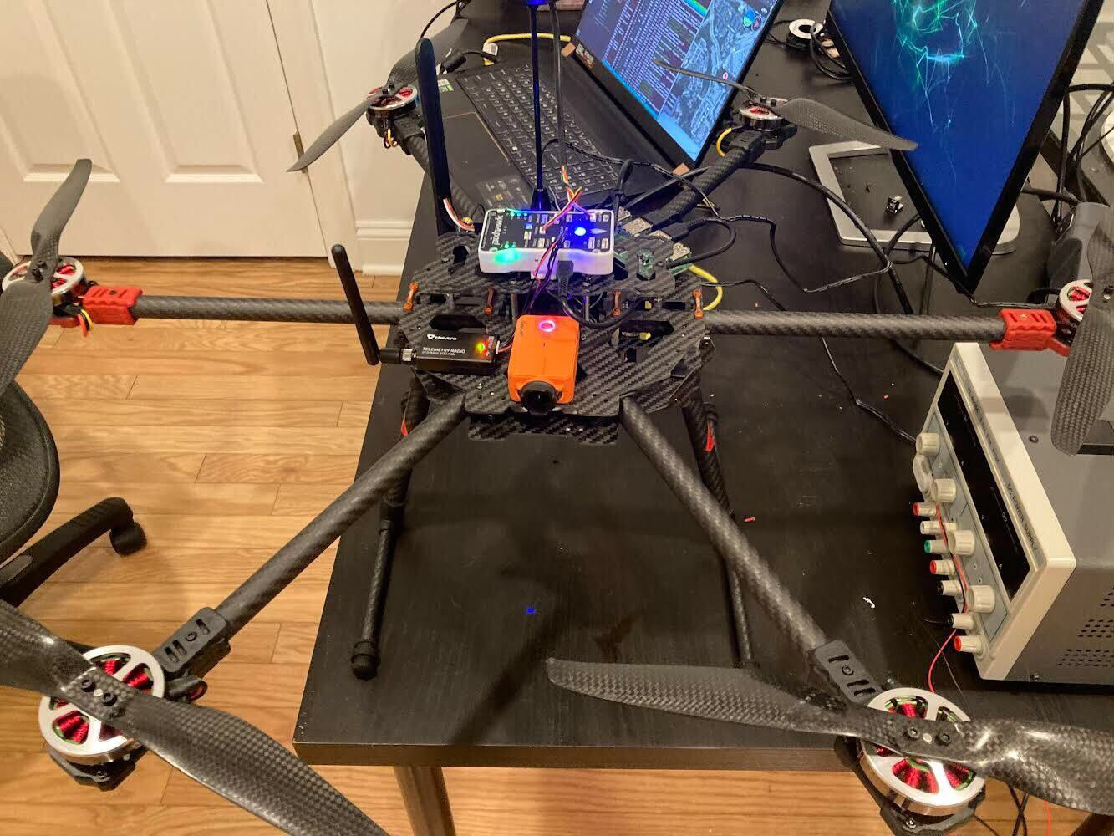
Hexacopter
Notes:
Matthew L

Slide 9
4G Module Startup
Tasked to write a bash script for the 4G module
Needed to:
  Check to see if module was plugged in
  Download and install drivers if needed
  Enable the 4G module
  Dial into the network and allocate an IP Address
Used @reboot crontab keyword to have it reboot on each startup
Notes:
Matthew L

Slide 10
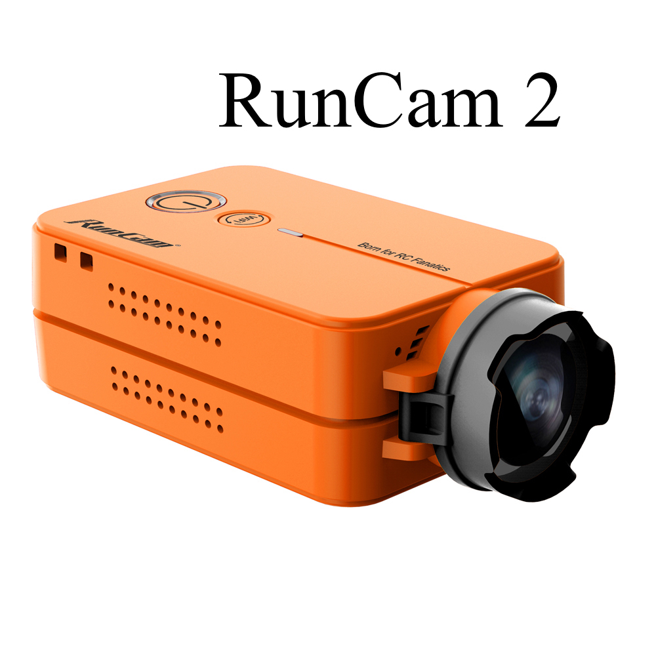
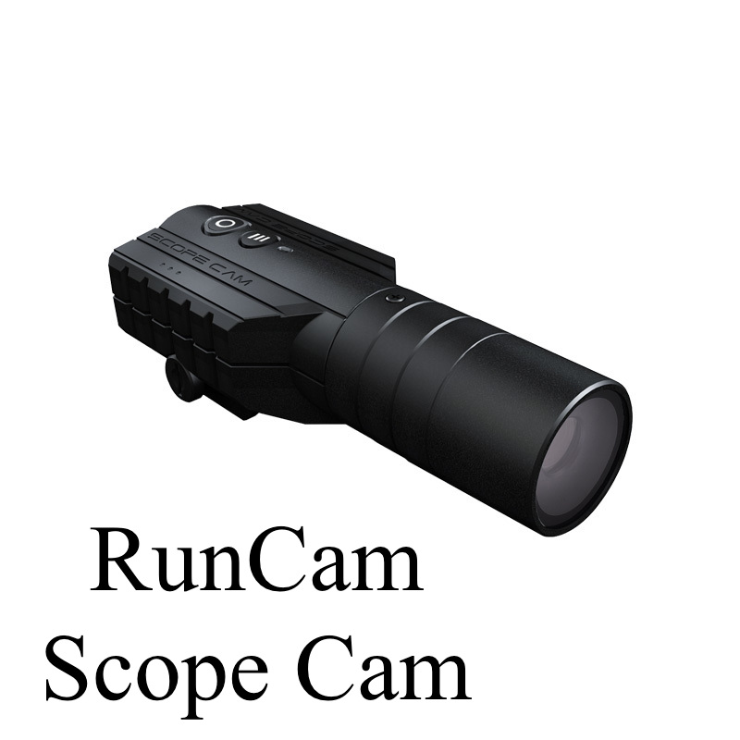
Running Multiple Cameras
Two cameras were writing to the same data output point
Modified camera launch files
Still waiting on power module to arrive for test with drone
Notes:
Matthew L

Slide 11
Scope Changes
Initial dashboard for modifications - never received
Flight tests largely were delayed
Received smaller tasks throughout project duration
Notes:
Cory

Slide 12
Challenges
Project Delays
  Waiting on other Drone Team members’ tasks
  Parts to arrive
  Troubleshooting
Many larger project tasks dependent on each other
Unclear about client’s long-term deadlines
Smaller, more frequent tasks instead of semester-long schedule
Notes:
Cory

Slide 13
Lessons Learned
Communicate frequently
  Clarifications and for help
  Ask for larger project deadlines
Plan work to progress during roadblocks
Learn and troubleshoot on your own
Clarify intentions for different project components
Notes:
Cory

Slide 14
Acknowledgements
The Drone Team
Dr. Francesco Ferretti | Dr. Simone Chesi
Jeremy Jenrette | Prachi Pundir
Zachary Wendel | Katie Gilbert
Marine Management Organization of the UK
Professor
GTA
Dr. Edward A. Fox | Kenneth Neba

Slide 15
References
SeaQL Lab Website: http://35.245.242.176/seaql/
Marine Management Organization of the UK: https://www.gov.uk/government/organisations/marine-management-organisation
https://news.un.org/en/story/2013/03/434272-mediterranean-and-black-sea-sharks-critically-endangered-un-agency-warns
http://35.245.242.176/seaql/index.php/research/sharkpulse/

