Slide 1

By Kyle Tanous & Aaron Richards
Virginia Tech, Spring 2016 CS-4624
Blacksburg, VA 24061
Notes:
Add city state

Slide 2
Outline
What is TimeBanks?
Goals
Design
Prototyping
Implementation
Status and Future Goals

Slide 3

What is TimeBanks?
Non-profit organization
Facilitates service exchanges
Users exchange services for hours, which function as Time Bank’s currency.
Useful for people in need of particular services
Soft-launch this year
Notes:
Make bullets

Slide 4
Goals: Support NRV
Promote tight-knit community within NRV
The NRV Time Bank supports the NRV area
        Community events post launch
Promote community inclusivity
  Everyone has skills to offer
Notes:
Break into parts: support NRV, inclusivity, build a better system

Slide 5
Goals: Build a Better System
Facilitate easy access to information for Time Bank staff
Implement necessary time bank functionality
  User data
  Offers & Requests
  Hour tracking
Provide a more usable interface to NRV Time Bank services compared to currently available interfaces
Notes:
Break into parts: support NRV, inclusivity, build a better system

Slide 6
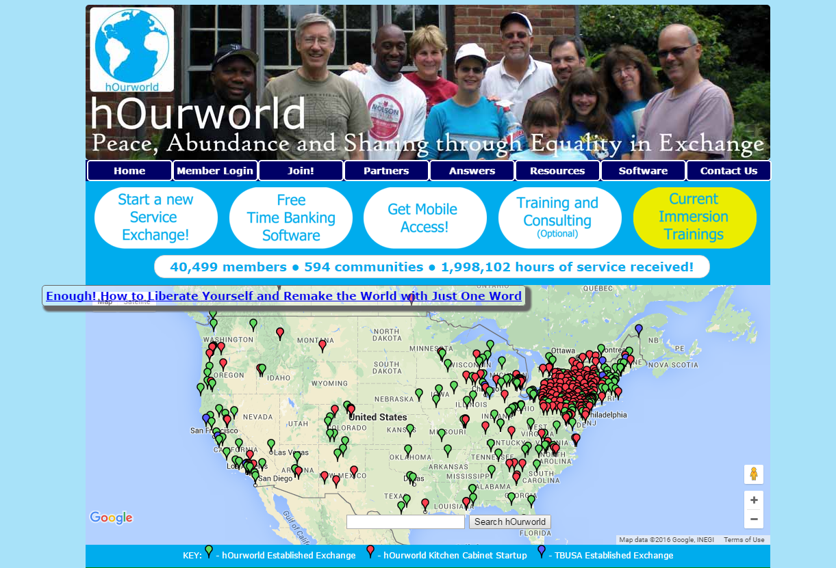
Popular System: hOurworld.org
Pros
  Capable back-end
  Integration with other time banks
Cons
  Usability issues
  Lack of interface customization options
  Poorly documented API
Notes:
Add screenshot

Slide 7
Design Approaches
Two possible approaches:
  Create wrapper around hOurworld using API
    Poor documentation of the API was a barrier
  Create our own site
    Use WordPress and its plugins to alleviate the workload
    Create functionality with a MySQL database and PHP scripting
Notes:
Clarify roles of approaches

Slide 8
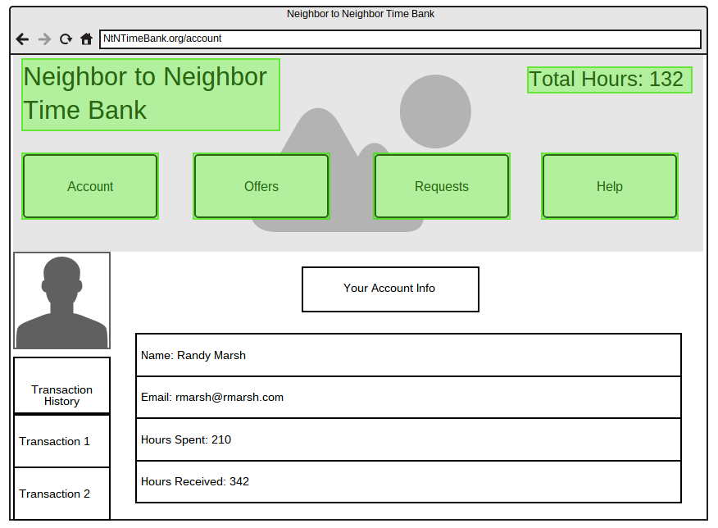
Prototyping
Focused on workflow and usability
Outline issues to be addressed during implementation
Provide examples to interviewees for data curation
Notes:
Two pieces: what we build, what we did with it -- add use cases to clarify functionality of the site

Slide 9
Implementation
Mostly consists of PHP scripting
  Back-end: Database interactions/alterations
  Front-end: HTML generation via PHP embedded in WP pages
Database setup
  Adding tables to store our own data types
    User data
    User posts
Notes:
Entity relationship diagram, demonstrate roles of database tables and roles
More detail

Slide 10
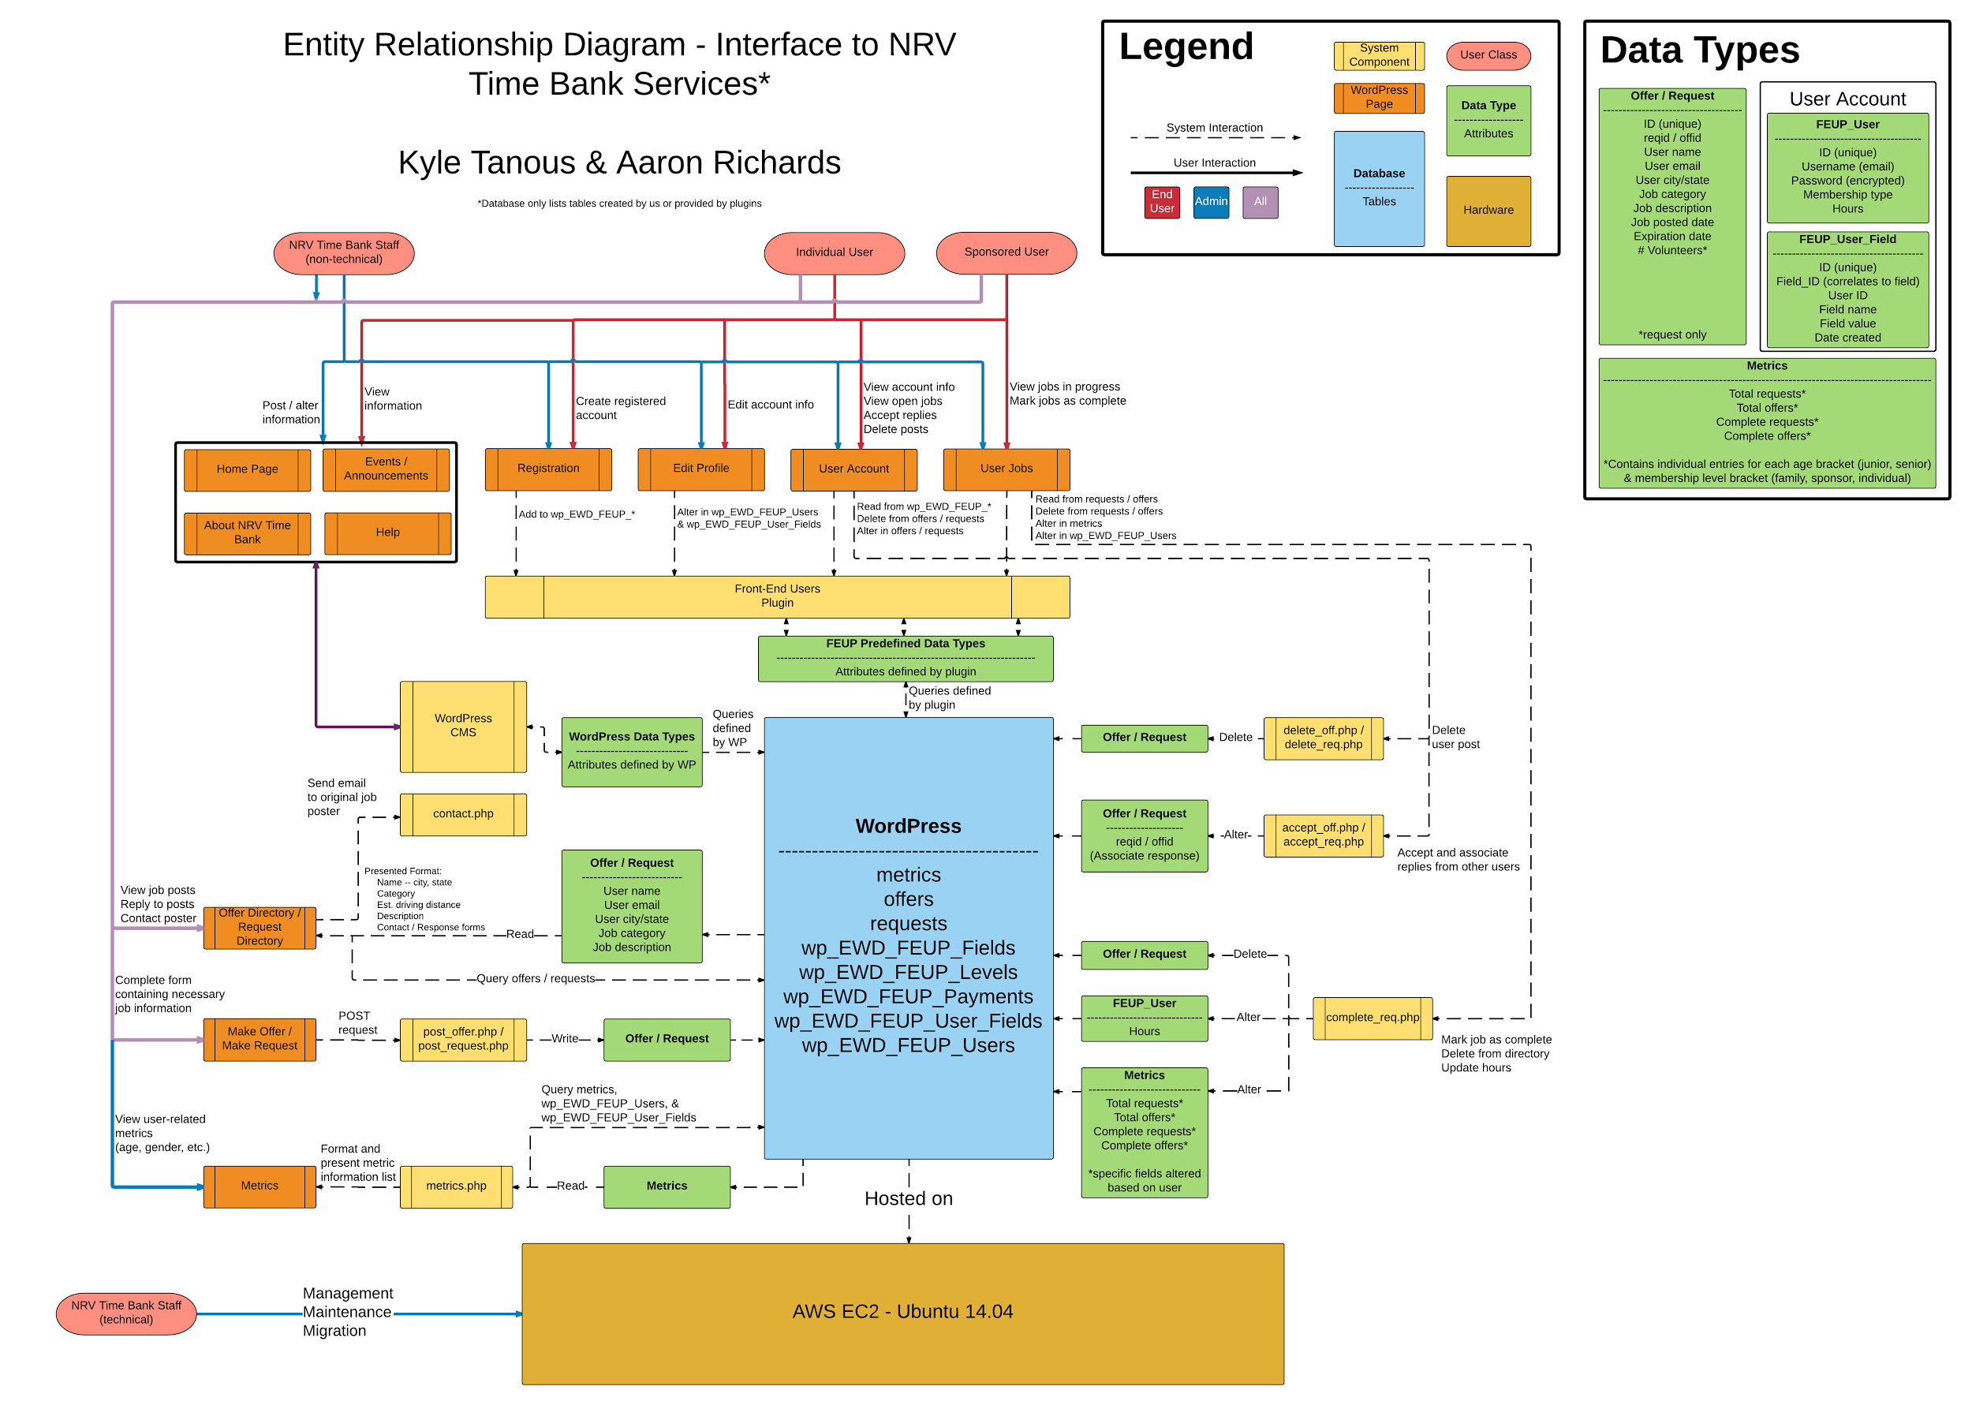
Implementation
Diagram
http://tinyurl.com/rediagram
Notes:
Entity relationship diagram, demonstrate roles of database tables and roles
More detail

Slide 11
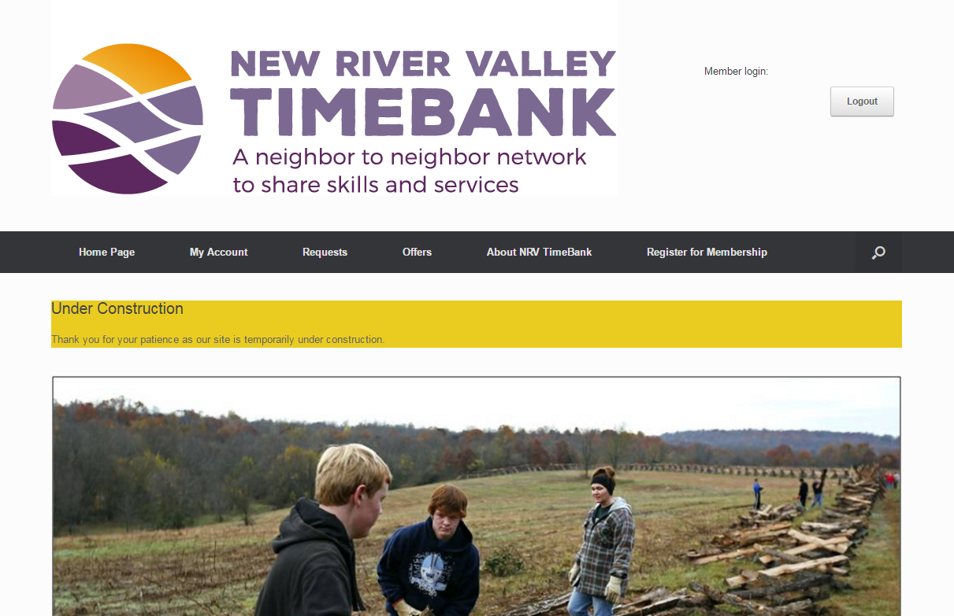
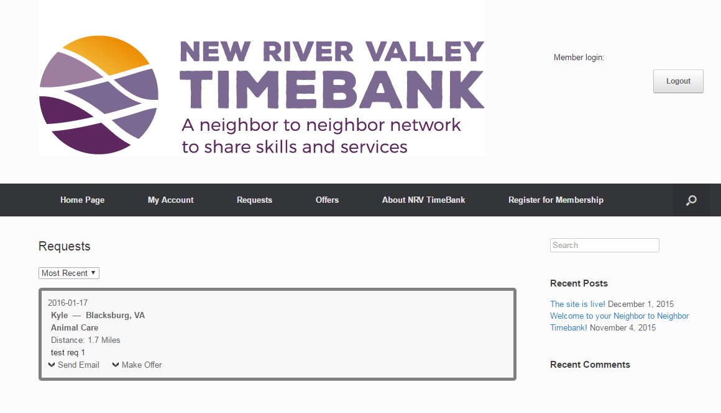
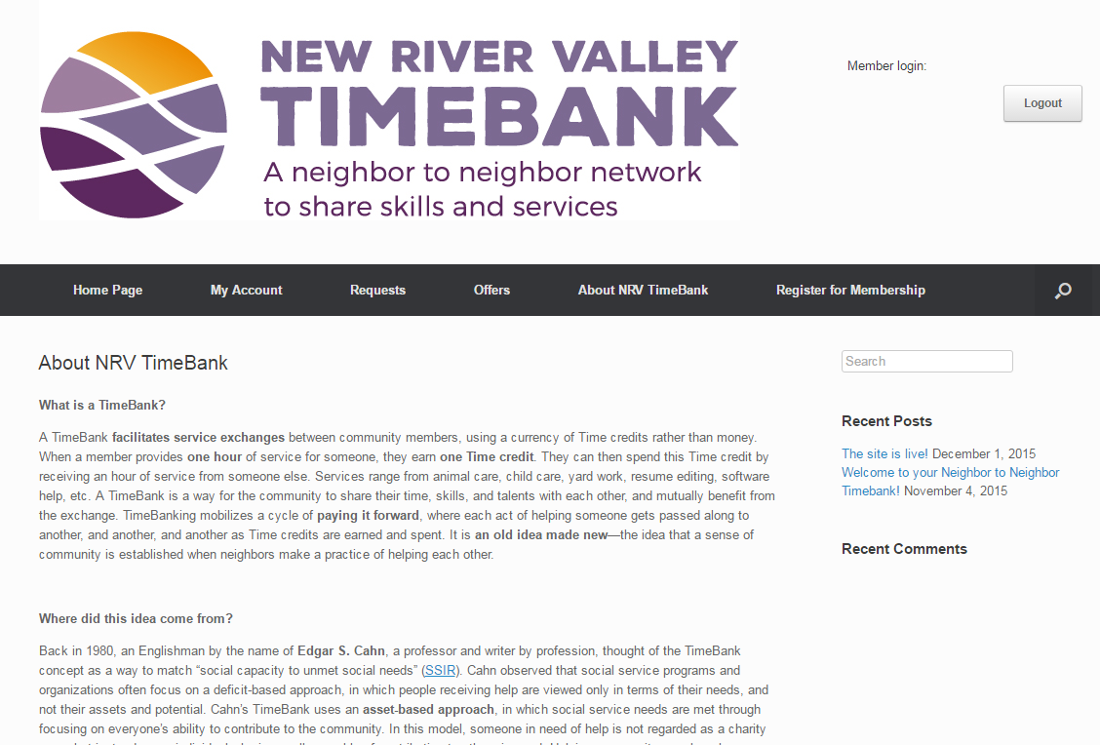
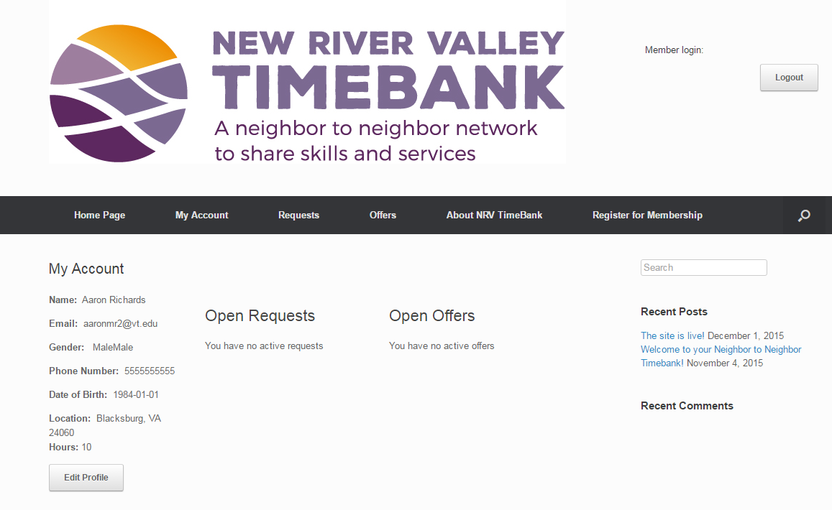
http://52.32.67.219
Notes:
Show basic screens

Slide 12
Future Goals
Register domain
  User-to-user contact
  Administrator-to-user contact
More effective information delivery (real-time feeds/chat)
Rich media help and about pages
More thorough documentation

Slide 13
Acknowledgement
Zoe Belyavsky, our client, along with Ellen Stewart of NRV Time Bank have been ever-present sources of guidance during development. Her insight into requirements set forth by the TimeBanks organization proved invaluable throughout the development cycle in ensuring we delivered a suitable software system to the NRV Time Bank.
Notes:
Entity relationship diagram, demonstrate roles of database tables and roles
More detail

Slide 14
Questions?
Notes:
Testing logs

