Slide 1
CS6604 Digital Libraries
Global Events Team Final Presentation
Presenters:
Liuqing Li, Islam Harb, Andrej Galad
{liuqing, iharb, agalad}@vt.edu
Instructor:
Dr. Edward A. Fox
Virginia Polytechnic Institute and State University
Blacksburg, VA, 24061
April 27, 2017

Slide 2
Outline
Background
Implementation
  Data Collection
  Data Processing
  Data Visualization
Future Work
Acknowledgement

Slide 3
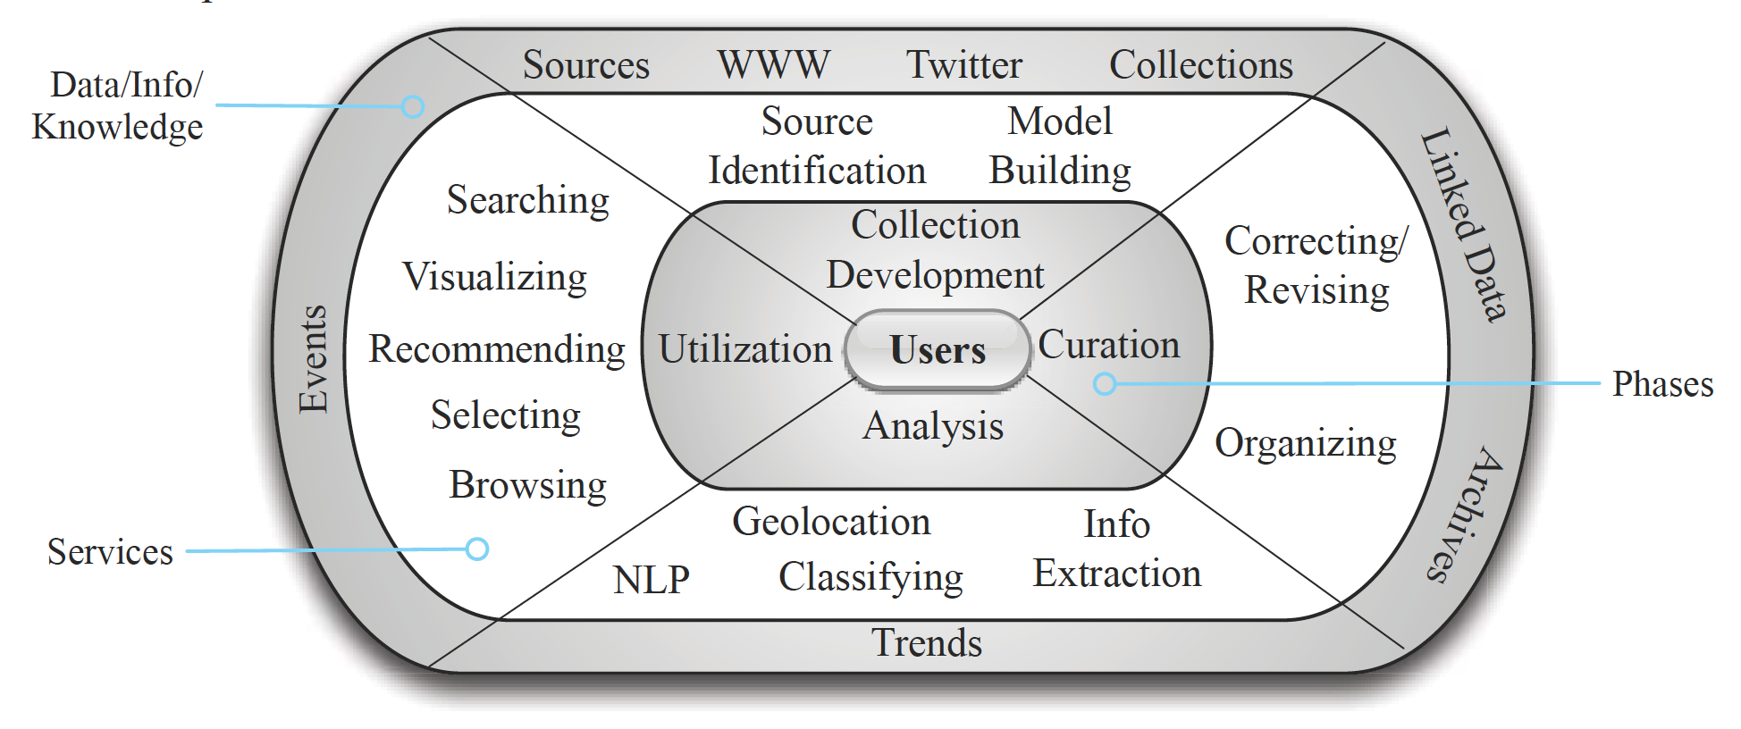
Background
GETAR*
  Global Event and Trend Archive Research
  Architecture
* Edward A Fox, Donald Shoemaker, Chandan Reddy, Andrea Kavanaugh, III: Small: Collaborative Research: Global Event and Trend Archive Research (GETAR), NSF grant IIS - 1619028, 2017-2019. http://eventsarchive.org

Slide 4
Implementation – Architecture
Event Focused Crawler (EFC)
Data
Collection
WARC Files
CDX Writer
CDX Files
ArchiveSpark
Apache Spark
Stanford NER
Regular Expression
Score Function
Data
Processing
Entity-based Results
Standalone HBase
Web
Application
Data
Visualization

Slide 5
Events of Interest
School Shooting Events | Year
Virginia Tech Shooting | 2007
Northern Illinois University Shooting | 2008
Dunbar High School Shooting | 2009
University of Alabama Shooting | 2010
Worthing High School Shooting | 2011
Sandy Hook Elementary School Shooting | 2012
Sparks Middle School Shooting | 2013
Reynolds High School Shooting | 2014
Umpqua Community College Shooting | 2015
Townville Elementary School Shooting | 2016

Slide 6
Focused Crawler – Collecting / Archiving
START
END
Manually
Curate Seeds
Yes
URLs Queue
Extract URLs
All URLs?
No
Download Page
Calculate Relevancy
Process Page & Convert into WARC Format
Yes
Relevant?
Append Result warc.gz Event File
No
Discard

Slide 7
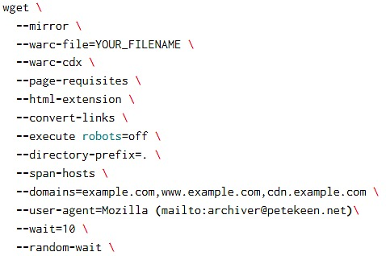
WARC Libraries
Wget (Version 1.14 or later)

Slide 8
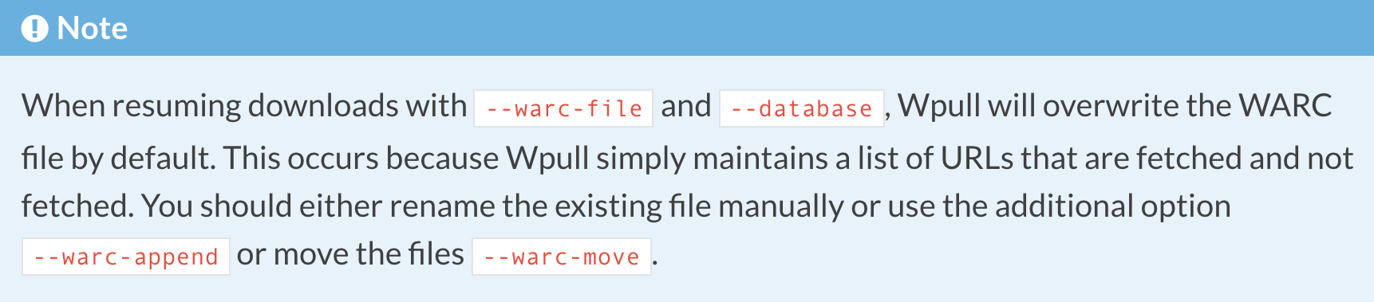
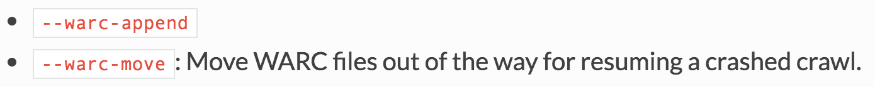
WARC Libraries
Wpull

Slide 9
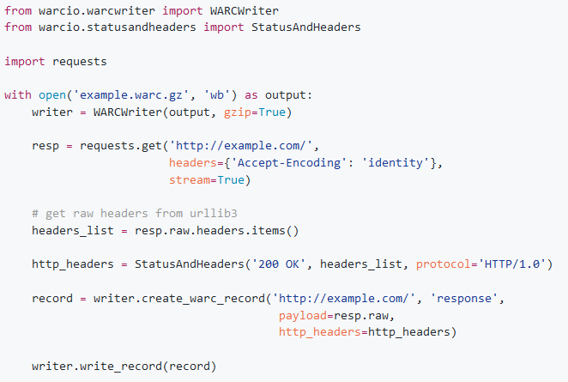
WARC Libraries
WARCIO: WARC (and ARC) Streaming Library
  Python 2.7+ and 3.3+
  Post-Processing: Read / Write WARC format

Slide 10
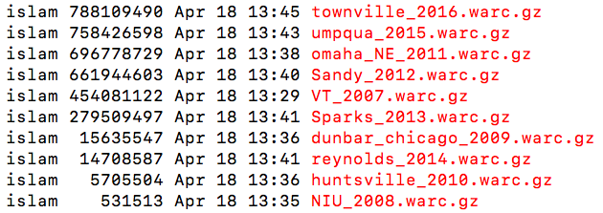
Ten Events Collections
Naming Convention
  [location]_[year].warc.gz

Slide 11
Tools for Data Processing
ArchiveSpark
  Apache Spark framework for Web Archives
  Easy data extraction
  Input: WARC and CDX files
CDX Writer
  Python script to create CDX files of WARC files
  Format: CDX N b a m s k r M S V g
    e.g., edu,vt,cnre)/ 20170422005601 http://cnre.vt.edu text/html
    200 BT3ILJXROIILHBKQPNYDUCUVZRDKG3OA - - 9478 20104749
    data/Virginia-Tech-Shooting_20070416.warc.gz

Slide 12
Data Preprocessing
Webpage Cleaning
  Extract Raw Text
    payload.string.html.body.text
  Remove jQuery & JavaScript
    { WPGroHo.syncProfileData( hash, id ); }, …
  Remove tags
    <br>, <p>, …
  Remove markers
    *, |, +, …
  Remove stopwords
    a, about, the, …

Slide 13
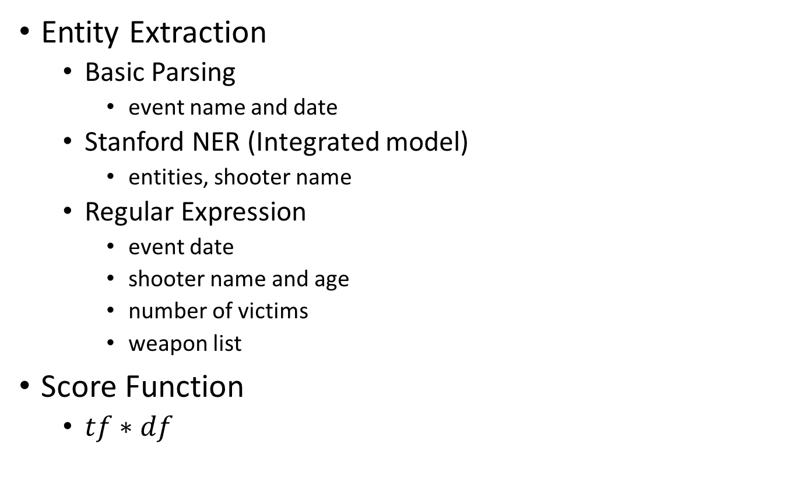
Data Processing
Entity Extraction
  Basic Parsing
    event name and date
  Stanford NER (Integrated model)
    entities, shooter name
  Regular Expression
    event date
    shooter name and age
    number of victims
    weapon list
Score Function
  $tf∗df$

Slide 14
HBase
Build-in ImportTsv Utility
  Import Data into HBase
Table Name | globalevents
Row_Key | Event_Date + Event Hash Value | 20070416217787922
Column Family | event
Column | event: name | Virginia Tech Shooting
 | event: date | 20070416
 | event: shooter_age | 23-year-old
 | event: shooting_victims | 32 victims
 | event: entities | Virginia;Tech;VA;University;…
 | event: entities_count | 146900;62415;13940;7732;…
 | event: entities_url | url1,url2,url3,url4,url6;url2,url3,url4,url5;url1,url3,url4,url5,url6;…

Slide 15
Data Processing – Demo
Key Stages
  Initialization
    Create Spark Session
    Create NLP Core
    Create Storage
  Processing
    Extract Event Name/Date/URL
    Extract Name Entities
    Extract Other Event Features
  Export and Import
    Generate TSV file
    Import TSV file into HBase

Slide 16
Global Events Viewer
Efficient visualization of long-term global events
  Show representative terms -> link to corresponding URLs
  Visualize events’ trends over time (time series)
Java 7 Spring Boot Web application
  Build system - Gradle
  Embedded Tomcat Web server
  Backend - HBase, in-memory
  Frontend - D3.js, Bootstrap
https://github.com/dedocibula/global-events-viewer

Slide 17
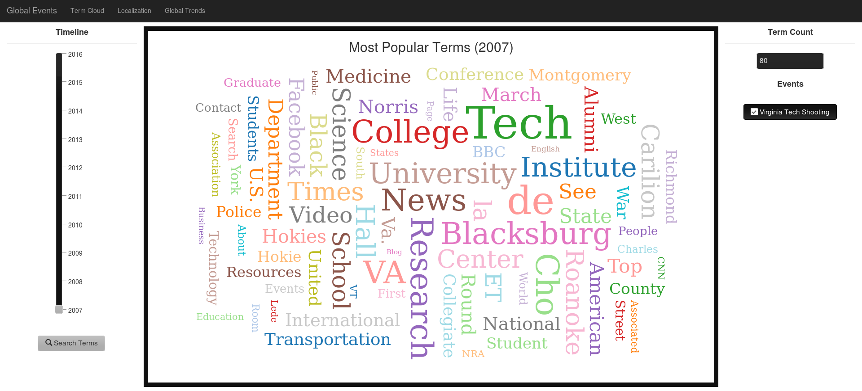
Global Events Viewer – Demo
Key Components
  WordCloud, Range Selection, URL List, Trends

Slide 18
Problem Faced
Data Collection
Encoding problems (UTF-8, ASCII and others)
Get more relevant seeds for old events
Data Processing
Lack of documentation (ArchiveSpark)
Version conflict (CDX Writer, Kernel in Jupyter)
JVM issue (Spark)
Data Visualization
Spring boot IntelliJ setup
JQuery UI

Slide 19
Lessons Learned
Data Collection
WARCIO
Focused Crawler
Data Processing
ArchiveSpark
Spark & Scala (Map/Reduce Process)
Data Visualization
D3 WordCloud
D3 Dynamic Line Charts

Slide 20
Future Work
Data Collection
Wayback Machine
Automatic Routine for Focused Crawler
Event Extension (Sources, Time, Space)
Data Processing
Standalone Mode -> Cluster Mode
Name Entity Recognizer
Automatic Processing (CDX Writer and HBase)
Data Visualization
Localization – Datamaps
Weapons

Slide 21
Acknowledgement
Projects
NSF IIS - 1319578 | III: Small: Integrated Digital Event Archiving and Library (IDEAL)
NSF IIS - 1619028 | III: Small: Collaborative Research: Global Event and Trend Archive Research (GETAR)
Organizations
Internet Archive
L3S Research Center
Persons
Instructor | Dr. Edward A. Fox
Alumnus | Dr. Mohamed Magdy Farag
Labmates | Prashant Chandrasekar, Xuan Zhang

Slide 22
Thank you !
Questions?

