Slide 1

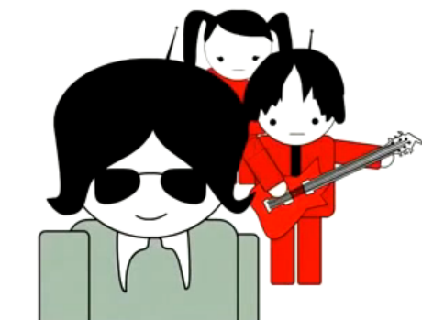

Get Creative (and stay legal):
Copyright Compliance with
Creative Commons and Open Educational Resources
© Screenshot from “Get Creative” Creative Commons CC BY-NC-SA
© Screenshot from “Get Creative”
Creative Commons CC BY-NC-SA
Anita Walz arwalz@vt.edu
Assessment, Open Education & Online Learning Environments Librarian
October 20, 2014

Slide 2

Anita Walz
Assessment, Open Education & Online Learning Environments Librarian
Virginia Tech Libraries
arwalz@vt.edu
This image is in the public domain.

Slide 3
An invitation to learn about:
Copyright, a few facts
Open licensing via Creative Commons
Overview of Creative Commons licenses
How to use openly-licensed materials
Finding openly-licensed works
How (and why) to openly license
© Screenshot from “Get Creative” Creative Commons CC BY-NC-SA

Slide 4
Copyright Basics
Works that can be copyrighted:
Literary works, musical, and dramatic works
Pantomime & choreographical works
Pictoral, graphic and sculptural works
Sound recordings
Motion pictures and other audiovisual works
Computer programs
Architectural works
Works that cannot be copyrighted:
Ideas, procedures, and methods
Titles, names, slogans (may be trademarked)
Facts, news, and research data
Works in the public domain http://librarycopyright.net/resources/digitalslider
Unrecorded, unwritten, un“fixed” works

Slide 5
Copyright Basics
Copyright holder’s exclusive rights for life + 70 years
Reproduce the work
Distribute the work
Publically perform the work
Publically display the work
Publically perform sound recordings by means of a digital audio transmission
Create derivative works
© Screenshot from “Get Creative” Creative Commons CC BY-NC-SA

Slide 6
Faculty Authors & VT Policy 13000
VT employees own copyright to their “traditional works of scholarship” (unless they are “works for hire”)
“…university rights are limited to free (no cost) use in teaching, research, extension, etc. in perpetuity”
Notes:
VT Policy 13000 “Policy on Intellectual Property” http://www.policies.vt.edu/13000.pdf

Slide 7
VT Faculty Author Rights
The author is THE copyright holder unless you sign away your rights.
As copyright owner, you have certain exclusive rights & control your work
Authors who have transferred their copyright without retaining any rights may not be able to place the work on course websites, copy it for students and colleagues, deposit the work in a public online archive, or create derivatives.
Consider using an Author Addendum to allow your work to be displayed and distributed, AND to retain some of your rights: http://www.sparc.arl.org/resources/authors/addendum
Adapted from © SPARC CC BY http://www.sparc.arl.org/resources/authors/addendum http://creativecommons.org/licenses/by/1.0
Notes:
Publisher still gets to publish (display and distribute) the article etc.

Slide 8
Copyright Basics
In the U.S. works are divided into three categories
  Public Domain (most US Gov works) and works with expired copyrights http://librarycopyright.net/resources/digitalslider
  Protected by Copyright (owned by someone else)
  Protected by Copyright (owned by YOU)
© Screenshot from “Get Creative” Creative Commons CC BY-NC-SA
Notes:
Sometimes it is unclear who owns a copyright. Heirs of deceased copyright owners might not know that they own copyright, and they may be difficult to track down. Such works are referred to as “orphan works.”

Slide 9
Teaching Faculty may want to (legally) …
Reproduce
Distribute
Publically perform
Publically display
Publically perform by means of a digital audio transmission, and/or
Create derivations of . . .
. . . works for which someone else owns copyright
© Screenshot from “Get Creative” Creative Commons CC BY-NC-SA

Slide 10
Ways to (legally) respond:
© Screenshot from “Get Creative” Creative Commons CC BY-NC-SA
Obtain permission/license rights for use of copyrighted materials
Identify an exempt or fair use under U.S. Copyright law
Notes:
Copyright is complex and confusing. Stuck between two main problems: 1) Fear of lawsuits 2) Orphan works. May lead to inaction or uninformed action, which is the opposite of the intent of copyright “…to promote the Progress of Science and useful Arts, by securing for limited Times to Authors and Inventors the exclusive Right to their respective Writings and Discoveries.”-U.S. Constitution

Slide 11
Copyright Exemptions
Chapter 17 of U.S. Code
Section 107: Fair use
Section 108: Library copying
Section 109(a): First sale doctrine
Section 109(c): Exemption for public displays
Section 110(1): Displays/performances in face to face teaching
Section 110(2): Displays/performances in distance learning
Section 117: Computer software
Section 120: Architectural works
Section 121: Special formats for persons who are blind or have other disabilities
Also valuable: Documentation of the exemption you used – that you acted “in good faith”

Slide 12
5 Ways to (legally) respond:
Obtain permission/license rights for use of copyrighted materials
Identify an exempt or fair use under U.S. Copyright law
Utilize Library links, reserves & eReserves
Use materials from the public domain
Use openly licensed materials

Slide 13
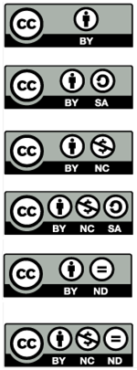
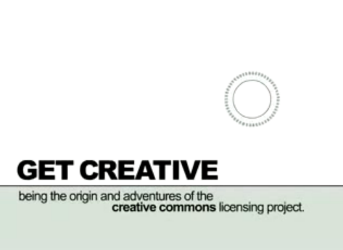
Creative Commons Licenses
© Creative Commons CC BY-NC-SA
https://www.youtube.com/watch?v=io3BrAQl3so
Notes:
How many have seen/used these symbols?

Slide 14
5 Ways to (legally) respond:
Obtain permission/license rights for use of copyrighted materials
Identify an exempt or fair use under U.S. Copyright law
Utilize Library links, reserves & eReserves
Use materials from the public domain
Use openly licensed materials (CC, GNU…)

Slide 15
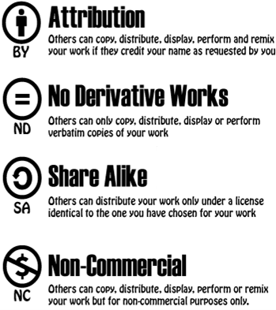
Creative Commons License Symbols

Slide 16
6 Creative Commons Licenses
Attribution “CC-BY”
Attribution ShareAlike “CC BY-SA”
Attribution Noncommercial “CC BY-NC”
Attribution NonCommercial ShareAlike “CC BY-NC-SA”
Attribution NoDerivatives “CC BY-ND”
Attribution NonCommercial NoDerivatives “CC BY-NC-ND”

Slide 17
6 Creative Commons Licenses
Attribution “CC-BY”
This license lets others distribute, remix, tweak, and build upon a work, even commercially, as long as they credit the original author for the original creation. This is the most accommodating of licenses offered, in terms of what others can do with a work licensed under Attribution.
Notes:
© University of Michigan CC BY
http://www.lib.umich.edu/copyright/using-cc-licensed-material
http://creativecommons.org/licenses/by/4.0

Slide 18
6 Creative Commons Licenses
Attribution “CC-BY”
This license lets others distribute, remix, tweak, and build upon a work, even commercially, as long as they credit the original author for the original creation. This is the most accommodating of licenses offered, in terms of what others can do with a work licensed under Attribution.
Attribution ShareAlike “CC BY-SA”
This license lets others remix, tweak, and build upon a work even for commercial reasons, as long as they credit the original author and license their new creations under the identical terms. This license is often compared to open source software licenses. All new works based on a work licensed this way will carry the same license, so any derivatives will also allow commercial use.
Notes:
© University of Michigan CC BY
http://www.lib.umich.edu/copyright/using-cc-licensed-material
http://creativecommons.org/licenses/by/4.0

Slide 19
6 Creative Commons Licenses
Attribution “CC-BY”
This license lets others distribute, remix, tweak, and build upon a work, even commercially, as long as they credit the original author for the original creation. This is the most accommodating of licenses offered, in terms of what others can do with a work licensed under Attribution.
Attribution ShareAlike “CC BY-SA”
This license lets others remix, tweak, and build upon a work even for commercial reasons, as long as they credit the original author and license their new creations under the identical terms. This license is often compared to open source software licenses. All new works based on a work licensed this way will carry the same license, so any derivatives will also allow commercial use.
Attribution Noncommercial “CC BY-NC”
This license lets others remix, tweak, and build upon a work non-commercially, and although their new works must also acknowledge the original author and be non-commercial, they don’t have to license their derivative works on the same terms.
Notes:
© University of Michigan CC BY
http://www.lib.umich.edu/copyright/using-cc-licensed-material
http://creativecommons.org/licenses/by/4.0

Slide 20
6 Creative Commons Licenses
Attribution “CC-BY”
This license lets others distribute, remix, tweak, and build upon a work, even commercially, as long as they credit the original author for the original creation. This is the most accommodating of licenses offered, in terms of what others can do with a work licensed under Attribution.
Attribution ShareAlike “CC BY-SA”
This license lets others remix, tweak, and build upon a work even for commercial reasons, as long as they credit the original author and license their new creations under the identical terms. This license is often compared to open source software licenses. All new works based on a work licensed this way will carry the same license, so any derivatives will also allow commercial use.
Attribution Noncommercial “CC BY-NC”
This license lets others remix, tweak, and build upon a work non-commercially, and although their new works must also acknowledge the original author and be non-commercial, they don’t have to license their derivative works on the same terms.
Attribution NonCommercial ShareAlike “CC BY-NC-SA”
This license lets others remix, tweak, and build upon a work non-commercially, as long as they credit the original author and license their new creations under the identical terms. Others can download and redistribute this work just like the by-nc-nd license, but they can also translate, make remixes, and produce new stories based on the work. All new work based on the original will carry the same license, so any derivatives will also be non-commercial in nature.
Notes:
© University of Michigan CC BY
http://www.lib.umich.edu/copyright/using-cc-licensed-material
http://creativecommons.org/licenses/by/4.0

Slide 21
6 Creative Commons Licenses
Attribution “CC-BY”
This license lets others distribute, remix, tweak, and build upon a work, even commercially, as long as they credit the original author for the original creation. This is the most accommodating of licenses offered, in terms of what others can do with a work licensed under Attribution.
Attribution ShareAlike “CC BY-SA”
This license lets others remix, tweak, and build upon a work even for commercial reasons, as long as they credit the original author and license their new creations under the identical terms. This license is often compared to open source software licenses. All new works based on a work licensed this way will carry the same license, so any derivatives will also allow commercial use.
Attribution Noncommercial “CC BY-NC”
This license lets others remix, tweak, and build upon a work non-commercially, and although their new works must also acknowledge the original author and be non-commercial, they don’t have to license their derivative works on the same terms.
Attribution NonCommercial ShareAlike “CC BY-NC-SA”
This license lets others remix, tweak, and build upon a work non-commercially, as long as they credit the original author and license their new creations under the identical terms. Others can download and redistribute this work just like the by-nc-nd license, but they can also translate, make remixes, and produce new stories based on the work. All new work based on the original will carry the same license, so any derivatives will also be non-commercial in nature.
Attribution NoDerivatives “CC BY-ND”
This license allows for redistribution, commercial and non-commercial, as long as it is passed along unchanged and in whole, with credit to the original author.
Notes:
© University of Michigan CC BY
http://www.lib.umich.edu/copyright/using-cc-licensed-material
http://creativecommons.org/licenses/by/4.0

Slide 22
6 Creative Commons Licenses
Attribution “CC-BY”
This license lets others distribute, remix, tweak, and build upon a work, even commercially, as long as they credit the original author for the original creation. This is the most accommodating of licenses offered, in terms of what others can do with a work licensed under Attribution.
Attribution ShareAlike “CC BY-SA”
This license lets others remix, tweak, and build upon a work even for commercial reasons, as long as they credit the original author and license their new creations under the identical terms. This license is often compared to open source software licenses. All new works based on a work licensed this way will carry the same license, so any derivatives will also allow commercial use.
Attribution Noncommercial “CC BY-NC”
This license lets others remix, tweak, and build upon a work non-commercially, and although their new works must also acknowledge the original author and be non-commercial, they don’t have to license their derivative works on the same terms.
Attribution NonCommercial ShareAlike “CC BY-NC-SA”
This license lets others remix, tweak, and build upon a work non-commercially, as long as they credit the original author and license their new creations under the identical terms. Others can download and redistribute this work just like the by-nc-nd license, but they can also translate, make remixes, and produce new stories based on the work. All new work based on the original will carry the same license, so any derivatives will also be non-commercial in nature.
Attribution NoDerivatives “CC BY-ND”
This license allows for redistribution, commercial and non-commercial, as long as it is passed along unchanged and in whole, with credit to the original author.
Attribution NonCommercial NoDerivatives “CC BY-NC-ND”
This license is the most restrictive of the six main licenses, allowing redistribution. This license is often called the “free advertising” license because it allows others to download works and share them with others as long as they mention the original author and link back to them, but they can’t change them in any way or use them commercially.
Notes:
© University of Michigan CC BY
http://www.lib.umich.edu/copyright/using-cc-licensed-material
http://creativecommons.org/licenses/by/4.0

Slide 23
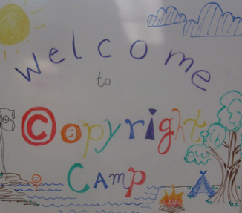
How to use openly licensed materials
Use of ANY and ALL Creative Commons licensed works requires attribution
  Credit the author or other parties (as they specify)
  indicate the title & URL of the work (if available)
  Indicate the license & URL of the license
  Examples:
  "Copyright Camp" by Greg Grossmeier from http://www.flickr.com/photos/grggrssmr/4846187035, used under a Creative Commons Attribution-ShareAlike license: http://creativecommons.org/licenses/by-sa/3.0 (Adapted)
  OR
  Adapted from "Copyright Camp" by Greg Grossmeier CC BY-SA
  (See also https://wiki.creativecommons.org/Best_practices_for_attribution and making notices machine readable: https://wiki.creativecommons.org/Marking_Works_Technical
Notes:
© University of Michigan CC BY http://www.lib.umich.edu/copyright/using-cc-licensed-material http://creativecommons.org/licenses/by/4.0
See also: http://wiki.creativecommons.org/Best_practices_for_attribution

Slide 24
Attribution for various formats
- Text document or webpage → works cited/bibliography
- Audio → Read aloud at the end or include in written description.
- Image → Caption
- Video → Include in credits at the end
© Screenshot from “Get Creative” Creative Commons CC BY-NC-SA
Notes:
© University of Michigan CC BY http://www.lib.umich.edu/copyright/using-cc-licensed-material http://creativecommons.org/licenses/by/4.0
See also: http://wiki.creativecommons.org/Best_practices_for_attribution

Slide 25
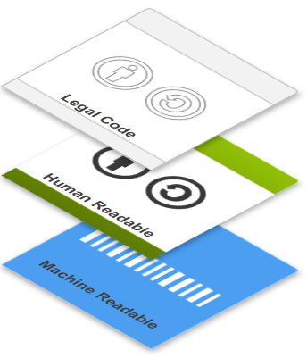
Three “layers” of licenses
Legal Code
Human Readable
Machine Readable
See: Making notices machine readable: https://wiki.creativecommons.org/Marking_Works_Technical
© [unnamed] by Creative Commons CC BY
Notes:
Adapted from http://creativecommons.org/licenses

Slide 26
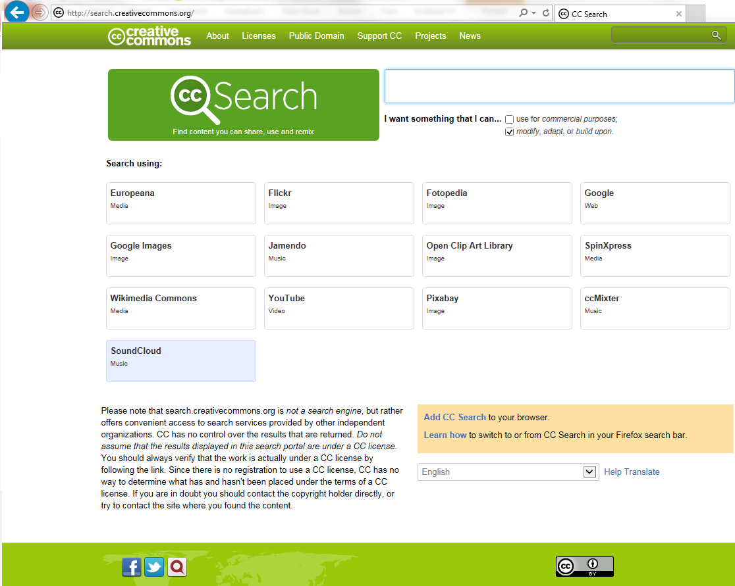
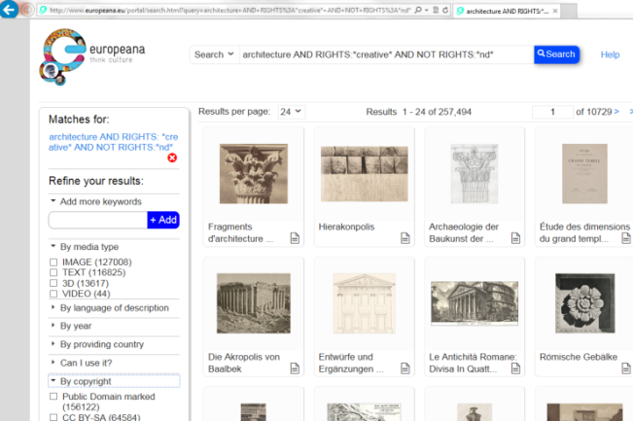
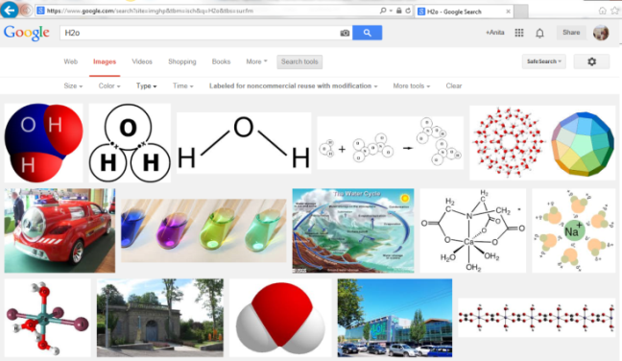
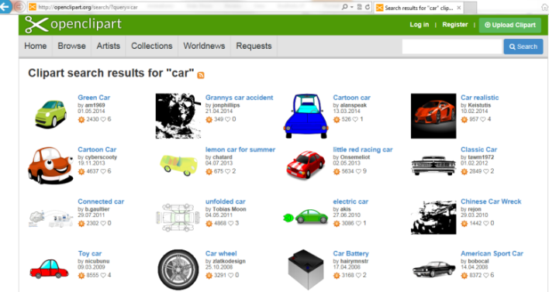
Finding openly-licensed works
[Search screen] © Creative Commons http://search.creativecommons.org CC BY

Slide 27
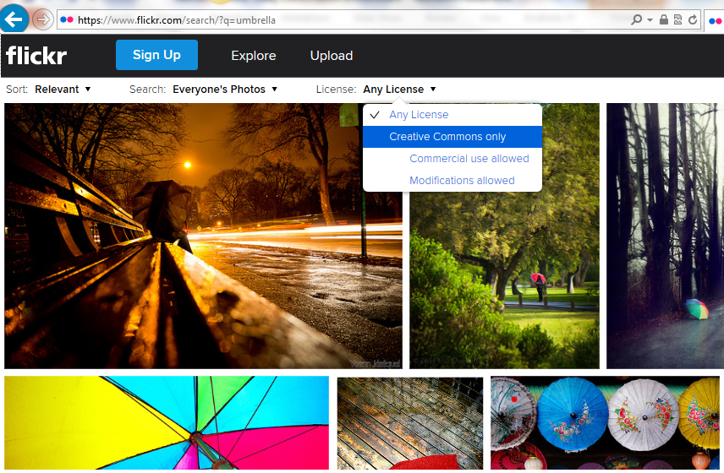
Finding openly-licensed works
http://www.flickr.com

Slide 28
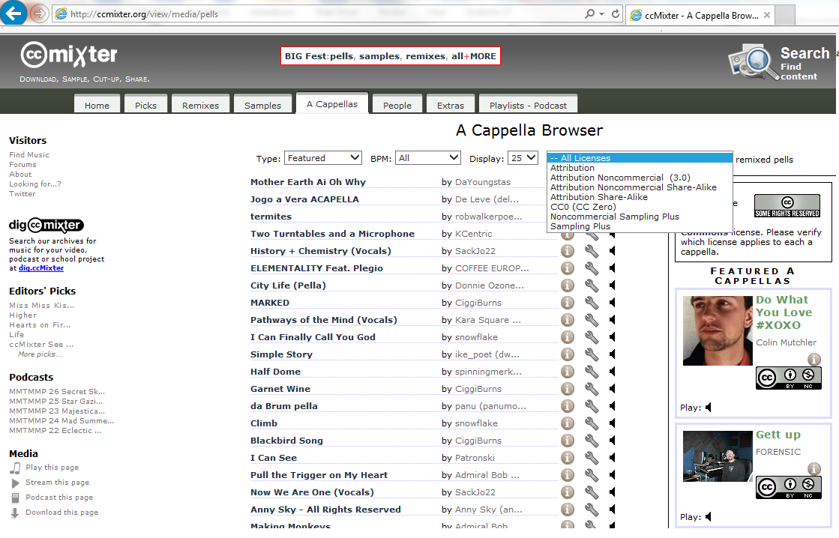
Finding openly-licensed works
http://ccmixter.org
Notes:
YouTube video on how to use ccMixter: https://www.youtube.com/watch?v=liAyK_VFy88
What is a remix? 5:00-5:31
Programs discussed:
Audacity http://audacity.sourceforge.net (free)
Reaper (low cost $)

Slide 29
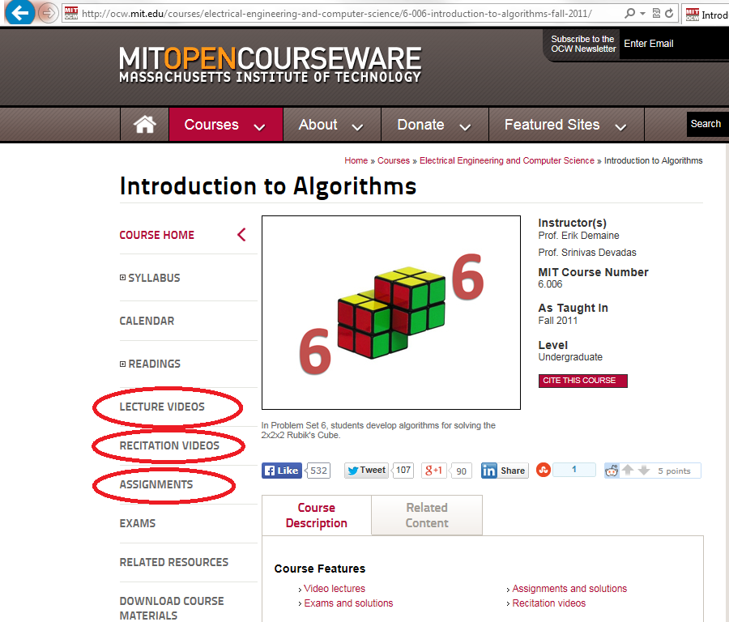
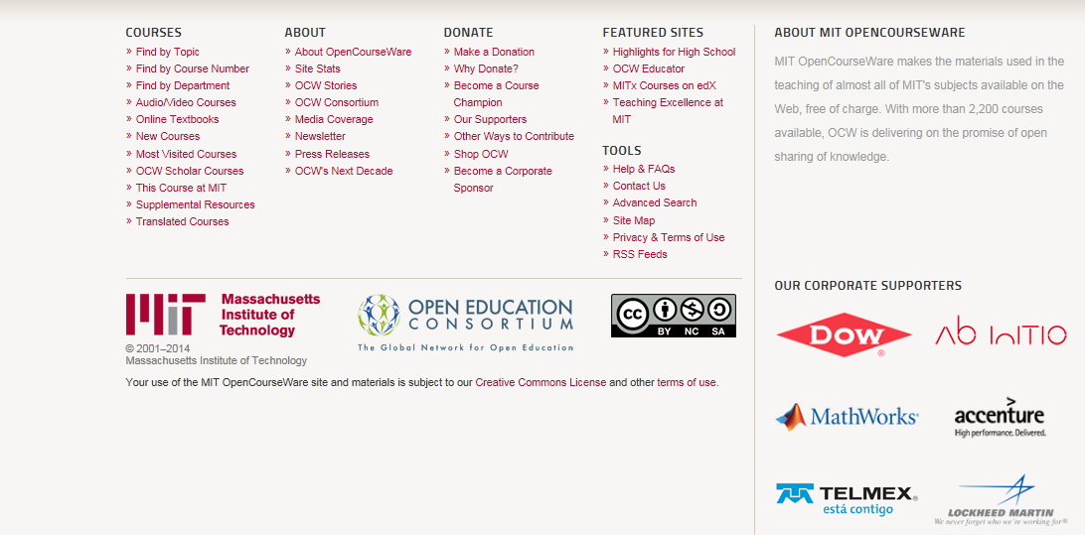
Finding openly-licensed works
“Introduction to Algorithms” © MIT CC BY-NC-SA
http://ocw.mit.edu
Notes:
http://ocw.mit.edu/courses/electrical-engineering-and-computer-science/6-006-introduction-to-algorithms-fall-2011/
Sample lecture: http://ocw.mit.edu/courses/electrical-engineering-and-computer-science/6-006-introduction-to-algorithms-fall-2011/lecture-videos/lecture-1-algorithmic-thinking-peak-finding/
Sample recitation: http://ocw.mit.edu/courses/electrical-engineering-and-computer-science/6-006-introduction-to-algorithms-fall-2011/assignments/MIT6_006F11_ps1.pdf
Quiz: http://ocw.mit.edu/courses/electrical-engineering-and-computer-science/6-006-introduction-to-algorithms-fall-2011/exams/MIT6_006F11_quiz1.pdf

Slide 30
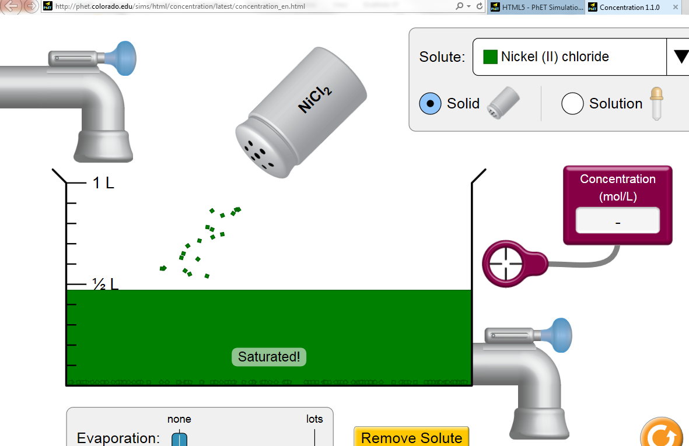
Finding openly-licensed works
“Concentration” ©University of Colorado CC BY
Notes:
http://phet.colorado.edu/sims/html/concentration/latest/concentration_en.html
http://phet.colorado.edu/en/simulations/category/html

Slide 31
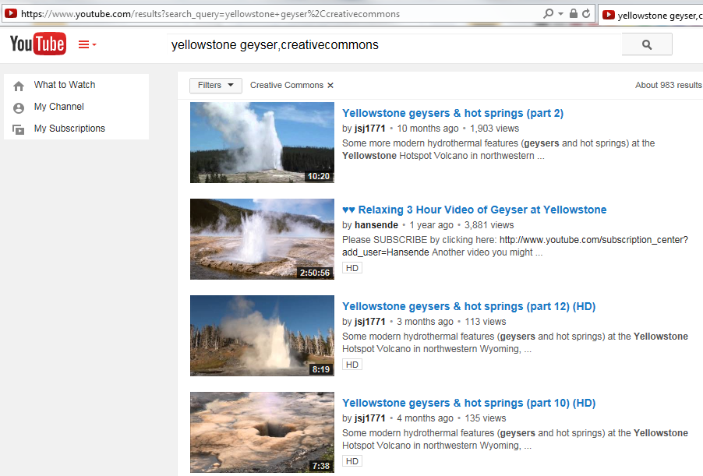
Finding openly-licensed works

Slide 32
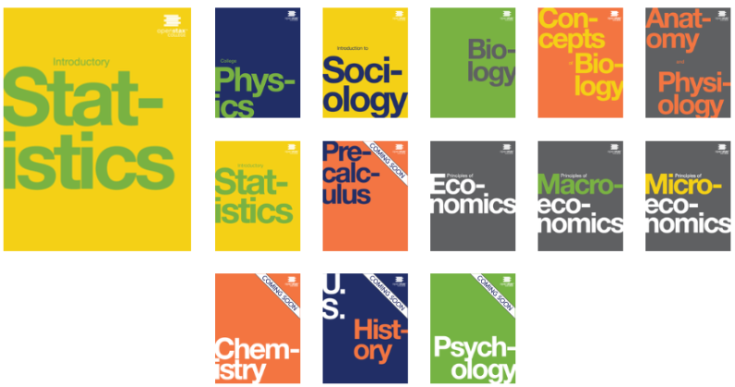
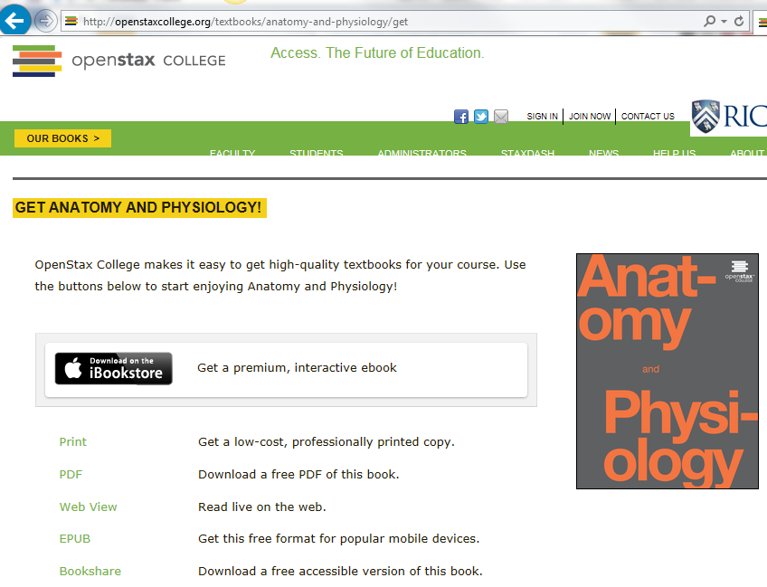
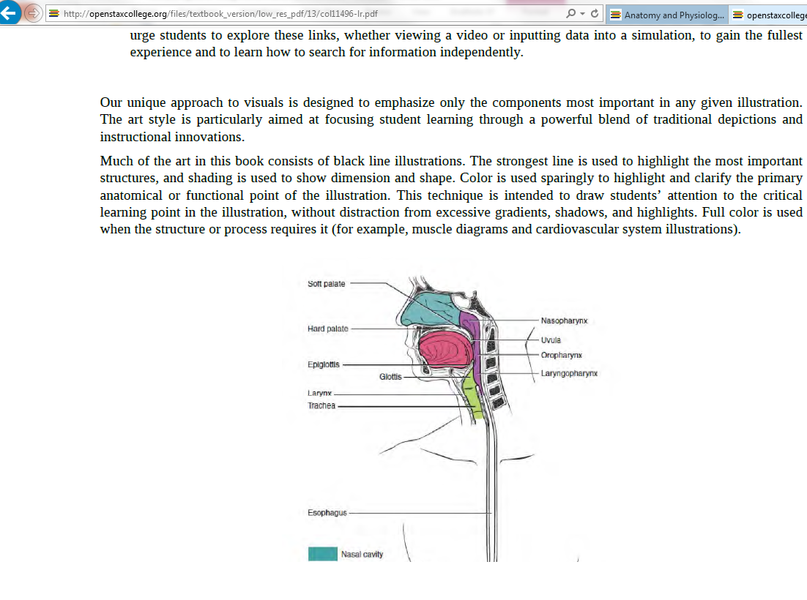
Finding openly-licensed works
http://openstaxcollege.org
Notes:
http://www.openstaxcollege.org/books

Slide 33

Finding openly-licensed works
http://open.umn.edu

Slide 34
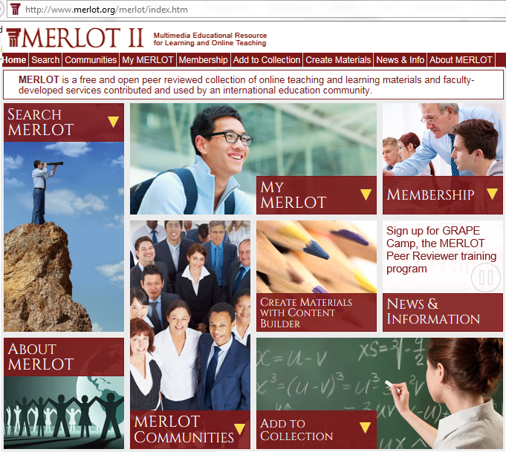
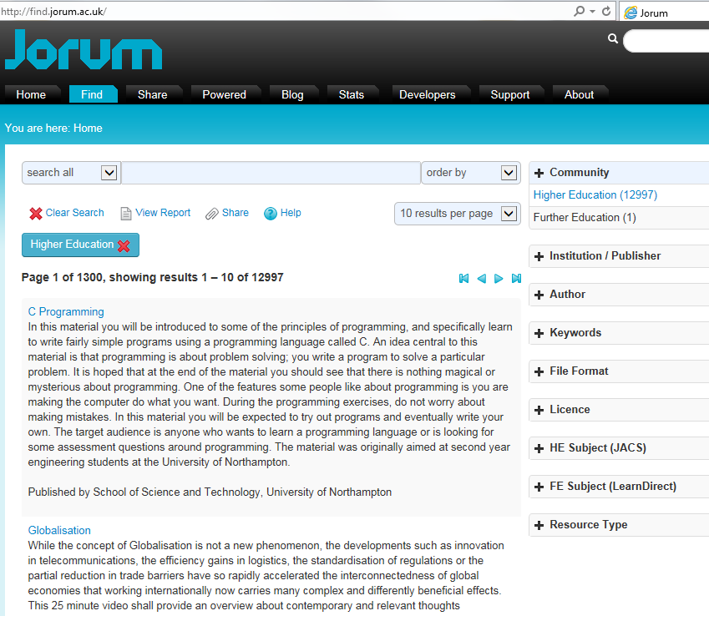
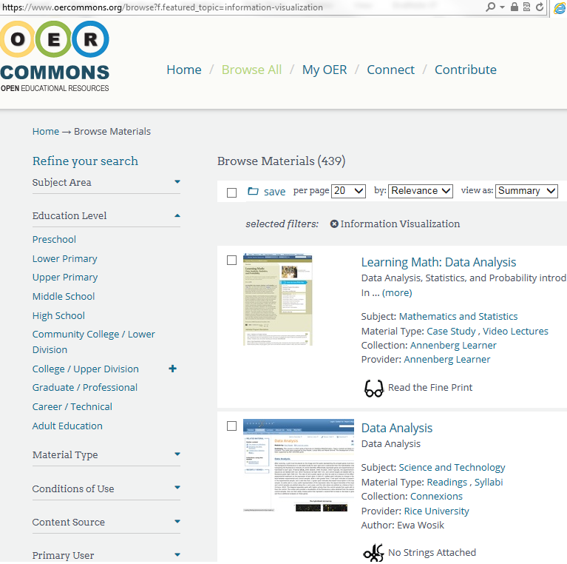
Finding openly-licensed works
http://www.oercommons.org
http://www.jorum.ac.uk
http://www.merlot.org

Slide 35
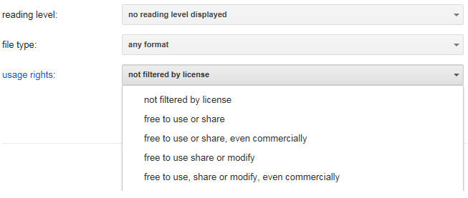
Finding openly-licensed works
Google Advanced Search
https://www.google.com/advanced_search (scroll down to “usage rights”)
More info: https://support.google.com/websearch/answer/29508?hl=
Notes:
Examples:
MATLAB tutorial
3D files helicopter
Architecture ancient Rome
Thermodynamics simulations

Slide 36
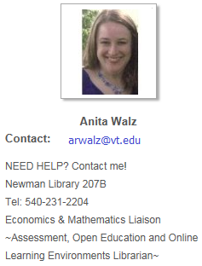
Finding openly-licensed works
Search by type:
Images OR media OR music OR video (find CCMixter, SoundCloud, Flickr & YouTube here!)
Creative Commons Search http://search.creativecommons.org
Syllabus
- Saylor Foundation http://www.saylor.org/courses
- Advanced Google search (filter by rights) https://www.google.com/advanced_search
- MIT OpenCourseWare http://ocw.mit.edu
Simulations
- PhET-Physics, chemistry, biology, earth science (University of Colorado) http://phet.colorado.edu
Short Video
KHAN Academy http://www.khanacademy.org
Vimeo http://www.vimeo.com
TED Talks https://www.ted.com/about/our-organization/our-policies-terms/ted-talks-usage-policy
Open Textbooks (full text, no cost, online)
- OpenStaxCollege (Rice University) http://openstaxcollege.org/books
- Open Textbook Library (University of MN) http://open.umn.edu/opentextbooks
- MERLOT II (California State University) http://www.merlot.org/merlot/index.htm
(select Material Type: “Open textbook”)
Virginia Tech Library’s Guide to Finding OER http://guides.lib.vt.edu/oer

Slide 37
Open Educational Resources (OERs) …
are “teaching, learning, and research resources that reside in the public domain or have been released under an intellectual property license that permits their free use and re-purposing by others.”
include “full courses, course materials, modules, textbooks, streaming videos, tests, software, and any other tools, materials, or techniques used to support access to knowledge.”
- Hewlett Foundation

Slide 38

. . . an alternative way for authors to share and for users to save time & money
Find, review, adopt,
customize, use
& share
Find, review, adopt
customize, use
& share
Find, review, adopt
customize, use
& share
Create, use
& share
Find, review, adopt,
customize, use
& share
© Screenshot from “Get Creative” Creative Commons CC BY-NC-SA
Notes:
Creating has everything to do with teaching & learning.
Faculty rely on textbooks, learning resources etc etc. We understand that you could create all of your instructional materials yourself . . . but that maybe you choose not to.

Slide 39
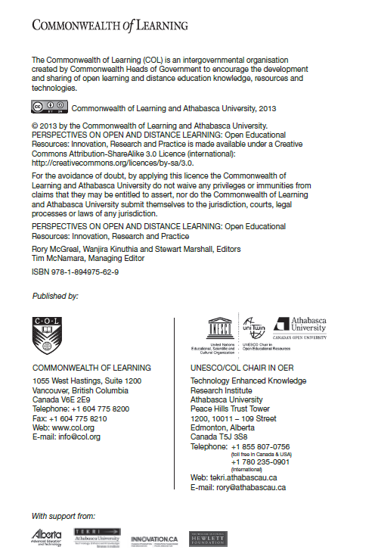
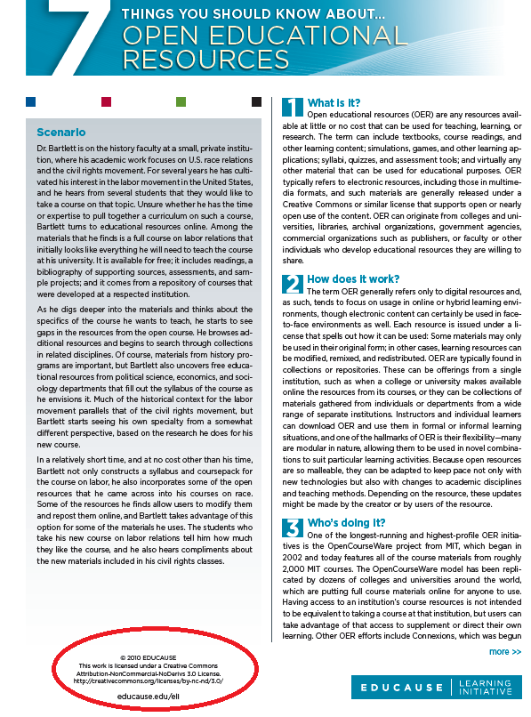
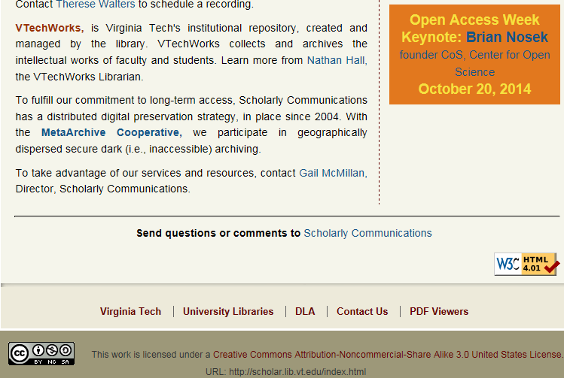
How and why to openly license?
Marking your work with a CC license
https://wiki.creativecommons.org/Marking_your_work_with_a_CC_license

Slide 40
Sharing so your work can be found
Local: VTechWorks
http://vtechworks.lib.vt.edu/register
MERLOT or OER Commons
http://www.merlot.com http://www.oercommons.org
Your discipline’s sharing networks
How do you already share?

Slide 41
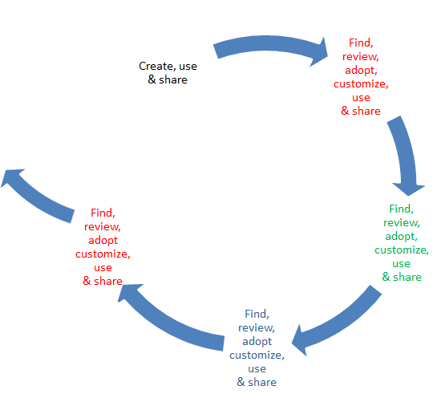
What will you . . .
Create, use & share?
Look for & use?

Slide 42
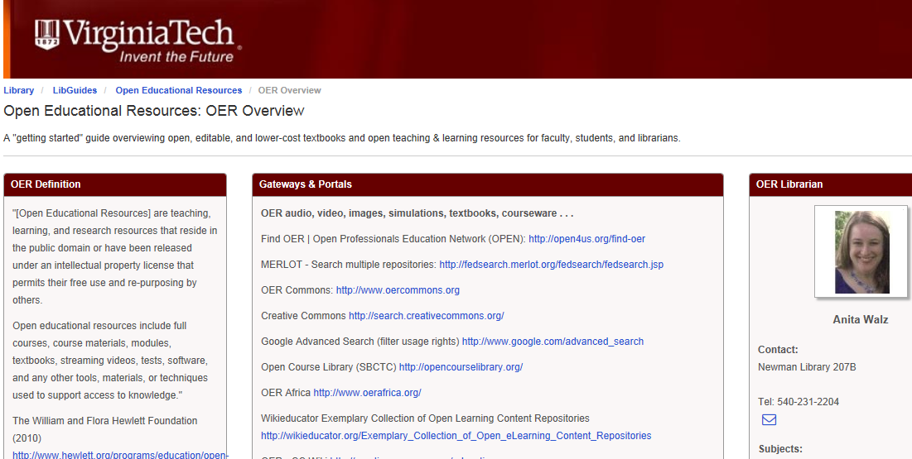
Questions? Looking for something specific?
We can help you!
Anita Walz
Newman Library #207B
arwalz@vt.edu
540-231-2204
Virginia Tech Libraries
http://guides.lib.vt.edu/oer
Interested in joining the OpenVT@googlegroups.edu listserv?
Notes:
Thanks for your time! Please contact me with any questions.
Mention: OpenVT@googlegroups.com

