Slide 1
Collection Management Webpages
Final Presentation
Tung Dao
Weigang Liu
Christopher Wakeley
  CS5604 – Information Storage and Retrieval
  Fall 2016
  Virginia Polytechnic Institute and State University
  Blacksburg, VA
  Professor Edward FoxA
  December 1, 2016

Slide 2
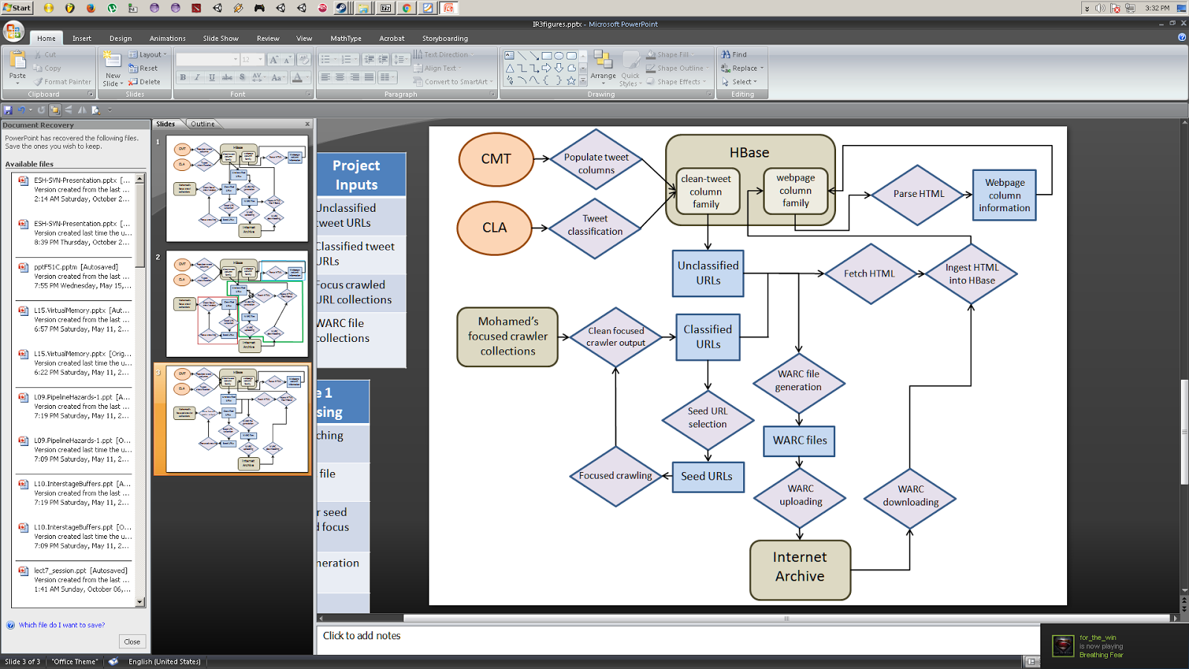
System Overview

Slide 3
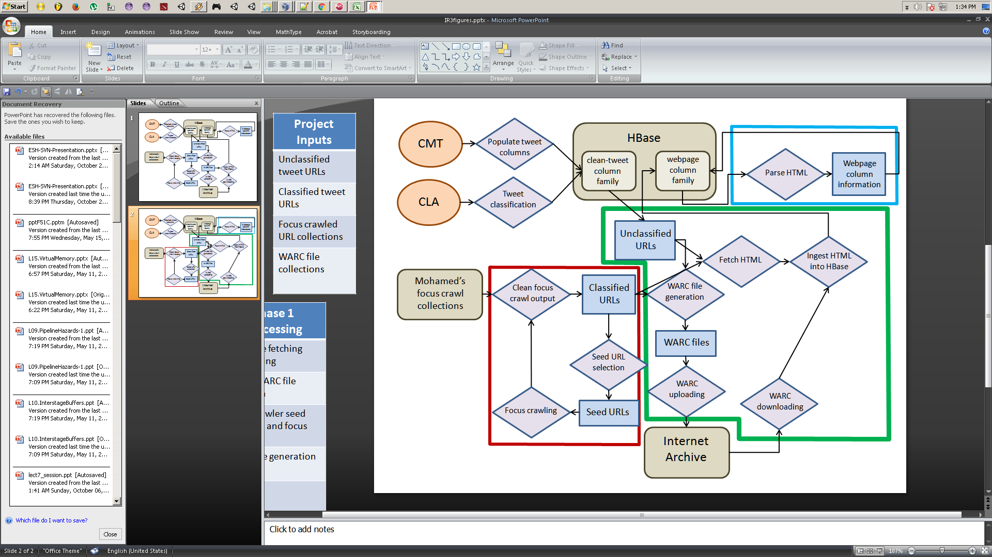
HTML Fetching and WARC Files
Fetch HTML
Generate WARC files
Ingest WARC files from IA

Slide 4
Fetching HTML
Orignal Pipeline
Only hit server once
Performance
Politeness
Problem:
Minutes to generate WARC
Unclassified URLs
WARC file generation
Ingest HTML into HBase
Revised Pipeline
Unclassified URLs
Fetch HMTL
Ingest HTML into HBase
WARC file generation

Slide 5
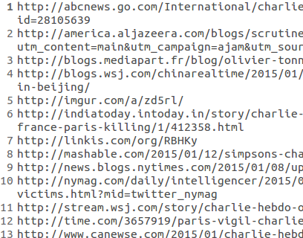
Fetching HTML Implementation
Line Delimited URLs.txt
Spark Application
Delimited HTML Content.txt
URLs | Runtime (s)
64 | 23.031
128 | 10.752
256 | 16.876
512 | 38.756
Performance (local mode):
Measure speedup in future

Slide 6
Fetching HTML Future Work
Incremental Update
  Add “fetched” column
  Compare with timestamp (Freshness)
Spark Application
HBase
HBase
RDD
Avoid Coalesce
  Don’t store all results on one partition
  Scalability

Slide 7
WARC Generation
Existing Tools
  NOT distributed
  All implement crawling functionality
  We already have a crawler
  (Focused Crawler)
Line Delimited URLs.txt
Python
Script
(wget)
WARC files
WARC files
WARC files

Slide 8
WARC Generation Future Work
Read from HBase
Upload to IA
WARC files
Scala
Script
(wget)
HBase
WARC files
IA
WARC files

Slide 9
WARC Ingestion (All Future Work)
Modify HBase insertion
  Input Schema
Implement IA downloads
WARC files
IA
WARC files
warcbase
HBase
WARC files

Slide 10
Focused Crawler
Focused Crawler:
  Introduction
    Role in CMW
    Outline
  Implementation
    Original Design
    Extensions
  Experiments & Results
    Effectiveness: Relevance and Correctness
    Efficiency: Running Time & Space (Memory)
  Future Ideas

Slide 11
Focused Crawler: Role in CMW

Slide 12
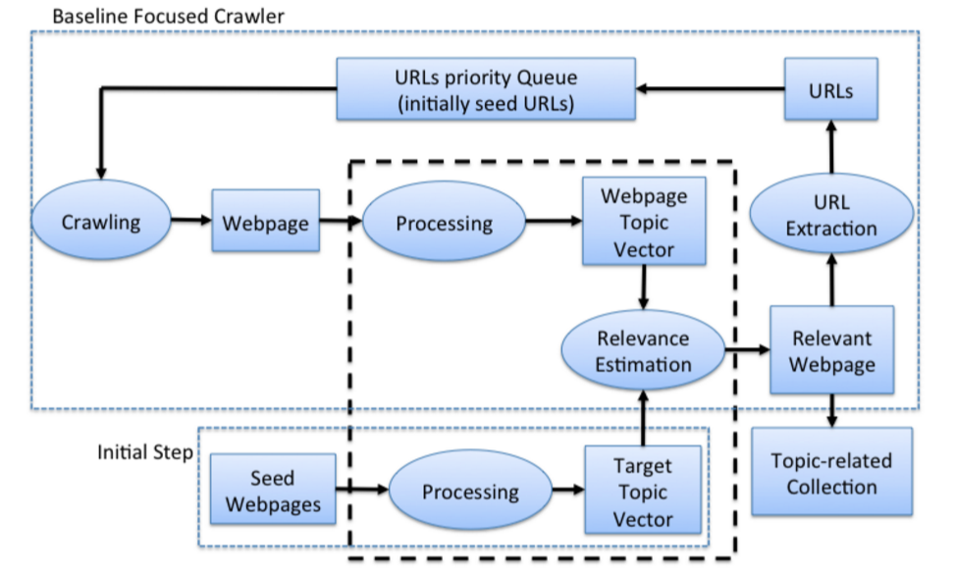
Focused Crawler: Architecture

Slide 13
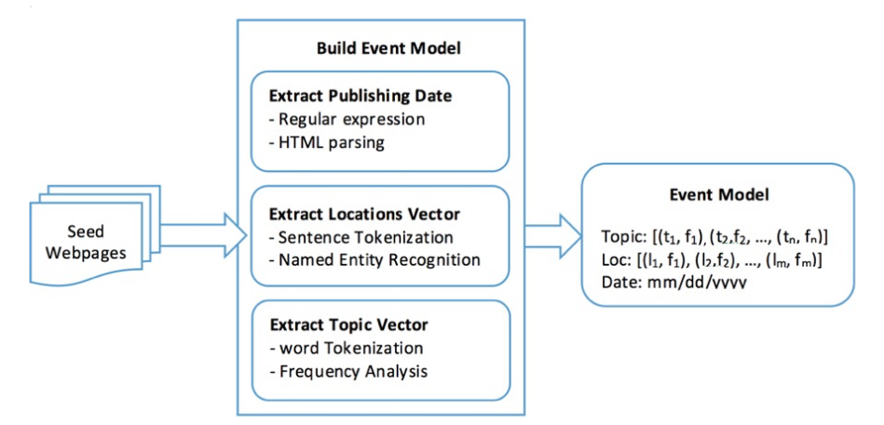
Focused Crawler: Event Model

Slide 14
Event Focused Crawler: Implementation
Three main components:
  Crawler → Baseline Focused Crawler (Topic only) → Event Focused Crawler (Topic, Location, Date)
  Feature Extractor:
    Topic
    Location
    Date
    Using Stanford NER
  Event Model
    Represent an event
    Calculate similarity/relevance score (webpage and event)
    Using TFIDF/Cosine model
Implemented in Python (~ 1K LOC)

Slide 15
Event Focused Crawler: Extensions (1/3)
Output Format
  “Column-based” format (title, URL, topic, locations, dates)– like JSON, instead of “flatted text”.
  Standardized WARC file, instead of text file (using WARC Python APIs).
Accuracy
  Distinguish (dates & locations) in the title and (dates & locations) in the content.
    Using BeautifulSoup & Stanford NER, respectively
    Weighting them differently (more for the first one)

Slide 16
Event Focused Crawler: Extensions (2/3)
Evaluation & Comparison
  Evaluation
    Crawl three events:
      “South China Sea Dispute”
      “USA President Election 2016”
      “South Korean President Protest”
    Numbers of seeds: 25
    PageThreshold: 0.5
    Top-K: 10
    Page Limits: 100; 10,000; 100,000 (couldn’t terminate in a time manner)
  Comparison
    Event Focused Crawler vs. Heritrix (not yet completed)

Slide 17
Event Focused Crawler: Extensions (3/3)
Scale up
Apply NLP to increase accuracy
  Synonyms
  Part-of-Speech taggers
  Sentiment Analysis
Multiple related-events focused crawler
  Focus only on intersection of multiple events
  Parameterize events’ importance

Slide 18
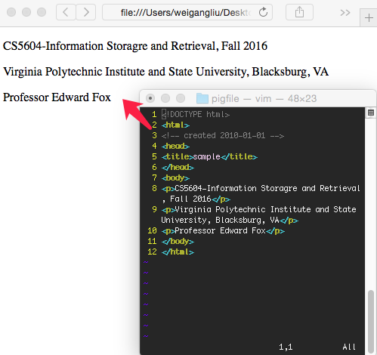
HTML
Ignore what it does
Don’t display the tags
Interpret the content!

Slide 19
BeautifulSoup
An HTML or XML parser
Pythonic idioms for iterating, searching, and modifying the parse tree
Automatic conversion
https://www.crummy.com/software/BeautifulSoup/

Slide 20
Readability
Measure the readability of text
Estimate the grade level of word density
Can be used for Noise Reduction
Only works for English
$ pip install https://github.com/andreasvc/readability/tarball/master

Slide 21
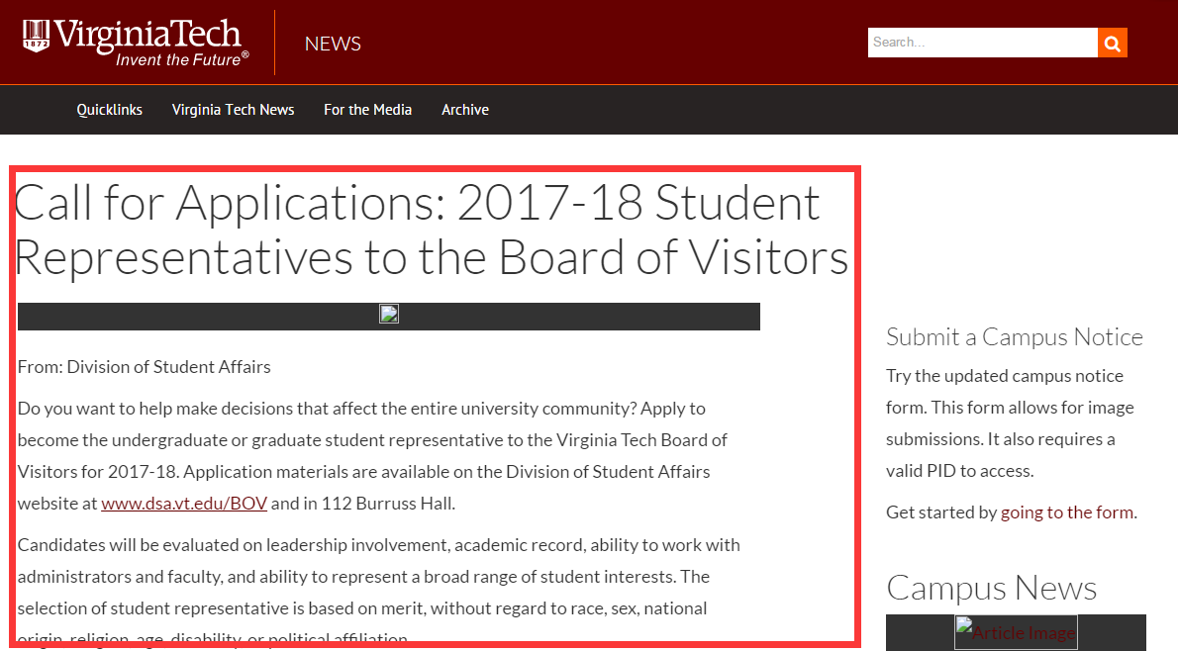
Readability
Readable article we want

Slide 22

Python Script Results
Mainly utilize above two packages
Test results on the static webpage collection of Charlie Hebdo shooting

Slide 23
Further Steps and Improvements
Final step
  Load the data into HBase for SOLR, FE
Future improvement
  Using AVRO file as the output
  to avoid text file concatenation
  Hadoop streaming (parallelization)

Slide 24
Project Summary
Many working individual components
Lots of work left to connect everything together
HBase connection needs implementation in most components

Slide 25
Acknowledgments
NSF grant IIS-1319578, III: Small: Integrated Digital Event Archiving and Library (IDEAL).
NSF IIS-1619028: Global Event and Trend Archive Research (GETAR)
Dr. Fox
GRAs:
Mohamed Magdy Farag
Sunshin Lee
Other current/past teams.

