Slide 1
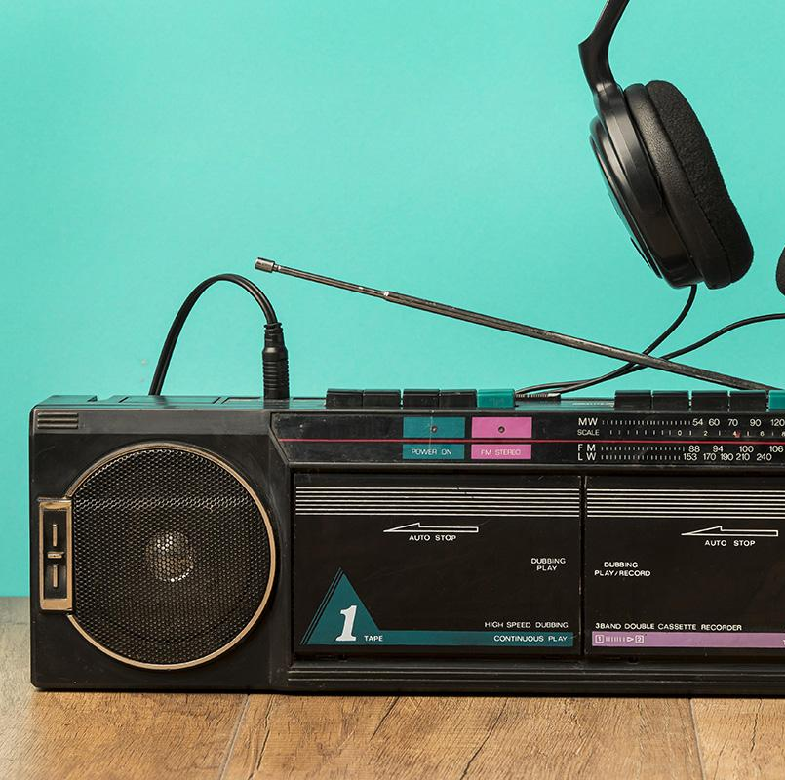
MusArt: Creating Musical Art Pieces
Reilly McLaren
CS4624 Multimedia, Hypertext, and Information Access
Dr. Edward A. Fox
Virginia Tech, Blacksburg VA 24061
Client: Dr. Ivica Ico Bukvic
April 29, 2021

Slide 2
Presentation Outline
01
02
03
04
Project Overview
Current Status
Future Plans
Acknowledgements and References

Slide 3
Goal
Incorporate music and art into existing technologies to create a tool that provides users a relaxing experience

Slide 4

Why Music + Art?
Music helps to regulate our heart rate
Art allows us to tune into the moment

Slide 5
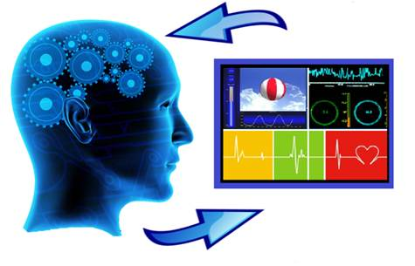

Original Project Plan
Create biofeedback tool that incorporates audio and visuals
Ideas
Generative Music based on Bio-indicators
Assistive Meditative App

Slide 6
A Variety of Perspectives
Enma Navarro
Dr. Benjamin Knapp
Dr. Katherine Biddle
Gong Master
Founding Director of ICAT at VT
Registered Expressive Arts Therapist at Carilion Clinic

Slide 7

Updated Plan: MusArt
Create a web app which allows users to build individualized Audio-Visual art pieces based on provided templates
Is it…
Accessible?
Feasible?
Useful?

Slide 8

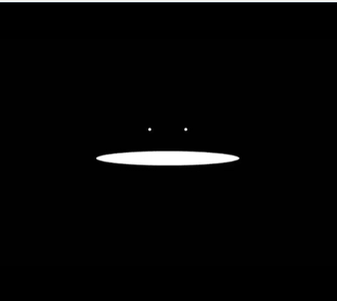
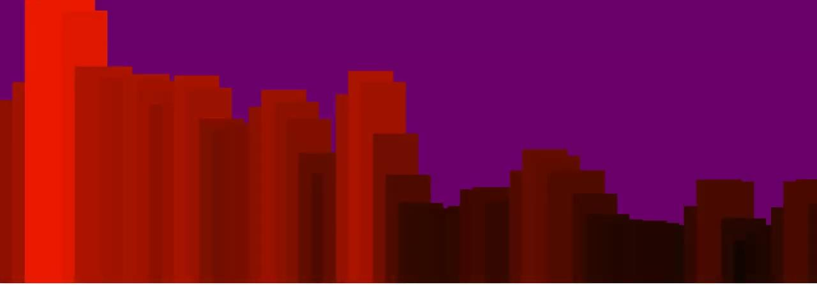
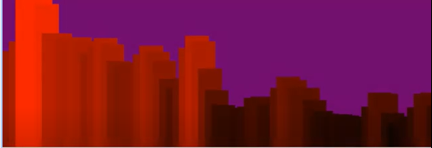
Early steps

Slide 9
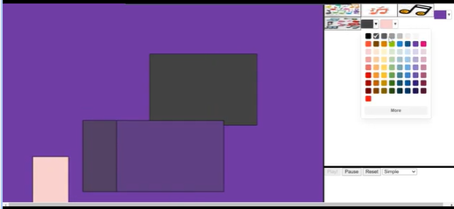
Beginnings of the Web App

Slide 10
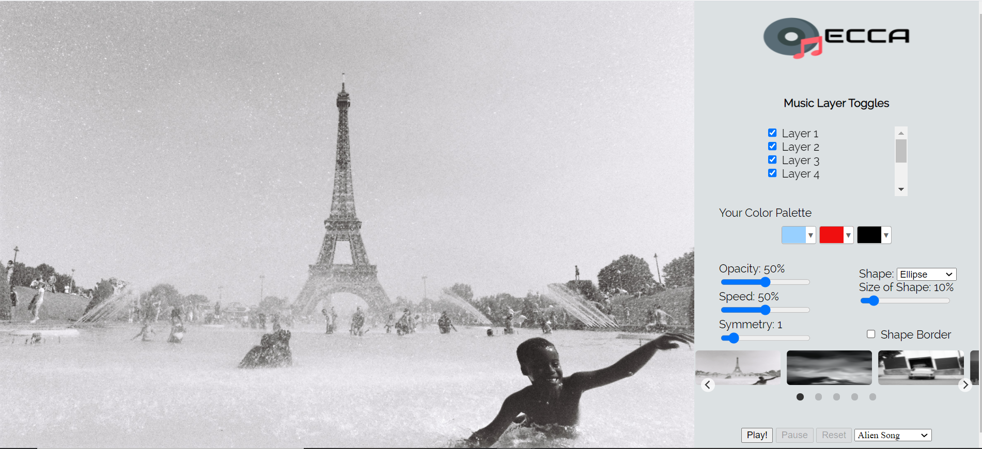
Current State

Slide 11


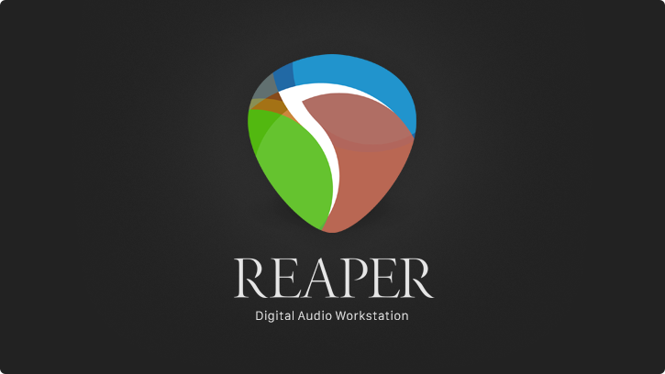
Key Technologies Used
Used for visual elements
Used for audio playback
Used for music creation

Slide 12

Next Features To Be Added
Recording
Random Variable
Audio Controlled by Drawing
Allow user to include their own voice recording for the song
Introduce random slider for visual
Have the drawing change various effects of the audio (panning, oscillators, etc.)

Slide 13
Main Areas Needing Improvement
Easy to Understand
Visually Interesting
“Bob Ross” Effect
Music-Visual Interaction

Slide 14
Lessons Learned
Thinking is hard
Life is Long
Others know much more
There is always time to add more features, sometimes it’s good to step away from the computer
Having additional perspectives gets you a long way
Having to think through a design makes the building process much longer

Slide 15
Acknowledgements
Thank you to:
Dr. Ivica Ico Bukvic - Client
Dr. Edward Fox
Dr. Benjamin Knapp
Dr. Katherine Biddle
Enma Navarro
Keith Ebeltoft
Ruchi Maniar

Slide 16
Resources
https://www.ncbi.nlm.nih.gov/pmc/articles/PMC5772659/ - Musical auditory stimulus acutely influences heart rate dynamic responses to medication in subjects with well-controlled hypertension, Martiniano et. al., 2018
https://www.health.harvard.edu/staying-healthy/music-and-health - A study of 80 patients undergoing urologic surgery under spinal anesthesia found that music can decrease the need for supplementary intravenous sedation, 2011
https://www.ncbi.nlm.nih.gov/pmc/articles/PMC3741536/ - A research review on evolution of music(why we make/listen to music) and its psychological role, Thomas Schäfer, Peter Sedlmeier, Christine Städtler, and David Huron, 2013
https://www.ncbi.nlm.nih.gov/pmc/articles/PMC1860846/ - Relaxation during intermission after listening to music, L Bernardi, C Porta, and P Sleight, 2005
Using Color Effectively in Computer Graphics(Textbook) - Lindsay W. MacDonald

Slide 17
Feedback is greatly appreciated! Any ideas would be helpful.

