Slide 1


NAWEA 2015 Symposium
June 9, 2015 Blacksburg, Virginia
The DOE Wind Vision: Costs, Benefits and Other Impacts
Ed DeMeo
Renewable Energy Consulting Services, Inc.
(DOE Wind Vision Core Management Team)

Slide 2


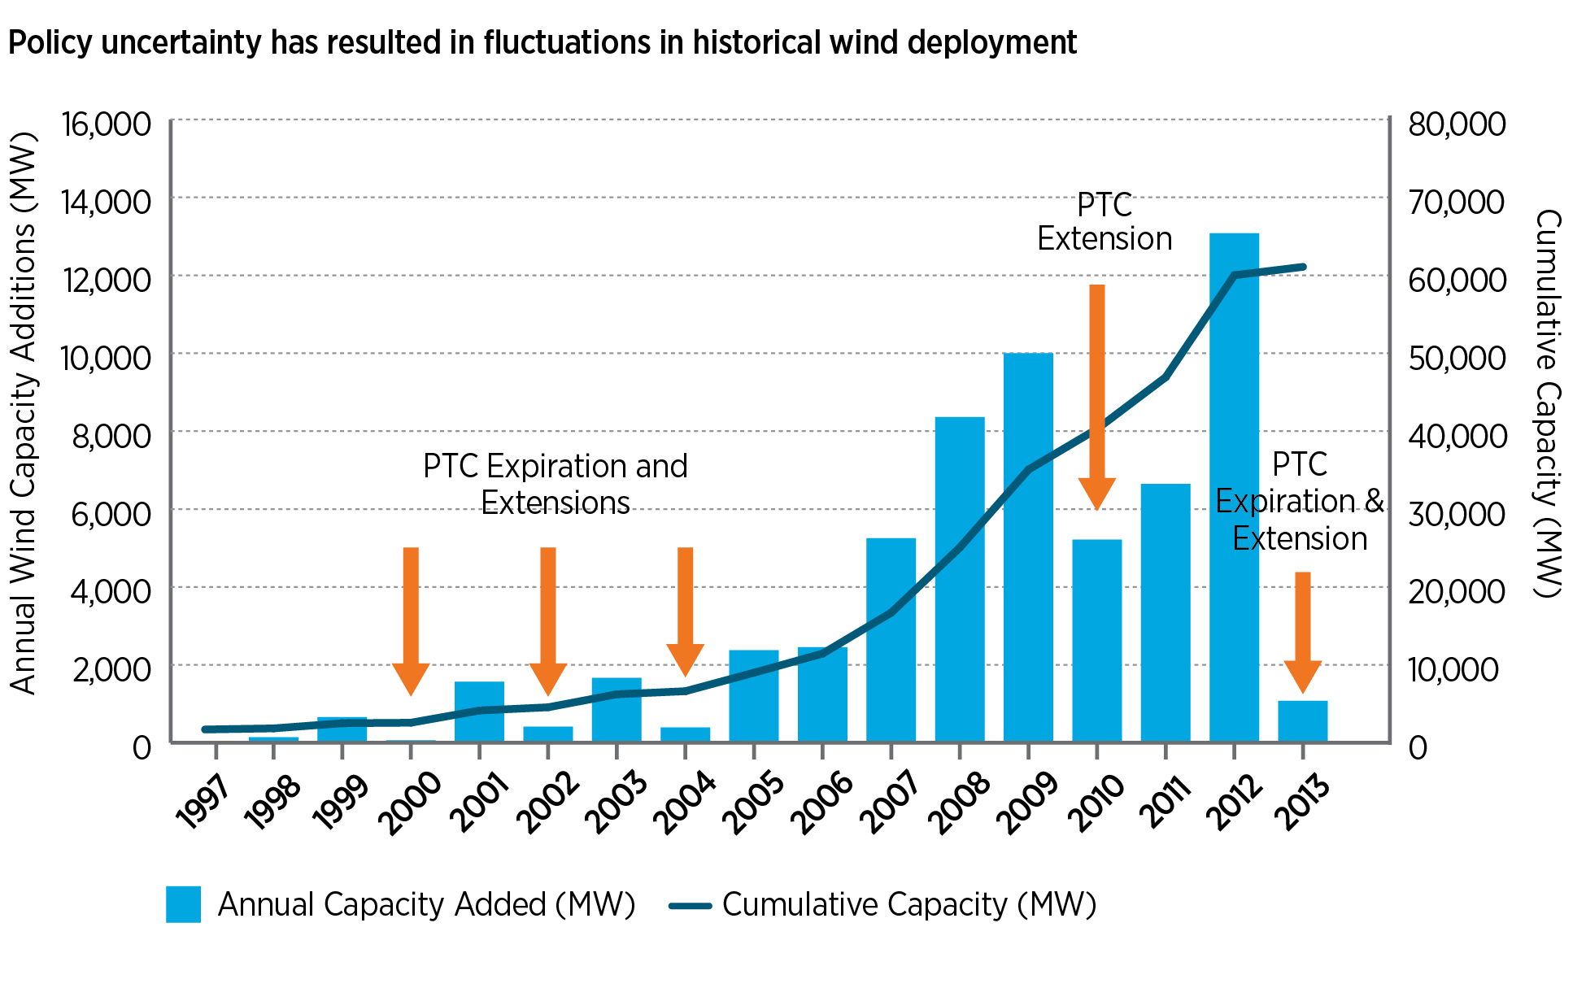
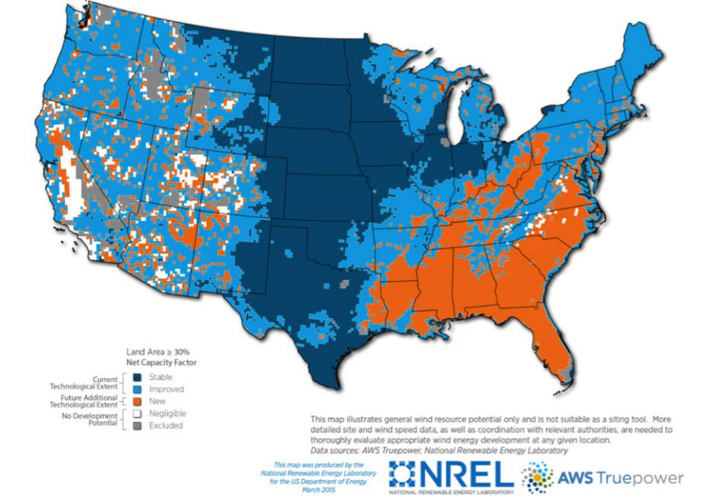
Discussion Topics
Highlights of New DOE Wind Vision findings
Focus on costs, benefits, and other impacts
Implications for wind deployment going forward
Prospects for regional expansion

Slide 3

An assessment of wind power’s status, prospects and contributions over the next three decades: costs, benefits, other impacts
Conducted by over 250 experts in wind, electric power, and the environment
Released March 2015 by the U.S. Department of Energy

Slide 4
Key Wind Facts
4.6% of U.S. 2014 power generation
42% of all 2012 U.S. power capacity additions, the highest of any resource (investment of $25 billion)
59 GW wind capacity added from 2005 to 2014
11 states with > 10% wind generation in 2014: Colorado, Idaho, Iowa, Kansas, Maine, Minnesota, North Dakota, Oklahoma, Oregon, South Dakota, and Texas
Two states with >25% wind generation in 2014: Iowa (30%) and South Dakota (25%)
Average of 73,000 U.S. jobs in installation, manufacturing and operations over 2010-2014

Slide 5
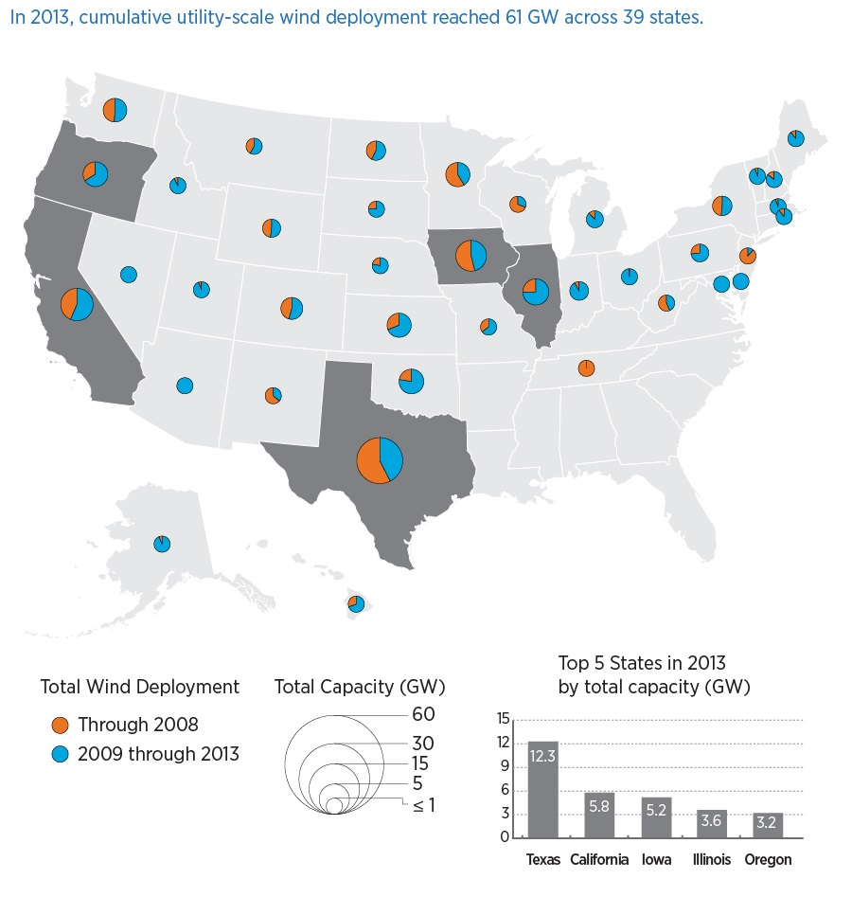
Cumulative utility-scale wind deployment reached 61 GW across 39 states in 2013

Slide 6
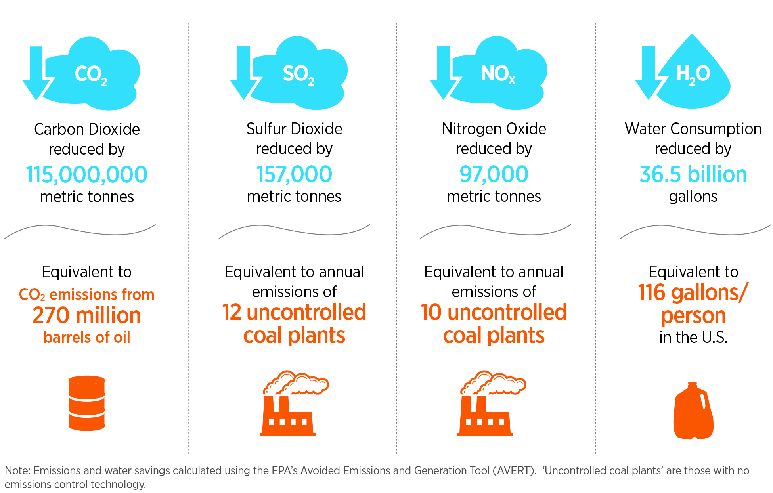
Wind Energy Is Delivering a Variety of Environmental Benefits Now
The avoided CO2 emissions from wind energy today help offset the equivalent of more than 24 million passenger vehicles
Key Fact

Slide 7
Wind Is A Reliable Source of Electricity
Yes, the lights will stay on!
Very high shares of wind -- 30% to 60% instantaneously -- have not brought the power system down
Several major electric utility operators now get over 10% of their annual generation from wind power
Wind has helped the Texas power grid operator avoid blackouts when extreme drought forced curtailment of fossil-fueled plants
Wind is variable and controlled largely by nature, but the myth that the power system can’t accommodate it has been disproven by actual operating experience

Slide 8
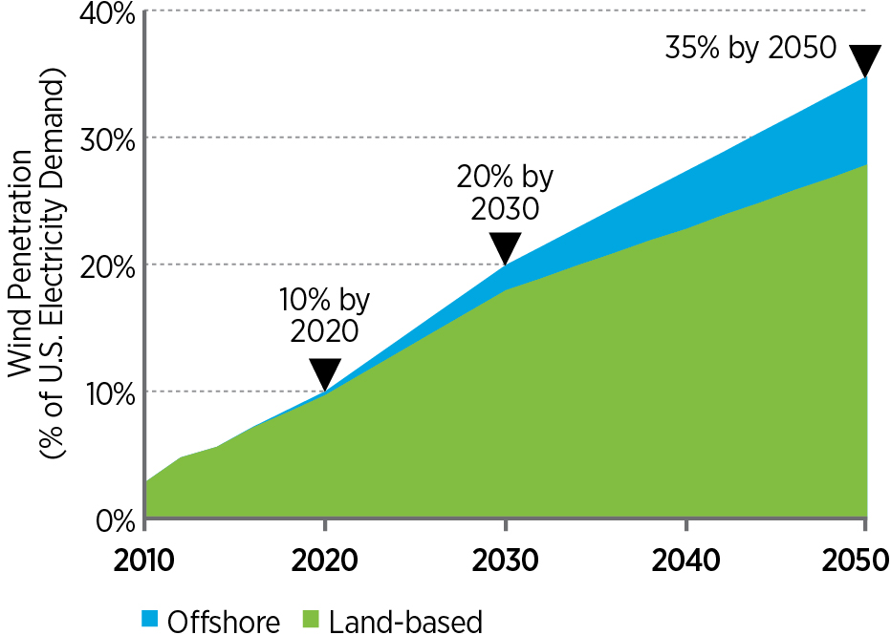
Wind Growth Scenario
Aggressive but Reasonable
Compare this to a baseline scenario with no new wind after 2013
Requires 8 to 10 GW/year of new wind

Slide 9
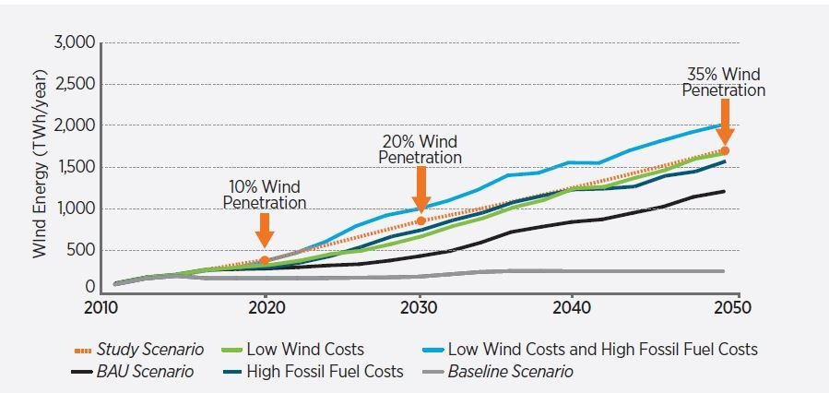
Wind Vision Sensitivity Scenarios
With Business as Usual (BAU – no incentives), wind deployment is minimal for the next 10 to 15 years.

Slide 10
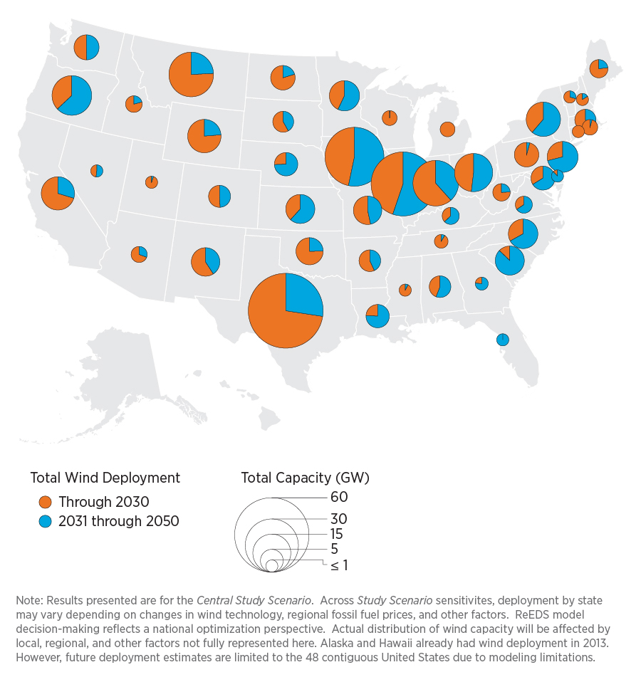
Wind Vision Scenario Yields Broad Geographic Distribution of Wind Capacity
Combined land-based and offshore wind capacity
Wind deployment is found to be geographically widespread; in the Central Study Scenario:
  all 48 (continental) states participate in the Vision by 2050 [compared with 39 today]; and
  37 states have over 1,000 MW of wind by 2030; 40 states by 2050 [compared with 16 today]
Range of deployment possibilities exist for any state due to possible future conditions (e.g. fuel prices, legislation, incentives, access to transmission, permitting)

Slide 11
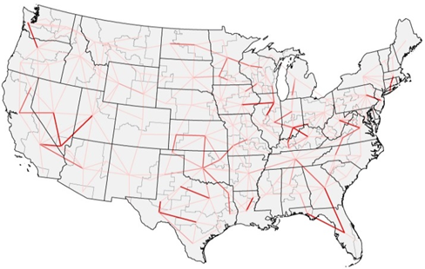
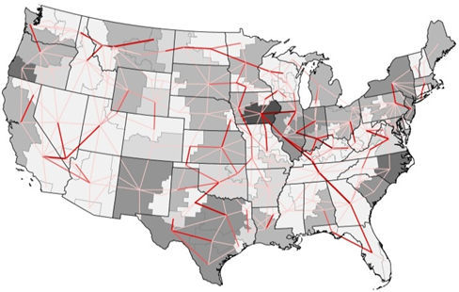
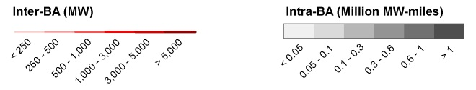
Example Results to Inform Priorities:
Transmission Expansion
Baseline
Study Scenario
Cumulative 2013-2050 Expansion
Note: Intra-BA shading also reflects transmission installed to move power from offshore plants to land-based substations
Study Scenario 2030 transmission needs, less than 10% greater than the estimated 200 million MW-miles in place today (approximately 11,000 miles of new transmission, assuming typical 345 kV carrying capacity)
Study Scenario 2050 transmission needs, less than 20% greater than the estimated 200 million MW-miles in place today (approximately 33,000 miles of new transmission, assuming typical 345 kV carrying capacity)
Long-distance transmission builds are spread across the U.S., but more concentrated in the Mid-West, Texas, and the West
Additional transmission investment is estimated at approximately $70 billion or 0.5 cents/kWh-wind

Slide 12

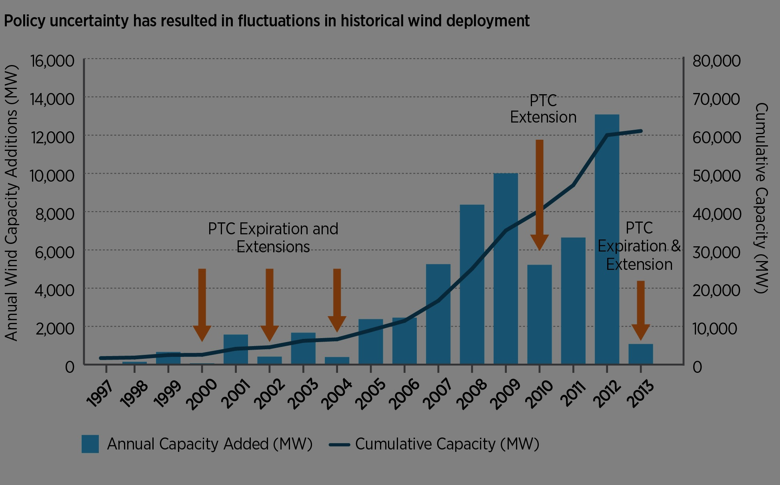
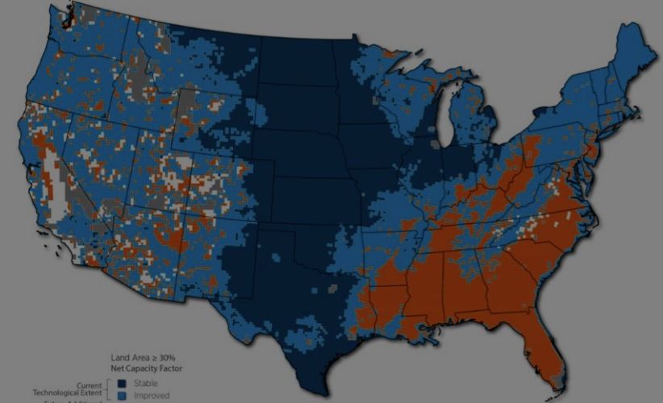
Discussion Topics
Highlights of New DOE Wind Vision findings
Focus on costs, benefits, and other impacts
Implications for wind deployment going forward
Prospects for regional expansion

Slide 13
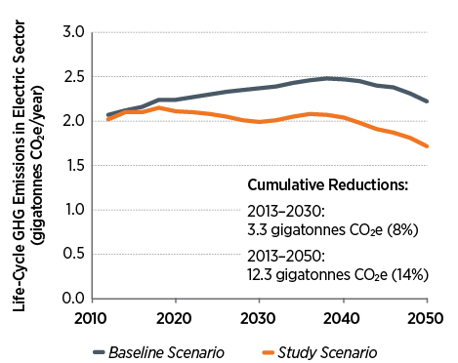
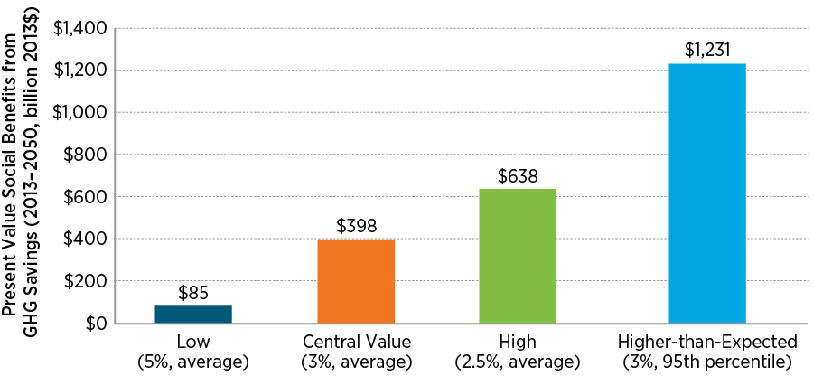
Wind Vision Scenario Reduces Damages from Global Climate Change
Wind Vision results in life-cycle GHG savings in U.S. power sector of 6% in 2020, 16% in 2030 and 23% in 2050 relative to No New Wind; economic value of those reductions estimated with IWG Social Cost of Carbon
Social benefits are equivalent to:
3.2¢/kWh-wind (central value)
0.7-10¢/kWh-wind (total range)

Slide 14
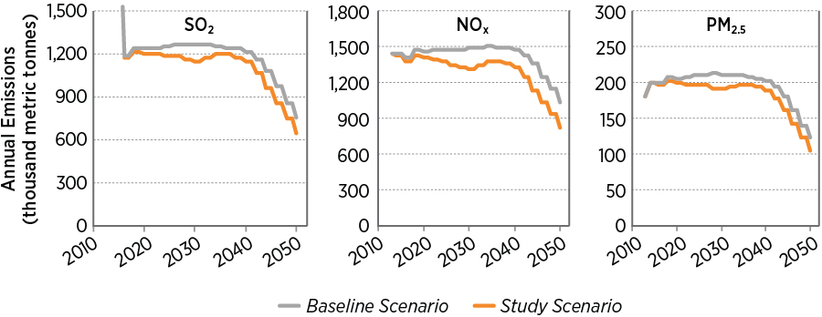
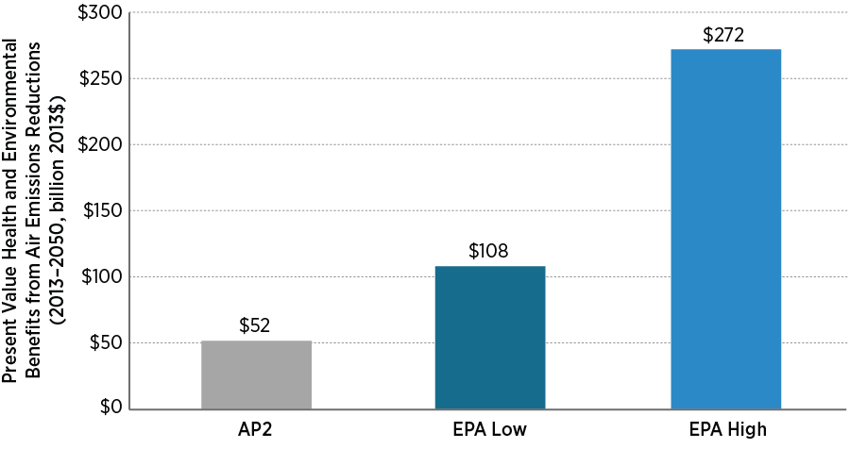
Wind Vision Scenario Provides Additional Health and Environmental Benefits
Wind Vision yields potential reductions in SO₂, NO_{x}, PM_{2.5}, creating benefits estimated using multiple methods
Majority of benefits derive from reductions in SO₂, resulting in lower concentrations of sulfate particulates; vast majority of benefits are located in Eastern U.S., and come from human health, especially reduced premature mortality
Air pollution benefits are equivalent to:
0.4-2.2¢/kWh-wind

Slide 15
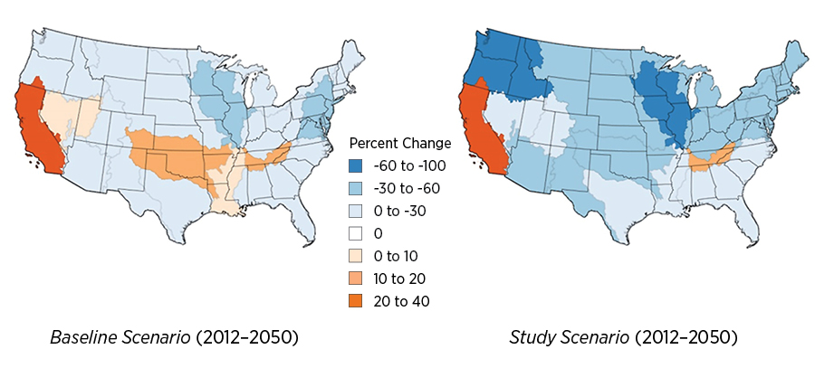
Wind Vision Reduces Water Use in Key Watersheds Relative to No New Wind
National Water Withdrawal Impacts in Wind Vision Scenario vs. No New Wind Scenario
(Source: Macknick et al., forthcoming; Cohen et al., forthcoming)
Regional Water Consumption Impacts in Wind Vision Scenario vs. No New Wind Scenario
(Source: Macknick et al., 2012a)
Power-sector water consumption in the Wind Vision scenario declines by 2050 in 16 of 18 watershed regions (more so than under the No New Wind scenario)

Slide 16
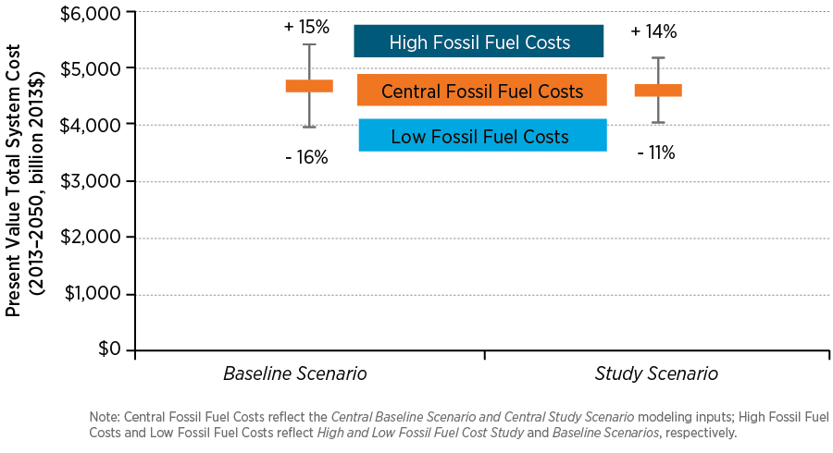
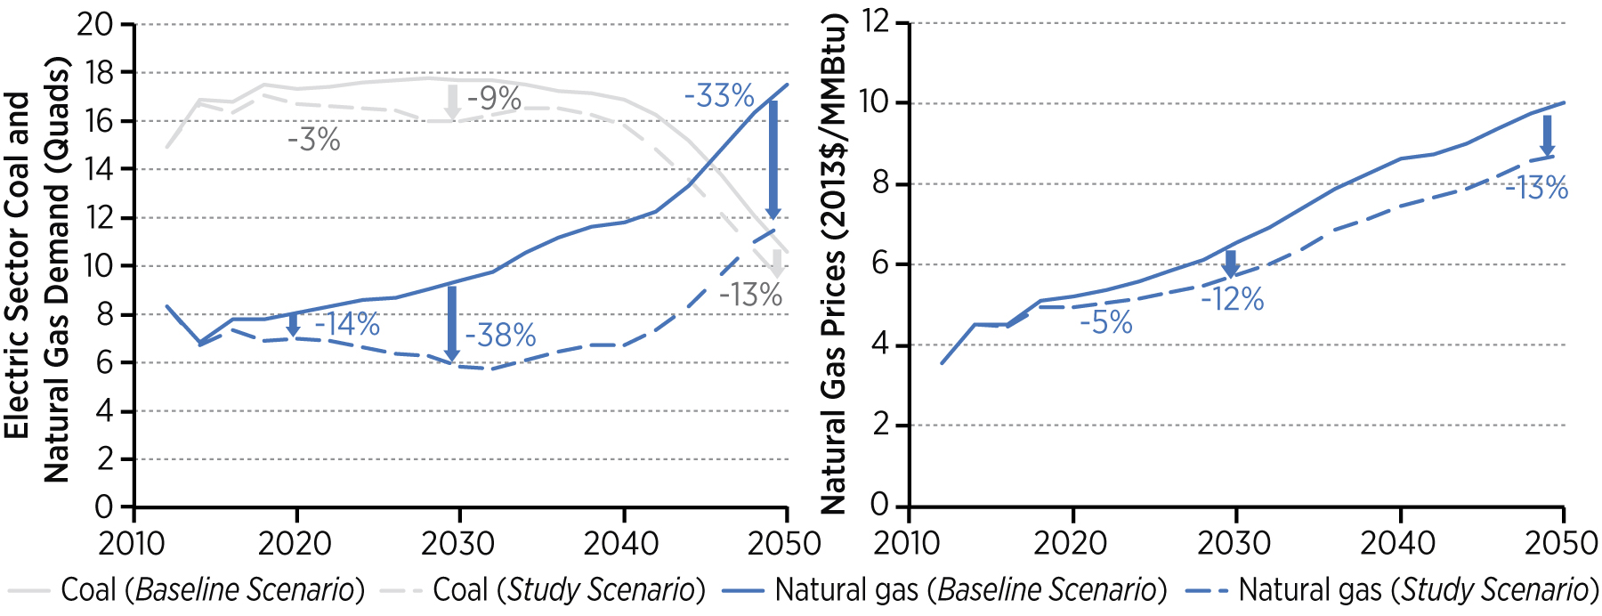
Wind Vision Has Impacts on Electric Sector Fuel Price Risks and Natural Gas Prices
Fuel price scenarios show that electric system costs under Wind Vision are 20% less sensitive to long-term fluctuations in fossil fuel prices
Lower natural gas demand in Wind Vision leads to lower gas prices; consumer benefits outside electric sector estimated at ~$280 billion, on present value basis (associated loss by natural gas producers)

Slide 17
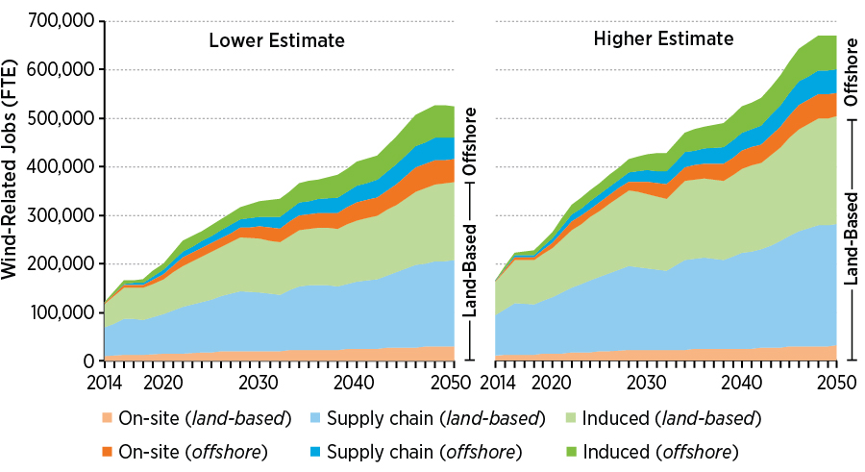
Wind Vision Leads to Wind-Related Jobs and Other Economic Development Impacts
Wind project development also estimated to lead to:
Land-based lease payments: $350 million in 2020, $1,020 million in 2050
Offshore lease payments: $15 million in 2020, $440 million in 2050
Property tax payments: $900 million in 2020, $3,200 million in 2050

Slide 18
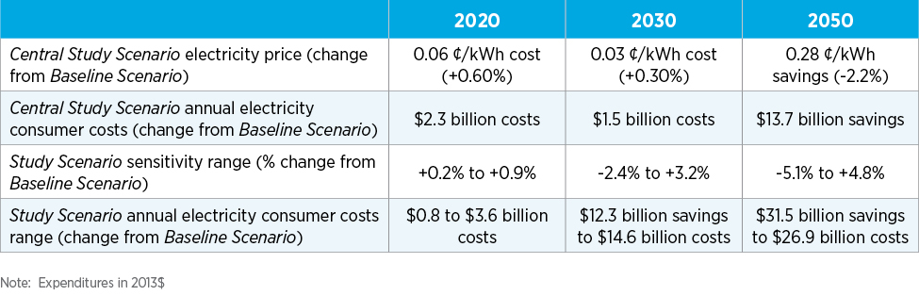
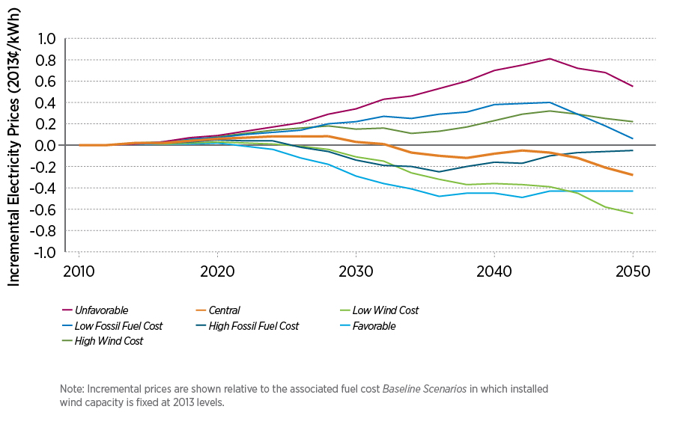
Wind Vision May Impose Incremental Cost and Price Impacts in Near to Medium Term
But also yields long term savings, in Central Study Scenario, compared to No-New-Wind Baseline

Slide 19
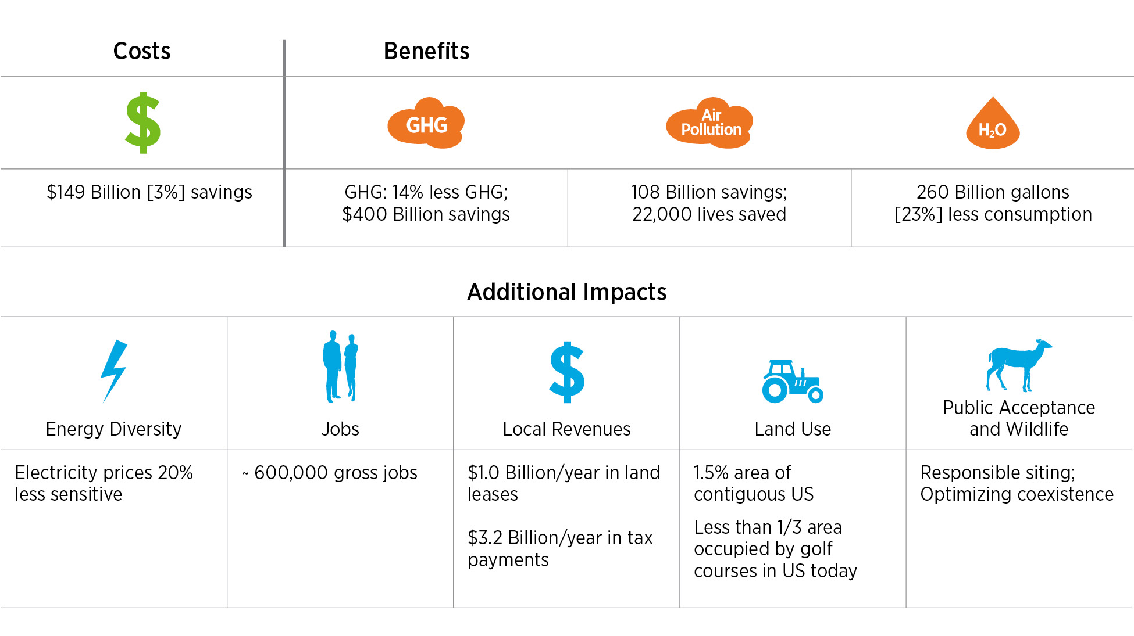
Costs, Benefits and Impacts Summary
The Potential of 35% of the Country’s Electricity Coming from Wind Energy by 2050
$
The Wind Vision Study Scenario results in modest increases in electricity cost in the near- and mid-term (<1% price increase), but in the long term electricity costs savings of 2% are achieved by 2050

Slide 20
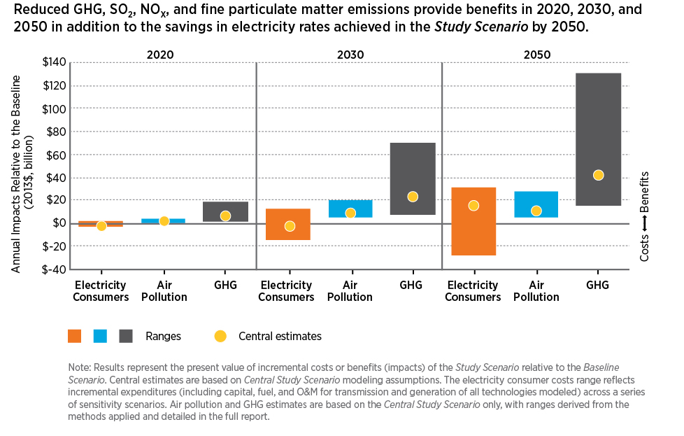
Benefits and Costs of the Wind Vision Over Time
The Wind Vision Study Scenario results in modest increases in electricity cost in the near- and mid-term (<1% price increase), but in the long term electricity costs savings of 2% are achieved by 2050

Slide 21
Conclusions
Modeling confirms industry forecasts of reduced annual wind capacity additions in near (2020) to mid term (to 2030) in BAU future
Aggressive reductions in wind technology costs, increases in fossil fuel prices, and/or policy action are needed to yield deployment consistent with Wind Vision Study scenario in 2020 and 2030 timeframe
Electric systems impacts, including grid integration and transmission challenges are surmountable
Increased electric system costs in 2020 and 2030 timeframe to achieve Wind Vision are offset by GHG, air pollution and other benefits; after 2030, wind likely to be economically attractive even without considering those benefits

Slide 22



Discussion Topics
Highlights of New DOE Wind Vision findings
Focus on costs, benefits, and other impacts
Implications for wind deployment going forward
Prospects for regional expansion

Slide 23
All Societies Subsidize Energy
Fact: All energy sources get public subsidies – generally through the tax code
Fact: Wind’s growth over the past 15 years has benefited from a production tax incentive
Fact: Fossil fuels (oil, gas, coal) have benefited from subsidies for nearly 100 years – many are in the permanent tax code
Fact: The fossil fuel industry is fighting tooth and nail to eliminate the wind incentive while maintaining their own incentives

Slide 24
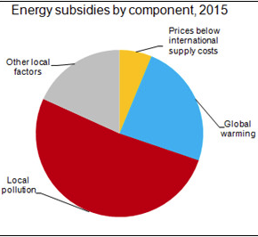
International Monetary Fund (IMF) Findings Issued May 2015
2015 energy subsidies worldwide: $5.3 trillion
  China: $2.3 trillion
  U.S.: $670 billion
Huge majority stems from public-health and environmental damages paid for by society rather than the polluters
Eliminating these subsidies would reduce premature deaths from air pollution, estimated at 3.7 million in 2012 by the World Health Organization -- by 55%.

Slide 25
Historical Policy Impacts on Wind

Slide 26
Wind Vision Sensitivity Scenarios
With Business as Usual (BAU – no incentives), wind deployment is minimal for the next 10 to 15 years.

Slide 27
Impact of Wind Incentive Uncertainty
Extensive analysis shows that, without policy support, wind growth in the United States stagnates until the late 2020s
The U.S. wind manufacturing and supply sector likely shrinks substantially
Wind expansion continues unabated in countries with stable policy support for clean energy (China, Europe)
Robust U.S. expansion resumes in the late 2020s
Where will we get our wind equipment?

Slide 28
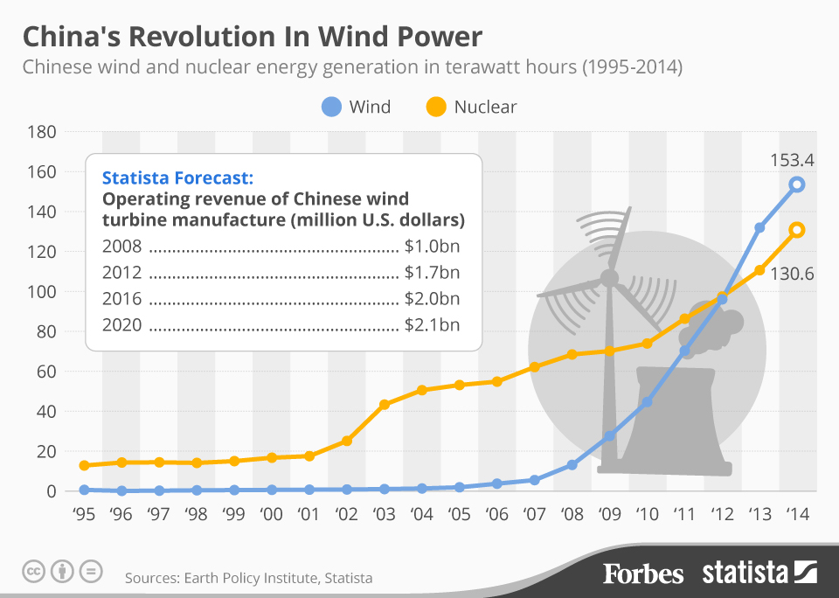
Wind and Nuclear Generation in China
Nuclear role leveling off
Wind role expanding

Slide 29
China 2050 High Renewable Energy Penetration Scenario and Roadmap Study*
2050 power generation:15,200 TWh
91% non-fossil
86% renewable
35% wind
28% solar
7% coal
wind
wind
*Energy Research Institute (China), National Development and Reform Commission, April 2015

Slide 30
Implications for Policy Makers
Without near-term policy support, wind deployment will be minimal and the domestic wind manufacturing sector will likely wither
Wind’s environmental benefits would more than offset any near term incremental costs, providing justification for policy support
Prospective sources of support:
  PTC
  EPA Clean Power Plan
  Other?

Slide 31

Discussion Topics
Highlights of New DOE Wind Vision findings
Focus on costs, benefits, and other impacts
Implications for wind deployment going forward
Prospects for regional expansion

Slide 32
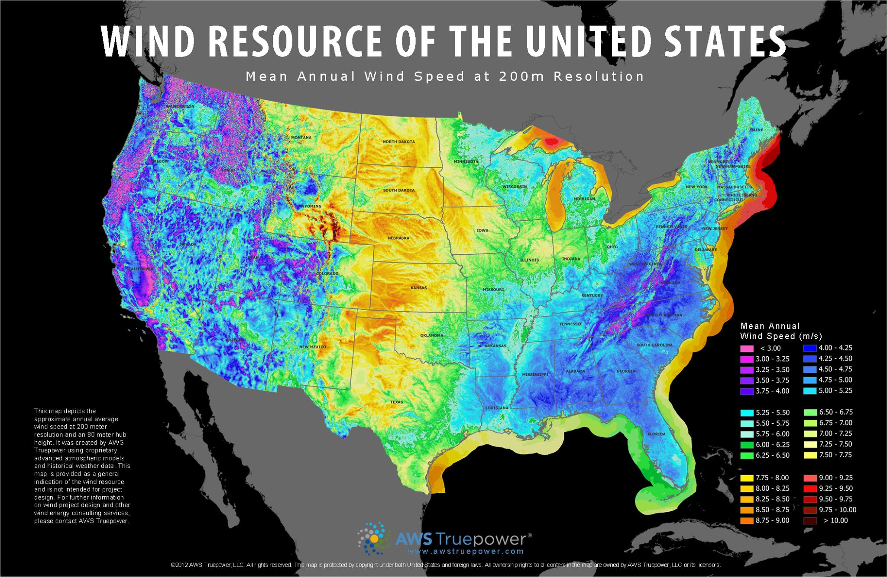
What’s the Size of the U.S. Wind Resource?
Authoritative Estimate: Developable wind resource is 13 times total U.S. electricity consumption

Slide 33
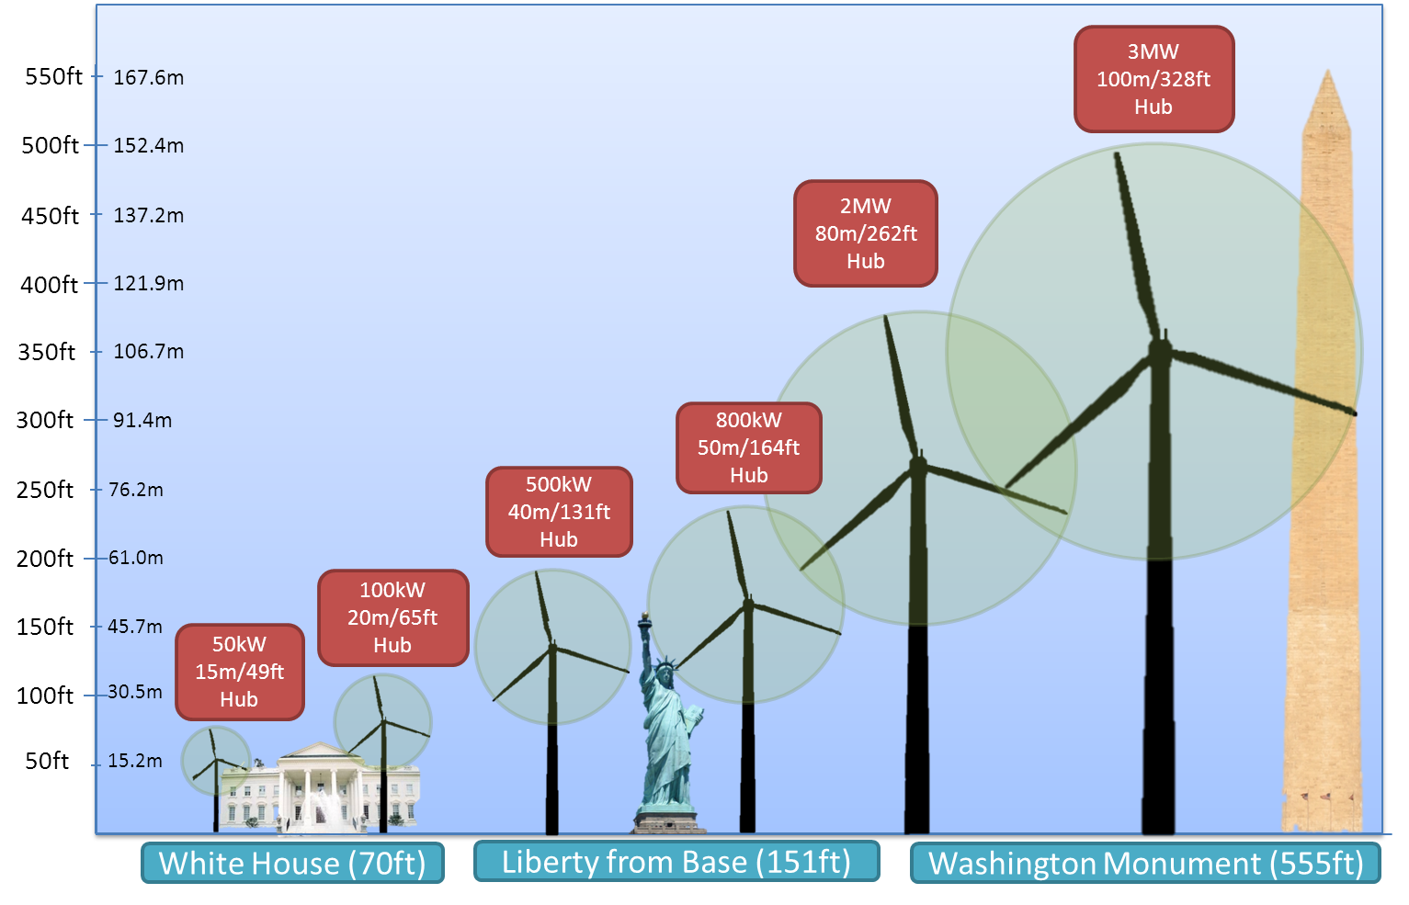
Evolution of Wind Turbine Size
(Land Based)

Slide 34
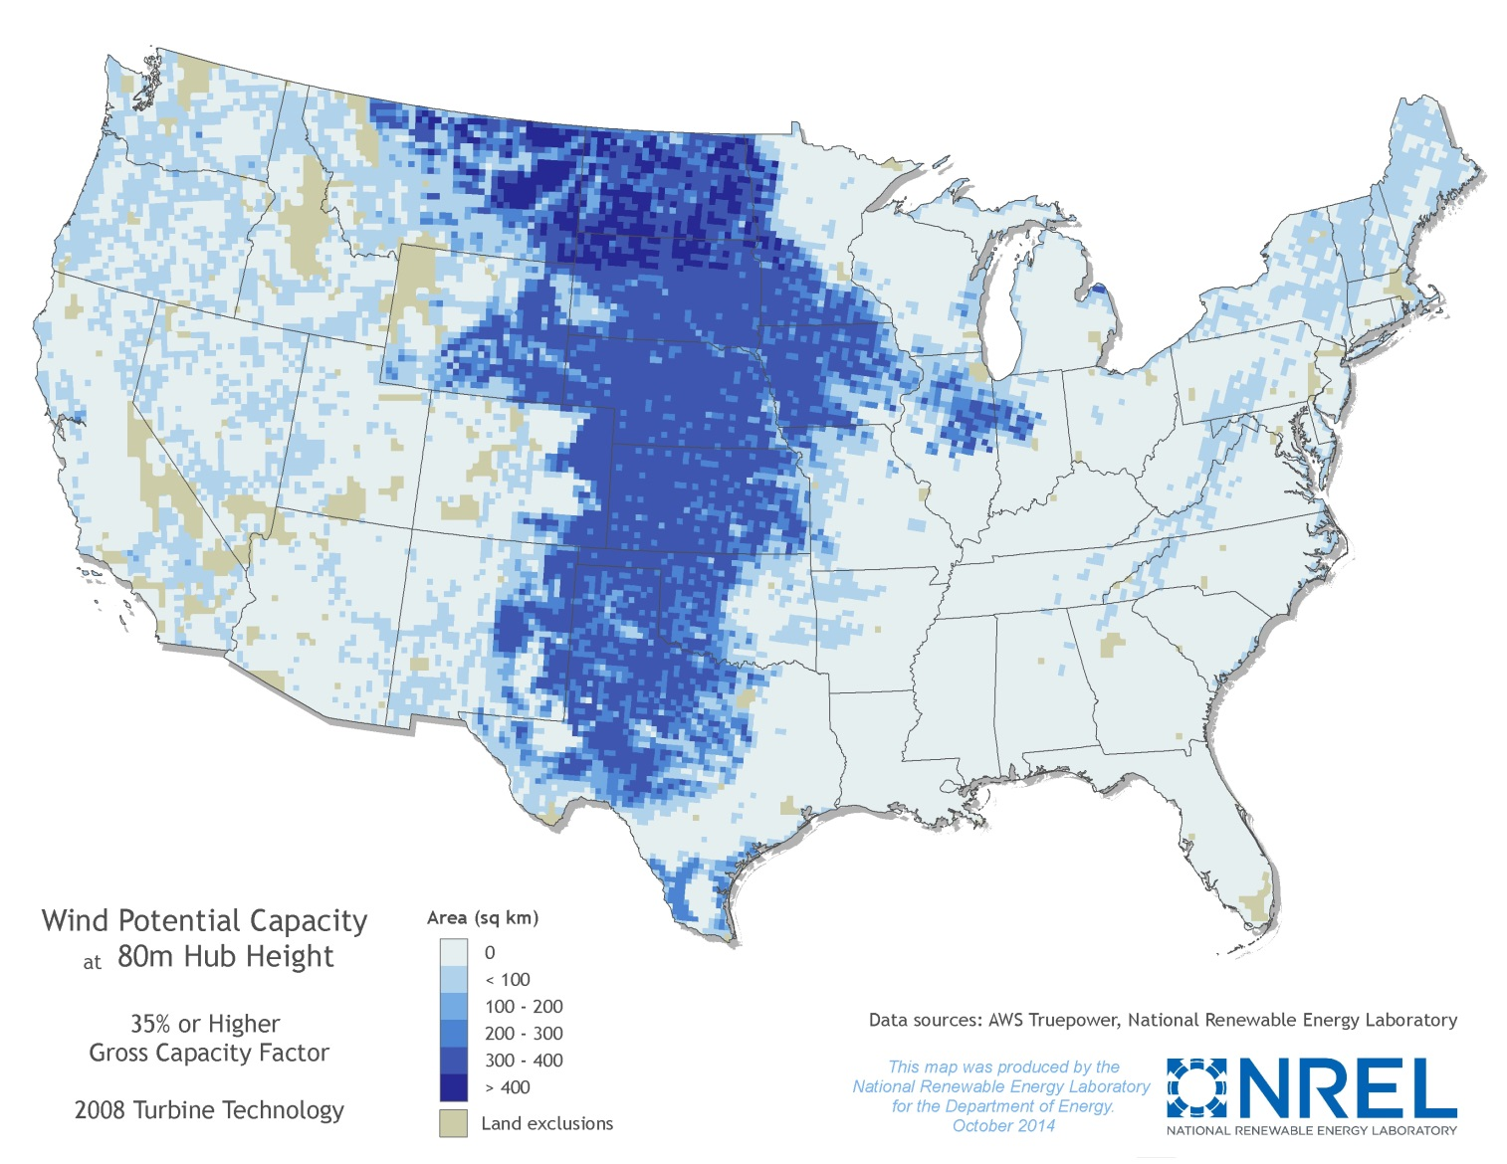
Yesterday’s Technology
Estimates of Economically Viable Development
Land area with a gross CF > 35% for a 2008 IEC Class 2 turbine at an 80 m hub height: 634,475 mi² above 35% GCF

Slide 35
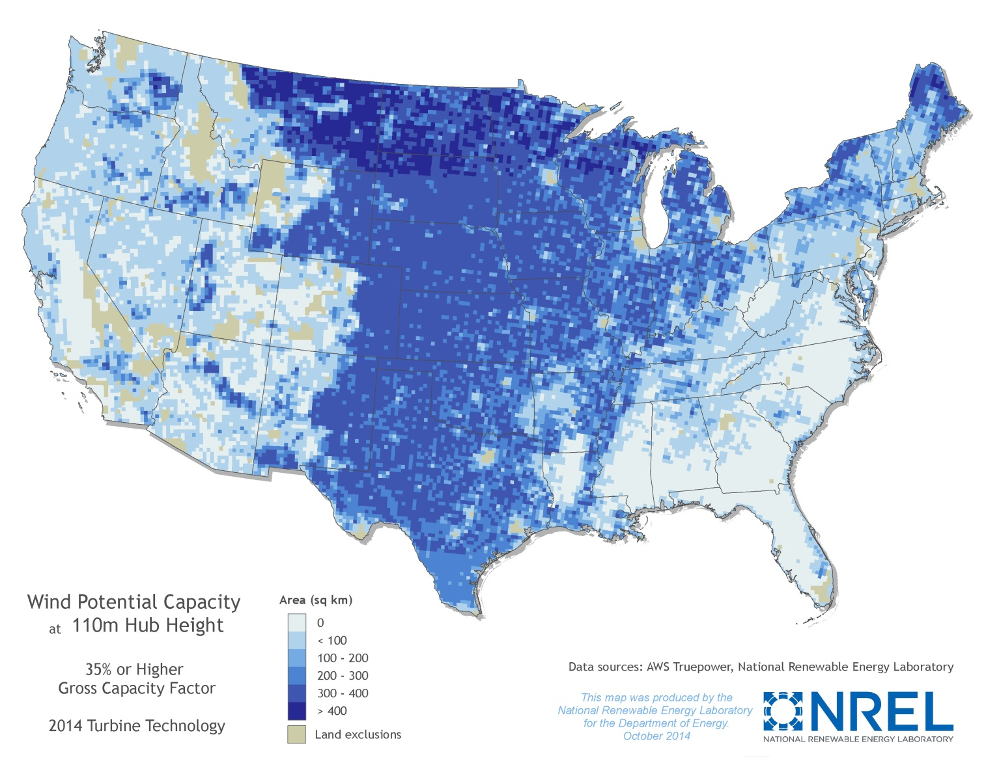
Today’s Technology
Estimates of Economically Viable Development
  Land area with a gross CF > 35% for IEC class appropriate GE turbine at an 110 m hub height: 1.3 million mi² above 35% GCF

Slide 36
New Opportunities for Wind
Larger rotor designs and a 140 m hub height provide the opportunity for wind power to expand to all U.S. states.
Next generation wind turbines will unlock additional wind power resource potential across over 1.1 million square miles, nearly tripling the amount of developable land area for wind when compared with 2008 turbine technology;

Slide 37
Expanded Regional Potential
New technology allows greatly expanded development potential in areas where limited potential was thought to exist

Slide 38
Wind Vision
http://energy.gov/eere/wind/wind-vision
Enabling Wind Power Nationwide
http://energy.gov/eere/wind/downloads/enabling-wind-power-nationwide

