Slide 1
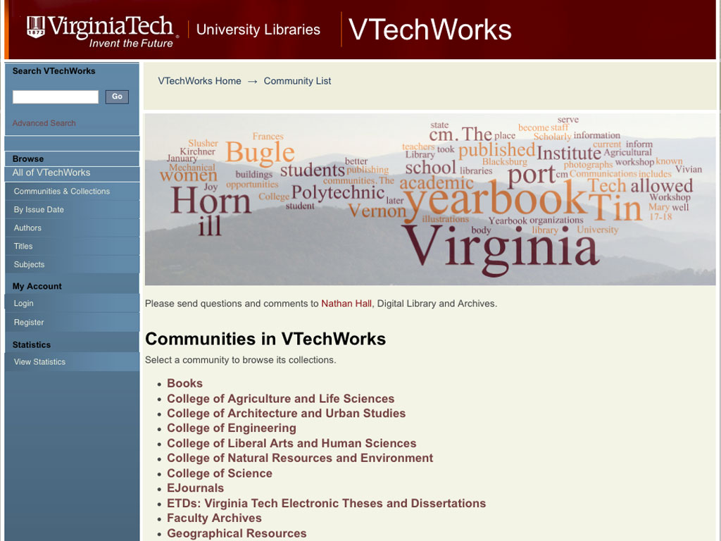
Notes:
Hi. I am Nathan Hall, VTechWorks Librarian. VTechWorks is Virginia Tech’s Institutional Repository. It was created in 2011 to preserve and provide access to the intellectual output and the historical record of the university.

Slide 2
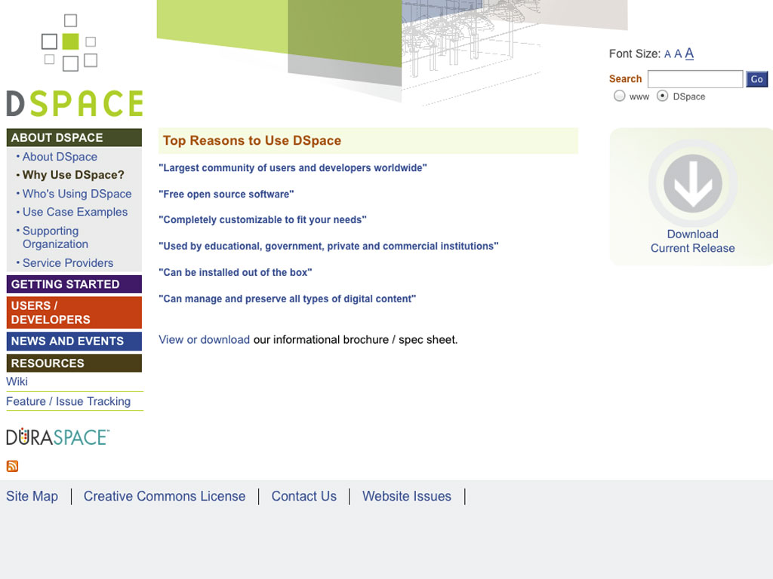
Notes:
We have chosen the Open Source software, DSpace, for the repository. It can be used “out of the box” but allows for substantial customization. With Open Source software, we benefit from free software and community support. We can also contribute by our use and development
to that community.

Slide 3
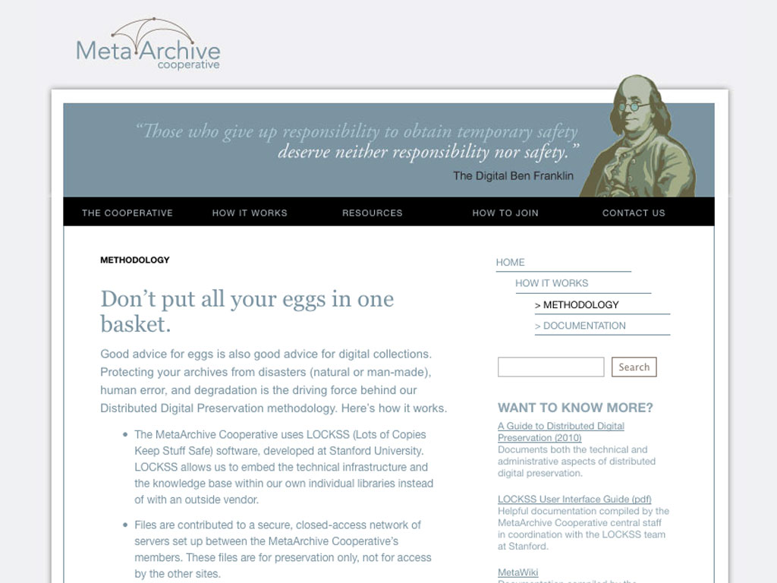
Notes:
The Virginia Tech Libraries is a member of the MetaArchive Cooperative. This cooperative uses the LOCKSS software to preserve members’ digital collections. VTechWorks content is replicated at 6 other institutions. LOCKSS software monitors the multiple copies for errors and can restore a copy, when necessary.

Slide 4
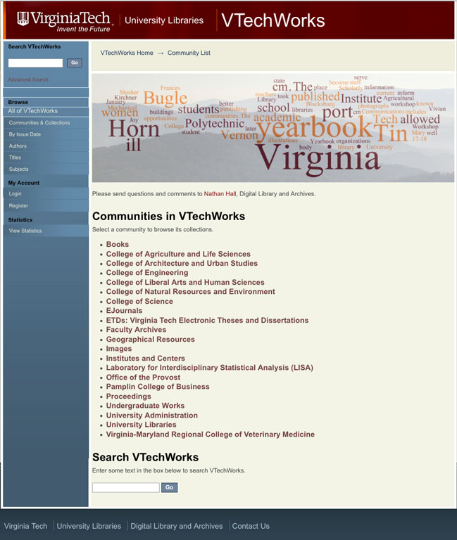
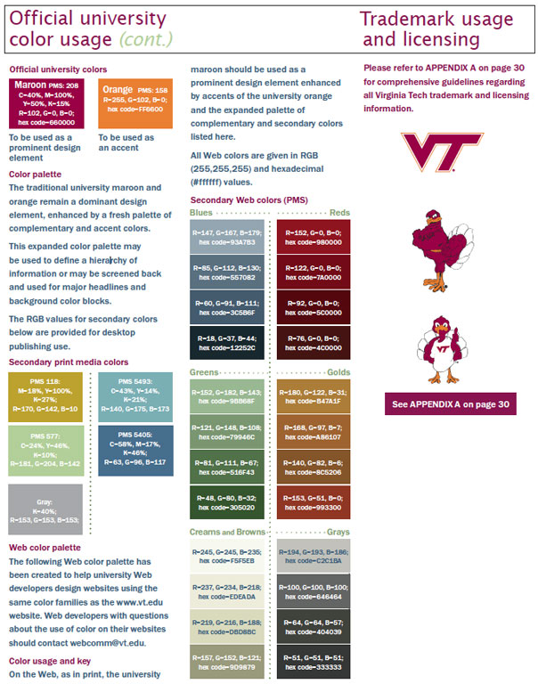
Notes:
We customized the VTechWorks website to follow the Virginia Tech templates. Besides the familiar color choices, we added navigation to other areas of the library and university. We continue to receive feedback about the interface and to refine it.

Slide 5
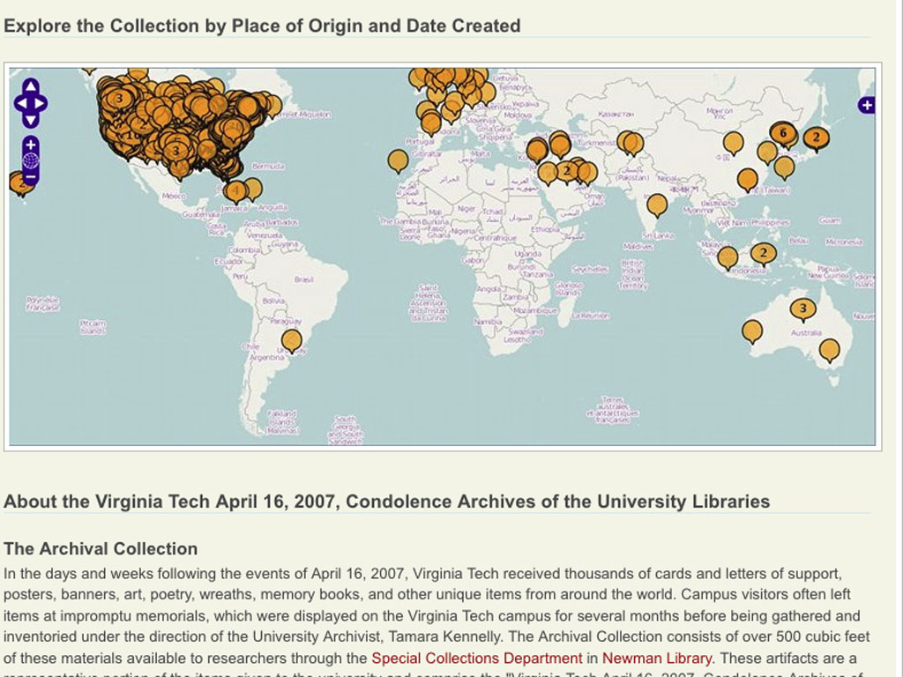
Notes:
We are enhancing VTechWorks functionality with a few specialized external services. One example is this map visualization in the 416 collection. Viewshare, Library of Congress’s visualization software, gets metadata from VTechWorks, displays it in a map or timeline view and links back to the records in VTechWorks.

Slide 6
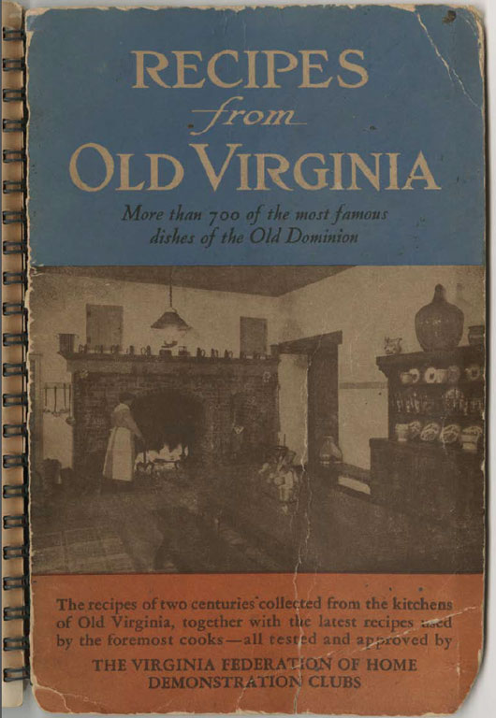
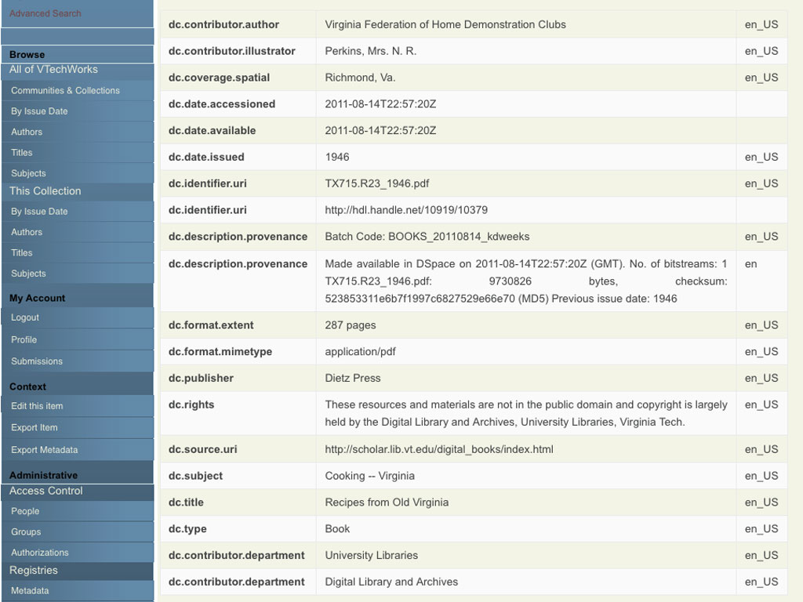
Dublin Core
Notes:
Recipes from Old Virginia is a rare book in the Culinary History Collection. VTechWorks stores the metadata in Dublin Core fields with a maximum of one level of qualification beyond basic Dublin Core. The metadata schema can be customized for each collection.

Slide 7
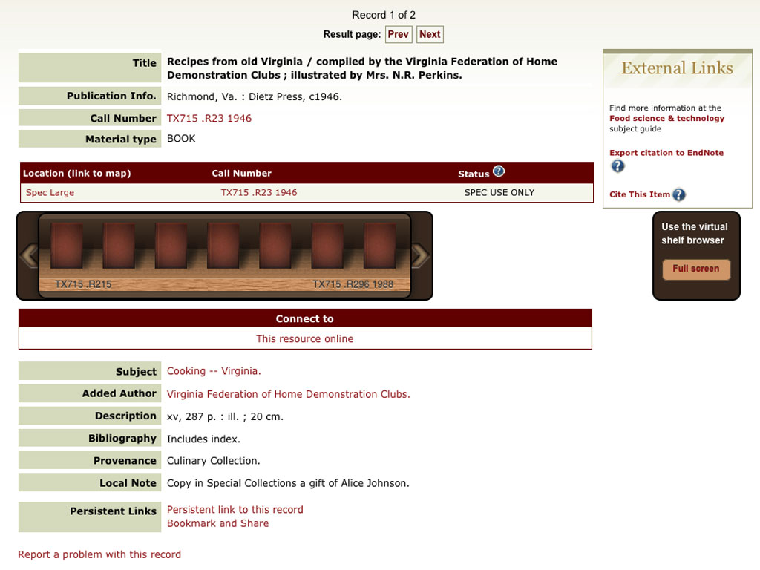
Notes:
This is the same book in Addison. DSpace is capable of exporting and importing metadata harvested by an OAI-PMH harvester. This would allow metadata to be imported to Addison.

Slide 8
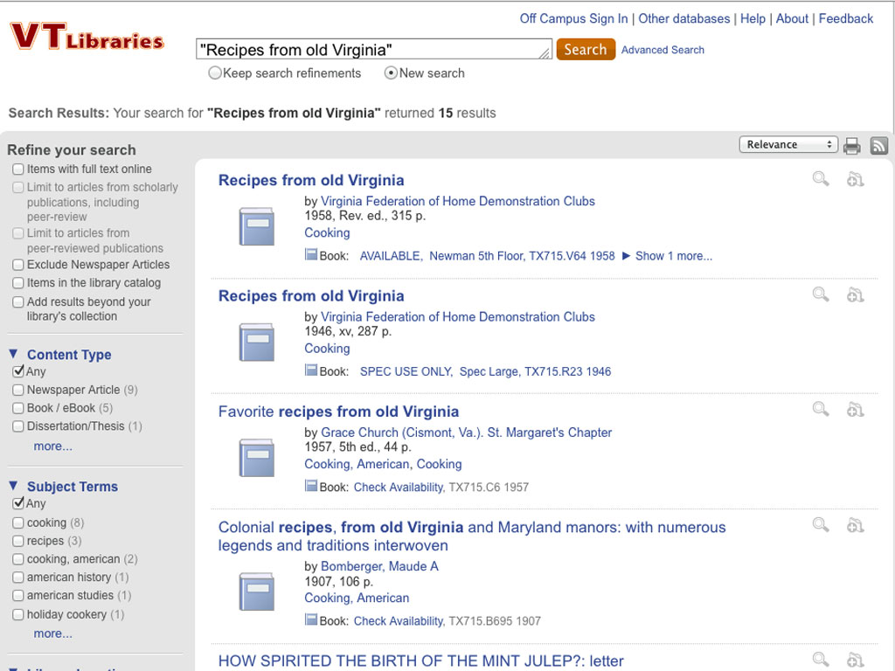
Notes:
This is the same book in Summon. Summon can also ingest metadata via OAI-PMH harvesting.

Slide 9
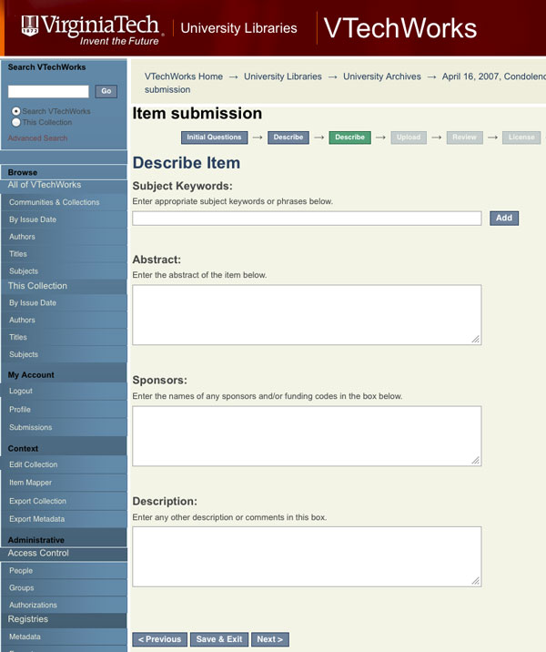
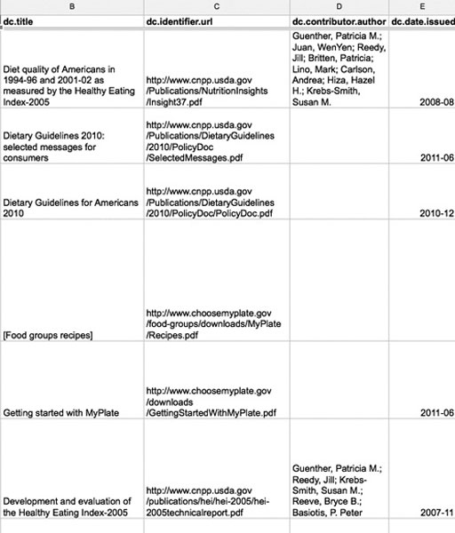
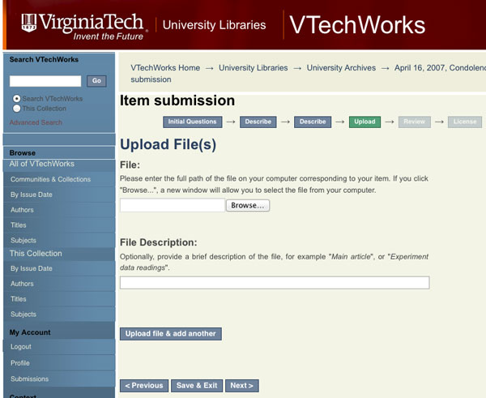
Item Submission
Online Form
Batch Upload
Notes:
VtechWorks allows for batch submission and on-line submission. Once a user has registered and has been given permission, they may upload metadata and files to the repository. A batch upload would be via a comma separated variable file typically from a spreadsheet.

Slide 10
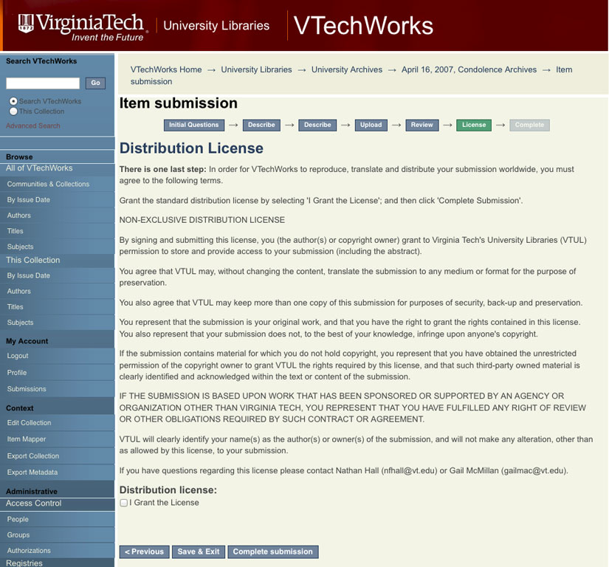
Notes:
A distribution license must be completed before submitting an item. We are developing another license for student presentations and coursework.

Slide 11
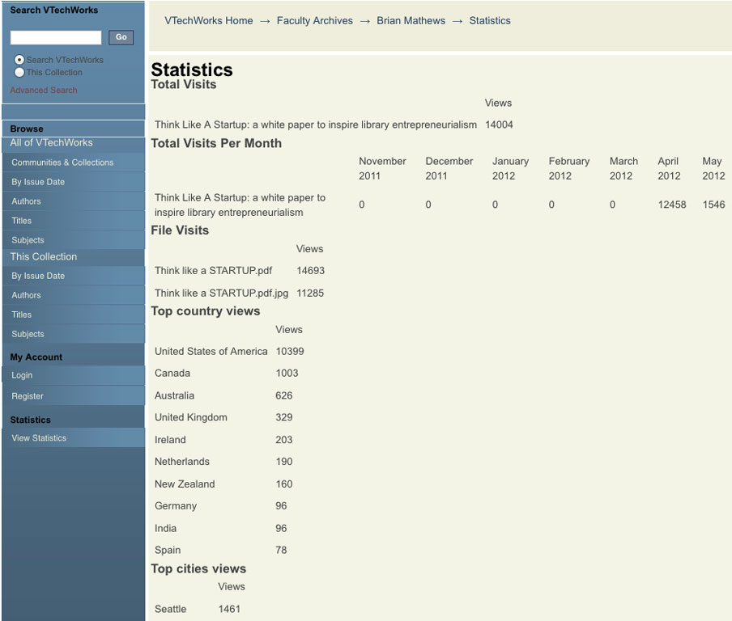
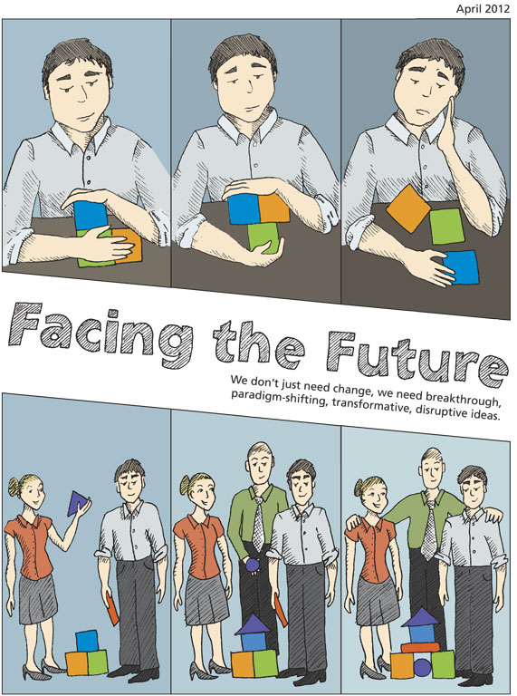
Notes:
VTechWorks provides access statistics for each item in the repository via the “View Statistics” item the left navigation bar. “Think Like a Startup” by Brian Mathews has been access 14,693 times in the past two months.

Slide 12
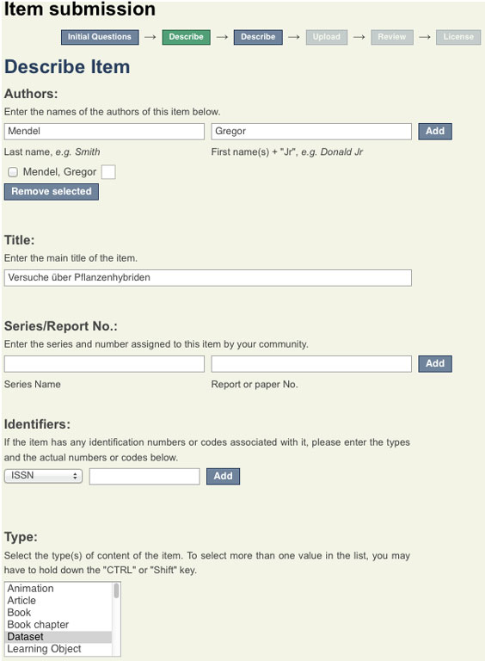

Data Sets
Notes:
Funding agencies such as NSF and NIH, now require data management plans for grant applications. We are developing VTechWorks to fulfill these requirements. Currently VTechWorks treats datasets as regular files. We are expanding VTechWorks to better visualize, manipulate, and exchange datasets with other repositories.

Slide 13
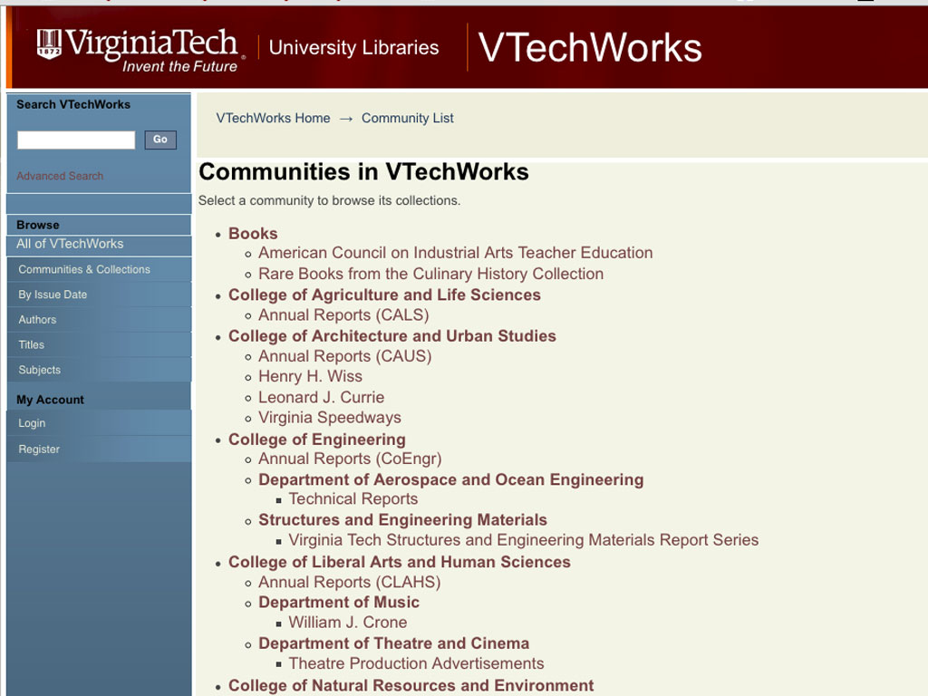
Notes:
VtechWorks, is organized at the top level into communities and sub communities. Within communities are collections. Items within a collection may be composed of multiple files.

Slide 14
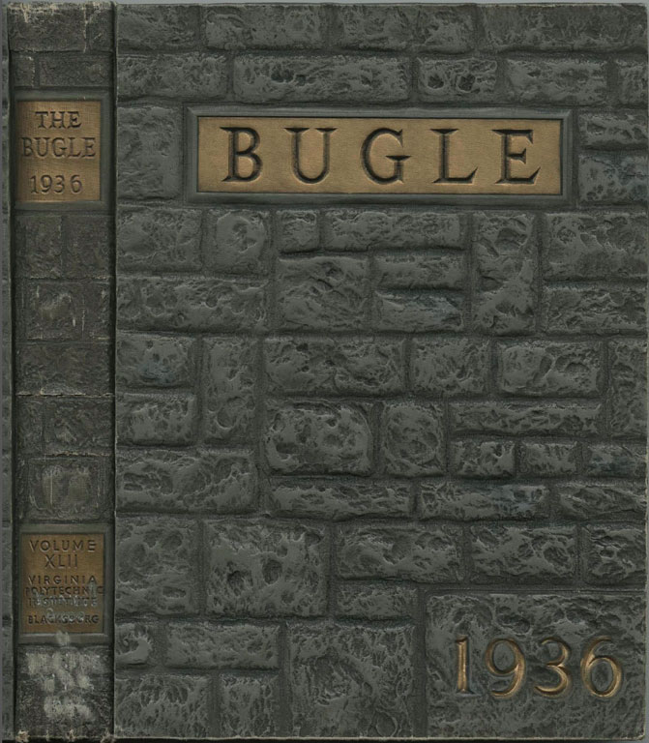
Notes:
VTechWorks contains items from Special Collections, such as this Bugle from 1936. Imaging and Archiving unit in Learning Technologies and Ryan Speer in Special Collections will be digitizing other material. Some will reside in VTechWorks.

Slide 15
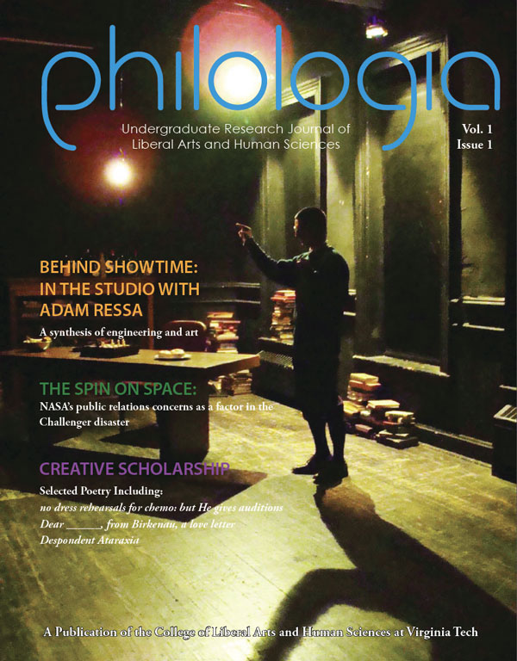
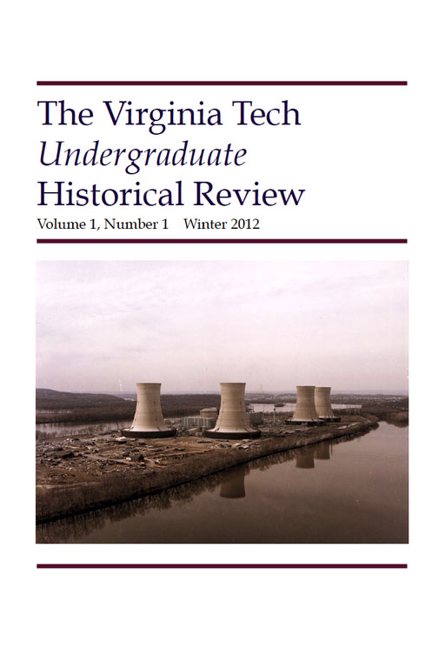
Notes:
Philologia and The Virginia Tech Undergraduate Historical Review are two undergraduate journals in VTechWorks. The Undergraduate Works community includes student projects, papers, and publications. The ETD collection currently includes a subset of unrestricted theses and dissertations.

Slide 16
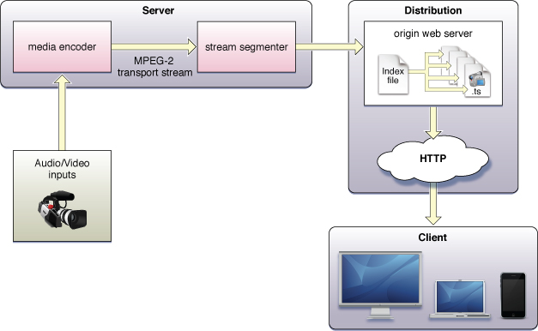
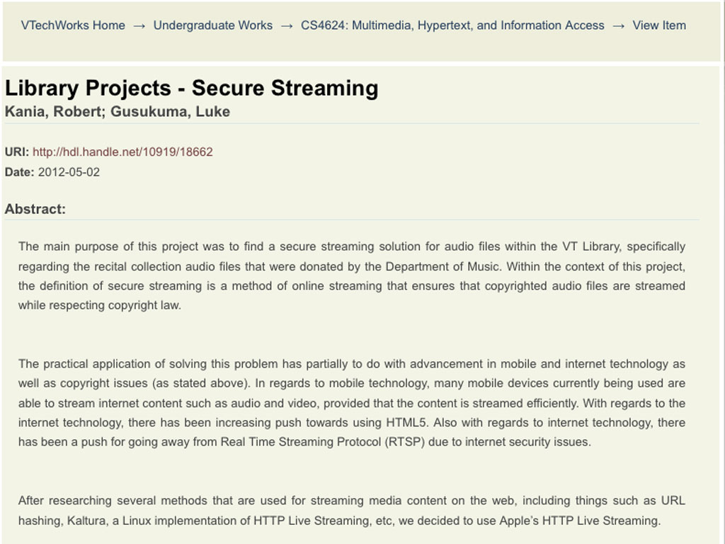
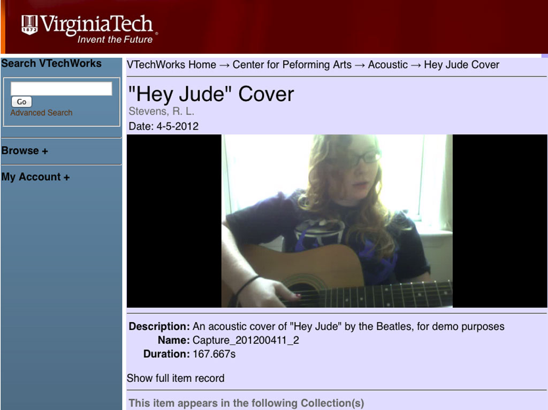
Student
Projects
For
VTechWorks
Notes:
Students works also include projects from the Computer Science class, “Multimedia, Hypertext, and Information Access.” One project was to develop a prototype secure streaming media player for VTechWorks. Michael Dunston, a Music professor had requested this to play recital recordings that he would like to submit to the repository.

Slide 17

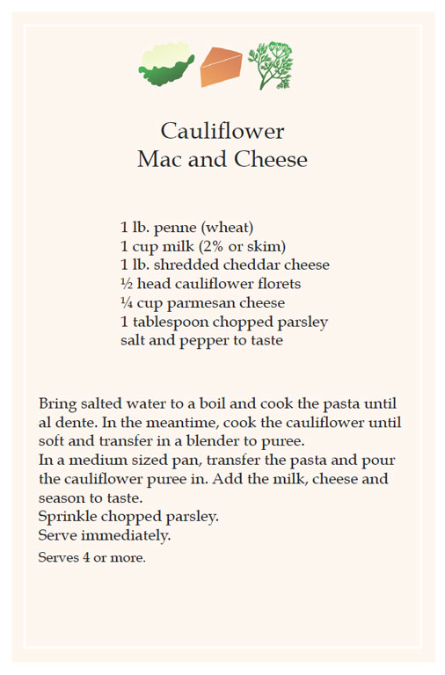
Notes:
The Nutrition, Obesity, and Health collection was developed across library departments by Rebecca Miller and Phillip Young. It contains a set of government websites on nutrition and health.

Slide 18
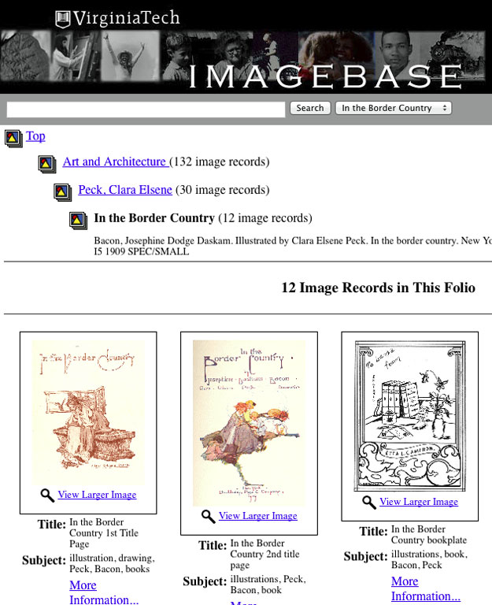
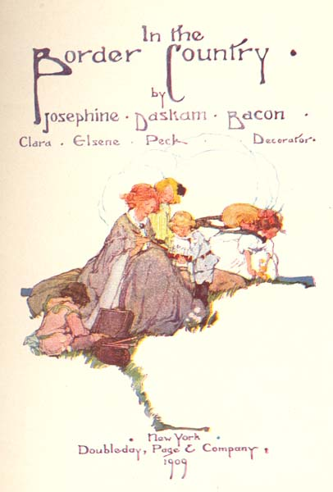
Notes:
We would like to migrate more DLA materials into VTechWorks. High on the list the image collection in ImageBase, which includes over 60,000 images. A challenge of this collection is preserving the metadata that currently exists in a hierarchical folio structure in the rather flat metadata structure of VTechWorks.

Slide 19
A Better User Interface
Functional
Easy
Nice
Notes:
We would also like make many improvements to the User Interface of VTechWorks. We want to make the repository easier to navigate and make resources more easily discoverable. We, especially, would like to enhance image display and add streaming media.

Slide 20
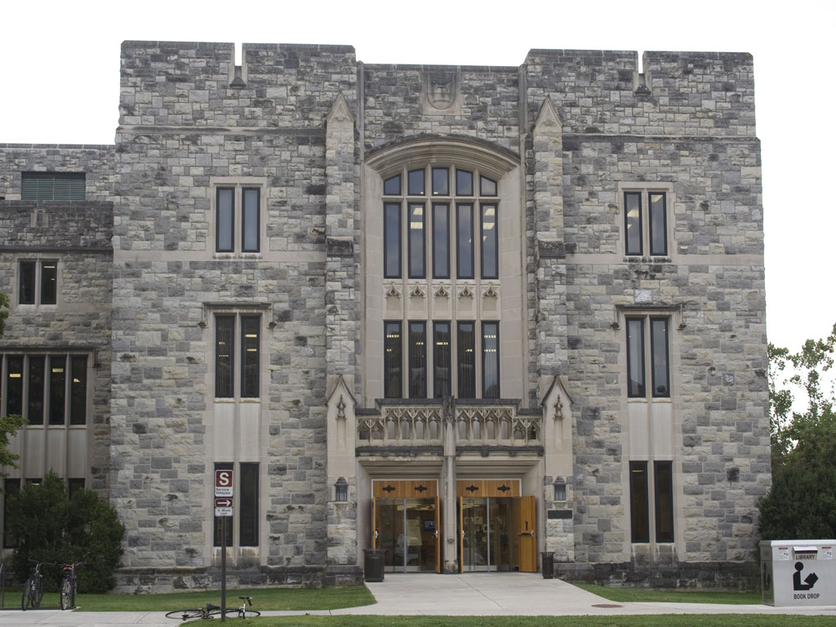
Notes:
Alumni and faculty expect to return to campus years from now and visit the Virginia Tech library. Now they can expect the same longevity for the content they submit to VTechWorks. And much of it will be available worldwide.

