Slide 1
Team 14: Facebook Data Breach
April Fitzpatrick, Akshay Goel, Leah Hamilton, Ramya Nandigam, Esther Robb
Final Presentation: 12/4/18
CS 4984/5984 Big Data Text Summarization - Taught by Dr. Edward Fox
Virginia Polytechnic Institute and State University
Blacksburg, VA 24061

Slide 2
Presentation Overview
Data and Tools
Pre-processing
  Data Cleaning
  Document Clustering
Summaries
  Template Summary
  Extractive Methods
  Abstractive Methods
Evaluation
Conclusions

Slide 3
Project Overview
Dataset: Facebook Data Breach
  Number of docs: 10829
Tools Used
  Scala
  ArchiveSpark
  PySpark
  Python
  NLTK
  Gensim
  SpaCy
  Pointer-Generator
  FastAbsRL

Slide 4
Data Cleaning Overview
Extract text from HTML tags
Preliminary bad document removal (404, Page not Found…)
6285 documents left
jusText [1] Cleaning
Re-encode into UTF-8
Final thorough dataset cleaning

Slide 5
Parameter
Based
Filtering
"twitter"
"recent news | whatshaking | current news feeds"
"objective news"
"landing page"
"401"
contains any of
title
Delete
"Money.us"
"Ti.me"
"Nakedcapitalism"
"reddit"
contains any of
originalurl
Delete
"as your browser does not support javascript you won't be able to use all the features of the website"
“trendolizer”
contains any of
text
Delete
does not contain
3887 documents left
“facebook”
is empty
originalurl
Delete

Slide 6
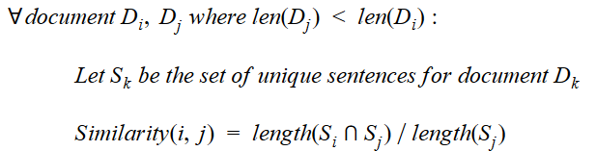
Removing Similar Documents
2922 documents left
Many documents were exact copies or similar to other documents
Sort all documents in descending order of size
Get similarity score for all document pairs (i,j) where j > i
If similarity is above threshold, delete document j
Threshold = 0.4

Slide 7
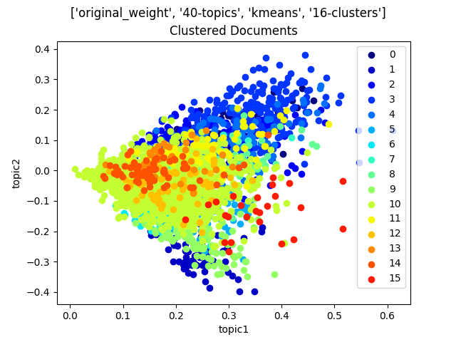
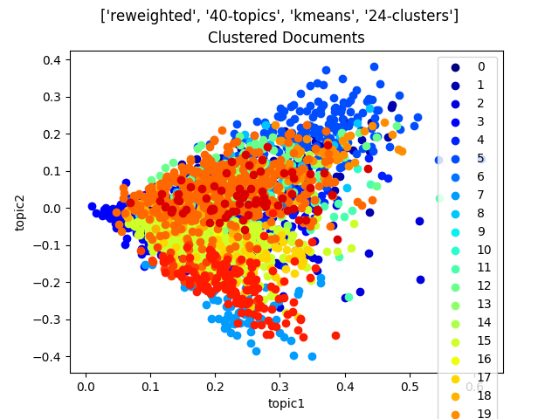
Clustering
Use LSA to do topic modeling
  Works better than LDA on our dataset
Cluster based on LSA topic weights
Observations:
  Low number of topics is better
  K-means works best

Slide 8
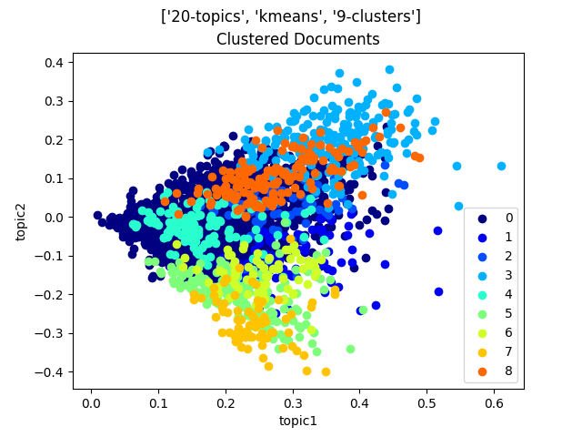
~~~~~~~~~~ Cluster 2 ~~~~~~~~~~~~
- federal trade commission investigation: is mark zuckerberg headed to facebook jail? #zuckerberg - tu.tv
- ftc launches probe into facebook privacy practices | mobile marketing magazine
- facebook stock slides after ftc launches data leak investigation
- ftc, eu, state attorneys general investigating facebook breach
~~~~~~~~~~ Cluster 8 ~~~~~~~~~~~~
- facebook ceo zuckerberg invited to testify by senate judiciary committee - the peninsula qatar
- facebooks discussions with congress signal mark zuckerberg will testify amid data-privacy scandal
- zuckerberg declines to testify in uk parliament - teletrader.com
- mark zuckerberg refuses to give evidence on facebook scandal | daily mail online
~~~~~~~~~~ Cluster 6 ~~~~~~~~~~~~
- facebook changing privacy controls as criticism escalates : the two-way : npr
- facebook changes layout to highlight privacy settings | wben 930am
- facebook announces overhaul of security and privacy settings - red team news
- facebook data scandal prompts redesign of settings, privacy pages | fox news
- facebook will make it easier for you to control your personal data | wired
~~~~~~~~~~ Cluster 3 ~~~~~~~~~~~~
- trump-linked firm collected data from 50 million facebook profiles -axios
- facebook suspends trump-linked data firm cambridge analytica (update: response)
- how trump consultants exploited the facebook data of millions | the seattle times
- facebook bans trump campaign's data analytics firm, cambridge analytica | breitbart
- trump-linked firm obtained data of 50m facebook users - cnet

Slide 9
Named Entity Recognition (NER)
Used SpaCy’s [2] Named Entity Recognizer
Capitalization apparently necessary for tagging of names
Entity Type | Named Entity
‘DATE’ | ‘2016’
‘QUANTITY’ | ‘as many as 50 million’
‘MONEY’ | ‘billions of dollars’

Slide 10
Template Summary
Used spaCy NER for dates and names.
Used spaCy word relations and parse trees for phrases.
Used num2words [3], word2number [4], and regular expressions for numbers:
\d+(?=[ ,-.]{1,2}([^ .,:;]+? )?(?:user|profile|customer)s?(?:(?: of )([^ .,:;]+?)[ .,:;])?)
In 2014, the data of 50000000 users of Facebook was compromised. Information from the accounts friends profiles as well as updates, likes, and in some cases private messages was illegally obtained by <ATTACKER>. The incident was made public by <WHISTLEBLOWER> on <DATE OF ANNOUNCEMENT>. Facebook has said <COMPANY STATEMENT> and will <CHANGES EFFECTED>.

Slide 11
Extractive Summaries
Two methods:
Both use
  Gensim’s [5] TextRank for summarizing
  difflib SequenceMatcher [6] for finding similar sentences
Summary on all articles in data set:
Summary of only certain clusters:
Summaries of each article (concatenated)
cleaned.json
Extractive Summarizer
Extractive Summarizer
Remove sentences
>50% similar
Final Summary
Summaries of each cluster (concatenated)
clusters. json
Select Best Clusters
Extractive Summarizer
Extractive Summarizer
Remove sentences
>50% similar
Final Summary

Slide 12
Extractive Summaries
Clustered approach was better
  Easier to customize important information
Also broke it up into two paragraphs
  Each paragraph was a different topic of clusters
  Got us an even broader range of topics covered
Clusters chosen:
Paragraph 1: Hack/Security Details | Paragraph 2: Effects of Hack
5 - actions that facebook has taken to improve privacy | 11 - zuck testifies before us congress (no uk information)
8 - ftc investigates fb | 14 - facebook stock falls
27 - zuckerberg's response to the whole fb crisis | 30 - zuck testifies before us congress
28 - christopher wylie, the whistleblower | 35 - FB under pressure, value falls
33 - actions that facebook has taken to improve privacy

Slide 13
Extractive Summary (Paragraph 1)
Tom Pahl, the acting director of the Federal Trade Commission’s Consumer Protection Division, wrote in a statement Monday morning that the agency is investigating Facebook’s privacy practices a week after news broke that the Trump campaign’s political-data firm, Cambridge Analytica, inappropriately obtained data on more than 50 million Facebook users and then allegedly lied about deleting it. Facebook is attempting to do a face saving act following severe criticisms against it so that it is able to maintain its user base and therefore the flow of advertisements and advertisers and investor. The largest social media platform in the world is facing close scrutiny of its privacy policies and actions both in the U.S. and the U.K. Last week there were allegations against Facebook that it did nothing to prevent the use of personal data of approximately 50 million Americans by British consultancy Cambridge Analytica which allegedly had misused the data during the 2016 Presidential elections in the U.S. The firm was appointed to assist President Donald Trump during the campaign. This weekend, a man named Christopher Wylie spoke with the New York Times about a consulting company he founded called Cambridge Analytica that, according to him, developed Facebook ads for the Trump campaign with the help of Steve Bannon and data stolen from the pages of 50 million Facebook users (including personal details, rather than passwords or private information).

Slide 14
Extractive Summary (Paragraph 2)
Facebook ended the day down nearly 7 percent, to US$172.56 making it the worst performing stock in the S&P 500, as the company sought to stem the damage from media reports that Cambridge Analytica, the U.S. data-mining arm of a Britain-based research firm, had improperly accessed personal details from nearly 50 million Facebook users to help Trump campaign advisers target political ads during the 2016 election. Calls for probe of misappropriation of the private information of tens of millions of Americans. Former Cambridge Analytica employee Chris Wylie said the company used information to build psychological profiles so voters could be targeted with ads. Wylie criticized Facebook for facilitating the process, saying it should have made more inquiries when they started seeing the records pulled a collection of powerful U.S. senators are demanding that Facebook explain how a third-party firm with ties to the Trump campaign was able to gain access to data on 50 million of its users. Washington revelations that a political data firm may have gained access to the personal information of as many as 50 million Facebook users drew new bipartisan calls on Capitol Hill Monday for Facebook CEO Mark Zuckerberg and the heads of other social media companies to answer questions from Congress.

Slide 15
Abstractive Summaries
Three Methods:
Pointer-Generator Network (PGN) or FastAbsRL as abstractive summarizer
Different sources of input (extractive summary/individual articles)
Method A (PGN)
Summaries of each cluster (concatenated)
clusters. json
Extractive Summarizer
Abstractive Summarizer
Final Summary
Method B (PGN and FastAbsRL)
Summaries of each article
cleaned. json
Abstractive Summarizer
Concatenate and Filter by Cluster
Extractive Summarizer
Final Summary

Slide 16
Abstractive Summaries
PGN (Method B) [7]:
  Many sentences identical to extractive summary
  Slightly less repetitive and shorter than pure extractive summary
  Some issues with pronouns/clauses (e.g., “The company” instead of “Facebook”)
  Some additional names and information not present in extractive summary
  Coherency of second paragraph is low
FastAbsRL [8]:
  Highly abstractive
  Some issues with noun repetition (“Facebook, Facebook and Facebook…”)
  Some issues creating coherent abstractive sentences

Slide 17
PGN Abstractive Summary (Paragraph 1)
The company announced a suite of new, more intuitive privacy controls Wednesday morning, including a way to download and delete data, a redesigned settings menu, and additional shortcuts for controlling private information. Tom Pahl, the acting director of the Federal Trade Commission’s Consumer Protection Division, wrote in a statement Monday morning that the agency is investigating Facebook’s privacy practices a week after news broke that the Trump campaign’s political-data firm, Cambridge Analytica, inappropriately obtained data on more than 50 million Facebook users and then allegedly lied about deleting it. Facebook CEO Mark Zuckerberg apologized on Wednesday for the social media website's role in what he previously called the “Cambridge Analytica Situation” wherein the research firm allegedly accessed 50 million Facebook user profiles improperly. Christopher Wylie, who previously revealed that consultancy Cambridge Analytica had accessed the data of 50 million Facebook users to build voter profiles on behalf of Donald Trump’s campaign, said AggregateIQ (AIQ) had built software called Ripon to profile voters. Facebook has announced new controls, privacy shortcuts, and tools to delete facebook data but said these were in the works before the cambridge analytica scandal exploded.

Slide 18
PGN Abstractive Summary (Paragraph 2)
The invitation asking Zuckerberg to answer questions at an April 10 hearing comes as the Federal Trade Commission confirmed it’s investigating Facebook’s privacy practices after reports the company allowed political consulting firm Cambridge Analytica to harvest 50 million users’ data. Analyst: “the risk here is that Facebook is paramount to the future of this company.” Facebook shares 6 percent and were on track for their worst day in more than three years on reports that a political consultancy worked on president Donald Trump’s campaign gained inappropriate access to data on more than 50 million users. Lawmakers in the United States, Britain, and Europe have called for investigations into media reports that political analytics firm Cambridge Analytica had harvested the private data on more than 50 million Facebook users to support Trump's 2016 presidential election campaign.

Slide 19
ROUGE Evaluation Scores
Summary Type | ROUGE-1 | ROUGE-2 | ROUGE-L | ROUGE-SU4
Cluster-based extractive | 0.06557 | 0 | 0.06557 | 0.01198
Extractive | 0.10714 | 0 | 0.10714 | 0.01316
PGN Method A | 0.10169 | 0 | 0.0678 | 0.01863
PGN Method B | 0.1 | 0 | 0.1 | 0.01829
FastAbsRL | 0.09091 | 0 | 0.09091 | 0.01099

Slide 20
Conclusion & Lessons Learned
Cluster-based extractive summary was the most useful summary we produced
Importance of data cleaning
Should’ve started on clustering and big summaries earlier

Slide 21
Future Work
Refine clustering results
Finish information extraction for template
Try other abstractive algorithms or workflows
Use summarization techniques on the Solar Eclipse dataset

Slide 22
Acknowledgements
This project would not have been possible without the NSF-funded (NSF: IIS-1619028) Global Event and Trend Archive Research (GETAR) project used to create our collections.
We would like to thank first and foremost, Dr. Edward Fox (fox@vt.edu).
We would also like to thank the Teaching Assistant for this course, Liuqing Li (liuqing@vt.edu).
We would like to thank our fellow classmates for the sharing of their ideas, workflows, and in some cases code.
And, finally, all of the presenters and consultants who took time to help us as well:
Xuan Zhang (xuancs@vt.edu)
Srijith Rajamohan (srijithr@vt.edu)
Michael Horning (mhorning@vt.edu)
Matthew Ritzinger (mritzing@vt.edu)
Ziqian Song (ziqian@vt.edu)

Slide 23
References
[1] M. Belica. “jusText heuristic based boilerplate removal tool,” GitHub, 5-Mar-2017. [Online]. Available: https://github.com/miso-belica/jusText. Commit ad05130df2ca883f291693353f9d86e20fe94a4e. [Accessed: 28-Nov-2018].
[2] Explosion AI. “spaCy v2.0,” GitHub, 2018. [Online]. Available: https://spacy.io/. [Accessed: 28-Nov-2018].
[3] V. Dupras, “num2words,” GitHub, 17-Nov-2018. [Online]. Available: https://github.com/savoirfairelinux/num2words. Commit 58613e0a18ad51e5372b22b59e2d304e958a3ec3. [Accessed: 28-Nov-2018].
[4] A. Nagpal, “Word2Number,” GitHub, 27-Jun-2017. [Online]. Available: https://github.com/akshaynagpal/w2n. Commit 33aac8a1d71ef1dffd4435fe6e9f998154bcb051. [Accessed: 28-Nov-2018].
[5] R. Řehůřek , “Gensim: topic modelling for humans,” RaRe Consulting, 20-Sep-2018. [Online]. Available: https://radimrehurek.com/gensim/summarization/summariser.html. [Accessed: 28-Nov-2018].

Slide 24
References
[6] Python Software Foundation. “7.4. difflib - Helpers for computing deltas,” Python 2.7.15 documentation, 08-Nov-2018. [Online]. Available: https://docs.python.org/2/library/difflib.html. [Accessed: 28-Nov-2018].
[7] A. See, “abisee/pointer-generator,” GitHub, 09-Jul-2018. [Online]. Available: https://github.com/abisee/pointer-generator. Commit a7317f573d01b944c31a76bde7218bcfc890ef6a. [Accessed: 28-Nov-2018].
[8] Y. C. Chen, “ChenRocks/fast_abs_rl,” GitHub, 06-Aug-2018. [Online]. Available: https://github.com/ChenRocks/fast_abs_rl. Commit aebf539107caba5be35720f5d1f9f98989a069e8. [Accessed: 28-Nov-2018].

