Slide 1
Project: Tourism Websites
Aditya Agarwal, Sparsh Bansal
CS 4624: Multimedia, Hypertext, and Information Access
Instructor: Dr. Edward A. Fox
Virginia Tech
Blacksburg, VA 24061
Date: December 15, 2021

Slide 2
Outline
Overview
Timeline
Implementation
Deliverables
Final Submission
Limitations
Lessons Learnt
Ideas for the future

Slide 3

Overview:
Establish a relationship between the meta tags and the website at different points in time, and check the effectiveness of each of the meta tags by studying their addition/removal.
Set up Visualization component (Plotly Dash) to represent the presence of keywords graphically.
Check website traffic at different points in time (after 01/2018) using the data collected from meta tag analysis

Slide 4
Decide the aspect of the project to work on and get approval from client
Document meta tags and use Alexa website tool for analysing website traffic
Arrange all keywords and deliverables from collected data and start visualising them
September 14
September 28
October 10
October 22
November 1
Write Python code and API support to extract meta tags
Plot the increasing or decreasing activity of each website.

Slide 5
Complete work on Interim report.
Run all the collected data through the API and the visualization tool.
Complete final report and document the code.
November 11
November 16
November 22
November 30
December 8
Implement Plotly visualization tool in Python
Analyse the data and generate trends.

Slide 6
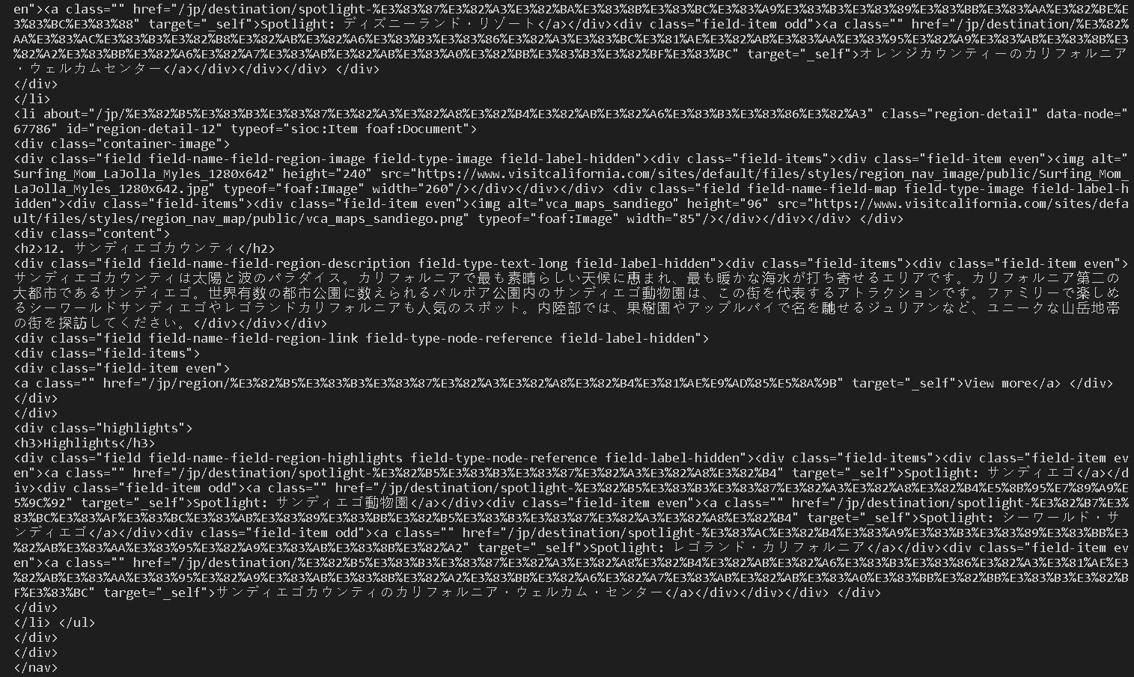
Implementation
The raw data that we started with was of the form .snappy.parquet.
This data was processed and converted to readable form by the students who worked on it in last semester.

Slide 7
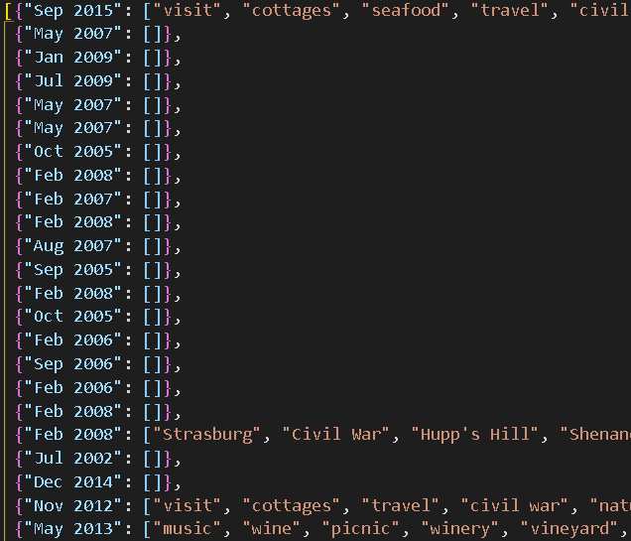
This extraction script goes through the raw data and extracts all the keywords and converts the data into the JSON format.

Slide 8
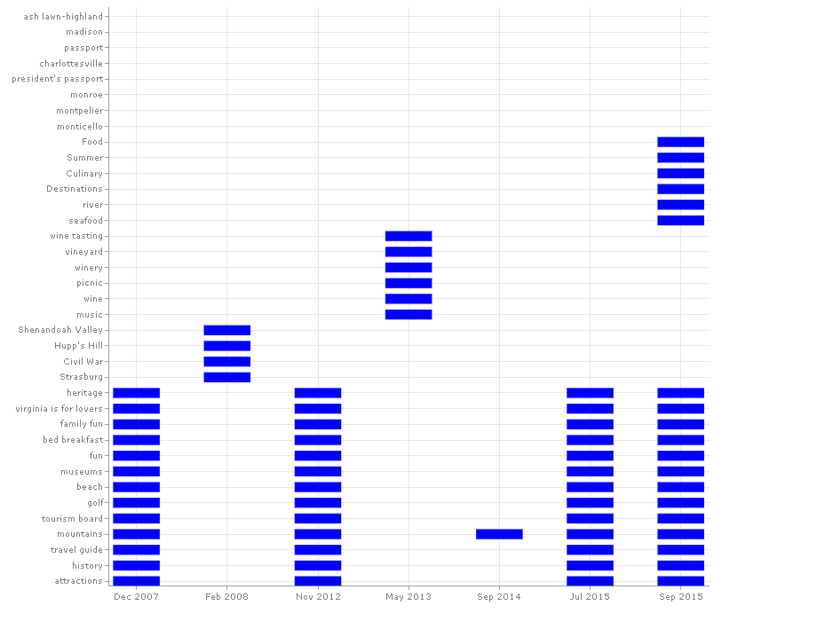
Final Submission
Our final submission is - Visual representation of the Keyword matrix that was being used at that time
- Website ranking variations on a monthly basis.

Slide 9
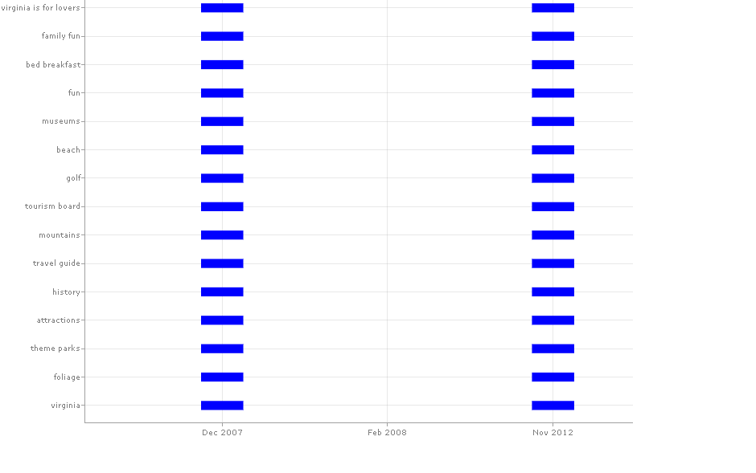
Zoomed in version of the Graph shown in previous slide

Slide 10
Deliverables
Extract all the keywords in a chronological order from the raw Internet Archive files.
Store data for each of the states individually in a JSON file. This adds to the productivity of the code and makes it run faster.
Plot the keywords to time graphs for each of the states and identify trends in addition/ removal of keywords.

Slide 11
Challenges we Faced
Given the high volume of data, downloading all the data would often end up with corrupted files.
The API we used only had ranking history for websites for the past 4 years. This highly limited how we could use the ranking data and the changes in the keyword matrix to identify some strong keywords and trends.
Plotly is a very vast library and we could not explore and implement all the features as effectively as we planned to do.

Slide 12
Lessons Learnt
During the course of this project, and under the guidance of Prof. Zach and Prof. Fox, we learned about the concepts of Search Engine Optimization techniques using keywords and about the Internet Archives.
We got a good working knowledge of Python and API consumption, which we did not have a lot of experience with.
We also learned how to use external libraries and use the Visualization tool called Plotly Dash.

Slide 13
Idea for Future
Can analyse the keyword usage for any website given the past data.
Future teams should be able to take our codebase and apply that to extracted information from other state’s Parquet files in order to help with researching state tourism efforts.
By changing the Python script, we can extract images, website description, social media links, and tool used for analysis. Visualization can proceed accordingly.

Slide 14
Acknowledgement
Dr. Florian Zach, our client.
Dr. Edward Fox, our Professor and mentor.

Slide 15
Reference
Keyword Research, competitor analysis, & website ranking: Alexa. Alexa.com. (2020, October 7). Retrieved November 9, 2021, from https://www.alexa.com/.
Dash documentation & user guide. Plotly. (2021). Retrieved November 9, 2021, from https://dash.plotly.com/.
Hardwick, Joshua. Meta Tags for SEO: A Simple Guide for Beginners, 29 Sept. 2020, Retrieved December 15, 2021, from, ahrefs.com/blog/seo-meta-tags/.

Slide 16
Questions?

