Slide 1

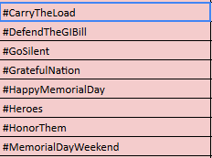




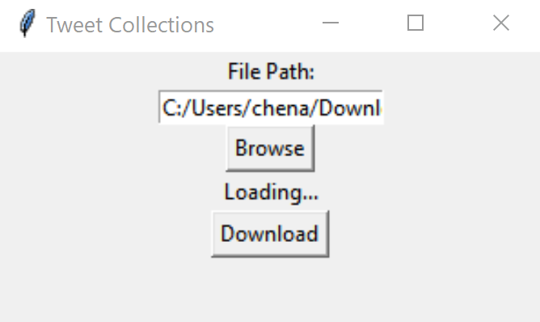
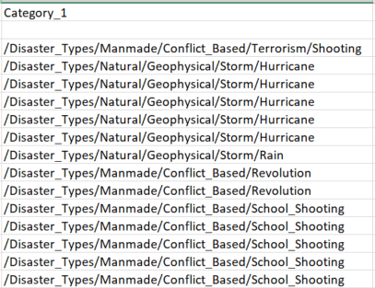
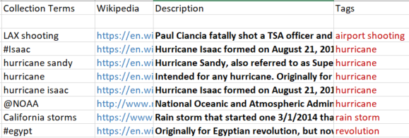
Tweet Collections
Kirk Chenault, Chris Keener, Brandon Chang, Joe Widrig
OVERVIEW:
PROBLEM:
Excel sheet contains no metadata
CONSTRAINTS:
Use Twitter collection input for data
Use ontology input for categories
SOLUTION:
Use Python to pull Wikipedia articles
Filter irrelevant results
Fill out empty cells in excel
Return solution as new file
Figure 3: Example Hashtags
HEURISTICS:
Pre-existing Categories
Date Relevance
Term Frequency
Parsing Hashtags
Improving Source Detection
Figure 2: Front end for our tool
Simple interface
Input excel sheet
Output generated excel sheet
Figure 1: Snippet of results
Figure 4: Category Structure
https://en.wikipedia.org/wiki/twitter
https://en.wikipedia.org/wiki/Microsoft_Excel
https://en.wikipedia.org/wiki/python
https://en.wikipedia.org/wiki/
http://zewaren.net/site/node/160
http://ecocar3.org/vthevt/about-us/

Slide 2

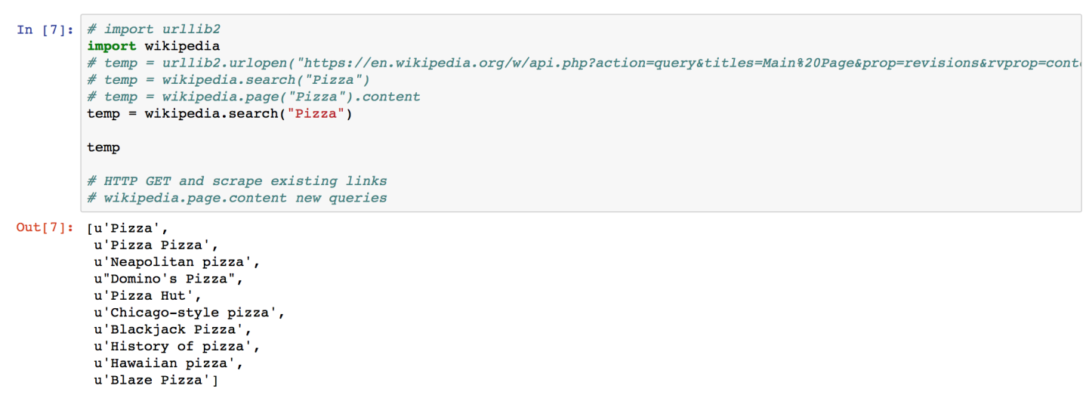
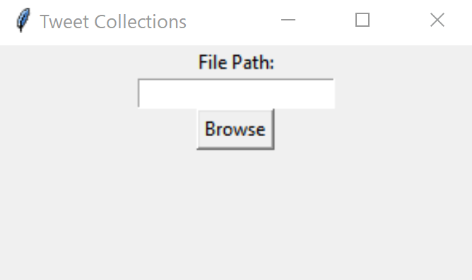
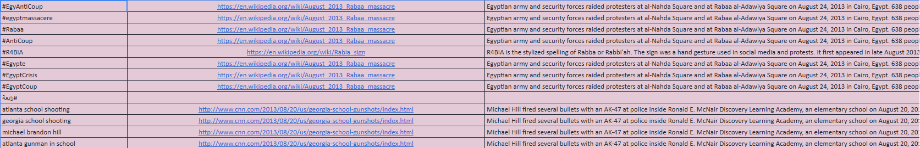
Tweet Collections
Kirk Chenault, Chris Keener, Brandon Chang, Joe Widrig
PROBLEM:
Excel sheet contains no metadata
CONSTRAINTS:
Use Twitter collection input for data
Use ontology input for categories
SOLUTION:
Use Python to pull Wikipedia articles
Filter irrelevant results
Fill out empty cells in excel
Return solution as new file
Problems and future work
Asdfasdfasdfasdfasdfasdfsdf
Asdfasdfasdfasdfasdfasfasdfasfas
Asdfasdfasdffasfdasdf
Figure 2
Simple interface
Input excel sheet
Figure 7
Problems and future work
Asdfasdfasdfasdfasdfasdfsdf
Asdfasdfasdfasdfasdfasfasdfasfas
Asdfasdfasdffasfdasdf
sdfasdfasdfasfasdfasfas
Asdfasdfasdffasfdasdf
sdfasdfasdfasfasdfasfas
Asdfasdfasdffasfdasdf
sdfasdfasdfasfasdfasfas
Asdfasdfasdffasfdasdfsdfasdfasdfasfasdfasfas
Asdfasdfasdffasfdasdf
Figure 3
Output generated excel sheet
Figure 1
https://en.wikipedia.org/wiki/twitter
https://en.wikipedia.org/wiki/python
https://en.wikipedia.org/wiki/
http://zewaren.net/site/node/160
https://en.wikipedia.org/wiki/Microsoft_Excel

Slide 3
Tweet Collections
Kirk Chenault, Chris Keener, Brandon Chang, Joe Widrig
PROBLEM:
Excel sheet contains no metadata
CONSTRAINTS:
Use Twitter collection input for data
Use ontology input for categories
SOLUTION:
Use Python to pull Wikipedia articles
Filter irrelevant results
Fill out empty cells in excel
Return solution as new file
Problems and future work
Asdfasdfasdfasdfasdfasdfsdf
Asdfasdfasdfasdfasdfasfasdfasfas
Asdfasdfasdffasfdasdf
Figure 2
Simple interface
Input excel sheet
Figure 7
Problems and future work
Asdfasdfasdfasdfasdfasdfsdf
Asdfasdfasdfasdfasdfasfasdfasfas
Asdfasdfasdffasfdasdf
sdfasdfasdfasfasdfasfas
Asdfasdfasdffasfdasdf
sdfasdfasdfasfasdfasfas
Asdfasdfasdffasfdasdf
sdfasdfasdfasfasdfasfas
Asdfasdfasdffasfdasdfsdfasdfasdfasfasdfasfas
Asdfasdfasdffasfdasdf
Figure 3
Output generated excel sheet
Figure 1
https://en.wikipedia.org/wiki/twitter
https://en.wikipedia.org/wiki/python
https://en.wikipedia.org/wiki/
http://zewaren.net/site/node/160
https://en.wikipedia.org/wiki/Microsoft_Excel

