Slide 1
Power and Cost Predictions for an Offshore Wind-Wave-Storage System
NAWEA 2015 Symposium
June 8, 2015
Jocelyn Kluger
PhD Candidate
Massachusetts Institute of Technology
Thesis advisors: Professors Alex Slocum and Themis Sapsis

Slide 2
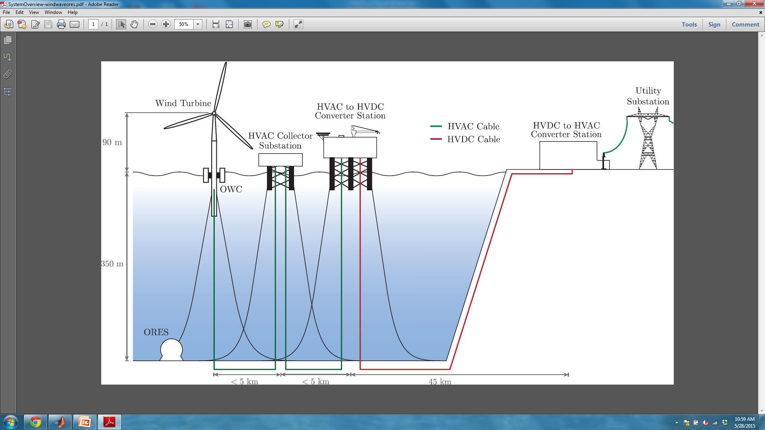
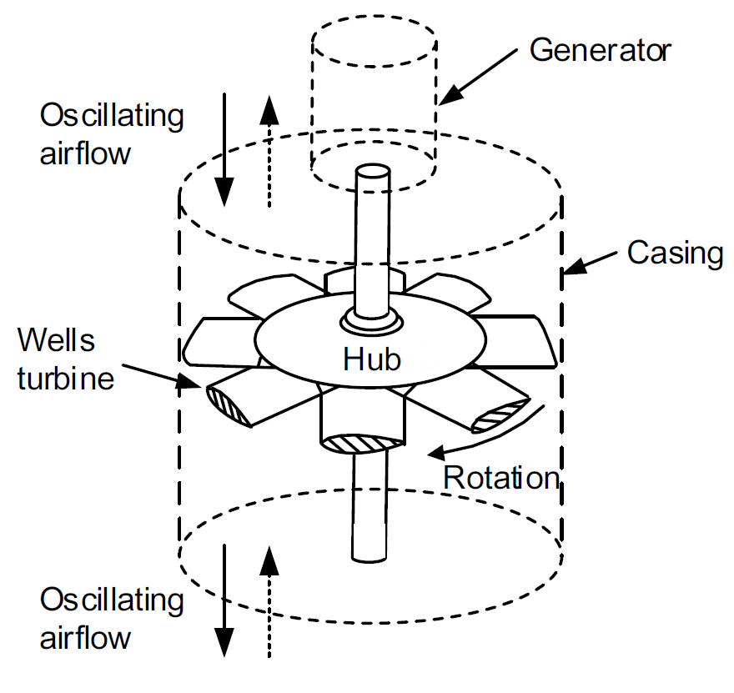
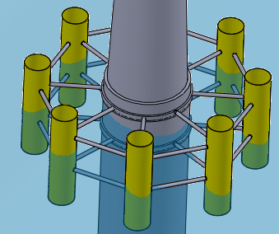
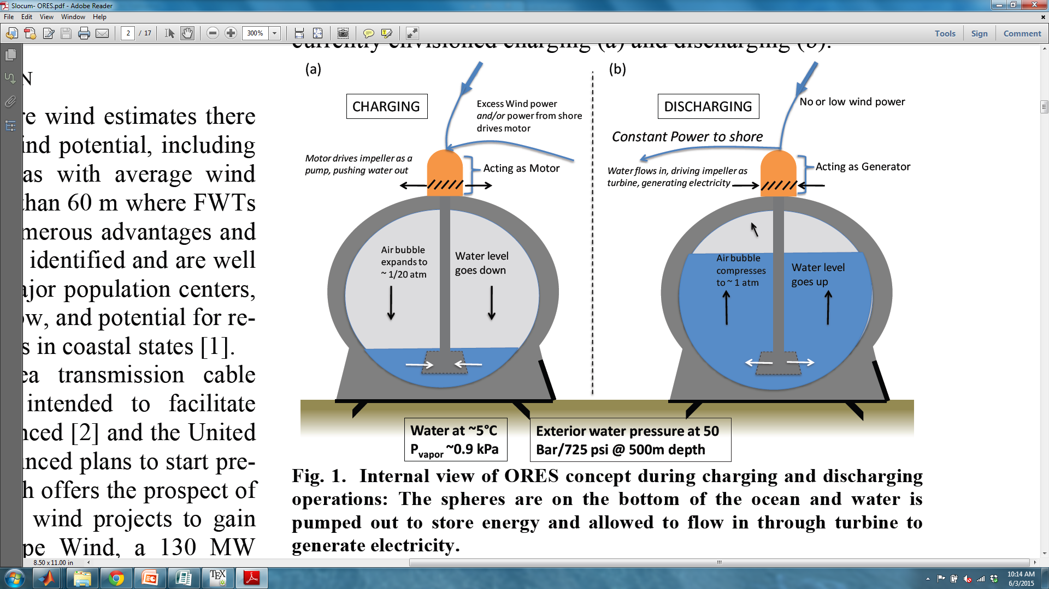
Introduction
Oscillating Water
Column array
Wells turbine
rotates in one direction independent of water flow
500 MW offshore wind farm
Goals
Minimize cost, stress of OWC
Minimize CEEP of nearby gas plant
Ocean
Renewable
Energy
Storage
Figure from: S. Okuhara et al., J. Fluid Dynamics 2013
Figure by M. Haji
Notes:
Main point: How can an offshore wind turbine structure be enhanced.
This presentation focuses on the wave power, with considerations for the energy supply smoothing effect of the wave-wind-storage system combined at the end.
emphasize: FIRST ORDER ESTIMATES + explore design space
The focus of my PhD is on optimizing the LCOE of a wave device that could be attached to an offshore structure.
Reduced wave cost.
Focus on offshore system: 500 MW wind farm near Mendocino, CA, with wave power and ORES.
Motivation: Reduced cost when combine systems (wave and ORES→ more constant “higher quality” power flow in lines. Share mooring and transmission line cost)

Slide 3
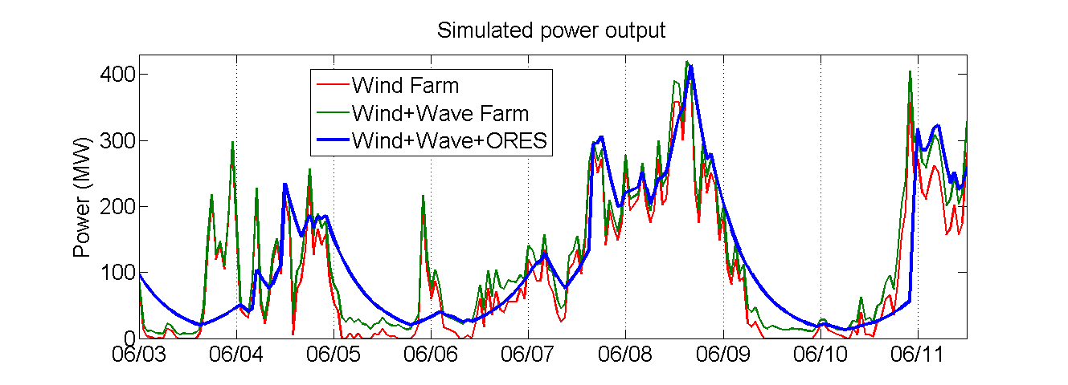
Why combine 3 systems?
Smooth out rapid fluctuations in available power
Collocation reduces Cost
  Shared transmission and mooring lines
  ORES can double as the anchor point
Based on 2007 wind and wave data
500 MW wind farm + 47 MW wave farm
+ 2000 MWh ORES
Notes:
Main point: Adding wave and storage eases electric grid power management and reduces the cost of renewable energy
500 MW wind + 47 MW wave + 2000 MWh ORES
Note: ORES can double as anchoring point. AND fossil fuel-free!

Slide 4
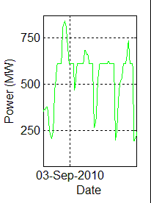
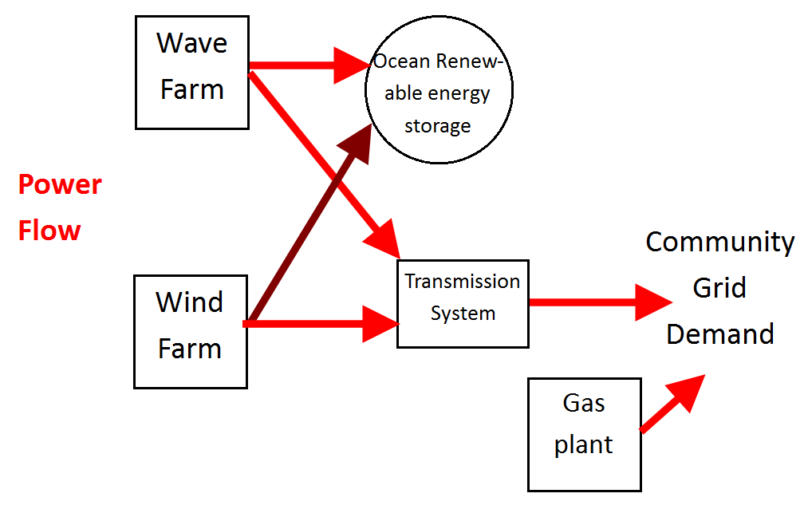
Goals
  Optimize OWC array Levelized Cost of Energy ($/kWh)
    Vary geometry
  Smooth out the offshore system power supply
    Vary energy storage and wave farm capacity
Notes:
Main point: In the next 10 minutes, I’ll describe how a wave device encircling a FWT may be optimized, and how wave and storage may smooth out a wind farm’s power curve.
Preliminary PhD work
Study: optimize two components of the offshore system:
1) Minimize LCOE of OWC
2) Investigate power supply-demand matching. CEEP= Critical excess of electricity production

Slide 5
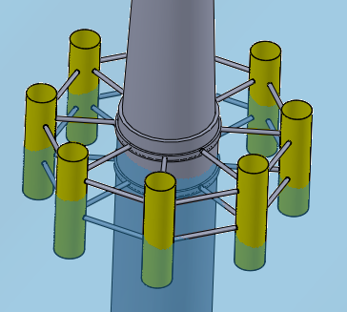
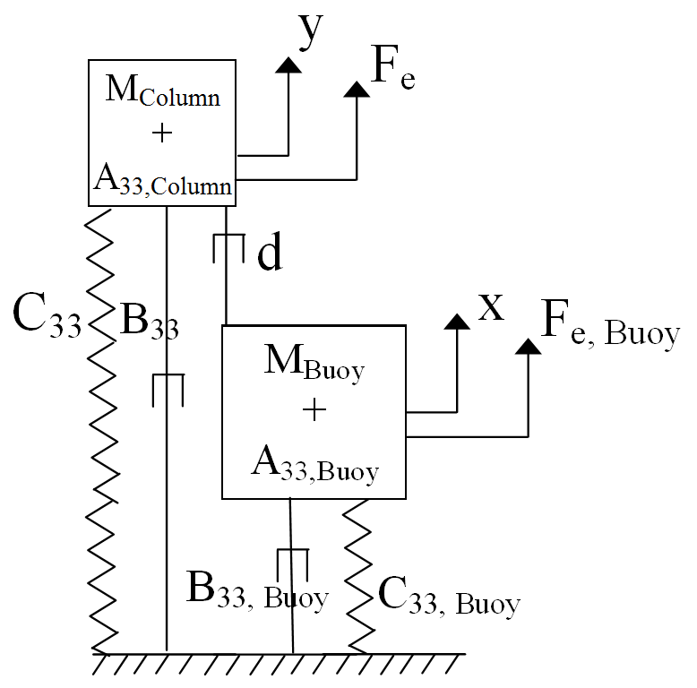
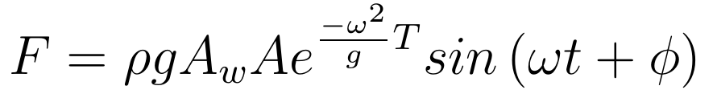
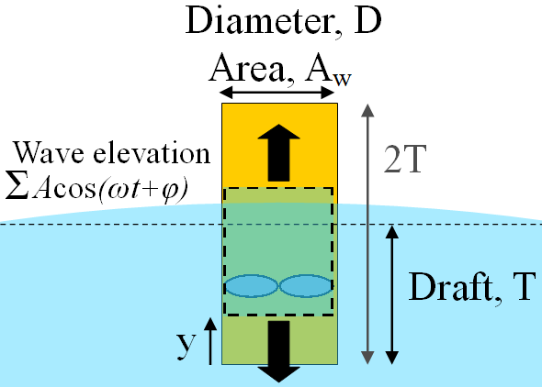
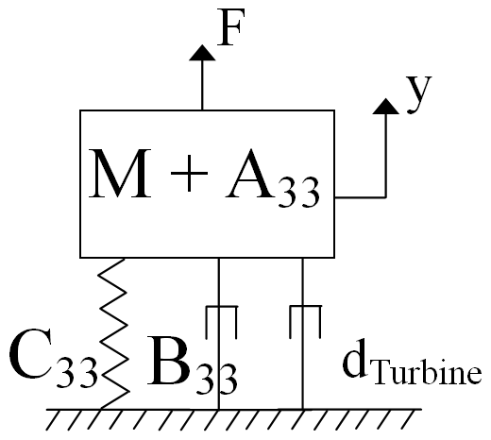
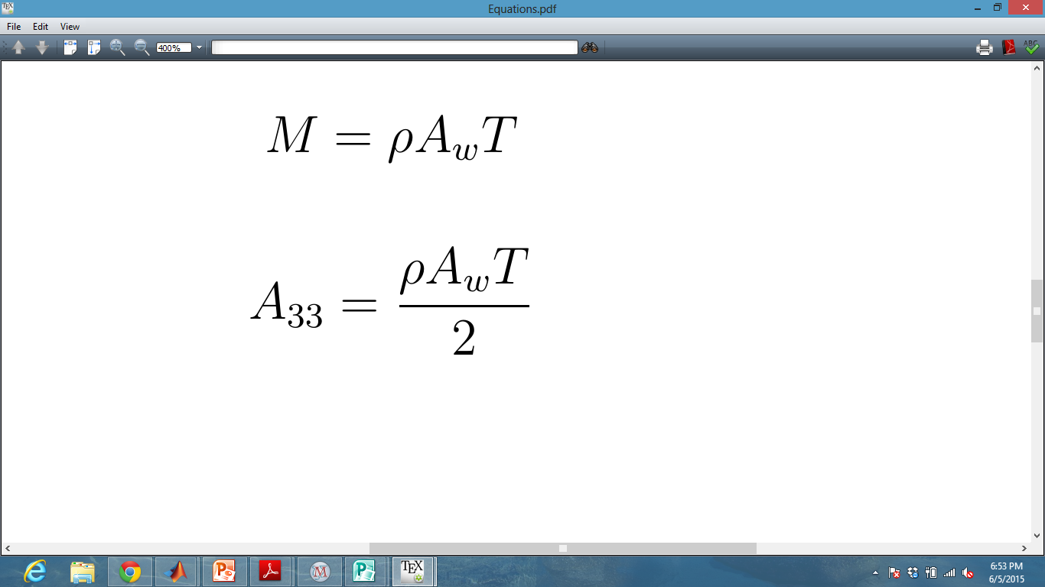
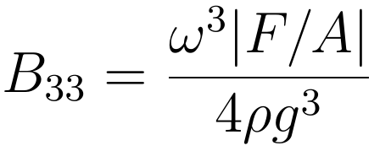
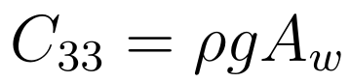
Power Model
For each water column in tube:
What are coefficients?
What is Fe?
How calculate annual power?
Which variables are from source, and which from simulation
Adjustable turbine linear damping
Frequency domain: For each column
Notes:
Main point: Varying the diameter and draft have a significant effect on the dynamics and power capture of a wave harvester.
Standard hydrodynamic coefficients (Newman MH). F is dynamic pressure/ Froude-Krylov/ GI Tayor force acting on bottom of column

Slide 6
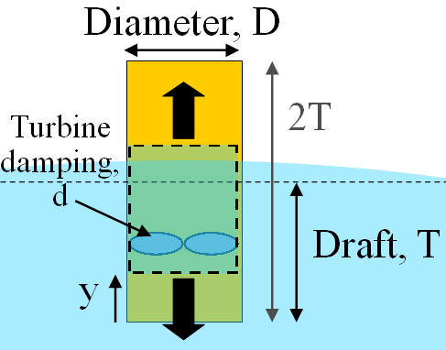
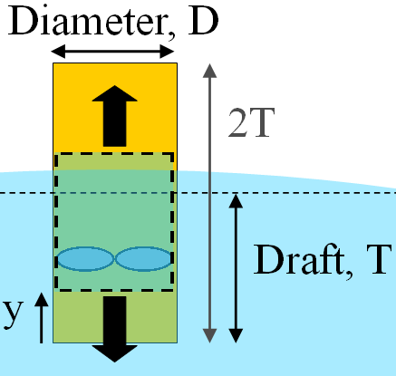
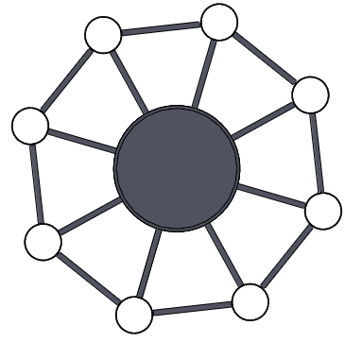
Optimization Procedure
Vary D and T
  Constrain water plane area: NA_{w} < 20A_{Tower}
  Limit wind turbine stress and motion
Use annual wave data
Constrain response
  displacement, Y<T
  Maximum power, P_{Max}< Mean(Punrestricted)
Sea State Probability Distribution
Sample Sea State
  A_{W}
  A_{Tower}
  N
  Columns
Notes:
Main point: Vary D and T, and damping for optimum power capture over entire year

Slide 7
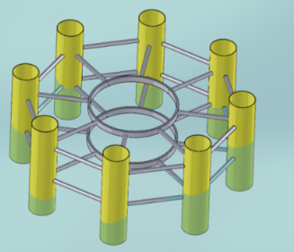
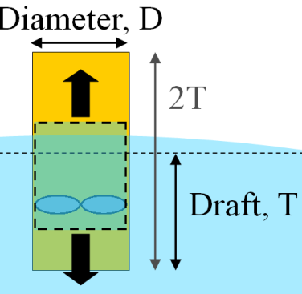
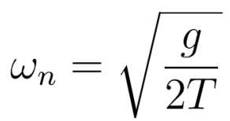
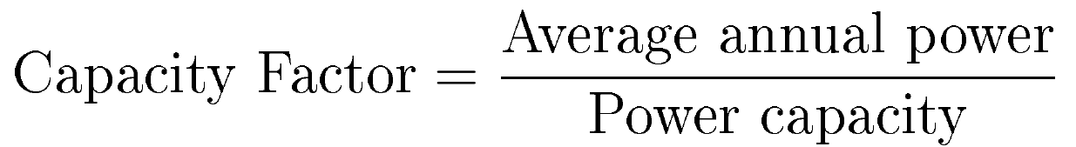
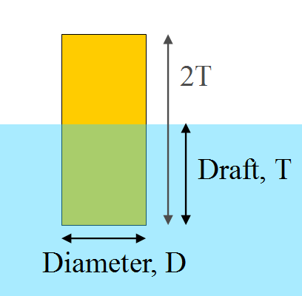
Power Results
ff
Notes:
Main point: Wave devices can have a high capacity factor. Devices with small drafts and midrange D produce most power.
Observe large power output when water column natural frequency corresponds to the ocean waves’ most common dominant frequencies
For systems that don’t show this resonant phenomenon, we can harvest about 0.3 MW average, with a capacity of 0.4 MW
This translates to a capacity factor of about 0.7.
Power goes down when deep draft: lower resonant frequency AND lower excitation force

Slide 8
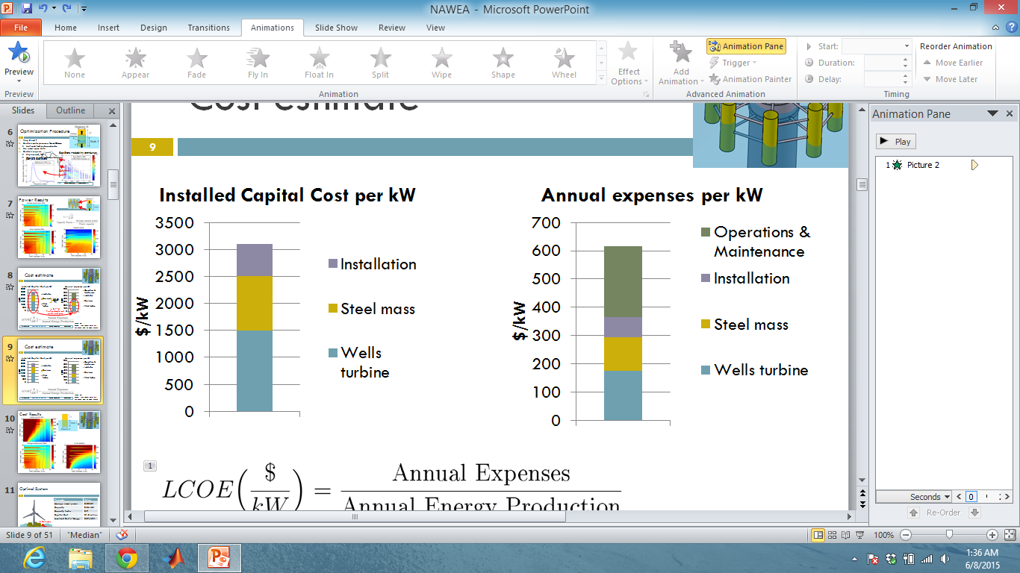
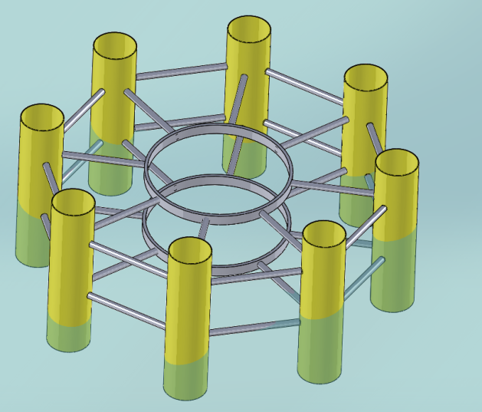
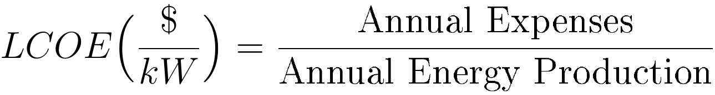
Cost estimate
Cost from turbine capacity, structural mass, hinge components
  Let O & M =, Lifetime= 20 years
$0.83
Kg
x 0.115
Portion of capital cost paid each year
Based on:
Sandia Labs Report 2014-18311
and Tegan Cost of Wind Energy
Notes:
Main point: The $/kWh depends on device size and capacity.
Steel mass: $830 per ton →. Typical values roughly 1200 kg per kW.
Capital cost representative for N= 3, D= 10 m, T= 6 m, Capacity= .25 MW
Note, significant cost savings without transmission and mooring lines
AEP= Capacity * hours in year

Slide 9


Cost Results
Power
Capacity
Then, capacity factor on top of capacity
Capital Cost
Capacity factor,
LCOE
ff
Notes:
Main point: Increasing diameter decreases Costs. Even though increasing diameter decreases power, diameter with lowest LCOE for larger diameter.
Power goes down when deep draft: lower resonant frequency AND lower excitation force
Main point: for middle values of diameter and low draft, low LCOE.
Sudden drops in LCOE may be unreal/due to buoy data resolution

Slide 10
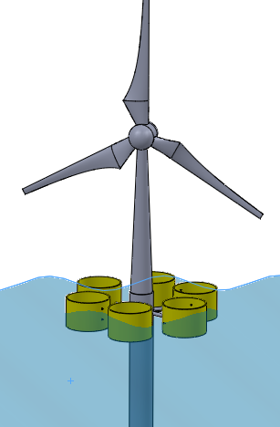
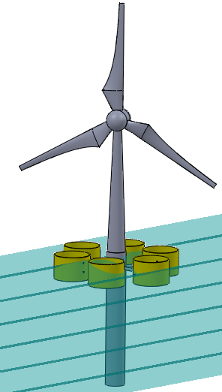
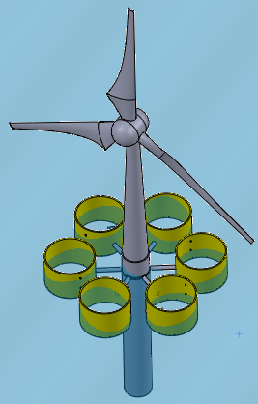

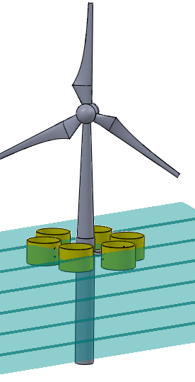
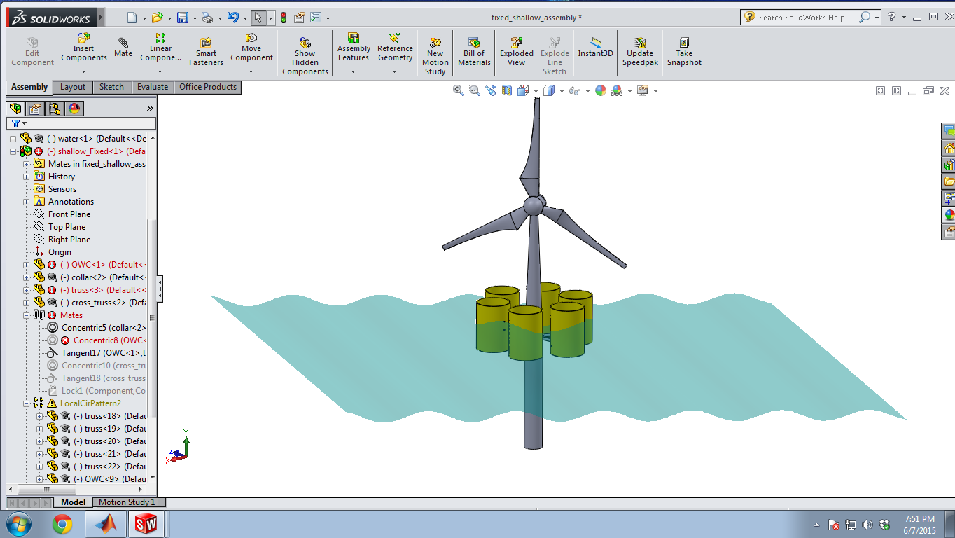
Optimal System
ff
Parameter | Value
Average annual power | 0.25MW
Capacity | 0.36 MW
Capacity factor | 0.7
Capital Cost | $1.3 million
Levelized Cost of Energy | $67/MWh
6 Columns
2T=14 m
D=12 m
Notes:
Main point: optimal wave device can produce .25 MW average, have CF= .7, and have LCOE of $67/MWh
Atower= Radius 3.25 m. 33m^2. Array= 660 m^2
Power goes down when deep draft: lower resonant frequency AND lower excitation force

Slide 11
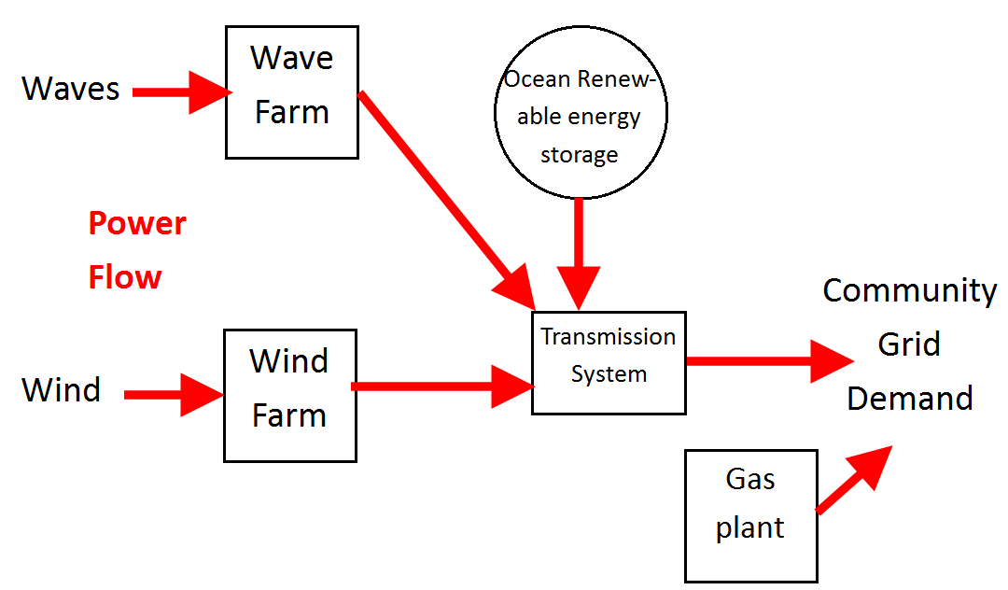
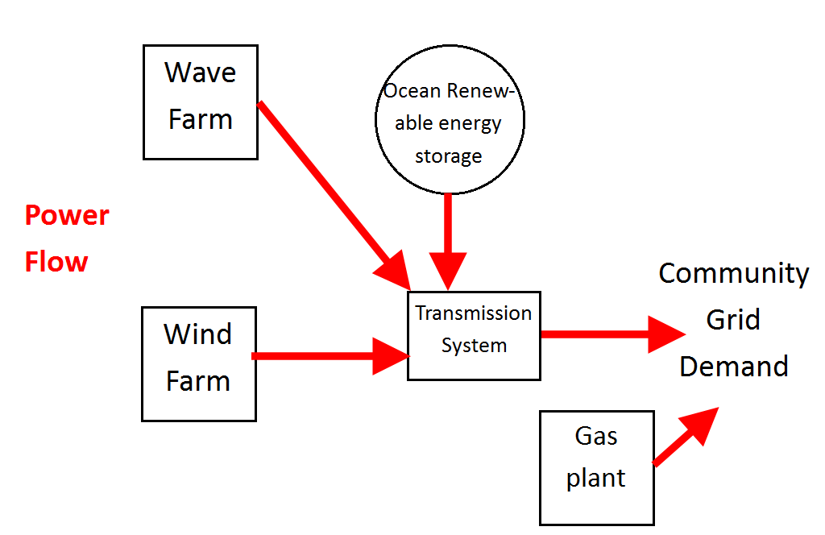
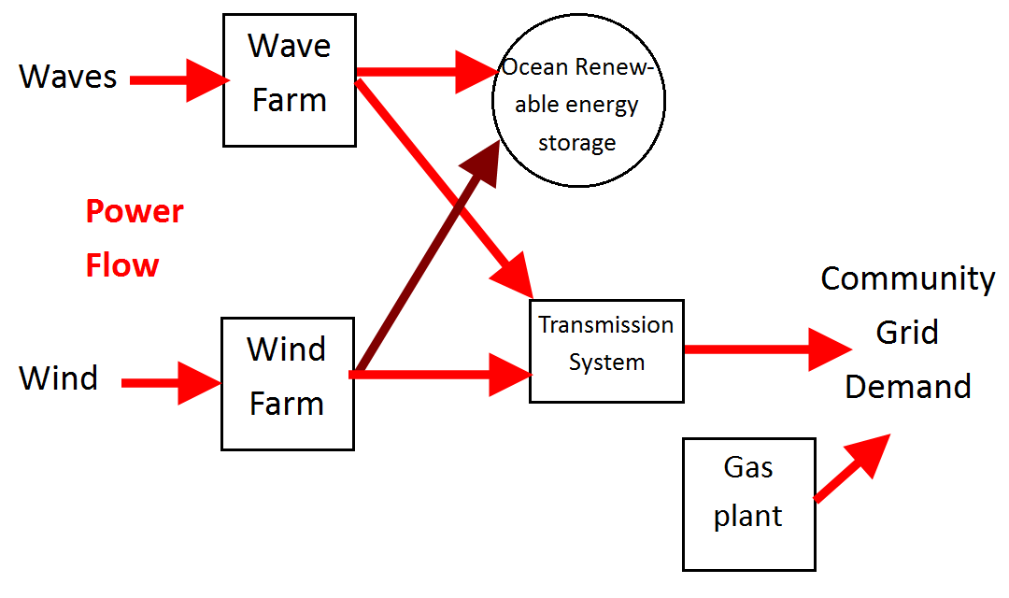
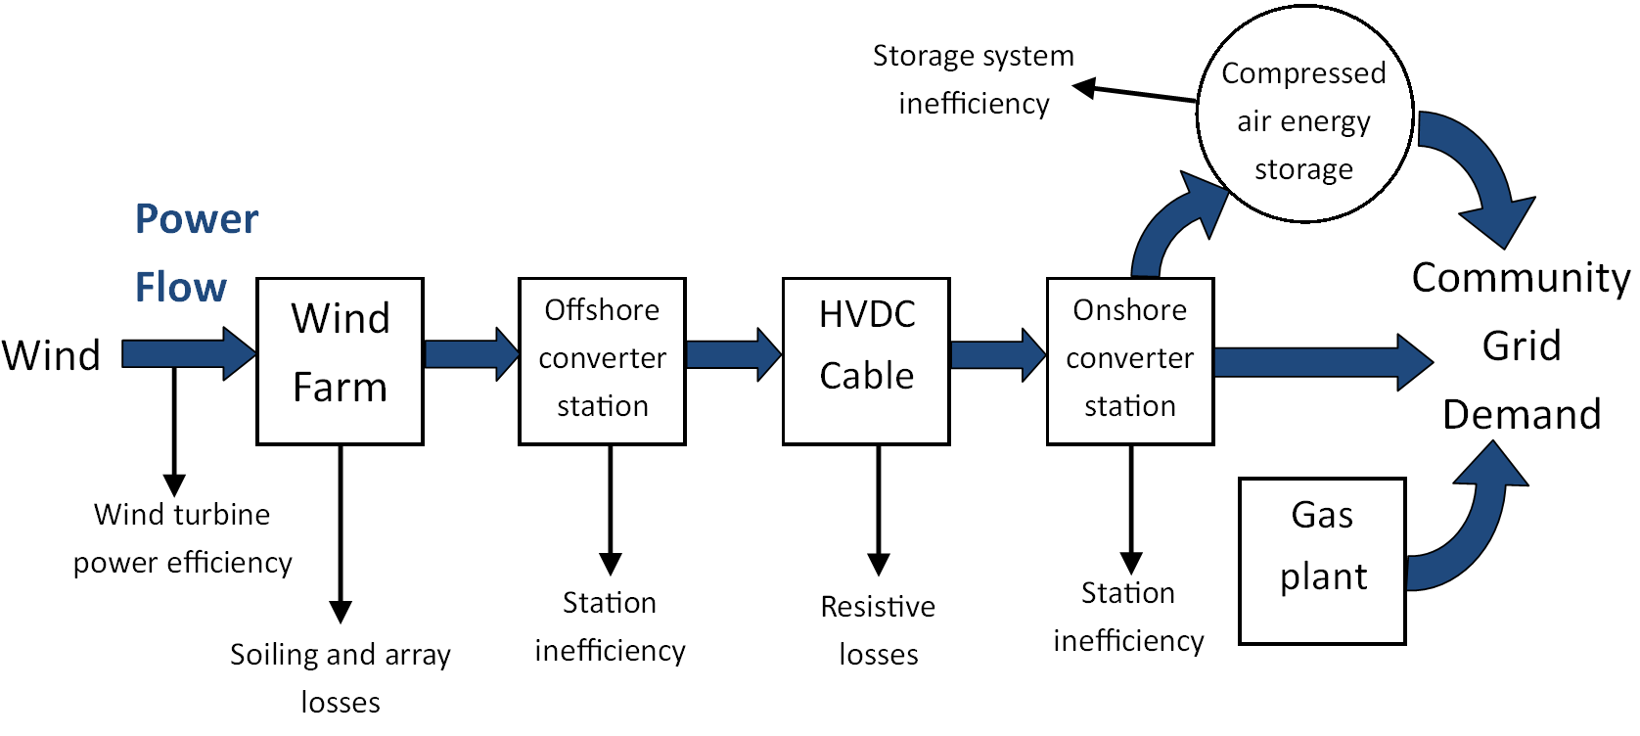
Supply Smoothing
Surplus Renewable Power Supply
500 MW wind farm + 47 MW wave farm
+ 2000 MWh ORES
Insufficient Renewable Power Supply
Goals:
  Keep each hour’s power within +10% previous hour’s power
  Minimize cost
      Vary storage and wave farm capacity
Notes:
Main point: Can storage and wave power smooth out the offshore farm’s power curve?
“scheduling cost”
500 MW wind farm. 50 MW wave. 2000 MWh storage

Slide 12
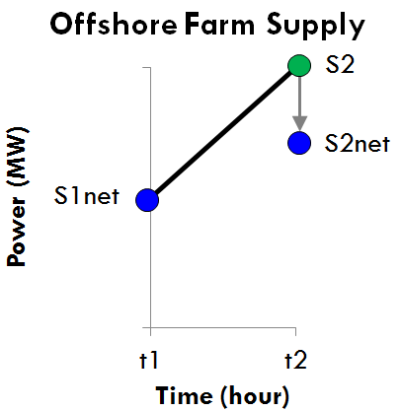
Control strategy to smooth output power
Effect of
  energy storage capacity
  Wave power
Power
S₂
  Use ORES to supply/absorb power as required, if it can
  Try to maintain ORES stored energy at 50% capacity
0.9S_{1net}
Acceptable net S_{2net} values
ORES absorbs difference
S_{2net}
Power (MW)
Wind + Wave Supply
S₂
Performance measure:
Minimize mean (S2-S1)
Minimize LCOE
Wind + Wave + ORES Net Supply
1.1S_{1net}
S_{2net}
S_{2net}
S_{2net}
Acceptable net S_{2net} values
S_{1net}
S₂
S₂
0.9S_{1net}
S_{2net}
S₂
Time (hr)
t₂
t₁
time t₂= t₁+1 hour
Notes:
Main point: I applied this control strategy on a wind-wave-storage system energized by actual buoy wind/wave data.

Slide 13
Supply-Demand Matching
Average hourly gas plant fluctuation for varied wave and ORES capacity and total system cost
Notes:
Main point: Combine wave and storage to smooth out offshore system supply curve.
Using more wave power can accomplish came smoothing effect for less cost.

Slide 14
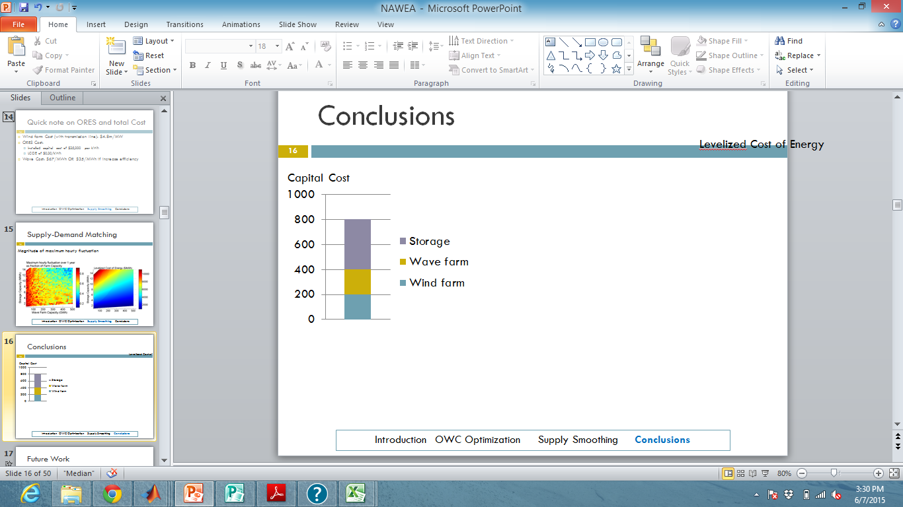
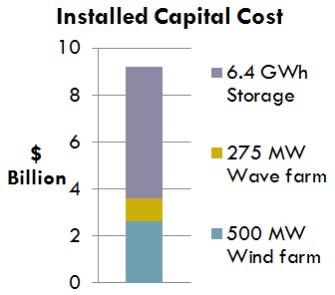
Conclusions
Capital Cost
Levelized Cost of Energy
Best “smoothed-power output” wind-wave-storage system
(room for improvement)
Parameter | Value
Levelized Cost of Energy | $287/MW
Capacity | 780 MW
Capacity factor | 0.51
Maximum hourly power fluctuation | 413 MW (12 times per year)
Notes:
Main point: For roughly 30% more levelized cost of energy, offshore farm’s power output to grid may be smoothed out

Slide 15
Future Work
Optimize wave device power
  Floating device, backward-bent duct
Predict stress and motion induced on wind turbine
Experimentally verify theory
Energy storage optimization

Slide 16
Acknowledgements
Much thanks to...
Maha Haji
My PERG labmates
My advisors, Prof.s Themis Sapsis and Alex Slocum

Slide 17
Conclusions
Capital Cost
Levelized Cost of Energy
Best “smoothed-power output” wind-wave-storage system
(room for improvement)
Parameter | Value
Levelized Cost of Energy | $287/MW
Capacity | 780 MW
Capacity factor | 0.51
Maximum hourly power fluctuation | 413 MW (12 times per year)
Notes:
Main point: For roughly 30% more levelized cost of energy, offshore farm’s power output to grid may be smoothed out

Slide 18
Thank you!

