Slide 1
21st Inventory
Brandon Dean, Elliot Garner, Brannon Mason

Slide 2
Background (Original Task)
Client was Network Infrastructure & Services (NI&S)
Currently using Oracle to inventorize products
Long, arduous, and complex
Requested we make a mobile app used to help inventory products more efficiently
Majority of experience in iOS

Slide 3
Background (Updated Task)
NI&S is adding Wireless Access Points (WAPs) to many buildings
Manually make note of Mac Address, Serial Number, Inventory Number, and others
A mobile app to scan and save all of that data automatically
Integration with Google Drive

Slide 4
Process
Setting up a project on Google Drive
https://console.developers.google.com/project
Created developer profile and project in XCode
A .csv is preloaded onto Google Drive that will be written to
The file is downloaded to the mobile application to be parsed
Users scan and then add or update the ID fields related to the inventory item
The file’s updates are uploaded back to the file on the Google Drive account

Slide 5
Difficulties
Despite choosing iOS, not all of us have a Mac to use
Poorly Documented Google Drive API
Difficulties communicating effectively between group members
Actual development started a little too late

Slide 6
Result

Slide 7
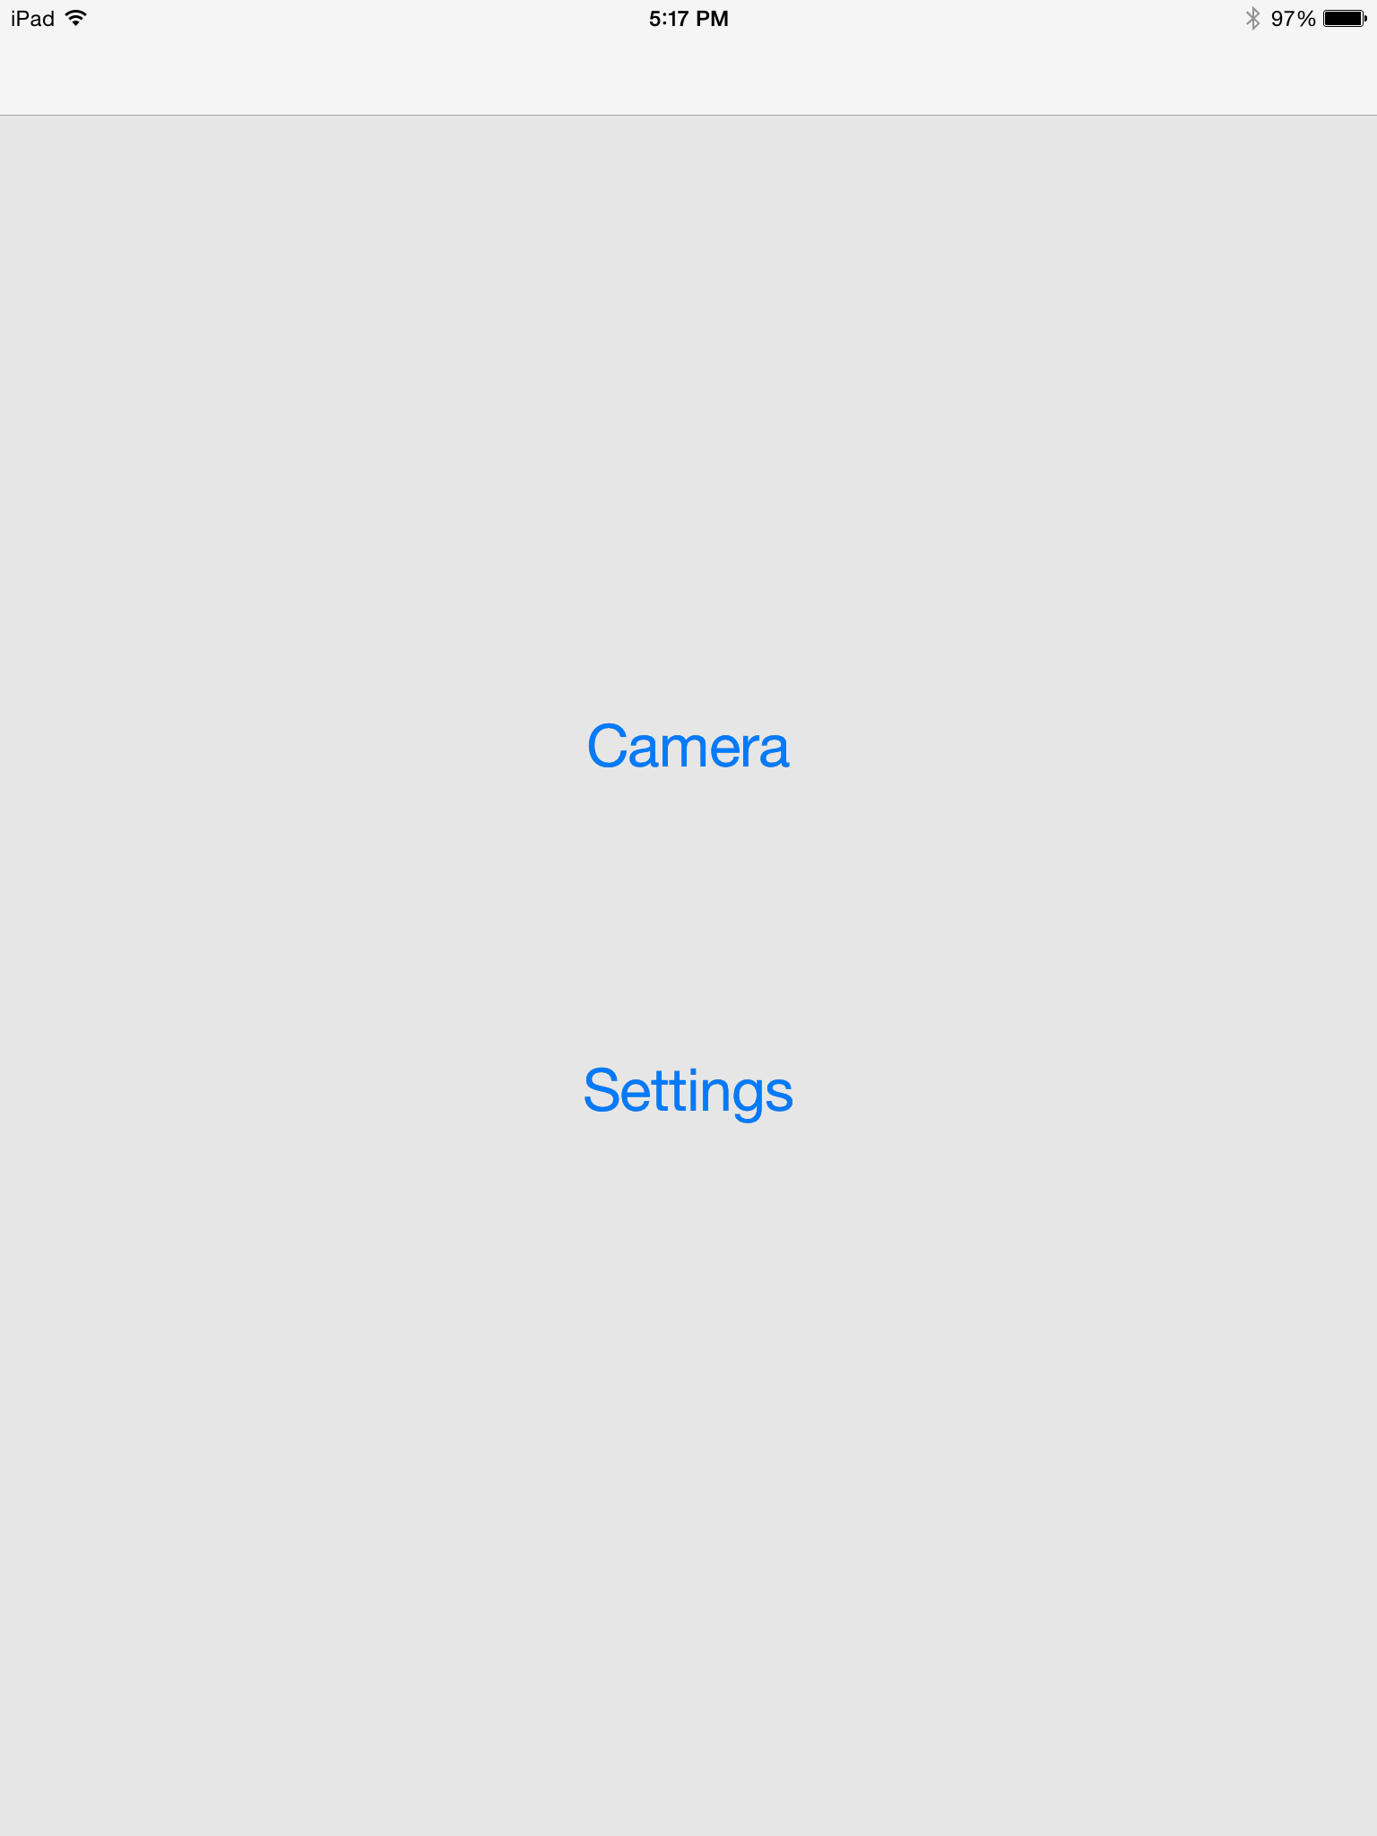

Slide 8
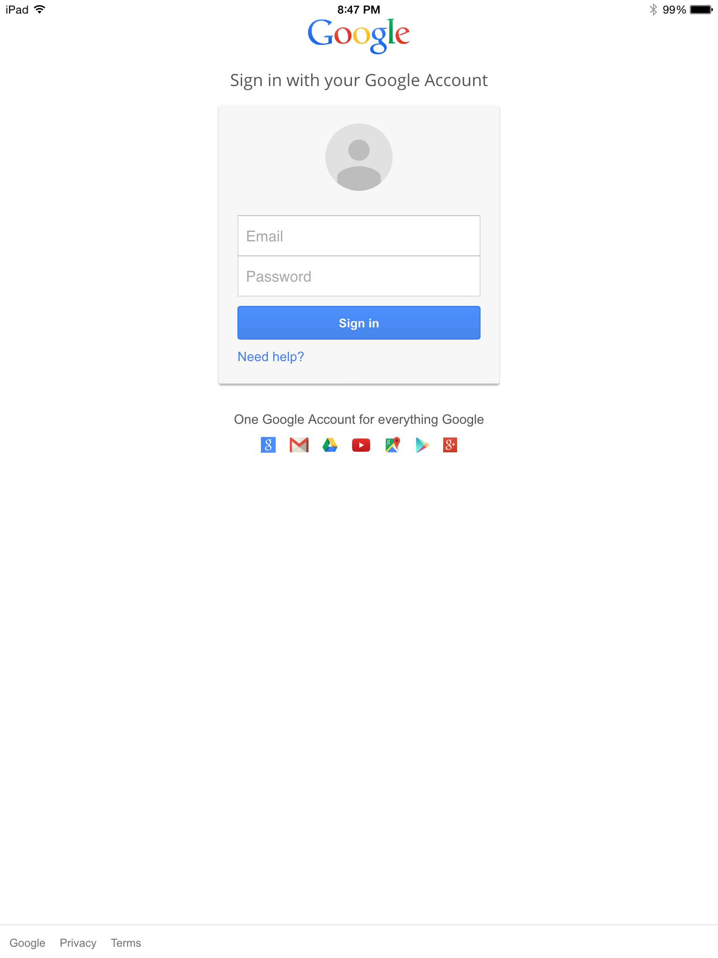

Slide 9
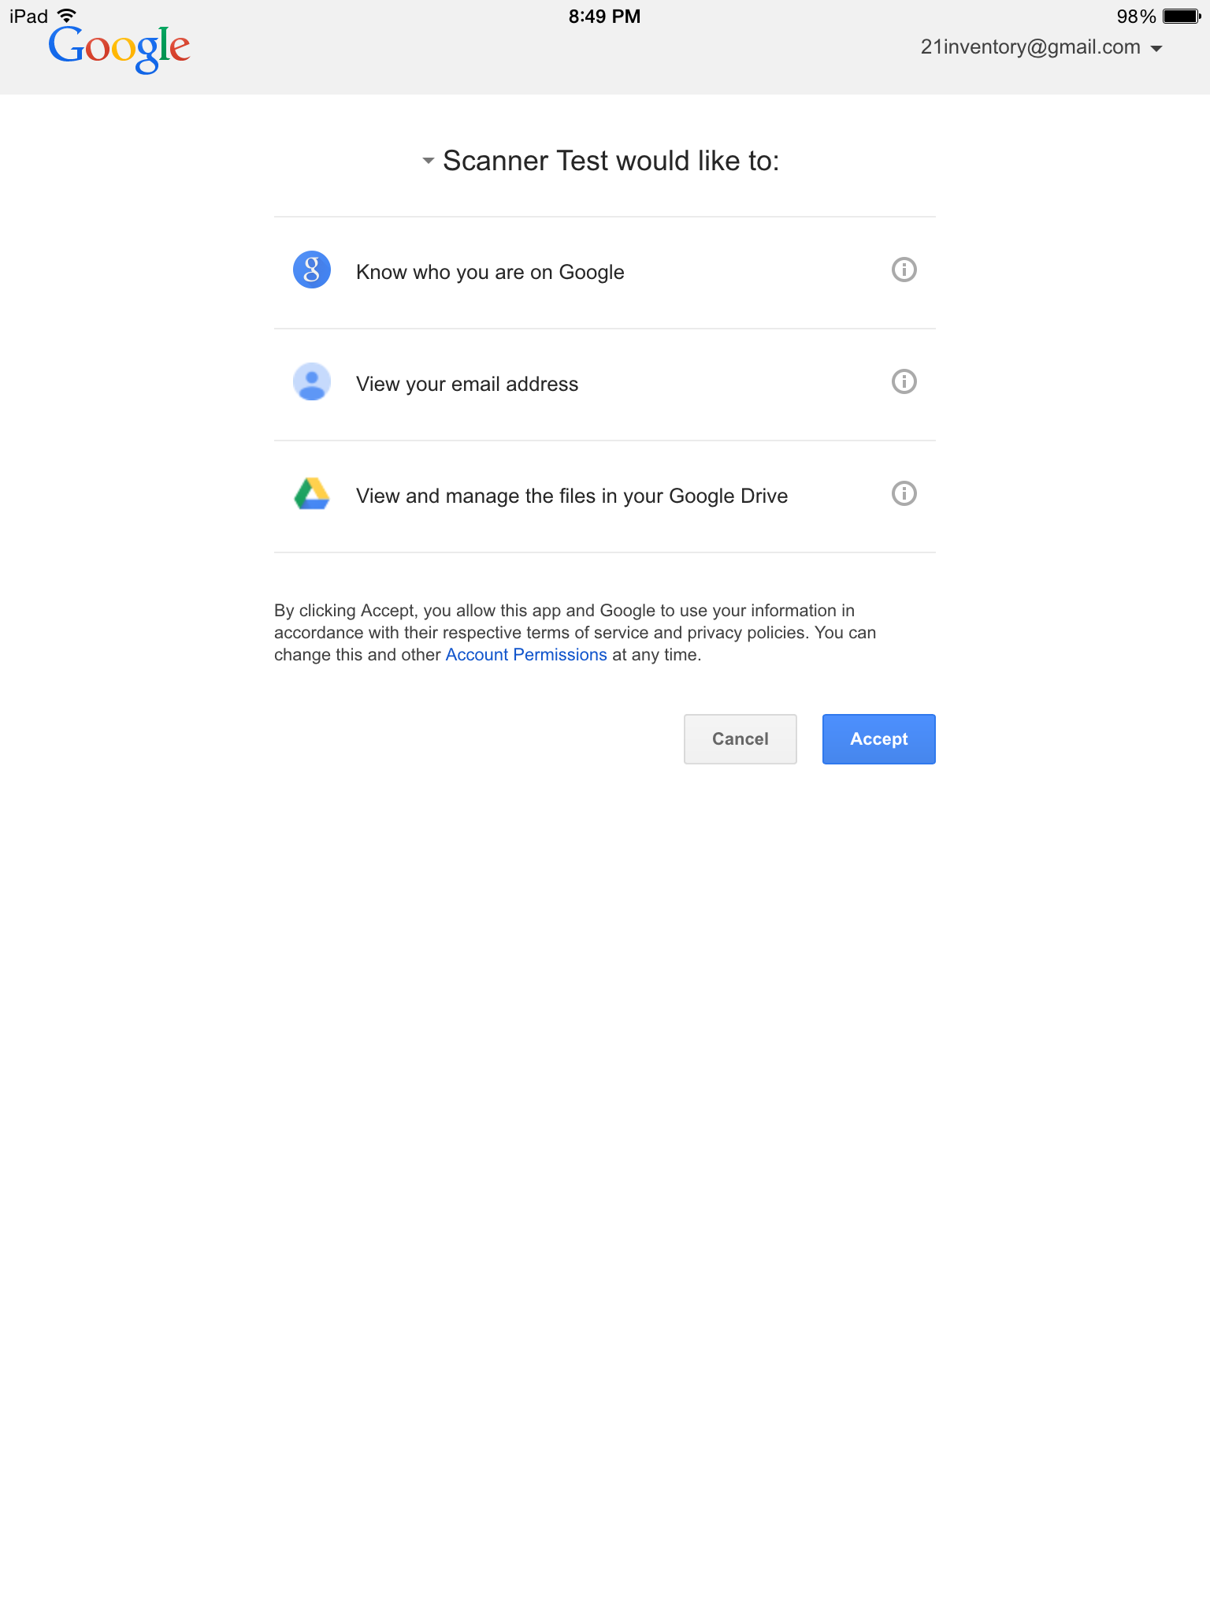

Slide 10
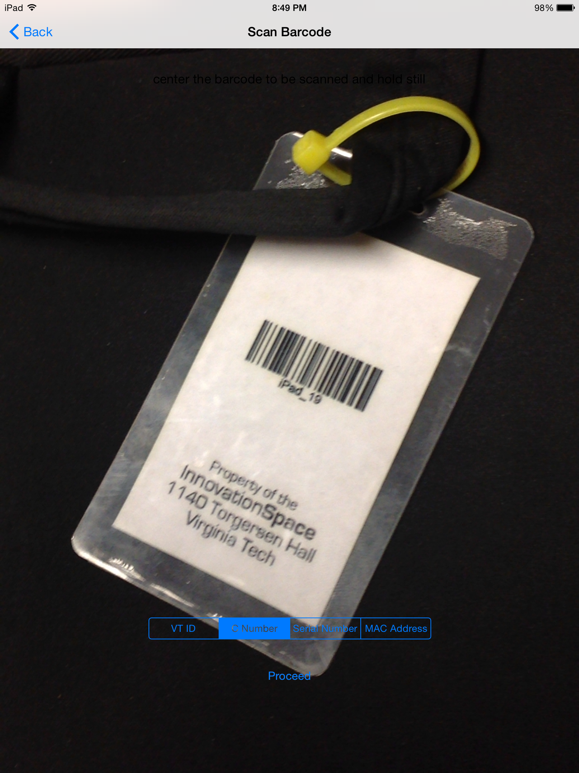

Slide 11
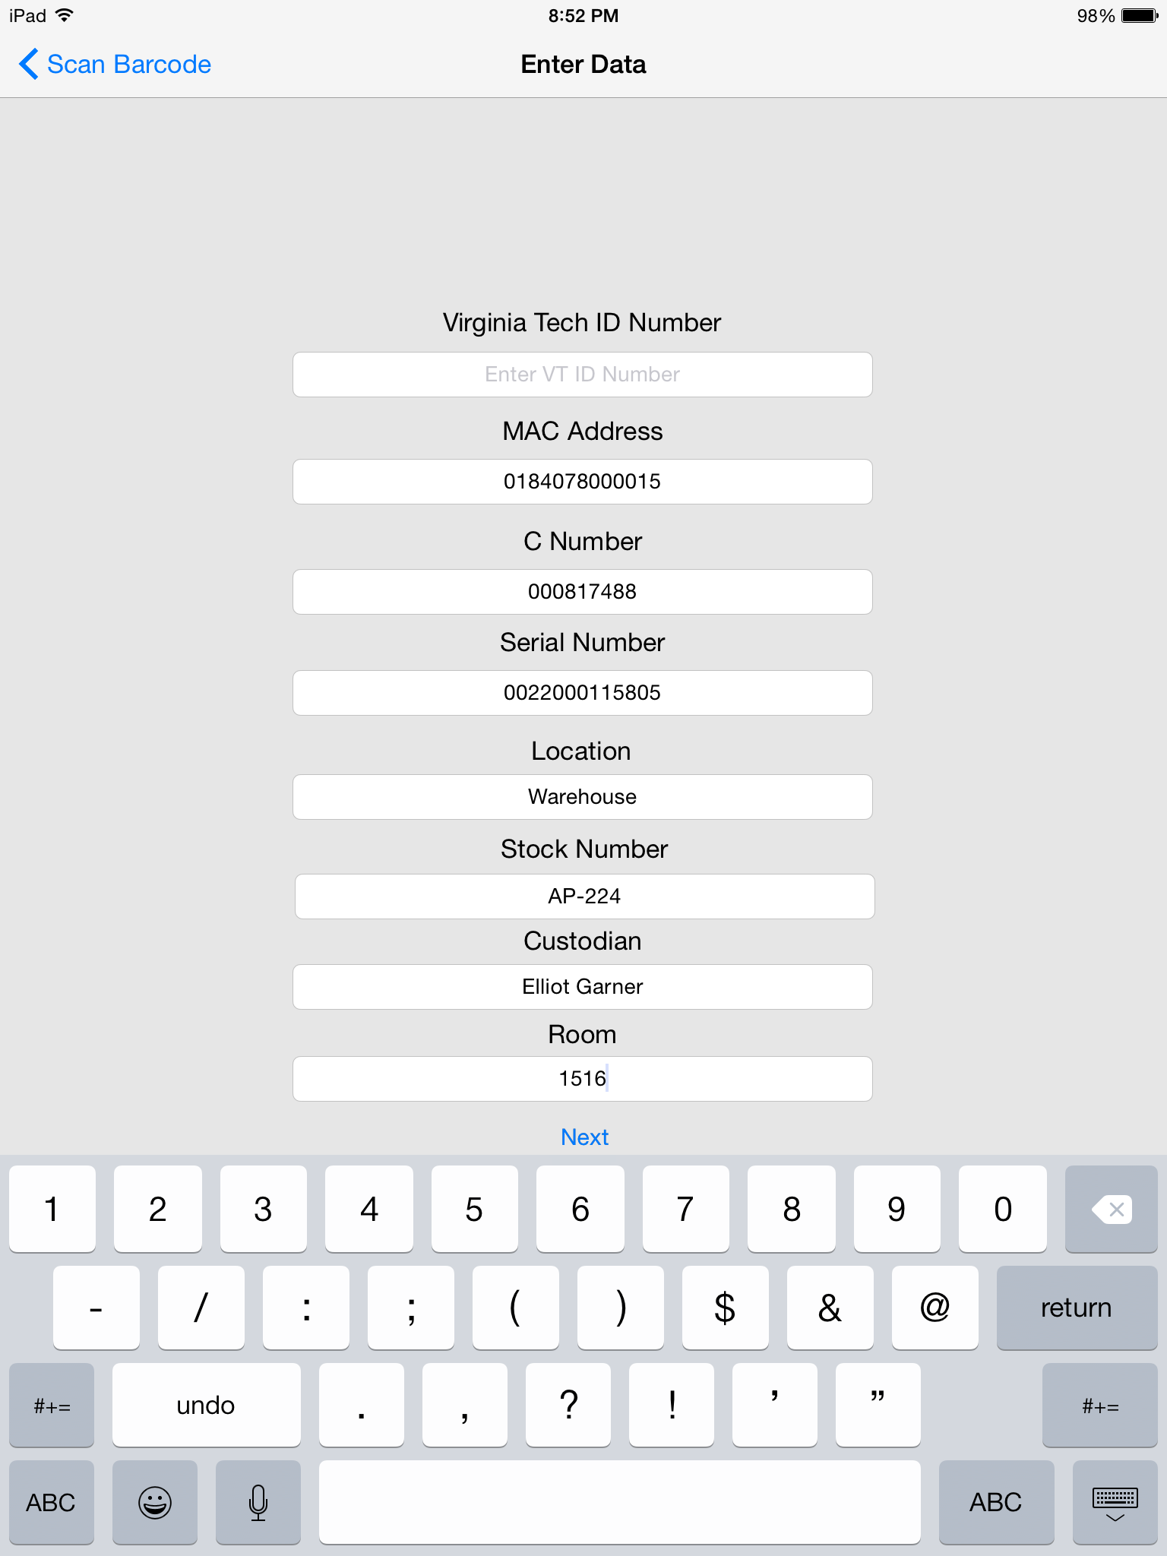

Slide 12
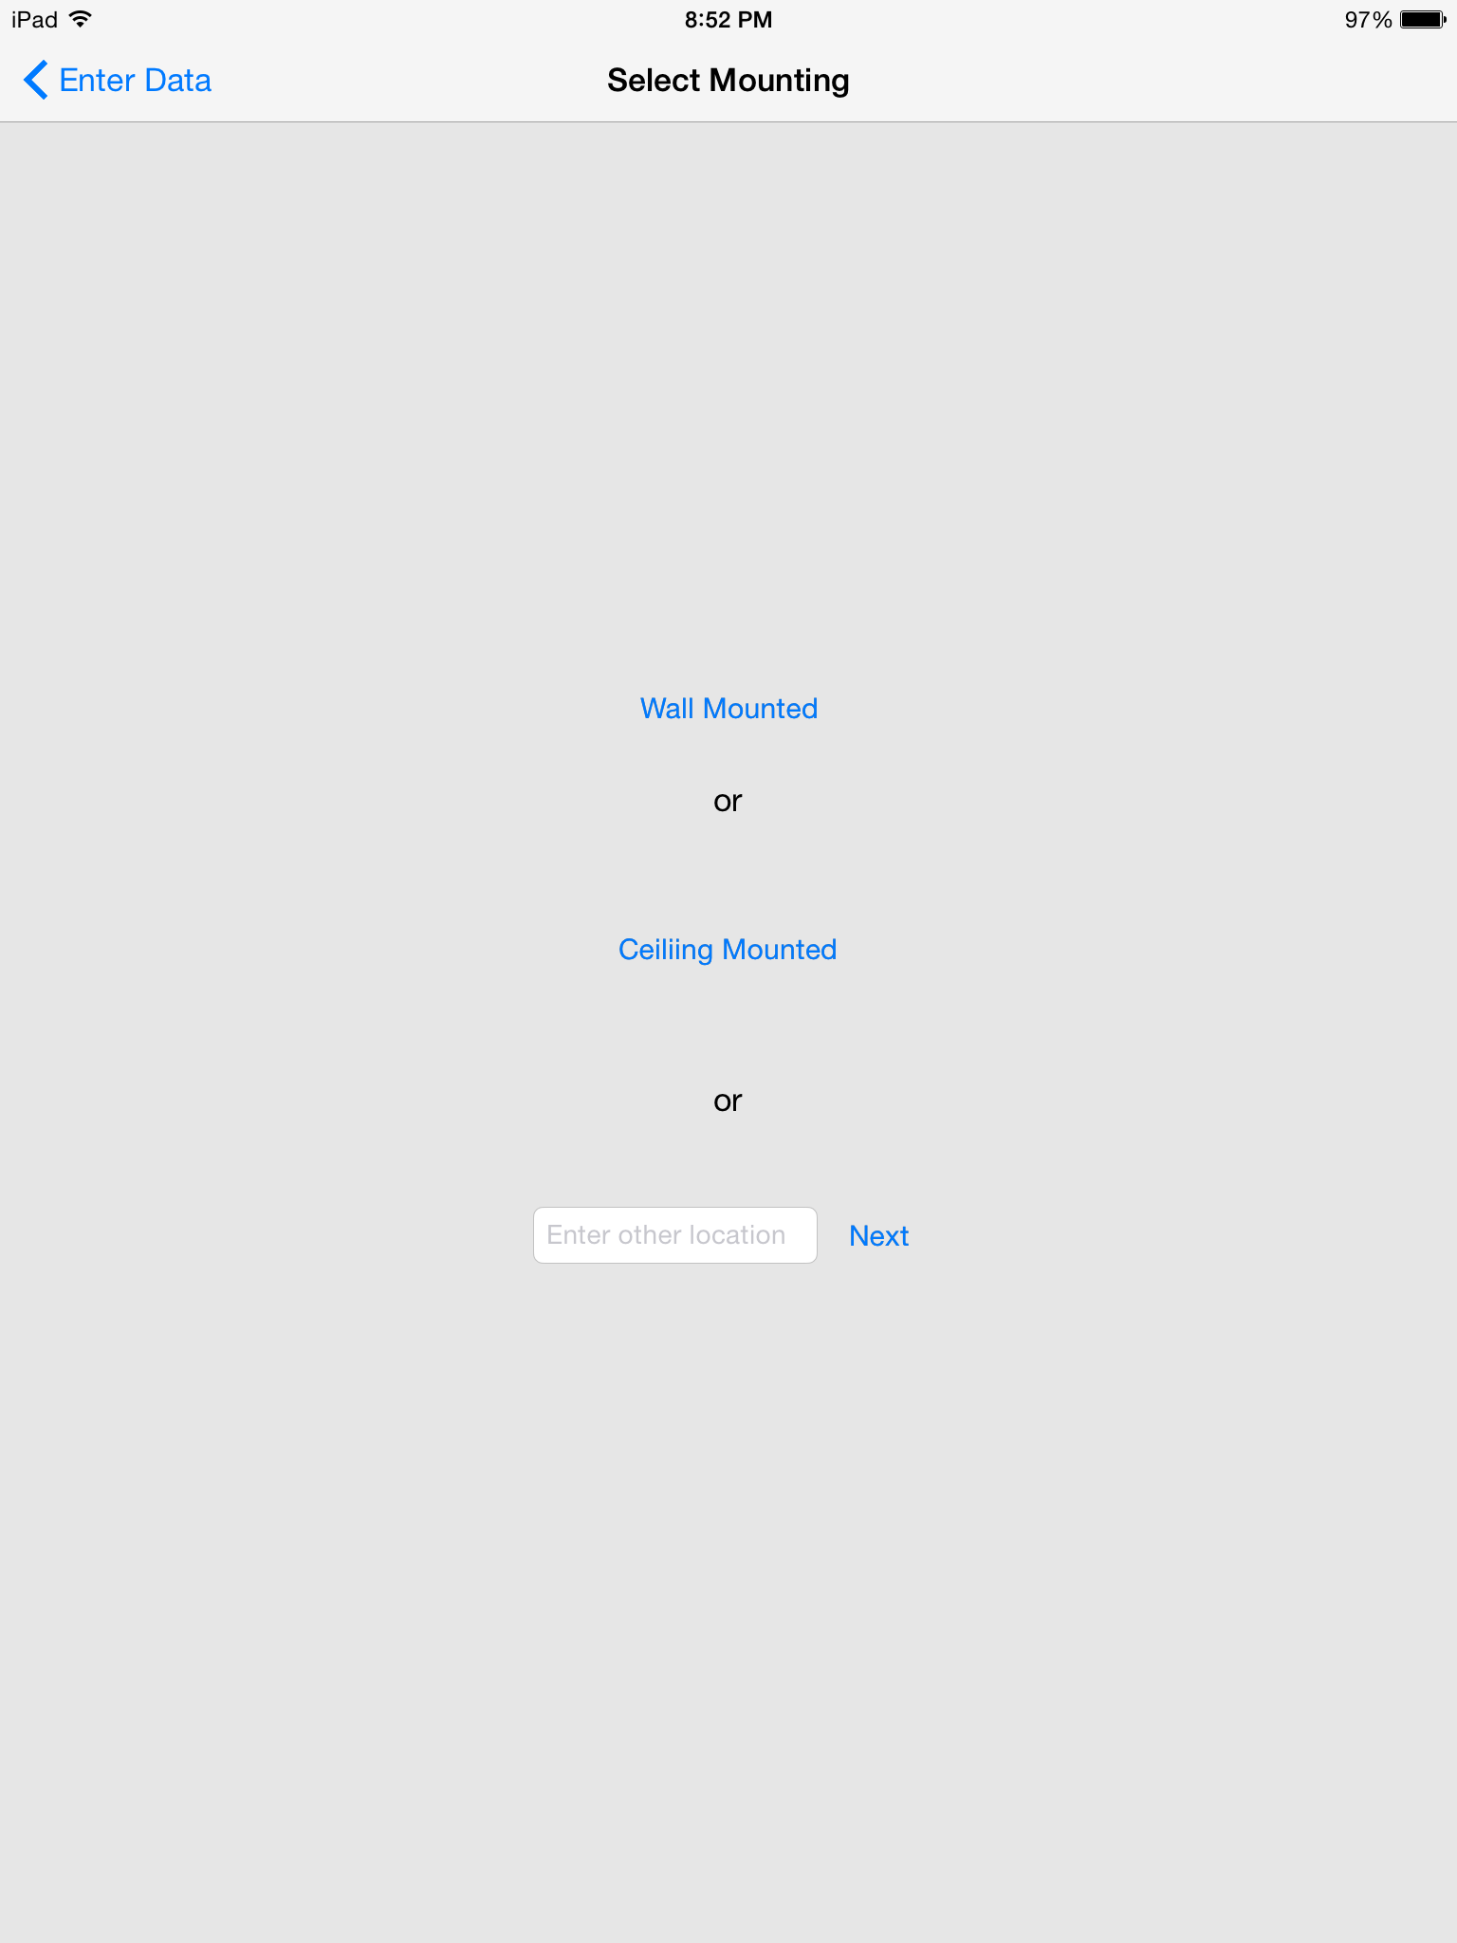

Slide 13
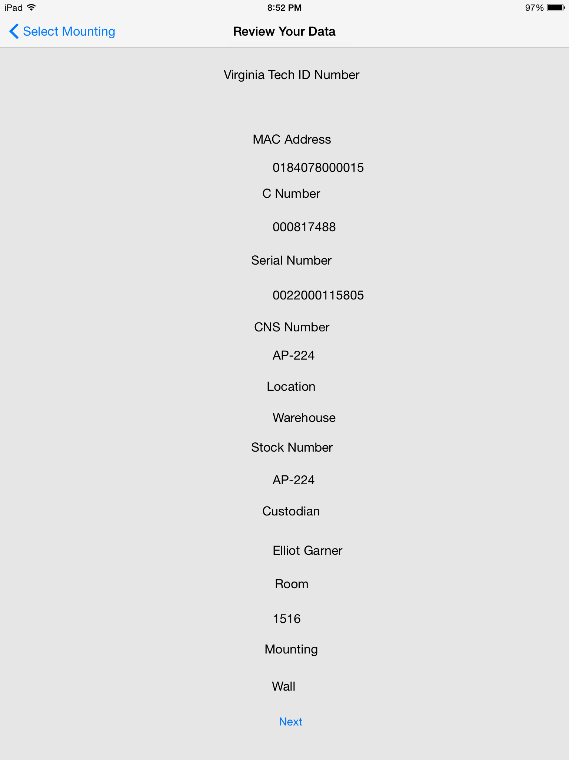

Slide 14


