Slide 1


Collection Management Tweet
CS5604, Information Storage &
Retrieval, Fall 2017
Farnaz Khaghani Junkai Zeng Momen Bhuiyan
Anika Tabassum Payel Bandyopadhyay
Professor: Dr. Edward Fox

Slide 2
Purpose of CMT
Processing Tweets of two events:
  Solar Eclipse (6M Tweets)
  Las Vegas Shooting (~0.18M tweets)
Creating a social network database based on the Twitter users and tweets relationships

Slide 3
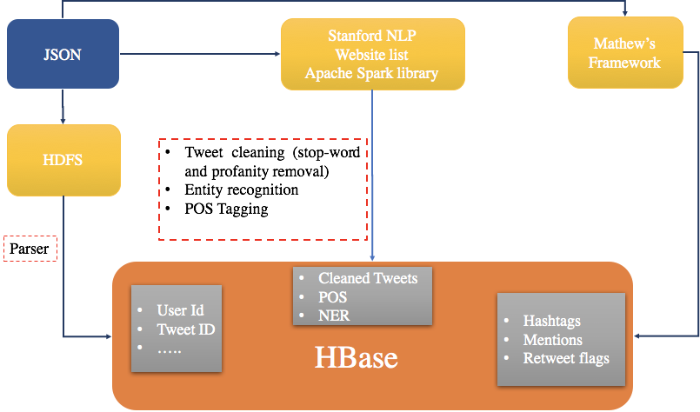
Tweet Processing Overview

Slide 4
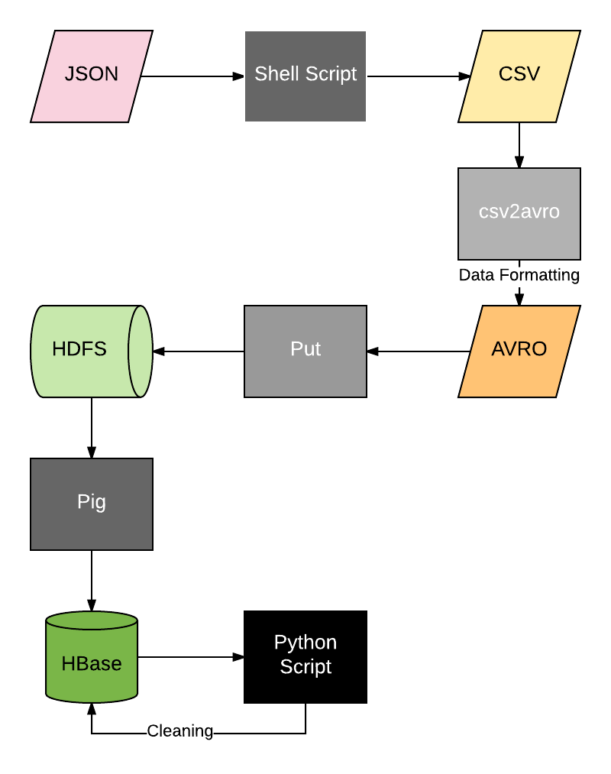
Previous Arch.: JSON to HBase

Slide 5
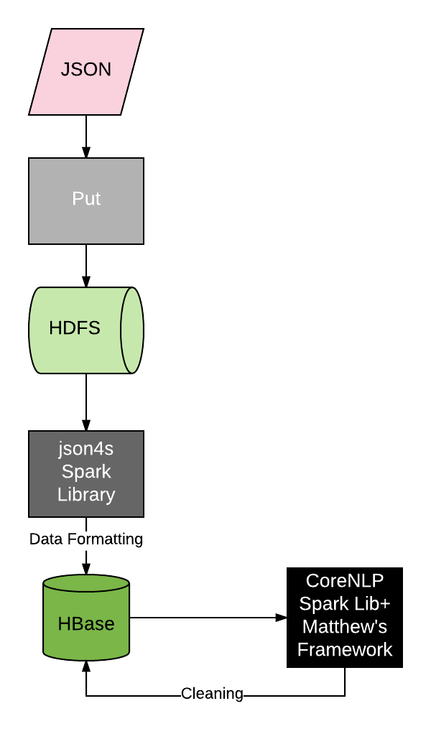
Current Arch.: JSON to HBase

Slide 6
Parsing
json4s: a json library in scala
For Las Vegas Shooting dataset (~180k tweet), the parsing took less than 2mins
Changes:
  Removal of Multiple Steps: Minimize Data Pre Processing
  Overhead: Copying the json file

Slide 7
Cleaning
Data cleaning
  NER, POS, Tokenization, Lemmatization: Stanford CoreNLP
  Hashtag, Mentions, Retweet: Matthew’s Framework
  Stopword Removal: Spark ML lib
  Cleaning Punctuation, Removing Profanity, Formatting: Scala Code
For Las Vegas shooting dataset, data cleaning took less than 2 hour

Slide 8
Schemas Provided in HBase
Column Family | Column-name | Example
clean-tweet | NER | Shooting a Chrome <em class='NUMBER'>.50</em> Cal Machine Gun on the <em class='LOCATION'>Vegas</em> <em class='LOCATION'>Strip</em> #lasvegas #vegas #shooting #SaturdayMotivation https://t.co/ZroMarY7un
clean-tweet | POS | <em class='NN'>RT</em> <em class='NN'>@troyglidden</em> : <em class='NN'>Scanner</em> ...
clean-tweet | clean-text-cla | security guard shot leg 32nd floor unk hotel vegas shooting
clean-tweet | clean-text-cta | security guard shot leg 32nd floor unk hotel vegas shooting
clean-tweet | clean-text-solr | security guard shot leg 32nd floor unk hotel vegas shooting
clean-tweet | clean-tokens | shooting;chrome;50;cal;machine;gun;vega;strip;lasvega;vega;shooting;saturdaymotivation;
clean-tweet | dates | Aug;21;2017;
clean-tweet | geo-location

Slide 9
Schemas Provided in HBase
Column Family | Column Name | Example
clean-tweet | geom-type
clean-tweet | hashtags | #lasvegas,#vegas,#shooting,#SaturdayMotivation
clean-tweet | long-url | http://freebeacon.com/culture/shooting-a-chrome-50-cal-machine-gun-on-the-vegas-strip/
clean-tweet | mentions | troyglidden
clean-tweet | rt | false
clean-tweet | sner-locations | Vegas;Strip;
clean-tweet | sner-organizations
clean-tweet | sner-people
clean-tweet | solr-gemo

Slide 10
Schemas Provided in HBase
Column Family | Column Name | Example
clean-tweet | spatial-bounding
clean-tweet | spatial-coord
clean-tweet | tweet-importance
clean-tweet | url_visited_cmw
metadata | collection-id | 1024
metadata | collection-name | #shooting #LasVegas
metadata | doc-type | tweet
metadata | dummy-data | false

Slide 11
Schemas Provided in HBase
Column Family | Column Name | Example
tweet | archive-source | twitter-search
tweet | comment-count | -1
tweet | contributor-enabled | false
tweet | created-time | Sat Sep 23 20:08:16 +0000 2017
tweet | created-timestamp
tweet | geo-0
tweet | geo-1
tweet | geo-type
tweet | language | en

Slide 12
Schemas Provided in HBase
Column Family | Column Name | Example
tweet | like-count | 5
tweet | place-country-code | US
tweet | profile-img-url | http://pbs.twimg.com/profile_images/894753143057137666/3U9Y6Di2_normal.jpg
tweet | retweet-count | 1
tweet | screen-name | pepesgrandma
tweet | source | <a href="http://twitter.com" rel="nofollow">Twitter Web Client</a>
tweet | text | Shooting a Chrome .50 Cal Machine Gun on the Vegas Strip \xF0\x9F\x98\x8D\x0A#lasvegas #vegas #shooting #SaturdayMotivation https://t.co/ZroMarY7un
tweet | to-user-id

Slide 13
Schemas Provided in HBase
Column Family | Column Name | Example
tweet | tweet-deleted | false
tweet | tweet-id | 911683653868113920
tweet | url | https://t.co/ZroMarY7un
tweet | user-deleted | false
tweet | user-id | 116384038
tweet | user-name | Babushka\xE5\xA5\xB3\xE5\xA3\xAB
tweet | user_favourites_count | 42111
tweet | user_followers_count | 5569
tweet | user_friends_count | 357
tweet | user_lang | en
tweet | user_location | Siberia China
tweet | user_mentions_id_str | Dahboo7
tweet | user_mentions_name | 1411455757
tweet | user_statuses_count | 31996

Slide 14
Social Network

Slide 15
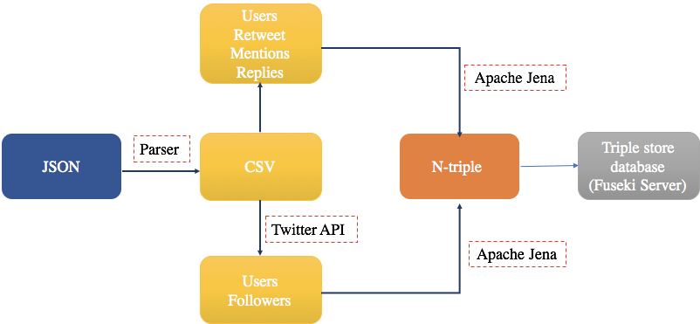
Overview

Slide 16
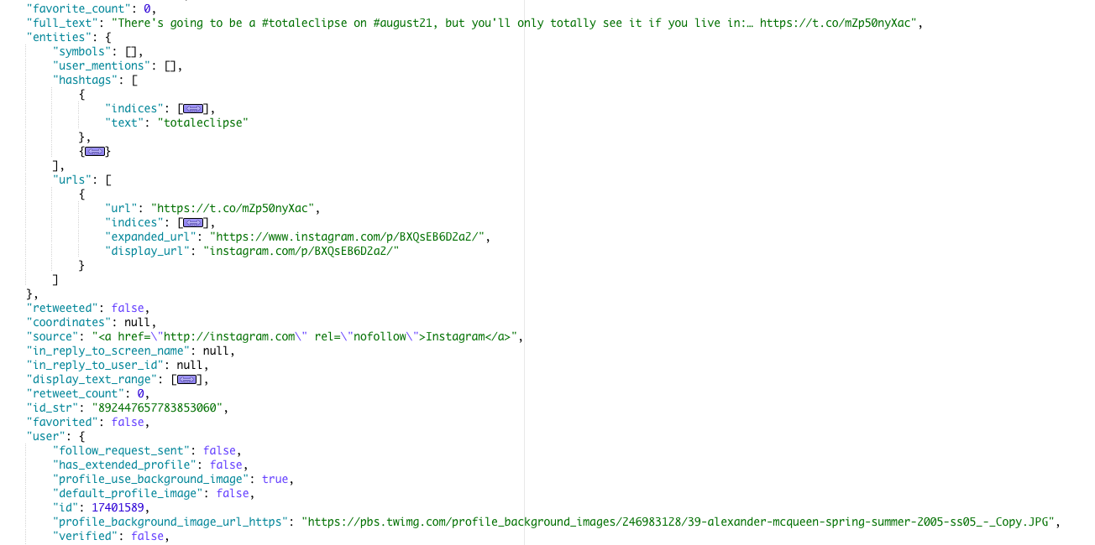
Initial Data: JSON

Slide 17
Pre-processing data for social network
Using shell scripts for pre-processing the data
Converting the tweets from JSON to CSV format
Created a full CSV file with all fields

Slide 18
Challenges of working with JSON file
Difficult to interpret → JSON formatter
Large files to process
Inconsistency in the fields
JSON
CSV

Slide 19
Commands to convert JSON to CSV
Used the “jq” library
Sample usage:
cat Eclipse.json | jq -r '. | [.user.id_str, .retweeted_status.id_str, .in_reply_to_user_id, .entities.user_mentions[].id] | @csv' > ./Eclipse/Eclipse.csv
The above didn’t worked when there were more than 2 fields having array elements.
For those cases, we processed the fields separately, then separated them using semi-colon, “;” and then merged the files

Slide 20
Sample pruned CSV file
id | favourite_count | full_text | user_id | retweeted_status_id | in_reply_to_user_id | entities_user_mentions
888201064817860613 | 5 | There's going to be a …. | 103167711 | 889882842242707456 | 15102849 | 713741422000807937
19199743 | 2 | I gotta buy some solar eclipse …. | 264792278 | 889941327202455553 | 125485258 | 2470058834
2762027475 | 0 | Cellphone service could be spotty …. | 466665274 | 889874789611048960 | 15102849 | 124197346
224233529 | 0 | Anyone else notice how …. | 101144034 | 889898800411688960 | 11348282 | 11348282

Slide 21
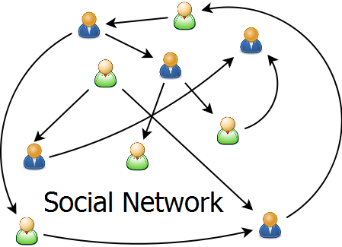
Social Network
Objective :
Build a social network to connect the tweets and users relationship
Nodes: 1) Users
2) Tweets
Edges: Existence of the relationship
Retweet
Mention
In reply to

Slide 22


RDF triplestore
RDF (Resource Description Framework) triplestore is a graph database for storing semantic facts:
Formally describes the semantics, or meaning, of information
Represents metadata
Consists of triples which are based on an Entity-Attribute Value (EAV) model
Selena Gomez follows Coach

Slide 23
What is triplestore?
Social network is a graph of nodes and edges (Every nodes as a user and edge as a relationship)
Triplestore stores every node-edge (user-user relationship in simple sentence form)
Simple sentence: <subject> <predicate> <object>
Subject: user, predicate: relationship object: user
We store each user in form of Twitter Ids

Slide 24
Why Triplestore?
Faster than relational databases
Support optional schema models, called ontology
Improve the search and analytics power
Use of SPARQL Query

Slide 25
Convert CSV to RDF N-Triple File
Apache Jena Library in Java to convert CSV file to N-Triple (.nt) file
Apache Jena Fuseki server to store social network (n-triple) data

Slide 26
N Triple file sample
<http://example.org/898620093059534848>
<http://xmlns.com/SNR/0.1/mentions> "1021074122" .
Subject: URI of the userID
Predicate: URI of the predicate
Object: userID (string)

Slide 27
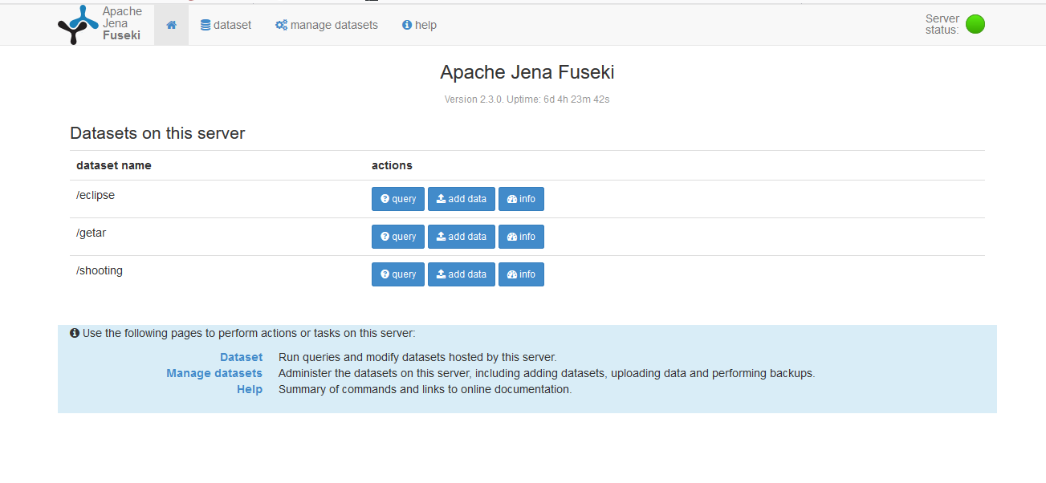
Triplestore Database

Slide 28
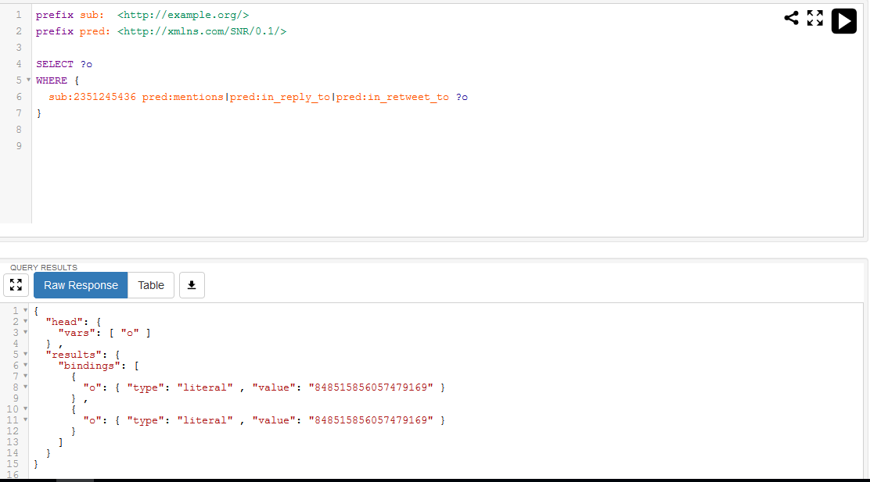
Triplestore Database

Slide 29
Front End Team Interface
Dataset:
Solar Eclipse event : /eclipse
LasVegas Shooting event : /shooting
(Both datasets are Persistent in fuseki server)
URI:
Subject: <http://example.org/>
Predicate: <http://xmlns.com/SNR/0.1/>

Slide 30
Front End Team Interface
Relations:
in_reply_to
mentions
in_retweet_to
followedBy

Slide 31
Front End Team Interface
Sample for fetching query result in JSON:
http://mule.dlib.vt.edu:3030/eclipse/query?query=prefix%20sub:%20%3Chttp://example.org/%3E%20prefix%20pred:%20%3Chttp://xmlns.com/SNR/0.1/%3E%20SELECT%20?y%20WHERE{sub:2351245436%20pred:mentions|pred:in_reply_to|pred:in_retweet_to%20?y.}&wt=json&json.wrf=my_callback
Will fetch all mentions, in_reply_to and in_retweet_to ids of user id 2351245436

Slide 32
Time to upload data
The largest Solar Eclipse file (~373MB) NT file takes ~4 min to upload
Time to upload whole Solar Eclipse core ~ 12 min
Time to upload Las Vegas Shooting core ~2 min

Slide 33
Challenges and Future Works
Fetching Twitter followers, friends takes time, not possible ~4M users
Converting directly to n-triple file from JSON
Parallelizing the conversion to N-Triple
Storing user names, screen names, followers, friends in social network
Calculating followers, friends for top N users who have highest number of followers, friends, tweets posted

Slide 34
Acknowledgment
First, we would like to thank Dr.Fox for his constructive comments and guidance during this project.
Our thanks are also due to US National Science Foundation for supporting Global Event and Trend Archive Research (GETAR) through IIS-1619028.

Slide 35
Questions?

