Slide 1

MetaArchive
Across Its Life Cycle:
Change and resilience in the
digital preservation ecosystem
Featuring panelists representing MetaArchive community leadership, LOCKSS, and Educopia
Moderated by Jessica Meyerson @ Educopia
Coalition of Networked Information Spring Meeting
Milwaukee, Wisconsin
April 8, 2025

Slide 2
Desired Takeaways
Key
Audiences
We need community-based digital preservation now more than ever.
MetaArchive’s deliberate sunset is not a reflection on the viability of distributed, community-governed digital preservation networks writ-large. Quite the contrary.
We know enough now (20 years into LOCKSS based digital preservation) to design for community resilience.
Inherent tension or false binary: balancing affordability of a community-owned digital preservation network with adequate resourcing to ensure that the network as a digital preservation solution is usable for institutions whose staff capacity varies widely
Library Deans
Assistant Deans
Chief Technology Officers
Consortial Project & Program Leads
Resource Allocators
Institutional & Field Level Changemakers

Slide 3
Framing: Many Paths
to an Abundant Future
In recent news: Abundance,
by Ezra Klein & Derek Thompson
Scarcity is the result of deliberate policy decisions
Scaling up production - building more of the stuff we need (e.g., affordable housing)
Institutional risk-aversion and inefficiency are making it difficult to build
Techno-optimism combined with policy realism
Abundance is a big tent - a vision accomplished via massive investment, public goods, and infrastructural expansion
While policy interventions are CRITICAL
how do we advance visions of abundance without relying solely or primarily on markets, the state, or key moments of national mobilization?

Slide 4
Framing: Many Paths to an Abundant Future
June Jordan, in her poem entitled “Poem for South African Women” (1956,1980) writes:
“We are the ones we have been waiting for”
There is a long and deep lineage of visionaries, pre-figuring abundant futures - people that are actively breathing those futures to life by practicing care and resource sharing inside our relationships. This practice is rooted in the understanding that what we practice inside of our everyday lives and the accumulation of choices throughout our day are ultimately reflected in our systemic realities.
Dr. Jessica Gordon Nembhard
Dr. Tyrone C. Howard
Dr. Kathleen Fitzpatrick
Dr. Marissa Duarte

Slide 5
MetaArchive’s Lifecycle Through the Lens of Abundance and Scarcity:
01
02
Formation (2004-2006)
MetaArchive emerged as a response to the scarcity of sustainable digital preservation infrastructure
First Private LOCKSS Network (PLN)
Demonstrated an early commitment to abundance—resource-sharing, collaboration, and decentralization—as opposed to isolated, proprietary solutions
NDIIP funding was key to its early instantiation
Validation (2007-2010)
MetaArchive transitioned from Emory to Educopia to ensure longevity beyond shifting funding priorities
2011, MetaArchive shifted from its reliance on NDIIP funding to a membership-funded model
Reflected an abundance mindset—investing in shared governance and community-driven sustainability rather than relying on a single institution’s resources.

Slide 6
MetaArchive’s Lifecycle Through the Lens of Abundance and Scarcity:
03
04
Acceleration (2010-2018)
Digital preservation became professionalized and programmatic
MetaArchive member reps shifted from high-level administrators to preservation specialists
Expansion in digital preservation also created budget constraints, barriers for smaller institutions, and a growing need for affordable solutions.
The SuperNode Pilot (2016-2018) aimed to lower technical barriers and expand access to preservation services for under-resourced organizations.
Transition (2019-Present)
Growing diversity in institutional needs and funding
Project Mycelium (2022) & CRTF/LOCKSS Transition (2023-2024).
These initiatives focused on
  redistributing technical expertise,
  refining business models, and
  ensuring equitable participation.
The decision to sunset was not due to a failure of these strategies, but a result of the community’s stewardship policies, which ensured resources for a thoughtful sunsetting process and the repurposing of resources to support the growth of existing and new PLNs.

Slide 7
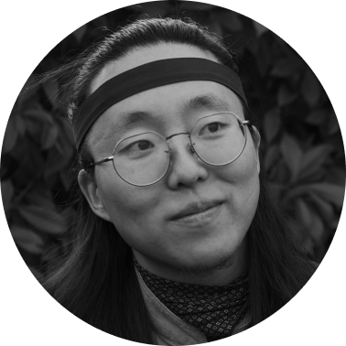
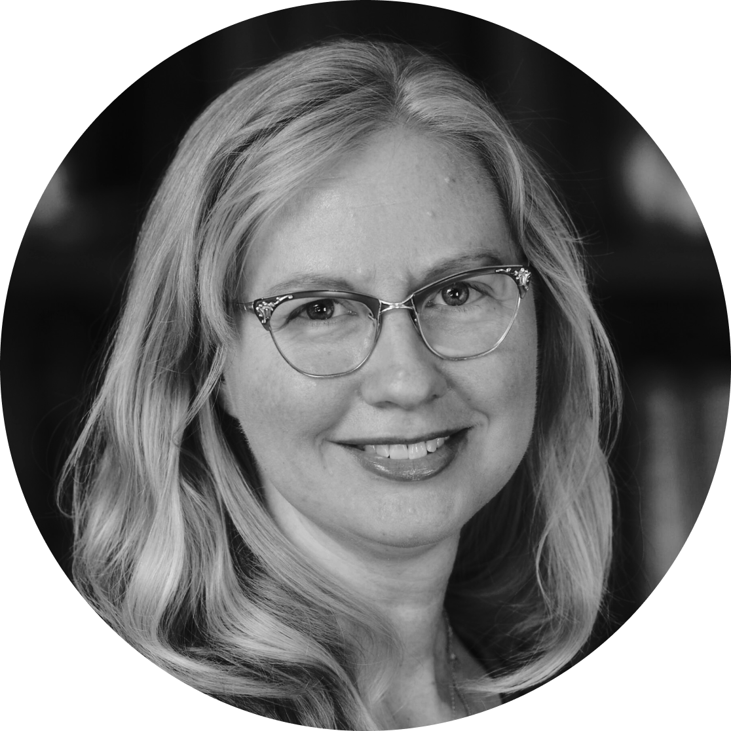
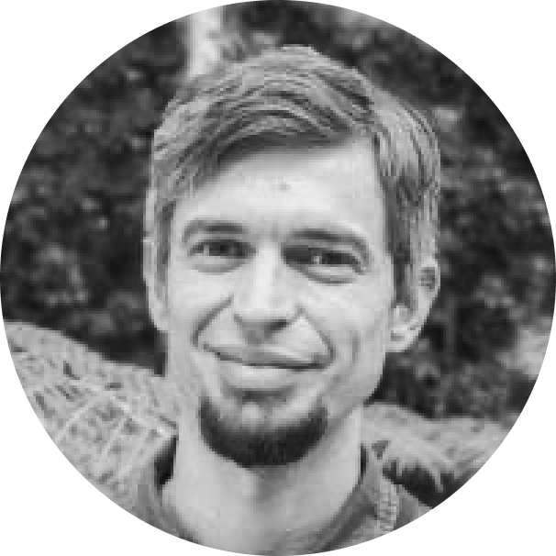
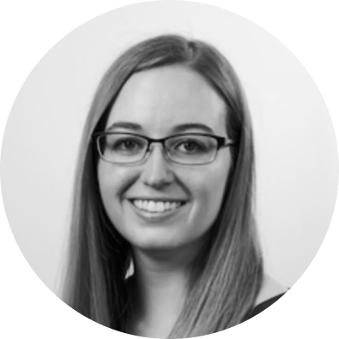
Introducing our Panelists: Community as key to abundance
Our panelists and moderator were all members of the MetaArchive Transformation Research Team (TRT). The TRT was responsible for “holding the whole” through the sunsetting process.Other TRT members included:
Christine Wiseman (Atlanta University Center), Reid Boehm (Purdue University),Hannah Pryor (University of Louisville), Thib Guicherd-Callin (LOCKSS), Aloma Antao (Educopia)
Jackson Huang
Educopia,
Research Lead & Consultant
Snowden Becker
Stanford University,
LOCKSS Program
Community Manager
Zach Vowell
CalPoly State University,
Digital Archivist / Digital Strategies Coordinator
Alex Kinnaman
Virginia Tech, Assistant Director, Digital Libraries & Preservation

Slide 8
Alex
What lessons from MetaArchive’s model challenge the scarcity mindset often governing institutional budget decisions?
How do Private LOCKSS Networks represent an opportunity to build community-owned infrastructure rather than rely on commercialized-scarcity driven alternatives?
How can digital preservation be reframed as an investment in abundance rather than
a cost to minimize?
Snowden
Instead of thinking about, “how cheaply can we get this done,” how can our necessary expenditure on preservation of digital assets become an investment in staff, community, and relationship-building?

Slide 9
What does it take to sustain community- driven infrastructure, and what happens when institutions fail to invest in it?
Jackson
Looking at MA’s lifecycle, what were key tensions between institutional resource allocation strategies
and the cooperative model?
Zach
What are the risks of short-term convenience choices (e.g., outsourcing) when institutions should be thinking generationally?

Slide 10
How can institutions invest in long-term capacity building for digital preservation?
Alex
What skills and knowledge should institutions be developing initially to ensure they are stewards of their own digital futures?
Zach
What are some of the components that need to be in place for a successful community-governed digital preservation network?

Slide 11
What models can we learn from in order to achieve greater resilience community-driven digital preservation networks?
Snowden
What do these models tell us about the benefits of understanding community-driven digital preservation networks as essential civic and technical infrastructure rather than as technical solutions?
Jackson
What lessons can be learned from mutual-aid networks, and other cooperative models to inform the future of community-driven digital preservation?

Slide 12
All Panelists
For our last question, each panelist will tell you why, specifically, they believe this statement to be true.
“In a time of field-and-nationwide change and transition,
investments in shared infrastructure and inter-institutional communities of practice help create both an abundant and resilient information ecosystem – only collectively can we guarantee access to
our cultural heritage in the long-term.”

Slide 13
Where to learn more & access resources:
Educopia’s website will permanently host information about MetaArchive’s history and the sunsetting process: https://educopia.org/sponsee-profile/metaarchive-cooperative/
GitHub repository of code and documentation related to the technical operation of the MetaArchive network: https://github.com/MetaArchive
LOCKSS wiki with PLN start-up docs: a collection of templates drawn from MetaArchive for the start-up and operation of other PLNs: https://github.com/lockss/community/wiki/PLN-Templates
Join former MetaArchive members and Educopians at the Digital Library Forum in November for a hands-on workshop exploring the intersection of technological and relational infrastructures needed for resilient digital preservation networks.

