Slide 1
Driving the Future: Analyzing Vehicle Energy Usage
Christina Chao, Courtney Quinn, Eric Tapia, Layla Scott, Rohin Batra
CS 4624 Multimedia/HyperText
Professor Mohamed Farag
Virginia Tech, Blacksburg VA 24061
December 5, 2024
Notes:
Eric
We’re team 14 and our project is on building a web app for a automated vehicles fuel consumption estimator

Slide 2
Content Overview
Project Recap & Motivation
The Team
System Architecture / Technologies
Tasks Completed
Live Demo
Lesson Learned
Future Improvements
Acknowledgements
Notes:
Eric
These are the topics were are going to be discussing today, going over:

Slide 3
Personnel
Courtney Quinn
Layla Scott
Group Leader
Backend/Frontend Lead
Frontend Lead
Christina Chao
Rohin Batra
Eric Tapia
Frontend Support
Meeting Minutes
Backend Support
Backend Support
Notes:
Eric
Alright, …
Wave when you are called on

Slide 4
Project Recap
Web application that integrates models developed by Virginia Tech Transportation Institute (VTTI)
Users upload speed profiles that will create energy analytics through charts based on the selected vehicle type:
Internal Combustion Engine Vehicles (ICEV)
Battery Electric Vehicles (BEV)
Hybrid Electric Vehicles (HEV)
Hydrogen Fuel Cell Vehicles (HFCV)
Notes:
Rohin
Web app to process vehicle information for a user to output fuel usage to be visualized and compared, provide profiles for the following types of vehicles

Slide 5
Project Motivation
Promote understanding of vehicle energy efficiency
Aid researchers in analyzing transportation energy use
Help consumers make informed vehicle purchase decisions
Support efforts to reduce carbon emissions in transportation
Notes:
Rohin

Slide 6
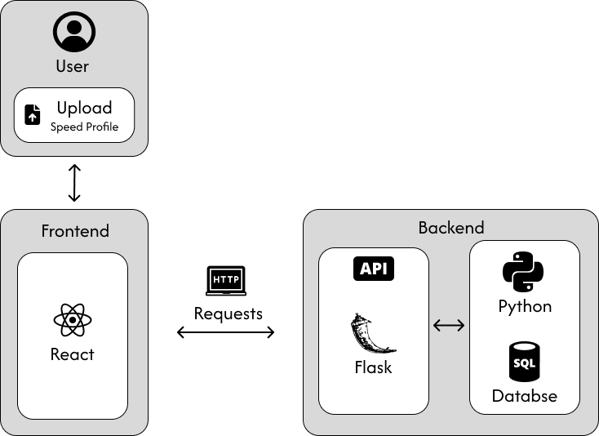
System Architecture
Notes:
Layla This diagram illustrates our system's three main components: user interface, frontend, and backend
Users interact with our React frontend to:
Create accounts and log in
Upload speed profiles
View energy analysis results
Frontend communicates with Flask backend via HTTP requests for:
Energy calculations
User authentication
Session management
Backend system consists of:
Python-powered energy calculation models
REST API endpoints
SQLite database storing user data and analysis results

Slide 7
Technologies
React.js for dynamic user interface
CSS for styling
Recharts for data visualization
Python 3.12
VS Code for development
Flask 3.0.0 web framework
SQLite for database management
GitLab for code collaboration
Notes:
Layla

Slide 8
Tasks Completed
✓ Set up Flask backend with SQLite database
✓ Implemented vehicle energy calculation models for all 4 vehicle types
✓ Created secure admin routes for vehicle parameter management
✓ Built responsive React frontend with modern UI components
✓ Developed file upload system for speed profiles
✓ Added session tracking and user history features
✓ Implemented data visualization for energy analytics
✓ Created comprehensive API documentation
✓ Added error handling and input validation
✓ Implemented user authentication and account creation
✓ Deployed application to production environment
Notes:
Rohin

Slide 9
LIVE DEMO
Deployed Version
Notes:
Courtney Quinn
Testuser first: make a collection, view the graphs, edit it
Test admin: show the vehicle params, user management
Speed Bins: Groups similar speeds together and shows the typical values for each group, like putting all data from 20-25 mph in one bucket.
Moving Average: Takes the average of nearby points to make the line smoother, like when you look at the general slope of a hill instead of every bump.
Sampled Data: Shows actual measurements but skips some points, like reading every 10th number from a list to get the basic idea.

Slide 10
Future Improvements
Create mobile-friendly version of the application
Develop batch processing for multiple speed profiles
Add ability to update the energy python code (for new engine types) without having to go through the code
Notes:
Christina

Slide 11
Lessons Learned
Integration between Python backend and React frontend requires thorough API planning and documentation
Better time management and milestone tracking
Earlier and more frequent collaboration between frontend and backend teams
Notes:
Christina

Slide 12
Acknowledgements
Client/Course Instructor: Professor Mohamed Farag
VTTI Researchers
Notes:
Eric
We want to acknowledge our client and course instructor for this project, Professor Mohamed Farag.

Slide 13
Thanks!
Does anyone have any questions?

