Slide 1
Chapter Summarization
Manasi Peta, Joe Grilli, Aidan Simms, Nandha Chokkan
CS 4624: Multimedia/Hypertext, and Information Access
taught by Dr. Edward A. Fox
Virginia Tech, Blacksburg VA 24061
4/20/2023

Slide 2
Outline
Project Overview
05
Acknowledgements/References
05
01
01
04
04
Frontend
Data Extraction
02
02
03
03
Summarization
Notes:
The second slide should be Outline, with a list of key headings of the sections of the presentation that follow.

Slide 3
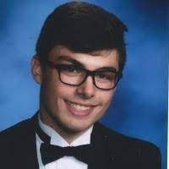
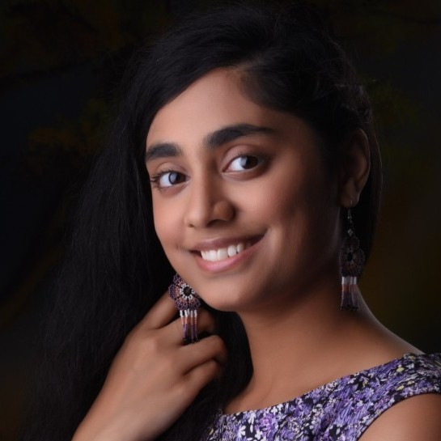
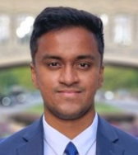

Team Members
Joe Grilli
Front End Main
Communications Backup
Manasi Peta
Communications Main
Back End Backup
Nandha Chokkan
R&D Main
Front End Backup
Aidan Simms
Back End Main
R&D Backup

Slide 4
Project Overview
Problems
Extremely long and not searchable
ETDs are not very accessible
Client - Bipasha Banerjee: PhD student, Natural Language Processing (NLP) researcher
Minimal metadata
Hard to discover interdiscipl-inary work

Slide 5
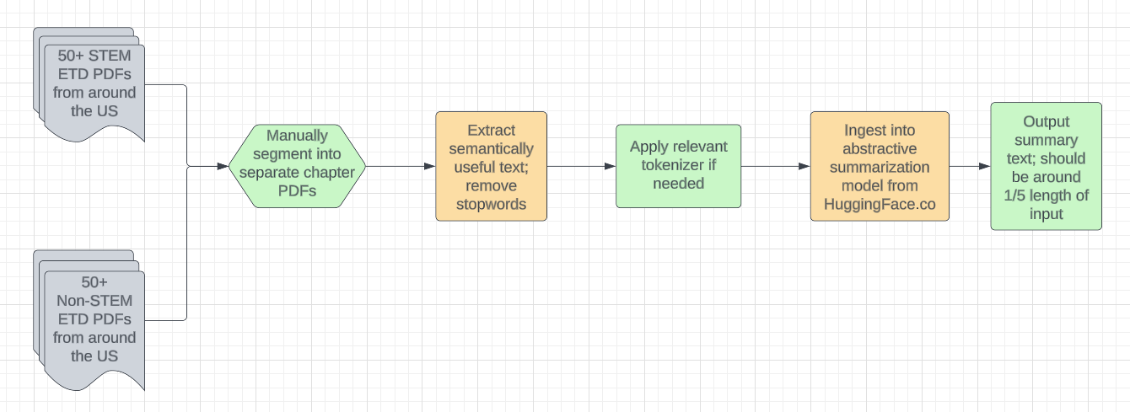
Backend

Slide 6
How? Object Detection (Intro)
Code and Research from ETD “Parsing Electronic Theses and Dissertations Using Object Detection” (Aman Ahuja, Alan Devera, Edward A. Fox, and others)
Visual Representation
PDF
PDF Images
Object Detection Model
Bounding Box Information
Pre-Processing

Slide 7
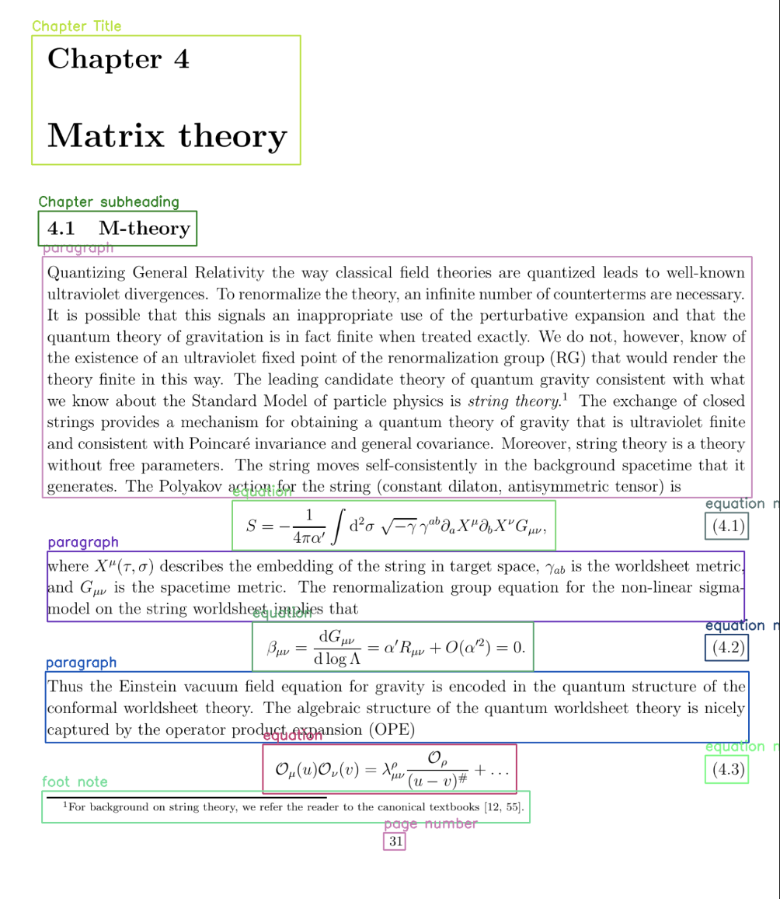
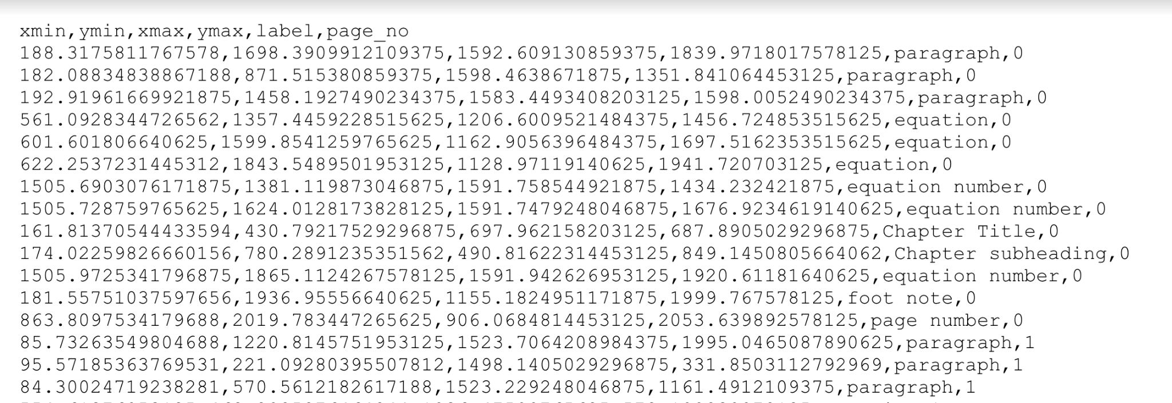
Object Detection Output (Partial)
ETD: Foundational Investigations &
Astronomical Implications of Quantum Gravity (Michael James Kavic)
http://hdl.handle.net/10919/29331
chapter4_marked_output.pdf
chapter4_bounding_box.pdf

Slide 8

Finding Summarization Models
Used pretrained text transformation models hosted at https://huggingface.co/

Slide 9
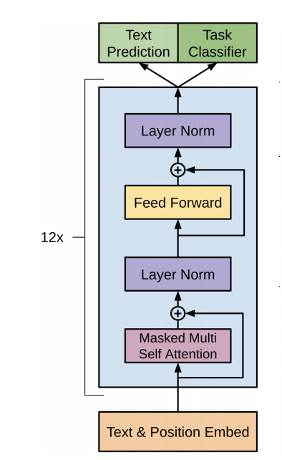
Implementing Summarization Models
Deliverable: 4 summarization models implemented
  BART
  T5
  BigBirdPegasus
    Block Sparse Attention
  Longformer-Encoder-Decoder (LED) - Book Summarization
    Longer input ability than most summarization models (~16000 tokens)
https://www.projectpro.io/article/transformers-bart-model-explained/553
Notes:
BART
Facebook AI
Trained on CNN dataset: News articles and such
Input Token Max: 1000
BigBirdPegasus
Block Sparse Attention improves upon normal attention by using a combination of global, sliding, and random connections to decrease the number of computational power needed per token (word)
Trained on “arxiv” which is an academic paper repository
Input Token Max: 4000
T5
Google
Large Pre Trained Dataset: C4 (Colossal Clean Crawled Corpus which is twice the size of wikipedia)
Input Token Max: 500
LonformerEncoderDecoder
Transformer models typically scale quadratically, but the LED model uses an attention mechanism to scale linearly
Trained on book summaries dataset
Input Token Max: ~16000

Slide 10
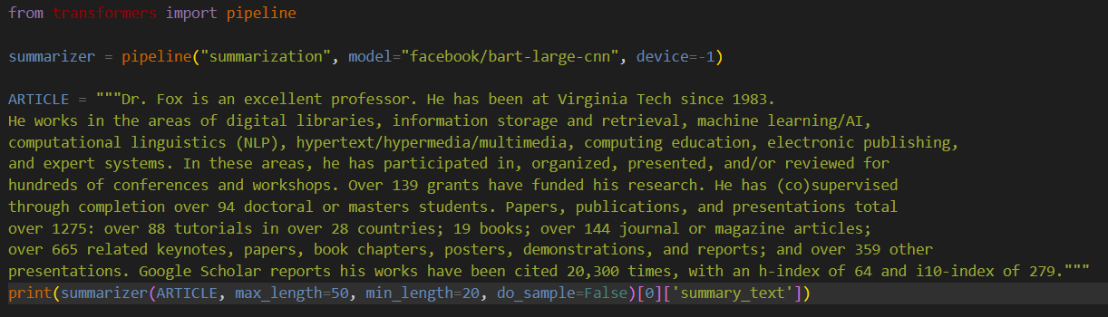
Example Summarization Scripts
Summary:
Team members wrote the above article taking information from various sources like Dr. Fox’s Virginia Tech and personal website.

Slide 11
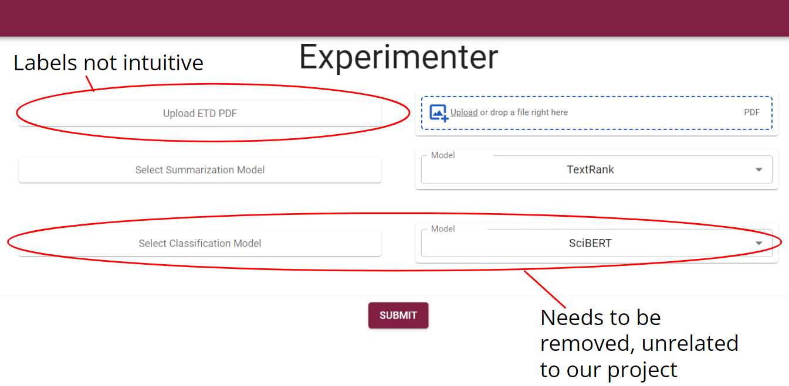
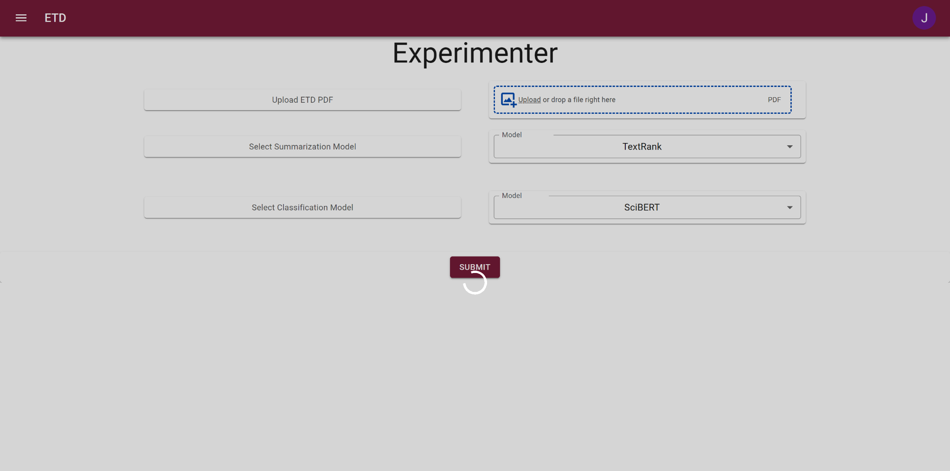
Original Frontend Work
Not customized to page
Site buffers indefinitely if button is pressed when no file is uploaded
Presentation from Fall 2022 CS5604 teams.
Ran summarization models and text extraction
Backend server no longer connected
Basic design with typos, unintuitive labels, and some bugs
Different scope

Slide 12
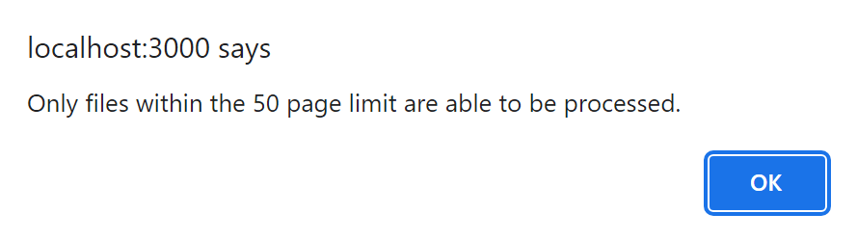
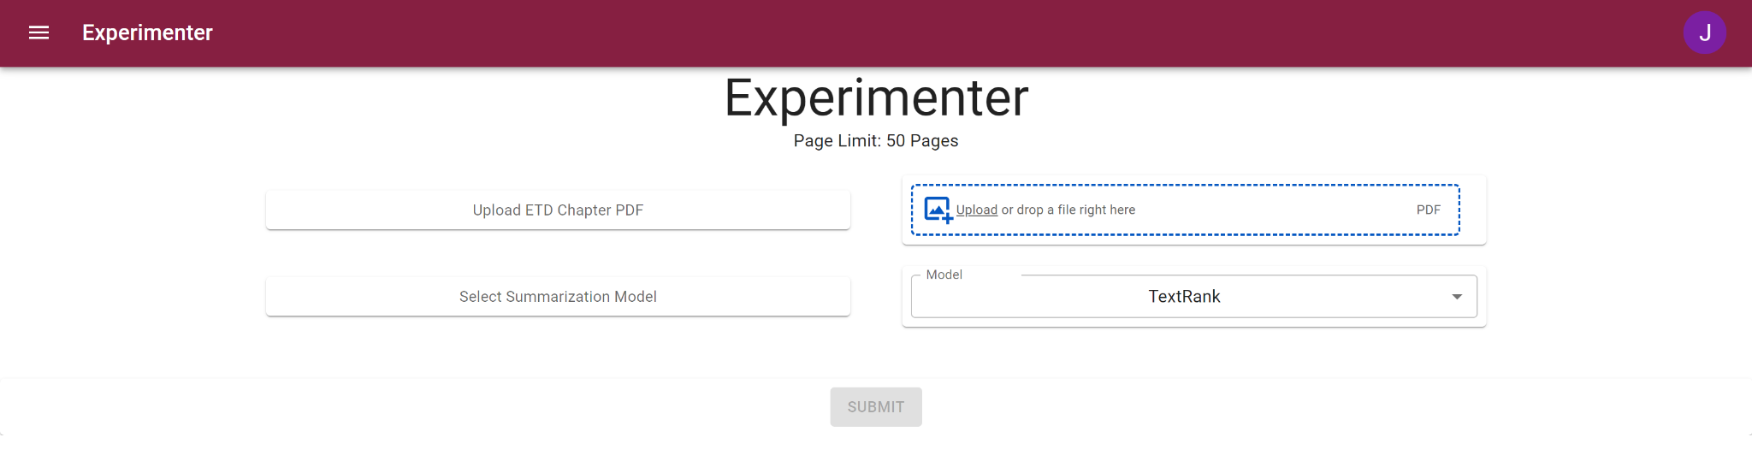
Frontend Changes
Removed components outside of scope
Altered page navigation and fixed typos
Implemented page limits
Custom page labels
Disabled buttons until file uploaded

Slide 13
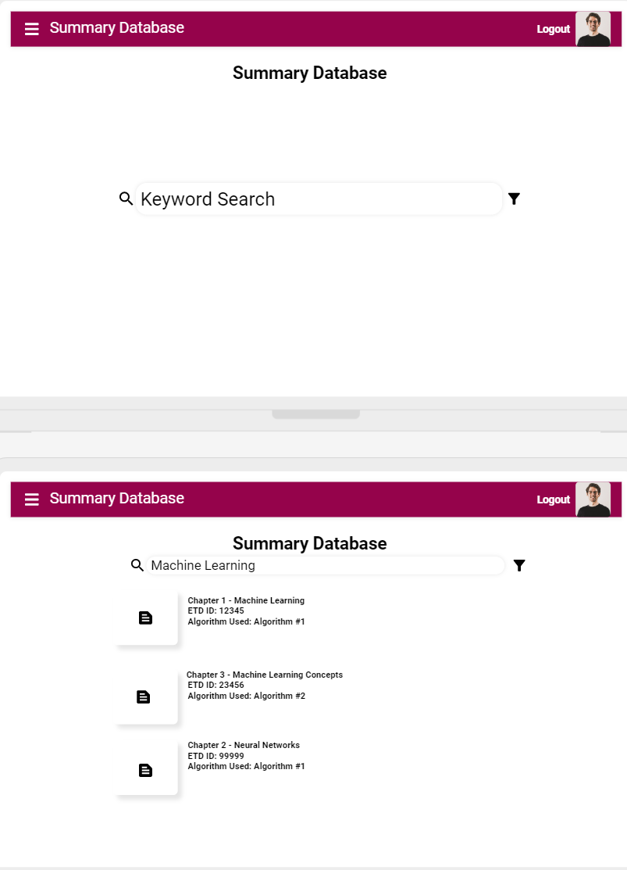
Summary Database
Used to view summaries produced by pipeline
Searchable by chapter name or ID
Display useful metrics like algo used

Slide 14
Future Plans
Implement summarize functionality for website
Explore different text extraction methods for cleaner and more complete output
Eventually implement with VTechWorks
UI alterations

Slide 15
Acknowledgements
Thanks to Aman Ahuja, Alan Devera, Edward Alan Fox, and others for the research in Object Detection in ETDs.
Thanks to the CS5604 Fall 2022 team guided by Dhanush Dinesh involved in creating the base frontend for our project.

Slide 16

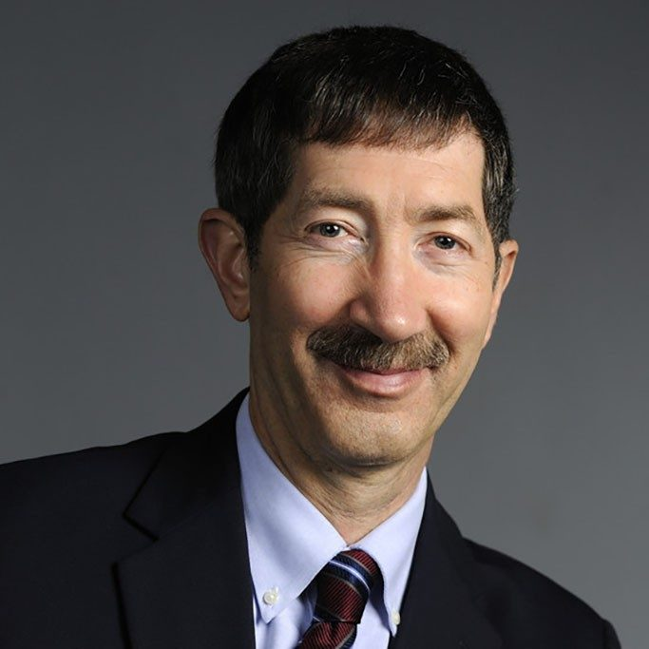
Acknowledgements
Special thanks to Bipasha Banerjee for providing us with the opportunity to work with a great client on such a meaningful project. Also, to Dr. Fox for guiding and informing the process thus far.
Notes:
The final slides should include: Acknowledgements (covering the client, any grants or sponsor details), References (books, papers, URLs with associated title/author/year information, other resources)

Slide 17
References
Parsing electronic theses and dissertations using Object Detection (Aman Ahuja, Alan Devera, Edward Alan Fox, and others)
PDF2Image Documentation (Edouard Belval)
PDFPlumber Documentation (Jsvine)
PyMuPDF Documentation (Jorj X. McKie, Ruikai Liu, Artifex)
Wordninja Documentation (Derek Anderson)
Yolov7 Documentation (Kin-Yiu Wong)

Slide 18
References
HuggingFace
Hugging Face - BART (Mike Lewis, Yinhan Liu, Naman Goyal, Marjan Ghazvininejad, Abdelrahman Mohamed, Omer Levy, Ves Stoyanov, Luke Zettlemoyer)
Hugging Face - BigBirdPegasus (Zaheer, Manzil and Guruganesh, Guru and Dubey, Kumar Avinava and Ainslie, Joshua and Alberti, Chris and Ontanon, Santiago and Pham, Philip and Ravula, Anirudh and Wang, Qifan and Yang, Li and others)
Hugging Face - T5 (Colin Raffel, Noam Shazeer, Adam Roberts, Katherine Lee, Sharan Narang, Michael Matena, Yanqi Zhou, Wei Li, Peter J. Liu)
Hugging Face - Longformer Encoder Decoder (Iz Beltagy, Matthew E. Peters, Arman Cohan)

