Slide 1

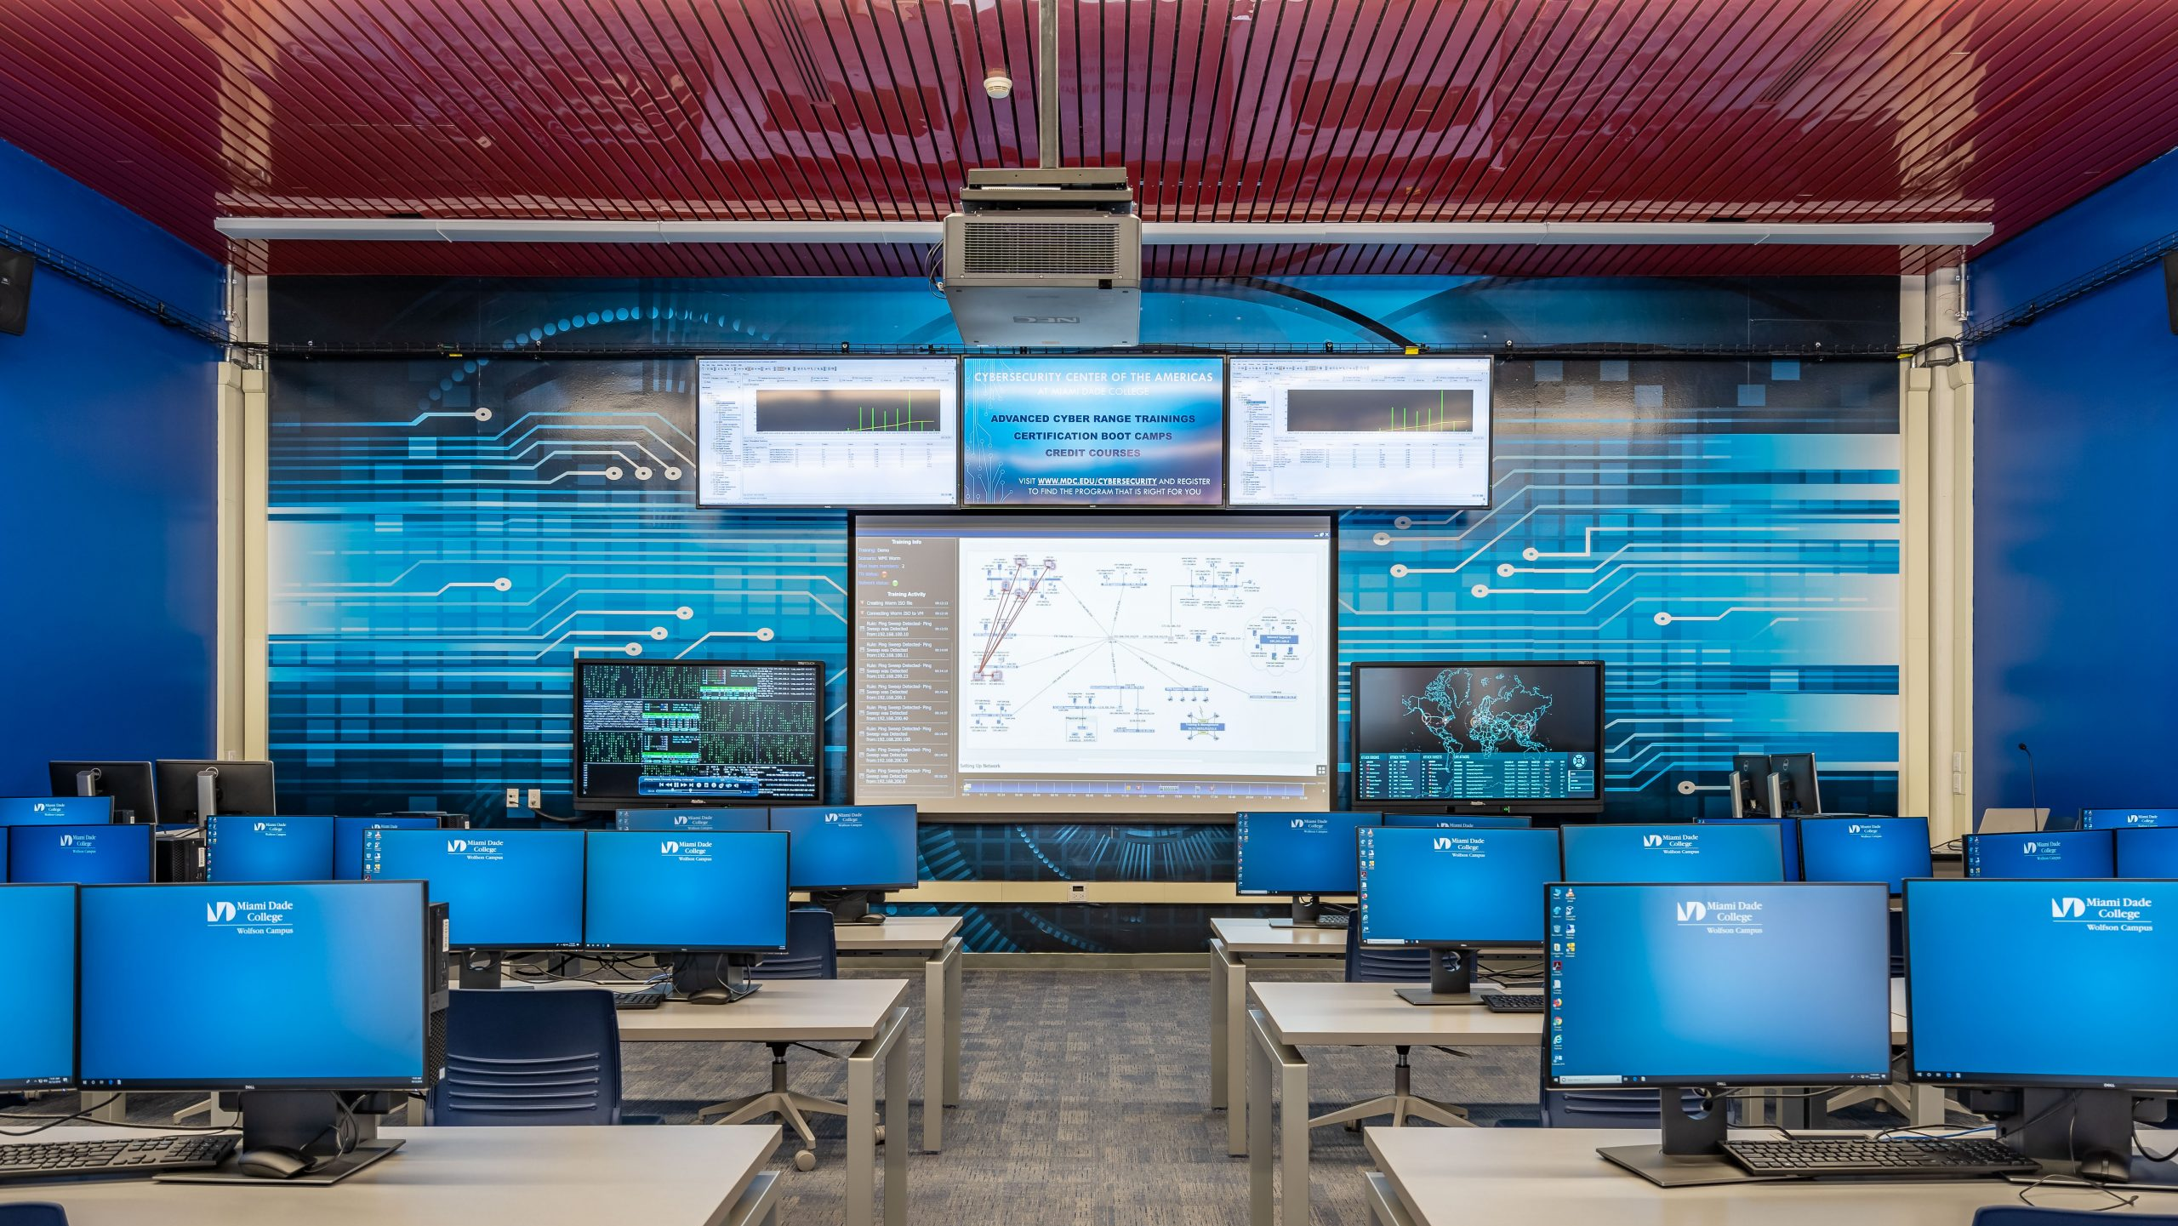
U.S. Cyber Range Website
CS 4624 - Multimedia, Hypertext, and Information Access
Dr. Edward Fox
Virginia Tech, Blacksburg VA 24061
December 14, 2021
Trenton Deel, Aiden England, Matthew Rogers, Vikramaditya Pratha

Slide 2
Outline
Project Refresher
Custom theme structure
How client uses it
Future work
Lessons learned
Acknowledgements

Slide 3

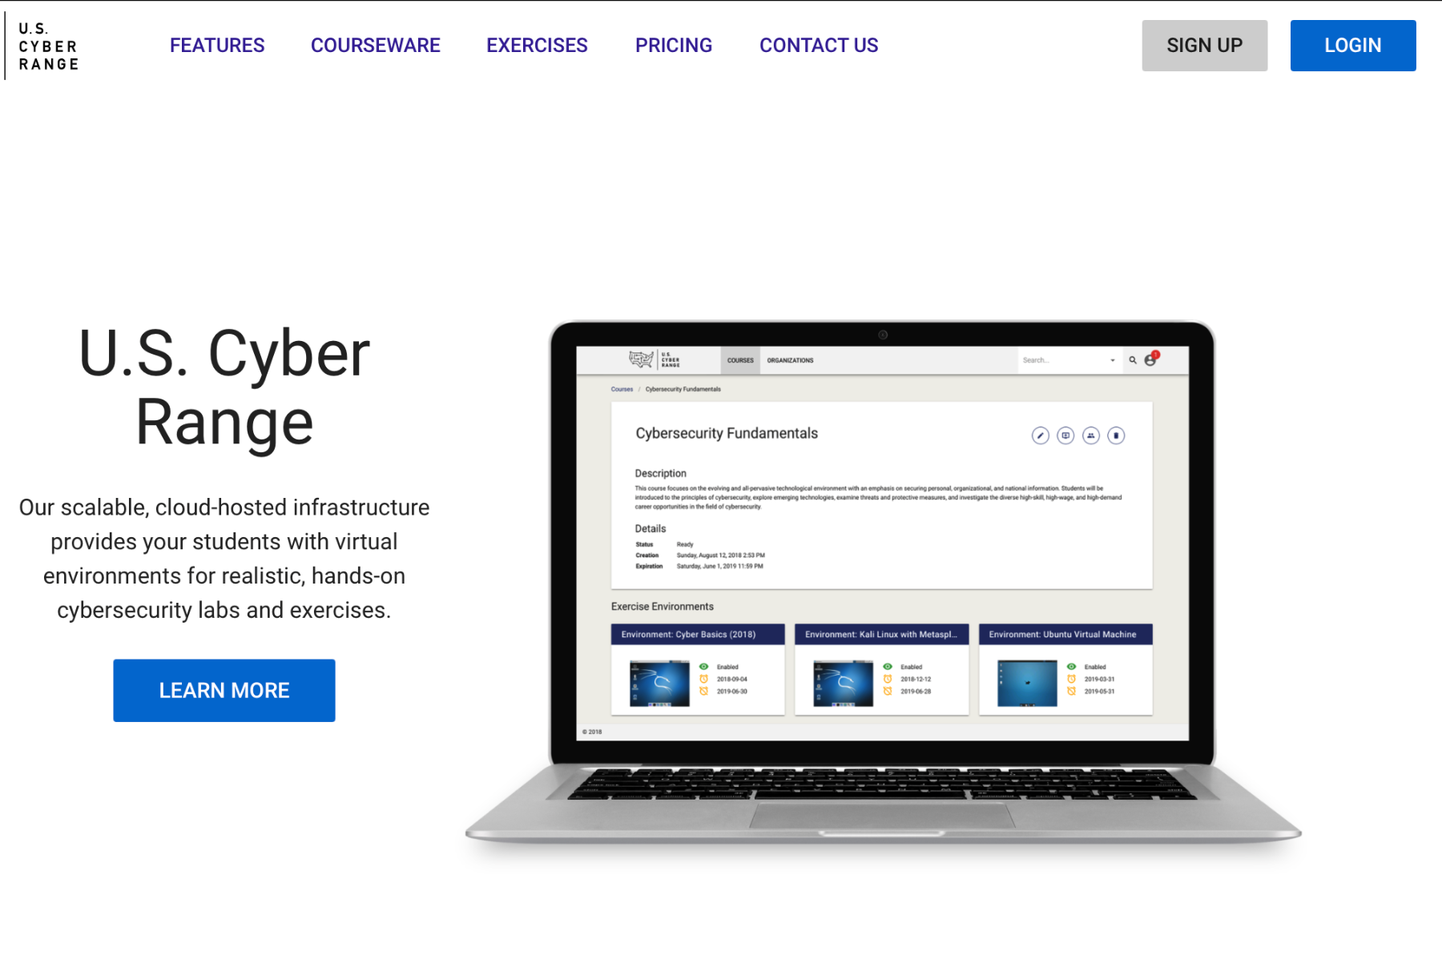
Project Refresher
U.S. Cyber Range website redesign
Collaboration with FourDesign team
Site will be client Maintainable

Slide 4
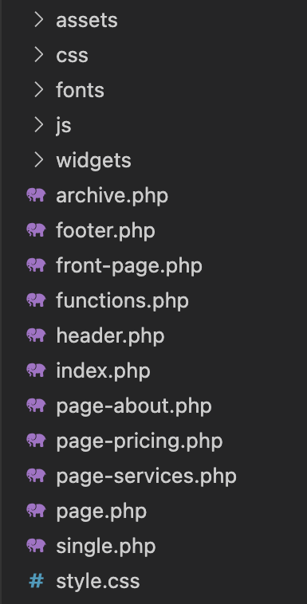
Custom theme
Main deliverable to client
Consists of
  Wordpress overhead
  Page templates
  Widgets
  Accompaning css/js files

Slide 5
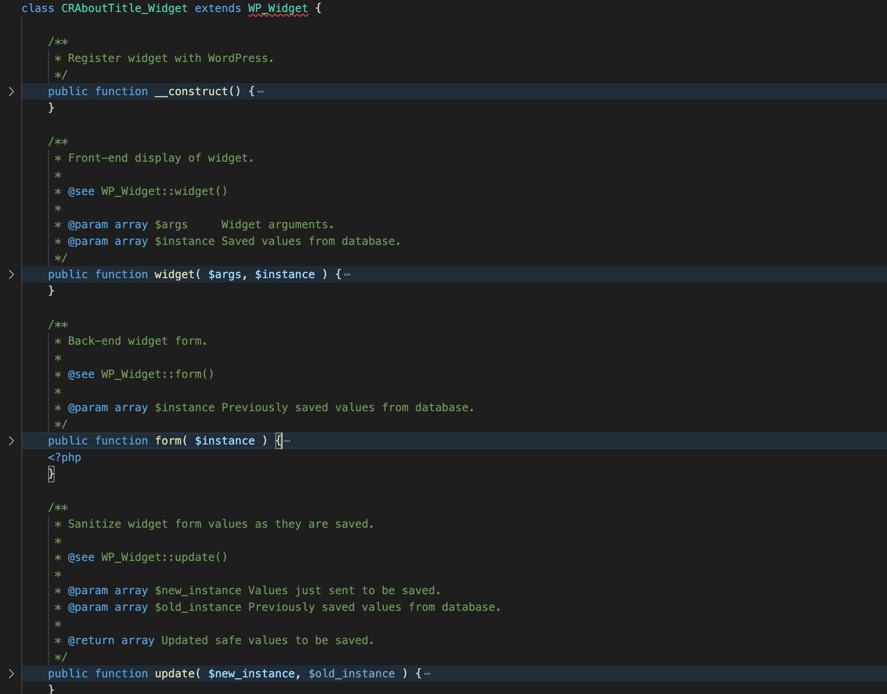
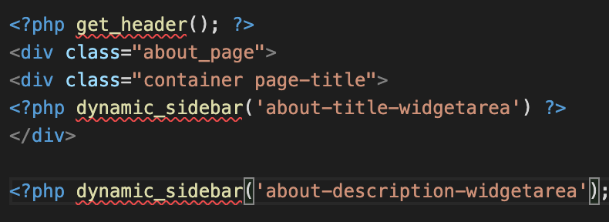
Widgets/Widget Areas

Slide 6
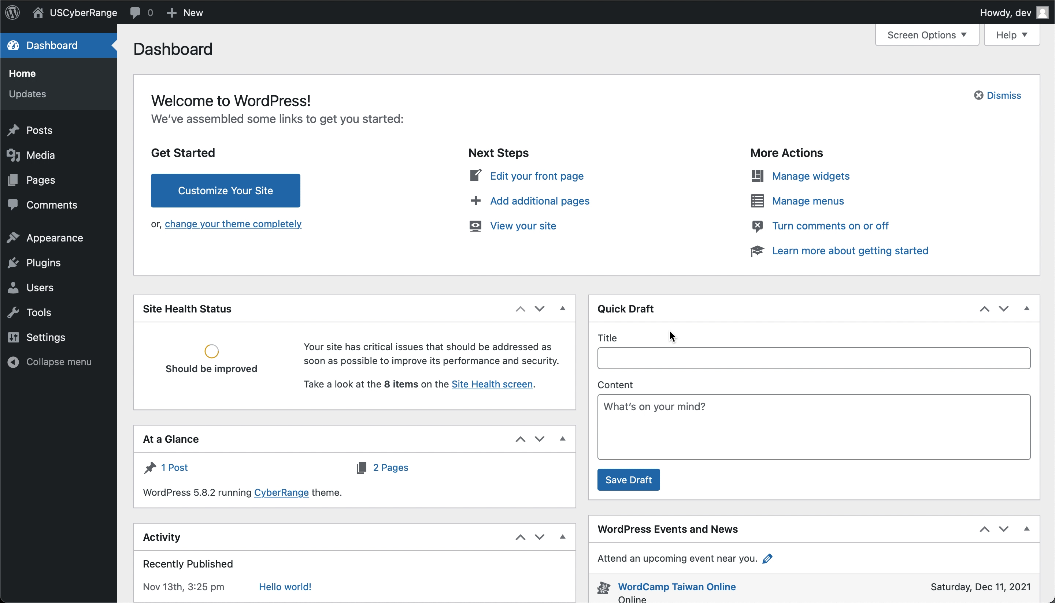
Sample use case

Slide 7
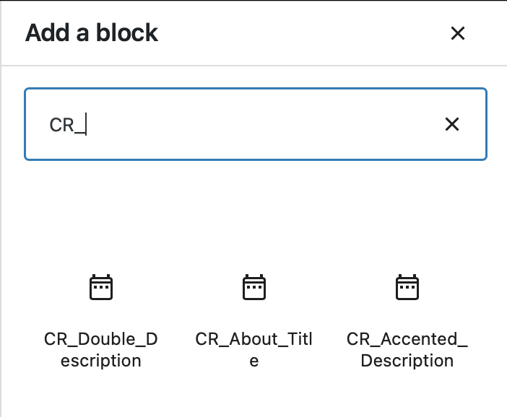

further customization options
A snippet, from the WordPress dashboard, of using the services template that we created.
Some of the custom widgets created shown on the WordPress dashboard

Slide 8




Independent Development
Client unable to provide hosting environment in timeframe - couldn’t get an environment for us in a timely manner
Running an instance of WordPress through XAMPP running mySQL and Apache concurrently

Slide 9
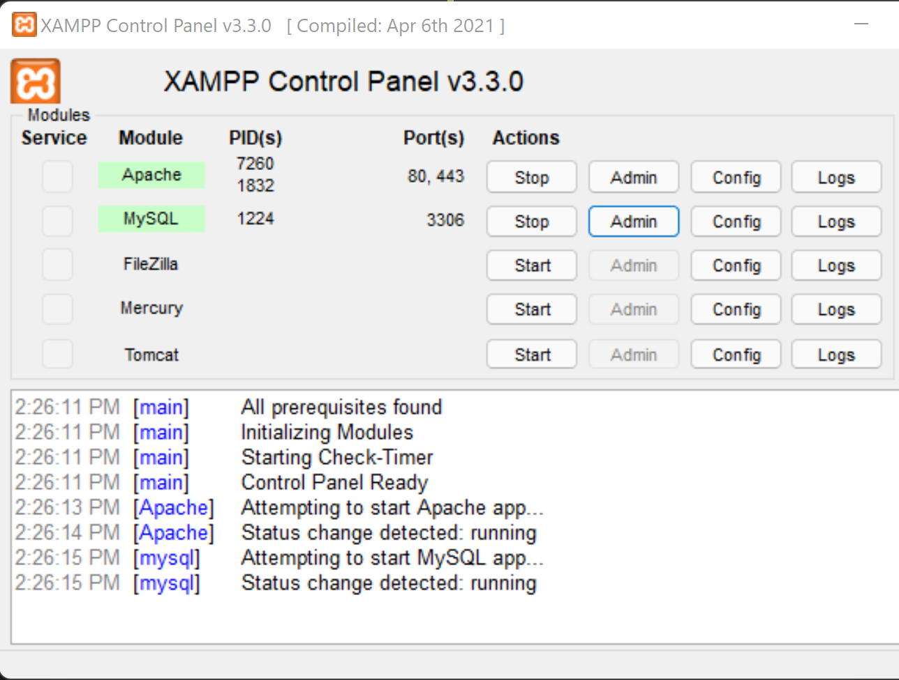
Xampp Dashboard
XAMPP is an Apache distribution that includes PHP, PERL, and mySQL for ease of development workspace setup and management

Slide 10
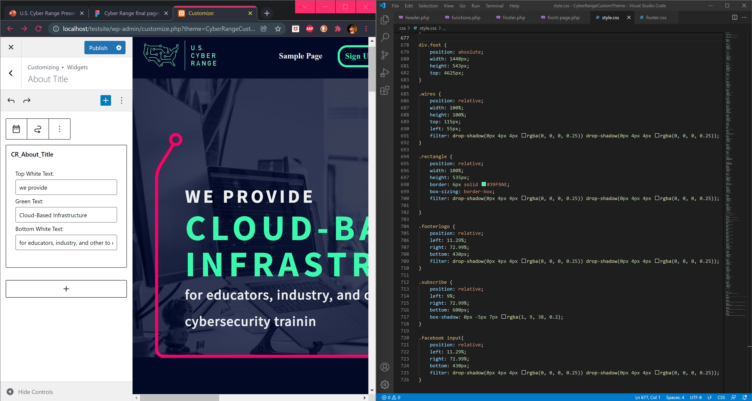

Slide 11
Future Work
Implement Remaining Site Elements
Search Engine Optimization (SEO)
Ensure site maintains accessibility standards (WCAG 2.1 Level AA)
Implement further revisions as site develops

Slide 12
Lessons Learned
Time Management and Efficient Scheduling
Team Communication
Design Process (Design, Revisions, Approval)

Slide 13


Acknowledgements
Dr. Fox – Professor
Jeff Joiner – Leader of Four Design Team

Slide 14
References
U.S. Cyber Range of Virginia Tech. (2019) About the U.S. Cyber Range. uscyberrange.org. Retrieved November 11, 2021, from https://www.uscyberrange.org/about.
“Apache Friends,” Apache Friends RSS, 2021. [Online]. Available: https://www.apachefriends.org/index.html. [Accessed: 30-Nov-2021].
WordPress.org. Main Page " WordPress Codex. (n.d.). Retrieved December 1, 2021, from https://codex.wordpress.org/Main_Page.
M. Achour, Betz, et al. “PHP Manual,” php, 30-Nov-2021. [Online]. Available: https://www.php.net/manual/en/index.php. [Accessed: 30-Nov-2021].

Slide 15
Questions?

