Slide 1

Mobile Parenting Website
Akshath Majumder, Shreyas Sakhalkar, Luke Marks, Nihar Satasia
CS 4624- Multimedia, Hypertext, and Information Access, Professor Fox, Virginia Tech, Blacksburg VA, 24061, May 6, 2024

Slide 2
Outline
Project Overview
Website Architecture
Requirements
Database Schema
Frontend Walkthrough
Challenges
Future Work
Acknowledgements
References

Slide 3
Project Overview
Goal: create a web application for teaching parents
Parents will complete weekly adventures
Adventures have content and prompts for the user to answer
  Adventures must be dynamically generated
  User responses must be saved for their future reference
  Adventures must be time-locked

Slide 4
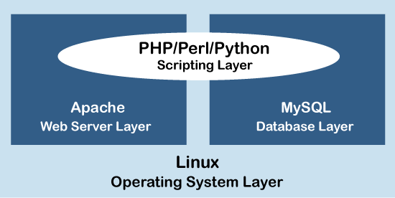

Website Architecture

Slide 5

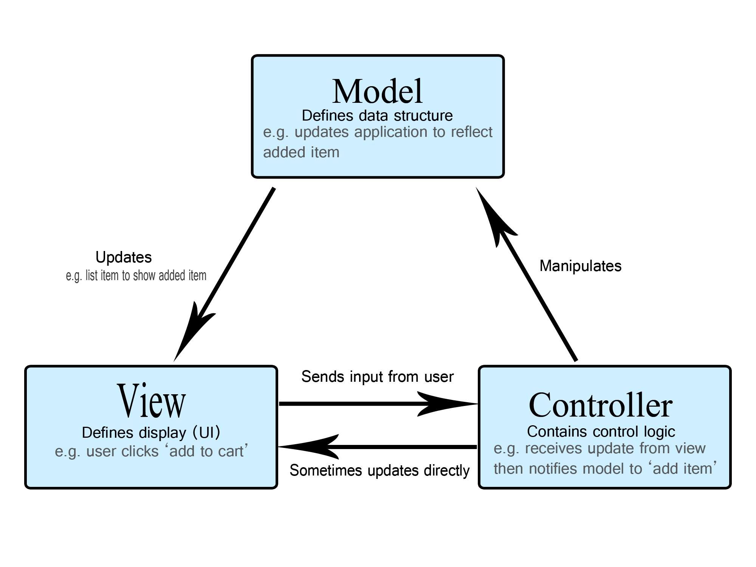
Website Architecture

Slide 6
Functional Requirements
Seamlessly transfer existing features from the Treks mobile app to the new web platform.
Increase interactivity and accessibility, adding multimedia content where useful.
Implement strong user registration and authentication policies to ensure data security and user privacy.
Offer user profiles that can be personalized, allowing parents and teachers to track their progress and preferences.

Slide 7
Functional Requirements
Develop interactive tools and features such as behavior tracking systems, interactive quizzes, and educational games to better engage users.
Include a community forum or discussion board for users to share experiences, tips and support.
Ensure that the platform is easy to navigate and that the content is easily accessible to technically savvy users.
Use a policy that works for access to different devices and screen sizes

Slide 8
Passive Requirements
The platform should load properly and process user requests simultaneously without significant delay.
Ensure uptime and reliability, with minimal downtime for repairs or upgrades.
Design the system to be scalable and not compromise performance with the growing number of users and resources.
Ensure that the platform architecture supports easy updates and integration of new features.
Implement industry standard security measures to protect user data and prevent unauthorized access.
Regularly update the platform and check for security vulnerabilities.

Slide 9
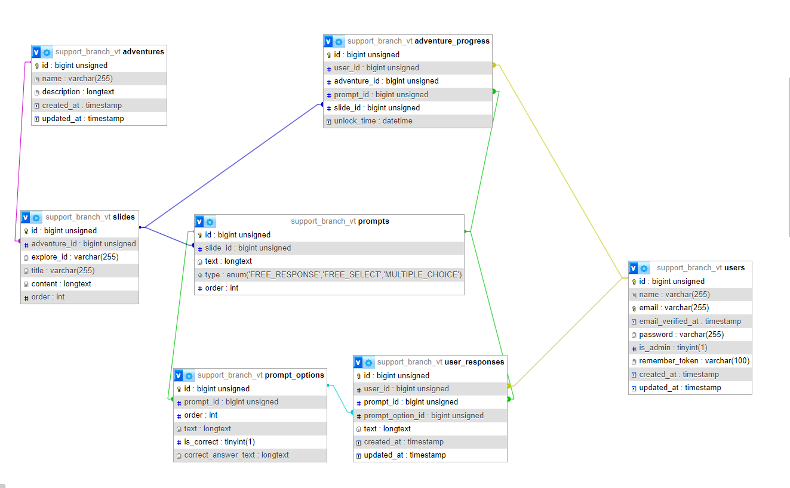
Database Schema

Slide 10
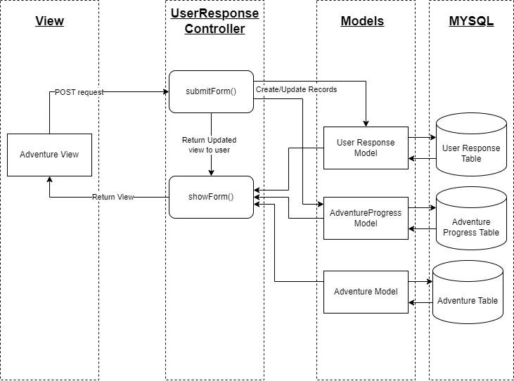
User Submission Backend

Slide 11
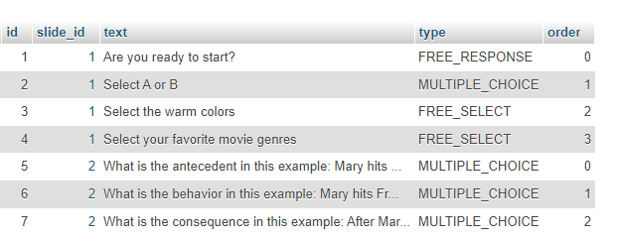
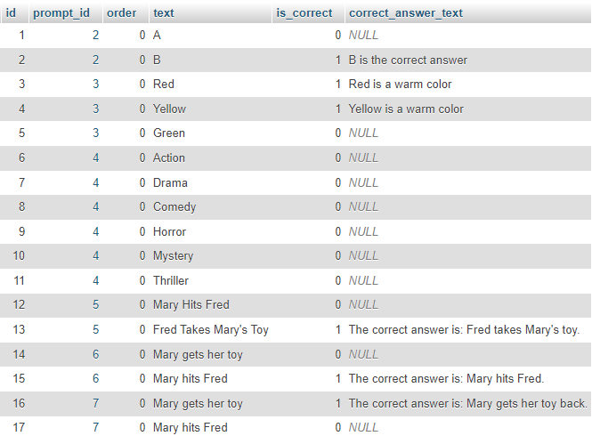

Sample Data
Options Table
Prompts Table
User Responses Table

Slide 12
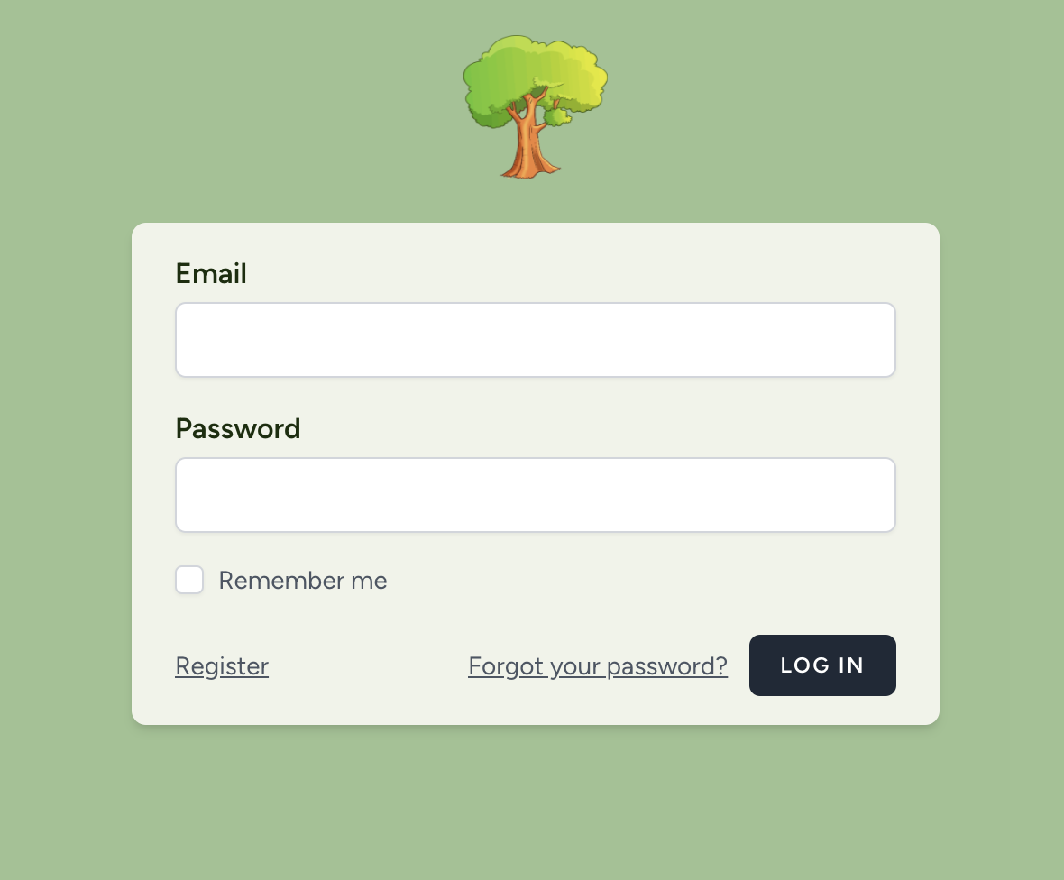
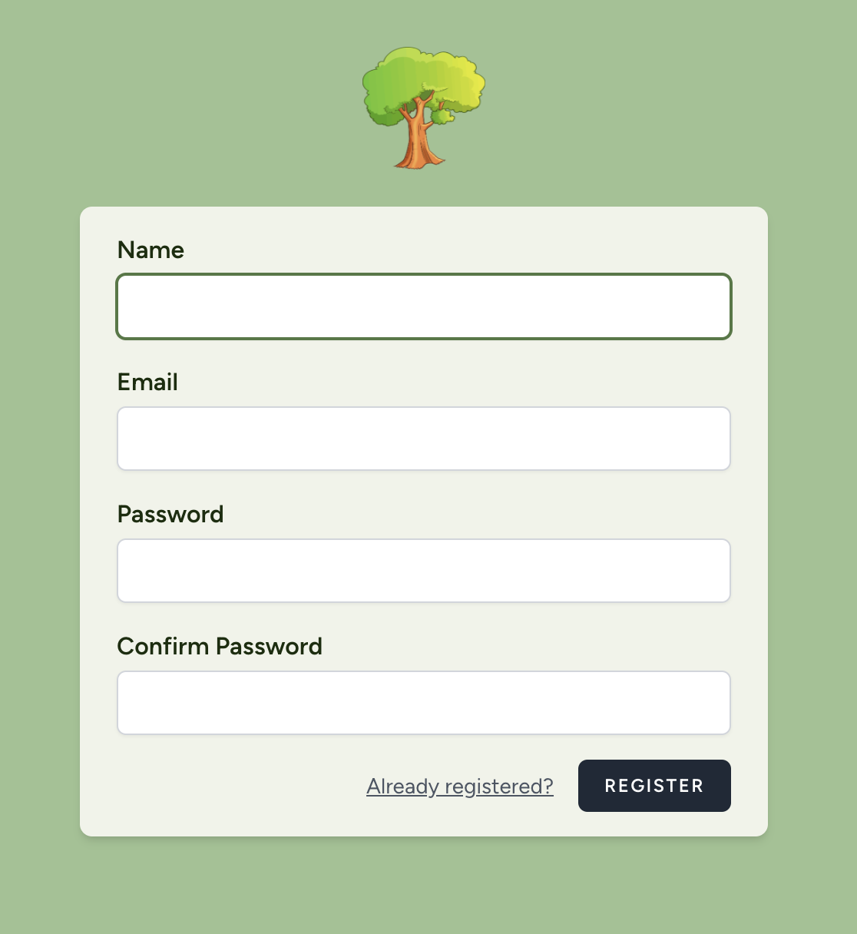
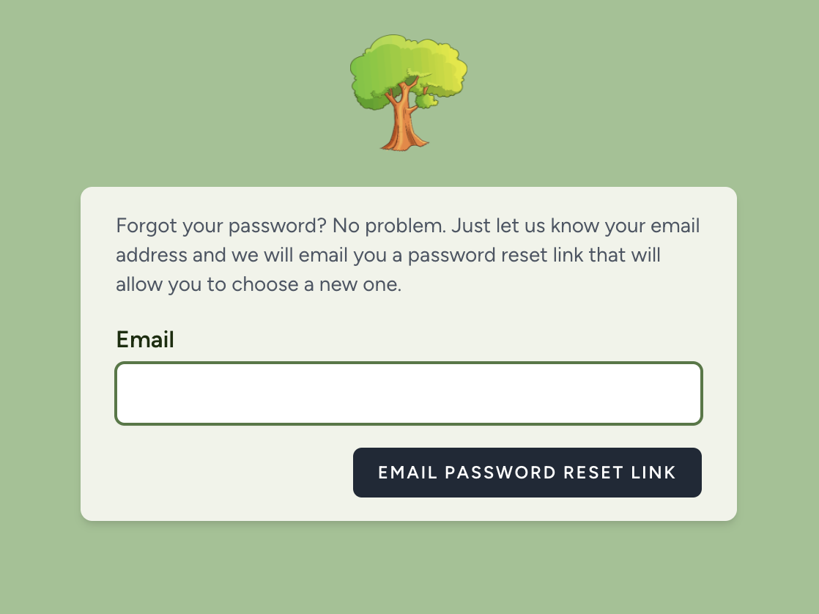
User Authentication

Slide 13
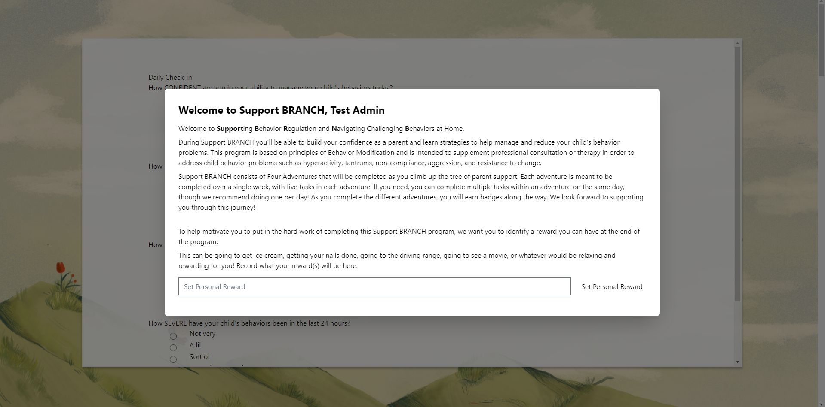
Home Page with Initial Pop-Up

Slide 14
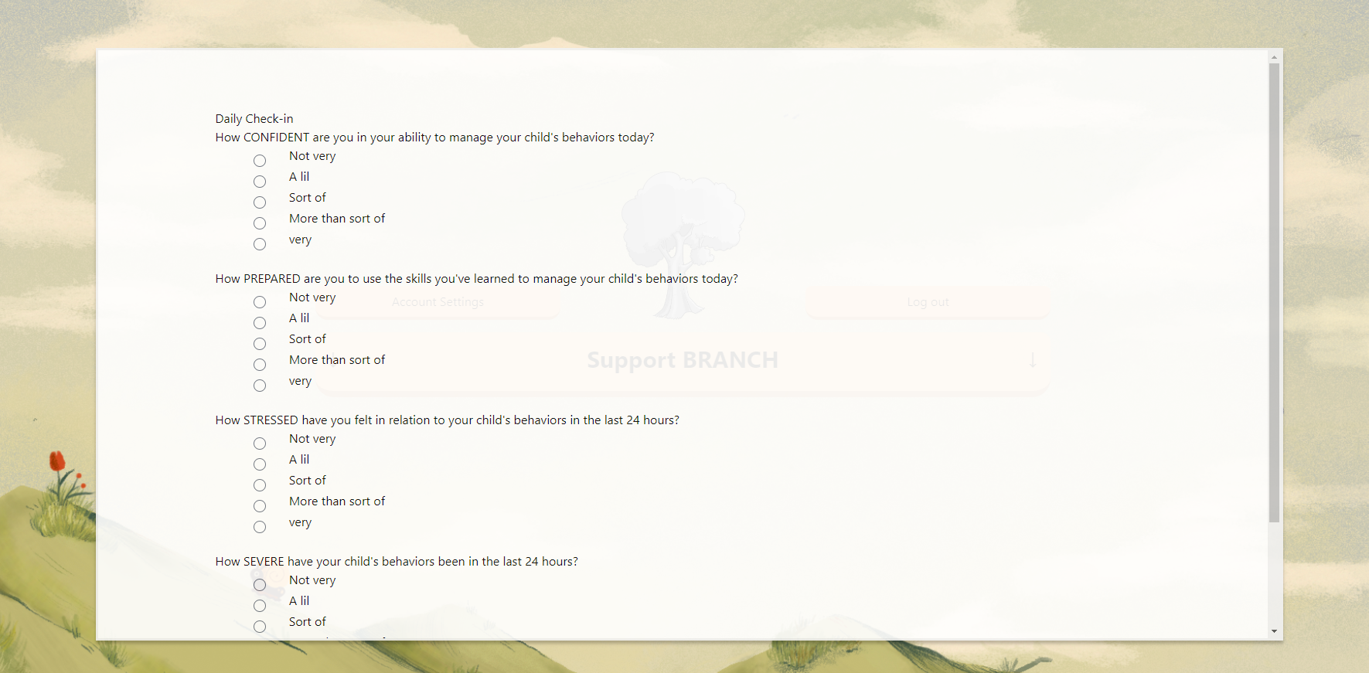
Home Page with Inactive User Pop-Up

Slide 15
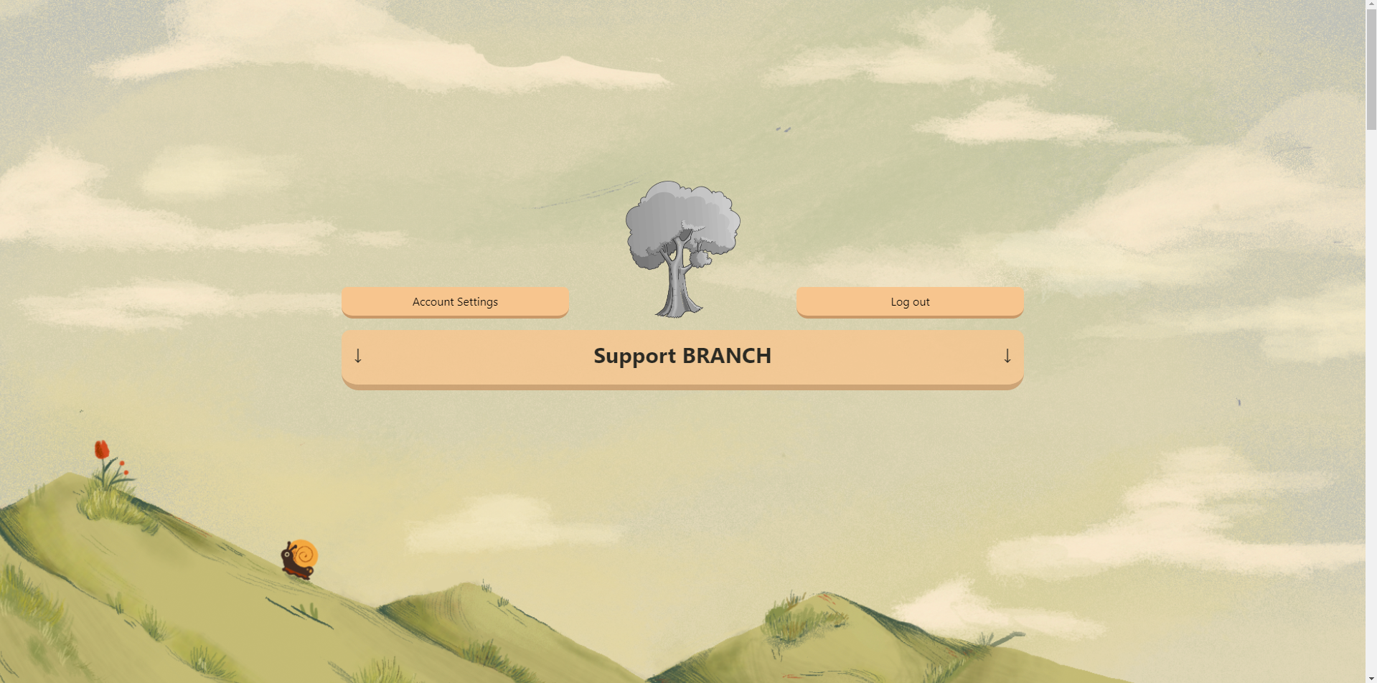
Home Page Top

Slide 16
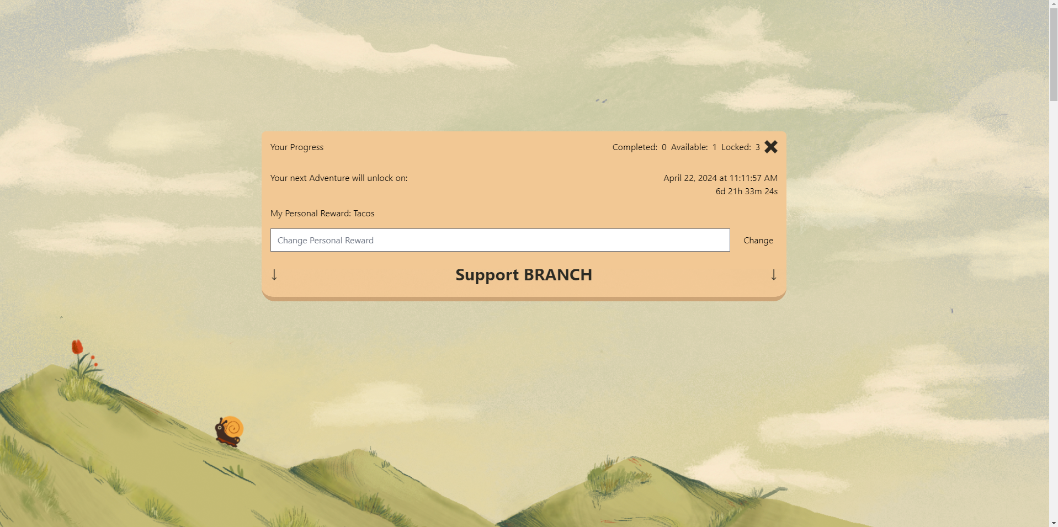
Progress Pop-Up (when gray tree is clicked)

Slide 17
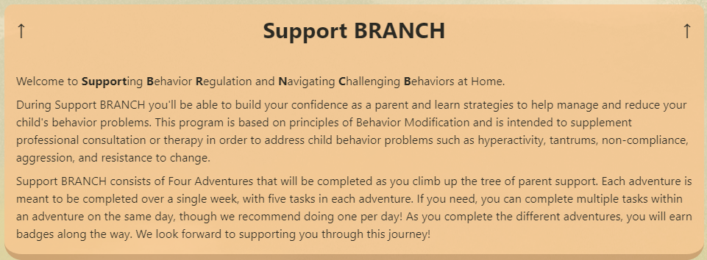
Overview Pop-Up (when banner is clicked)

Slide 18
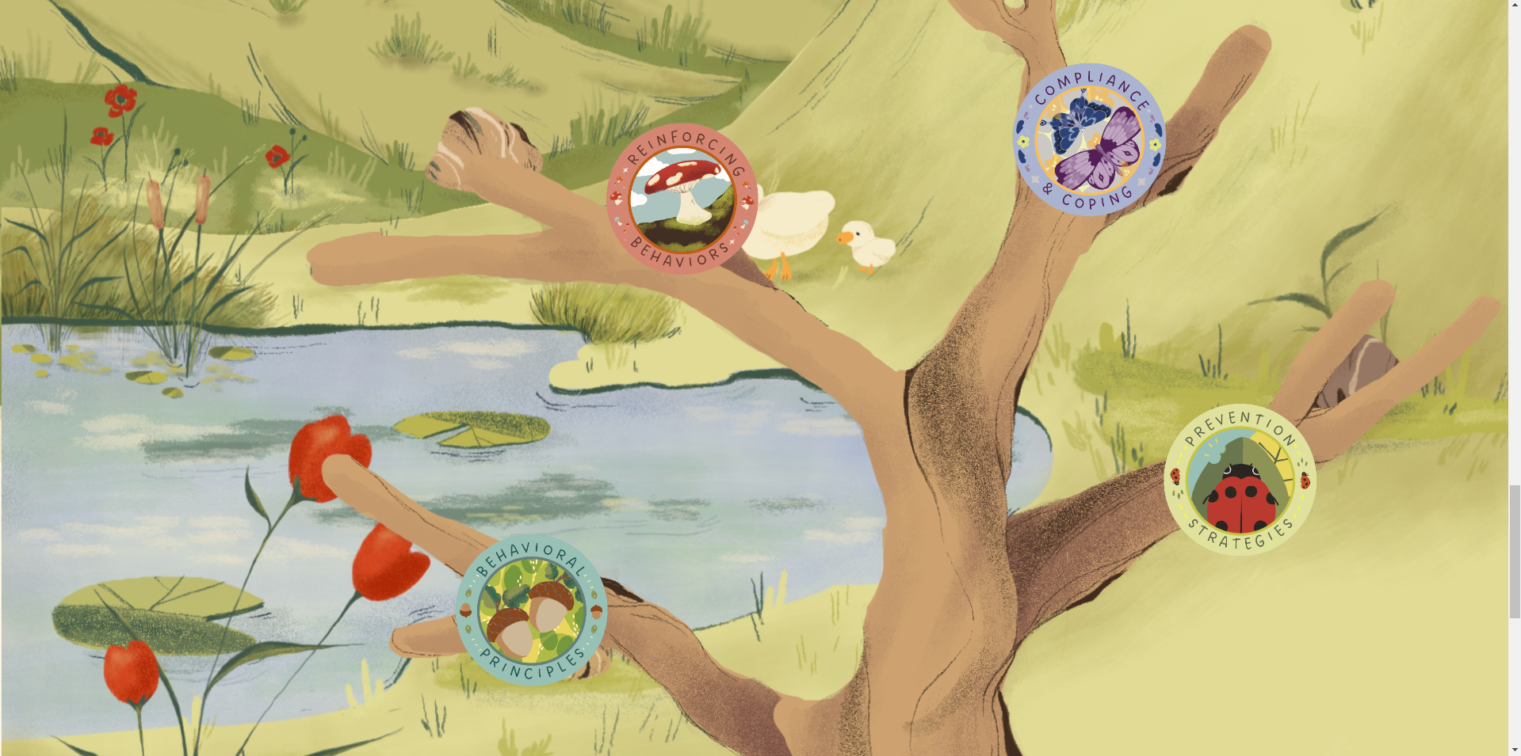
Home Page Bottom

Slide 19

Adventure Page

Slide 20
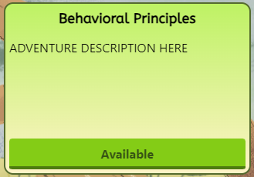
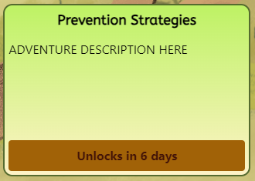
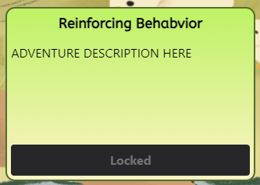
Adventure Badge Pop-Up (click on adventure)

Slide 21
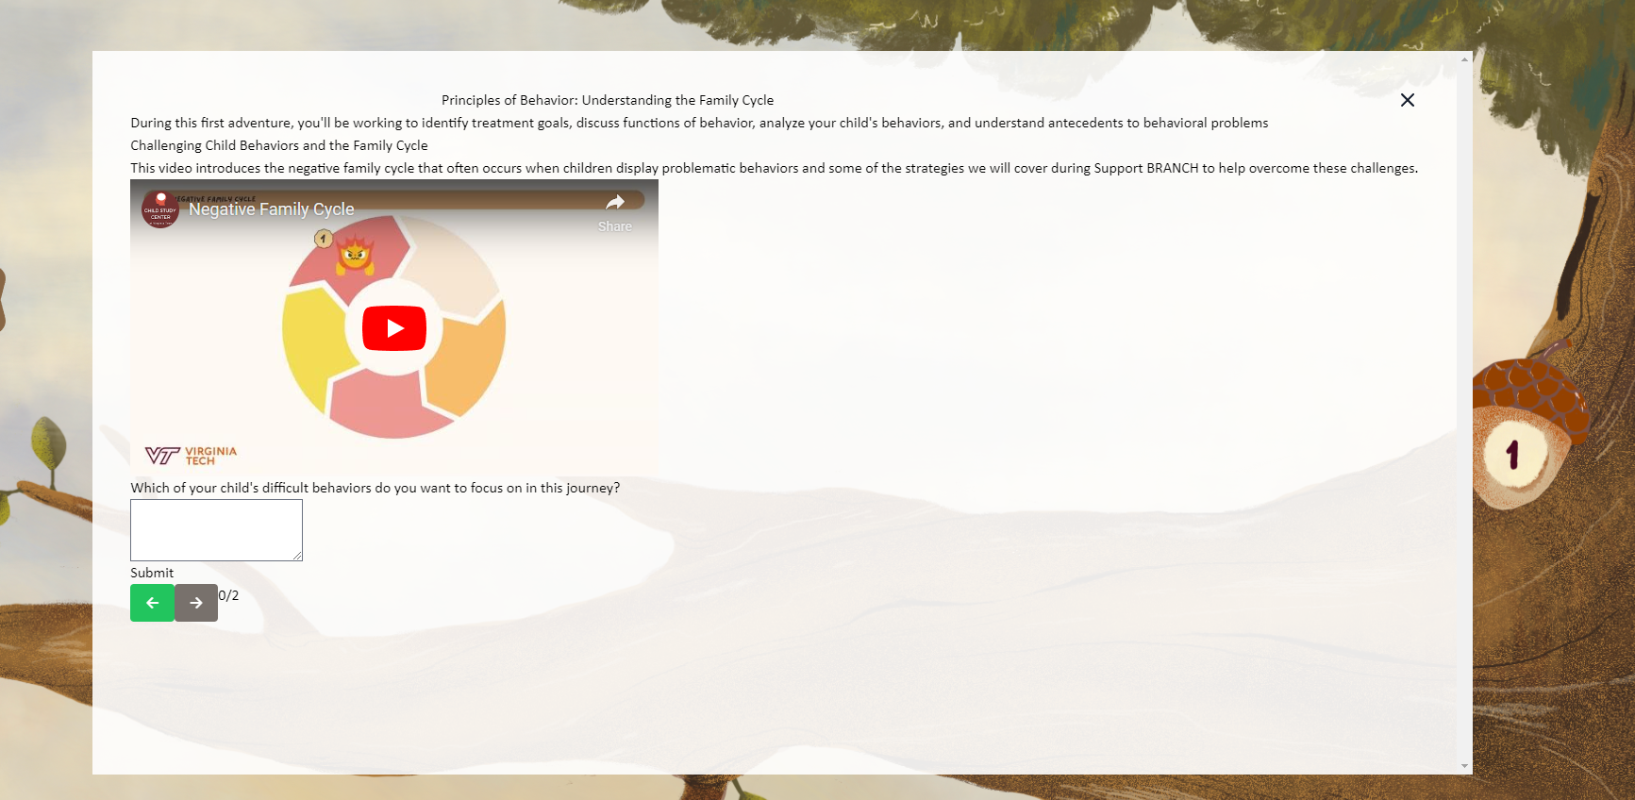
User Submission

Slide 22
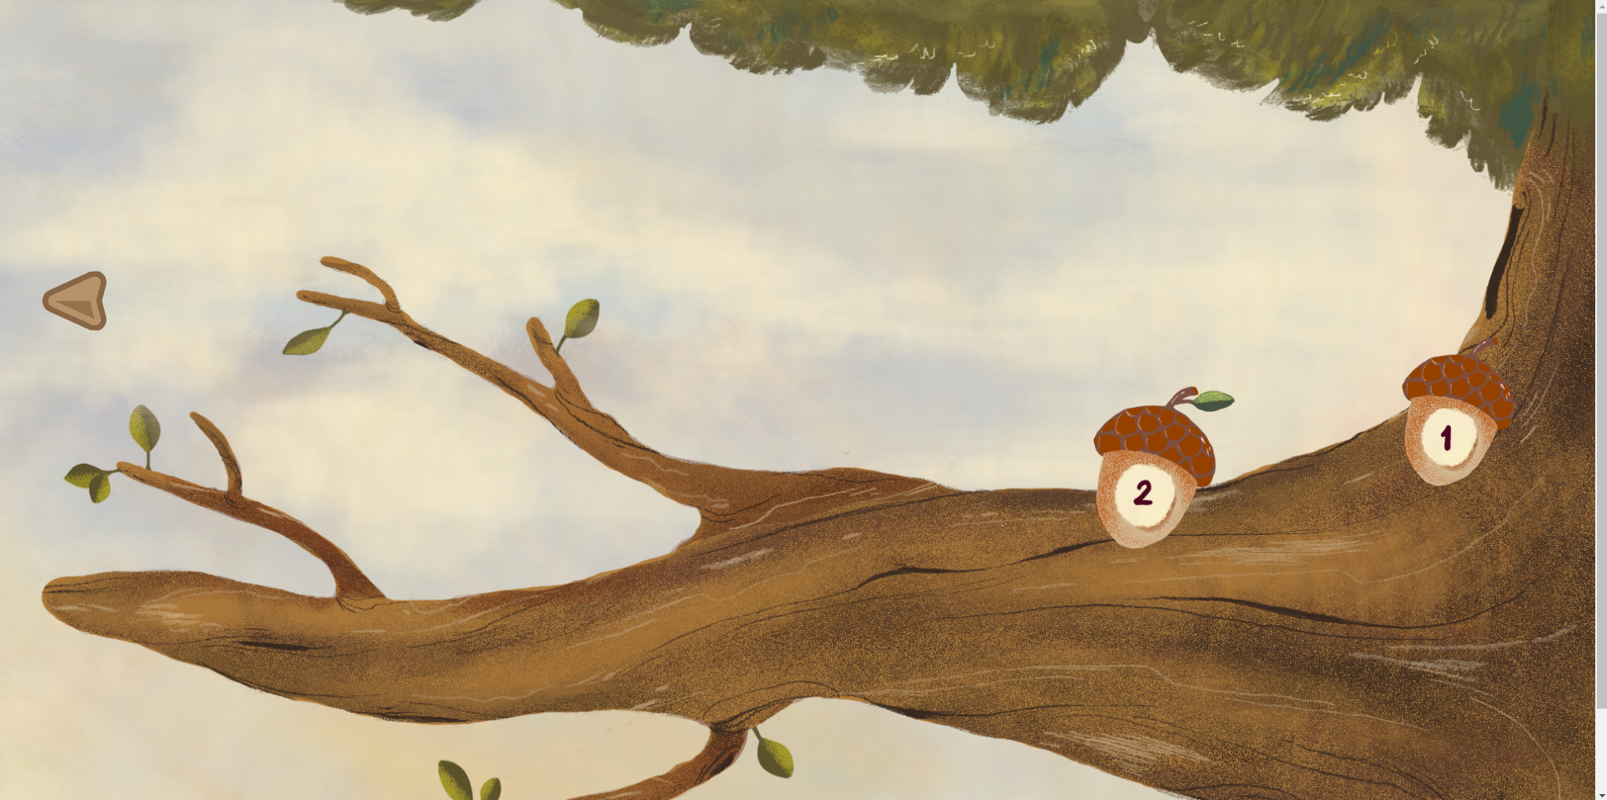
Adventure Page after Explore Completion

Slide 23
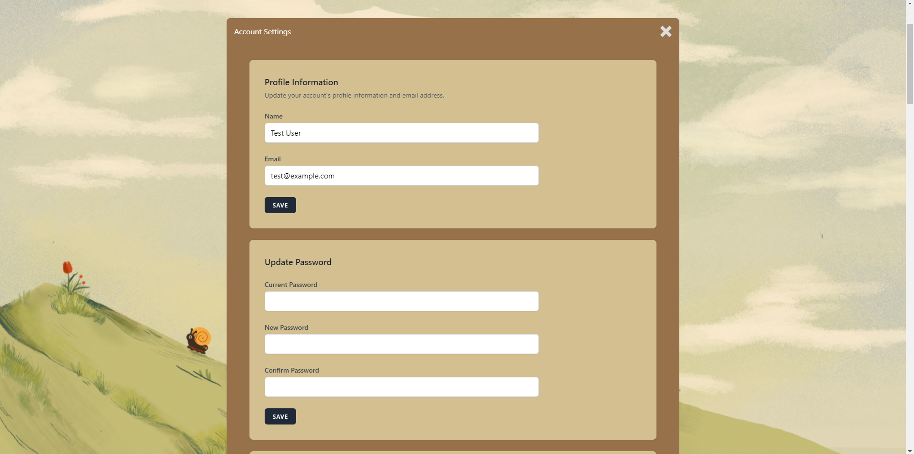
Account Settings

Slide 24
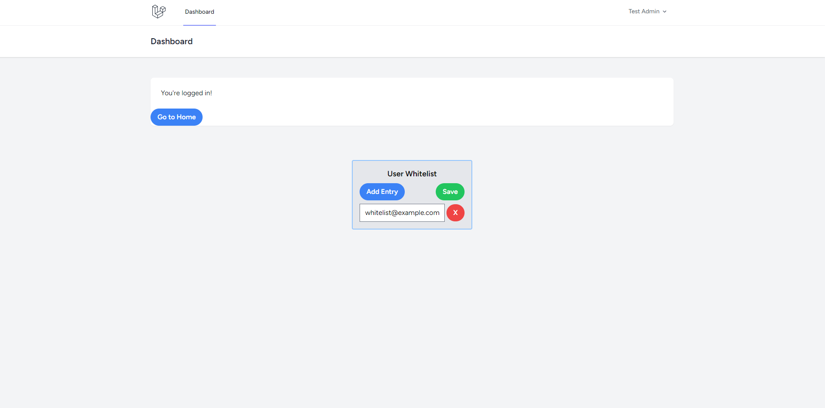
Admin Dashboard

Slide 25
Challenges
Docker - Performance issues handling Linux containers
Drupal - Wasted a lot of time
Alpine JS - Implemented late

Slide 26
Future Work & Stretch Goals
Email notification system
Completion pop-ups
FAQ / User Guide

Slide 27
Acknowledgements
Client
Rosanna Breaux, Director of Child Study Center and CALMER Lab
Benz Huynh (Consultant)
Stephanie Pham (Graduate Student)
Professor
Dr. Edward A. Fox

Slide 28
References
Our GitHub Repository:
Calmer-Lab-VT. (2024). Support-branch [Software]. GitHub. https://github.com/Calmer-Lab-VT/support-branch
LAMP Stack Application Template:
Sprintcube. (2024). Docker-compose-LAMP [Software]. GitHub. https://github.com/sprintcube/docker-compose-lamp
Laravel Documentation: https://laravel.com/docs/11.x
Alpine JS Documentation: https://alpinejs.dev/
Tailwind Documentation: https://tailwindcss.com/

