Slide 1
Optimize Access to Your Published Research
Author Rights for Life & Health Sciences
Ginny Pannabecker
Life Science & Scholarly Communication Librarian
GinnyP@vt.edu
This presentation is
licensed CC-BY 4.0

Slide 2
Today’s Session Plan
Author Rights
what they are
what you want to keep
what you may be signing away
Life Science Journals & Author Rights
Your Work & Open Access
Your Data & Open Access

Slide 3

Open Access = Global Access
Notes:
Your work has global potential
http://pixabay.com/en/mouse-globe-world-map-symbol-www-311299/

Slide 4

Your Copyrights
Reproduce the work
Distribute the work
Publicly Perform the work
Publicly Display the work
Create Derivative works

Slide 5
Scholarly / Creative Works
Scholarly works
no income to scholar expected
Creative works
provide income to the creator

Slide 6
What rights do you want to keep...
for yourself?
to allow others?

Slide 7
What rights do you sign over to publishers?

Slide 8
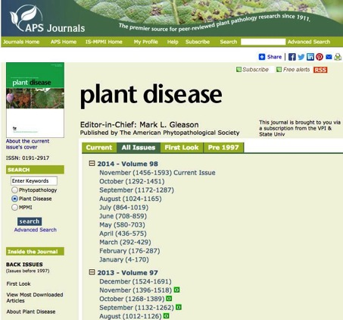
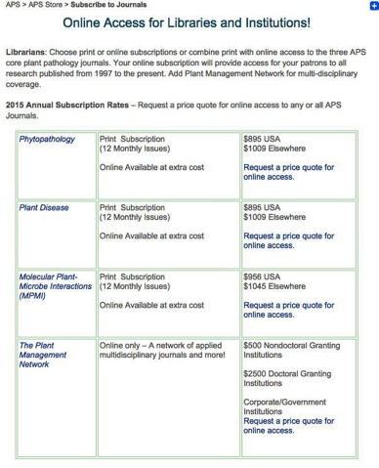

Life Science Journals &
Author Rights

Slide 9

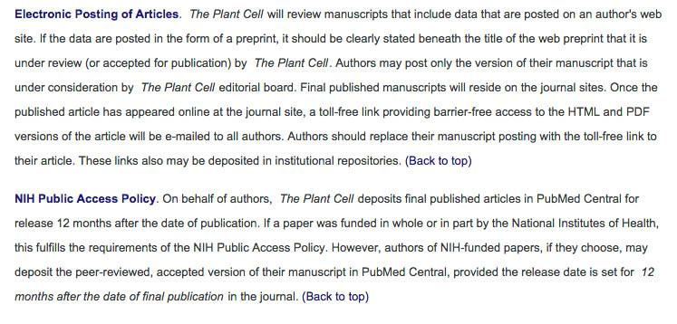
Life Science Journals &
Author Rights

Slide 10
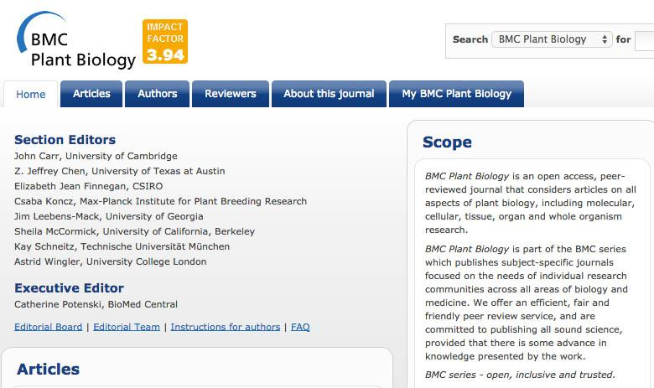
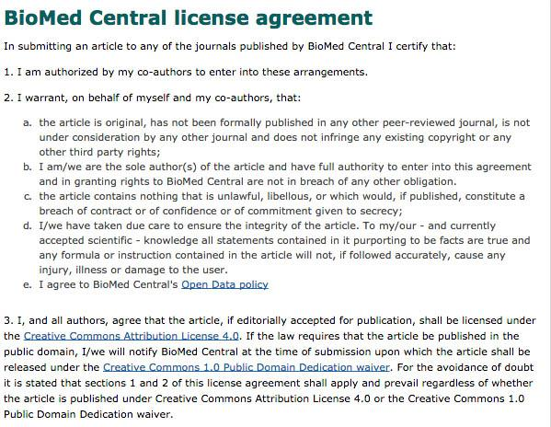
Life Science Journals &
Author Rights

Slide 11
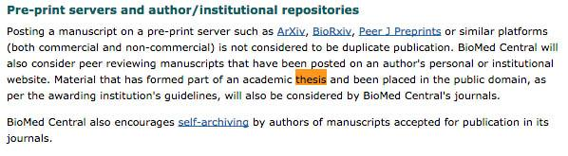
ETD Policies in
Life Science Journals
BioMed Central Plant Biology

Slide 12
Life Science Journals &
Author Rights
Selecting a Journal
Ulrich’s Periodicals Directory
VT University Libraries Database
DOAJ
http://doaj.org/
Eigenfactor
http://www.eigenfactor.org/costeffectiveness.php

Slide 13

Life Science Journals &
Author Rights
http://www.sherpa.ac.uk/romeo/

Slide 14


OA Subvention Fund
http://www.lib.vt.edu/oafund/index.html

Slide 15
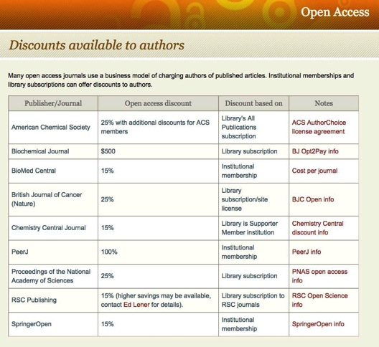
OA Journal Discounts
http://www.lib.vt.edu/openaccess/discounts.html

Slide 16
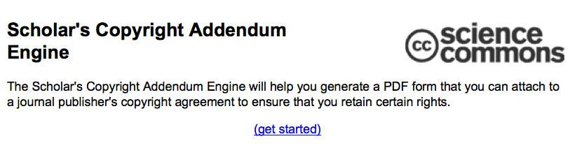
Scholar’s Addendum
http://scholars.sciencecommons.org/

Slide 17
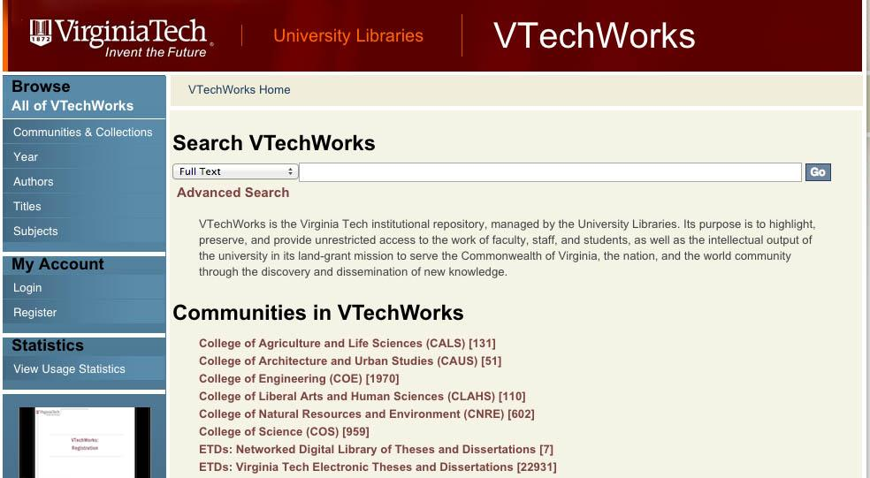
VTechWorks
Our Institutional Repository

Slide 18
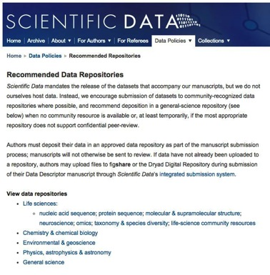
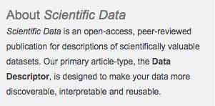
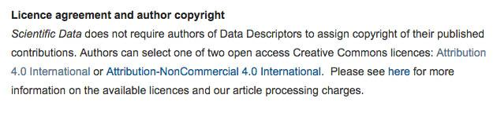
Open Data
Life Sciences Data Repositories
http://www.nature.com/sdata/data-policies/repositories

Slide 19
Images
Public Domain Images from Pixabay
http://pixabay.com/en/mouse-globe-world-map-symbol-www-311299/
http://pixabay.com/en/copyright-sign-symbol-icon-98570/
http://pixabay.com/en/dollar-symbol-money-sign-currency-311344/
Screenshots taken by G Pannabecker using the Mac Grab utility application, or using the Windows Snippy application.

