Slide 1
Campus Jobs
CS 4624 - Multimedia, Hypertext, and Information Access
Dr. Edward Fox
Virginia Tech, Blacksburg VA 24061, December 12, 2021
Nuvya Baliyan, Emily Ashburn, Matthew Hunderup, Adam Chen

Slide 2
Outline
Project Overview
Requirements
Preliminary Work
Implementation
  Database
  Front end
  Matching service
Finishing Touches
Beta Testing
Acknowledgements

Slide 3
Project Overview
Client: Trey Mayo, Director of CS Graduate Programs
Project Goal: To provide CS graduate students with VT-exclusive job opportunities and to provide professors seeking assistance a way to find candidates.
Importance of VT-exclusive job opportunities:
Student visas
Streamlining job/candidate search
Notes:
Nuvya

Slide 4
Timeline
Complete login pages for employers/students
Begin implementation of the find a job page
Begin implementation of matching algorithm
Deploy bug fixes
Finish project
Work on stretch goals
Complete Interviews
Begin construction of database schema
11/5
11/27
10/1
11/19
12/5
Begin implementation of login authentication
Finish prototype for matching algorithm
Begin beta testing
Complete find a job and post a job pages

Slide 5
Requirements
Database to store student and employer information
Website
  User authentication
  Security
  Access to database
Matching algorithm
  Associated pages to show potential jobs/candidates
Email notifications for job application results

Slide 6
Preliminary Resources
Need ability to host website and store data
Elected to go with Virginia Tech VM
  Suggested by Dr. Fox, allows for remote computing resources
  Allows for hosting on cs.vt.edu domain
  Allows for hosting of MySQL database
TomCat for web hosting
HTML/CSS/JavaScript for the front end

Slide 7
Preliminary Interviews
Professors
  Would you like a self assessment of a student’s proficiencies in certain languages?
  Would you have a preference for whether they have participated in academic research/published a paper before? How much would you value this?
Graduate students
  Would you want personal information about the professor, i.e., past experience, credentials, languages of interest?
  What information would you like to know about potential job opportunities?
Notes:
Nuvya

Slide 8
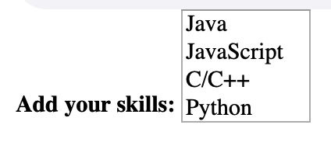
Interview results
Professors want:
Information on citizenship status, PHD vs. Masters spec, degree program/concentration, interests, relevant coursework, previous experience
A ‘skill’ list
Manage jobs and applicants
Graduate students want:
Simplicity
Non-redundancy
Information on pay, required/preferred qualifications, responsibilities
Good matching service
Remove filled positions
Notes:
Nuvya

Slide 9
Database
Hosted in MySQL on VM
Contains student and professor login information
  Uses hashed passwords for security purposes
Maintains general information about students and professors
Contains records of all completed applications
  Tracks status of application
    Submitted, accepted, rejected, or withdrawn

Slide 10
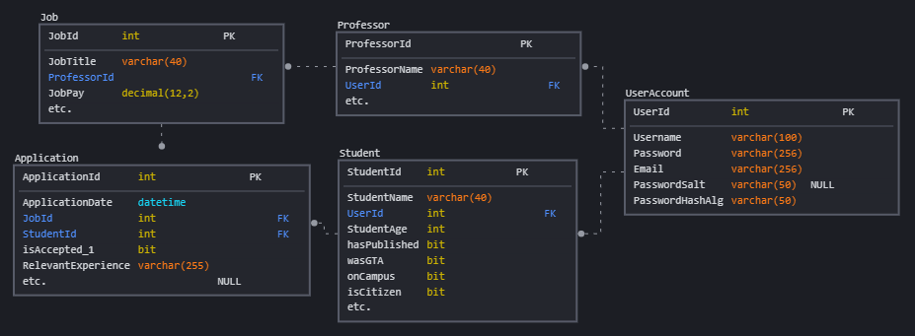
Database Schema

Slide 11
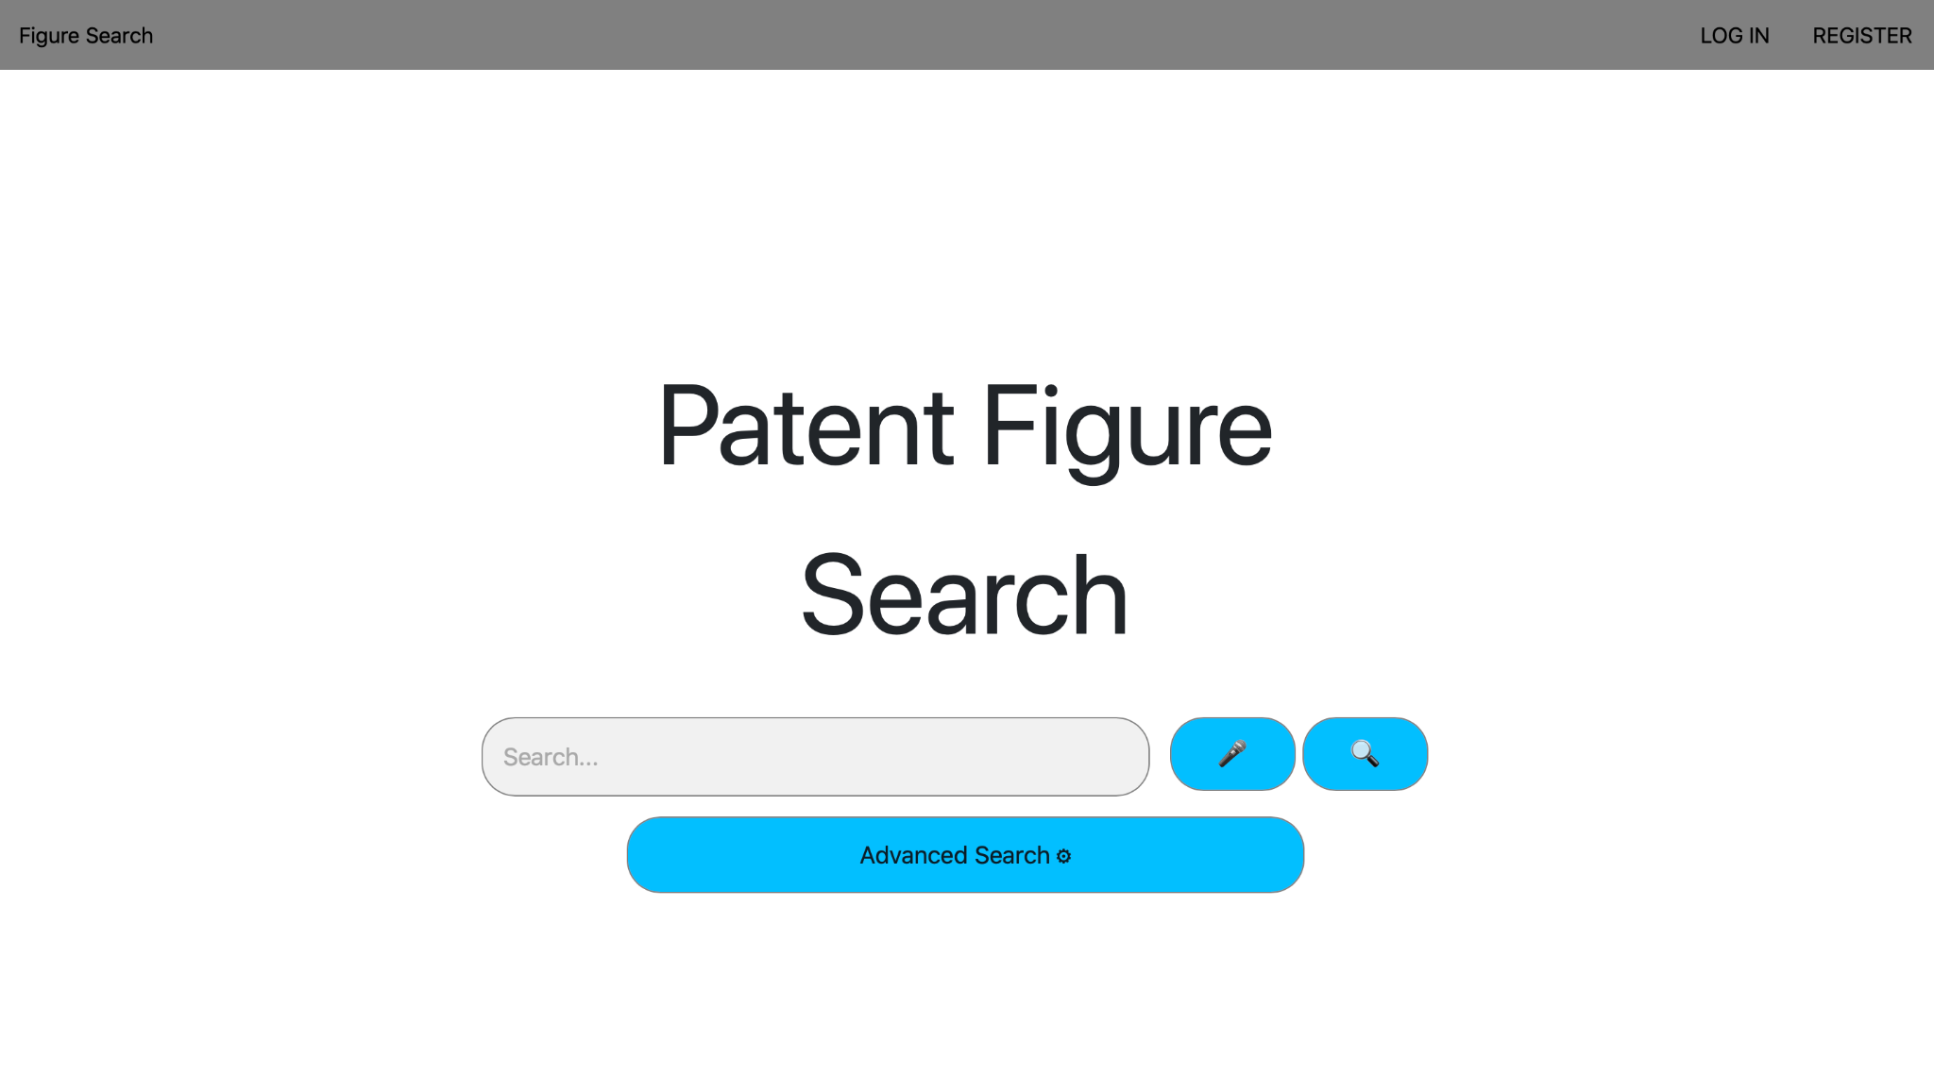
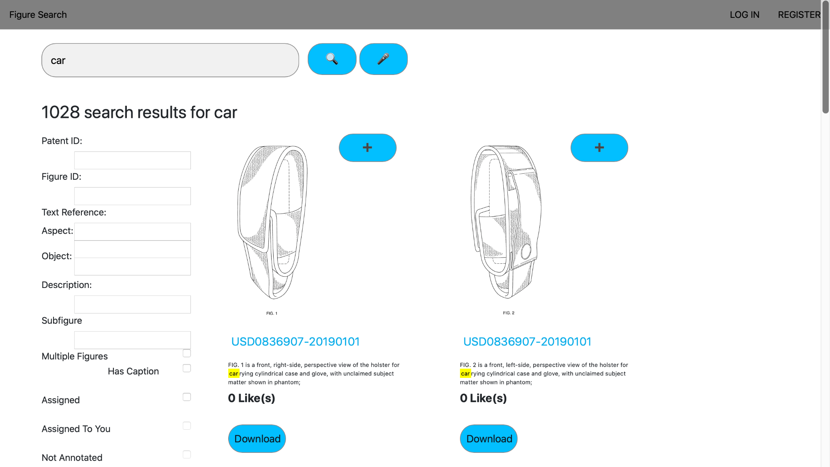
Matching Service: Elasticsearch @ ODU
Winston Shields: https://www.cs.odu.edu/~penzias/Figure-Search-Engine/public/views/index.php
Notes:
Nuvya

Slide 12
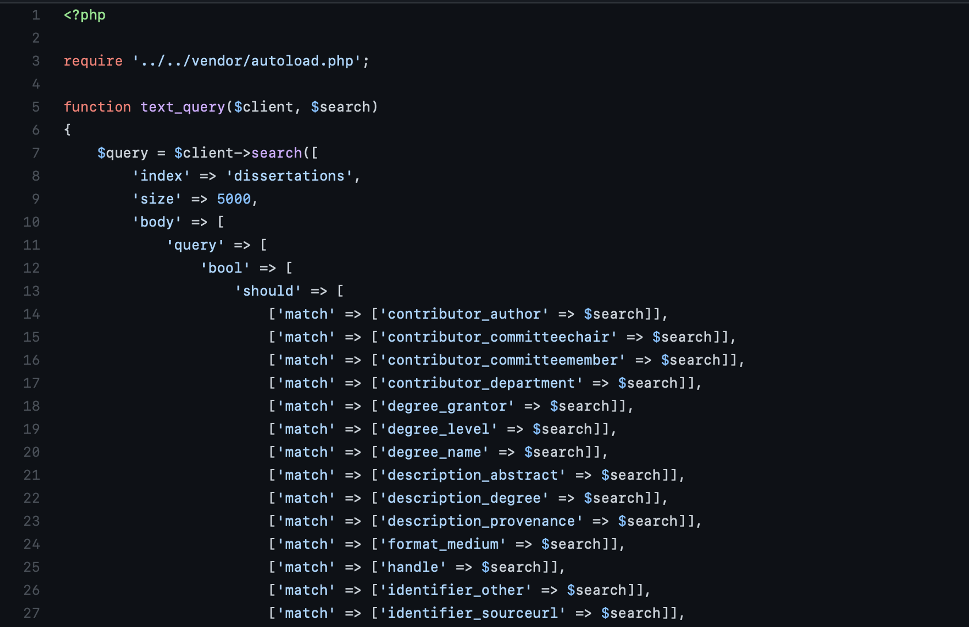
Matching Service: Elasticsearch @ ODU
Utilizes PHP instead of Java
Notes:
Nuvya
https://github.com/WinstonShields/Search-Engine/blob/main/src/elasticsearch/normal_search.php

Slide 13
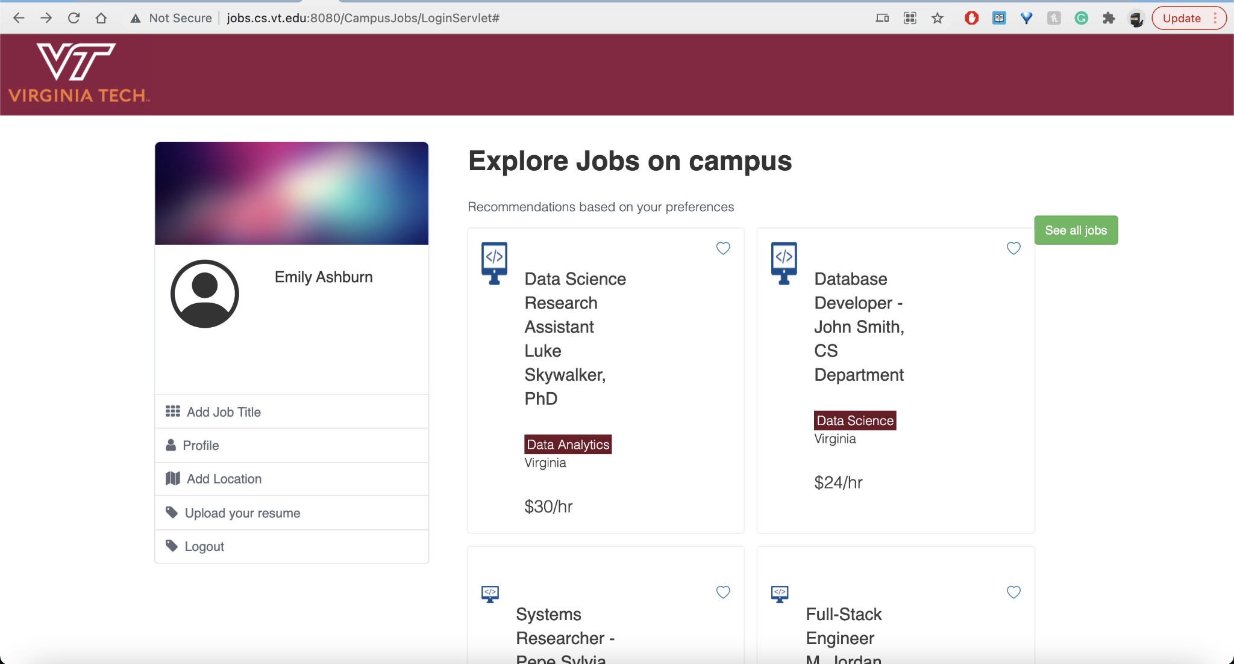
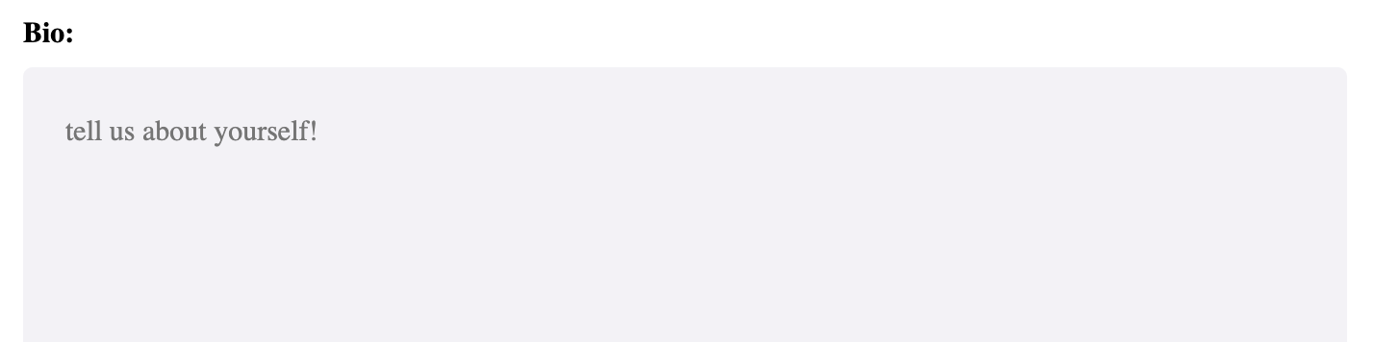
Matching Service: Manual
Uses a tag-based system
Similar to Faceted searching
Uses JSPs:
Servlets
Static pages
Notes:
Emily

Slide 14
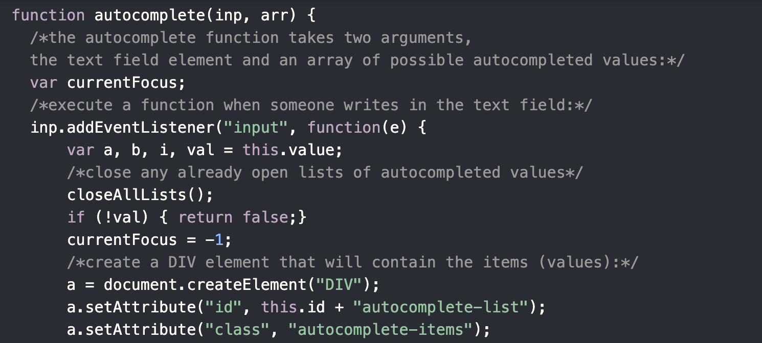
Matching Service: Manual
JSPs/JavaScript:
More flexibility
Slower
  Not much data
Easier to learn
More difficult to implement

Slide 15
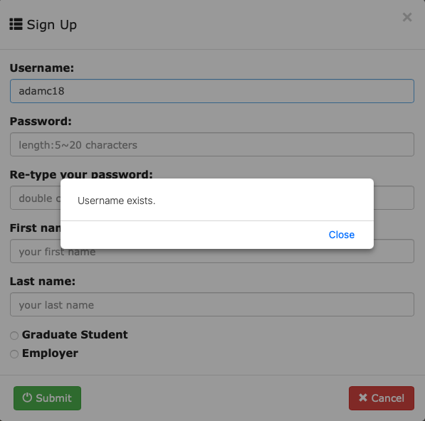
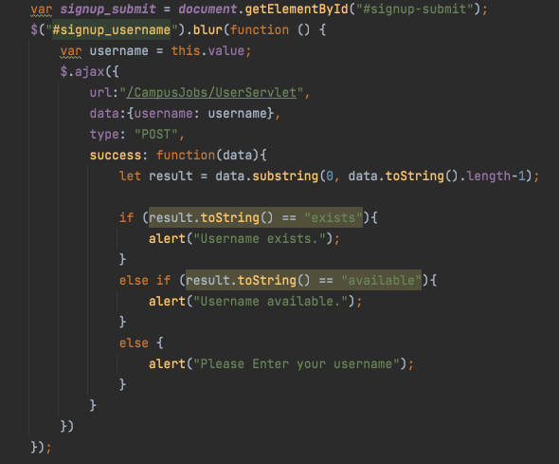
Project Design/Implementation
Use Ajax to handle and check the request data before submit

Slide 16
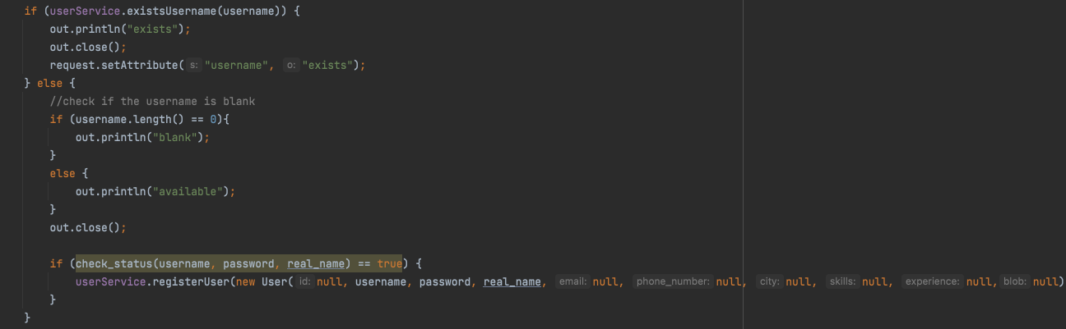
Project Design/Implementation
2) Servlet: handle the request and data from the web

Slide 17
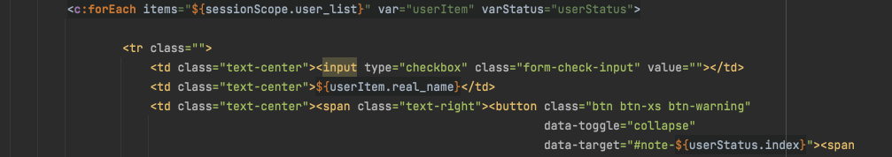
3) Use servlet to loop through the database and Expression Language expression to interact with HTML page

Slide 18
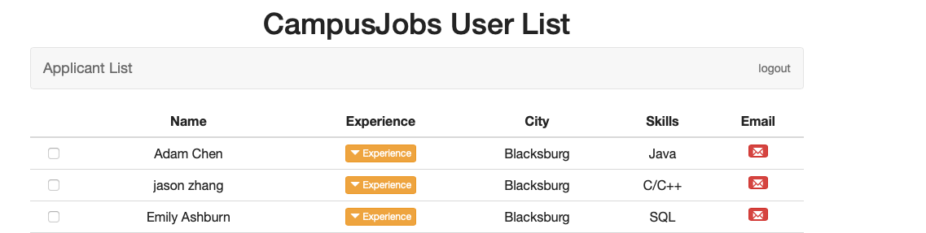
Here is the resulting page:

Slide 19
Beta Testing/Quality Control
First round complete -- fixed bugs
Next steps:
  Gather graduate students and professors to beta test the student and employer perspectives
  Gather data on bugs, performance and usability
Notes:
Nuvya

Slide 20
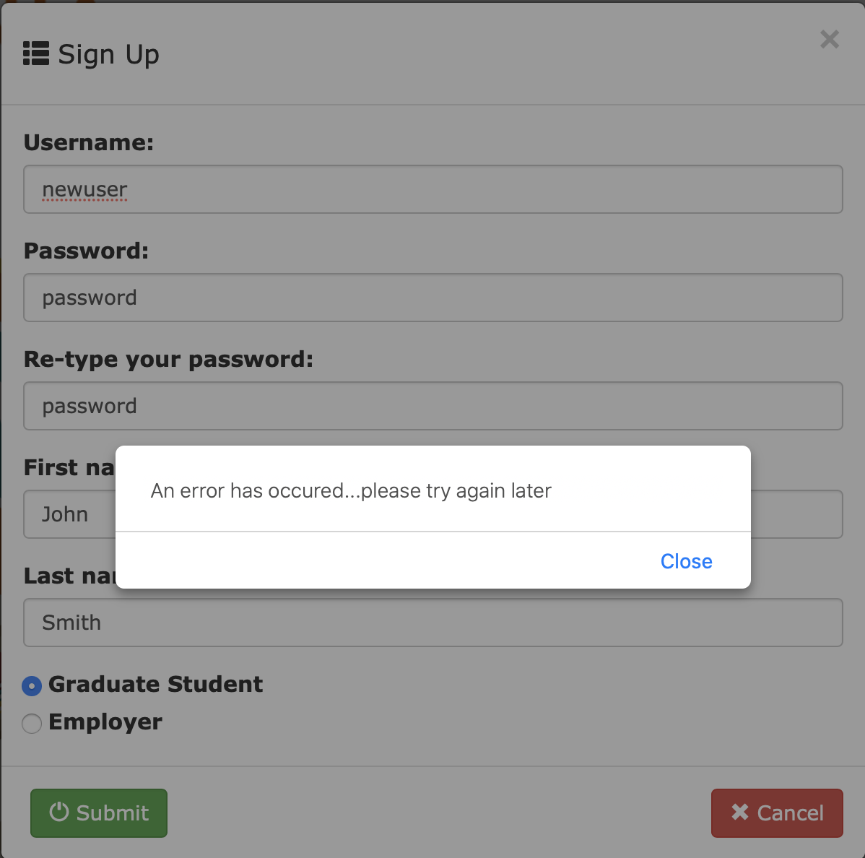
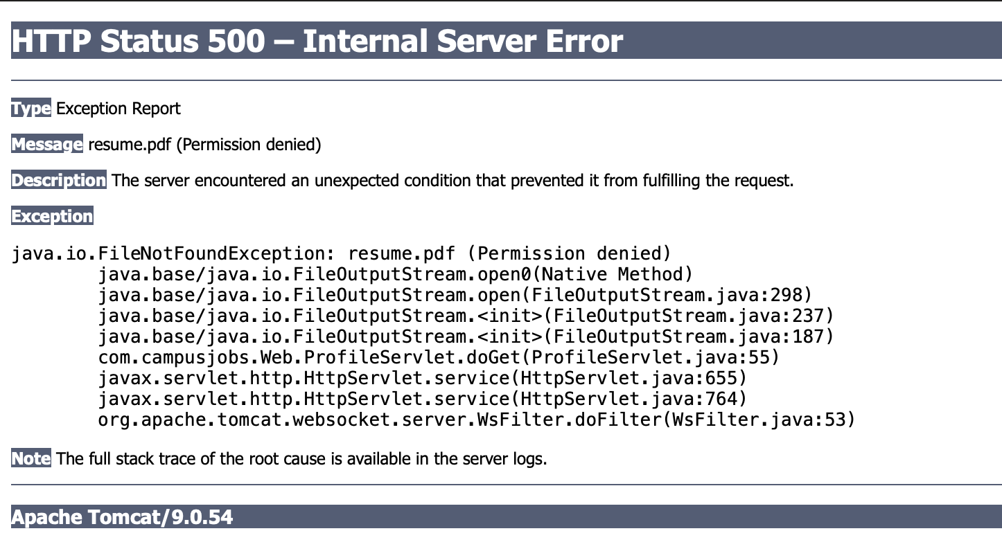
Beta Testing/Quality Control
Resume download error
SFTP (SSH File Transfer Protocol) validation bug
Notes:
Nuvya

Slide 21
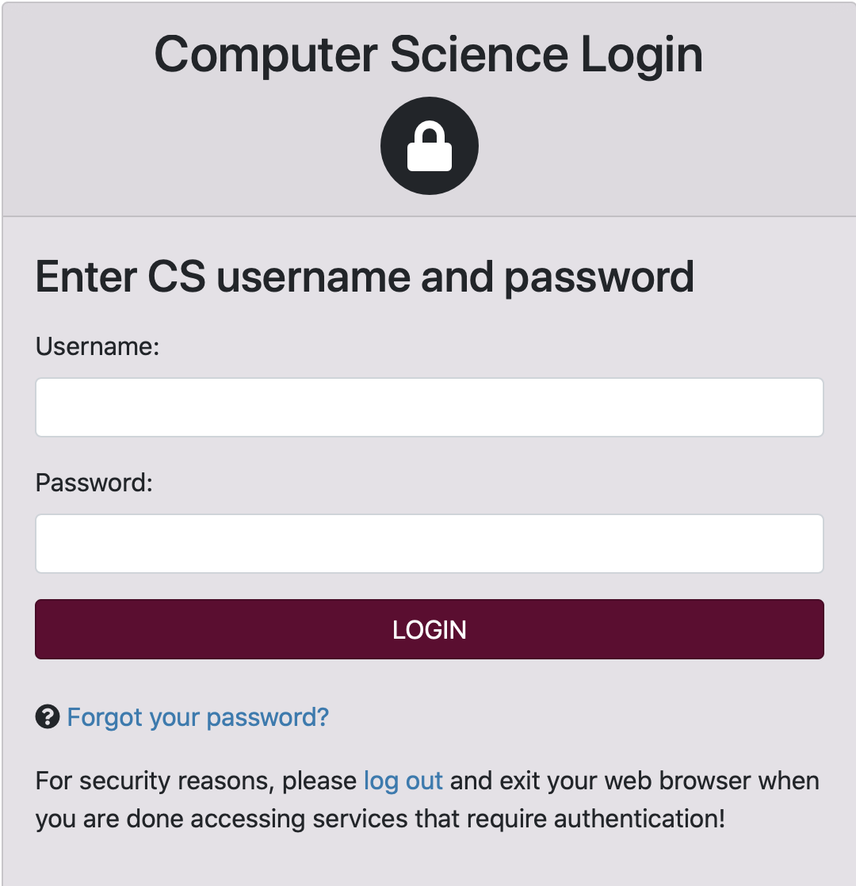
Future Work
Beta testing
Cybersecurity
  Database security
  Account security
Extend usage beyond CS department
Email notifications
CAS login
https://login.cs.vt.edu/cas/login

Slide 22
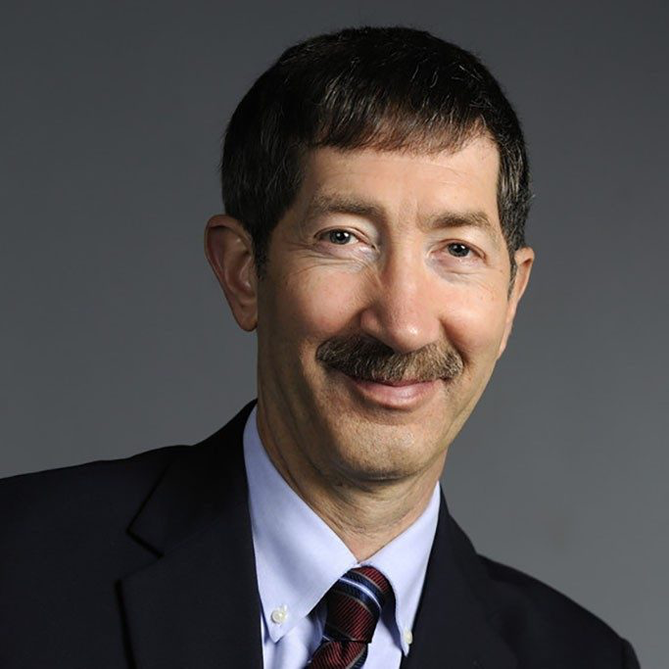
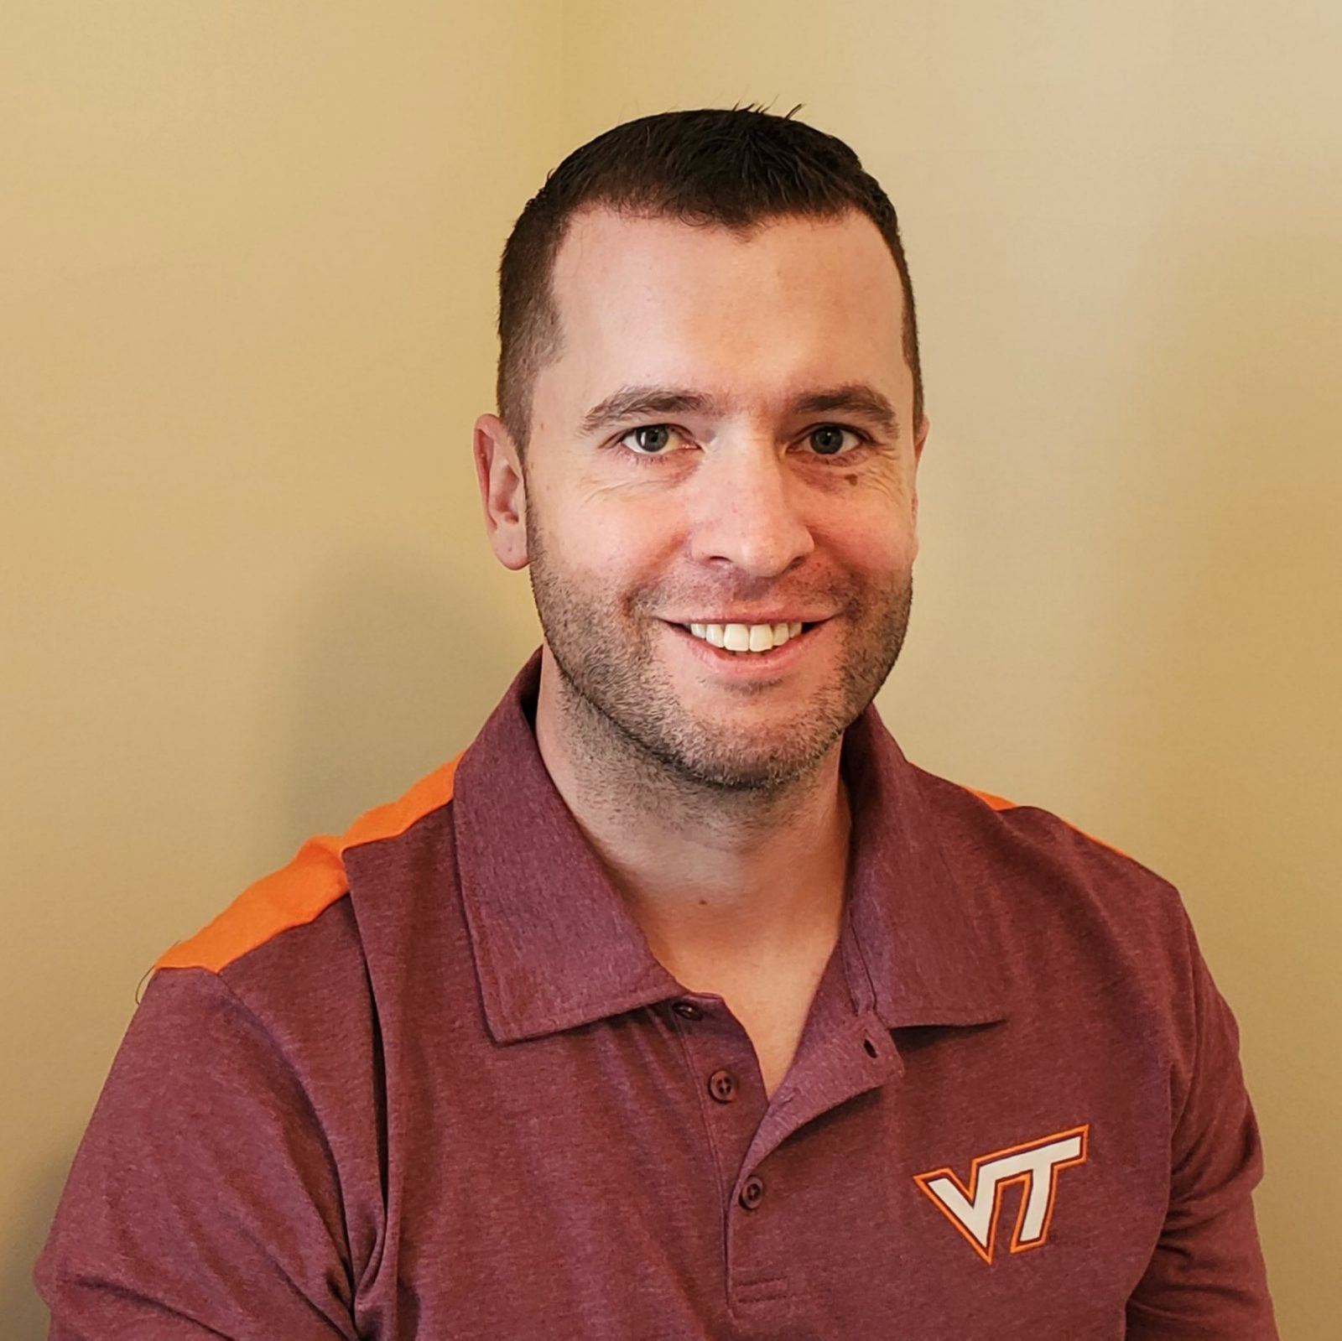
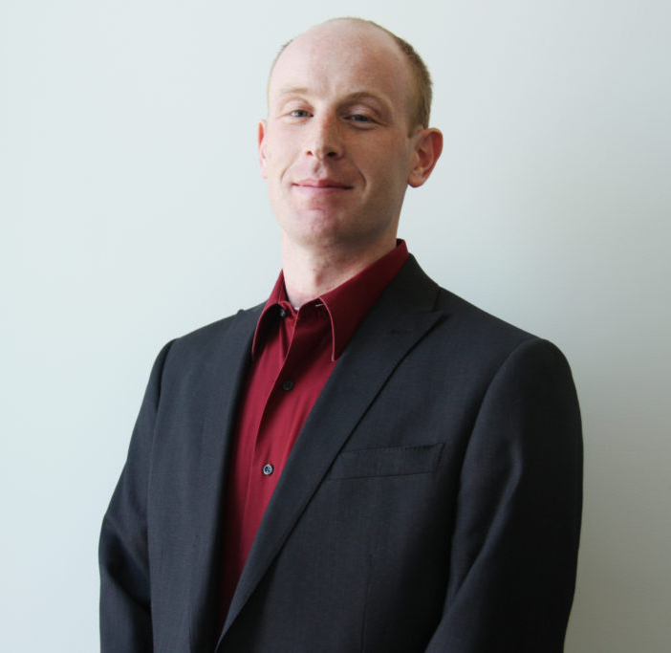
Acknowledgements
Dr. Edward Fox
Mr. Trey Mayo
Mr. Brian Mayer
Graduate student interviewees
Winston Shields (ODU)
Notes:
https://sanghani.cs.vt.edu/person/bryan-mayer/
https://cs.vt.edu/people/faculty/edward-fox.html
https://cs.vt.edu/people/leadership.html

Slide 23



Resources/References
http://tomcat.apache.org/
https://www.javascript.com/
https://www.oracle.com/java/technologies/jspt.html

Slide 24
Bibliography/Images
https://javatutorial.net/java-jsp-example
https://commons.wikimedia.org/wiki/File:Unofficial_JavaScript_logo_2.svg
http://tomcat.apache.org/
https://sanghani.cs.vt.edu/person/bryan-mayer/
https://cs.vt.edu/people/faculty/edward-fox.html
https://cs.vt.edu/people/leadership.html

Slide 25
QUESTIONS ?

