Slide 1
CS 5604 Information Storage and Retrieval
Solr Team Final Presentation
Presenters:
Liuqing Li, Ye Wang, Anusha Pillai, Ke Tian
{liuqing, yewang16, anusha89, ketian} @vt.edu
Instructor:
Dr. Edward A. Fox
Virginia Polytechnic Institute and State University
Blacksburg, VA, 24061
December 6, 2016

Slide 2
Outline
Background
Implementation
Problems Faced
Lessons Learned
Future Work
Acknowledgement

Slide 3
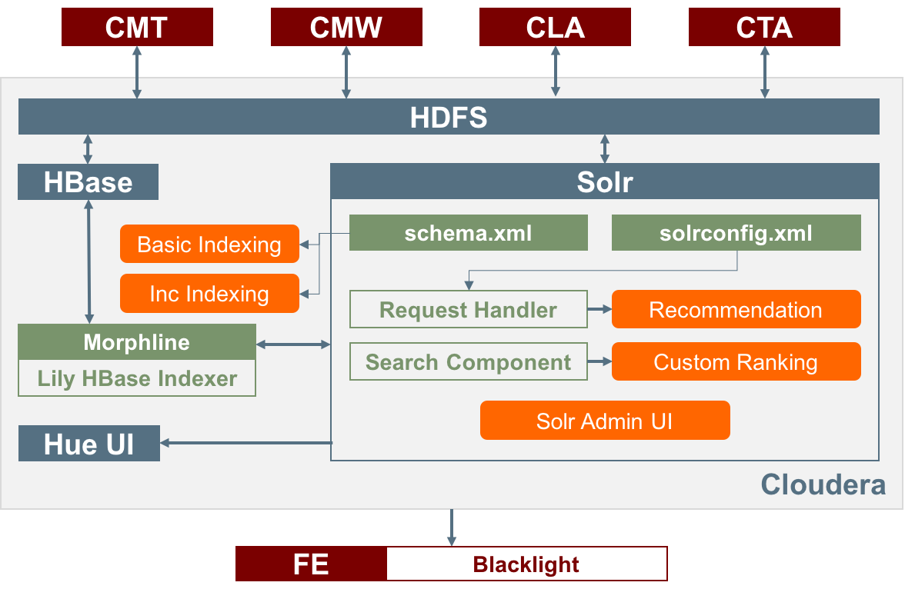
Background — Overview

Slide 4
Background — Updates
 | Spring 2016 | Fall 2016
schema.xml | Coarse grained | Fine grained
 | No copyfields | Copyfields for all fields search
 | Create stopwords.txt & profanity.txt | Update the two files
morphlines.conf | Two field types: string and text | Multiple field types
 | Field “time” => string | Field “time” => datetime
 | No multiple-valued fields | Multiple-valued field parser
Basic Indexing | Small collection | 1.2 billion tweets dataset
Incremental Indexing | Virtual Cloudera (VC) | VC & Hadoop Cluster (HC)
Recommendation | Brief description | Implemented in VC & HC
Custom Ranking | Brief description | Implemented in VC & HC
Solr Admin UI | Brief description | Detailed description
 | Limited faceted search | Detailed faceted search

Slide 5
Implementation — Basic Indexing
Live Mode
  Continuous stream of HBase cell updates into live search indexers
  Simple and efficient
  Cannot handle big data
Batch Mode
  Batch index tables in HBase by using MapReduce jobs
  Write index files into HDFS (/user/cs5604f16_solr/…)
  Can handle big data

Slide 6
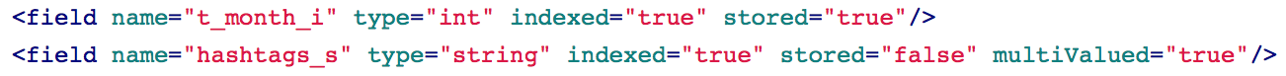
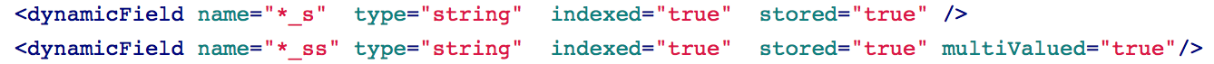
Implementation — Basic Indexing
schema.xml: fields configuration
  field (e.g., ideal-cs5604f16-fake)
    # of fields: 30
    Types: string (22), text_general (2), int (2), float (2), long (1), date (1)
    Stored: True (17), False (13)
  dynamicField: matching multiple fields, using wildcard
  copyField

Slide 7
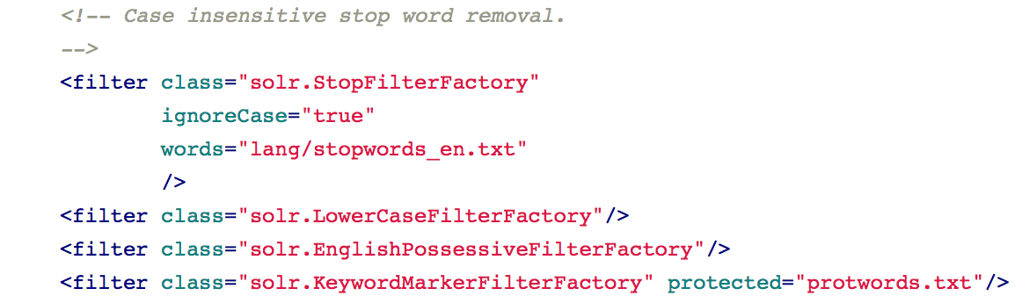
Implementation — Basic Indexing
stopword.txt and profanity.txt
  stopword.txt: tf-idf value will not be calculated
  profanity.txt: quick response for such search queries
  Solr loads the two files while reading schema.xml
Source:
https://pypi.python.org/pypi/many-stop-words
http://www.freewebheaders.com/full-list-of-bad-words-banned-by-google/

Slide 8
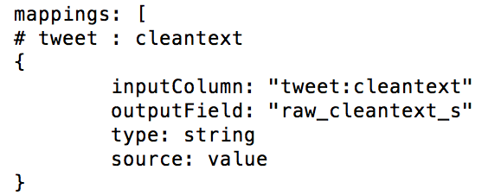
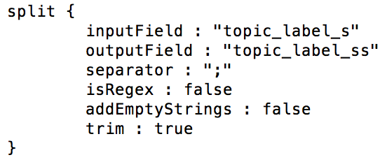
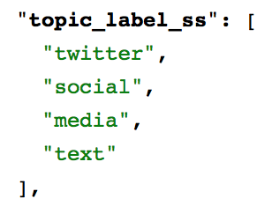
Implementation — Basic Indexing
morphlines.conf: mapping and parsing
Mapping data from HBase to Solr
Split multiple values into list
"topic_label_s":
"twitter;social;media;text"

Slide 9
Implementation — Basic Indexing
Index the big dataset
 |  | ideal-cs5604f16 | ideal-cs5604f16-1204
Dataset |  | All collections (raw tweets) | All collections (raw tweets + processed data)
Indexing | # of DataNode | 18 | 17
 | Space Cost | 392.33 GB | 399.21 GB
 | Time Cost
 | Mapping | 1h21m | 1h45m
 | Reducing | 5h11m | 5h13m
 | Merging | 3h18m | 3h10m
 | Total | 9h50m | 10h8m

Slide 10
Implementation — Incremental Indexing
Purpose
  Process a continuous stream of HBase cell updates into live search indexes (Near Real-Time, NRT Indexing)
  Solve the problem of frequent inserts, deletes and updates
How does it work?
  Enabling HBase replication (columnfamily)
  Pointing an NRT Indexer Service at an HBase table
  Starting an NRT Indexer Service
Our work
Source:
http://www.cloudera.com/documentation/enterprise/5-6-x/topics/
search_config_hbase_indexer_for_search.html

Slide 11
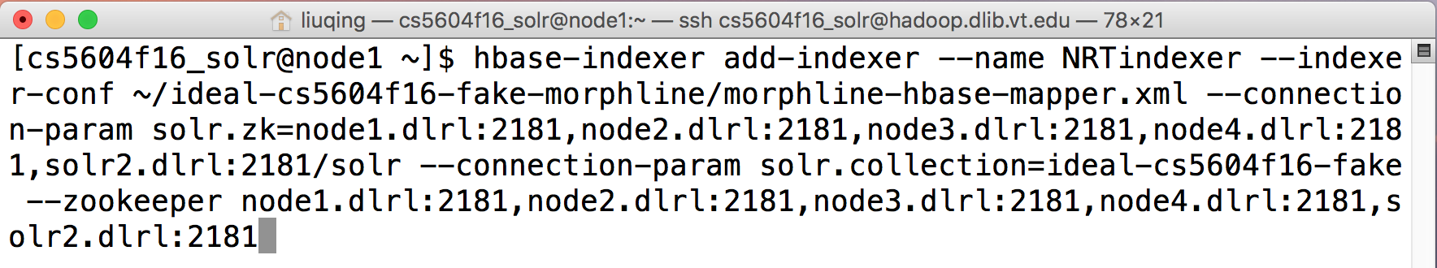
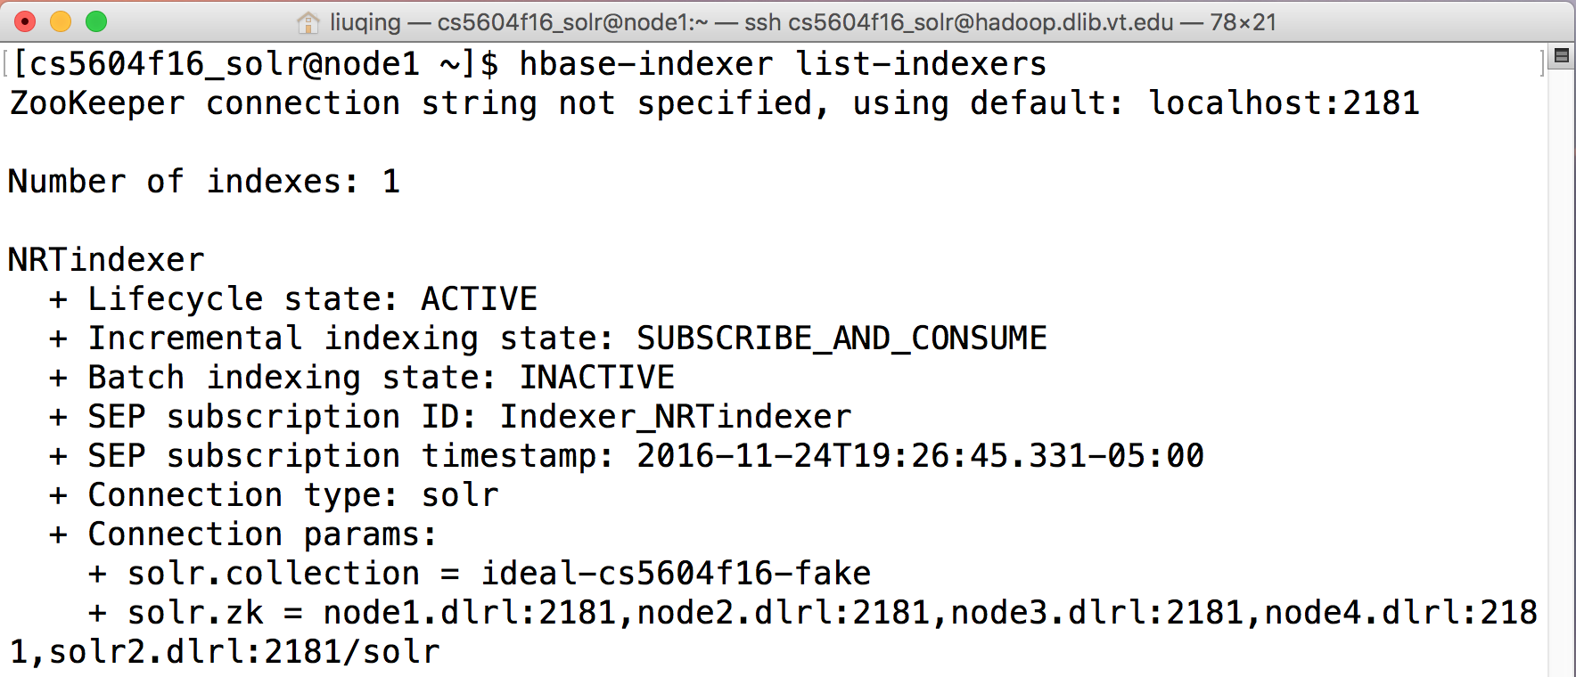
Implementation — Incremental Indexing
Create and check the NRT indexer

Slide 12
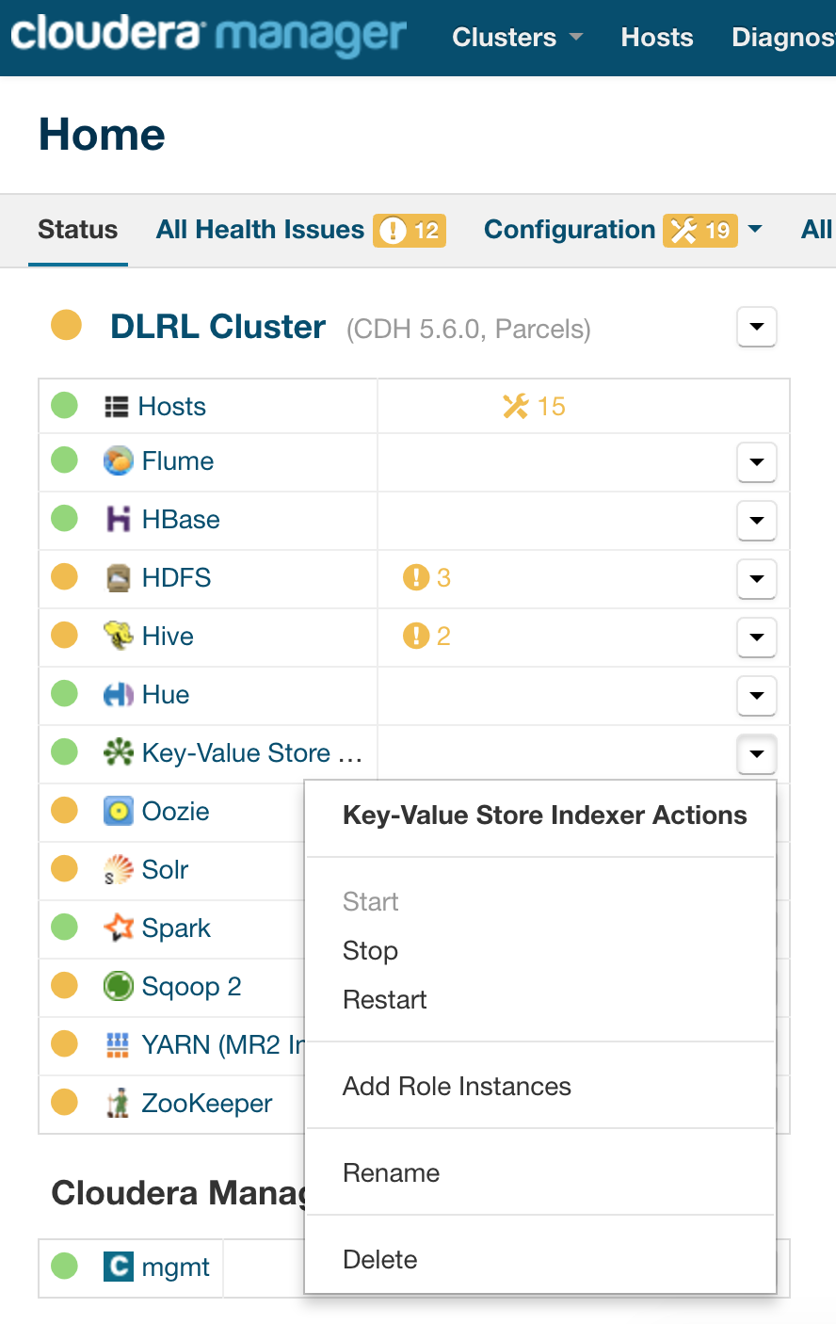
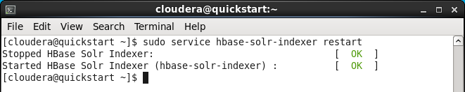
Implementation — Incremental Indexing
Restart the HBase Solr Indexer service
Restart the service in HC
Restart the service in VC

Slide 13
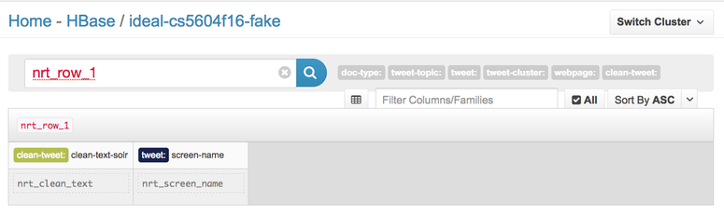
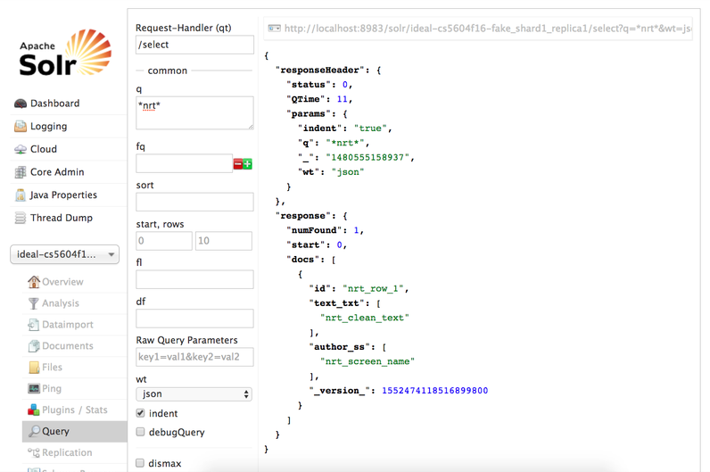
Implementation — Incremental Indexing
Check the results in HBase and Solr Admin UI
Create and check the NRT indexer

Slide 14
Implementation — Recommendation
Types
  Textual similarity based
  Collaborative filtering
More Like This Component
  Identifies similar documents to search result documents.
  Can be configured as a request handler or search component
  Uses term vectors to compute similarity.
  Term vector can be calculated during query runtime or precomputed during indexing
  Extracts highest matching terms based on tf-idf similarity

Slide 15
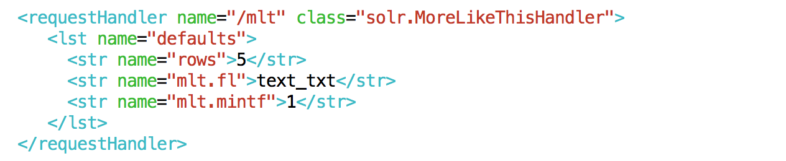
Implementation — Recommendation
schema.xml
  Set stored = true
  Set termVectors = true (for calcalating tf-idf)
    After making changes, reindexing is mandatory
solrconfig.xml
  Enable mlt
  Define other configuration parameters
  e.g., mlt.fl, mlt.mintf, mlt.mindf, mlt.maxdf, mlt.qf

Slide 16
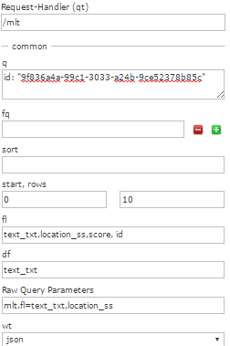

Implementation — Recommendation
Request Handler
Link:
https://drive.google.com/open?id=0B2iasHDgHqGyYUk0R3RkVktkM2M

Slide 17
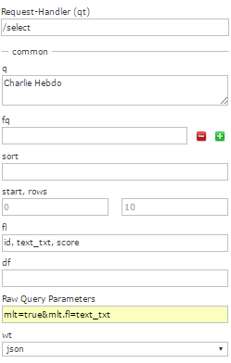
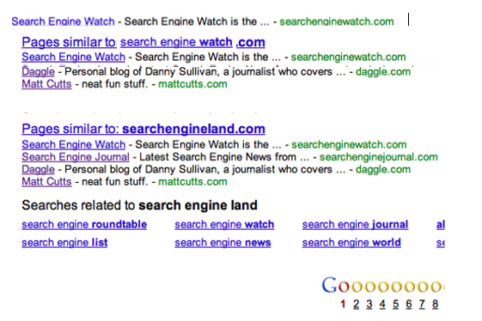
Implementation — Recommendation
Search Component
Link:
https://drive.google.com/open?id=0B2iasHDgHqGyU0doVEpidlh3c2c

Slide 18
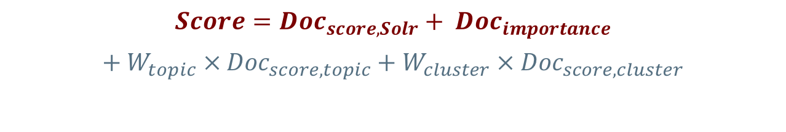
Implementation — Custom Ranking
Purpose
  Customize and optimize the ranked results
How does it work?
  Search Component
    prepare(): pre-processing, invoked before query is executed
    processing(): post-processing, invoked after all the results are fetched
  Custom Scoring
  Re-ranking
$$Score={Doc}_{score,Solr}+ {Doc}_{importance}$$
$$+ W_{topic} × {Doc}_{score, topic}+W_{cluster} ×{ Doc}_{score, cluster}$$

Slide 19
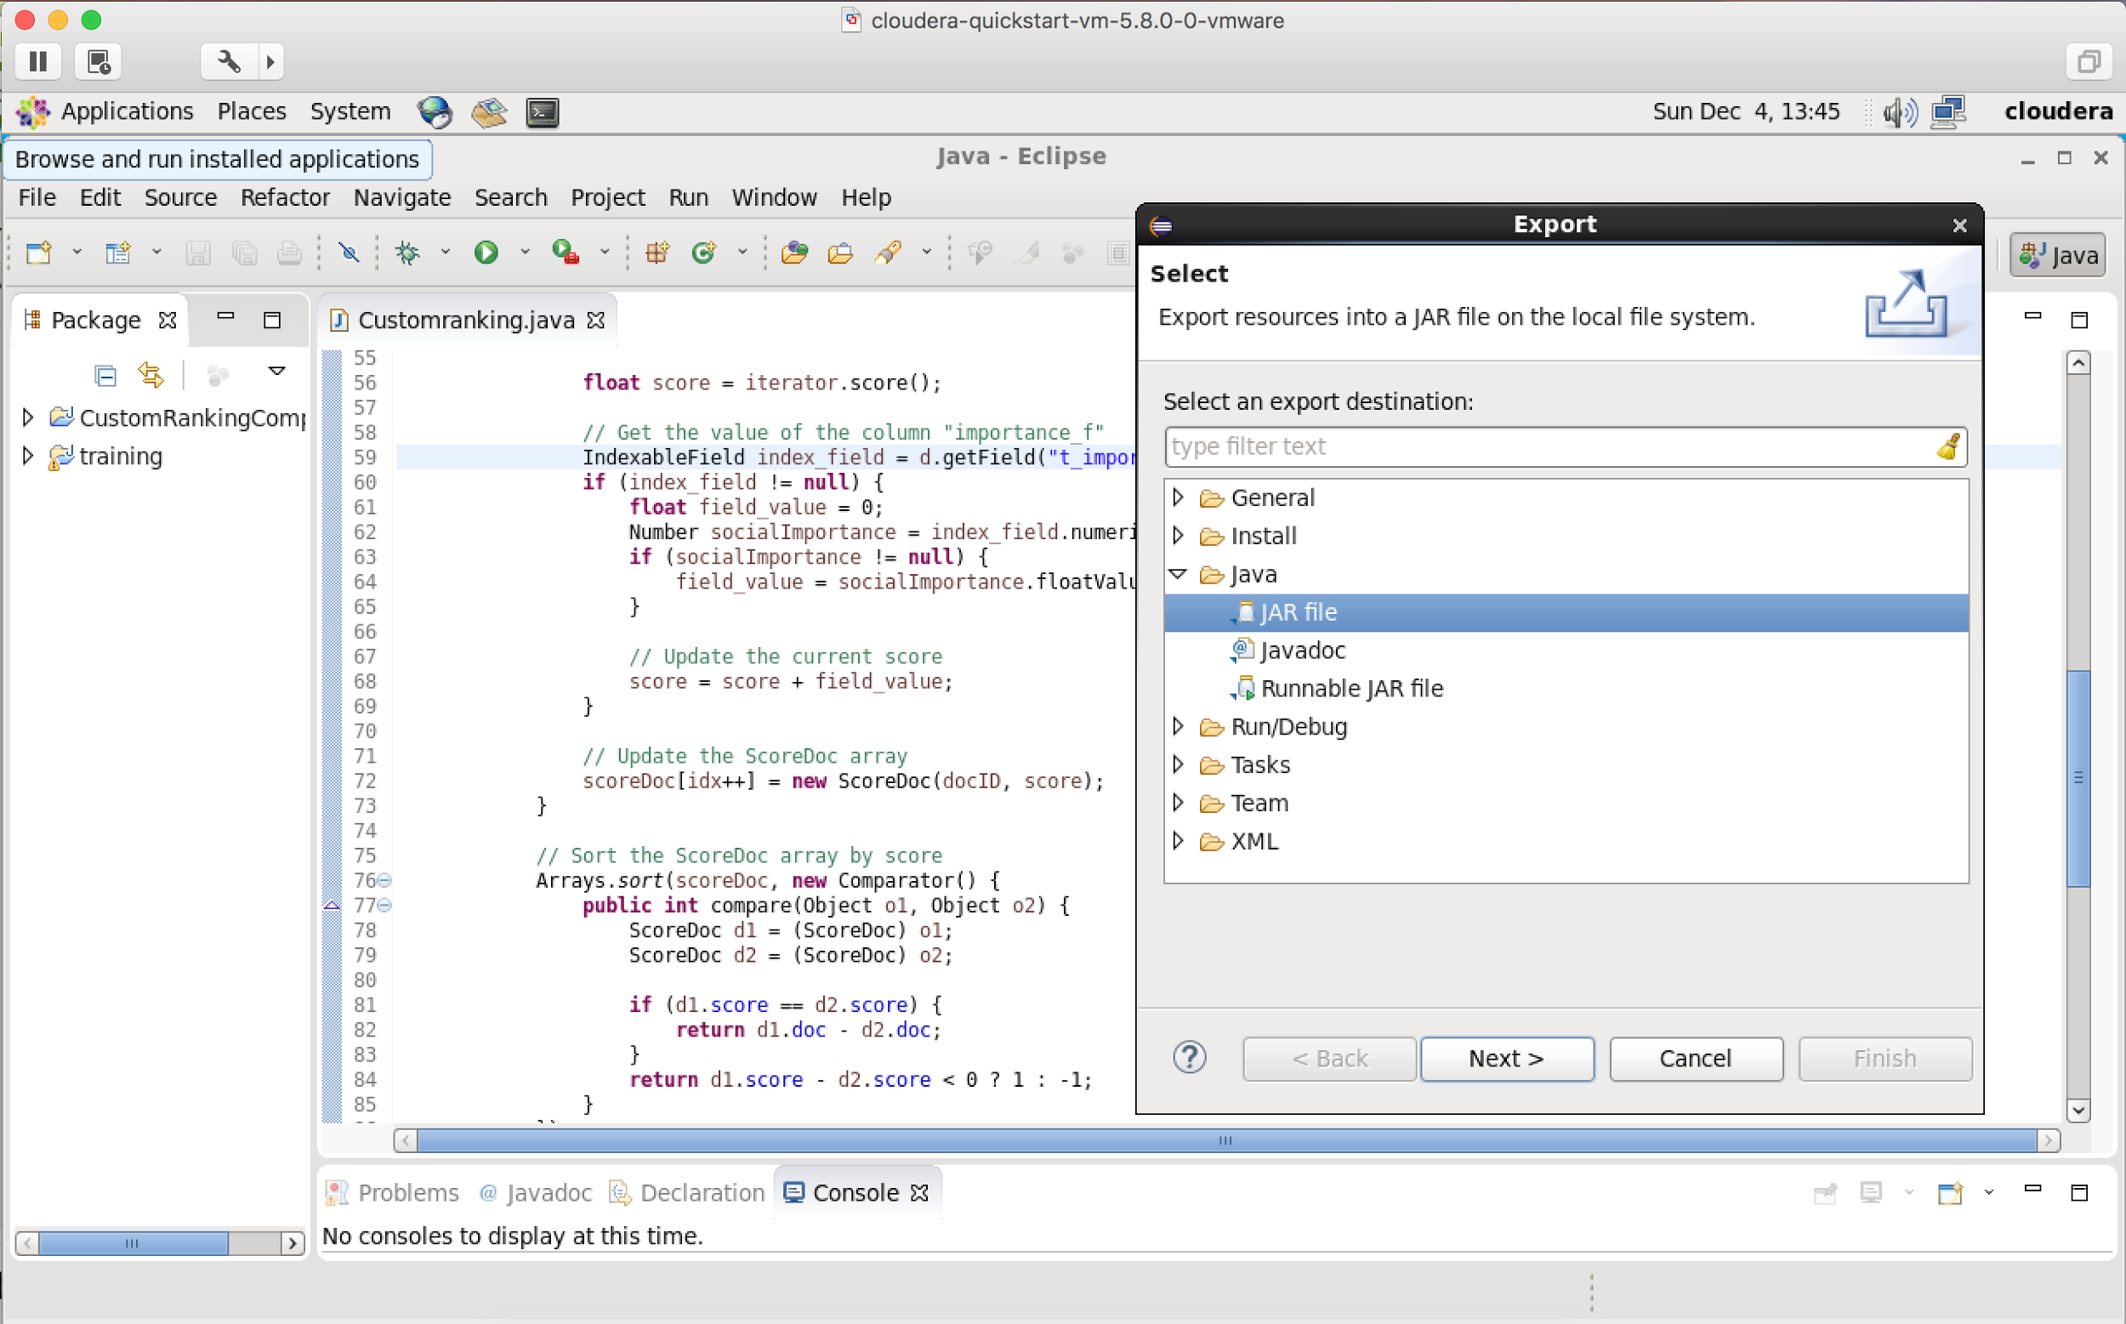
Implementation — Custom Ranking
Build and copy jar file into Hadoop Cluster

Slide 20
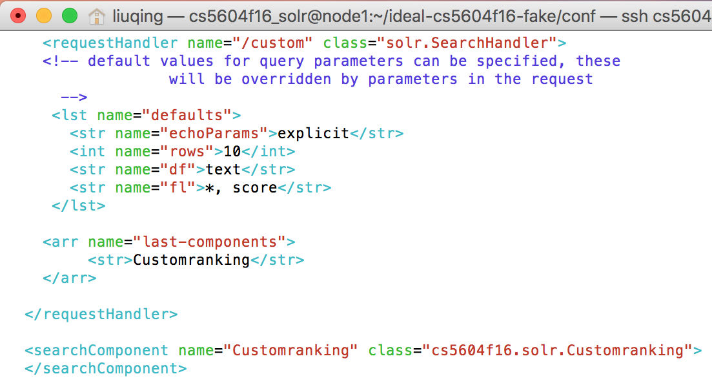
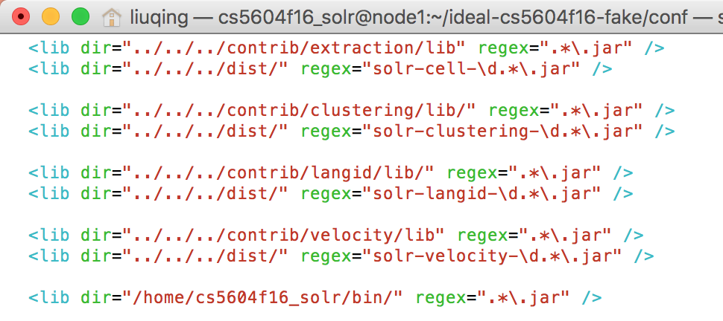
Implementation — Custom Ranking
Build and copy jar file into Hadoop Cluster
Modify the solrconfig.xml

Slide 21
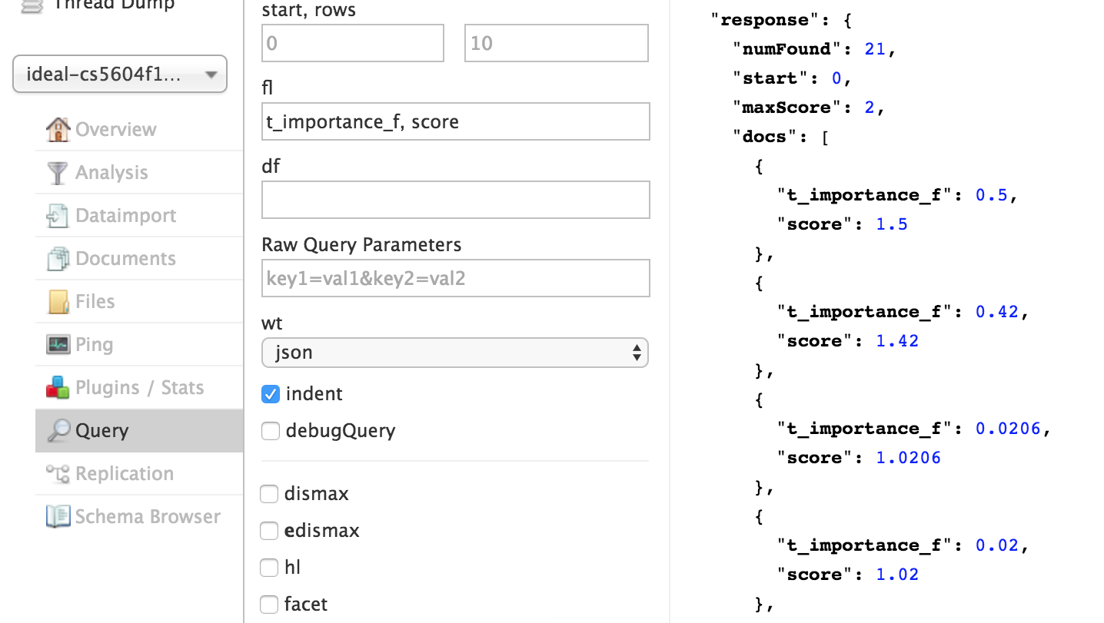
Implementation — Custom Ranking
Update the instanceDir
Reload the collection
Check the results in Solr Admin UI

Slide 22
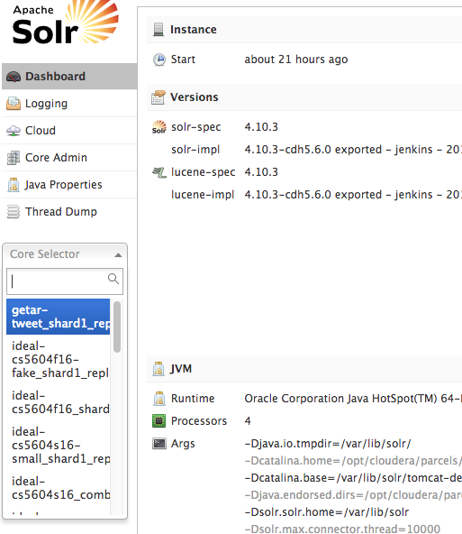
Implementation — Solr Admin UI
3
1
DashBoard: provide basic functions for users to choose. (Logging to check Solr logs for debugging)
2
Core Selector: select the core (dataset) for queries
Solr instance Information: current versions, JVM information
Choose ideal-cs5604f16-fake for querying
Notes:
This is the solr admin interface.
The dash board provides basic functions for users. For example, we could use logging to see the log information for debugging.
Core selector is used to select cores in solr. Each core is associated with an index and configurations. In our example, we use Choose ideal-cs5604f16-fake for querying to show
How to use solr.
The notation 3 shows current solr instance information. For example. We have the solr version 4.10.3 and our use oracle jave virtual machine

Slide 23
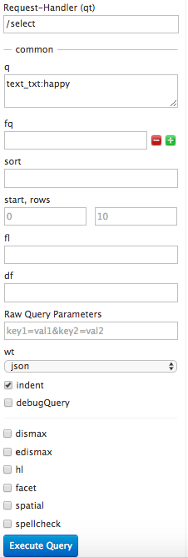
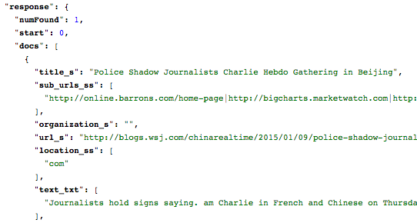
Implementation — Solr Admin UI
1
The request-handler: /select
2
The query event: q
Parameters for query: fq (filter queries) sort (descending or ascending)
Execute query
Results outputs: json format
Result statistics
3
4
Field name
5
22
Notes:
The request handler is use to choose what kind of query we want to perform: e.g,, /select is used to select items from the index
The notation 5 shows the result information.

Slide 24
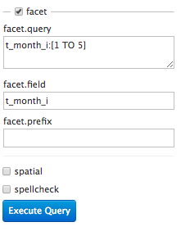
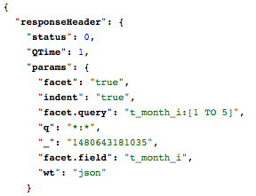
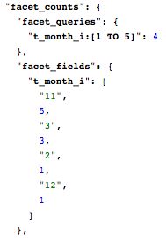
Implementation — Solr Admin UI
1
4
3
2
5
The faceted search query: range
Faceted search field: t_month_i
Parameters, true when enabled
Search Results: counts
Search Results: details
23
Notes:
The t_month_i is an integer from 1 to 12, we use range to focus the month that is between 1 to 5.
The faceted search will match the number 1,2,3,4,5,
As the result 4 shows, there are total 4 items matching the t_month_i filed.
Let us look into the details shown in notation 5.
More details on Solr use manual is in our final report.

Slide 25
Problem Faced
Cloudera and OS
Virtual Cloudera seems slow and often crashes due to the memory
Not familiar with the whole architecture at the beginning
Versions of Cloudera and Solr
Data
Consistency check
Not enough real data available to perform tests
Not much information available regarding logs to perform collaborative filtering
Collaboration
Communication and modification

Slide 26
Lessons Learned
Solr
HBase
HDFS
Patience
Team Collaboration
Carefulness

Slide 27
Future Work
Search
Customize more request handlers
Deal with the profanity issue
Custom Ranking
Customize more search components
Recommendation
Create a custom recommendation component (Probabilities – CTA team)
Implement the collaborative filtering (Log files – FE team)
Solr
Figure out SolrCloud, multiple Solr nodes in Cloudera Search

Slide 28
Acknowledgement
Projects
NSF IIS - 1319578 |  | III: Small: Integrated Digital Event Archiving and Library (IDEAL)
NSF IIS - 1619028 |  | III: Small: Collaborative Research: Global Event and Trend Archive Research (GETAR)
Teams
CMT, CMW, CLA, CTA, FE teams
Persons
Instructor | Dr. Edward A. Fox
GRA | Sunshin Lee

Slide 29
Thank you !
Questions?

