Slide 1
“The Auto/biographical Narrative and Ethical issues: Reflections on Three Projects”
(Scholarly Integrity and Research Compliance Investigator Series Webinar)
April 21, 2021
Suchitra Samanta
Associate PROFESSOR, Collegiate faculty
Women’s & Gender Studies program
Dept. of sociology, Virginia tech

Slide 2
An overview on personal narratives: How we tell our stories
Let me count the ways!
Short and anecdotal
Longer, maybe chronological, with a beginning, a middle, and an end
Free-associative, recounting experiences that don’t respect time and space, yet connect coherently to tell a life

Slide 3
Scholarship on autobiographical narrative holds that:
Memory and remembering is selective
Thus, making connections between remembered events in a life is centrally an imaginative process, one that gives meaning to that life
By definition, such selectivity is never perfect!
Moreover, stories emerge in a particular encounter: a researcher’s particular questions; a participant’s perceptions of the researcher; the possible inequities of power between the two, by race/ethnicity, language, class, nationality, gender, religion, profession and more

Slide 4
Different contexts, different questions
I describe three projects, with different contexts of research, different questions, involving different ethical issues, in research, in the field, and in publishing my work
1) An Auto/Biographical paper on my mother’s life (2016)
2) Three papers, on Indian Muslim women and education, each involving different ethical questions (2004 and 2016); Another paper on this project, published in an article for the Encyclopedia of Women and Islamic Cultures (2017 online; 2020 in print)
4) A paper on Asian/American women in the American community college (2018)

Slide 5
What connects these projects?
My own feminist, and rights-based ethic, of giving voice to underprivileged and/or minority women’s aspirations to education, their struggles, and possibly achievement
My projects involve seeking “educational histories,” focusing on narratives of educational trajectories in a life
My questions, differently, in different contexts, seek in narrative the constraints to education (of culture, religion, socio-economic circumstances, minority status, immigration, history)
My second question seeks an ‘anti-deficit’ component, where found, namely, what has worked? How do we understand motivation, agency, achievement, in a context of aspirations to education?

Slide 6
Reading my mother’s life across time and space: uncertainties in putting a context to her story
My mother’s album of photographs, February 1942
‘Memory archives’: drawing from reading of Holocaust photographs
Scholarship on studio photography in British India
Historical research on women in medicine in British India
Medical school records from South Asia archives in British Library, London
Other documents, e.g. exam registration forms, personal postcards
Family anecdotes, my mother’s classmates’ memories
My own memories of my mother

Slide 7
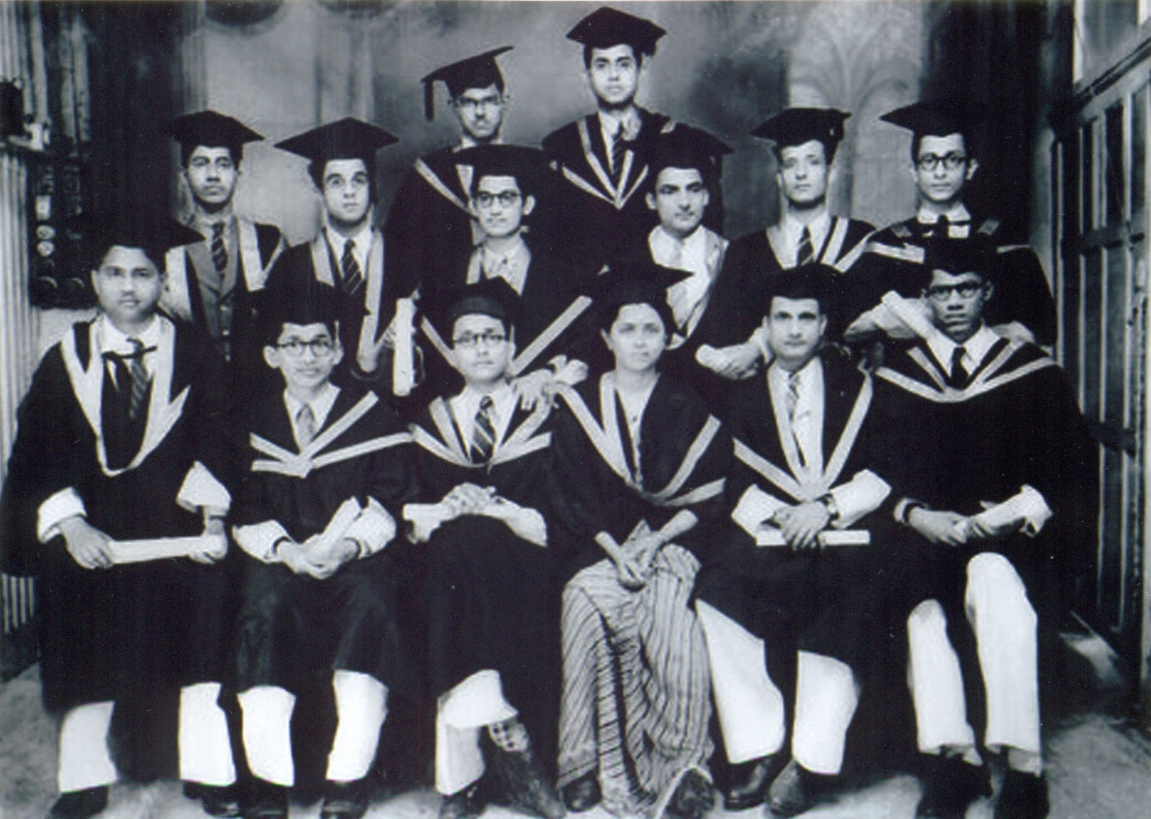
Calcutta Medical College Graduation (1941): Dr. Surabala Karmakar, with classmates: a memory that inspired me

Slide 8
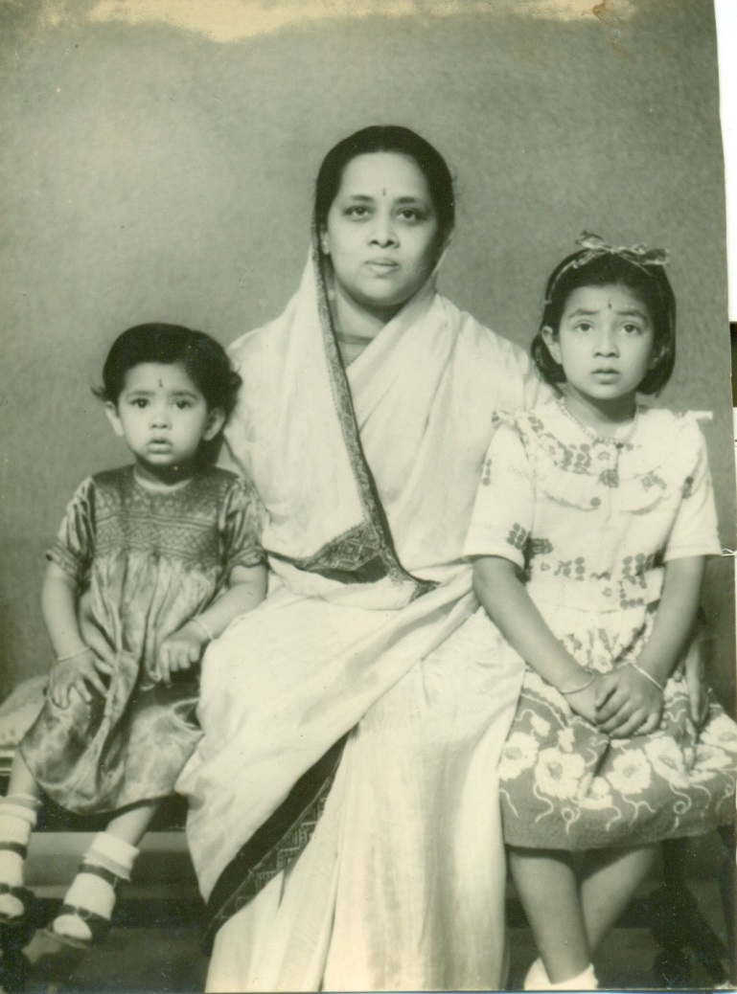
My memories are of a different person to the mother in this photograph!

Slide 9
Indian Muslim women and educational status: Methodology
Recording, in a journal, also on tape, my open-ended conversations with girls and young women in a majority Muslim impoverished area (basti) in SW Kolkata, over mostly summers, 1998-2002, focusing on ‘educational histories’
Gathering documentation, statistics from the non-profit whose work I was observing, with a focus on educating the adolescent girl child
Meeting with the American charitable organization in Richmond, VA to sponsor a girl child in this basti

Slide 10
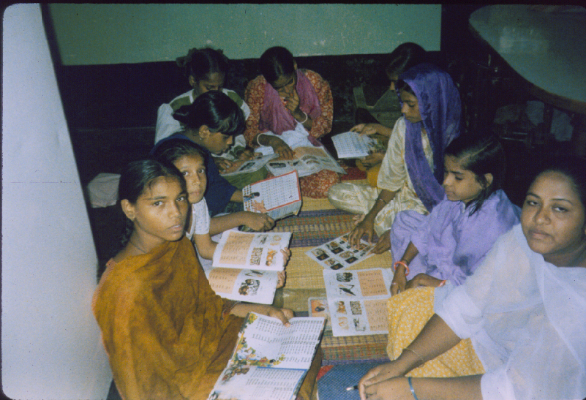
Non-formal education: “Home School”
The young teacher is in the right corner

Slide 11
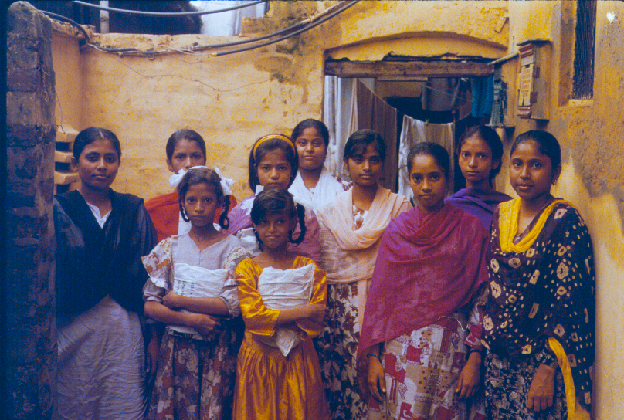
Non-formal education: Nayla’s Home School
Nayla, in the black and yellow salwar-kameez, with her students (ages 12-23)

Slide 12
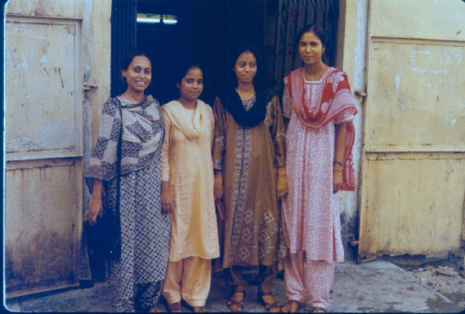
Social workers and their assistants
Shahnaz (red and white outfit) and Shamsa (blue outfit), both Senior Social Workers with AAES/FAB, have Masters degrees from Calcutta University

Slide 13
Uncertainties in the ethnographic “encounter”
My own privilege, by class, education, and as a member of the religious majority (Hindu) in India, in this ethnographic encounter
What worked for me: shared languages (Bengali, Hindi), and culture; as a woman speaking with women
However, given the exigencies of very hard lives, I could meet and talk only once with some participants; some I met several times
The very personal details in narratives, of extreme financial hardship, family illness, responsibilities for younger siblings
The dowry project, which I requested because I could not effectively conduct this
A participant’s secret engagement to a fellow social worker

Slide 14
“Education as a path to ‘being someone’” my concluding words
I refer to Martha Nussbaum, on education as a matter of social justice, a human right, and integral to women’s self-respect (2010)
“Muslim women, who, in the face of considerable odds, evidently aspire to an education, who persevere towards their goals of “being someone,” and towards some degree of autonomy, inspiring those who follow. It requires political will in India to recognize [their realities]…to…implement those measures that afford Muslim women their human rights in a secular democracy.” (Samanta 2016)

Slide 15
Two other publications from this project, why and how I wrote them
Why did I stop work on this project in 2002?
My paper, “The ‘War on Terror’ and Withdrawing American Charity” (Meridians, 2004): writing an indictment “from the trenches”
Article-sized entry in Encyclopedia of Women and Islamic Cultures on women and education: giving voice to Muslim women (2017 Brill online; 2020, print, Volume 4)

Slide 16
Asian/American women in U.S. community college
My objectives: two related motives:
(1) to add dimension, in a context of immigrations, in qualitative research involving ‘educational histories’, to the Model Minority Myth about Asians in the U.S.
(2) the role of the community college in furthering the aspirations of this diverse demographic that is homogenized, by class and cultural difference, and different histories
“Democracy’s colleges,” majority are students from minorities
Asians as 6% of around 9 million students in community colleges nationwide
Around 60% are women; a quarter of that number are mothers
Advantages: scholarships, Pell grants, smaller classes, flexible 2-year programs; low tuition (a third of public universities)

Slide 17
Four stories of women in community college
Sarita, born in India, married to naturalized Indian American, a mother, in Nursing
Jeanne, born in Seoul, Korean/white, a mother, in Information Technology
Jennifer, born in the U.S., Vietnamese, in Nursing
Lily, born in the U.S., Cambodian, in Business Administration
[These speak of financial hardship, family obligations, cultural norms of gender, and related expectations, mental illness, but also of perseverance and achievement, facilitated by the community college; other stories speak of families experiencing downward mobility, reversed gender norms]

Slide 18
The American Community College as ‘Stepping Stone’ (my concluding words, Samanta 2018)
“Life stories speak to a people’s humanity, their strivings, their achievements, but also to their setbacks. Personal histories…speak of trajectories and of change. It is in accounts of real lives that we can add dimension to the Asian story in the United States” (Samanta 2018).

Slide 19
An overview, in conclusion
My ethical imperative that inspired each project: centrally to give voice where these voices are unheard
The personal narratives speak, I suggest, both of multiple patriarchies as well as geopolitical forces at play:
In my mother’s story, in British India; of new opportunities, but also social, cultural, and gendered constraints to a career; that we see her life, achievements, and early death in this larger context
For the Muslim women in contemporary, post-colonial India: as a minority in a majority-Hindu Indian state; of ‘negotiating’ patriarchy in families, and confronting state bias in educational policies
For the Asian/American women in American community college, in a context of immigration: “We are here because you were there” (Cathy Park Hong, Minority Feelings, 2020)

Slide 20
Ethical issues
In project on my mother’s life: incomplete records; photographs without provenance; historical scholarship for context; uncertain memories, including my own
On Muslim women, it’s their stories, what they choose to tell me; do I reveal personal details? (yes, to some degree, as pertinent)
Do I bring a polemic to the Encyclopedia article, even when the editors tell me not to? (Yes! The women’s voices count!)
Do I write against the American charity’s pulling out precipitously, with consequences for a destitute community, after 17 years? (Yes!)
Do I keep the details of the Asian/American women’s stories, however personal? (Again, yes!)

