Slide 1


Virginia Cooperative Extension – Mecklenburg County
4-H Youth Development

Slide 2
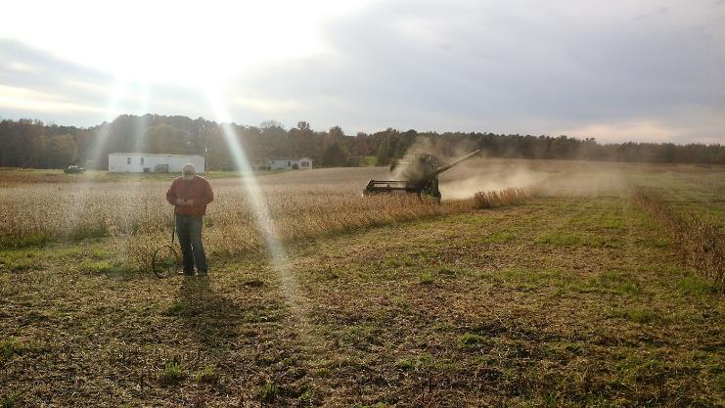
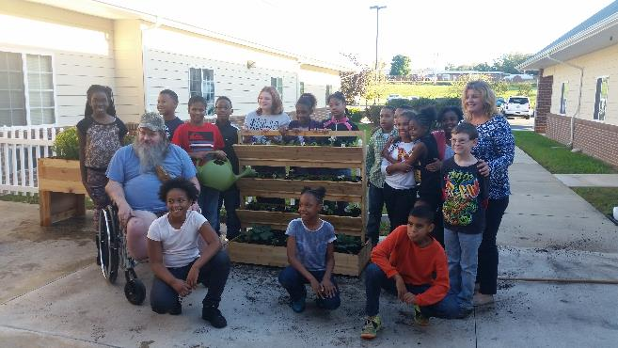
VCE - Local Program Areas
Agriculture and Natural Resources – Taylor Clarke
Family and Consumer Sciences – Amy Hawkins
SNAP-Ed/Family Nutrition Program – Nancy Jimmerson
4-H Youth Development – Jennifer Bowen

Slide 3
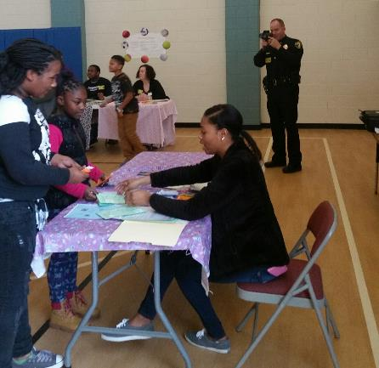
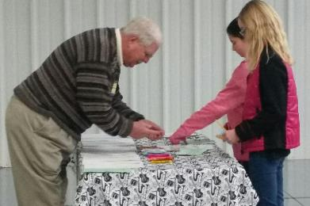
In-school 4-H programs
Science Enrichment
  45 minutes/monthly
  4th and 5th grades at Clarksville, Chase City, and LaCrosse Elementary Schools
21st Century Grant After-School Programs
Kids’ Marketplace
Reality Store

Slide 4
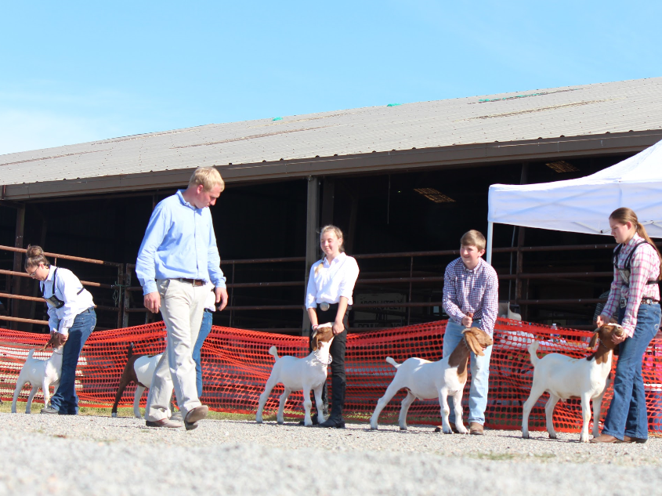
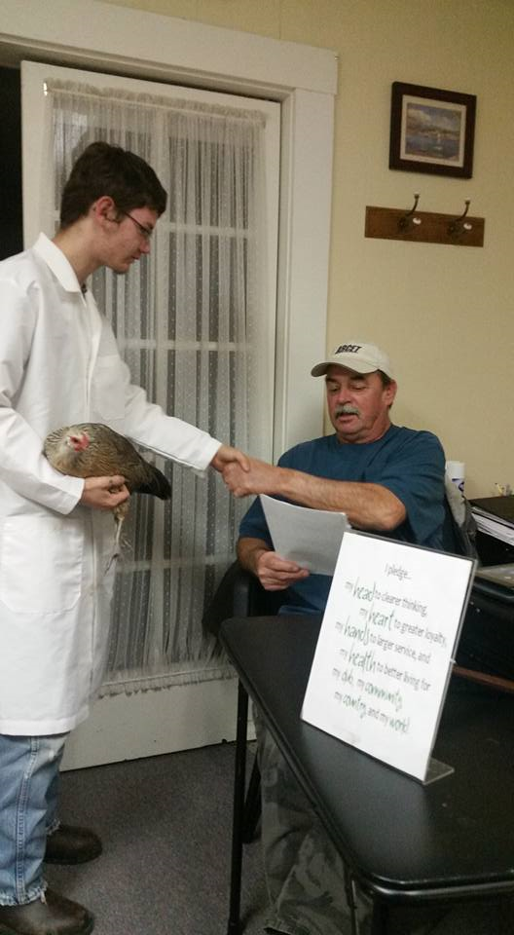
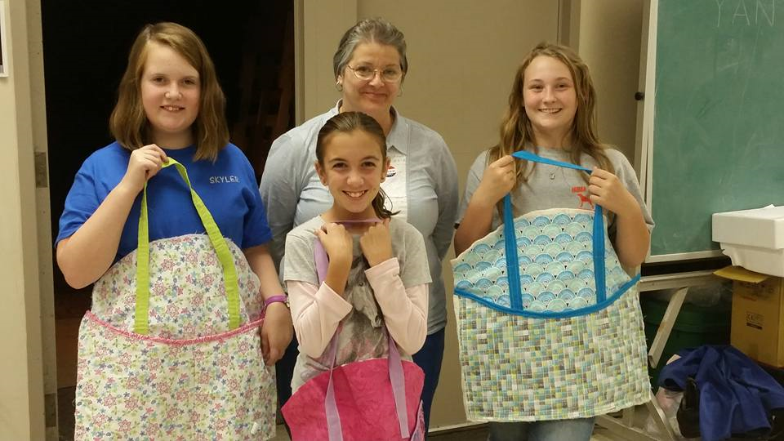
Volunteer-Led 4-H Clubs
  Mecklenburg 4-H Livestock Club
  Mecklenburg 4-H Fur and Feathers Club
  Sewing Club
  Freeland 4-H Shooting Education Club

Slide 5
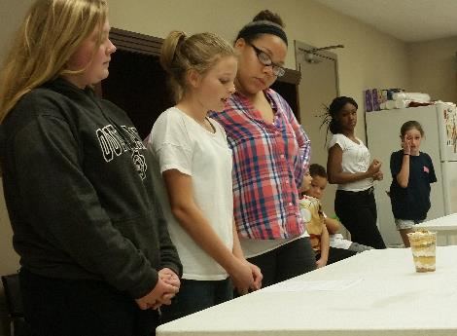
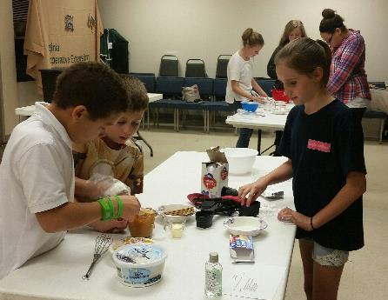
Workshops and Special Programs
4-H Food Challenge Program
Teen Leadership Programs
  Leadership Retreat (Youth Engaged in Learning about Leadership – NY 4-H)
  Junior 4-H Camp Teen Leader Recruitment and Training

Slide 6
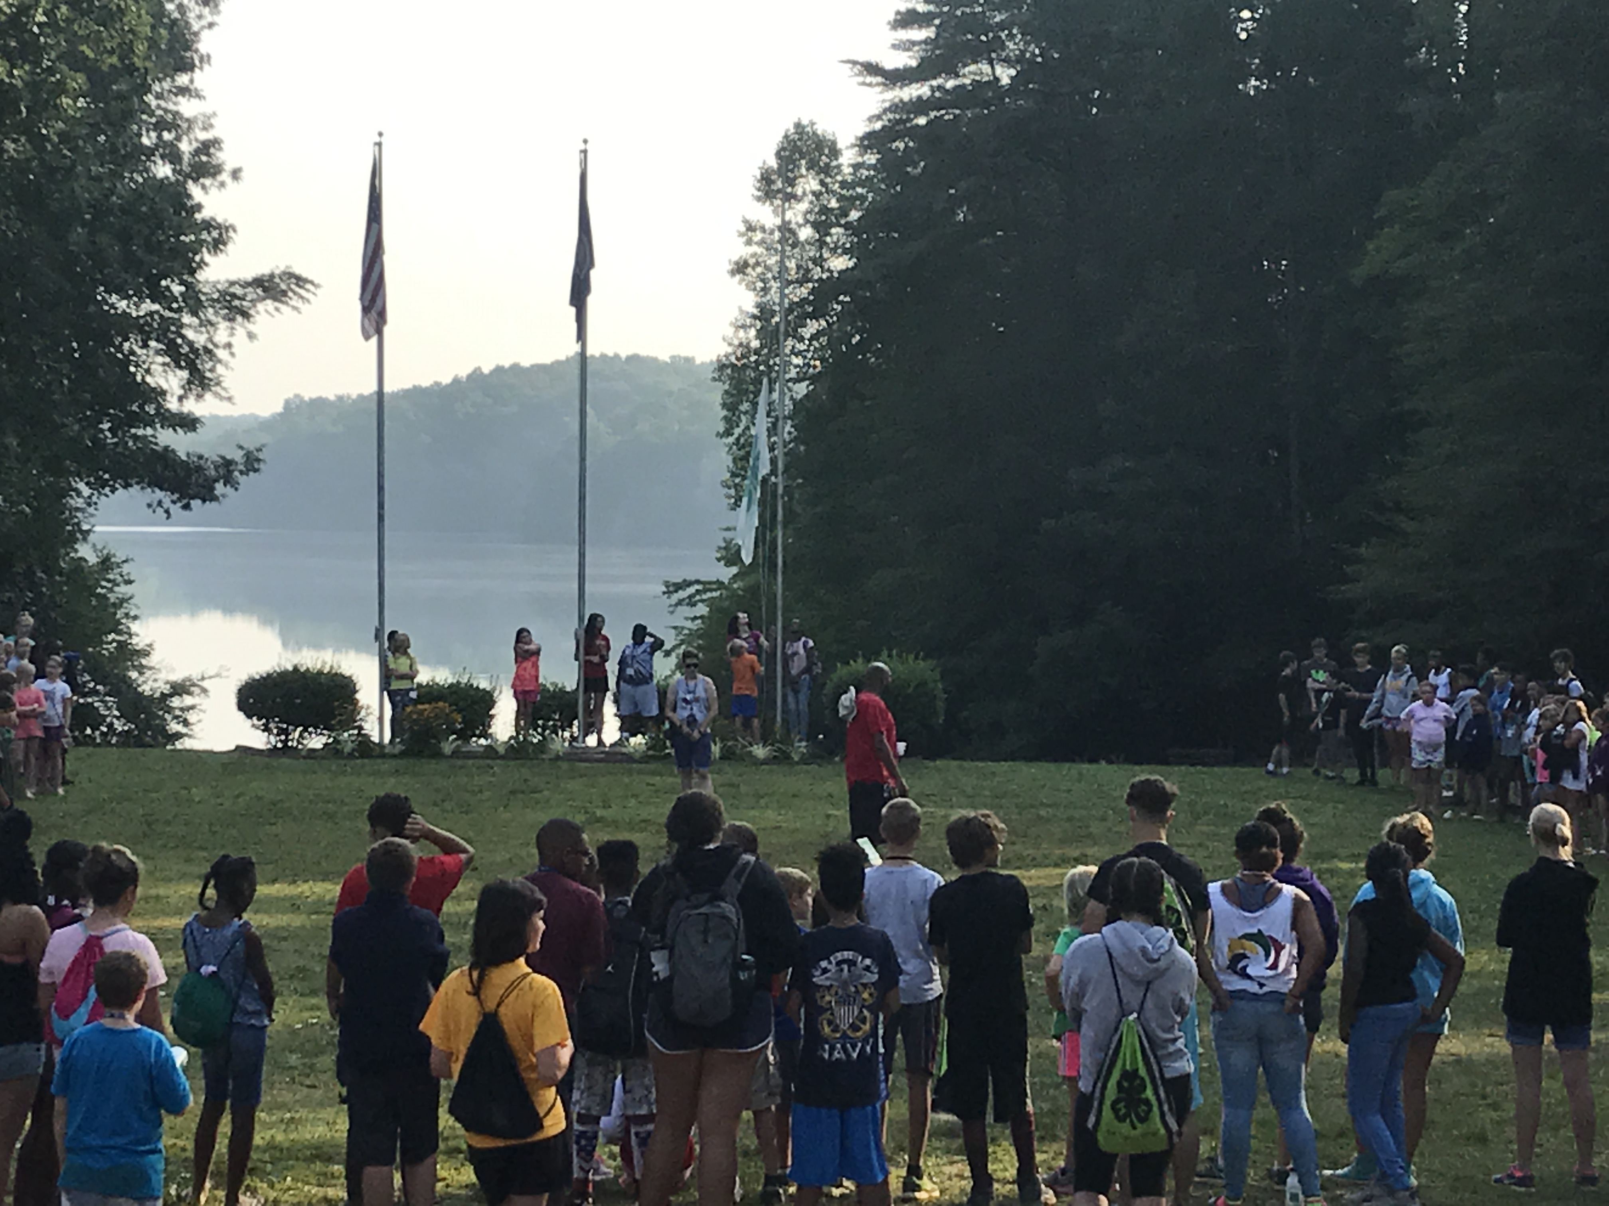
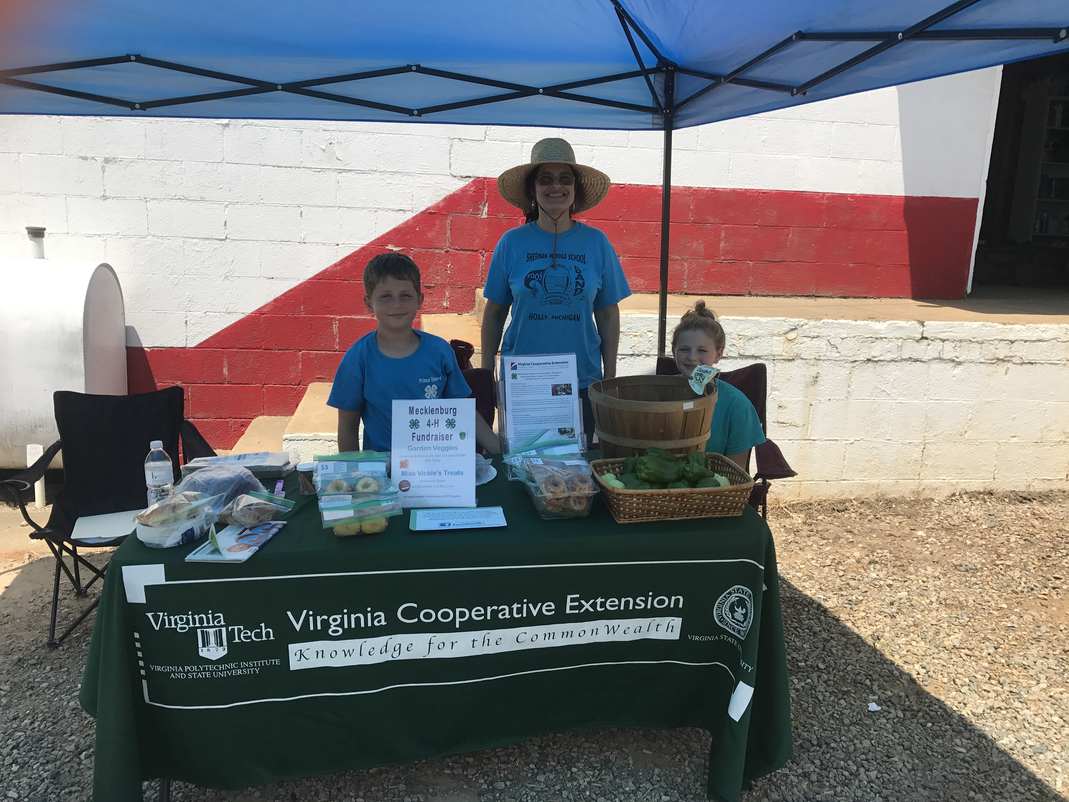
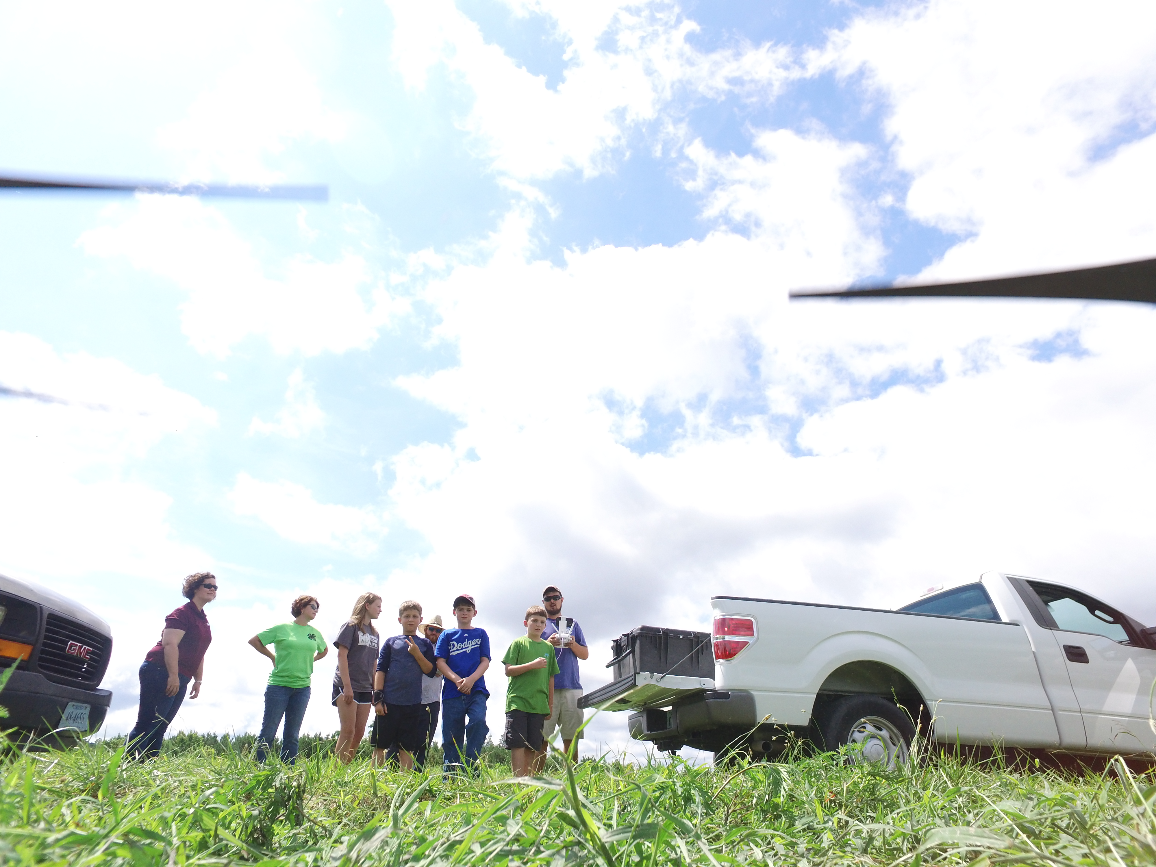
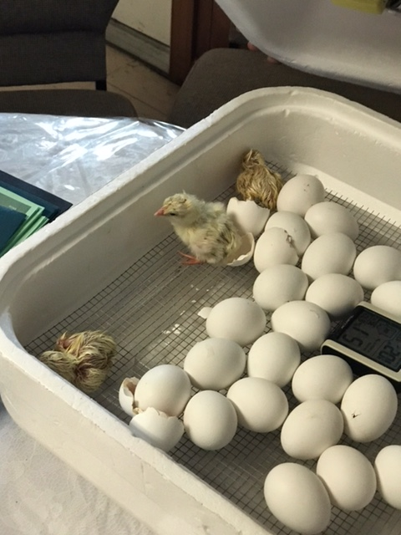
4-H Summer Programs
  Junior 4-H Camp
  Camp Loud and Clear (Partnership with Longwood)
  Summer program in Boydton community garden
  St. John Baptist Church Summer Program
  Cloverbud Super Science Club – partnership with library

Slide 7
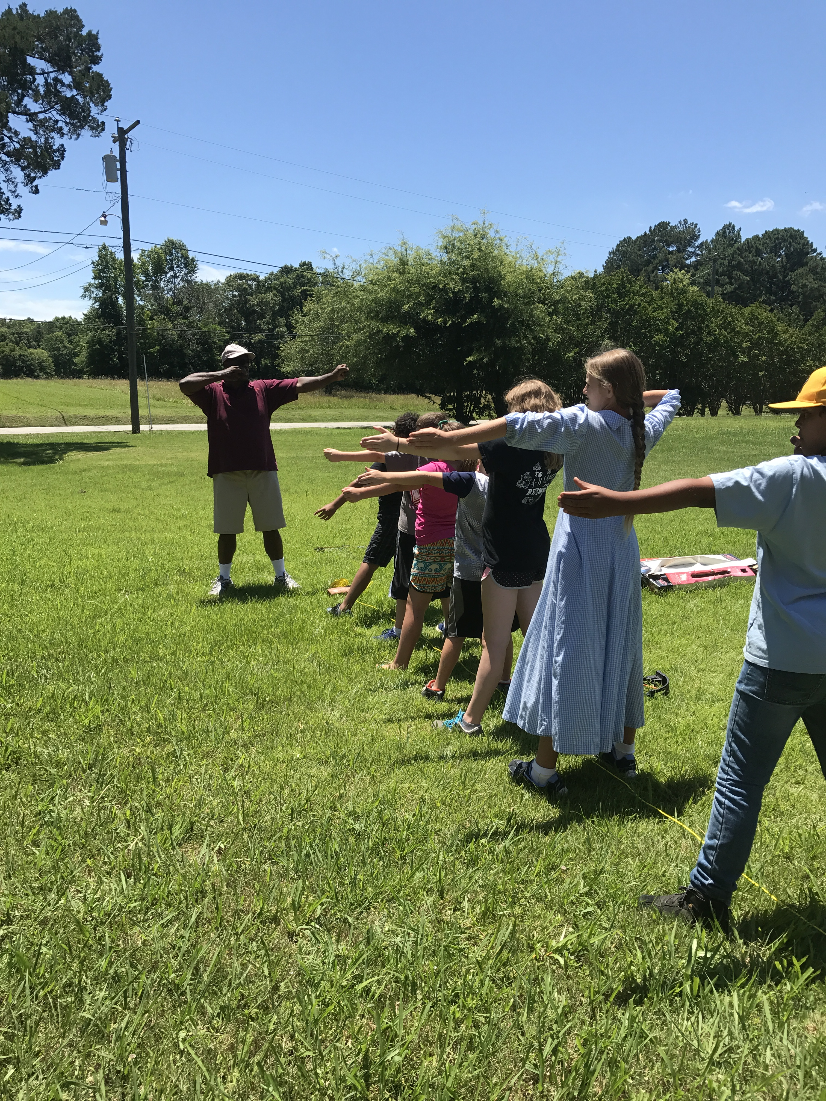
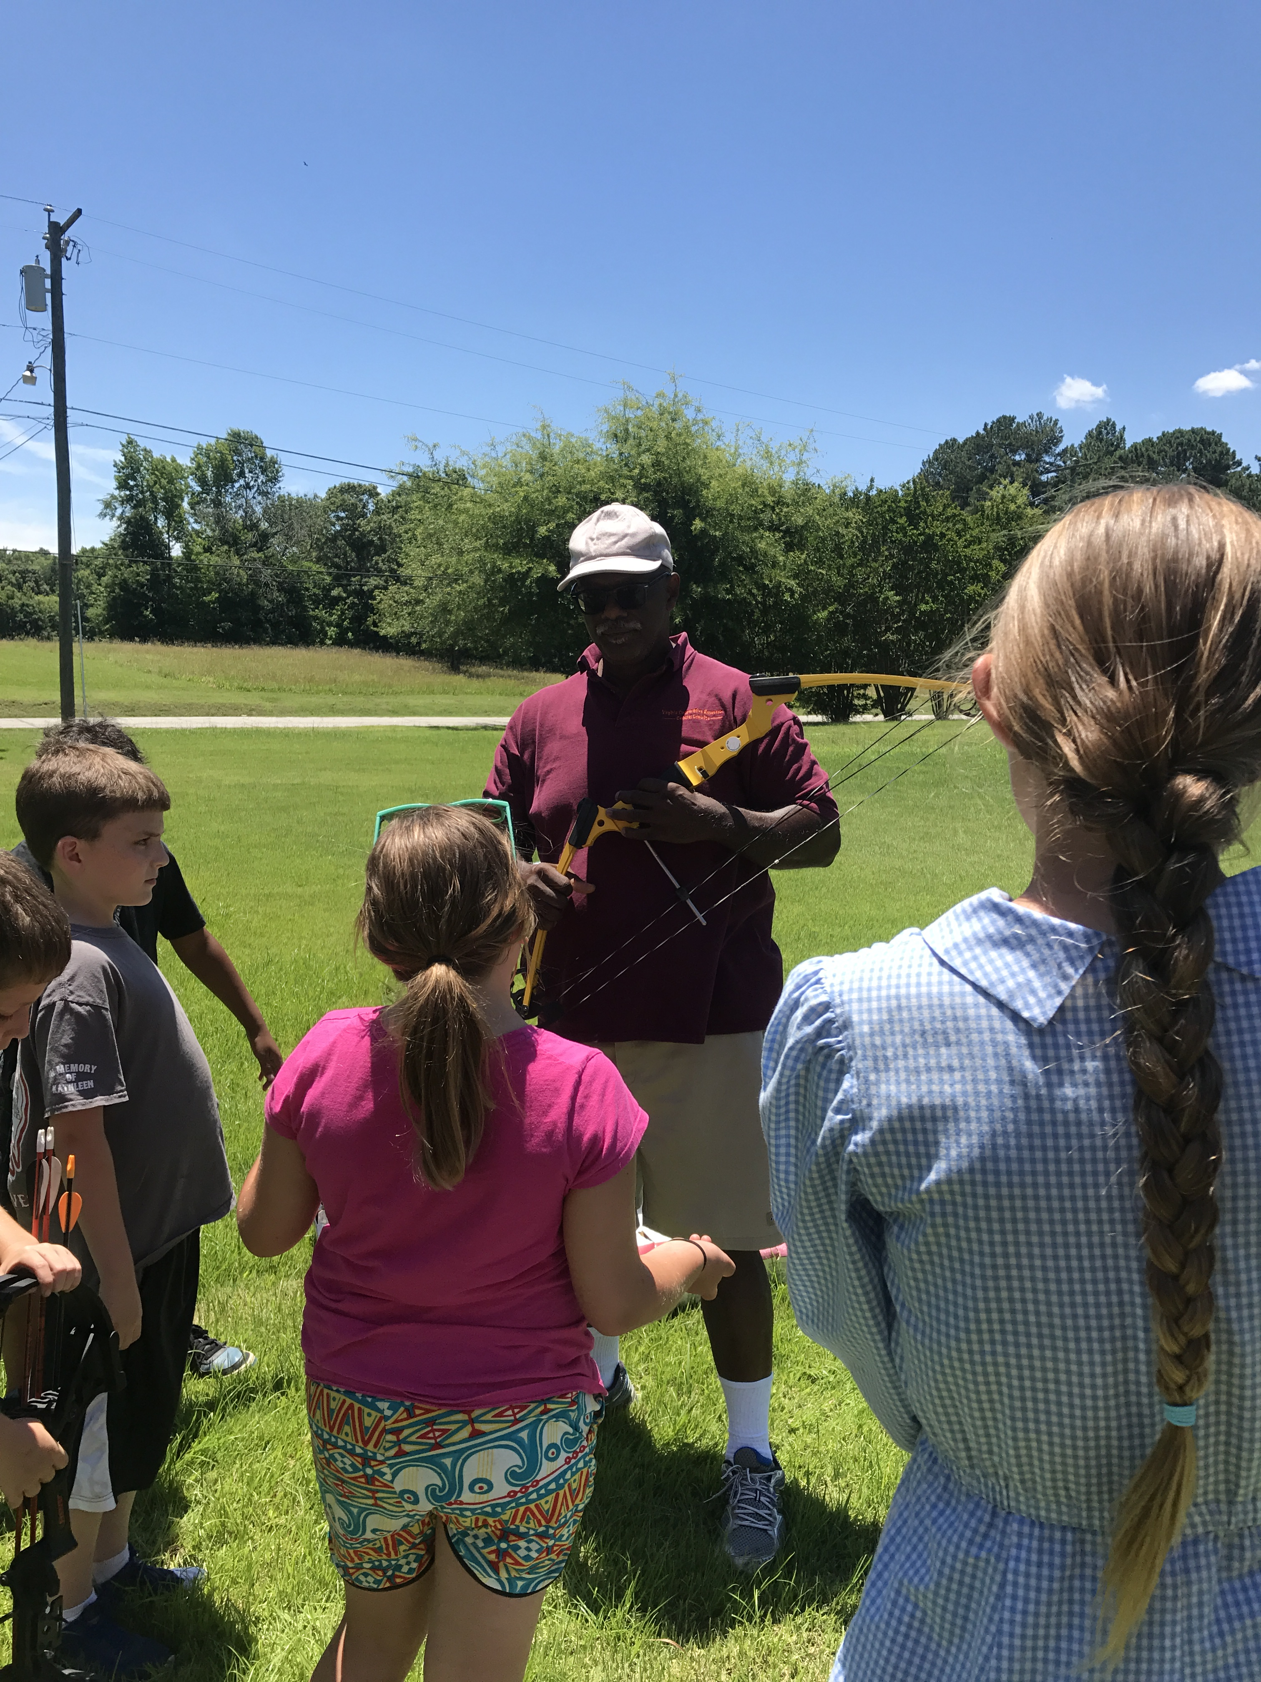
Planned Programs
Innovative Leadership Academy – 2017 – 2018 school year
SHEEP Program at SHUMC
4-H at First Christian School and South Hill Elementary
SPIN Clubs – Volunteers Needed!

Slide 8
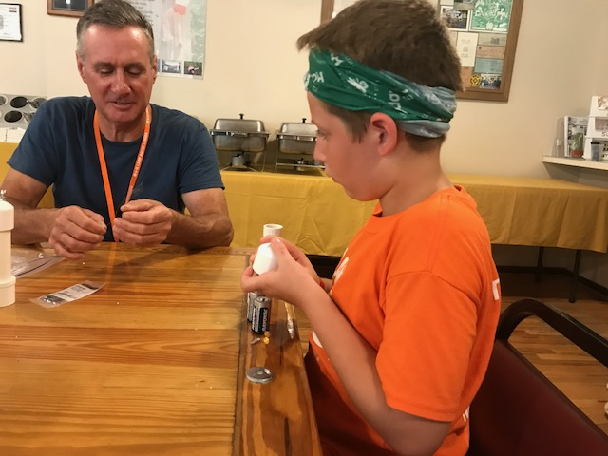

Local 4-H Program Needs
  Volunteers
    Short Term
    Long Term
    One Time/Occasional
    Cloverbud Club
    4-H SPIN Programs
  Funding
    Participant Scholarships
    Funding for specific programs

Slide 9

Keep Up With VCE – Mecklenburg
Like us on Facebook!
  Virginia Cooperative Extension – Mecklenburg County

