Slide 1



AGRICULTURAL, OFF-FARM, MIGRATION, & SOCIAL PROTECTION STRATEGIES TO INCREASE RURAL HOUSEHOLD RESILIENCE TO RAINFALL SHOCKS IN SUB-SAHARAN AFRICA
Bradford Mills
Genti Kostandini
Anthony Murray
Jianfeng Gao
Jawoo Koo
Zhe Guo
Joseph Rusike
Steven Omamo
This research was supported by Michigan State University Global Center for Food Systems Innovation USAID Cooperative Agreement No: AID‐OAA‐13‐00006.

Slide 2
Climatic Shocks/ Change
Other Responses
Agricultural Production
Agricultural Response
Migration
Off-farm activities
Transfers
Crop Mix
Τechnology
Intensity
Δ Off-farm Income
Household
Well-Being
Δ Agri. Output

Slide 3
Climatic Shocks/ Change
Other Responses
Agricultural Production
Agricultural Response
Migration
Off-farm activities
Transfers
Crop Mix
Τechnology
Intensity
Δ Off-farm Income
Non-resilient Household
Δ Agri. Output

Slide 4
Climatic Shocks/ Change
Other Responses
Agricultural Production
Agricultural Response
Migration
Off-farm activities
Transfers
Crop Mix
Τechnology
Intensity
Δ Off-farm Income
Resilient Household
Δ Agri. Output

Slide 5
Presentation Objectives
Present monetary estimates of the costs of drought and rainfall variability for rural households in Ethiopia and Zambia
Explore the effectiveness of alternative resiliency strategies in reducing household costs from variable rainfall
Identify policy interventions that anticipate and mitigate impacts

Slide 6
Data Sources: Ethiopia & Zambia
Long-term household panel data:
  Ethiopia : 1999-2004-2009
  Zambia: 1999/2000, 2002/2003, and 2006/2007
Historical daily rainfall data
  1980 to 2010
  DSSAT model crop simulations:
    1980 to 2010
    future projections to 2050

Slide 7
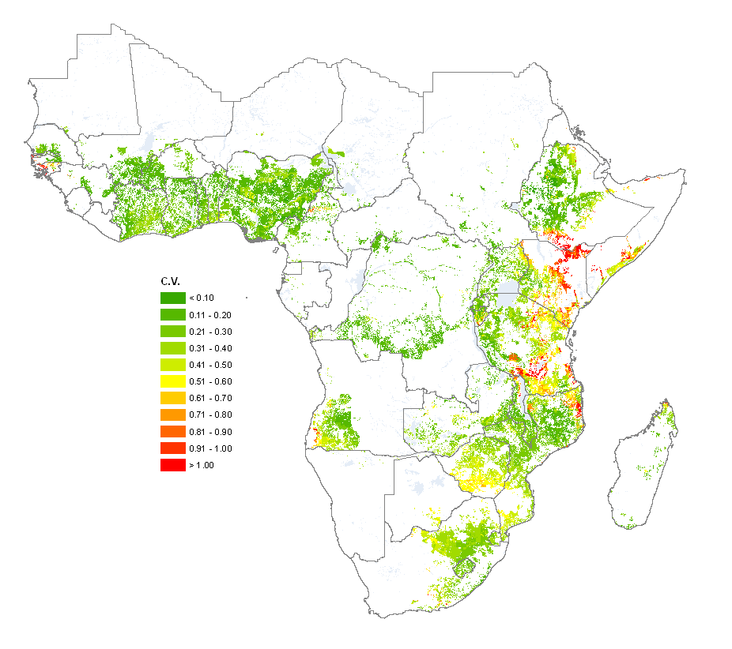
Drought and Rainfall Variability

Slide 8
Rainfall variability Ethiopia and Zambia
Average growing season CVs of annual rainfall from 1980 to 2010 are 0.38 in Ethiopia, and 0.21 in Zambia
A severe drought roughly once every four years in at least one zone in Ethiopia, and roughly once every six years in at least one district in Zambia

Slide 9
Climatic Shocks/ Change
Decreased rainfall
- Lower yields
More variable rainfall
- More yield and income variability
Household well-being

Slide 10
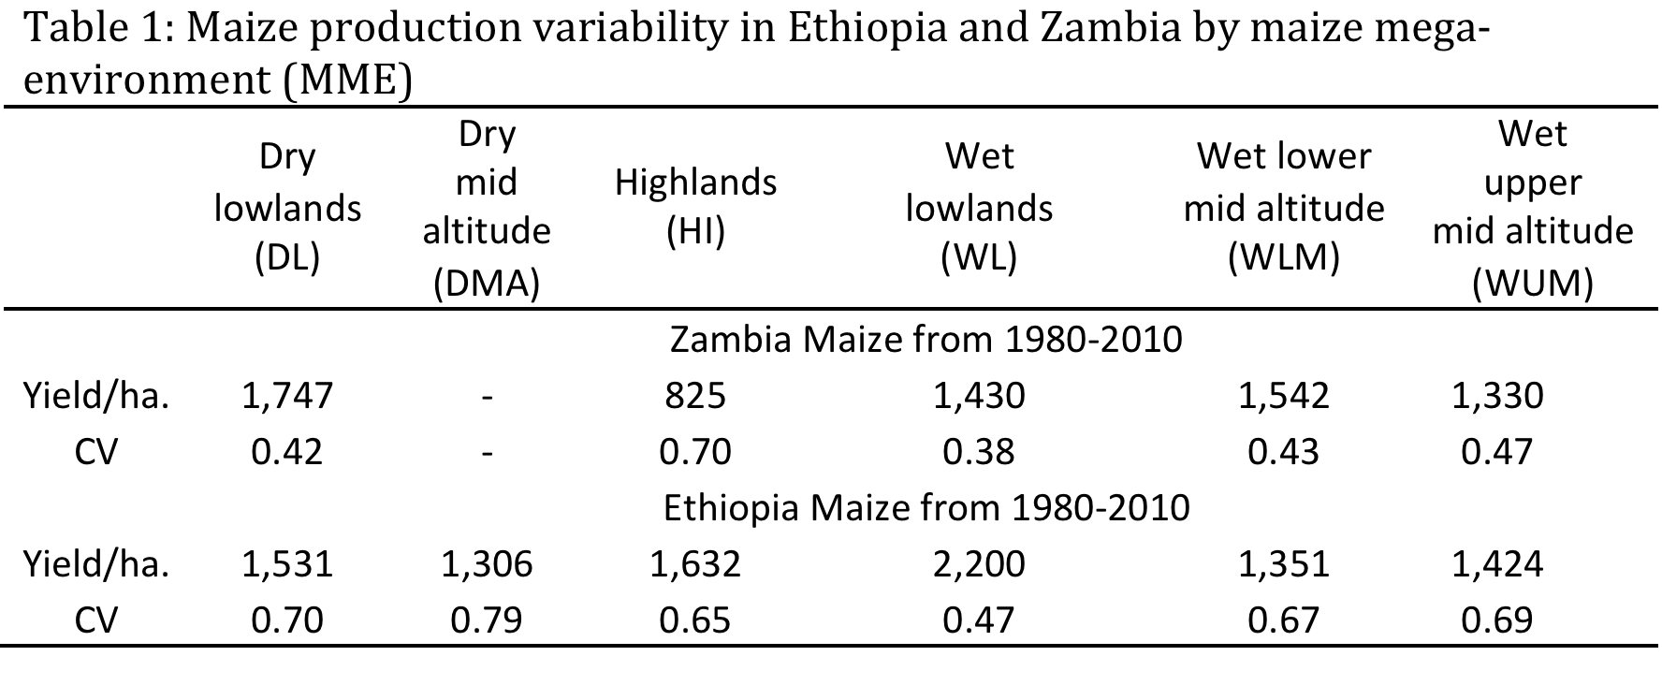
Crop simulation results
High CVs in both countries
- Before farmer adaptation
- Adaptation is costly

Slide 11
Costs to Households
2 Types:
  Lost income from average crop yield losses due to drought and other low rainfall events
  Cost from household income variability associated with variance in agricultural production
    Risk averse households will pay to not have variable income
      How much?

Slide 12
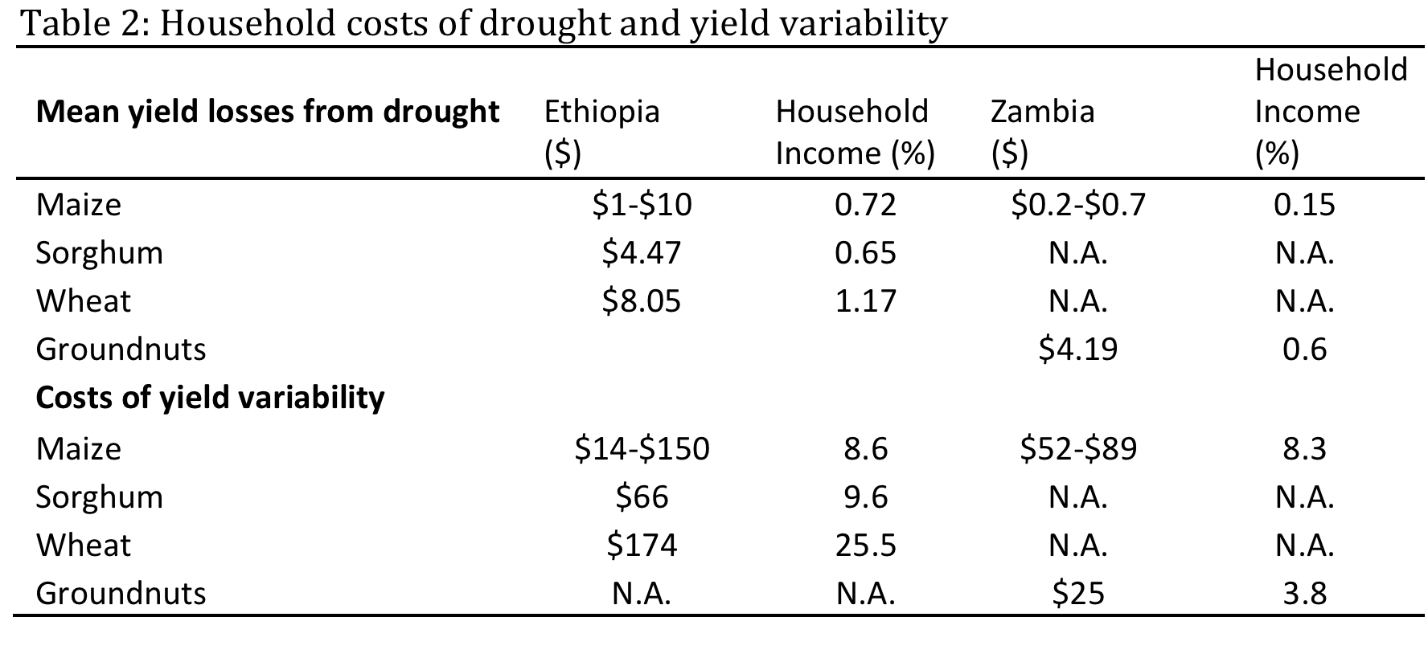
Costs of agricultural income variability are high

Slide 13
Climatic Shocks/ Change
Evidence crop mix response
Agricultural Production
Agricultural Response
Crop Mix
Τechnology
Intensity

Slide 14
Area Crop Share Responses
Maize share:
Increases with past season rainfall (small)
Increases with planting and growing season rain variation (large)
Decreases with harvest season rain variation (large)
Cassava share:
Decreases with past season rainfall (large)
Decreases with planting and growing season rain variation (small)
Increases with harvest season rain variation (small)
Groundnut share:
Decreases with planting and growing season rain variation
Sweet potato share:
Increases with planting and growing season rain

Slide 15
Climatic Shocks/ Change
Evidence crop mix response
Technologies can buffer shocks
Agricultural Production
Agricultural Response
Crop Mix
Τechnology
Intensity

Slide 16
Technologies/interventions that buffer shocks
Drought resistant/tolerant crop varieties
  Maize: CIMMYT/IITA (DTMA ), WEMA project
    Up to 90% mean yield gains and 20% variance reduction compared to other improved varieties
  Wheat: ICARDA (Bread wheat), CIMMYT (wheat CRP)
  Rice: IRRI
  Benefits from reducing variance comprise 40% of all benefits in maize, rice and wheat drought tolerant crops
Micro credit
Rainfall or vegetative index based crop insurance

Slide 17
Empirical Evidence - Zambia
Post farm adaptation
Lower rainfall:
  Lower Maize, Sweet Potato and Groundnut yields
  No impact on Cassava
Increasing rainfall variance:
  Sweet Potato and Cassava yields decreases
  Maize yield increases
Agricultural adaptations do not fully buffer rainfall shocks

Slide 18
Climatic Shocks/ Change
Migration (14%)
  Increases with lower and more variable rainfall environments
  Does not buffer consumption against rainfall shocks
Off-farm employment (33%)
  Increases with lower rainfall rainfall and higher rainfall variance
  Buffers consumption against climate shocks
Other Responses
Agricultural Production
Migration
Off-farm activities
Transfers

Slide 19
Climatic Shocks/ Change
Informal transfers
  Do not respond to rainfall
  Do not buffer consumption against rainfall shocks
Public social protection programs
  Do not respond to rainfall
  Buffer consumption against rainfall shocks
Other Responses
Agricultural Production
Migration
Off-farm activities
Transfers

Slide 20
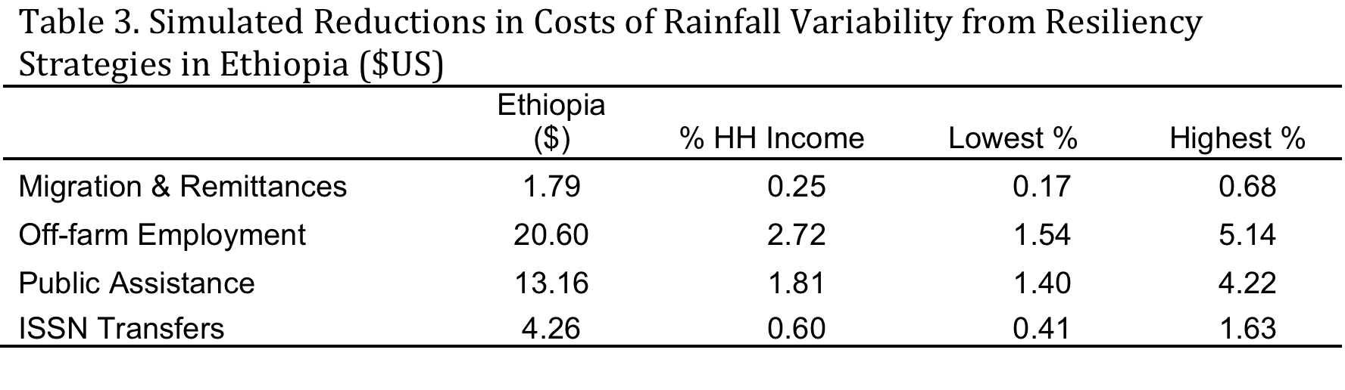
Resiliency strategy effectiveness: simulation evidence
Results driven by largest income shares
Lower bound estimates – no adaptation

Slide 21
Resiliency strategy effectiveness: empirical evidence
Household per-capita consumption
  Decreases with lower growing season rainfall
    Particularly negatively impacted by low rainfall levels
  Decreases with increased rainfall variance
  Off-farm employment and public transfers buffer negative climate shock impacts on consumption
  Resiliency strategies do not fully buffer rainfall shocks

Slide 22
Climatic Shocks/ Change
Decreased rainfall
Decreased yield
Decreased per-capita consumption
Use of resiliency strategies
Resiliency strategies do not fully absorb shocks
Room to improve household resiliency
Household well-being

Slide 23
Implications – What is not working
  Informal transfers do not buffer covariate shocks
    All in the same boat problem
  Public/formal transfer programs do not respond rapidly
    But are effective buffers when received
Need for adaptive social protection programs
  Responsive to seasonal rainfall variation
    Early warning systems
    Registry of vulnerable households
  Effective targeting mechanisms
    Which households are vulnerable to rainfall shocks

Slide 24
Implications – What can work better
Agricultural technologies
  More focus on stabilizing household incomes (rather than mean yield increases)
Other agricultural income stabilizing interventions
  Index based insurance (rainfall or vegetation)
Policies that help households diversify
  Support (or don’t actively deter) migration
  Support off-farm opportunities
    ‘Thicken’ rural economies
Future is now

