Slide 1
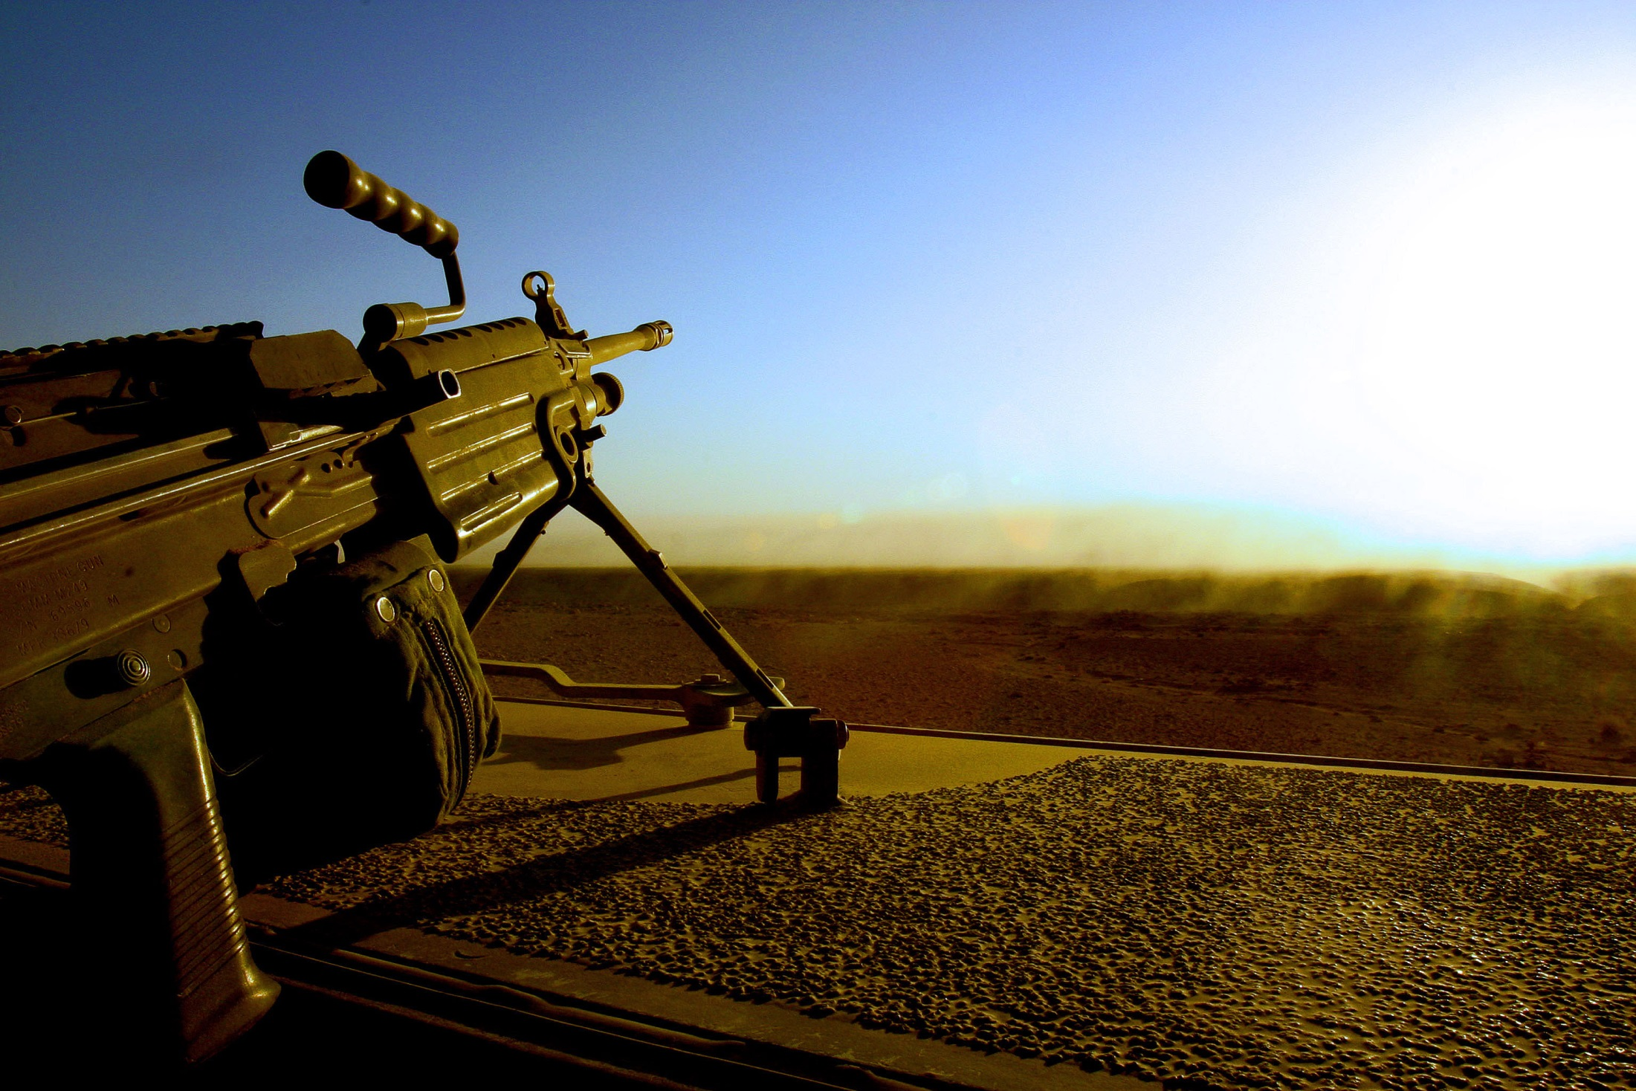
Military experience & The arts
MEA
Military Experience and the Arts
Bridging the Gap
Between Military and Civilian Cultures Through Creative Expression and Scholarship
Bridging the gap between military and civilian cultures through creative expression and scholarship
Presentation by Travis L. Martin

Slide 2
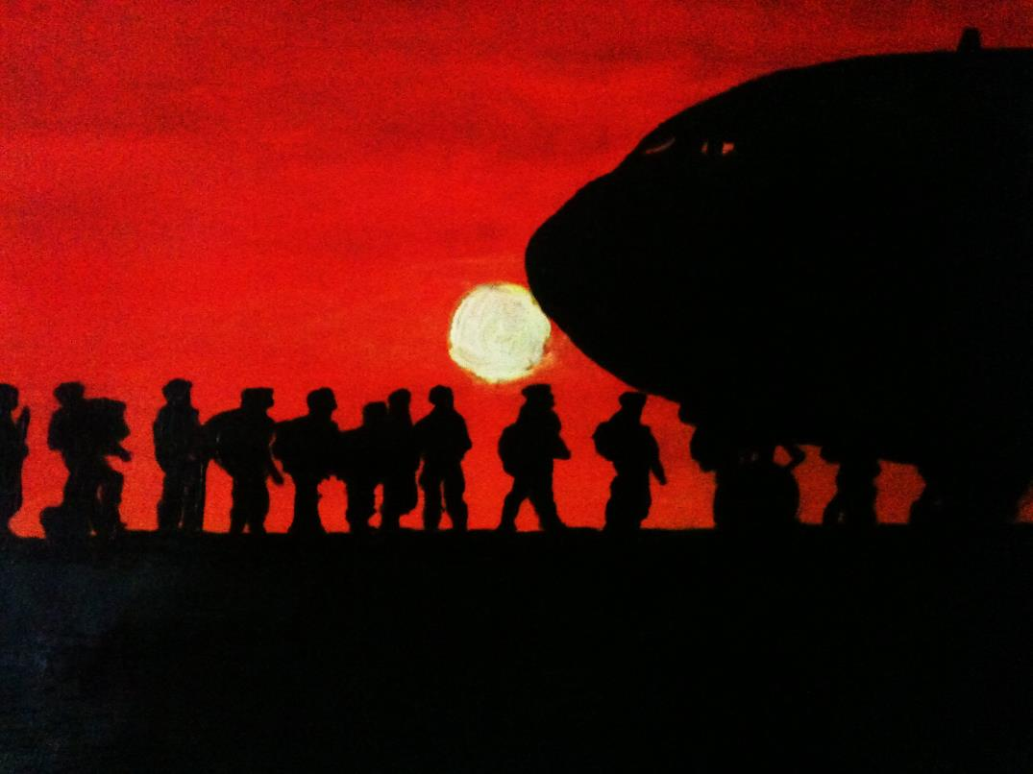
Order of March
MEA
Motivations & Background
Vet-Only Student Success
Seminar
Veterans Studies
Military Experience and the Arts
Military
Experience
The Arts
Bridging the Gap
Creative Expression
Scholarship
Theory & Practice
Healing?
Healing? (Cont.)
Acceptance
How to Apply This?
Questions
This acrylic painting by veteran artist Steve Beales entitled “Hope and Fear” was published in the second volume of The Journal of Military Experience.

Slide 3
Part 1: Motivations & Background
MEA

Slide 4
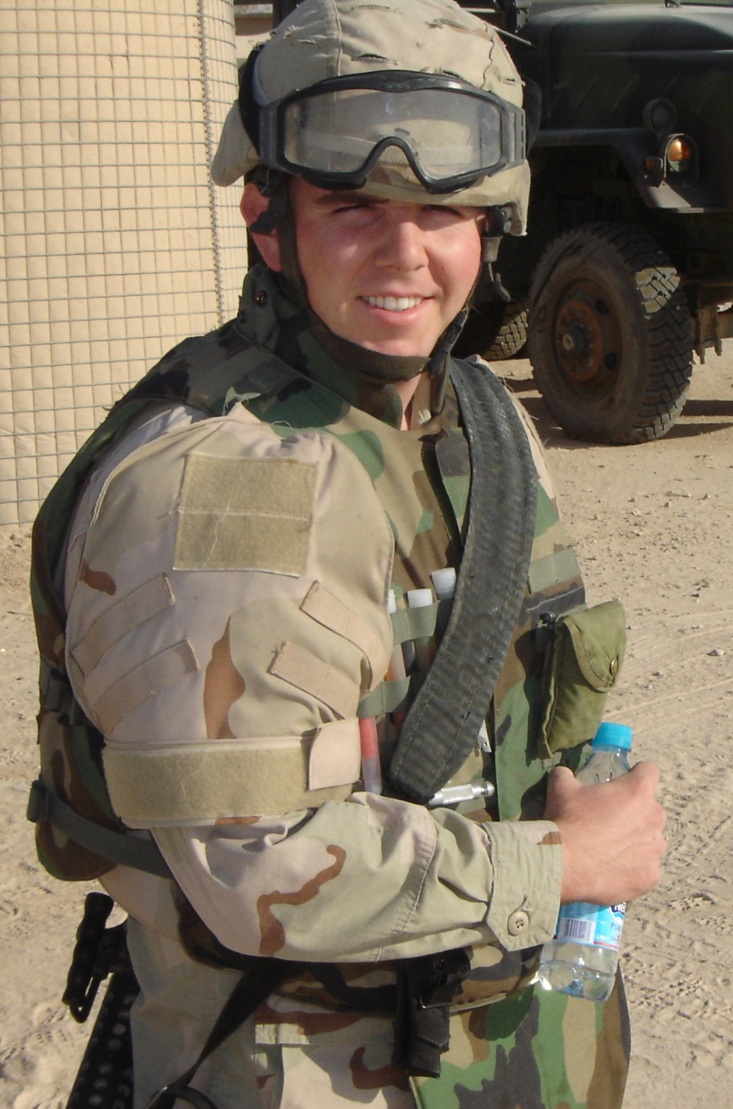
Motivations
MEA
Service
Education
Pedagogy
Research
Community Service

Slide 5
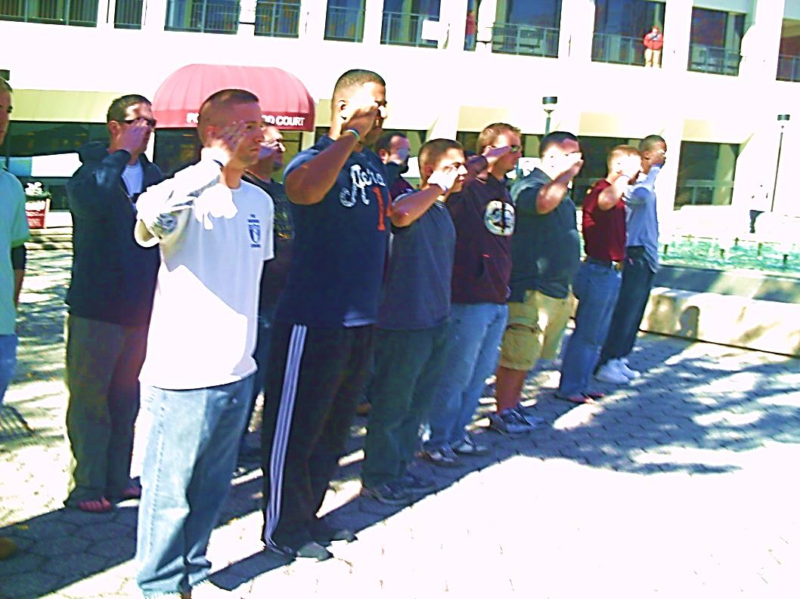
Vet-Only Student Success Seminar
MEA
3 credit-hour course
Required for those with developmental needs
Vet-cohort is optional
Combines:
Basic orientation to college life/resources
Exposure to veterans resources (VA, Vet Center, VSO’s, student veteran organization)
Study skill refreshers and research techniques
Narrative making
Student veterans from the first vet-only student success seminar cohort saluting the colors during the Remembrance Day National Roll Call on November 11, 2010.

Slide 6
Veterans Studies
MEA
VTS 200 – Introduction to Veterans Studies
+
+
+
Inter-Departmental
Certificate
&
One Course in Each Dimension
Associates of General Studies Concentration
CDF
PSY
SOC
SWK 440
HIS
POL
MSL
PLS 375
BEM
ENG
WGS 304
Minor
One Additional Course
VTS 400– Issues in Veterans Studies

Slide 7
Part 2: Military Experience & the Arts
MEA

Slide 8

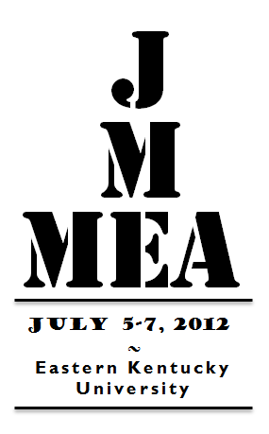
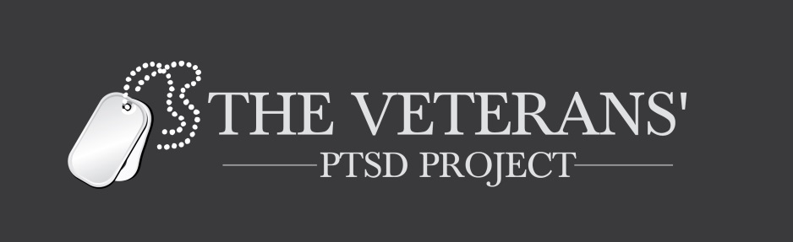

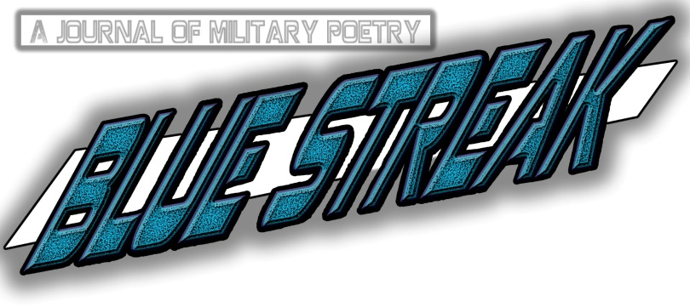
Military Experience and the Arts
MEA

Slide 9
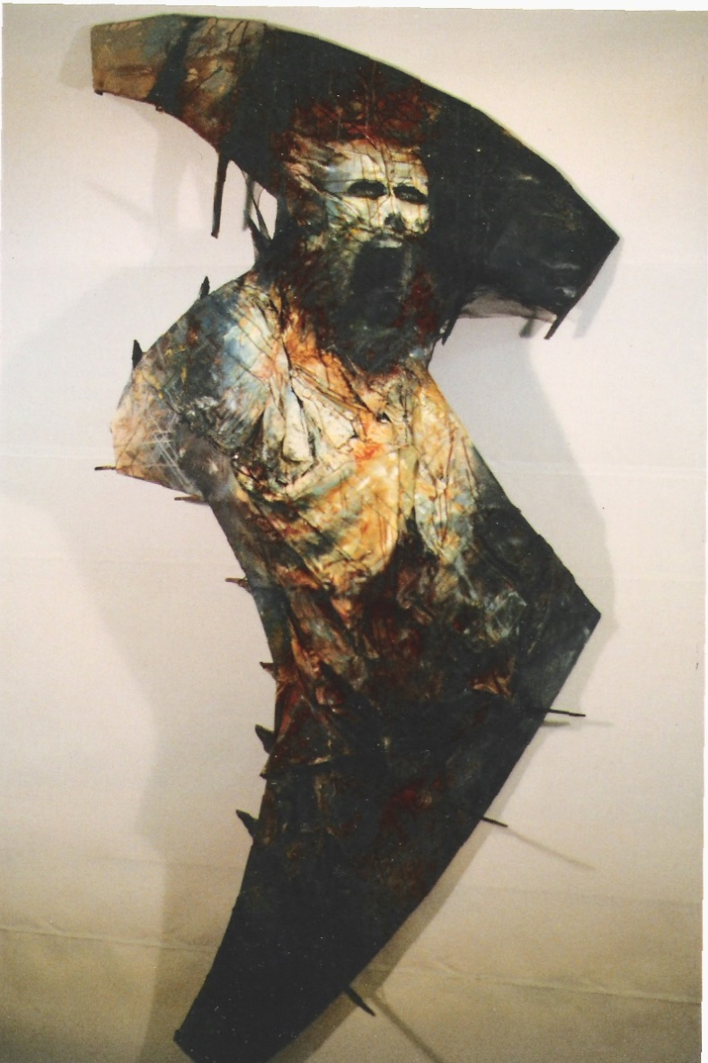
Military
MEA
This writing is called ‘In Parenthesis’ because I have written it in a kind of space between—I don’t know between quite what—but as you turn aside to do something … the war itself was a parenthesis—how glad we thought we were to step outside its brackets at the end of ‘18—and also because our curious type of existence here is altogether in parenthesis (xv).
—David Jones, In Parenthesis (1937)
Veteran artist Stephen McCall’s Nalepa from the second Journal of Military Experience

Slide 10
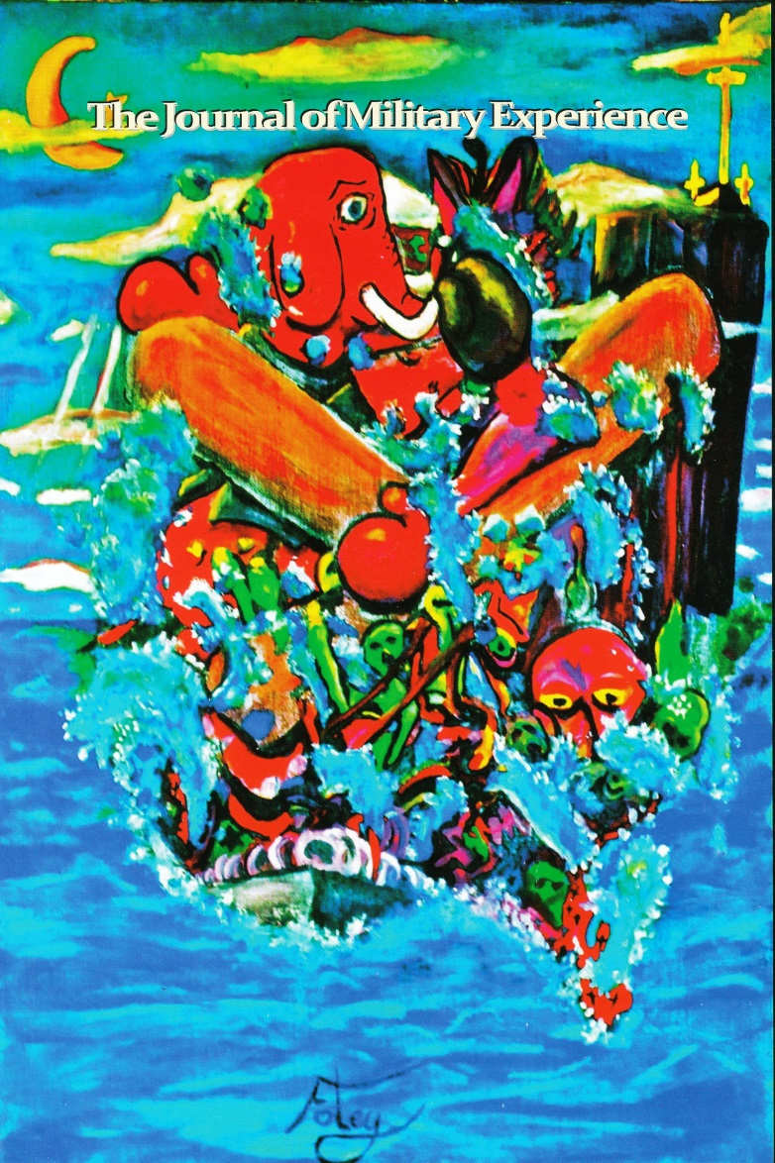
Experience
MEA
“While you fight and suffer and struggle, you are also changing, becoming someone totally different. The harsh and violent realities of war force you to change. Emotions are an inconvenience—they distract you—making you feel and think instead of react. A distracted soldier is a dead soldier.”
—Brad Johnson, The Journal of Military Experience, Vol. 1
Cover art for the first volume of the JME, The U.S. Island, by veteran artist Matthew Foley

Slide 11
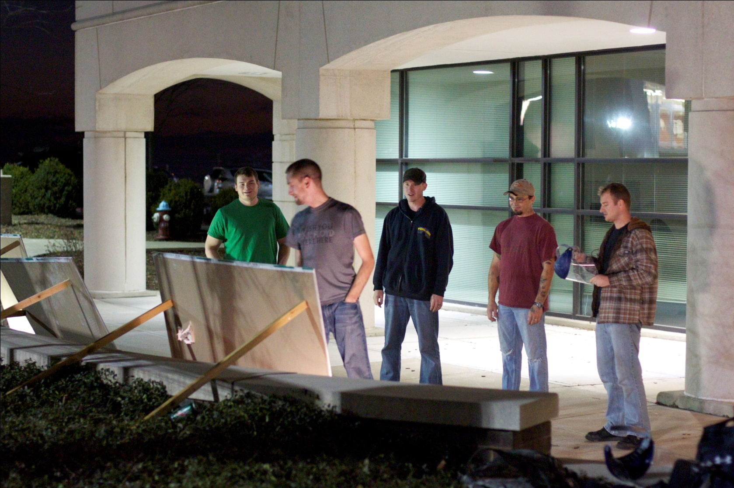
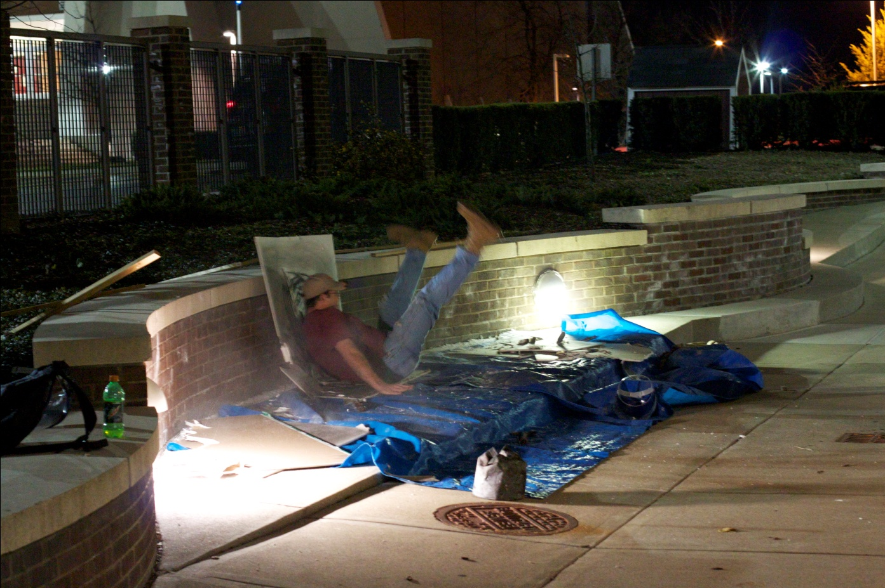
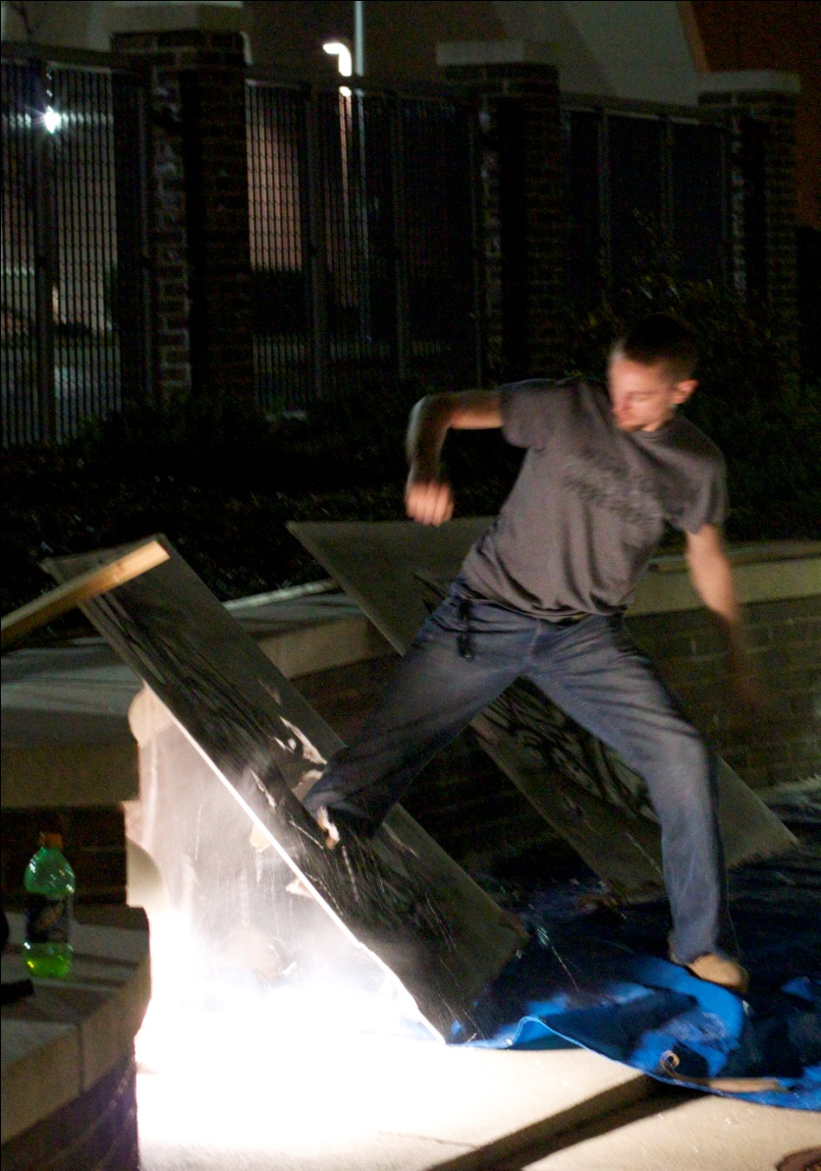
The Arts
MEA
“The answer does not lie in something that is new or expensive, or once is said, surprising: it lies in community. Vietnam veterans came home alone. The most significant community for a combat veteran is that of his surviving comrades” (33).
—Jonathan Shay, Achilles in Vietnam
The Illumination process art piece in Fall 2010

Slide 12
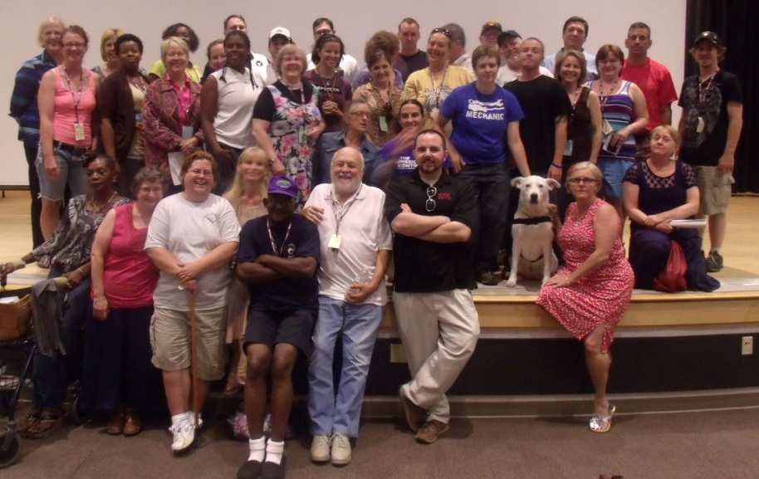
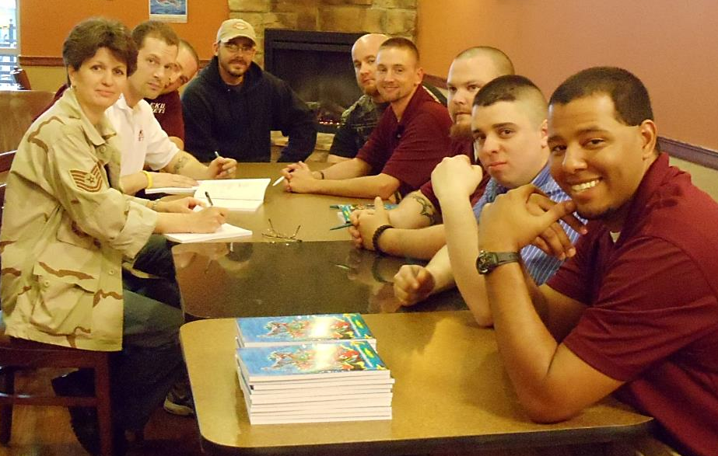
Bridging the Gap
MEA
“The personal essay asks students to begin a journey into themselves, but the journey will take them ultimately out of themselves and back to a community which can reestablish our common humanity” (198).
—Marian MacCurdy, “From Trauma to Writing: A Theoretical Model for Practical Use”
Top: Participants in the 2012 MEA Symposium. Bottom: Contributors to the first Journal of Military Experience.

Slide 13
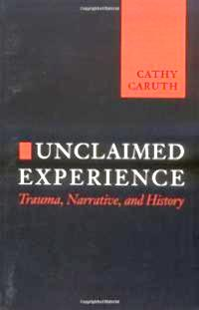
Creative Expression
MEA
“Traumatic experience, beyond the psychological dimension of suffering it involves, suggests a certain paradox: that the most direct seeing of a violent event may occur as an absolute inability to know it; that immediacy, paradoxically, may take the form of belatedness” (91-92).
—Cathy Caruth, Unclaimed Experience
Cathy Caruth’s “paradox of trauma” explains how traumatic events are doomed to be re-experienced through the symptoms of PTSD.

Slide 14
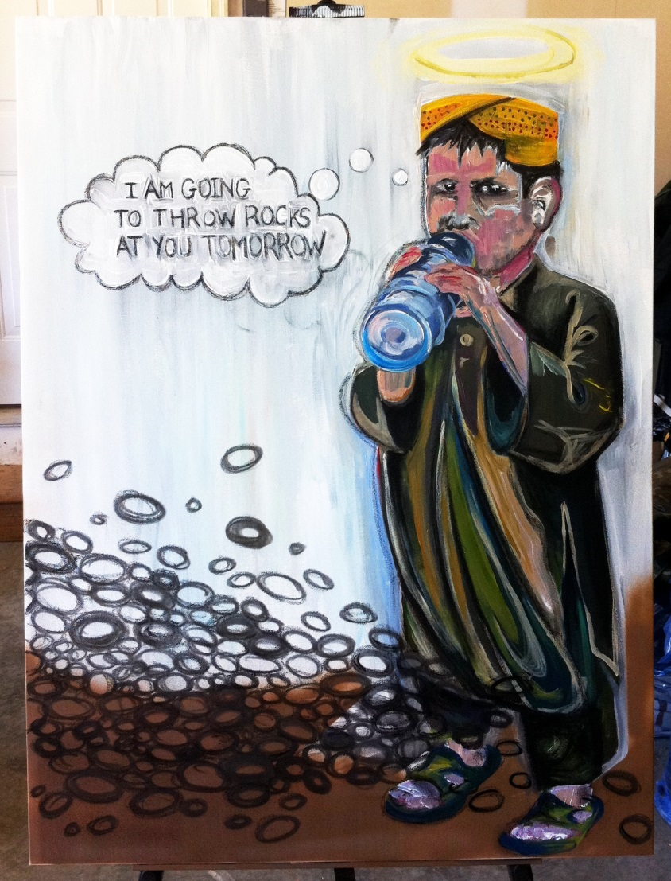
Scholarship
MEA
“These scholars, diverse in their experiences and interests, come together here in testimony to the work they do in the real world and to their commitment to translating those realities into textual expression. Though they have never met and though their intentions were different at the outset, they share a tone of optimism about the future of the relationship between the Humanities and our armed forces” (164-65)
— Ami Blue, Scholarship Editor for The Journal of Military Experience, Vol. 2
Artwork submitted to the second Journal of Military Experience by veteran artist Jessica Dittbenner captures the cultural complexities inherent in working through wartime memory.

Slide 15
Part 3: Theory and Practice
MEA

Slide 16
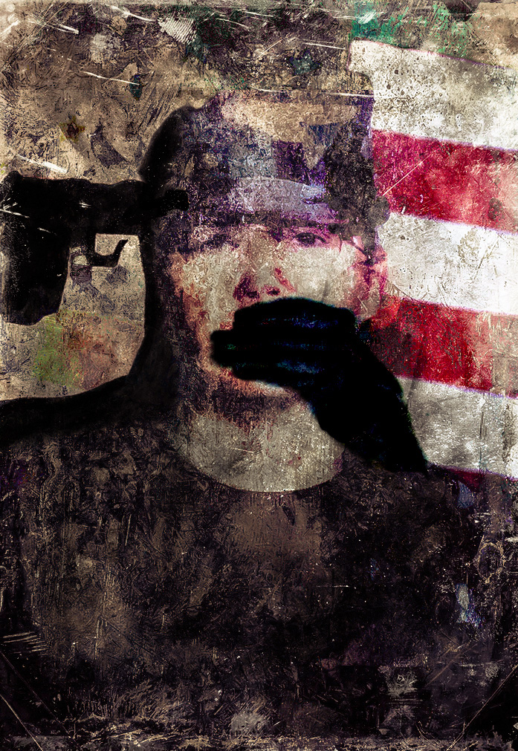
Healing?
MEA
We must break down the barriers to expression veterans face so that they may:
Organize the fragments of memory associated with traumatic events
Reunify fragmented identities that emerges after taking off the uniform
Relate their experiences in socially appropriate and meaningful ways to friends, family, and co-workers.
Situates where you’ve been with who you are and where you want to go
Veteran artist Tif Holmes’s work illustrates often illustrates the plight of veterans suffering from the invisible wounds of war and the politicization of their image.

Slide 17
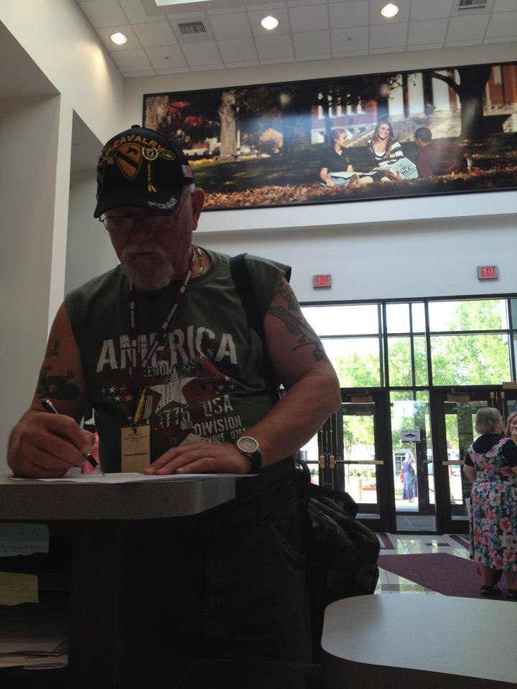
Healing? (cont.)
MEA
Coherent narratives:
Situate the narrative in time, space, and personal context
Display elements of an episode system: initiating event, internal response, attempt, consequence
Provide accounts of the emotional significance of the story to the speaker
Imparts info coherently and within the context the larger life narrative (Baeger and McAdams 74-75)
Vietnam veteran James Hackbarth was one of the more engaged and grateful participants to find community at last summer’s MEA Symposium.

Slide 18
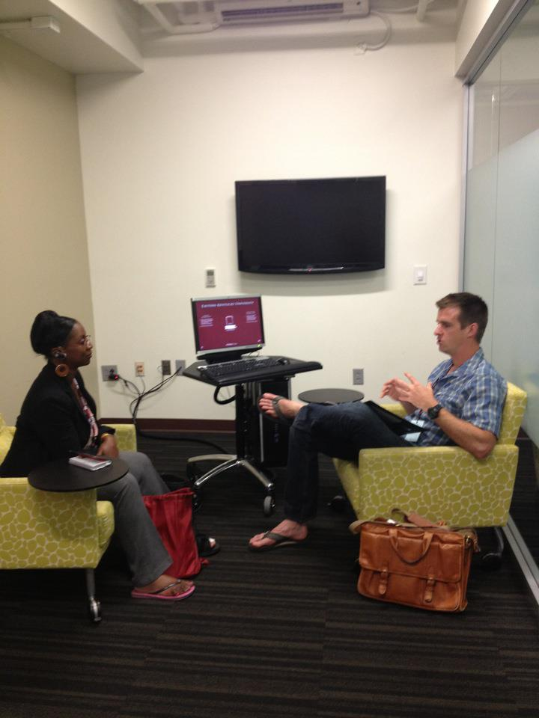
Acceptance
MEA
“Attention to punitive unconscious self-criticism soon leads the analyst to recognize that neutrality requires more than silent acceptance, for in the presence of punitive unconscious self-criticism , the analyst's silence is experienced as confirmation of the self-critical attitude” (615)
—Anton O. Kris, “Helping Patients by Analyzing Self-Criticism”
Iraq War veteran and combat correspondent Brian Mockenhaupt serves as the JME’s non-fiction editor. The healing power of narrative building comes from more than listening by building a conversation around the author’s work.

Slide 19
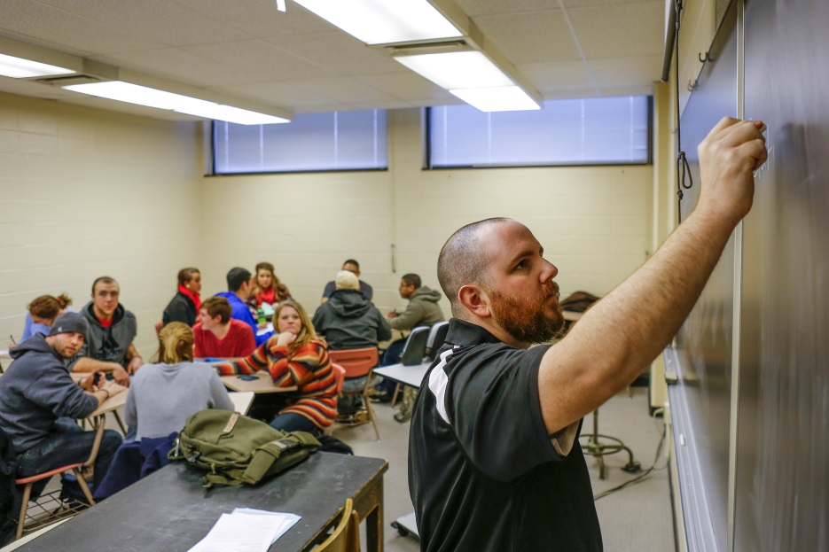
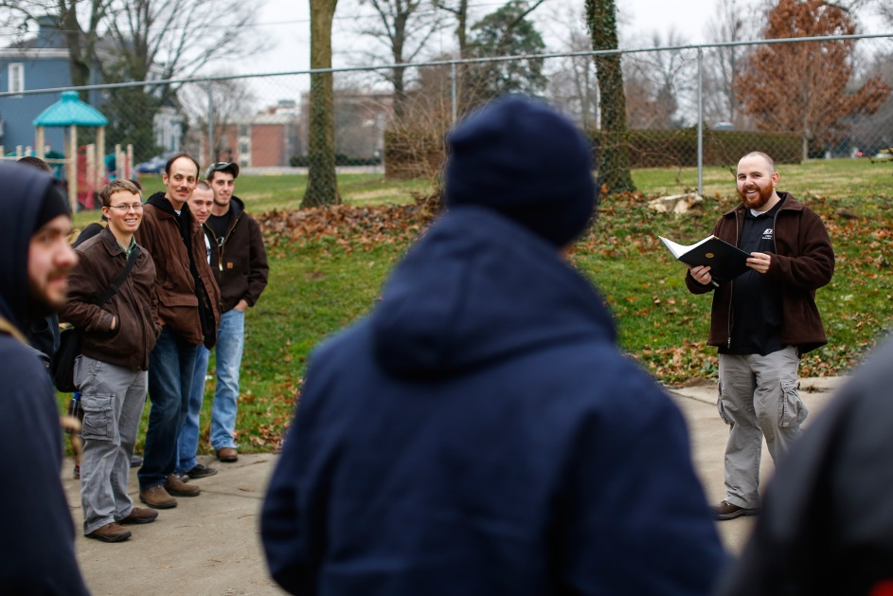
How to apply this?
MEA
Create narrative making opportunities:
In existing courses
In new courses and academic programs where possible
Practice acceptance:
Through scholarly consideration of the works presented
Through dialogue with the veteran authors and artists
Collaborate, don’t isolate

Slide 20

Questions
MEA

