Slide 1


D.C. Crime Insights Application
Enhancing Safety and Awareness in D.C. Area
Alex Marrero, Ka Wai Wu, Kuan-Fu Lin,
Pei-Hsuan Sung (Patty), Venkata Chaitanya Kanakamedala

Slide 2
Project Description

Slide 3
Context and Background
The D.C. Crime Insights Application is a comprehensive platform designed to provide daily updated and historical crime data, helping users make informed safety decisions. It integrates advanced analytics, machine learning, and natural language processing (NLP) to offer intuitive and personalized crime reporting and safety features.
With growing concerns about public safety, existing crime data tools often lack accessibility, timely updates, and user-friendly interfaces. Our application bridges the gap by leveraging open-source data from federal and local agencies, advanced analytics, and user-centric design to deliver actionable safety insights.
Notes:
Crime Dashboard for the Crime overview that you can view Total Crime Numbers, Top crime Type or High Crime Zone….
Crime Map using Leaflet + OpenStreetMap

Slide 4



Project Goals & Target Users
General Public
To stay informed about local safety and plan safer routes.
Law Enforcement
For better resource allocation and crime prevention strategies.
Urban Planners
To integrate safety considerations into development projects.
Notes:
Enable users to access localized crime data.
Provide tools for generating detailed crime reports.
Offer interactive features to enhance user engagement.
Target Users
General Public: Individuals seeking insights into crime patterns in their neighborhoods.
Law Enforcement: Officers analyzing crime trends for resource planning.
Urban Planners: Professionals incorporating safety data into development projects.

Slide 5
Main Functions & Unique Features
Main Functions:
1. Dashboard: Provides an overview of key crime statistics, trends, and insights at a glance.
2. Crime Search: Search crime data by type, zone, and date range for targeted insights.
3. Crime Map: Interactive map visualizing crimes with filters for categories and time.
4. Crime Reports: Generate customizable reports with trends and insights.
Unique Features:
1. Crime Prediction: AI-powered risk predictions using LLMs for personalized insights.
2. Safety Routing: Suggests safest routes based on crime trends.
3. Chatbot: AI assistant answering queries and providing safety tips.
Notes:
Crime Dashboard for the Crime overview that you can view Total Crime Numbers, Top crime Type or High Crime Zone….
Crime Map using Leaflet + OpenStreetMap

Slide 6
System Building

Slide 7





IDEs and Tools
Frontend Development: React.js
Backend Development: FastAPI
Database Management: MySQL
Visualization: Leaflet, OpenStreetMap, GoogleMapAPI
Deployment: AWS(EC2)
Development Tools: Visual Studio Code (VS Code)
Notes:
Frontend:
The frontend is built with React.js to create a dynamic and responsive user interface. The design prioritizes usability, featuring dropdown filters for parameter selection and tooltips for enhanced data exploration. This ensures a smooth and intuitive experience for users accessing crime data.
Backend:
The backend is developed using FastAPI, chosen for its high performance and seamless integration with Python. It enables efficient data processing and serves as the foundation to handle user requests and deliver real-time crime insights.
Database:
A MySQL database is used to store structured crime data, hosted on AWS RDS for scalability and reliability. Also, Amazon EventBridge and Lambda to update the data every night.
Visualization:
Interactive charts and maps are implemented to provide clear and insightful visualizations of crime trends and distributions. These tools empower users to analyze crime data effectively and identify patterns.
Deployment:
The application is deployed on AWS EC2 instances, leveraging the cloud’s flexibility and scalability to ensure consistent performance and availability for users.
Frontend:
The frontend is built with React.js to create a dynamic and responsive user interface. The design prioritizes usability, featuring dropdown filters for parameter selection and tooltips for enhanced data exploration. This ensures a smooth and intuitive experience for users accessing crime data.
Backend:
The backend is developed using FastAPI, chosen for its high performance and seamless integration with Python. It enables efficient data processing and serves as the foundation to handle user requests and deliver real-time crime insights.
Database:
A MySQL database is used to store structured crime data, hosted on AWS RDS for scalability and reliability. Also, Amazon EventBridge and Lambda to update the data every night.
Visualization:
Interactive charts and maps are implemented to provide clear and insightful visualizations of crime trends and distributions. These tools empower users to analyze crime data effectively and identify patterns.
Deployment:
The application is deployed on AWS EC2 instances, leveraging the cloud’s flexibility and scalability to ensure consistent performance and availability for users.

Slide 8
Technical details & Design Choices

Slide 9
Crime Prediction - Machine learning algorithms
Linear Regression
Advanced Preditions - XGBoosting
Predict Number of Crimes by Specified Region and Time Frame
PSA (Police Service Area)
ANC (Advisory Neighborhood Commission)
Ward(largest political subdivisions in Washington, D.C.)
Neighborhood Cluster
week
month
6 months
year
2 years
5 years
Notes:
The Linear Regression Graph illustrates weekly crime totals for various offenses over the past two years, alongside projections for future trends. This visualization highlights historical patterns and provides predictive insights tailored to the selected crime type, enabling users to identify trends over time and anticipate future crime occurrences.
Complementing the graph, the Crime Prediction Table offers a detailed breakdown of projected crime statistics across different regions and time frames. Together, these tools empower users to effectively assess safety risks and make well-informed decisions, whether for personal security, urban planning, or resource allocation. The XGBoost algorithm enhances the advanced analytics capabilities on the Crime Prediction page, delivering precise forecasts through a robust and efficient machine learning model.

Slide 10
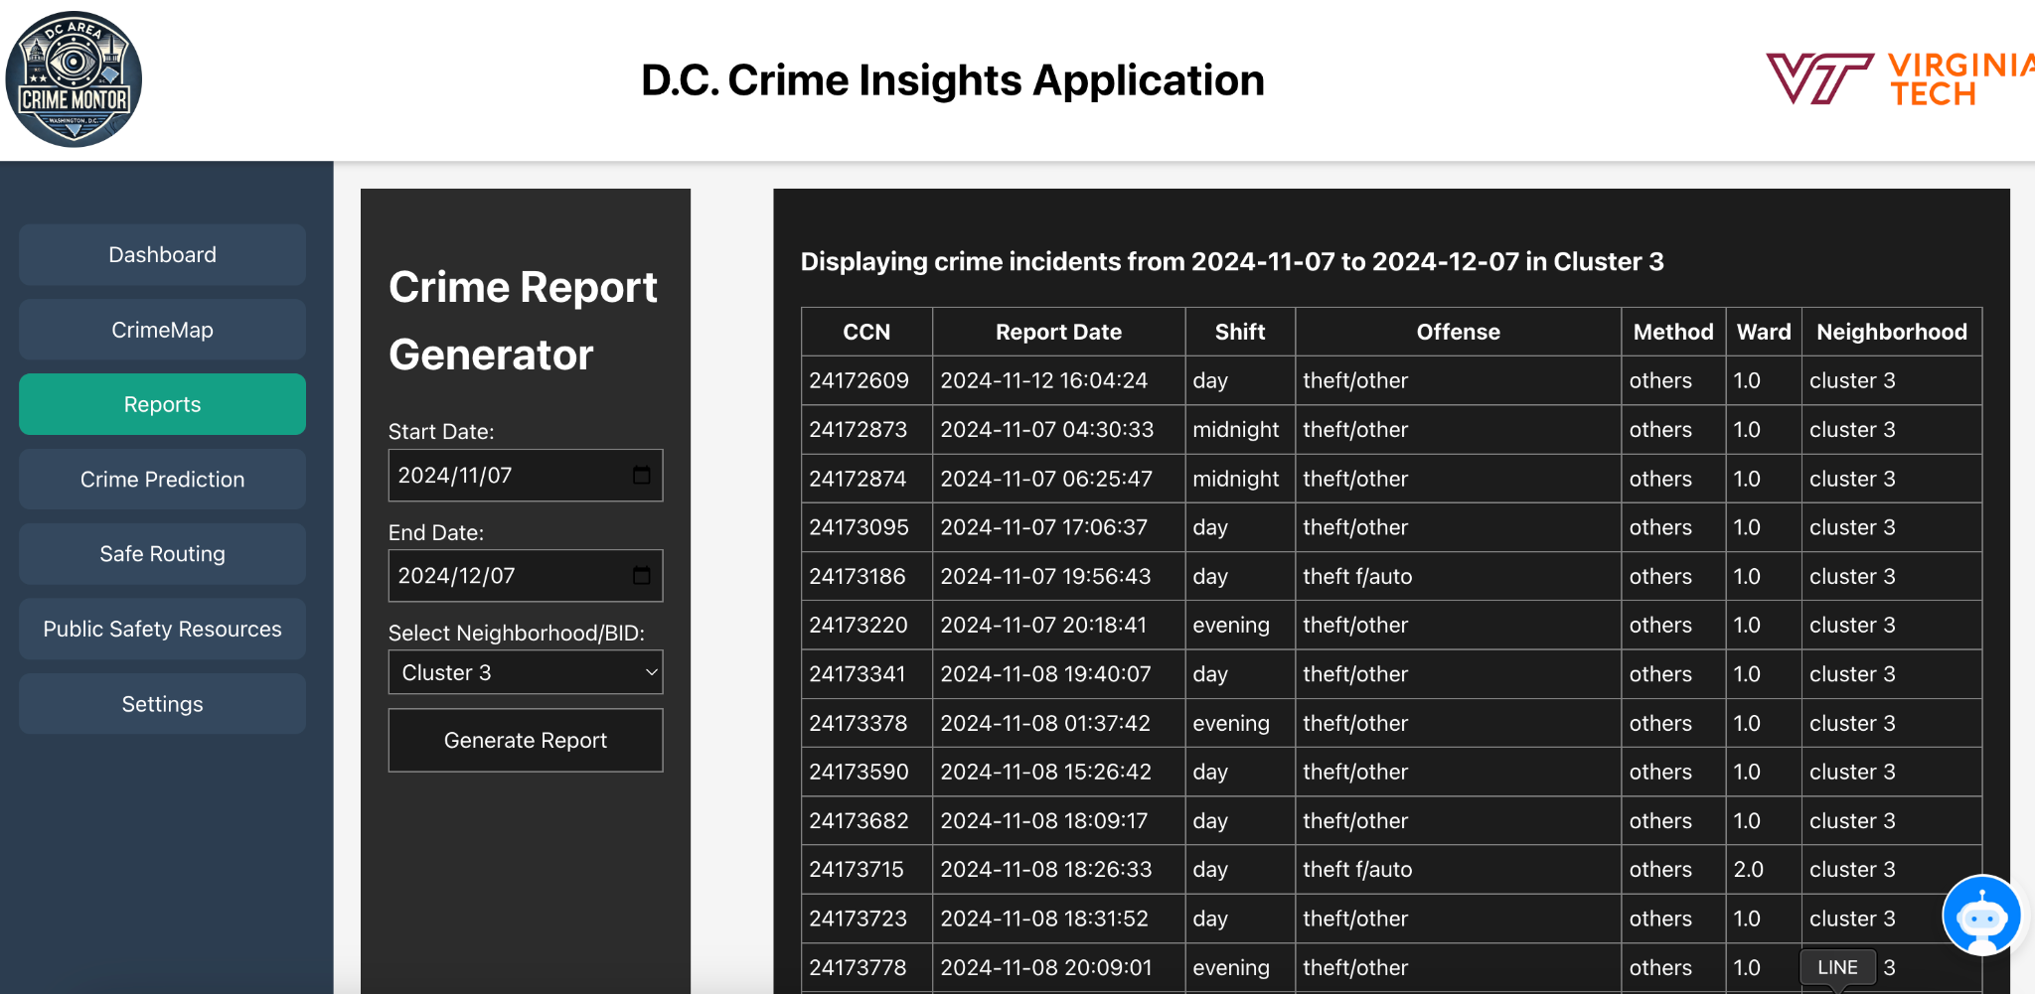
Crime Report Generator
Notes:
The Crime Report Generator feature allows users to generate highly customizable and detailed crime reports. This tool is designed for both public users and professionals, providing tailored insights to enhance safety and inform decision-making. Also, it leverages GPT-based Natural Language Processing (NLP) models to dynamically create detailed, user-specific reports, transforms structured crime data into human-readable insights, improving the usability and accessibility of crime analytics.

Slide 11
Chatbot
Natural Language Interface: Users can ask questions in plain English, making the system user-friendly and accessible.
Crime Data Insights: Processes queries to provide meaningful trends, patterns, and statistical insights from the crime database.
Dynamic SQL Querying: Automatically generates and executes SQL queries based on user input, ensuring accurate data retrieval.
Powered by GPT-4: Leverages advanced natural language processing to deliver clear, human-like explanations.

Slide 12
Safe Routing
1. Problem Solved:
Challenge: Ensure safety by avoiding crime-prone areas during route planning.
Solution: Integrate real-time crime data with dynamic route adjustment.
2. Crime Data Analysis:
Fetch recent crime reports from a database.
Cluster crime locations using DBSCAN
Identify dangerous zones based on proximity and frequency.
Use Google Maps Directions API to calculate the initial route.

Slide 13
Difficulties and Solutions
Diverse Team Backgrounds:
Lack of Familiarity with Field - Frontend, Deployment
Scalability Issues
Limited Cloud Resources
Notes:
Crime Dashboard for the Crime overview that you can view Total Crime Numbers, Top crime Type or High Crime Zone….
Crime Map using Leaflet + OpenStreetMap

Slide 14
Demonstration

Slide 15
Lessons
Learned & Reflection

Slide 16
Lessons Learned
Testing Results
  Route overlaps in low-crime areas validated algorithm
  Waypoint restrictions confirmed effective
API Management
  ChatBot token limits optimized
  Langchain monitoring implemented.

Slide 17
Reflection and Retrospective
Key Achievements
What Worked Well
Growth Areas
Core feature implementation
  Crime prediction
  Safe routing Interactive visualization
API monitoring system integration
Scalable architecture deployment
Sprint objectives alignment
Enhanced UI/UX design
Effective team collaboration
Complex feature time management
Testing buffer allocation
ML feature task estimation

Slide 18
Future Directions
Mobile-responsive design
Enhanced route optimization
Polynomial regression integration
PDF report downloads
Cloud monitoring expansion

Slide 19

Thank you!

