Slide 1
Disease Spread Simulator
Cameron Stevens, Joey Merline, Anthony Castellone, Justin Hess
CS 4624: Multimedia, Hypertext, and Information Access
Professor Fox, Virginia Tech, Blacksburg VA 24061
Presented on 4/22/2021

Slide 2

Outline
Background
Overview
Implementation
  Statistics/Backend
  UI
Timeline
Acknowledgements
Questions

Slide 3

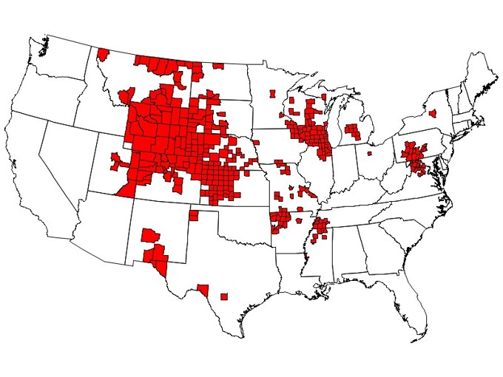
Background
deer with chronic wasting disease
Chronic Wasting Disease (CWD)
  Caused by infected proteins called prions
  Affects Cervidae family (Deer, Elk, Moose, Reindeer)
  Causes severe weight loss, neurological symptoms and death
Spread
  Can pass between saliva, feces, urine and through water or soil.
  Affected deer can spread the prion for over a year before developing symptoms
  CWD has spread to over 25 states in the US
CWD by county across the US

Slide 4
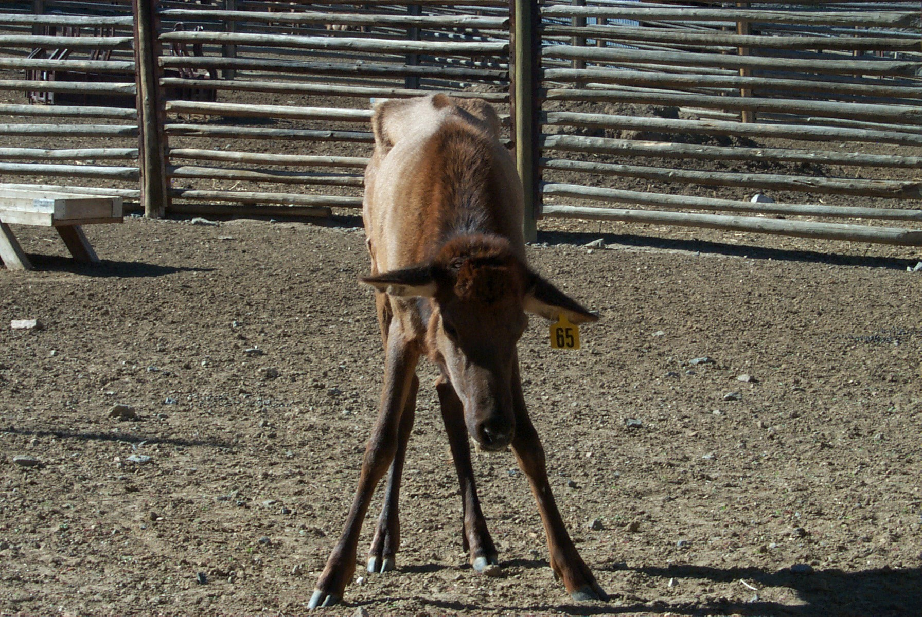
Background
Chronic Wasting Disease in Virginia
  Disease first identified in US in the wild in 1981 (Colorado)
  CWD first seen in the eastern US in 2005 (West Virginia)
  The disease spread into Virginia by 2009
  CWD now detected in 9 VA counties
Impact of CWD
  Largest impact is Deer population health
  Infected Deer cannot be consumed
  Increased handling procedures to slow spread
  Studies have shown limited spread to other species

Slide 5

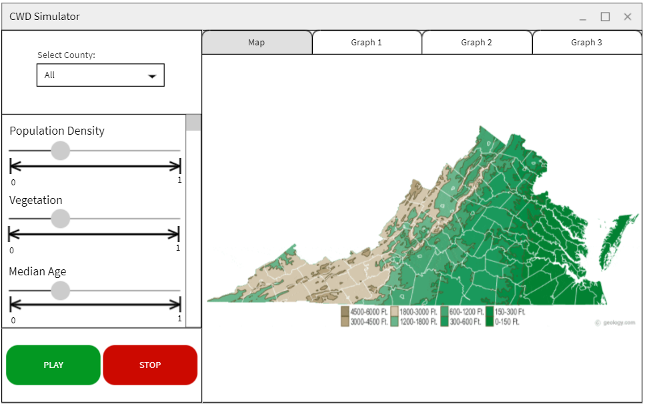
Overview/Project Goals
Predict & map CWD prevalence
Predictions based on:
  Vegetation
  Age
  Population Density
UI designed in R-Shiny
  Get user input
  Display output visuals
  Display prevalence values
Statistical analysis done in R
early wireframe of UI

Slide 6

Data
Samples from Virginia Department of Wildlife Resources
  roadkill
  hunters
  deer suspected of having CWD
across several years and counties
included sex, age, coordinates, CWD positivity
Enhanced Vegetation Index data
  measure coverage of plants
  coefficients corresponding to coordinates
medium to high vegetation index

Slide 7
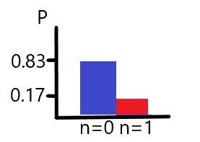
Statistics
general shape of Bernoulli distribution
Observations follow a Bernoulli Distribution
  unobserved disease state
  sensitivity (P(detection | infected))
  specificity (P(not detected | not infected))
unobserved disease state
  predicted by demographic variables

Slide 8


Data Processing
Model set up in RStan
  R interface for Stan
  built in probability mass functions
Organize data by county
  Separate by year
  model for each demographic variable
  lowest widely applicable information criterion (WAIC)
    based on mean/variance of likelihoods
  posterior distribution for best fit

Slide 9
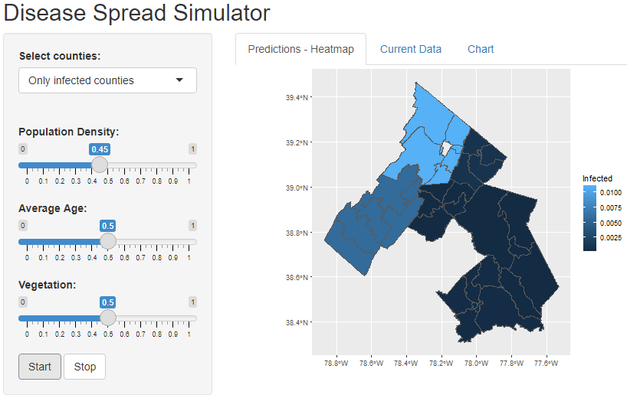
User Interface
Toggle between views
Tabs with various options to display data
Sliders to edit values, alter outcomes

Slide 10
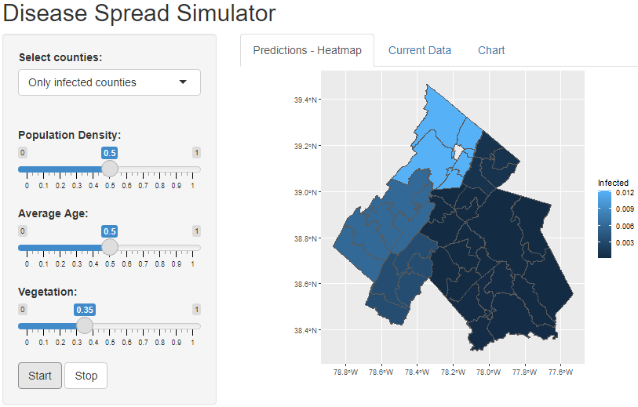
User Interface - What if Scenarios
Start from current data
User adjusts sliders, change view at will
Can handle significant changes

Slide 11
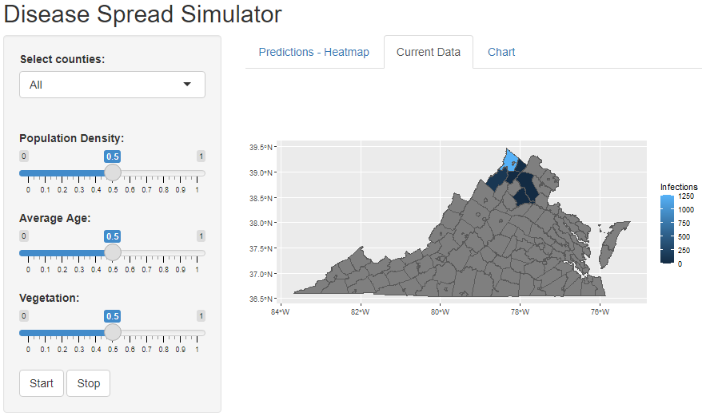
User Interface - Continued
Other forms of data visualization
Current Data:
Raw totals, ratio heatmap, graph coordinates
Toggle view
Charts:
Graphs of infection rates
Ratio of healthy to unhealthy deer

Slide 12
Timeline
Completed Groundwork
Several meetings with client
Basic R script, wireframes
Wrapping things up
R Shiny
Polish off R Script
March
May
February
April
More Progress
R script near completion
Statistical models
Future
Bug fixes & Testing
Refining features

Slide 13

Acknowledgements
Professor Luis Escobar
  Assistant Professor, Department of Fish and Wildlife Conservation
Mariana Castaneda-Guzman
  M.Sc. Student, Department of Fish and Wildlife Conservation
Michael Tabak
  co-author of a similar study

Slide 14
References
B. Chesnutt, “Bernoulli Distribution: Definition, Equations & Examples,” Study.com. [Online]. Available: https://study.com/academy/lesson/bernoulli-distribution-definition-equations-examples.html. [Accessed: 03-May-2021].
“Photo Examples of CWD,” CWD-INFO. [Online]. Available: http://cwd-info.org/photo-examples-of-cwd/. [Accessed: 03-May-2021].
“Hunters asked to help battle chronic wasting disease,” Cache Valley Daily, 21-Sep-2019. [Online]. Available: https://www.cachevalleydaily.com/news/archive/2019/09/21/hunters-asked-to-help-battle-chronic-wasting-disease/#.YCSQMuhKiUk. [Accessed: 03-May-2021].
“Chronic Wasting Disease Occurrence,” Centers for Disease Control and Prevention, 24-Feb-2021. [Online]. Available: https://www.cdc.gov/prions/cwd/occurrence.html. [Accessed: 03-May-2021].

