Slide 1
Website Psychology Diversity
Team: Michael D’Avella, Ian Imperial, Nathan Mussie,
Nabil Saad, Jay Park
Class: CS 4624 - Multimedia, Hypertext, and Information Access
Instructor: Edward A. Fox
Location: Virginia Tech, Blacksburg VA, 24061
24 April 2018

Slide 2
Outline
Project Description
Setbacks
Accomplishments
Remaining Work
Acknowledgements
Resources

Slide 3

Project Description
Create a standalone scalable website for Diversity and Inclusion for the Psychology Department
Showcase the Diversity Committee’s activities and accomplishments
https://www.psyc.vt.edu/

Slide 4

Setbacks
Server Maintenance
Design Schemes
Mobile Responsive
Multimedia Content
https://easytechnow.com/learn-technology/what-means-the-famous-error-404/
Notes:
Trouble migrating WordPress at first because the domain we got was not live when we were attempting to use it
There was maintenance on the server hosting our website when we went to meet with the clients last week, but luckily we had screen grabs.
Department does not have a large stock of multimedia content for us to use, so we have had to search around and rely on them to upload pictures and video for us

Slide 5
Accomplishments

Slide 6
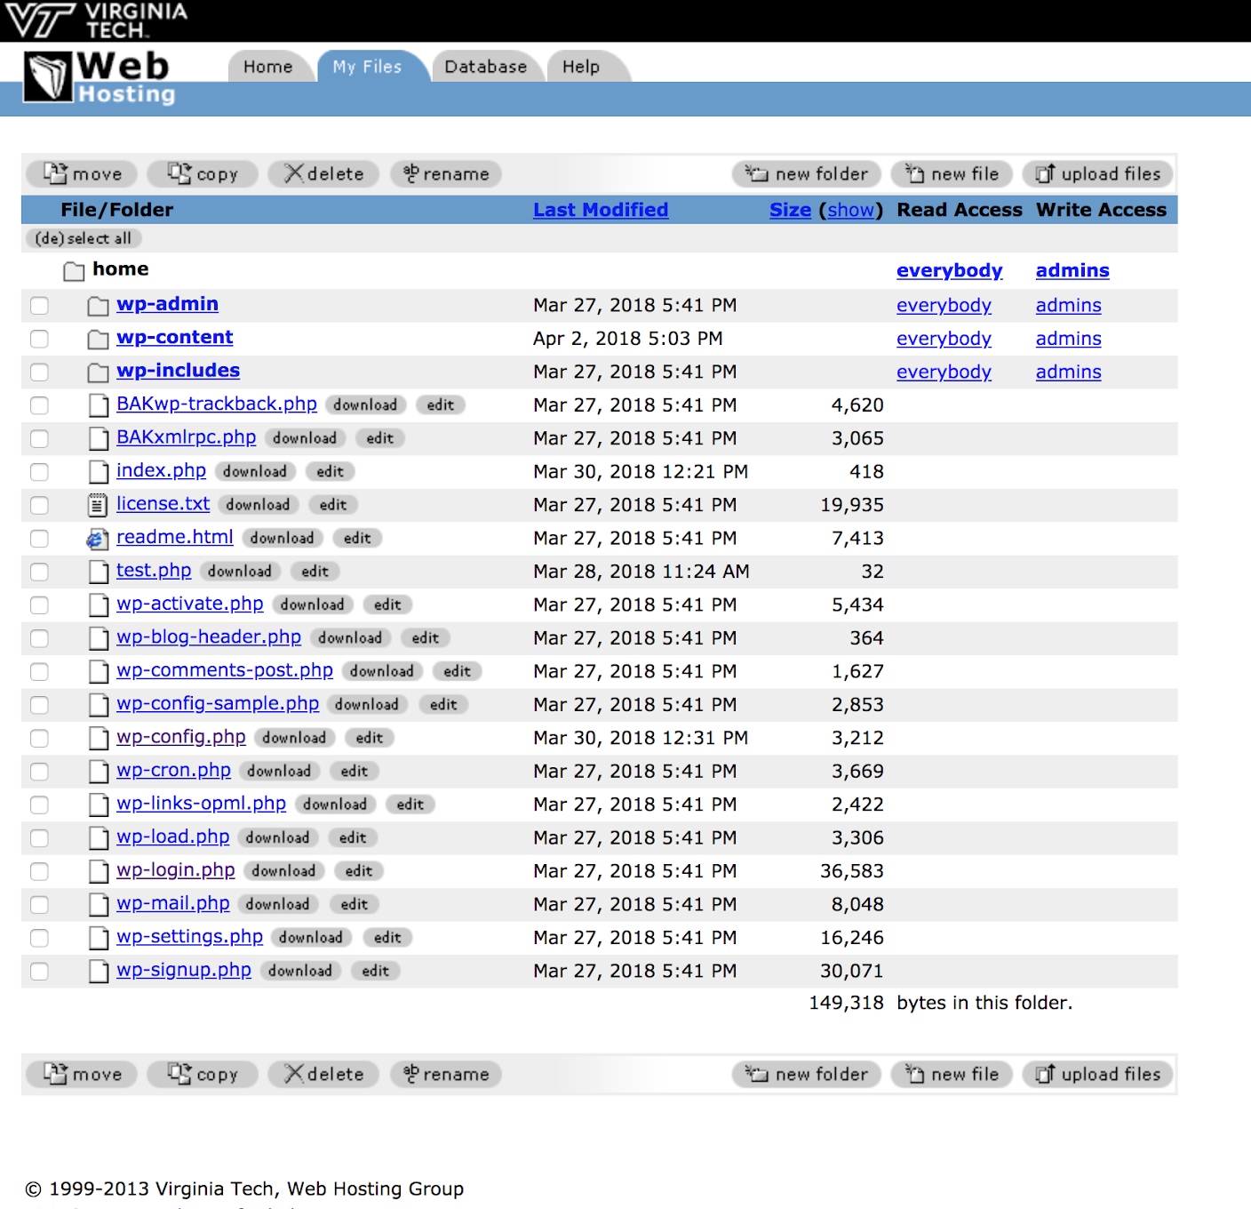
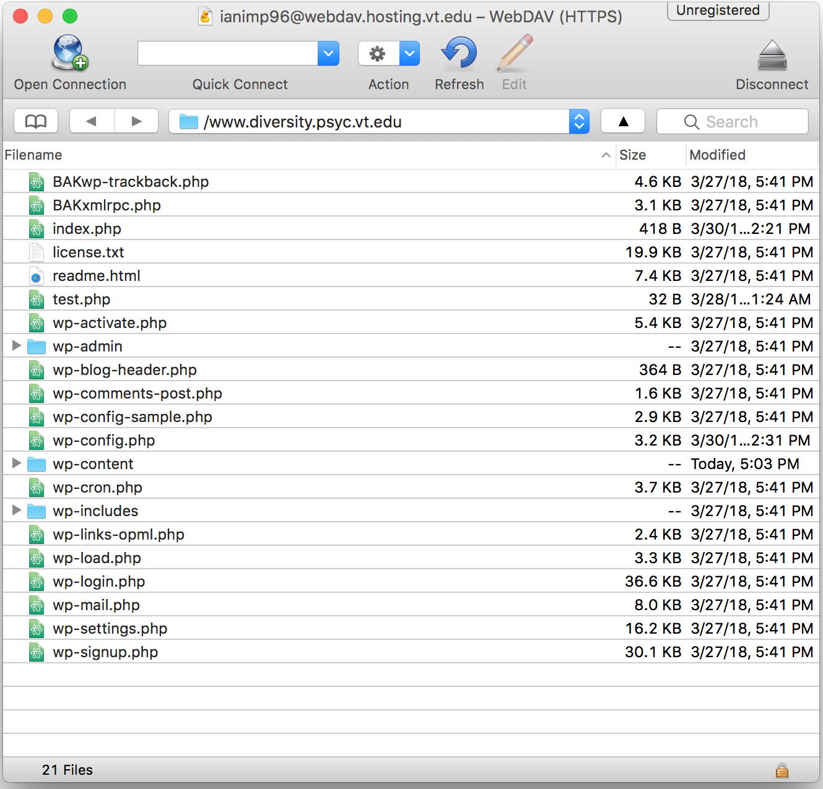
Hosting Through Virginia Tech
https://secure.hosting.vt.edu/admin/filemanager/index.jsp?r=1
Cyberduck
Notes:
After Joy helped us with getting our hosting secured, we followed the installation steps for WordPress.org by uploading these files onto the server.

Slide 7
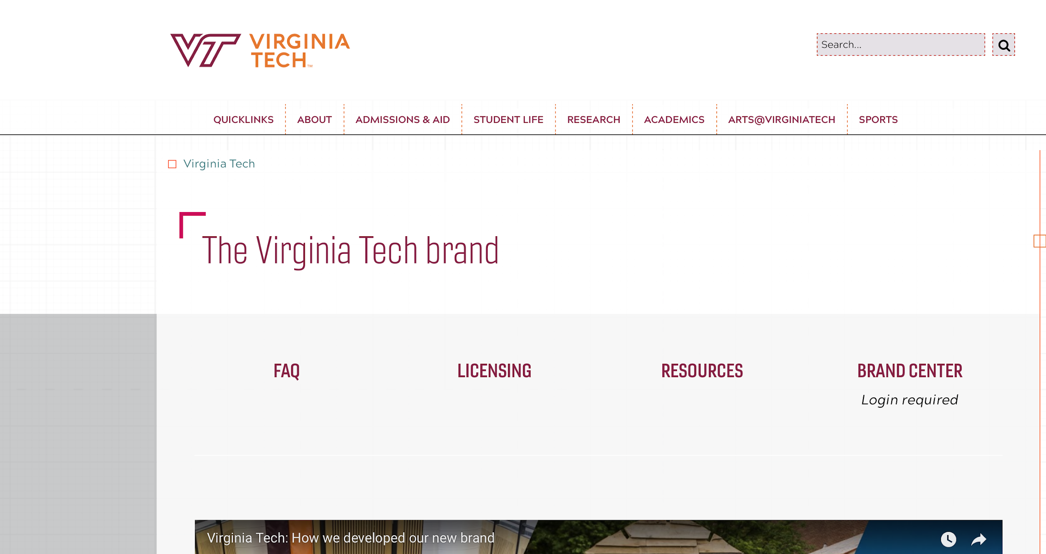
Working with Branding
https://vt.edu/brand.html
Notes:
Because we are working with a Virginia Tech Department, throughout our work, it is important that we continuously refer back to the branding to make sure we don’t get in trouble

Slide 8
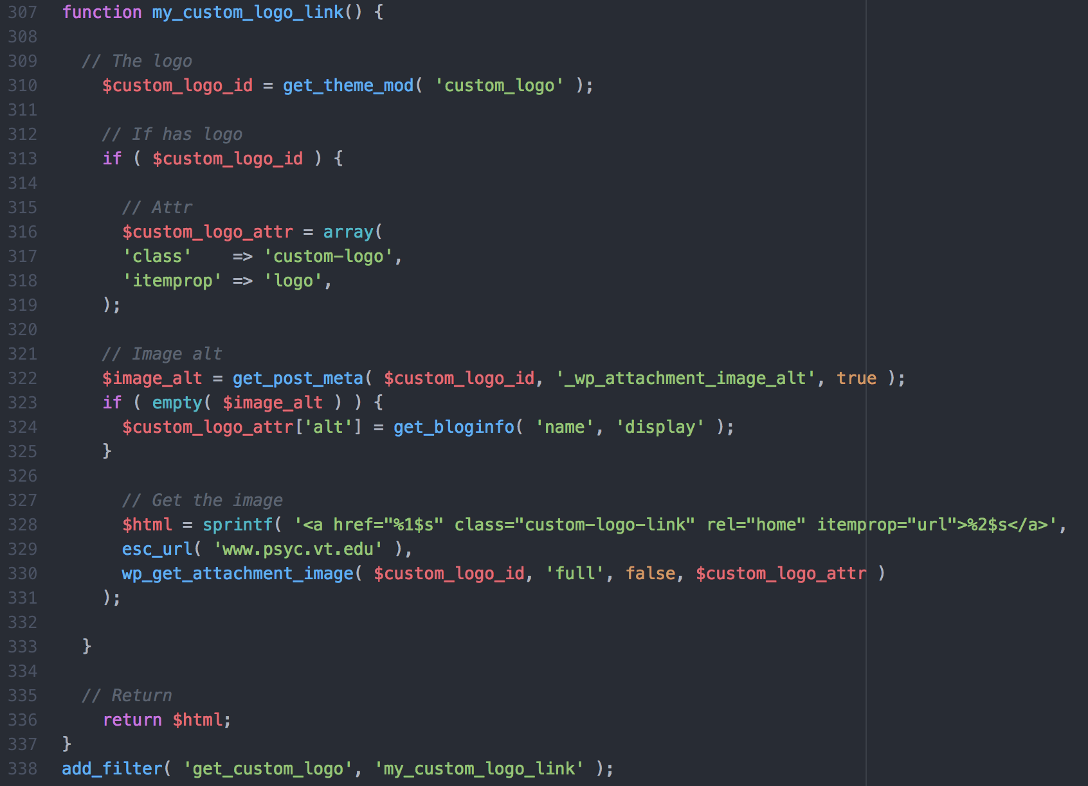
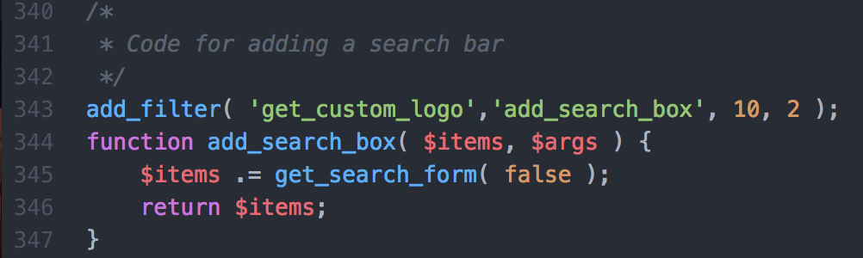

php Coding
www.diversity.psyc.vt.edu
Notes:
Had to dig in a little into the php to accomplish some of the functionality (clicking on logo image brings user to psychology homepage, search bar for searching the whole website)

Slide 9

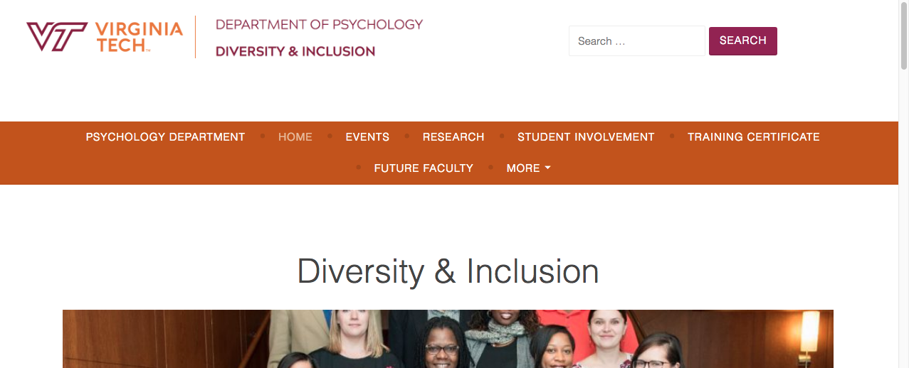
CSS Coding
https://pace.oregonstate.edu/catalog/web-development-certificate-introduction-html-css-and-javascript-programming
www.diversity.psyc.vt.edu
Notes:
To further enhance and tailor our design to match our vision, we had to dig into some of the CSS of the website. Things like where we put things, certain colors, sizes, margins, etc.

Slide 10
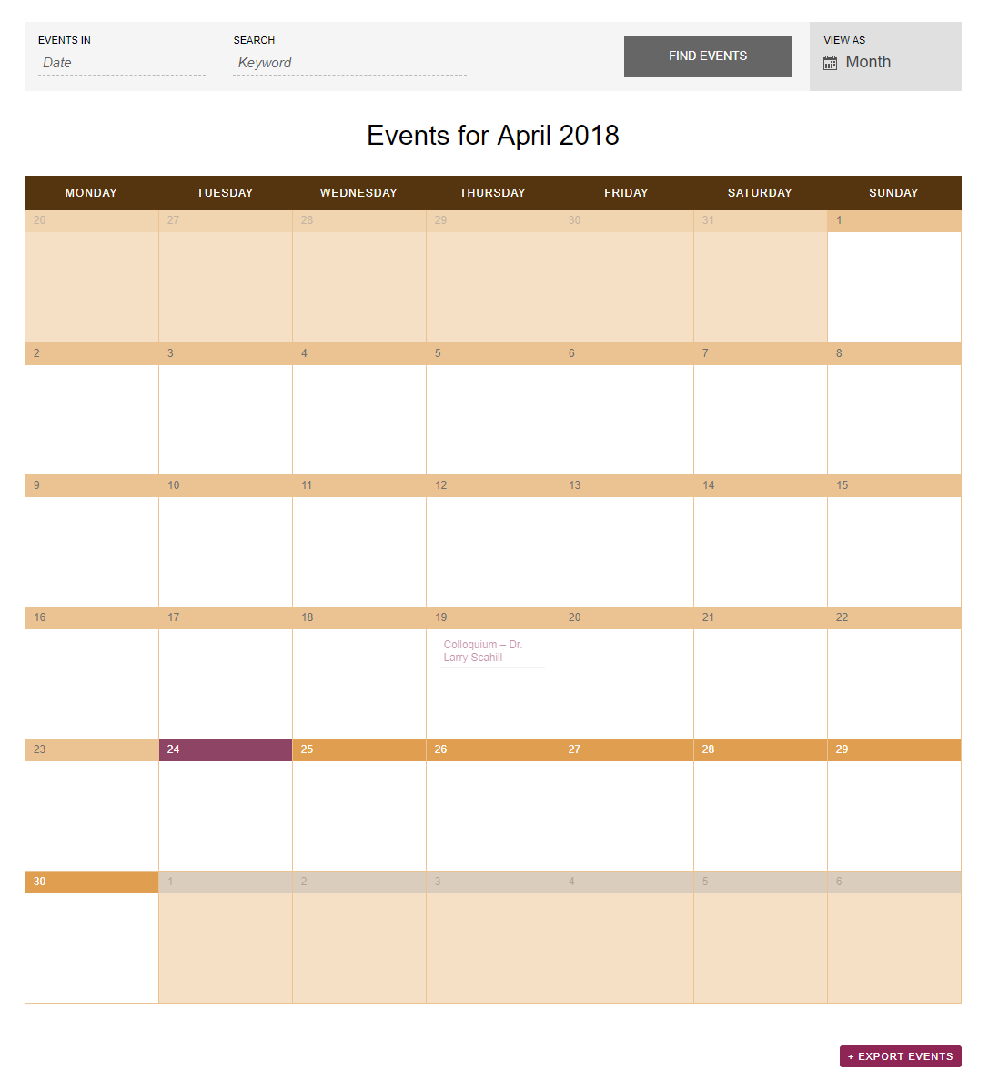
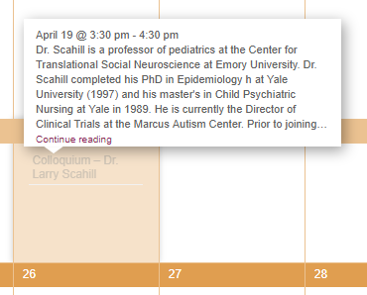
Events Calendar
https://www.diversity.psyc.vt.edu/events/

Slide 11
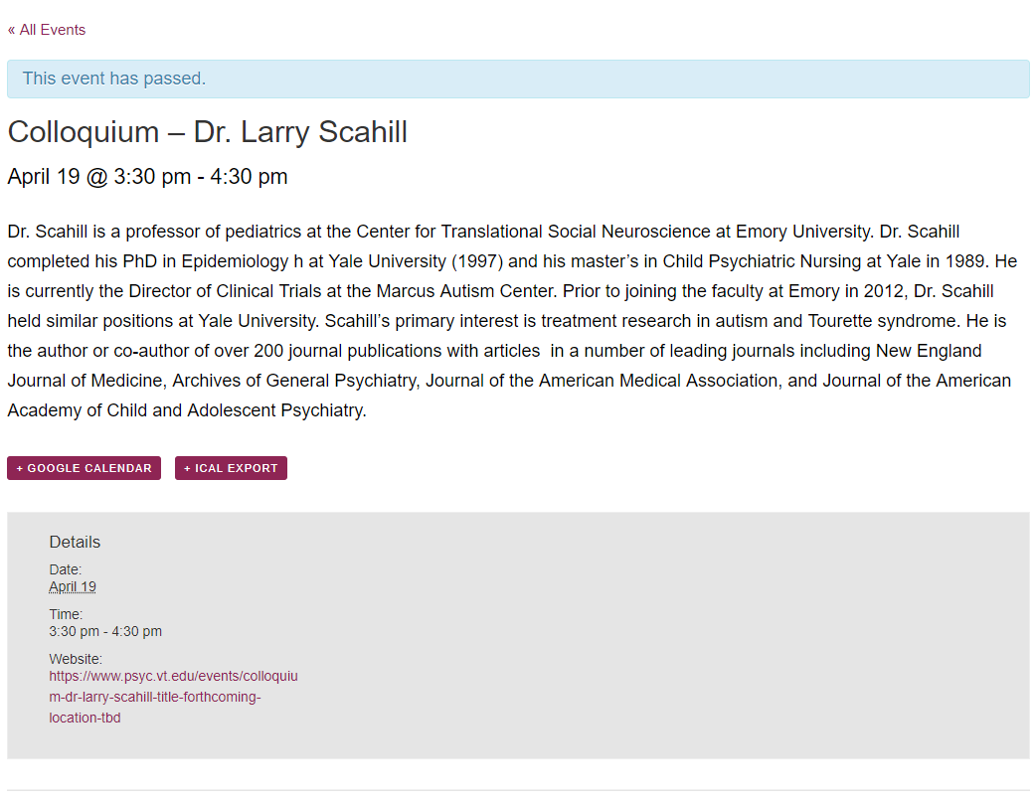
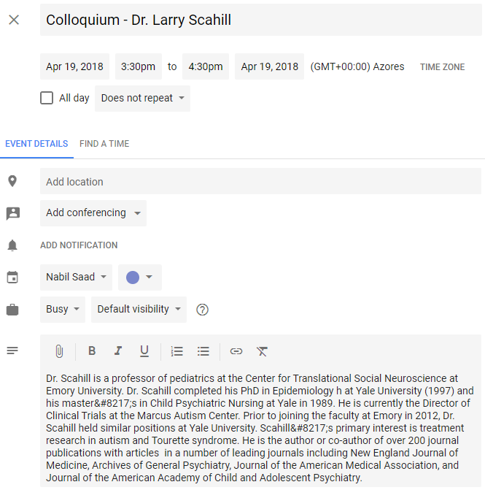
Dedicated Events Page
https://www.diversity.psyc.vt.edu/event/colloquium-dr-larry-scahill/

Slide 12
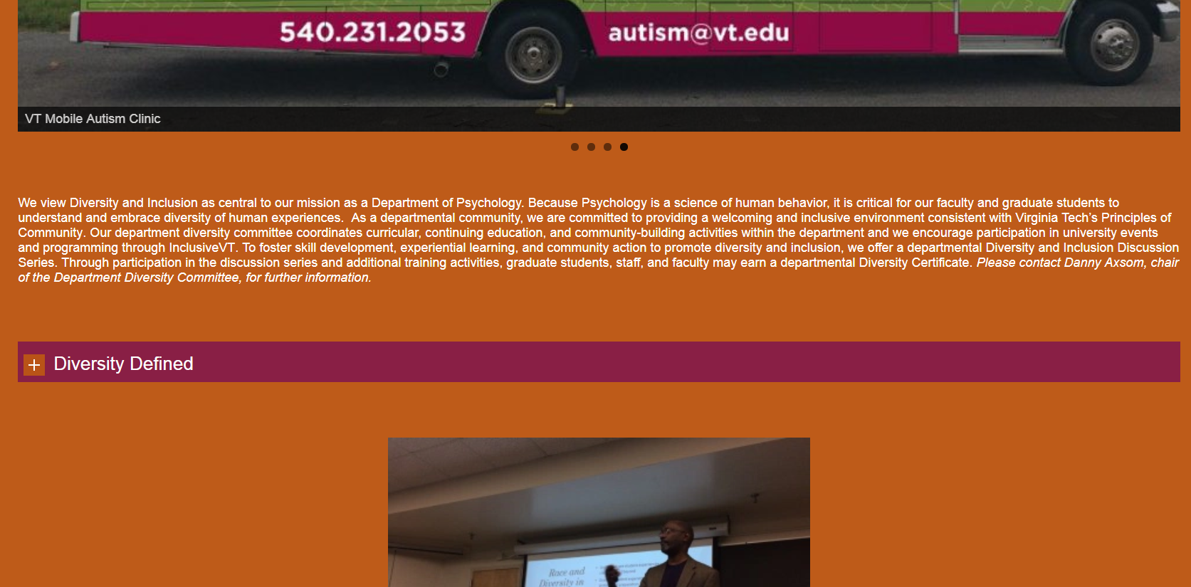
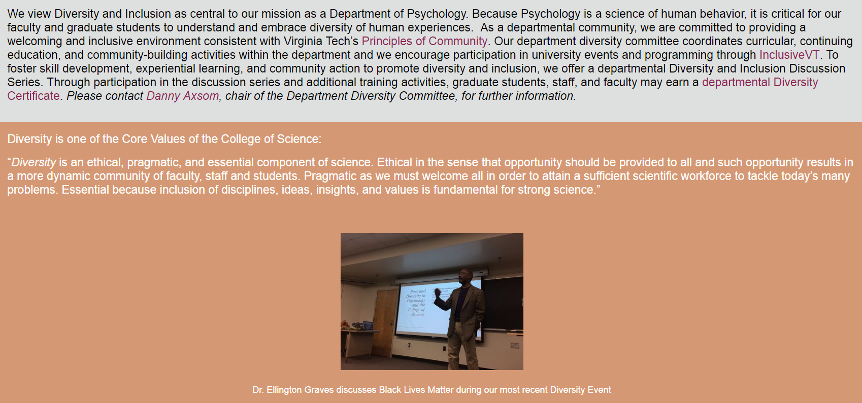
Theme Considerations
https://www.diversity.psyc.vt.edu/
https://www.diversity.psyc.vt.edu/
Notes:
We decided to create two new design themes for the website and present them to the clients because they noted there was a lot of unused space in the pages.
We ended up using the second design, utilizing alternating background colors behind the sections of the pages.

Slide 13
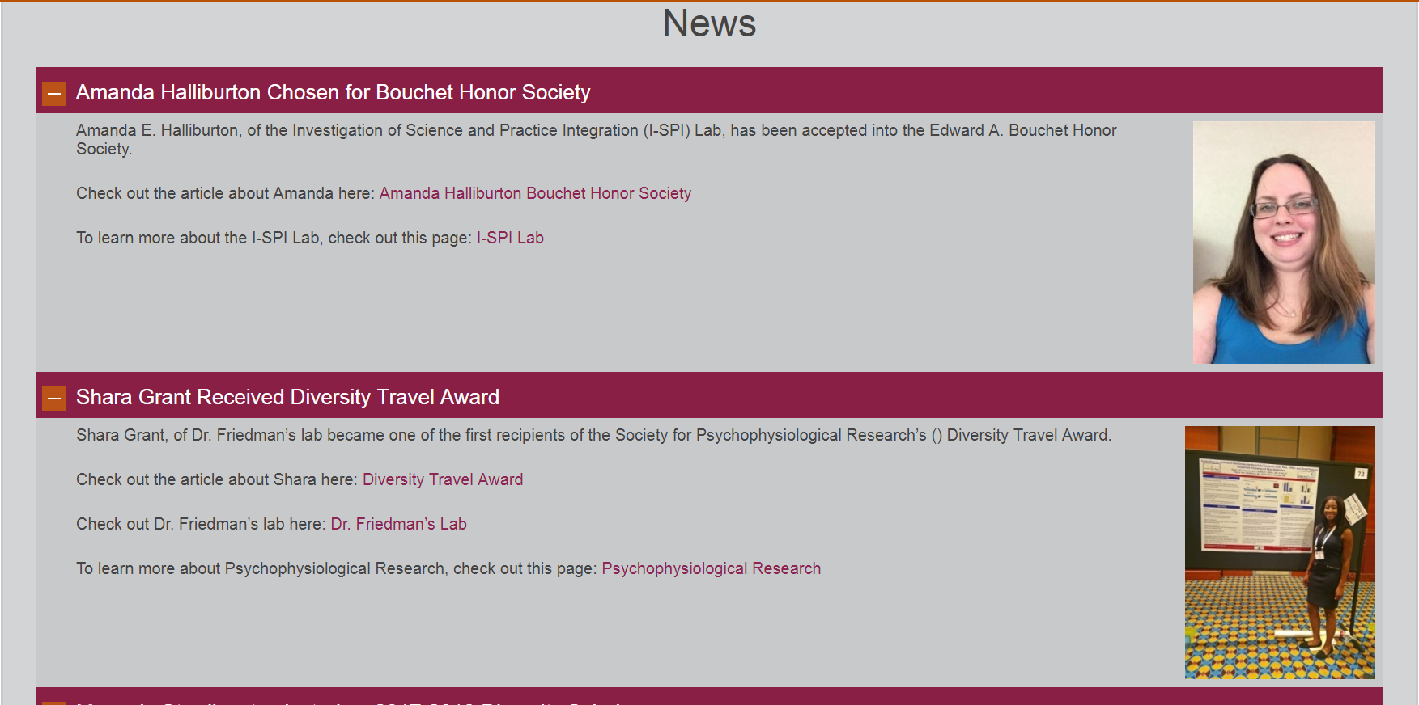
Dropdown Content
https://www.diversity.psyc.vt.edu/
Notes:
We utilized dropdown content for the extra information on the slides, so that we weren’t filling the pages with text.

Slide 14
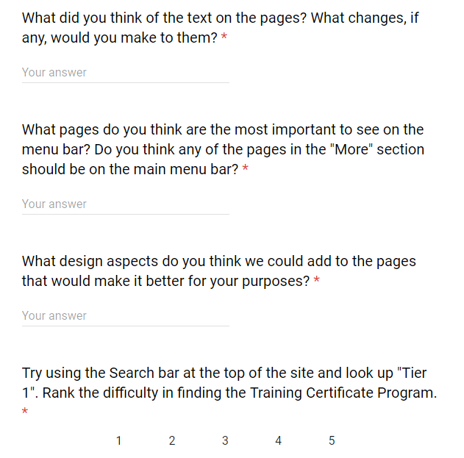
User Testing and Evaluation
Committee Testing
Department Testing
Artist Testing
Feedback Gathered
https://docs.google.com/forms/d/e/1FAIpQLSe2Ur7cC8AmhIFe_cUjEXCxFPDTgi94gwt3hYsn8UtiCo_yIQ/viewform
Notes:
We distributed a survey and the link to the home page to the Diversity Committee and the Department so that they could offer us feedback.
We also gave the link to an artist we know to get her opinion on design, flow, and readability.

Slide 15
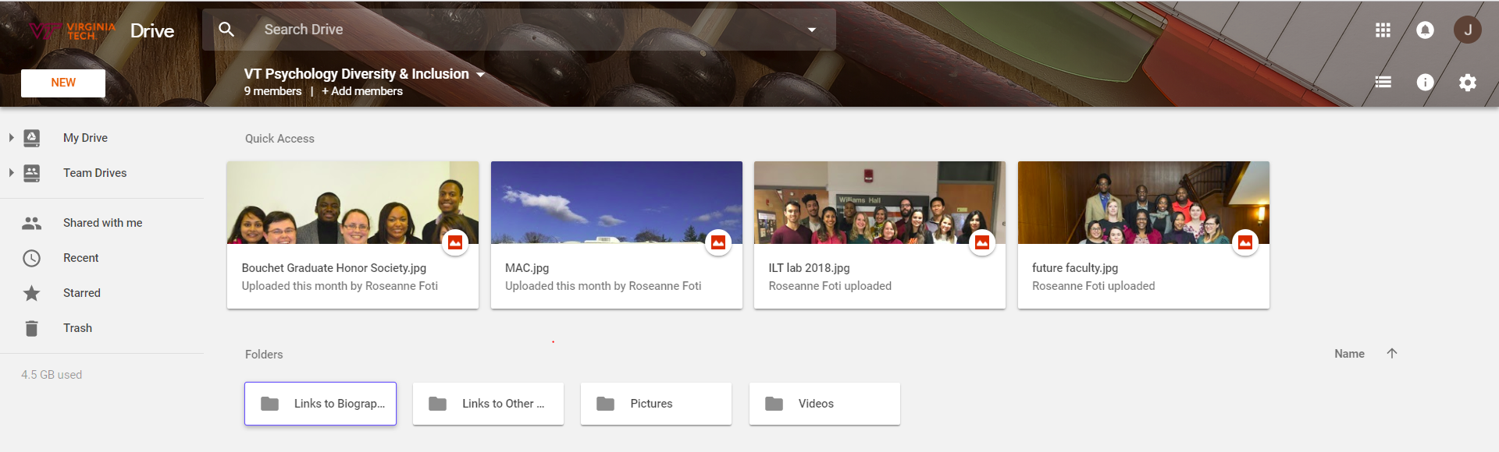
Multimedia Content
Eleven distinct pages with content
Research, Resources, Programs, Achievements
Gathered multimedia from user survey and Google Drive shared with clients
Google Drive shared with clients
Notes:
Whereas the original Diversity and Inclusion presence of the Department was only one webpage with minimal information on initiatives, we have expanded that to an additional 10 webpages with information on each facet of the Committee’s endeavors
We gathered a good number of multimedia content from the user survey and from the clients.

Slide 16
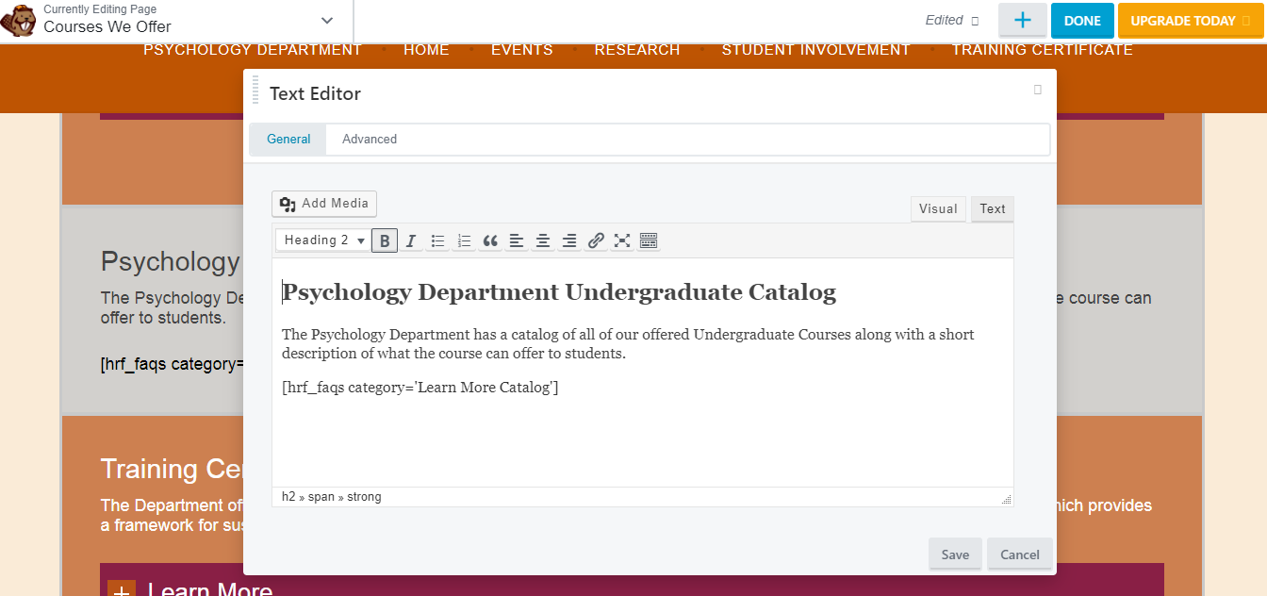
Extra Deliverables
Current Department website is difficult to edit for non-technical personnel
SOLUTION:
Use a software to facilitate easier changes (i.e. WordPress)
Video tutorials on how to make any changes/add to the website
Courses We Offer Editing Page

Slide 17
Remaining Milestones
Apr. 24:
Creating video tutorials for future editing
Find CS students to maintain for the long run
Final presentation
Apr 26:
Showcase website
Gather additional feedback
May 1:
Final report submitted
Deployment of video tutorials
Fine-tuning and troubleshooting

Slide 18
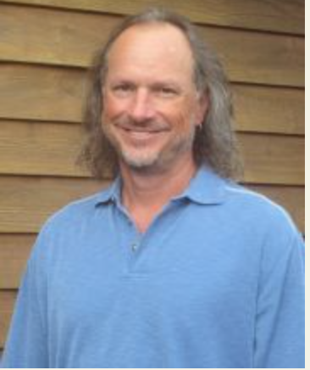
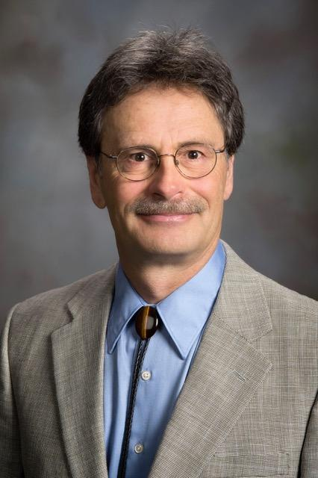
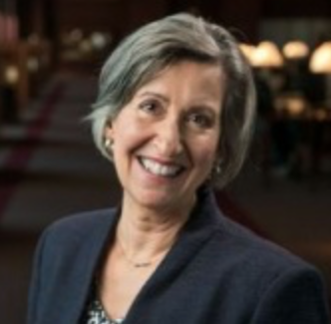
Acknowledgements
Dr. Robert Stephens - Chair of the Psychology Department
Dr. Danny Axsom - Chair of the Diversity Committee
Dr. Roseanne Foti - Incoming Chair of the Psychology Department
Ben Pfountz - IT Specialist
http://www.psyc.vt.edu/users/stephens
Provided by Danny Axsom
https://www.psyc.vt.edu/users/rfoti

Slide 19

Resources
Current Website: https://www.psyc.vt.edu/
Psychology Department, Ben Pfountz, 2010
InclusiveVT Inclusion and Diversity Strategic Planning Guide
Dr. Robert Stephens, 9 June 2017
https://vt.edu/brand.html

Slide 20

Questions?
http://clipartbarn.com/question-mark-clipart_1592/

