Slide 1
Satellite Image Finder Parking Lot & Spots
Alex Lambrides, Thomas Wolfe, Khoa Le, Patrick Jahnig
CS 4624 – Multimedia, Hypertext, and Information Access
Virginia Tech, Blacksburg VA, 24061
May 2, 2018

Slide 2
Outline
Summary
Final Dataset
Testing
Final Training Statistics
Results
Deliverable
Accomplishments
Lessons Learned
Future Improvements

Slide 3
Summary
Detect parking lots in satellite images
Acquire and label large set of satellite images
Train Faster R-CNN model for detection
Build Python script to use model to output GeoJSON
Several iterations of trial and error
Research methods of improving model

Slide 4
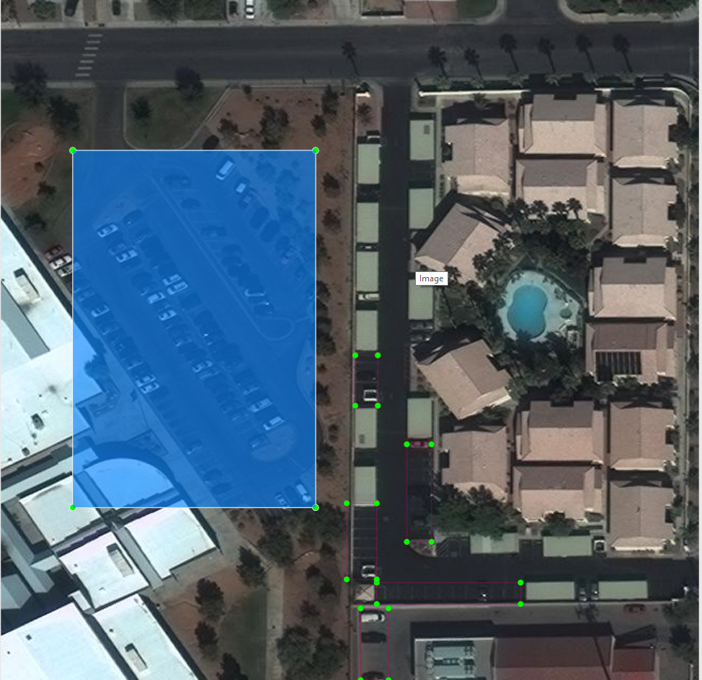
Final Dataset
3,000 images from Las Vegas, Paris, and Shanghai
~500 labelled images
Labelled using LabelImg
Can only label along vertical and horizontal axes
Difficulty labelling certain images

Slide 5
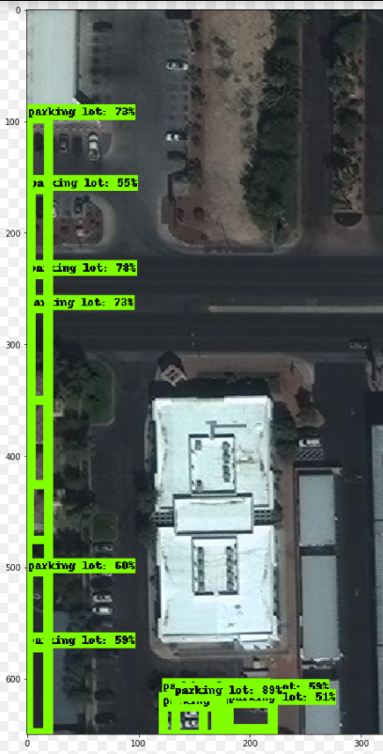
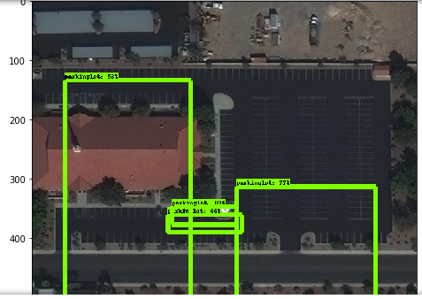
Testing
First Training Run
Second Training Run

Slide 6
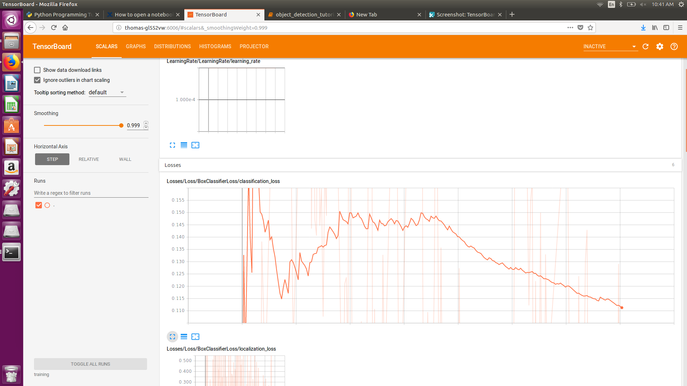
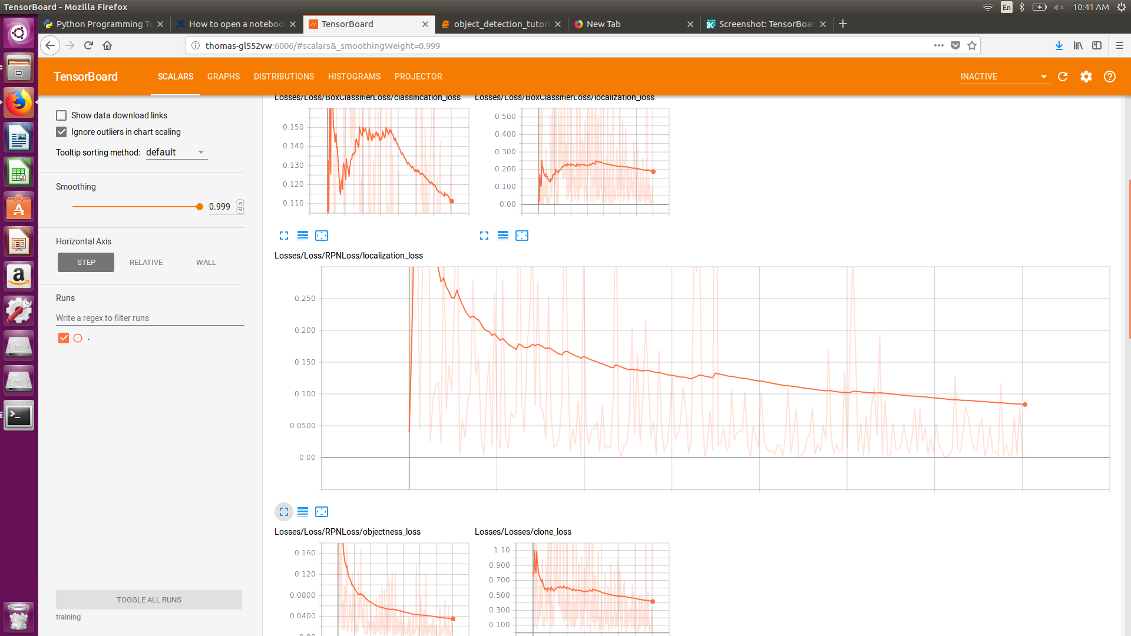
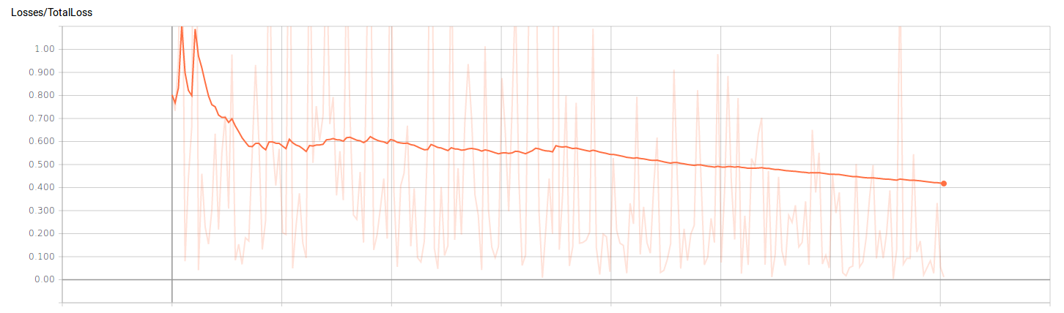
Final Training Statistics

Slide 7
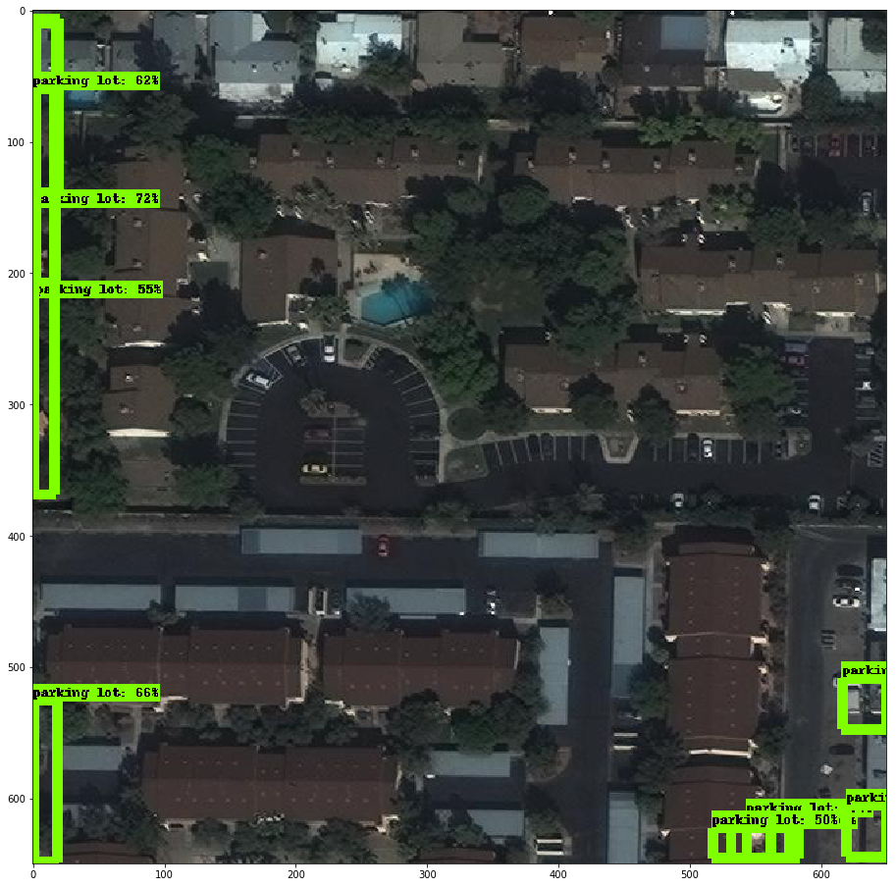
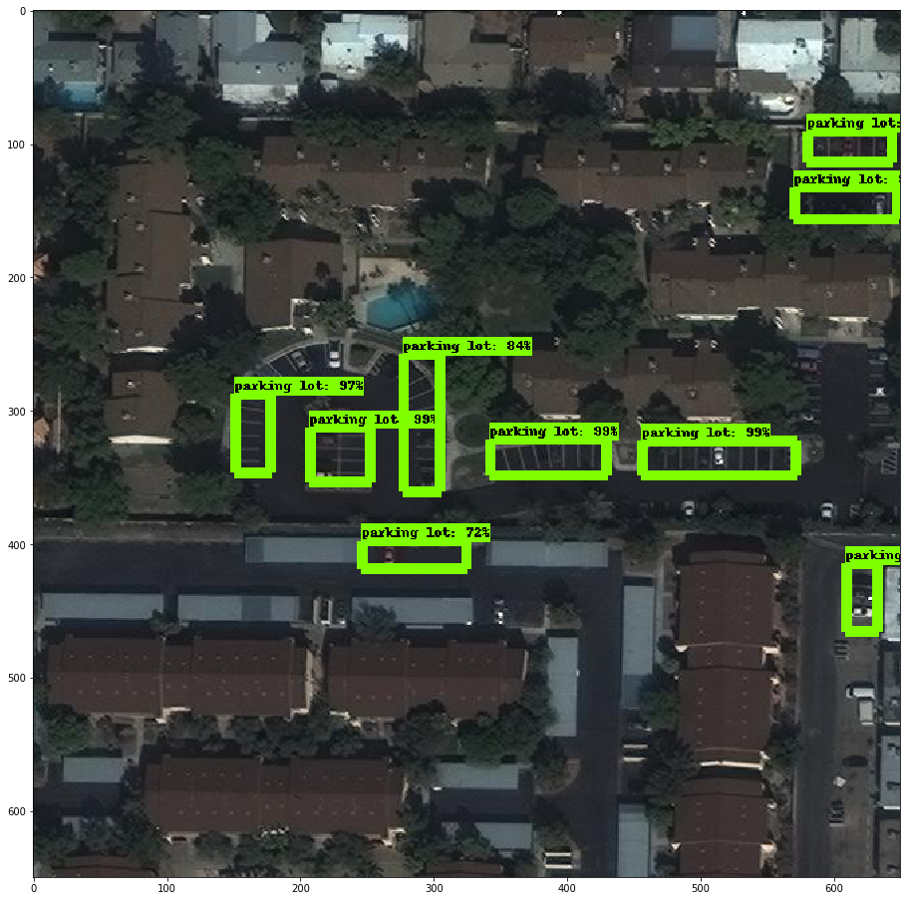
Results
First Training Run
Final Training Run

Slide 8
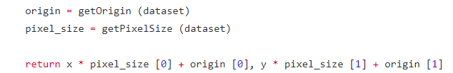
Deliverable
Python script for detecting parking lots
Convert geoTIFF to JPG
Run JPG on model -> return bounding boxes
Use GDAL to extract geographic information
Convert bounding boxes to GeoJSON

Slide 9
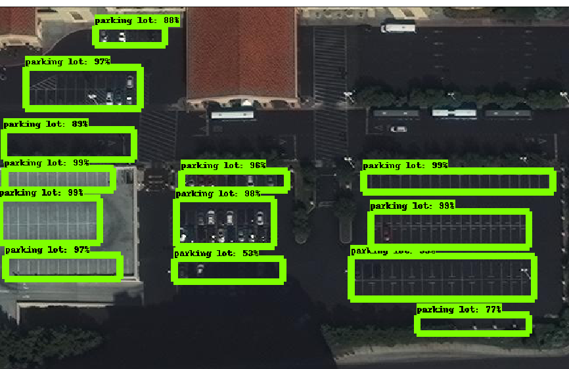
Accomplishments
Detection of parking lots
Decent accuracy when the parking lots are not tilted
Doesn’t detect parking lots in negatives
Large stockpile of training data
Documentation for improving model

Slide 10

Lessons Learned
Machine learning is really difficult - several headaches
Failure is OK, led to our eventual success
Research models before labelling data
Setting up the infrastructure is difficult
Prioritize good quality deliverable over stretch goals
Notes:
https://cdn-images-1.medium.com/max/760/1*YxY6eODg3r-Z8_P43oOarA.jpeg

Slide 11
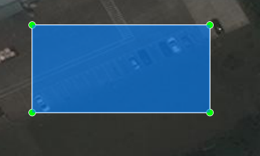
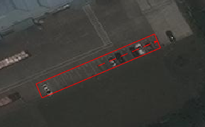
Future Improvements
Adjust parameters and checkpoints
Build bigger dataset
Train on VT ARC for faster iterations
Relabel and train with rotated bounding boxes
  We have documented steps how to do this
VS

Slide 12
Acknowledgement and References
Client: Reinventing Geospatial - Mary Carome, Steven Lander and Mike Szaszy.
References:
https://medium.com/the-downlinq/establishing-a-machine-learning-workflow-530628cfe67
https://medium.com/the-downlinq/getting-started-with-spacenet-data-827fd2ec9f53
http://www.machinalis.com/blog/obia/
https://github.com/ujjwalkarn/DataSciencePython
http://www.mdpi.com/2072-4292/8/9/715?trendmd_shared=0
https://aws.amazon.com/public-datasets/spacenet/
https://github.com/tzutalin/labelImg
https://github.com/cgvict/roLabelImg
https://towardsdatascience.com/deep-learning-for-object-detection-a-comprehensive-review-73930816d8d9
https://www.tensorflow.org/tutorials/
https://tryolabs.com/blog/2018/01/18/faster-r-cnn-down-the-rabbit-hole-of-modern-object-detection/
https://cdn-images-1.medium.com/max/760/1*YxY6eODg3r-Z8_P43oOarA.jpeg
www.cvlibs.net/datasets/kitti/

