Slide 1
SIMobile
Amy Vogrig-Emily Croeber-Tyler Collins
CS 4624: May 2016
Virginia Tech: Blacksburg, VA 24061
Client: John Crawford
NIH Grant 1R01DA039456-01

Slide 2
Project
Social Interactome (SI) is an anonymous, social media support system for recovering addicts.
Turn SI’s desktop version into a mobile version

Slide 3
Responsive Web Design
Most changes are through CSS
  Change design based on screen size
  Change formatting
  Declare what is visible

Slide 4
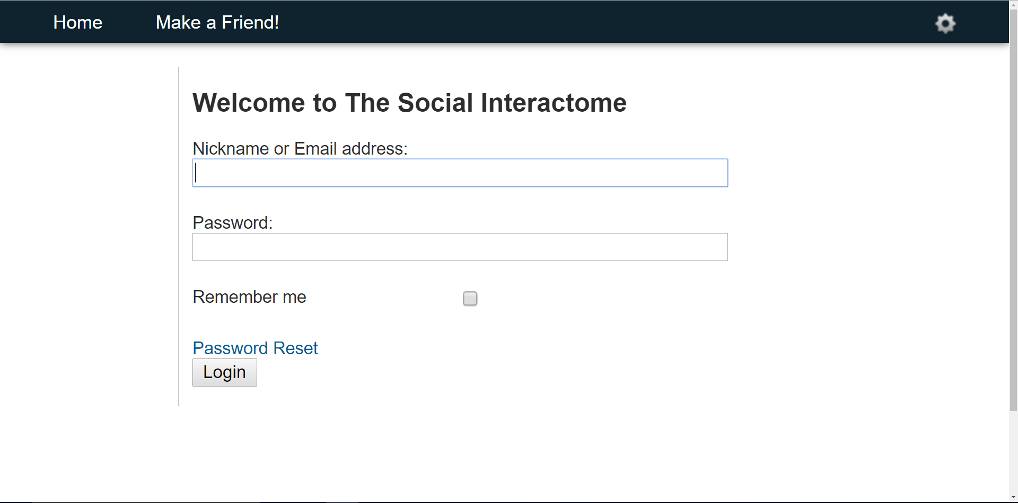
Current Desktop Version

Slide 5
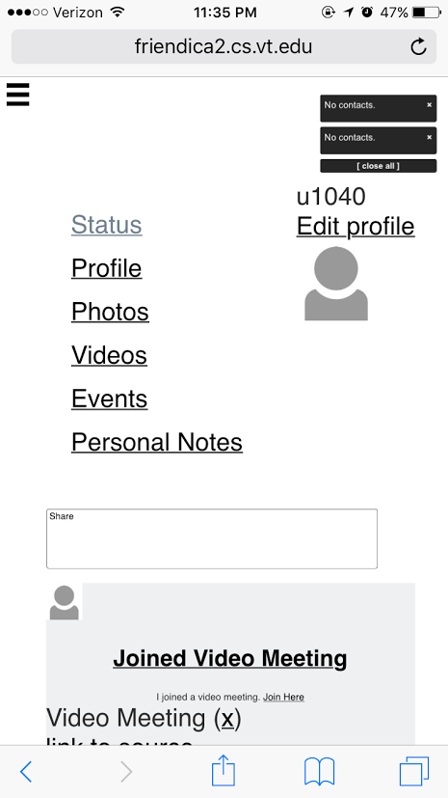
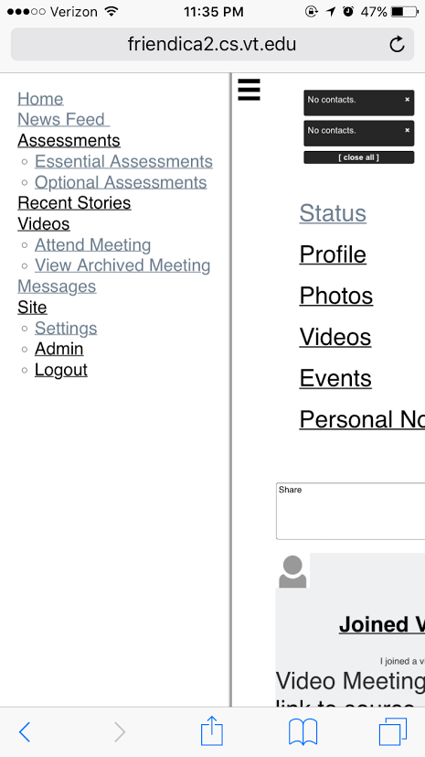
Navigation
Use of a “hamburger,” push-drawer menu
Allows for hidden navigation
“Hamburger” push-drawer menu enlarged to show all navigation content

Slide 6
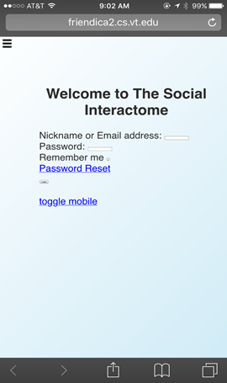
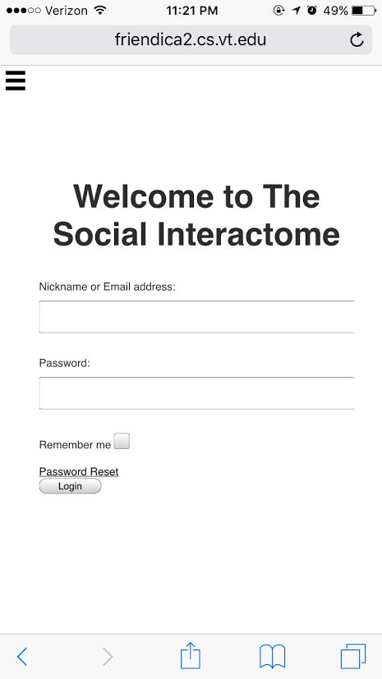
Formatting

Slide 7
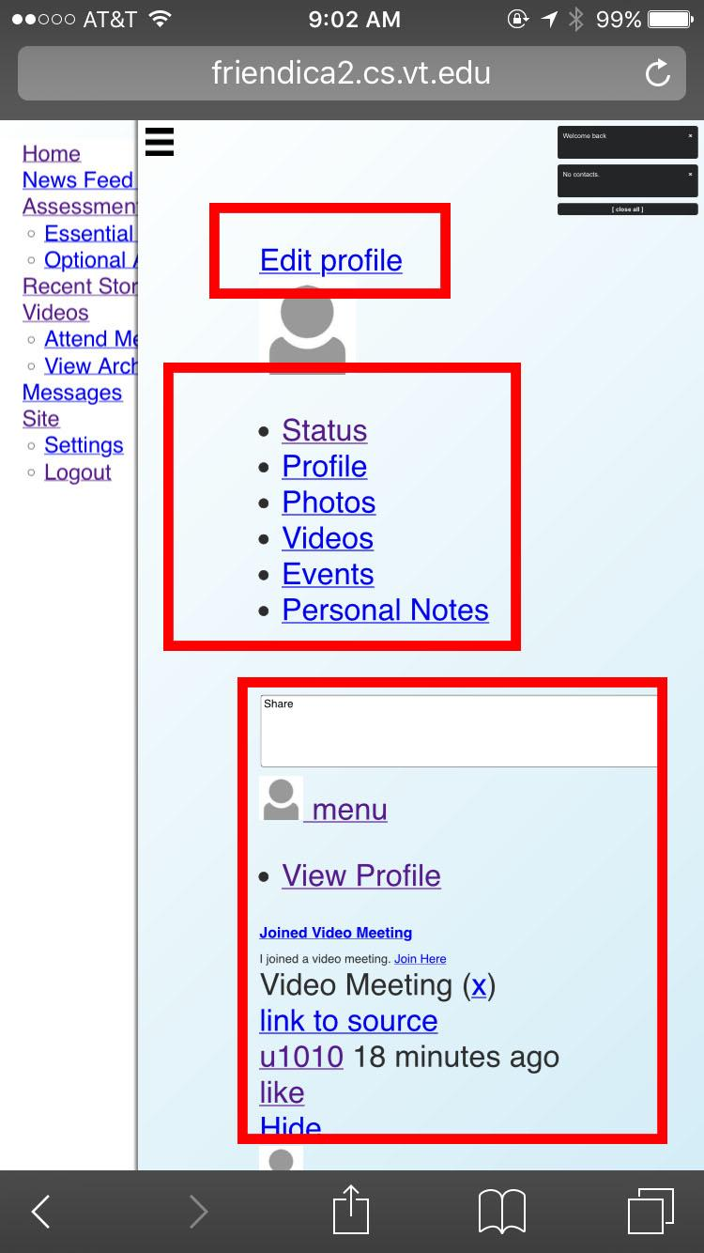
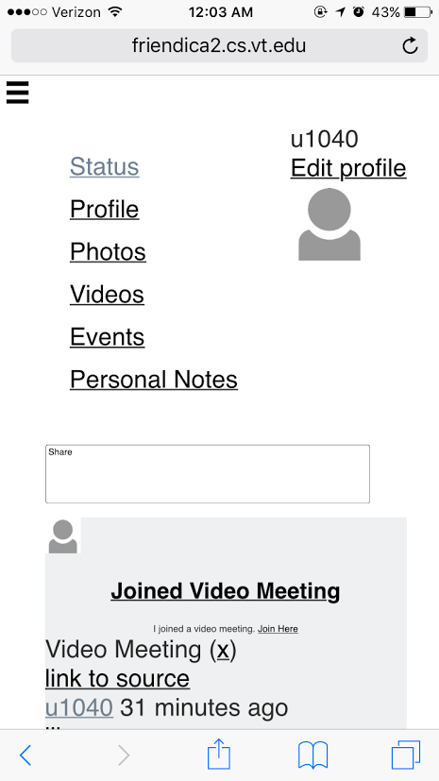
Reformatting Home Page

Slide 8
Other CSS Changes
Formatted text to match
Centered the headings
Eliminated unnecessary navigation content and information
Enlarged font sizes to be more readable

Slide 9
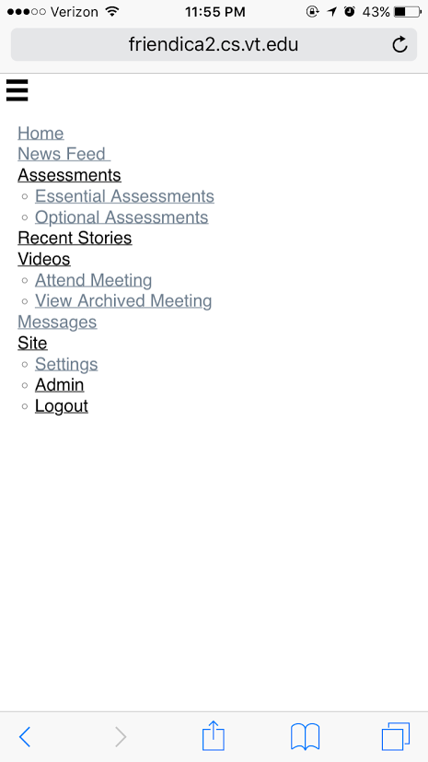
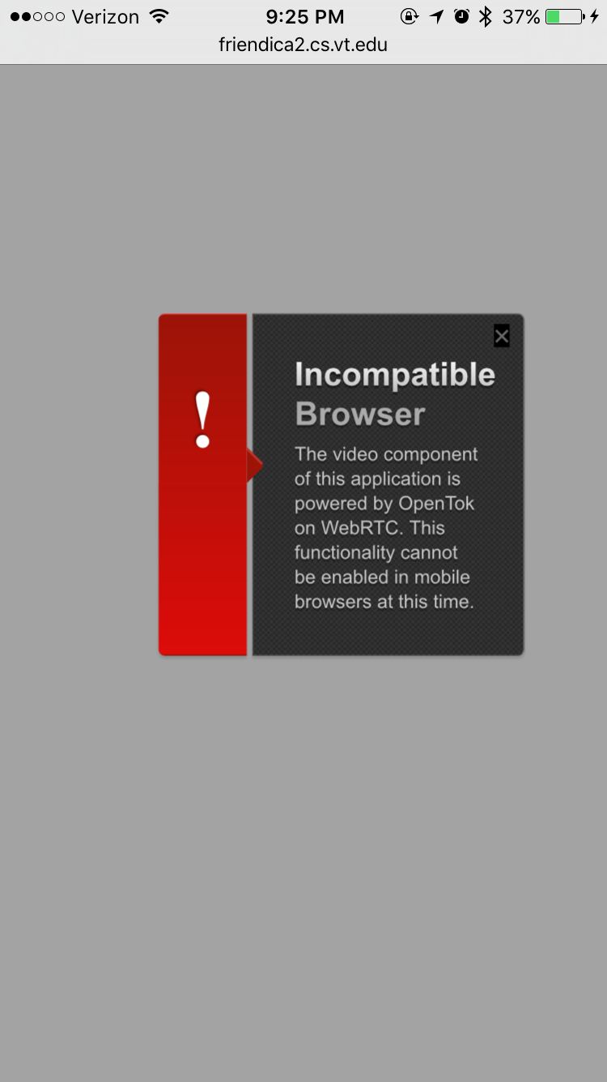
Remaining Known Issues
Notes:
Elastic (over-scrolling) shows the hidden navigation when the bottom of the screen is reached
Declared acceptable by client
Attending a video conference plugin and others used by desktop is not supported via mobile browsers.
Incompatible plugins need to be changed for mobile devices
Out of scope of project

