Slide 1
Team FE
Final Presentation
Global Event and Trend Archive Research (GETAR), supported by NSF IIS-1619028.
Virginia Tech, Blacksburg, VA, 24060
CS 5604
Fall 2017
12/12/2017
Haitao Wang
Yali Bian
Shuo Niu
Jieun Chon
Notes:
DONE

Slide 2
Table of contents
GETAR Portal Front-end
  Project Workflow
  Frontend Modules
  Core Metadata
  Schema
  Functionality
  Future Work
2. GETAR Visualization
  Functions
  Framework
  Search
  TweetList
  SNS
  User Information
  Timeline
  Views
Notes:
DONE

Slide 3
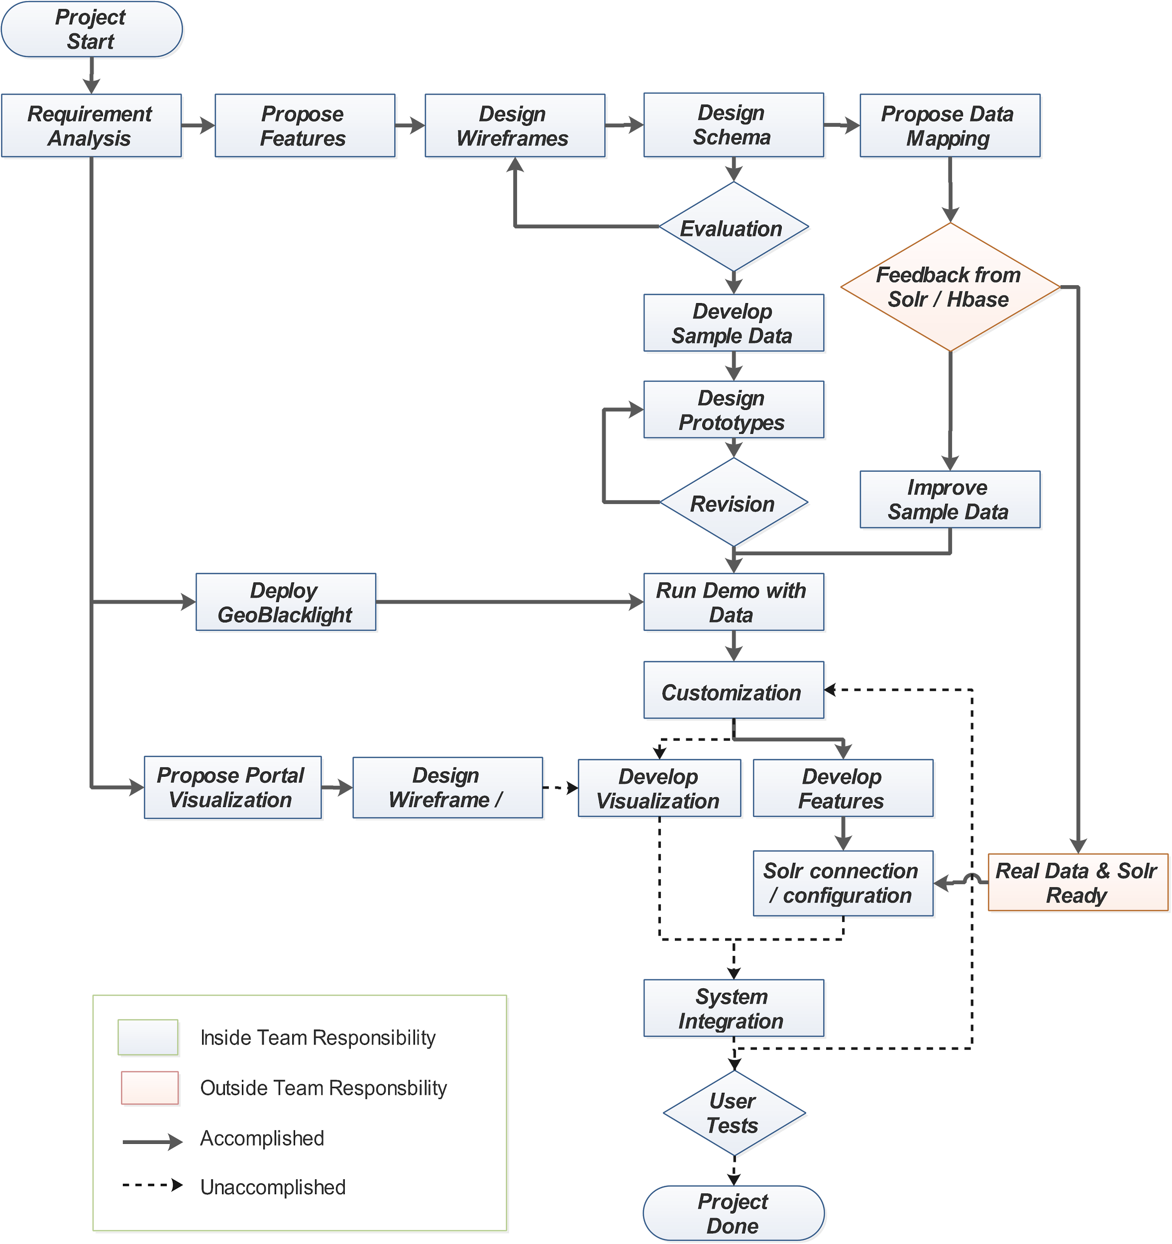
GETAR Portal Front-end Project Workflow
(w/ GeoBlacklight)
Notes:
HaiTao -- Can you fix some texts?

Slide 4
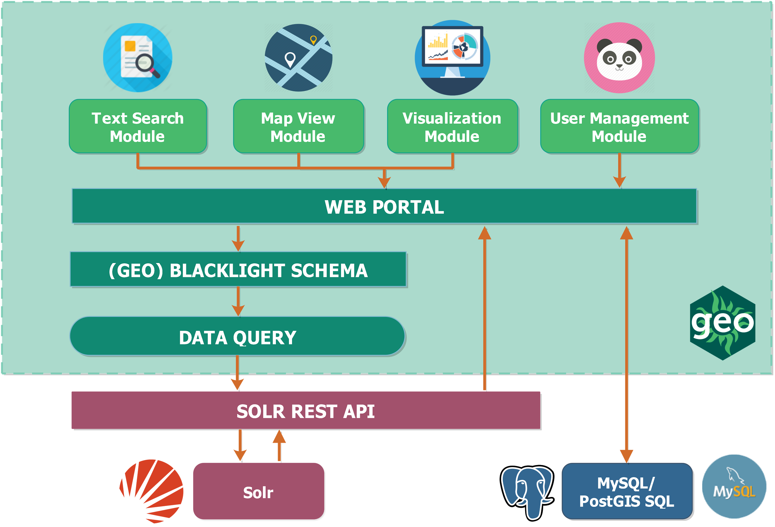
GETAR Portal - Frontend Modules
Notes:
HaiTao -- where this picture from?

Slide 5
GETAR Portal - Core Metadata
Metadata | Field | Description | Example
Document ID | id | Unique document identifier | 899664353946996738
Author | dc_creator_sm | Document author | jhdee
Year | solr_year_i | Year when publishing the document | 2017
Spatial coverage | dct_spatial_sm | Interpreted location as place name | Radford, virginia
Institution | dct_provenance_s | Institution of data collection holder | Virginia Tech
Spatial bounds | dct_bounds_s | Bounding box for S,W,N,E of interpreted location | ENVELOPE (34.0, -118.2, 36.5, -117.4)
URL | dct_url_s | URL of orginal documents | http://xxxx.yy.zz
Full text | dc_description_s | Full text of tweet / webpage | Full text
Topics | dc_topics_s | Related topic name | "midflight experience"
Collections | dct_isPartOf_sm | Related collection name | "Solar eclipse"
Geometry type | dc_geotype_s | Point or polygon | "point"
Document type | dc_format_s | Tweet or webpage | "webpage"
Hashtag | dct_hashtag_s | Hashtags of tweets | #solareclipse
Notes:
DONE!

Slide 6

GETAR Portal - Schema
for sorting text fields
dc_publisher_s
dc_title_s
dct_provenance_s
for text search
dc_creator_sm
dc_description_s
dc_format_s
dc_identifier_s
dc_publisher_s
dc_rights_s
dc_subject_sm
dc_title_s
dct_isPartOf_sm
dct_provenance_s
dct_spatial_sm
dct_temporal_sm
layer_geom_type_s
layer_slug_s
for spell checking
dc_creator_sm
dc_publisher_s
dc_subject_sm
dc_title_s
dct_provenance_s
dct_spatial_sm
for suggestions
dc_creator_sm
dc_publisher_s
dc_subject_sm
dc_title_s
dct_provenance_s
dct_spatial_sm
Notes:
DONE!

Slide 7
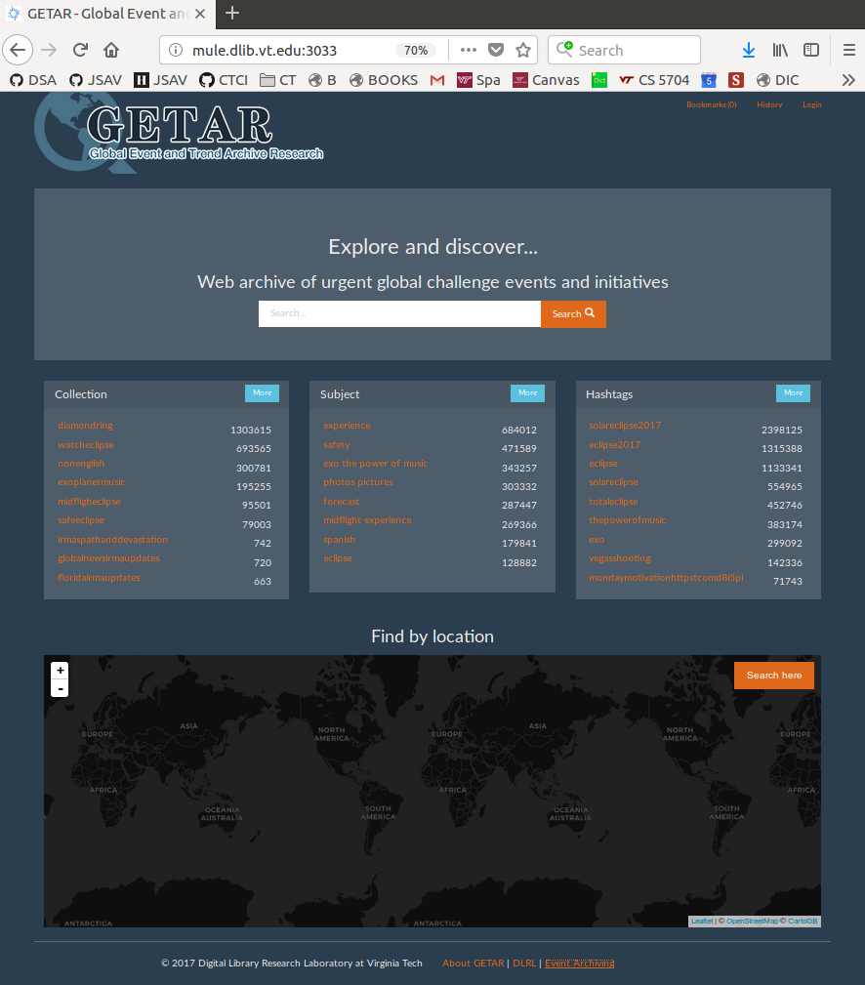
GETAR Portal - Functionality
Home Page
http://mule.dlib.vt.edu:3033

Slide 8
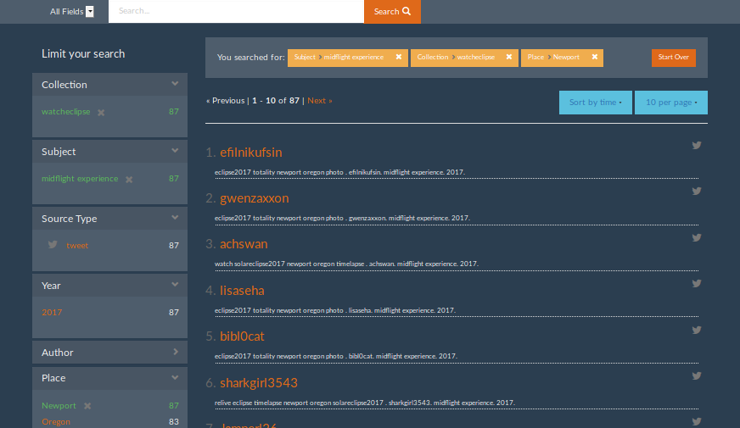
GETAR Portal- Functionality
Facet Search

Slide 9
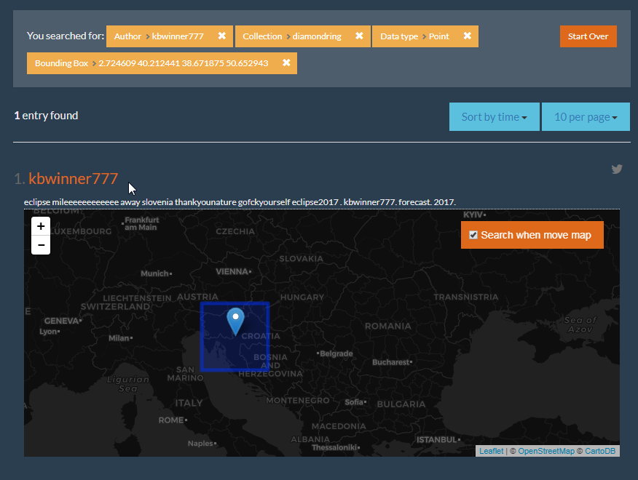
GETAR Portal- Functionality
Spatial Search

Slide 10
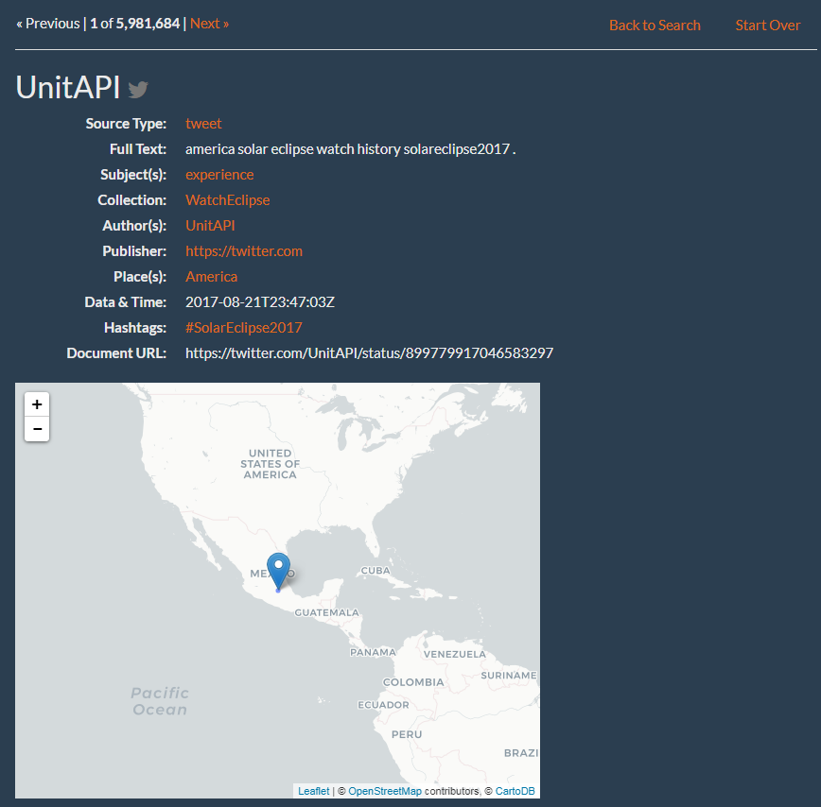
GETAR Portal
- Functionality
Document Details

Slide 11
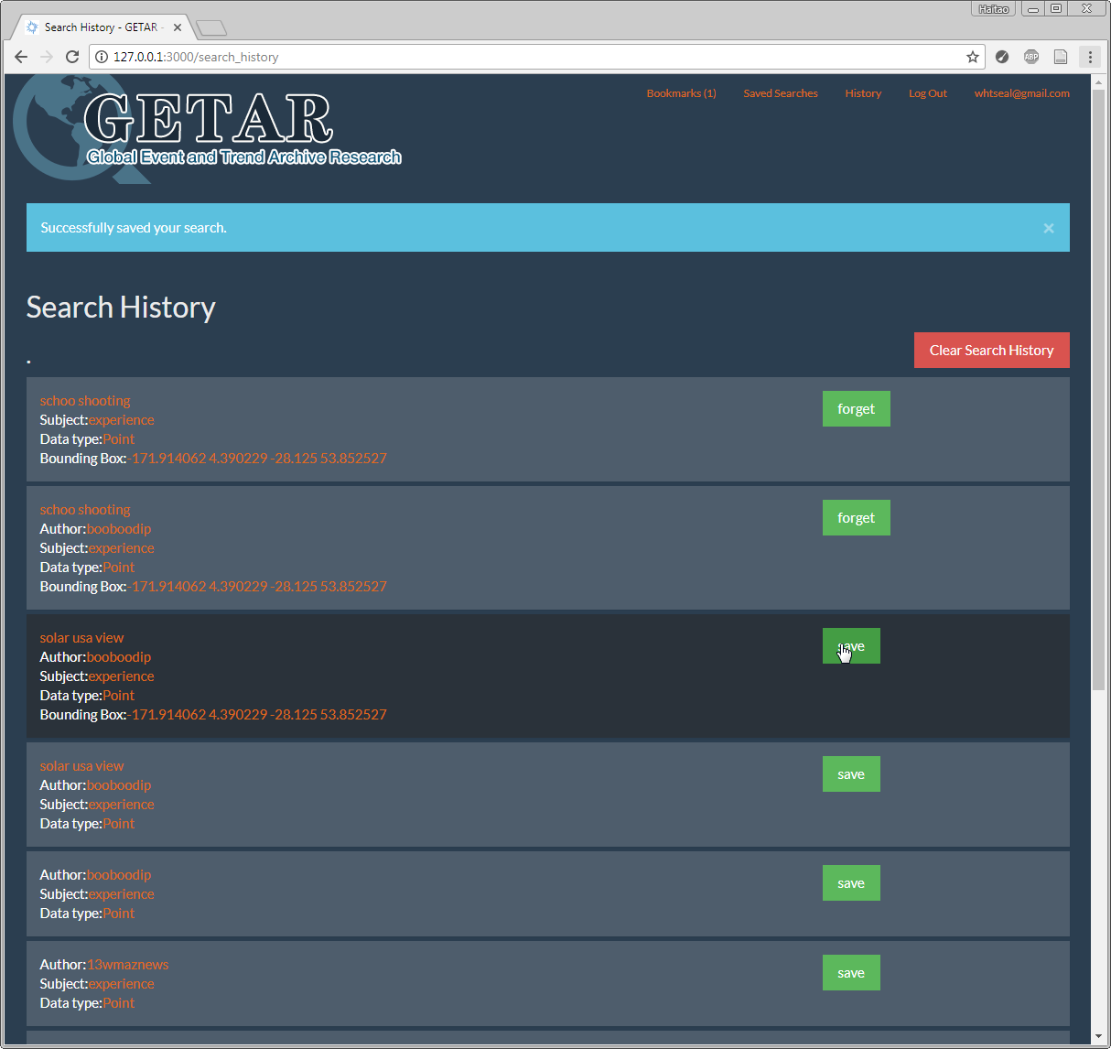
GETAR Portal
- Functionality
Search History

Slide 12
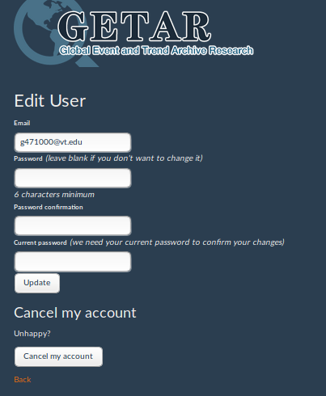
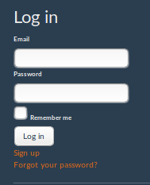
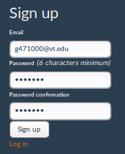
GETAR Portal -
Functionality
User login

Slide 13
GETAR Portal - Future Work
Spatial and temporal representation visualization of data
Integration of GETAR Portal with GETAR Visualization
More Customization
Performance Analysis
Usability Testing
Documentation for the future users/developers
Notes:
HaiTao -- Could you please fix this too?

Slide 14
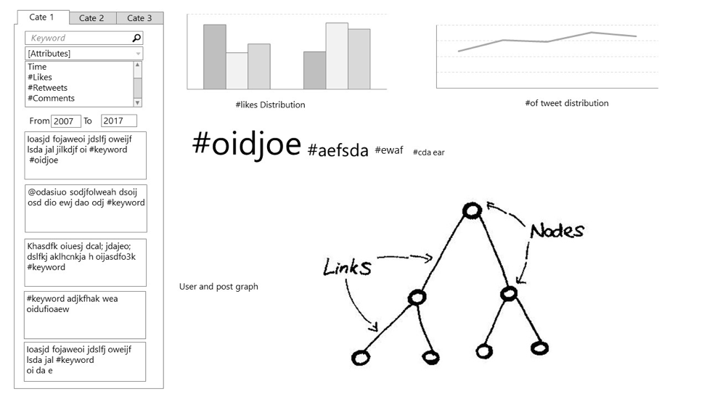
GETAR Visualization
Functions:
Search
View Tweets
Social Network
User Information
Timeline
Keywords
Geo-location

Slide 15
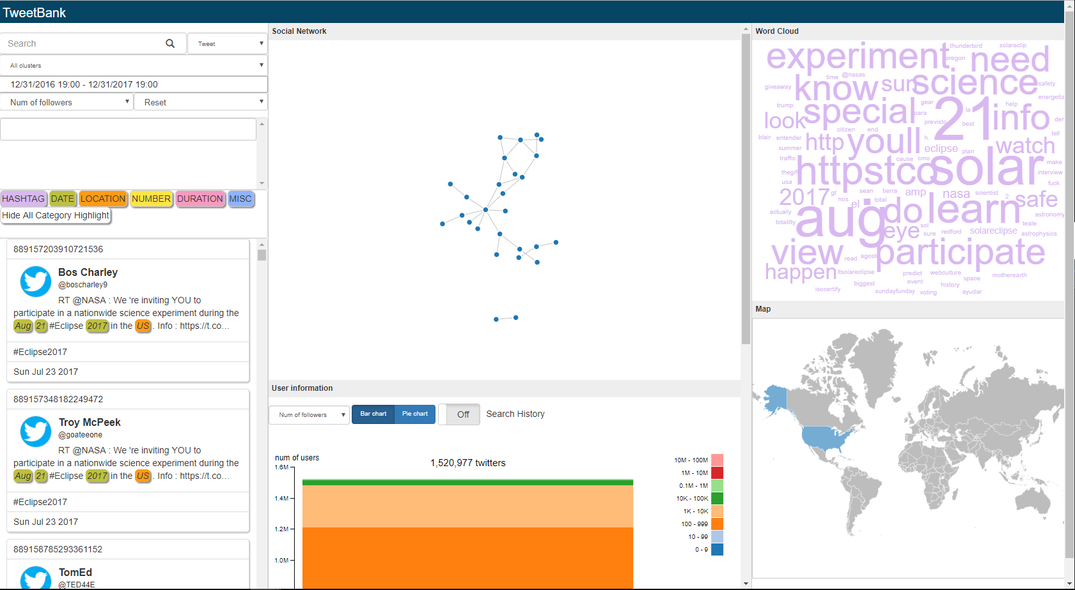
GETAR Visualization
Functions:
Search
View Tweets
Social Network
User Information
Timeline
Keywords
Geo-location
http://mule.dlib.vt.edu/cs5604f17_fe/TweetBank/src/

Slide 16
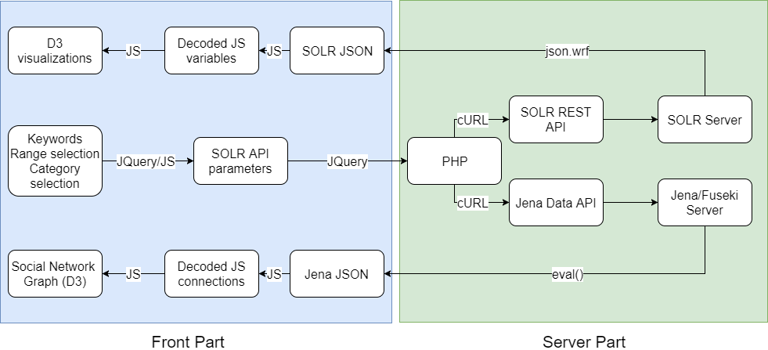
GETAR Visualization - Project Framework
User input → Solr Query → PHP → Solr/Jena → JSON → Decoded Values → D3
Notes:
Prof wants to fix eval with bigger font in text box

Slide 17
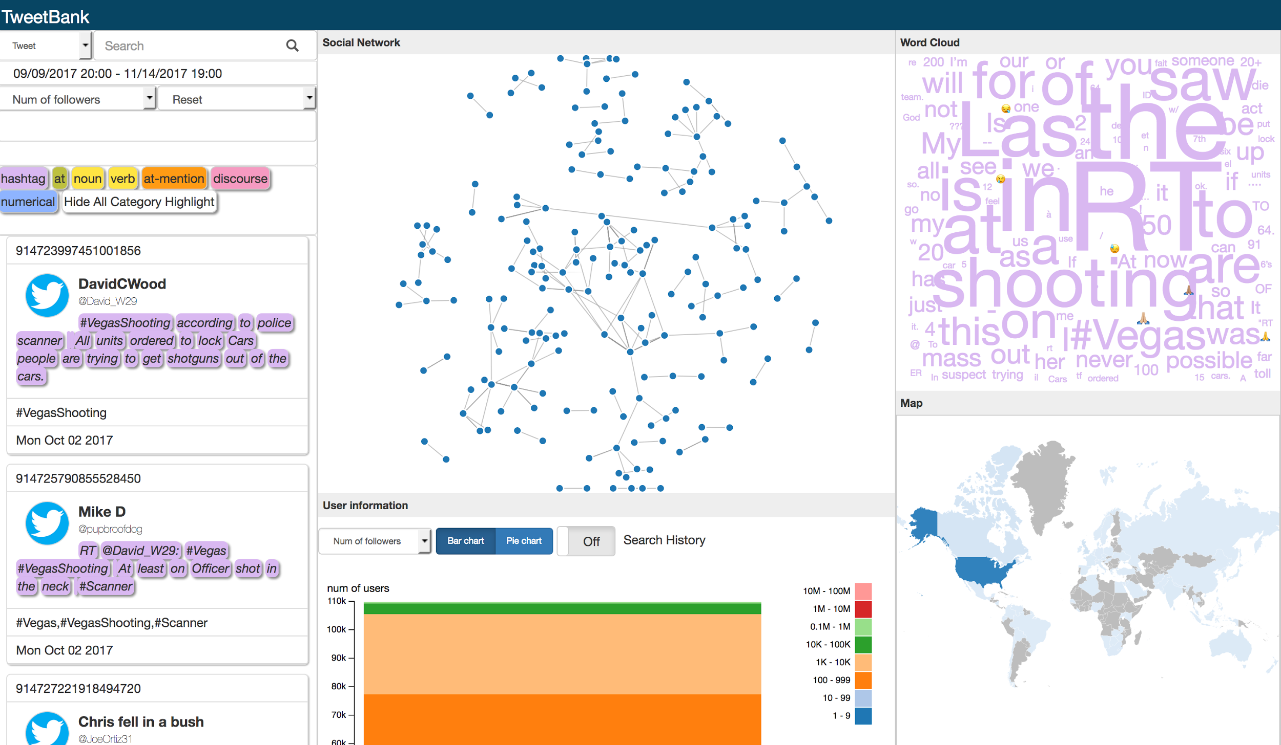
GETAR Visualization - Framework
Feature 2 - Interactive
overview and detail
brushing and linking
exploratory searching
Feature 1 - Flexible
  Easy to add new data types
  Easy to extend new views

Slide 18
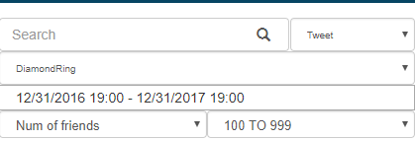
Search
Search fields:
Tweet
User name
Hashtag
Keyword:
Single word
Multiple words
Cluster:
DiamondRing
WatchEclipse
NoEnglish
...
Time range
User info
Follower #
Friends #
Tweet #
Favorite #
User lang
User info range:
0-10
10-100
1000-10000
...

Slide 19
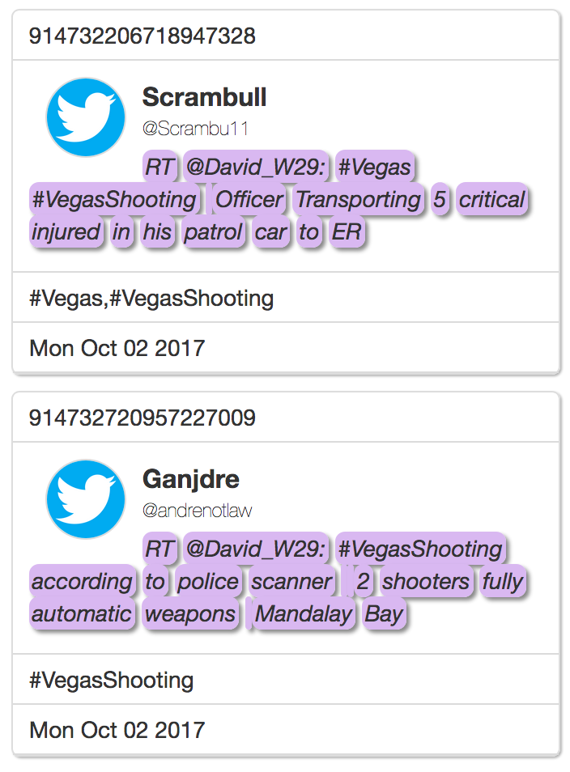
GETAR Visualization - Views: TweetList
Embed all tweet metadata (Query from SOLR Team)
  UTF-8
  Links
  Emoji
Highlighted with keywords (NER, POS from Tweet Team)
  HASHTAG
  Place
  Organization
  Time
  Number
Interactions:
  Search and highlight, rerank
  Search and update tag cloud
  highlight/unhighlight
Notes:
DONE

Slide 20
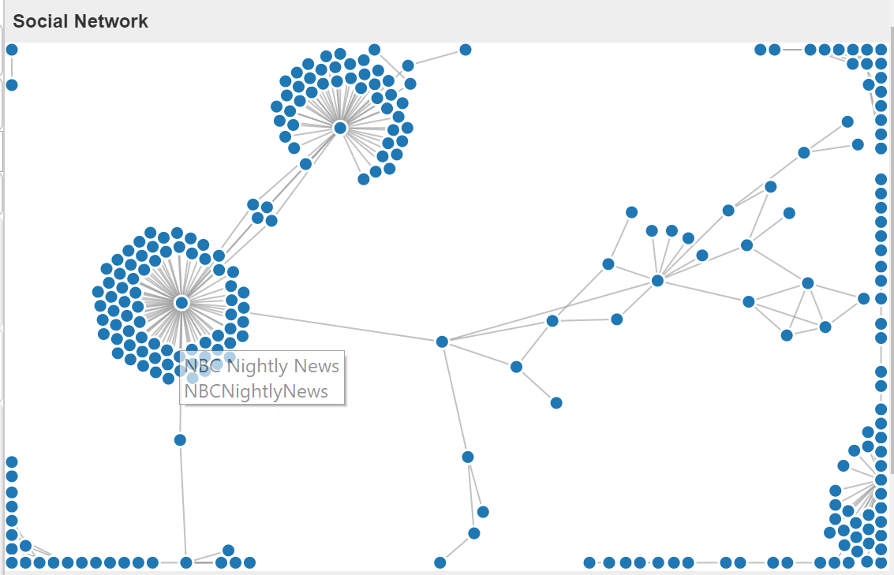
GETAR Visualization - Social Network
Nodes: individual accounts
Links: mentions
Interaction: hover to show user name

Slide 21
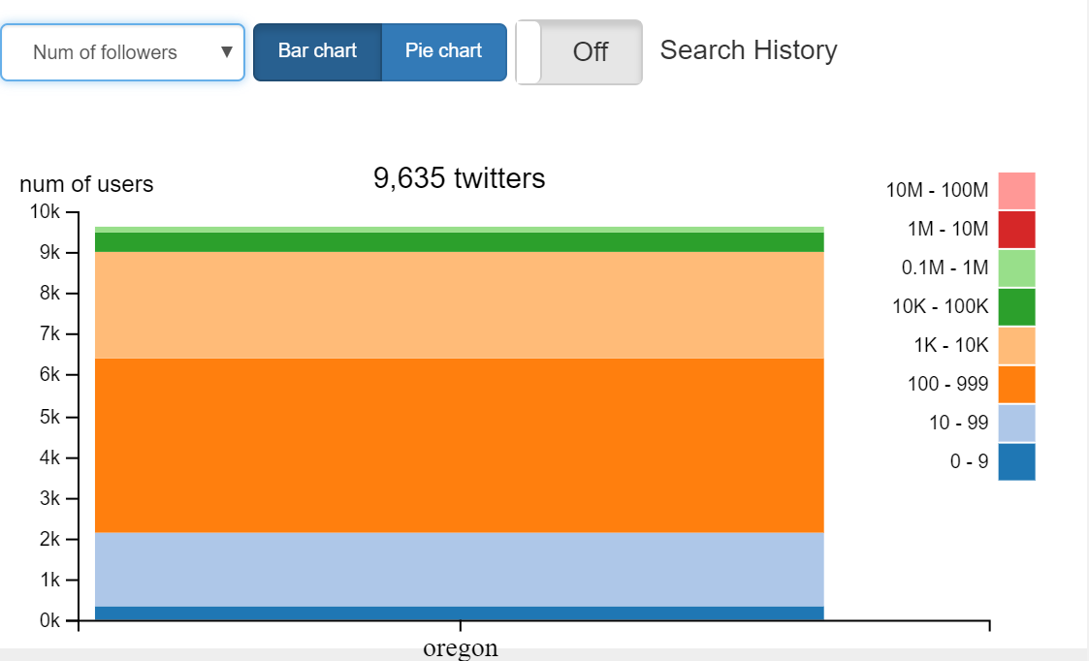
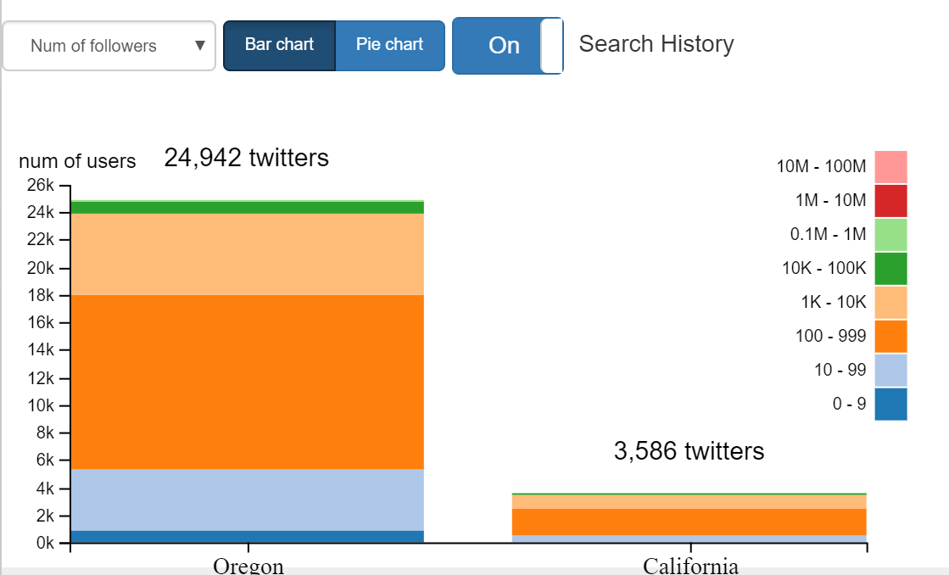
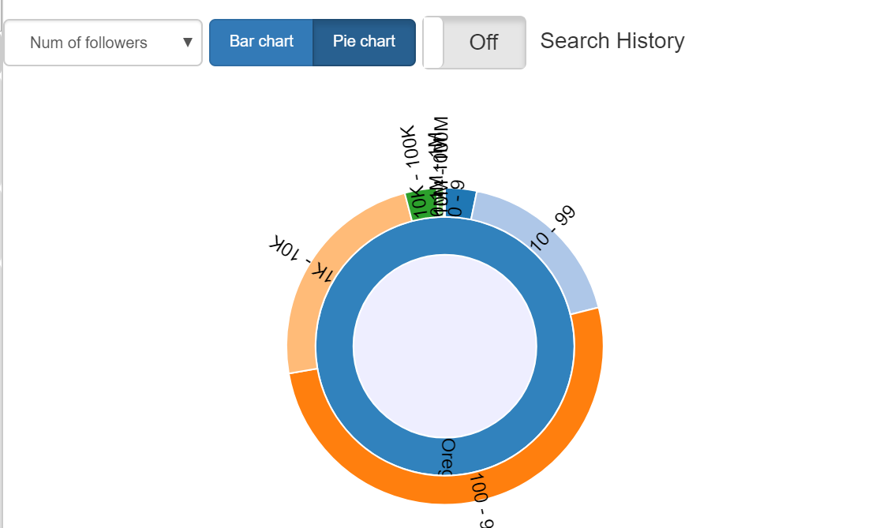
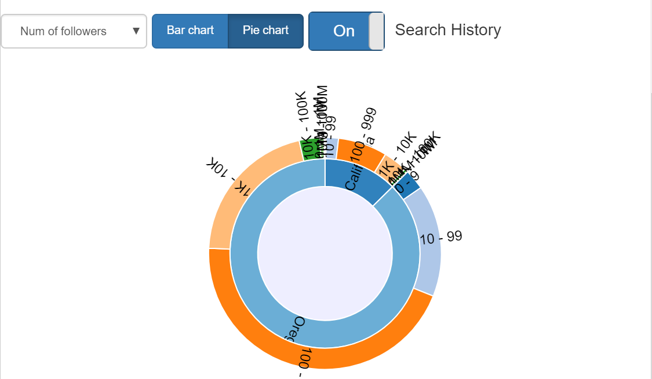
GETAR Visualization - User information

Slide 22
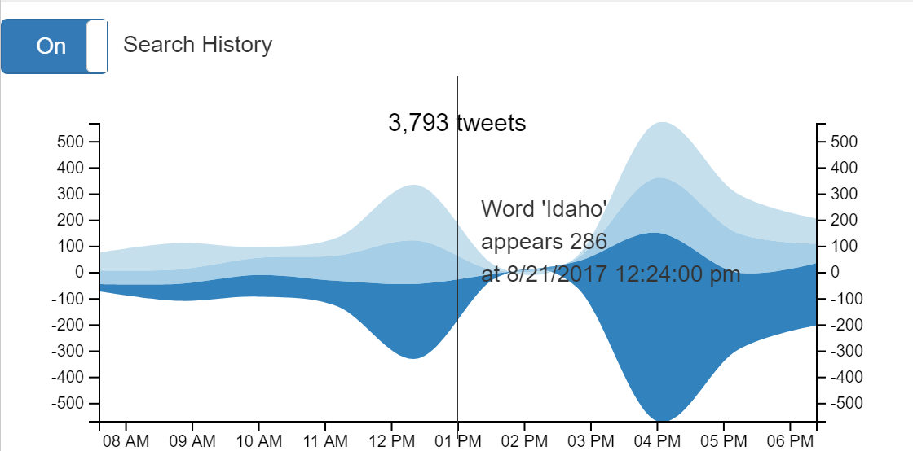
Timeline

Slide 23
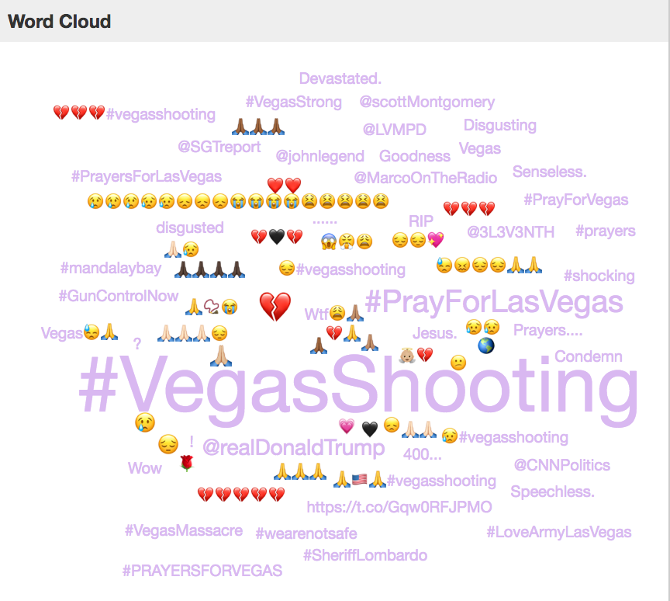
Visualization Views - Tag Cloud
D3-cloud: tag cloud generator for D3.js
Dynamic Update through Interactions
  Summarization of current search results.
  Help users narrow down tweet list
  Exploratory search
Generalization and Emotional Expression
  Key Words from POS/NER
  Emoji
Interaction Reaction
  Searching: update based on tweet-list
  Highlight: update based on filtered tweet-list
Notes:
DONE: Yali

Slide 24
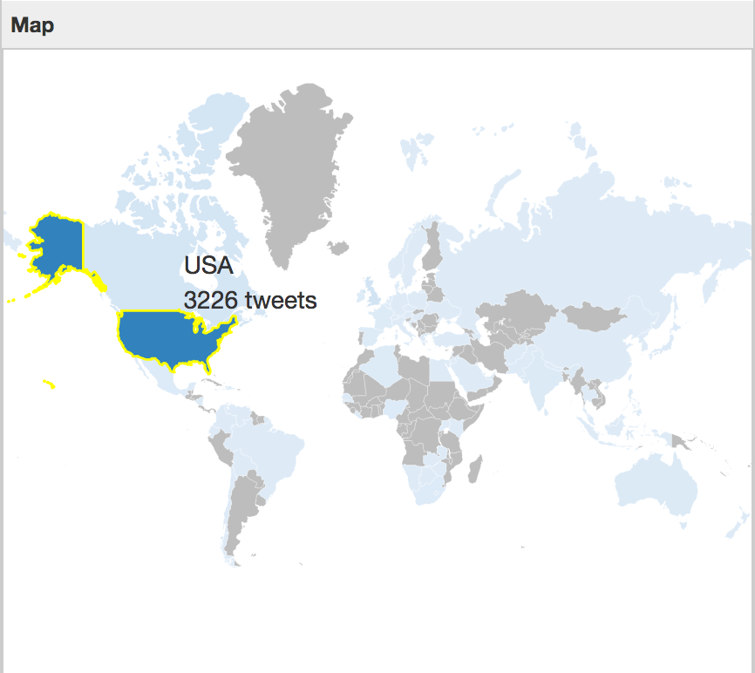
Visualization Views - Geo Map 1
Different Levels
World map, US map, State map
Notes:
DONE

Slide 25
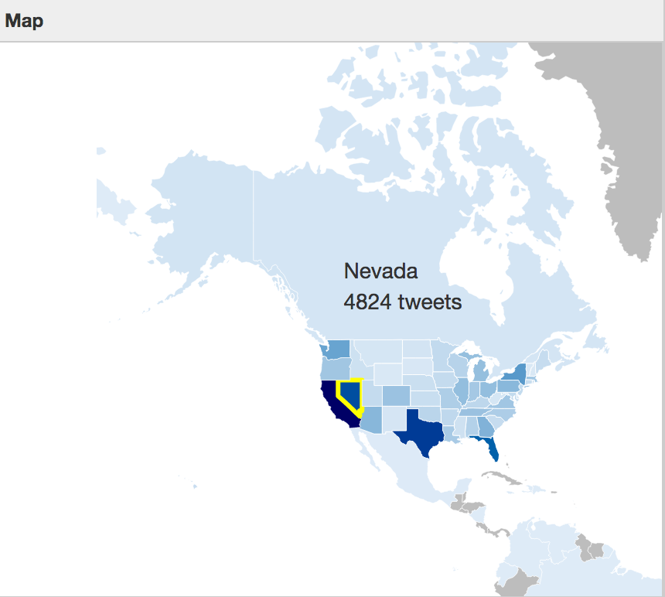
Visualization Views - Geo Map 2
Overview and Details
Zoom in and zoom out
Click Countries/ States to zoom in
Click white parts (sea) to zoom out
Notes:
DONE

Slide 26
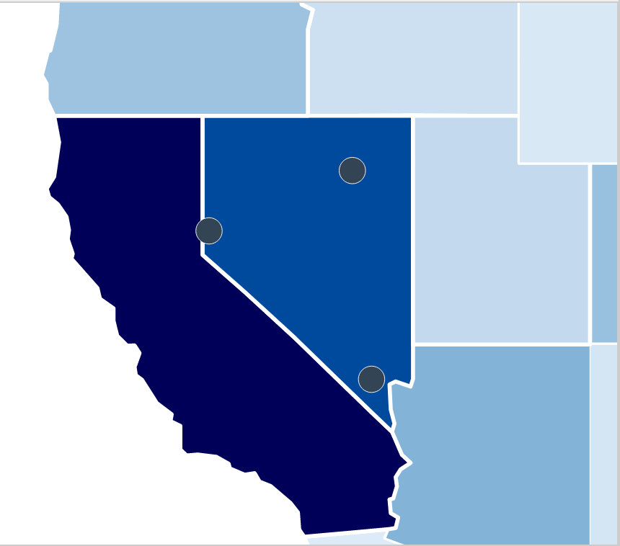
Visualization Views - Geo Map 3
Extended based on TopoJSON
More detailed data can be added
Cities.JSON for all cities in CA
Notes:
DONE

Slide 27
QUESTIONS?
Thanks go to the US National Science Foundation for supporting Global Event and Trend Archive Research (GETAR) through IIS-1619028.
Thank you!

