Slide 1

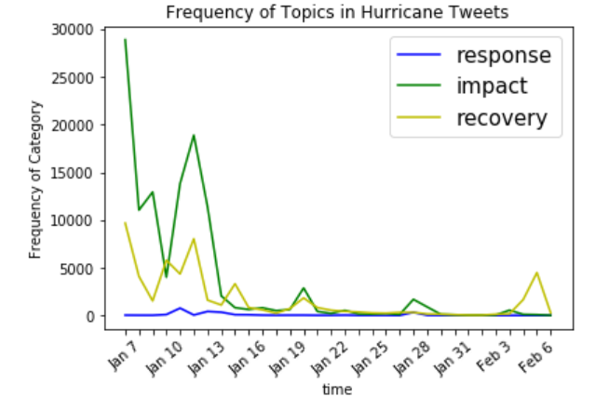
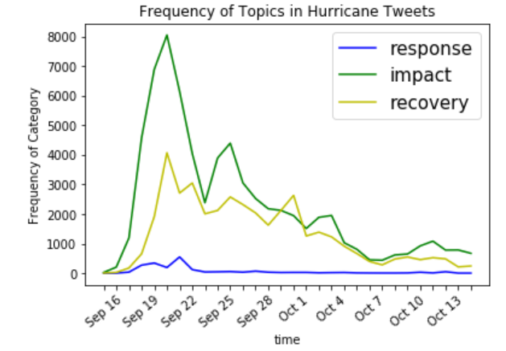
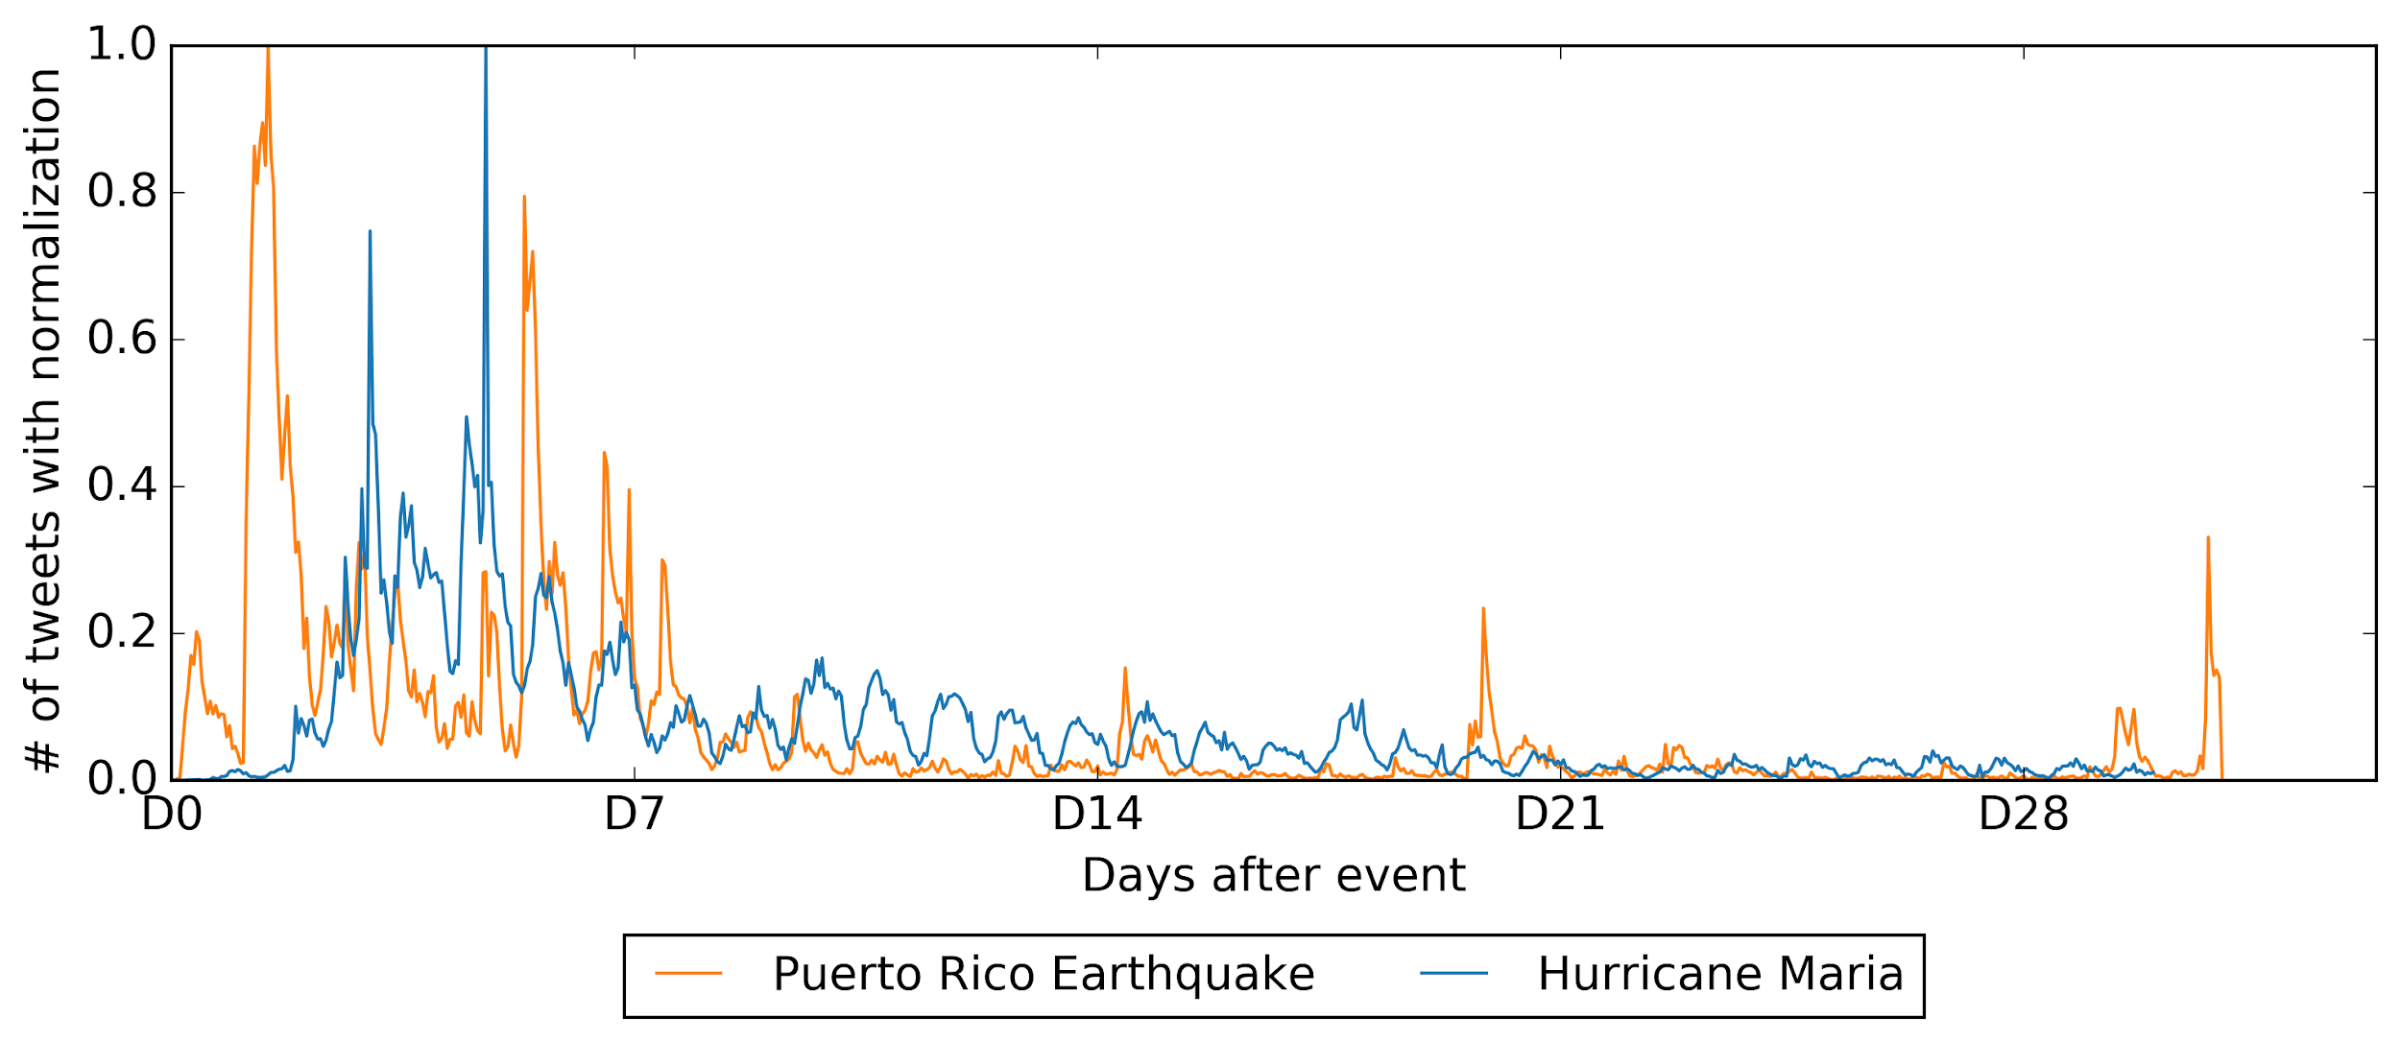
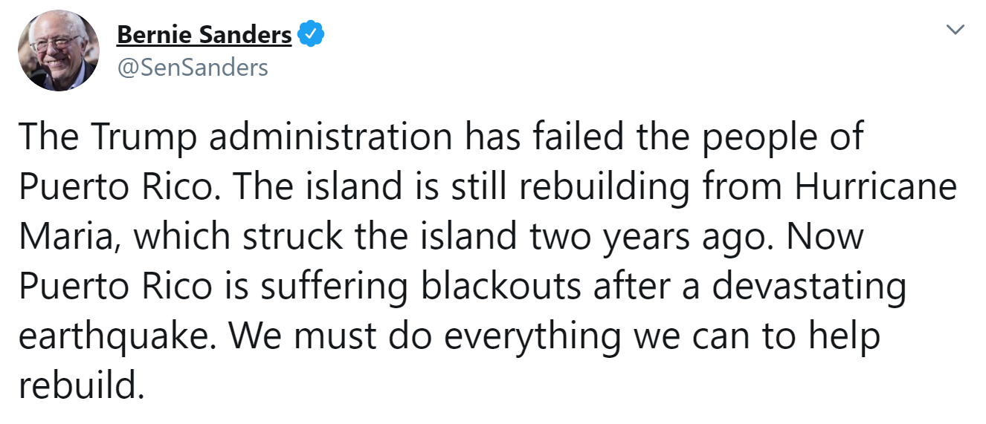

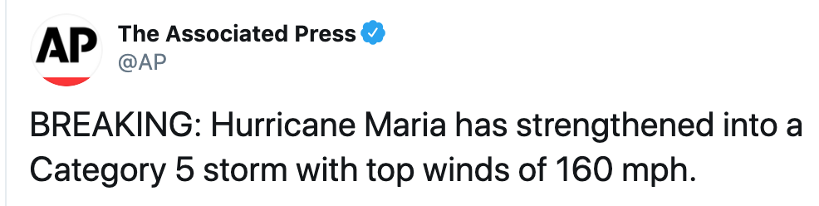
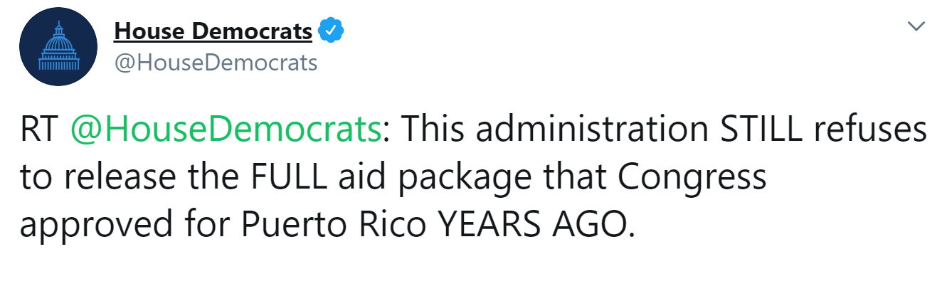
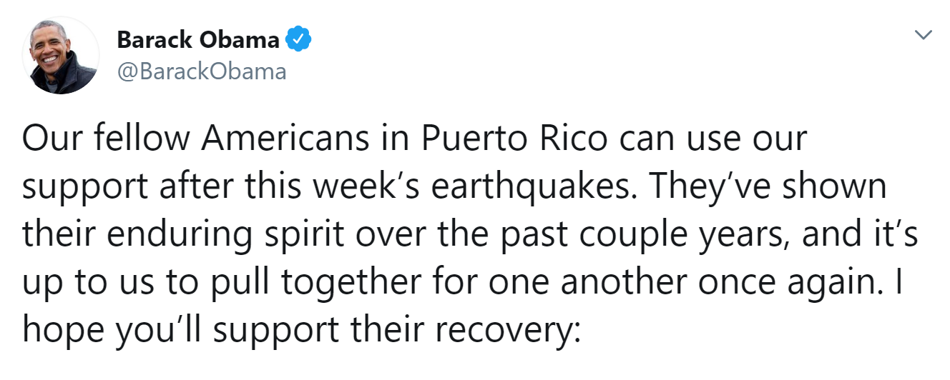
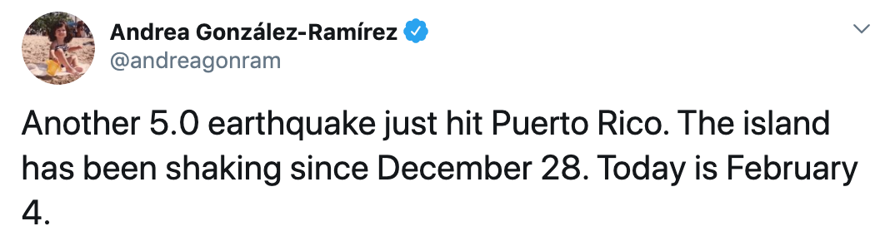
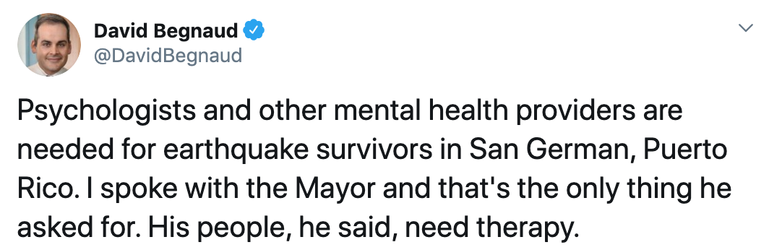
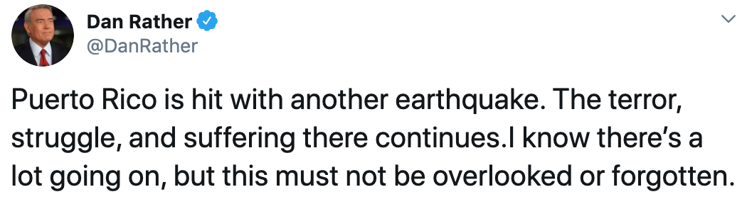

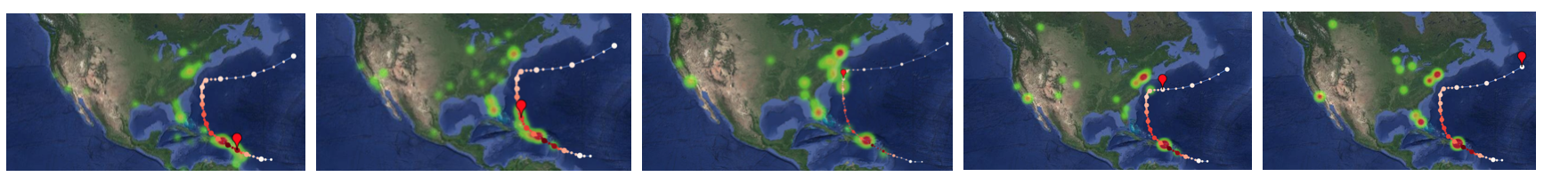
Tweet Comparison for Puerto Rico Earthquake and Hurricane Maria
Frequency of Topics in Earthquake Tweets
Frequency of Topics in Hurricane Tweets
Introduction
Since December 2019, Puerto Rico experienced several earthquakes > 5.0 magnitude.
By analyzing over 300,000 tweets, we plan to identify behavioral patterns.
We consider the geotags associated with tweets and key words or topics in tweets.
Similar analysis is run on tweets from Hurricane Maria to compare the behavioral patterns of tourists and locals of each event.
Data
402,016 Tweets related to Puerto Rico Earthquake between January 7, 2019 and February 6, 2019
317,214 Tweets related to Hurricane Maria between September 15, 2017 and October 14, 2017
Frequency of Topics for the Puerto Rico Earthquakes and Hurricane Maria
Conclusions
Hurricane Maria’s arrival was forecasted, resulting in a larger corpus of tweets about it occuring the days leading up to and during the event.
The earthquakes were not predicted, and sporadic aftershocks meant that sharp spikes of activity started every time there was another earthquake.
The overall decrease in discussion over the time period is likely due to external (mainland US) lack of interest or relevance.
Methods
Collecting Tweets pertaining to disaster topics
Using Python to analyze data using a Tweet parser
Graphing data, such as
  Frequency of Tweets
  Frequency of Topics
Analyzing popular topics mentioned in Tweets
Acknowledgement
Ziqian Song, Austin Spencer, Taylor Thackaberry, Kayley Bogemann, Shane Burchard, Jessie Butler, Liuqing Li, Kris Wernstedt, Pamela Murray-Tuite, Edward A. Fox (2020). A comparison of people’s use of Twitter in Puerto Rico Earthquake and Hurricane Maria. Poster, with abstract in Proceedings International Conference on Information Systems for Crisis Response and Management (ISCRAM 2020), May 2020, to be published in 2020 and presented in May 2021 at ISCRAM 2021. Blacksburg, VA.
NSF CMMI-1638207 CRISP: Collaborative Research:
Coordinated, Behaviorally-Aware Recovery for Transportation and
Power Disruptions
The above maps illustrate Hurricane Maria’s path compared to a heatmap of Twitter activity

