Slide 1
Tweet Collections
Multimedia, Hypertext, and Information Access
Dr. Fox
Virginia Tech, Blacksburg, VA 24061
4/26/18
By: Brandon Chang, Kirk Chenault, Chris Keener, Joseph Widrig

Slide 2
Outline
Overview
Testing
Assessment
Deliverables
Accomplishments
Lessons Learned
Ideas for the Future
Acknowledgements/References

Slide 3




Overview
1
2
3
4
https://en.wikipedia.org/wiki/twitter
https://en.wikipedia.org/wiki/Microsoft_Excel
https://en.wikipedia.org/wiki/
https://en.wikipedia.org/wiki/python
Notes:
Problem:
Mostly empty spreadsheet of tweet collections with trending keyword and date.
Goals:
Fill in the empty cells of metadata using various web sources.
Execution:
Using python to fetch, filter, and fill a newly created spreadsheet for delivery.

Slide 4
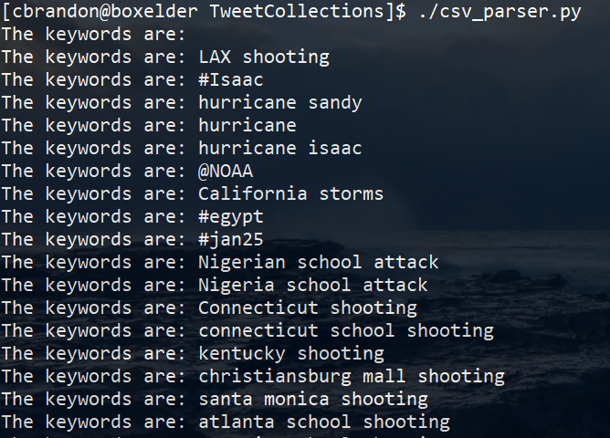
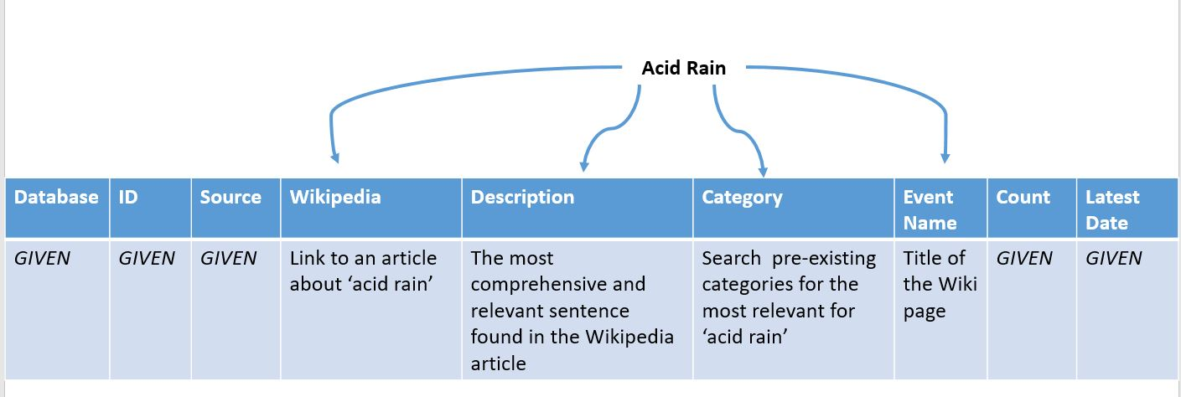
Overview Further Details
Tweet collections may be vaguely named
CSV contains these names
We must assign meaning/more data

Slide 5
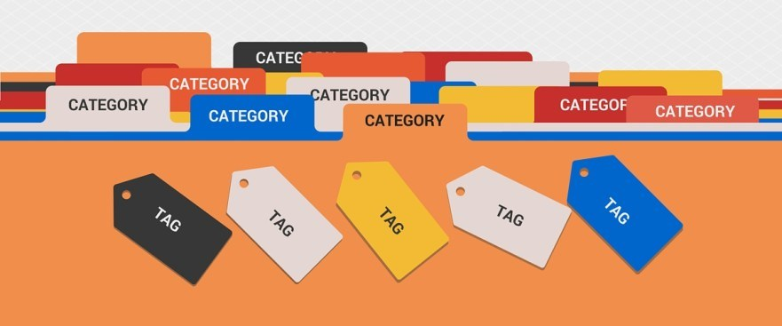
Testing
Manual review of output from program
Noticed a need for more categories
Developing methods for category suggestion
Could always make more categories
https://i0.wp.com/criticalphysio.net/wp-content/uploads/2017/07/Categories.jpg?resize=881%2C367&ssl=1

Slide 6
Assessment
>> Header comments
>> Meaningful variable names
Make current design developer friendly
Redesign code into a modular format
Flesh out documentation
>> Encapsulation
>> Easily editable
>> For future developers ease of use

Slide 7


Deliverables
Developer friendly script
Documentation
Excel Spreadsheet
Python
http://www.biotech.com/wp-content/uploads/2014/05/psc-biotech_icon_documentation.png
Notes:
Basically fix up the code as well as document

Slide 8


Ideas for the Future
Modify search terms to improve results
Automatically create categories when criteria are met
More advanced metric to measure automated success
https://cdn.pixabay.com/photo/2017/01/13/01/22/magnifying-glass-1976105_960_720.png
https://i0.wp.com/criticalphysio.net/wp-content/uploads/2017/07/Categories.jpg?resize=881%2C367&ssl=1

Slide 9


Lessons Learned
Automation
Automate testing whenever possible
Better to stick to one heuristic and improve it
Frequently interact with client for an agile development process
http://surgicalalternative.com/wp-content/uploads/2014/03/comm.jpg

Slide 10
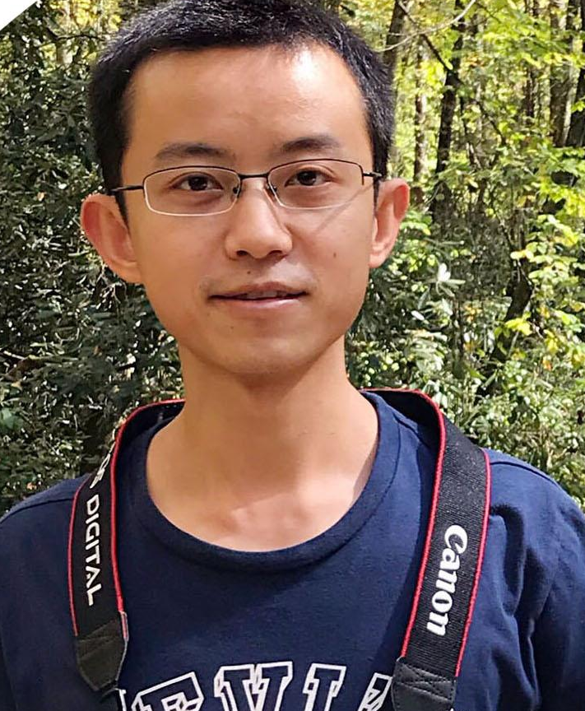
Acknowledgements & References
Client: Liuqing Li: liuqing@vt.edu Ziqian Song: ziqian@vt.edu
Images: https://upload.wikimedia.org/wikipedia/commons/thumb/b/b3/Wikipedia-logo-v2-en.svg/1200px-Wikipedia-logo-v2-en.svg.png
https://itunes.apple.com/us/app/microsoft-excel/id586683407?mt=8
GETAR: Thanks go to NSF for support by grant IIS-1619028
GETAR: http://www.ctrnet.net/

