Slide 1
Not Just Going
Through the Motions: Pragmatic Parliamentary Procedure
Chad N. Proudfoot
4-H Extension Specialist
Virginia Cooperative Extension; Virginia Tech
CNProudfoot@vt.edu

Slide 2
Where will we go today?
Overview of Parliamentary Procedure
Using Robert’s Rules of Order, Newly Revised
Fundamentals: Motions, Debate, Quorum, Voting
Concepts of Effective Meetings
Basics of Motions & Debate
Beyond the Basics: Amendments, Tabling, & Complex Motions

Slide 3
Icebreaker Activity
List one meeting pet peeve and one topic you’d like to learn more about.

Slide 4
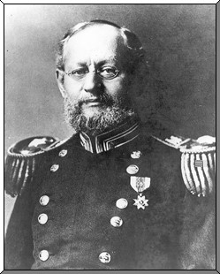
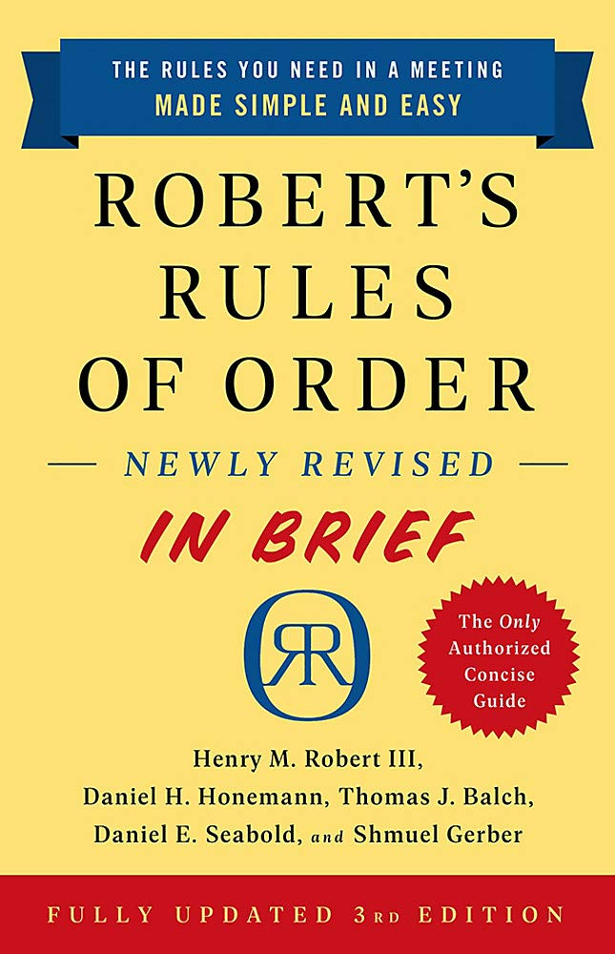
Who is Robert and why does he care about my meeting?
First published in 1876 by Henry M. Robert
  Brigadier General, United States Army; Chief of Engineers
Guide for meetings in non-legislative organizations
How to conduct meetings and run the business of an organization
Most commonly used parliamentary authority in the United States
Currently RONR Newly Revised 12th Edition
  At least 80% needed less than 20% of the time
Newest revision released September 1, 2020
  RONR In Brief (3rd Edition)
  eBook

Slide 5
Fundamentals of Parliamentary Law
Why do we need rules for meetings?
All members have rights, and there are rules for:
The majority
The minority (especially that greater than 1/3)
Individual members
Absentees
All of these together

Slide 6
Fundamentals of Parliamentary Law
Motion: A formal proposal, in a meeting, that the organization take a certain action.
Debate: Any form of discussion on the merits of a motion. A member must “be recognized” to keep debate orderly.
Quorum: The number of members who must be present in order that business can take place.
Voting:
  Majority Vote: More than half the votes cast by persons entitled to vote, excluding abstentions
  Two-Thirds Vote: Used for altering the rights of members or governing documents

Slide 7

Robert’s Rules Scavenger Hunt
Find these in the book…
What is the standard order of business for a meeting?
What are ways that a group can postpone action on a motion?
What is The “Settled” Rule?
Where can you find information about amending an amendment?
Find at least two motions that are not debatable.
What are the five rules for debate?
What are the three types of “number of votes required” in the book?
How do you handle abstentions?
What are the “ranking order of rules?”
What are the assigned duties of a vice-president?

Slide 8
Running an Effective Meeting
(handouts from Jim Slaughter, PRP)
Agenda
Standard order of business
Common errors
Minutes
Treasurer’s Report
Role of the Chair
Ensuring fairness
Acting impartially

Slide 9

Activity
Agenda Planning

Slide 10
A Few Tips for Presiding Officers
Try not to be nervous
Most other people aren’t RONR experts either
It’s alright to say “I don’t know”
It’s fine to put the brakes on things
When in doubt, stop and look it up
When really in doubt, do your best
“They’re you’re rules, you can change them”
When mistakes are made – admit it, correct it, and move on

Slide 11
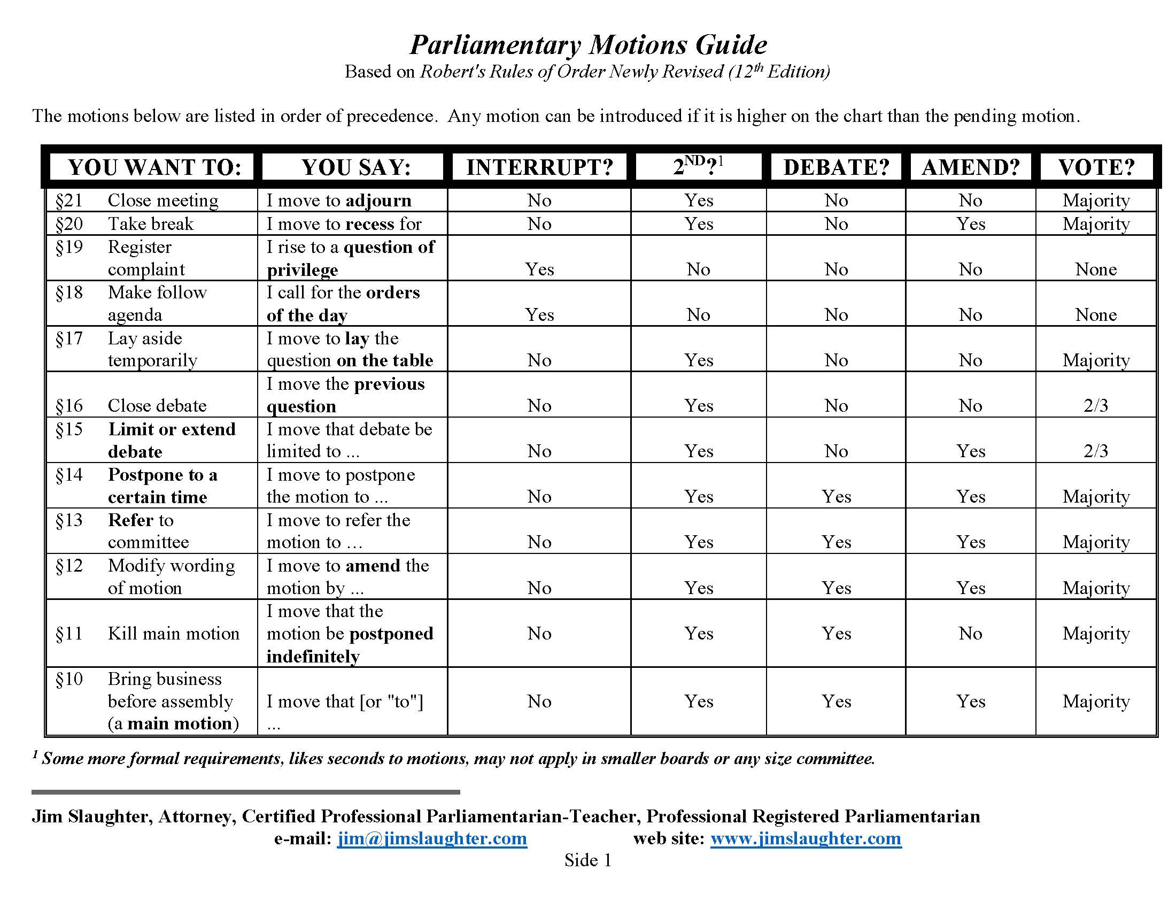

Slide 12
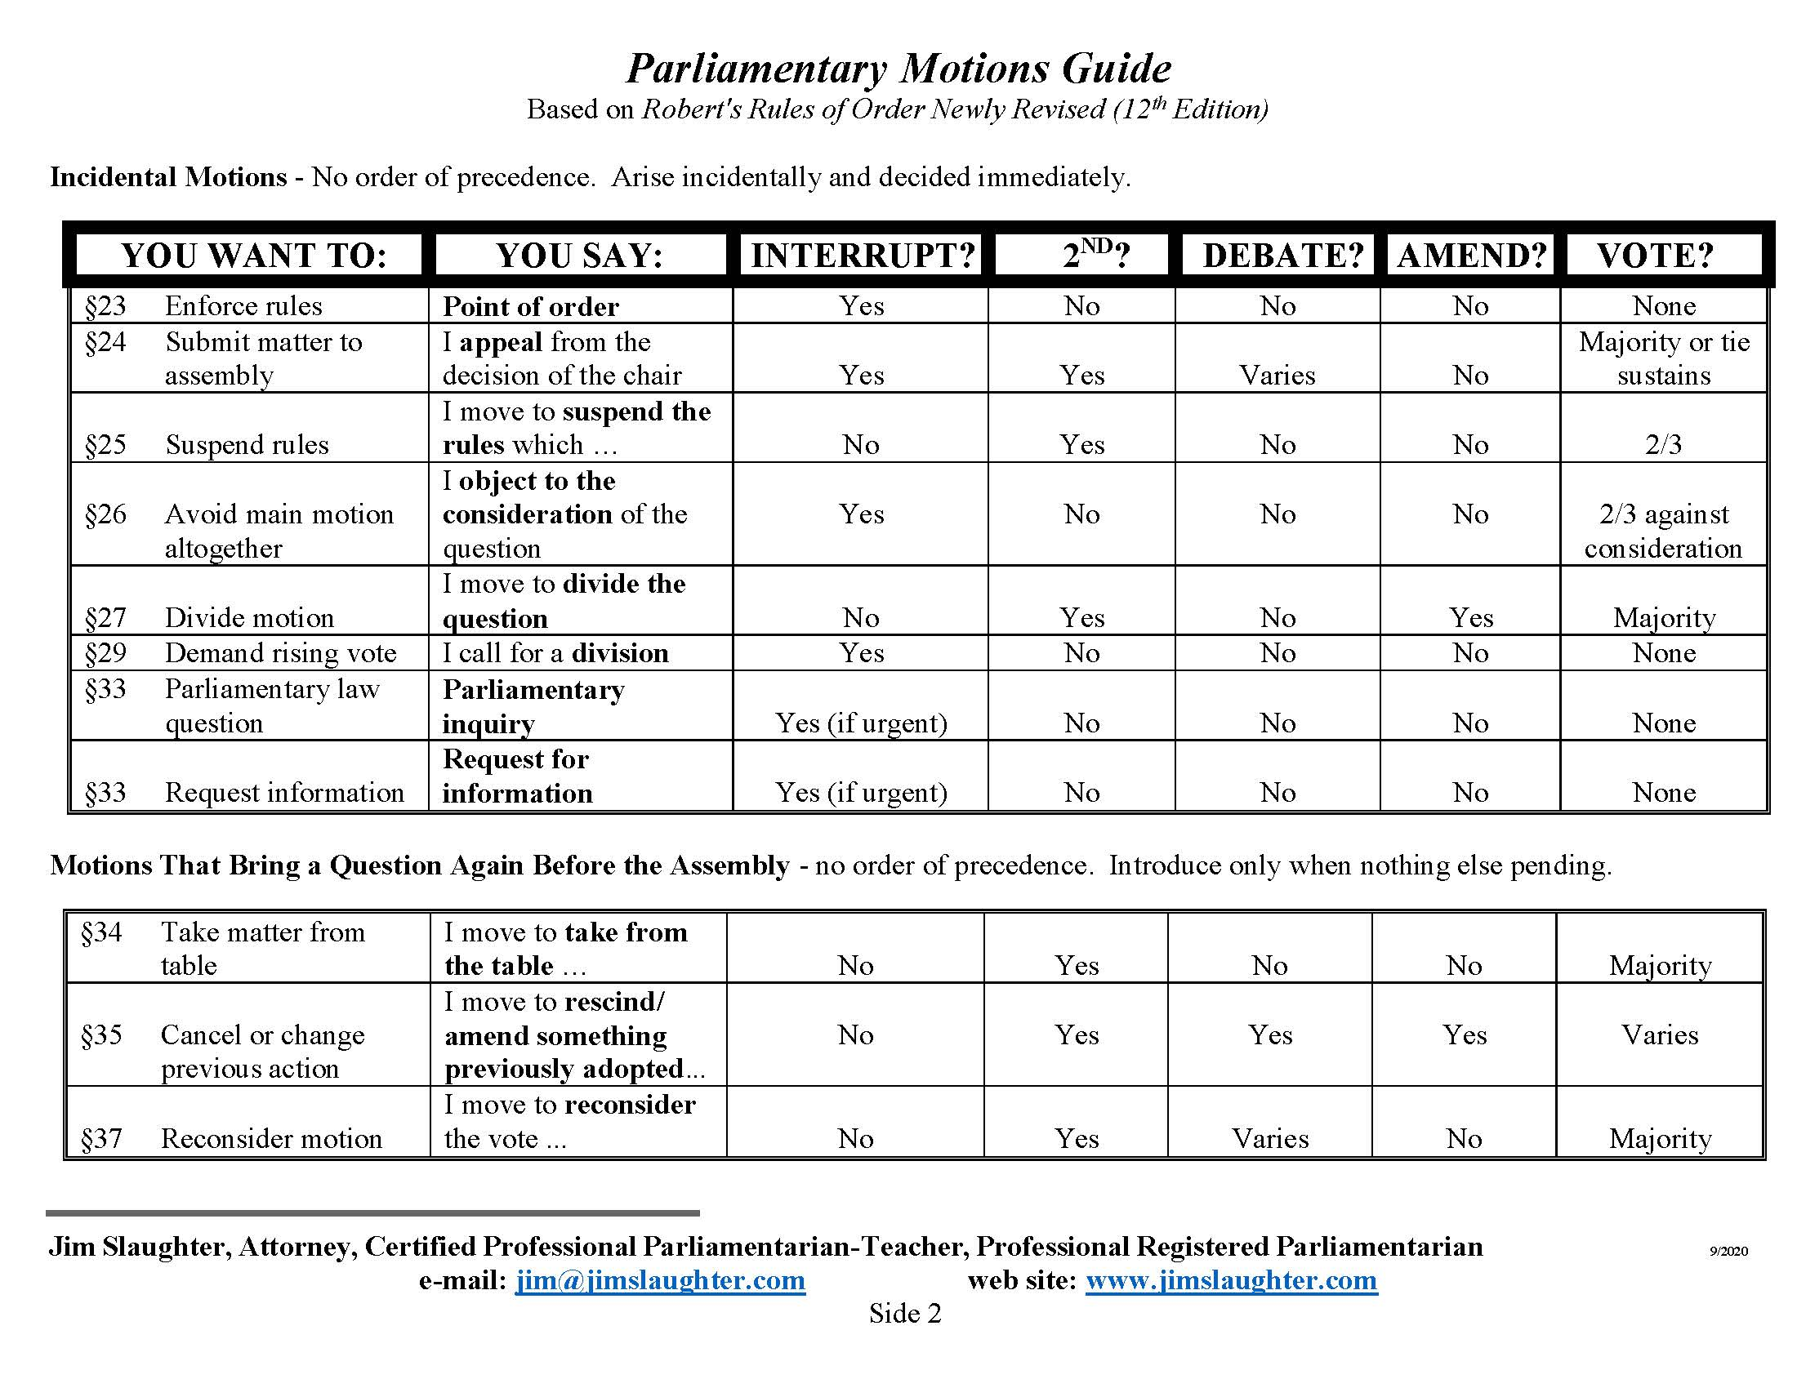

Slide 13
Activity
Motions & Debating

Slide 14
Bored About Boards?
Robert Can Help!
Special Procedure for “Small Boards” (Section 49:21)
Motions need not be seconded*
No limit on speaking
Informal discussion
Unanimous consent

Slide 15
What do we do about virtual meetings?
Create a situation electronically that replicates as much of the face-to-face meeting as possible.
Everyone must be able to hear and speak to one another
Quorum requirements (and any other requirements) still count
Must be able to receive reports and make motions
Must be able to conduct votes
Follow standard agenda
Have a program (if applicable)

Slide 16
Making Zoom Work for Meetings
Designate a “Zoom Master” for each meeting
Monitors participants, chat box, etc.
Advises presiding officer
Helps keep things on task
Should not be the presiding officer or secretary
Possible job for vice-president
Don’t forget about someone on the phone!
Remember to slow down

Slide 17
Beyond the Basics
Amendments to motions
Delaying action
Tabling
Referring to committee
Postponing
Points of Order / Parliamentary Inquiry
Appeals
Disruptions and Disruptive Members

Slide 18
Voting – Regular Methods
Unanimous consent - easy
“Is there any objection to…?”
Voice votes
Presiding officer
Remember to re-state the motion
“Are you ready for the question?”
Remember, never ask for abstentions

Slide 19
Voting – Ballots
Not allowed to not have a ballot vote if the bylaws mandate it
Can not allow one ballot cast for the whole group
Use online ballot through Google Forms, etc.
  Be sure to check settings
  May be able to prepare beforehand
  Designate tellers to review
Possibly use poll feature in Zoom (remember host/co-host lockout)
Share results live with group
Keep record with secretary and in minutes
Accommodations for those on the phone
Take time to ensure fairness

Slide 20
Making Accommodations
Creating a welcoming environment
Changing the setup without changing the rules
Modifying what can be modified
Knowing our audience
  “Warm up” activities
  Seating/Zoom arrangements
  Taking Breaks
“When procedure stands in the way of the mission, it’s time to alter the procedure.”

Slide 21
Activity
Role Play a Meeting

Slide 22

Debrief & Questions

Slide 23
Resources
Robert’s Rules of Order official website
  www.robertsrules.com
Parliamentary Procedure Charts / Handouts
  https://www.jimslaughter.com/charts-handouts
  https://www.parliamentarians.org/

Slide 24

Thank You
for attending!

