Slide 1
Safe-Eating App
Riddhima Deshpande
Jonathan Awad
Aditya Tikhe
Sai Chittela
Anish Madala
Pranav Simha
CS 4624: Multimedia, Hypertext, and Information Access
Professor Fox
Virginia Tech, Blacksburg, VA 24061
12/1/2022

Slide 2
Overview
Quick background
  Problem Background
  Mission Statement
  Deliverable
Overall Timeline Recap
What’s Done
  Meeting with the Client
  Current Application Status
    Setbacks
What’s Next
Plan of Action
  Completed OKRs
Acknowledgements/References

Slide 3
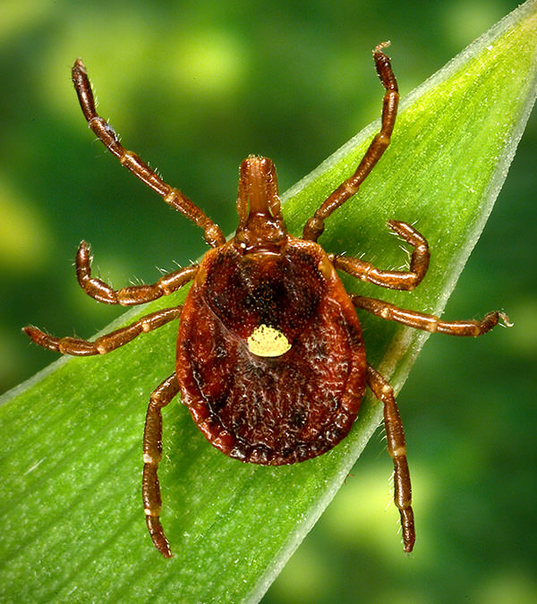
Problem Background
Alpha-Gal Syndrome
  Lone Star Tick Bite
    Carried through tick bites
  Red Meat Allergy
    Consuming red meat
  Life threatening
  Takes about 4-6 weeks to see symptoms

Slide 4

Mission Statement
Our goal is to provide Blacksburg residents the opportunity to have access to the easiest diagnosis of food choices based on their dietary restrictions without having to second guess if what they are consuming is compatible with their body.

Slide 5

Deliverable
Final Deliverable: An App that scans products in grocery stores and gives feedback based on user-entered dietary sensitivities. Multiple users can be added to account for young or old users who cannot properly use technology.
Notes:
This means talking about how it occurs, what restrictions there are, and what could happen if someone with this syndrome consumes something dangerous for them.
An App that scans products in grocery stores and gives RED, YELLOW, or GREEN light based on user-inputted dietary sensitivities. Certain users have severe allergies to certain byproducts while some users have no sensitivity to the same byproducts. Multiple users can be added to account for young and old users that cannot properly use technology.

Slide 6

Overall Timeline
9/9/2022: First meeting with client
  Final deliverable idea finalized
10/7/2022: First iteration of Figma deliverable done to present to client
10/12/2022: Second meeting with client
  Figma Demonstration, getting feedback from client
10/13/2022: Google Form published for possible ideas in implementation
11/4/2022: First iteration of SafeEats Application done to show client
  Implementation of feedback
  Sharing application with friends to get additional feedback
11/7/2022: Third meeting with client
  Walkthrough of application
11/29/2022: Final version of application done
12/5/2022: Final demonstration of application to clients

Slide 7
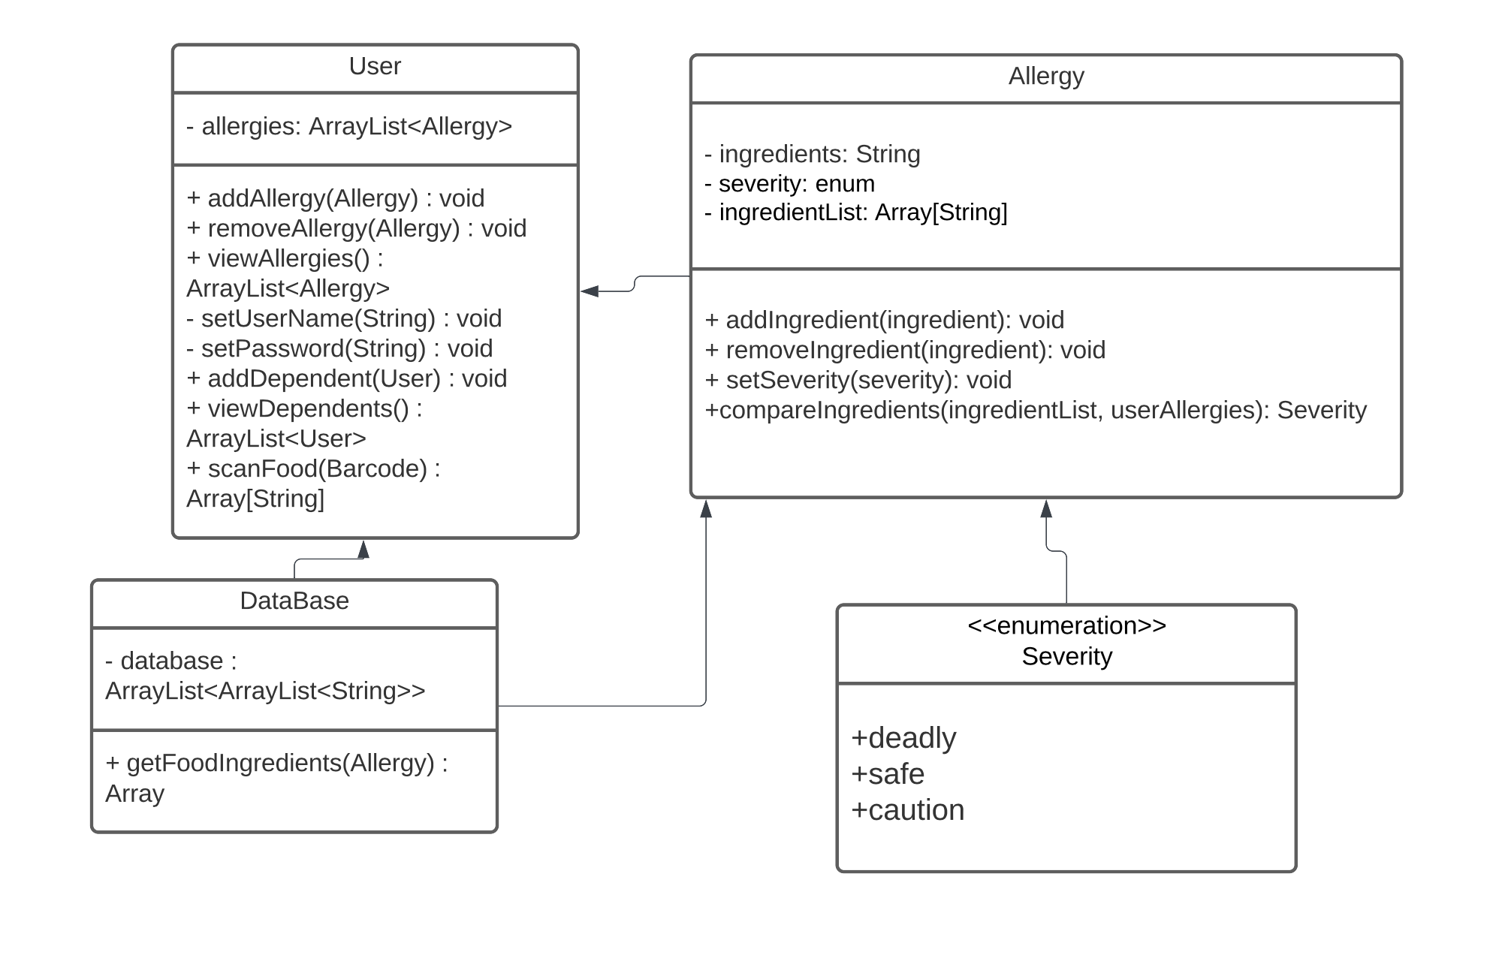
What’s Done: Back-End UML Diagram

Slide 8
What’s Done: Choose a Database
Can compare scanned food ingredients to ingredients relevant to allergen
Same database throughout project
Why we chose this database
  Open source and collaborative
  Constantly updating with new food that users find and want to add
  Available in many different formats (MongoDB dump, JSONL, and CSV) so we have choices on how we want to access and query this data

Slide 9
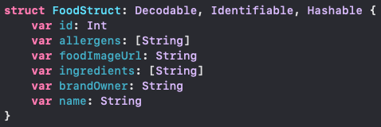
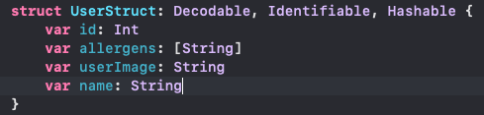
Implementation Simplified
Get the product name from the barcode user took a picture of
Parse the database for the specific food item
Retrieve the JSON object associated with the food containing all of its ingredients
Compare the ingredients to the list of user allergies
Decide whether the scanned food is safe for the user

Slide 10
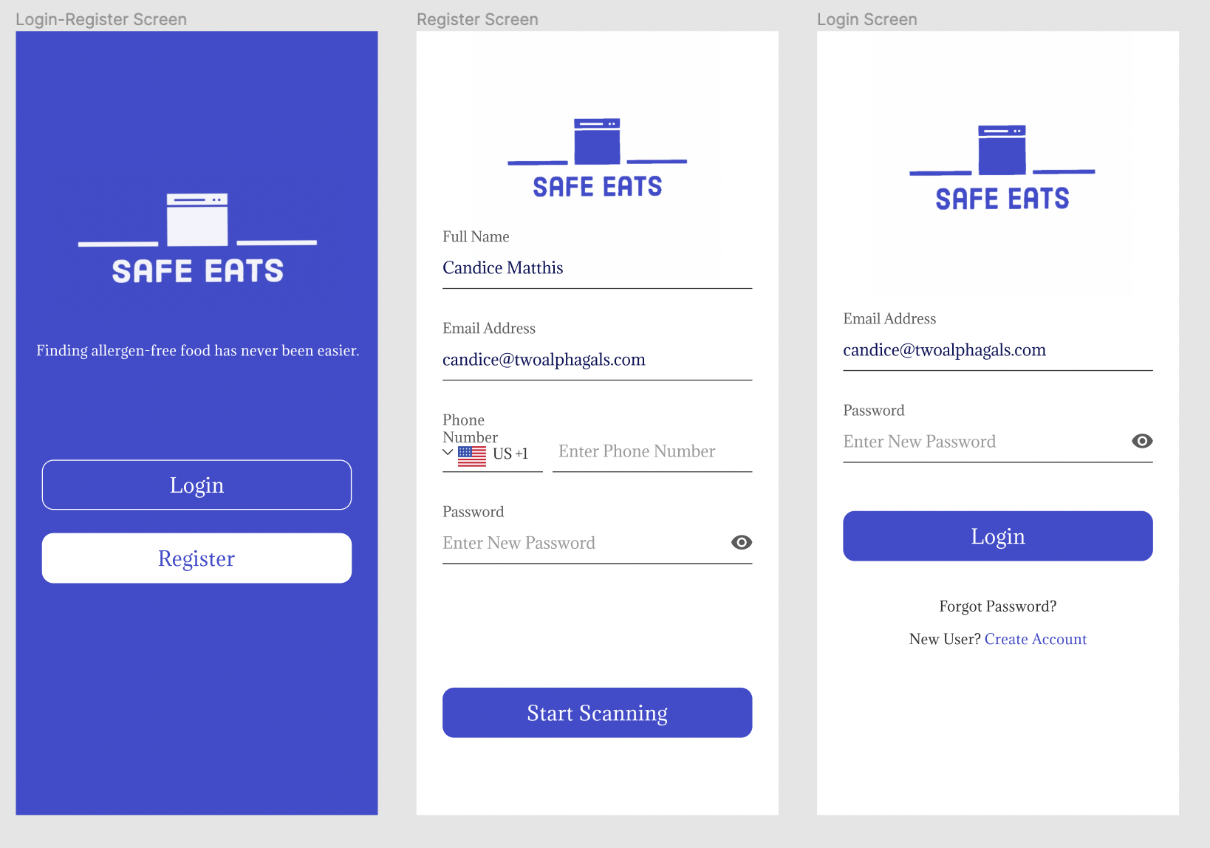
What’s Done: Current Application Status

Slide 11
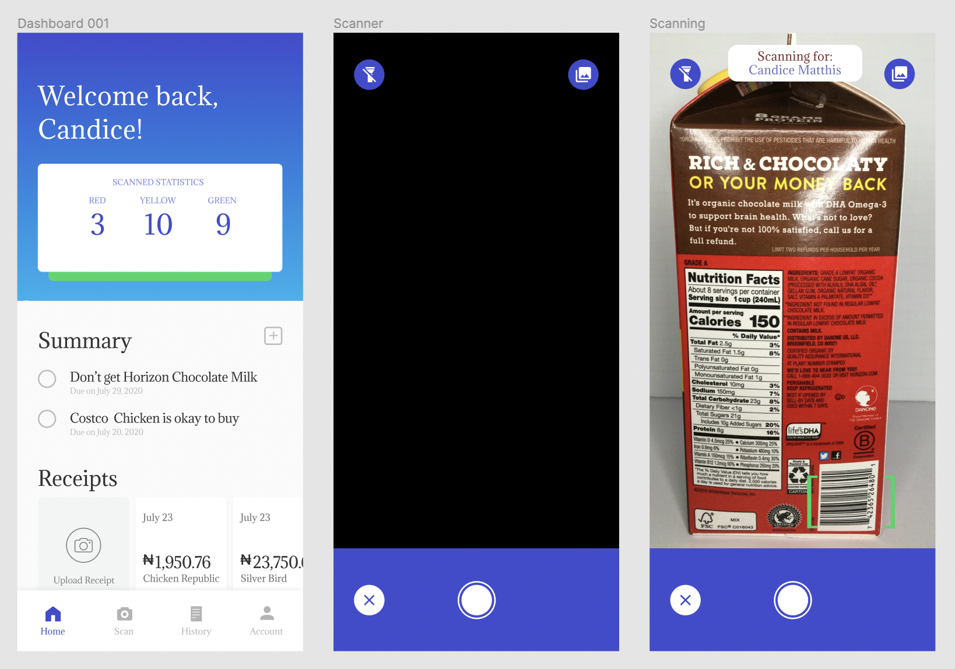
What’s Done: Current Application Status

Slide 12
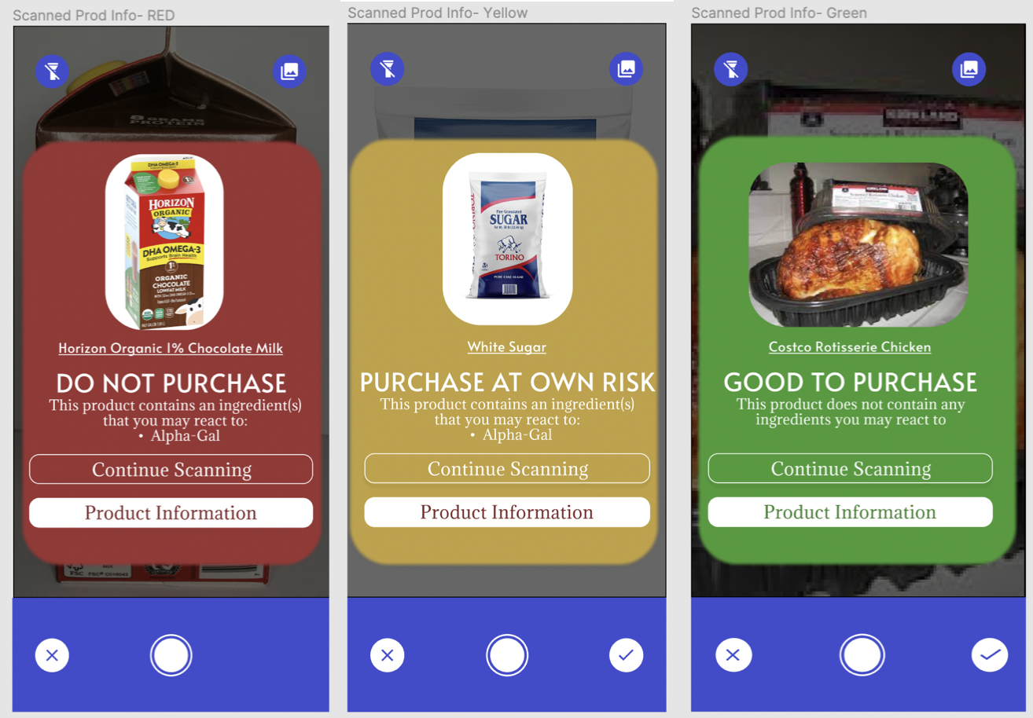
What’s Done: Current Application Status

Slide 13
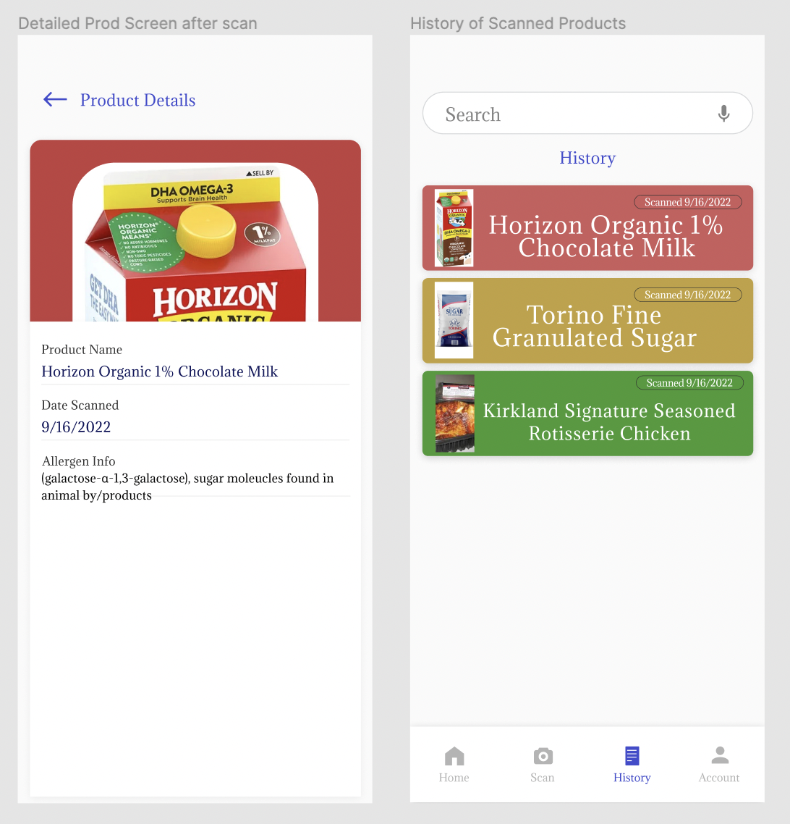
What’s Done: Current Application Status

Slide 14
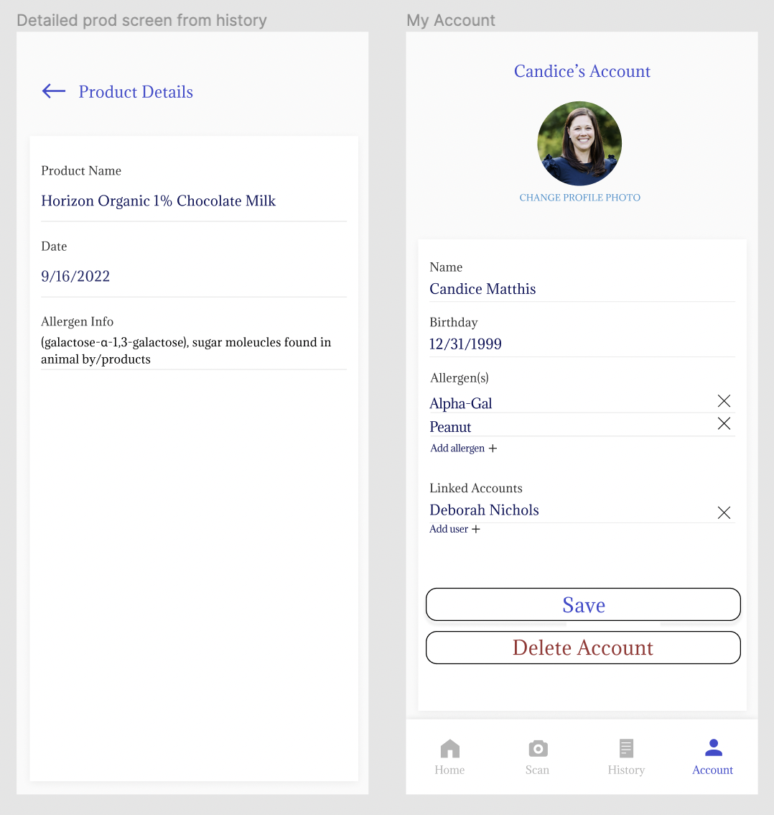
What’s Done: Current Application Status

Slide 15
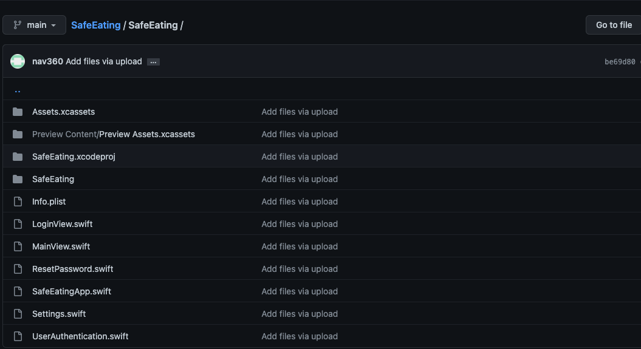
Testing
Sent app files to friends’ computers if they have a Mac
Can download app to their phone and begin scanning
Not all users had allergies so had them include things they wanted to avoid, like gluten.

Slide 16
Testing Results
App worked as expected with users being able to scan products in their house and compare to their list of allergens

Slide 17
User Feedback
Users also wanted ability to share recipes along with common allergens in them
UI was easy to understand
Function to remember previously scanned items was helpful

Slide 18
What’s Next
Incorporate another database that allows for food from restaurants as well.
Licensing for the app to deploy
Final app demo to clients, Alpha-Gals
  Finding any more features they want that we could hand off to next group handling this project.

Slide 19
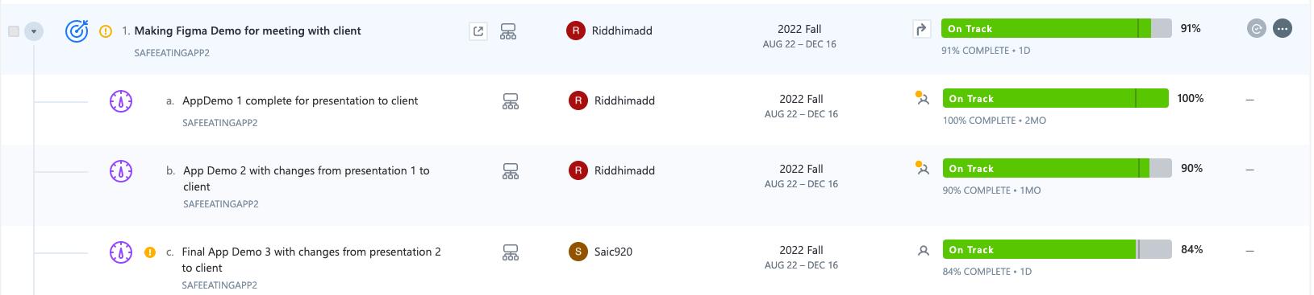
Plan of Action: OKRs

Slide 20
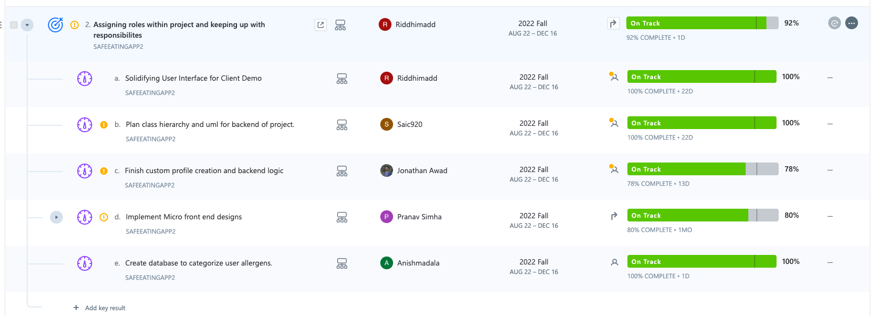
Plan of Action: OKRs

Slide 21
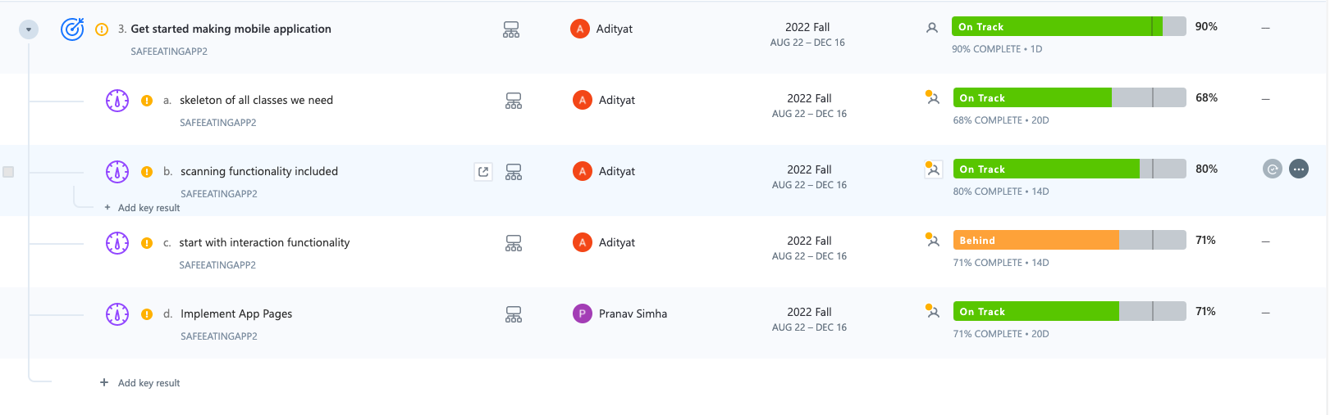
Plan of Action: OKRs

Slide 22
Setbacks
Tried to deploy app through VT with the help of Dr. Balci.
  Was unable to help us because not enough of us in our group took his mobile app development class.
  Recommended us to pay the fee to make it available in App Store.

Slide 23
Acknowledgements/References
Acknowledgements:
Professor Fox
Debbie Nichols, Candice Matthis, Bennett
References:
Database with Common Allergens: https://www.cdc.gov/ticks/alpha-gal/products.html
Alpha-gal Information: https://alphagalinformation.org/
Client Website: https://www.twoalphagals.com/
CDC Alpha-Gals Syndrome: https://www.cdc.gov/ticks/alpha-gal/index.html
Figma: https://www.figma.com/
Previous Project: http://hdl.handle.net/10919/110054
Allergen Information: Allergy Facts | AAFA.org
Database with ingredients and allergen information: https://world.openfoodfacts.org/data

