Slide 1


Slide 2
Midterm Presentation Status: Done
Functional Player
  Search
  Playlists
Rebuilt Signup Procedure
Shared Player
Social Integration

Slide 3
Midterm Presentation Status: To Do
Social Data Aggregation
  Music listen actions
  Continuous Indexing
  Data Storage
Social Stream UI

Slide 4
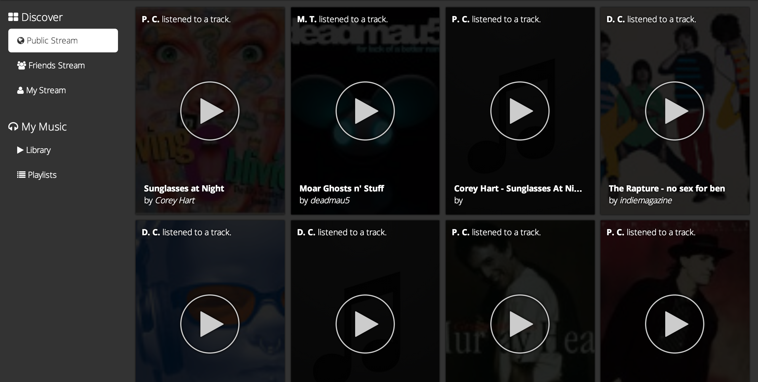
Friends Stream
Global Stream of Music Listen Activity

Slide 5
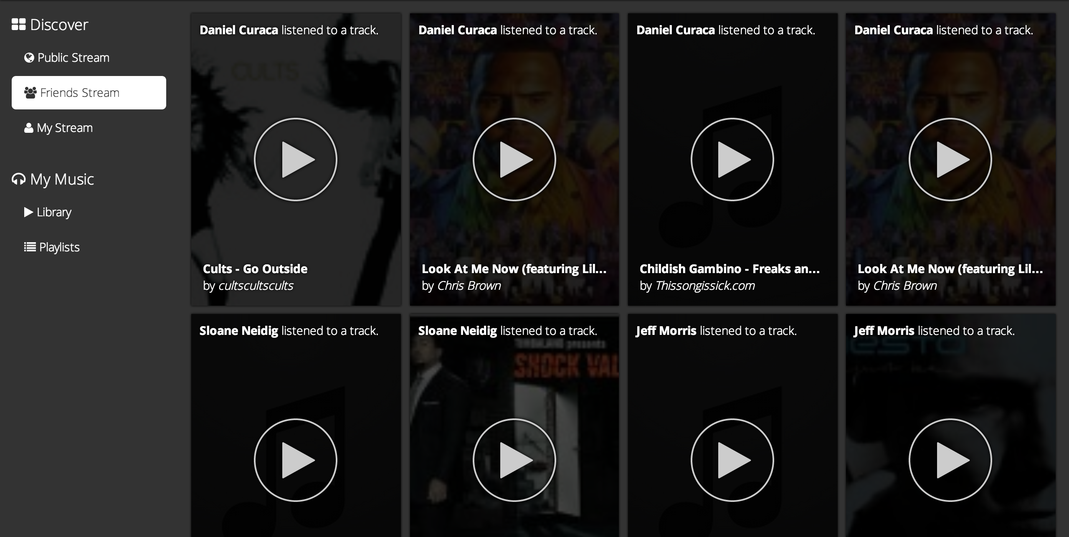
Public Stream
See what your friends are listening to…

Slide 6
Social Data Aggregation
Uses Facebook Music.Listens API
Content from
  Spotify
  Pandora
  MOG
  Myspace

Slide 7
Users Reached & Indexed

Slide 8
Individual Tracks Indexed

Slide 9
Music Listens Actions Indexed

Slide 10
Next Steps
TrackPunch Mobile
  HTML5 mobile webapp
Improving Data Aggregation
  Batch Writes
  Cache Pages for Public & Friend Streams
    Redis
New Discovery Features
  Discography

