Slide 1
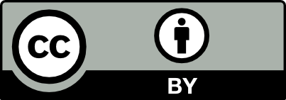
Scholarly Communication and Open Access
GRAD 5204, April 14, 2020
Gail McMillan

Slide 2
Scholarly communication is
Discovery
Preservation
Creation
Dissemination
Evaluation
Notes:
It’s about the information life cycle
What we’re talking about today and maybe all semester:
Discovery: research
Open Access, Creative Commons
Create
Copyright, fair use
Evaluate: peer review, quality control
Blind and open, (preprint) repositories
Disseminate: publish
Journals, monographs,
Preserve
Standard, open formats (PDF not MSWord)
And because it’s preserved, it’s discoverable and accessible—and the cycle begins again

Slide 3
Open Access is
Open Access literature is digital, online, free of charge, and free of most copyright and licensing restrictions.
Gold OA: immediate public access at time of publication
Green OA: self-archiving [publisher/journal policies], sometimes temporary embargoes
Bronze OA: No APC--publisher good will, but will it endure?
Platinum/Diamond OA: No APC—library/university press funded journals
Notes:
OA is different things to different people, but broadly speaking it means public access.
A formal definition “literature that is ….
What makes it possible is the internet and the consent of the author or copyright-holder.
(“A Very Brief Introduction to Open Access” by Peter Suber http://legacy.earlham.edu/~peters/fos/brief.htm)
How is Gold OA paid for? Coming: business models

Slide 4
Open Access Benefits
Increasing visibility of research (Wang et al., 2015)
Increasing citations counts (Gargouri et al., 2010)
Helps build research capacity in developing countries (Chan, Kirsop & Arunachalam, 2005)
Decreases financial pressure on academic and research libraries (McGuigan & Russell, 2008)
Increases funders’ impacts--higher return on investment (Tennant et al., 2016), reaching beyond academia to industry and the public
Reduces duplicative efforts
Notes:
For students OA means being able to access scholarly literature online without paying fees to read an article.
For alumni OA means not losing access to online, scholarly literature once you've graduated.
For authors OA means opting to remove barriers that inhibit scholarly communication (i.e., Creative Commons licenses), and wrestling with costs and uncertainties that come with using newer business models.
For the world OA means barrier-free access to information leading to research collaborations that promote discoveries.
From Strasser C, Khare E. (2017) Estimated effects of implementing an open access policy for grantees at a private foundation. PeerJ 5:e3853 https://doi.org/10.7717/peerj.3853
Wang X, Liu C, Mao W, Fang Z. 2015. The open access advantage considering citation, article usage and social media attention. Scientometrics 103(2):555-564
Gargouri Y, Hajjem C, Larivière V, Gingras Y, Carr L, Brody T, Harnad S. 2010. Self-Selected or mandated, open access increases citation impact for higher quality research. PLOS ONE 5(10):e13636
Chan L, Kirsop B, Arunachalam S. 2005. Open access archiving: the fast track to building research capacity in developing countries. Science and Development Network Epub ahead of print Feb 11 2005
McGuigan G, Russell RD. 2008. The business of academic publishing. Electronic Journal of Academic and Special Librarianship 9(3):mcguigan_g01
Tennant JP, Waldner F, Jacques DC, Masuzzo P, Collister LB, Hartgerink C. 2016. The academic, economic and societal impacts of open access: an evidence-based review. F1000Research 5 Article 632

Slide 5
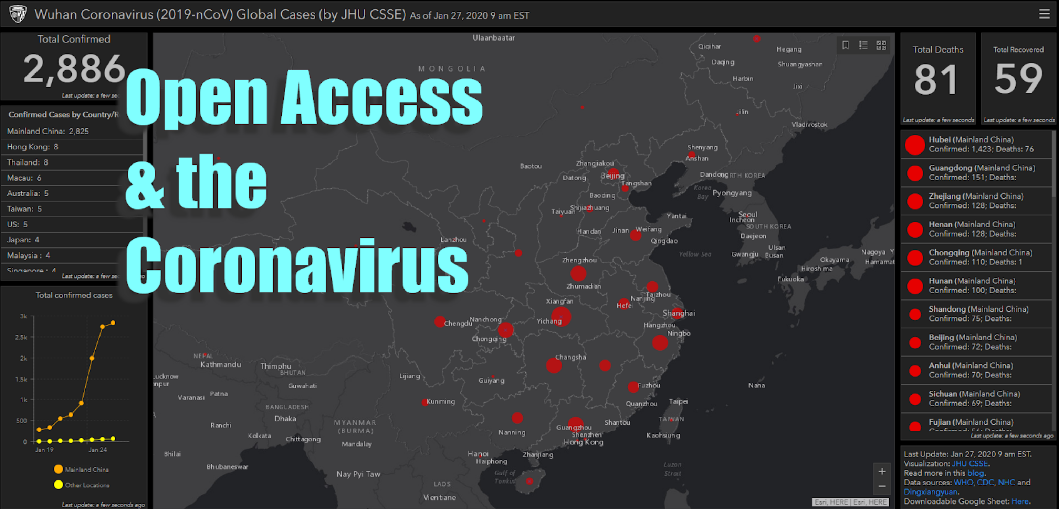
WHO) learns of Wuhan's string of pneumonia-like cases
https://armacostlibrary.blogspot.com/2020/01/oa-coronavirus.html
Notes:
Just 3 weeks
Dec. 31, 2019: WHO learns of Wuhan's string of pneumonia-like cases
Jan. 10, 2020: Researchers in China release the genomic sequence of the Wuhan coronavirus to GenBank, an OA repository and DB from NIH.
Jan. 11: Andrew Mesecar, biology professor at Purdue, redirects his lab to analyze the DNA sequence; scientists from NIH's Rocky Mountain Laboratories in Montana takes steps to study the sequence in their labs.
January 22: NIH scientists publish a preprint of their analysis in bioRxiv, a preprint OA repository. About twelve hours later, scientists in China confirm that analysis.
Paige Mann, STEM Librarian | Scholarly Communications Librarian, U of Redlands (Calif.)
https://gisanddata.maps.arcgis.com/apps/opsdashboard/index.html#/bda7594740fd40299423467b48e9ecf6 in https://armacostlibrary.blogspot.com/2020/01/oa-coronavirus.html

Slide 6
Funding Open Access
Subscribe to Open
Submission fees
Transformative agreements
APCs: article processing charges
  https://guides.lib.vt.edu/oasf
Notes:
No such thing as a free lunch
New business models
Subscribe to Open converts gated access journals to open access (OA) using existing library relationships and payments. Institutions subscribe in the normal fashion and, assuming that sufficient revenue is collected, the journal is published OA.
Submission fees
Transformative agreements: institutions pay to publish their authors works but all can read; authors retain copyright; transparency
APC at VT 2013 $24,000 21 articles supported (28 requests, 25% not approved)
APC at VT 2020 $140,000 143 articles supported (170 requests, 15% not approved) as of April 13, 2040
Everyone currently at VT is eligible (faculty, students, staff)

Slide 7
Guidelines for VT OASF Support
Author requesting funds in currently at VT
Peer-reviewed article accepted for publication in OA journal (not hybrid journal )
Publisher practices appropriate code of conduct (i.e., transparent: editorial board, fees, licenses, peer review, etc.)
Journal is registered in a directory
Subvention funds are allocated in order requests received
Invoice received by library within 30 days
Notes:
How to qualify for funding: Journal's publisher must be a member of the Open Access Scholarly Publishers Association (OASPA), Committee on Publishing ethics, or comply with OASPA's Code of Conduct.
clear contact info
peer-review
editorial or governing board of recognized experts
clear about fees
markets appropriately
clear copyright license
clear instructions
website has high standards
has a means of reporting misconduct
As of Dec. 31, 2018 we no longer support hybrid OA journals. (In line with international practices and publishers largely double dipping.
So far this FY, OASF funded 83% of requests. Most frequent reason for not funding:
non-qualifying hybrid journals: 84%
other sources of funding: 8%
other: 8% (not immediately OA)

Slide 8
Scholarly Communication
Open Access
    OA Guide
    OA Subvention Fund
    VTechWorks
    Directory of OA Journals
    SHERPA/RoMEO
    ThinkClickSubmit
Virginia Tech Publishing
Useful Tools
  Unpaywall
  OA Button
  ORCiD
Open Educational Resources
    Open Education Guide
    Odyssey
    Open Education Week

Slide 9
Scholarly Communication and Open Access
THANK YOU GRAD 5204
Gail McMillan
Director, Scholarly Communication
Professor, Virginia Tech Libraries
gailmac@vt.edu

