Slide 1
Tracking Theatre/Cinema Production Experience
Keegan Weiler, Austin Sedita, Zachary Sullivan
CS 4624: Multimedia, Hypertext, and information Access
Prof: Edward Fox: Virginia Tech, Blacksburg VA, 24061
Last edit: 5/9/2018

Slide 2
PRESENTATION OUTLINE:
Project Overview
Milestones
Demo
Accomplishments and Impediments
Testing and Assessment
Lessons Learned
Acknowledgements/References

Slide 3
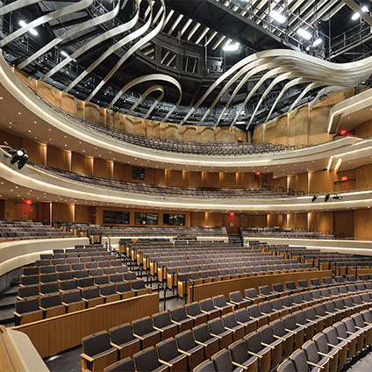
OVERVIEW
Client: Virginia Tech School of Performing Arts
Required by the National Association of Schools of Theatre (NAST) to track student production (plays, film, music, etc) experience
They want a webform and database to gather and store the required information

Slide 4

MILESTONES
Feb 10th
Feb 20th
Apr 1st
Functioning prototype, begin testing, including UX analysis.
Database design and E/R model. Website wireframes and initial draft of forms
Prototype web page/forms. Working database with base functionality
Apr 12th
April 20th
May 2nd
Fully functioning version (not live on website), extensive user testing, provide documentation and train client in product’s use
Complete version live on website, continued testing and improvement. Client fully capable of using the product.
Deliver the final product to the client.

Slide 5
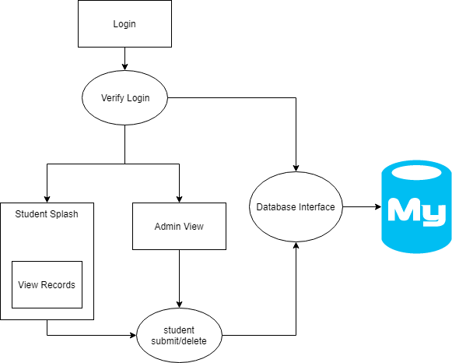
Site Map

Slide 6
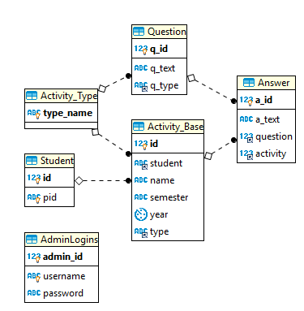
ER Diagram

Slide 7
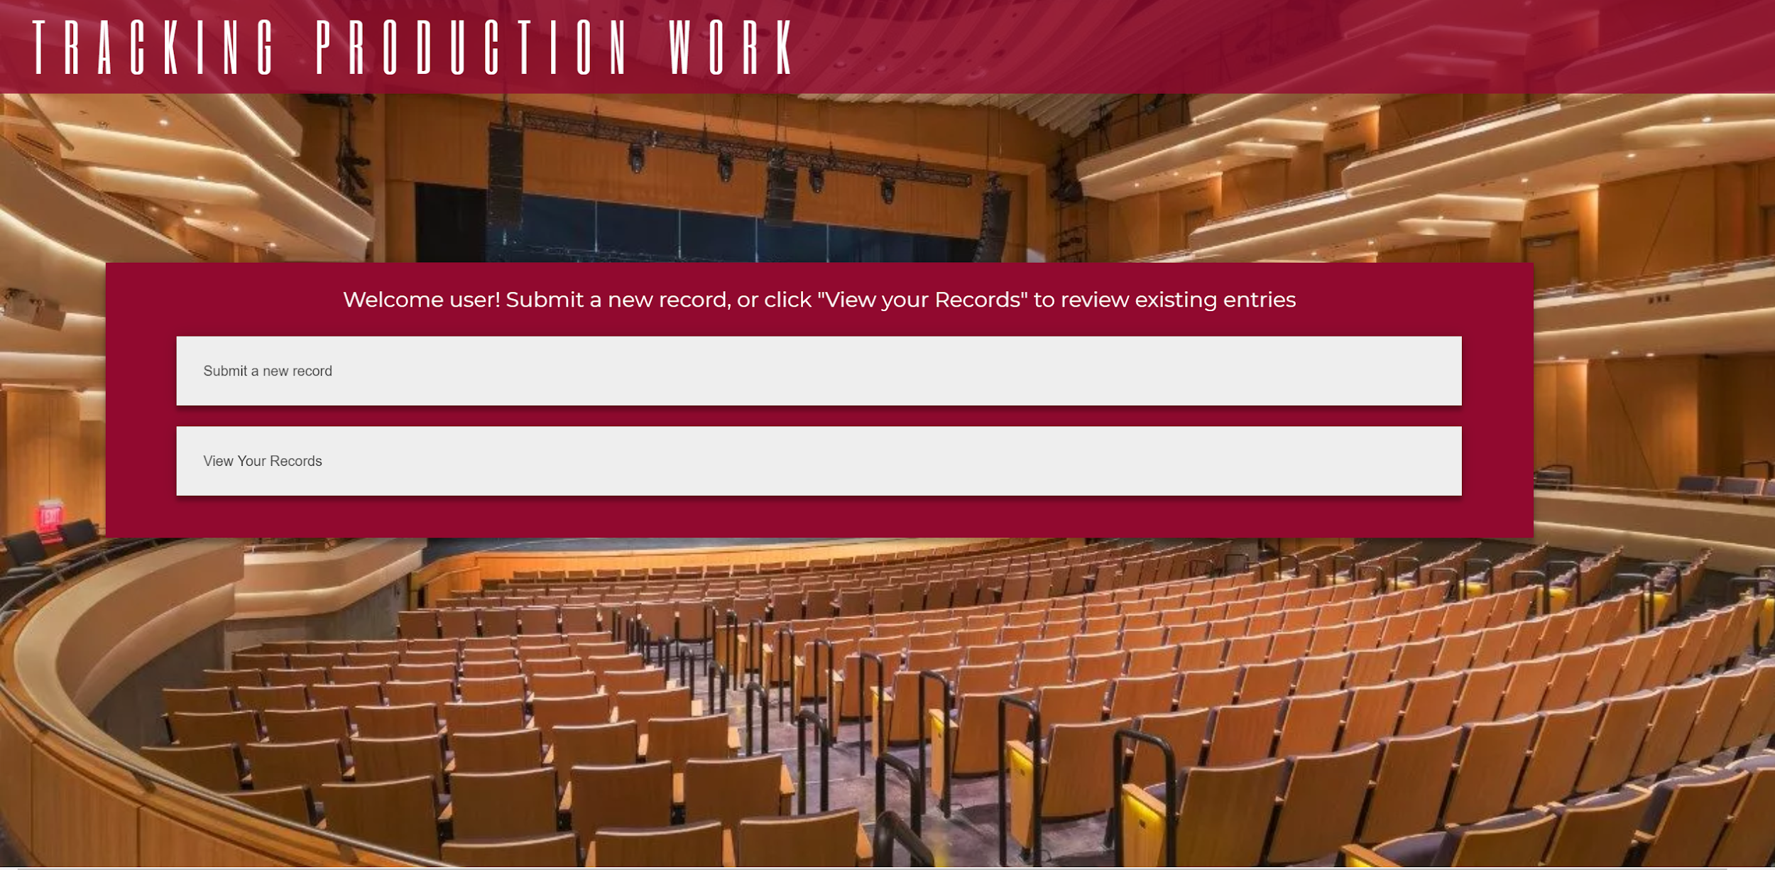
Demo

Slide 8
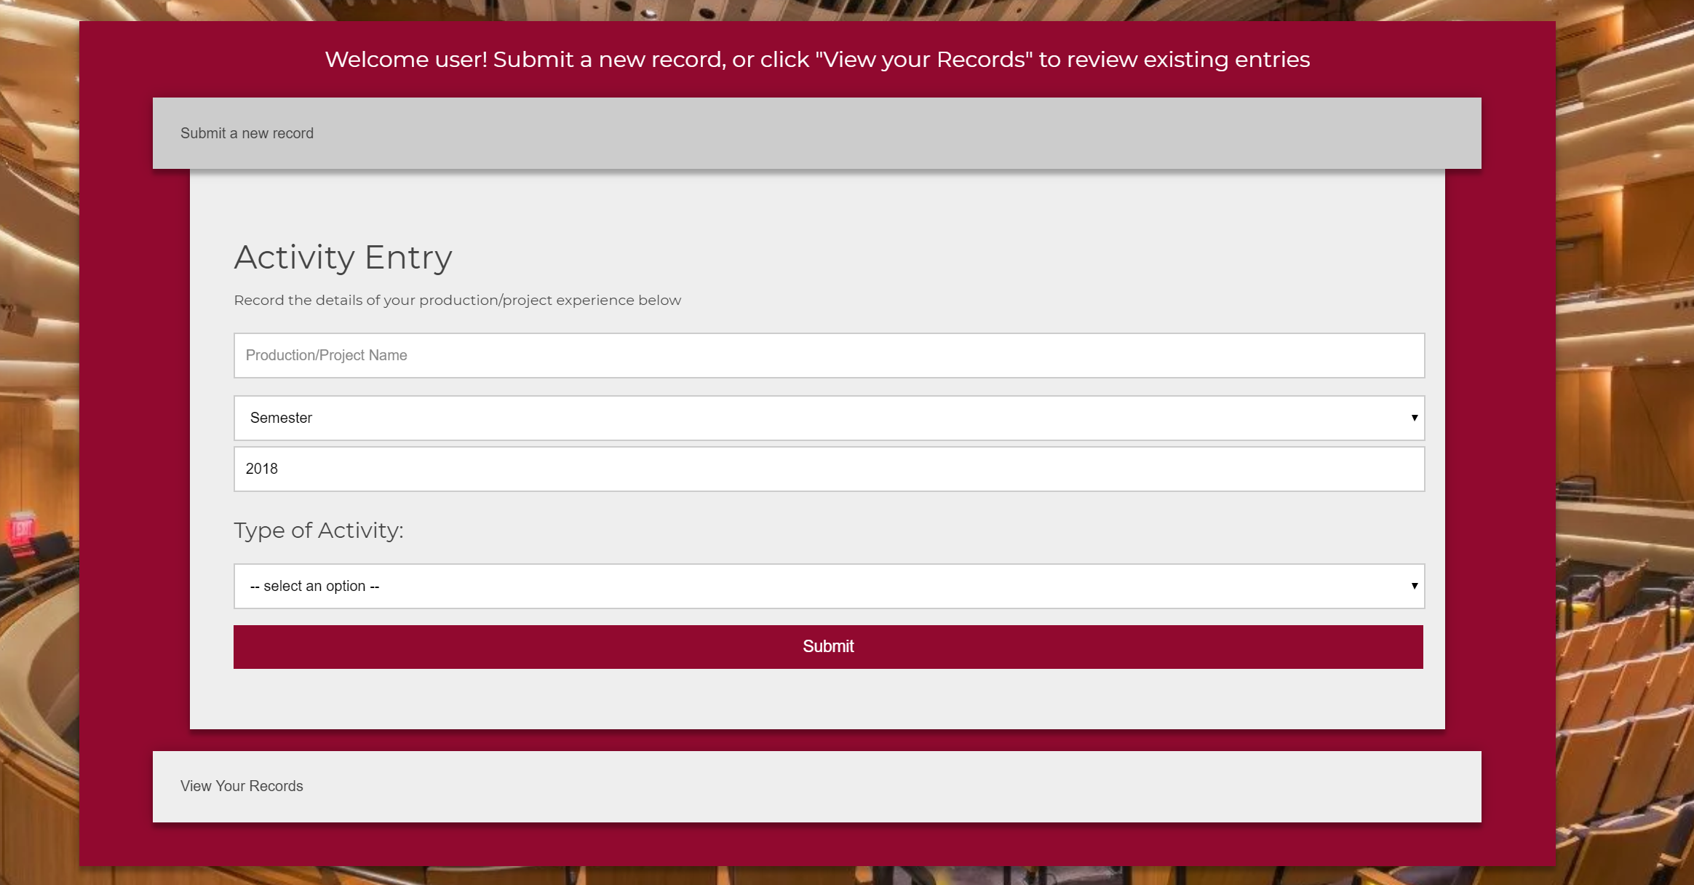
Demo

Slide 9
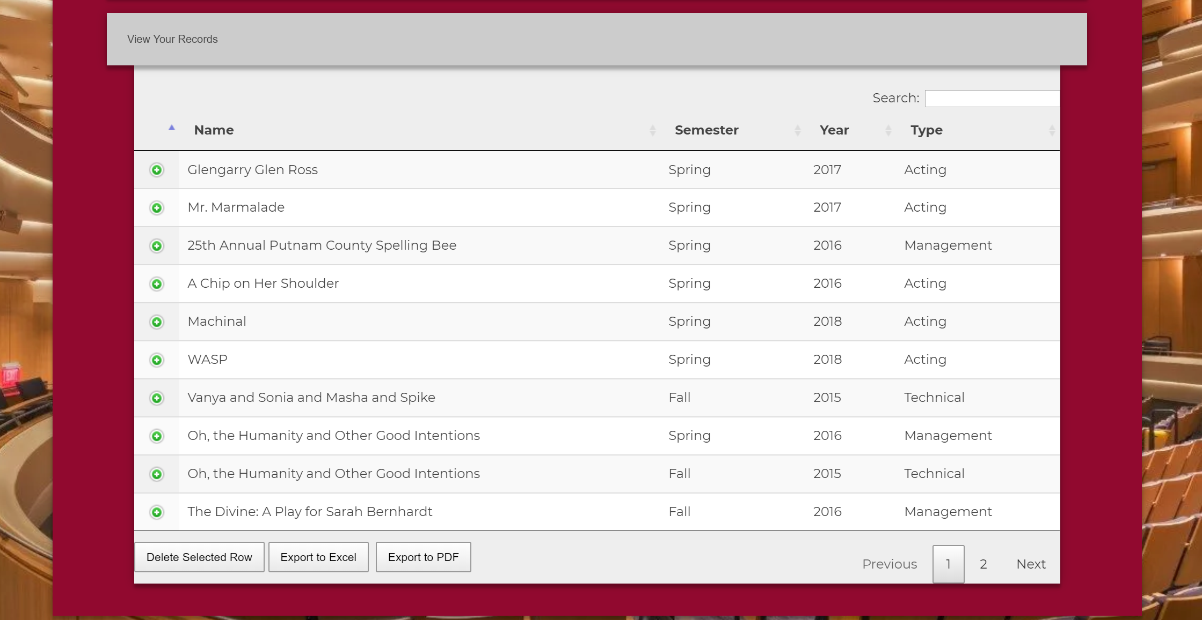
Demo

Slide 10
Accomplishments and Impediments
Goals Accomplished
Working product
Client needs met
Extensive documentation
Impediments Encountered
CAS Integration
Form for database customization

Slide 11

Testing and Assessment
Internal Testing with fake accounts
Empirical Evaluation with given PIDs
They could not find any errors
If we had more time, we could do an Analytic Evaluation

Slide 12

Lessons Learned
The importance of reasonable milestones
Communicating with a client
Database Creation

Slide 13
Acknowledgements/References
Acknowledgements:
Our Thanks to:
Patsy Lavender
Paul Steger
Jane Harrison
Jayden Smith (the guy who made this PowerPoint theme)
References:
Young, Denise. The Moss Arts Center's Anne and Ellen Fife Theatre in the
Street and Davis Performance Hall. Digital image. Virginia Tech Magazine. Virginia Tech, https://foursquare.com/v/moss-arts-center/4cc2facaf49676b0b9af71d5?openPhotoId=528a5cd411d2e03c089315b9
Accessed February 15th, 2018

