Slide 1
A Human-Machine Interface to Assess Tactile Perception in Individuals with Stroke
Jackson Todd
CS 4624 - Multimedia, Hypertext and Information Access
Professor: Dr. Edward Fox
Virginia Tech, Blacksburg, VA 24061
11 May 2023

Slide 2
Outline
Background
Plan
Results
Future work
Acknowledgements

Slide 3
The Client
Dr. Netta Gurari, head of the Robotics and Sensorimotor Control Laboratory in the Department of Biomedical Engineering & Mechanics
  The name of the lab is often abbreviated RoSenCo
Researchers, primarily Anna Feldbush

Slide 4
Motivation
RoSenCo endeavours to understand how people move after brain injury.
Stroke is a leading cause of disability, and the asymmetric nature of strokes allows comparing the two sides of the brain to gain insight.

Slide 5
The Problem
Currently:
Old software written in a mix of MatLab, C, and Python
Bespoke hardware, difficult to make and use
Goal:
Python only code-base, open and more well-known
Off-the-shelf hardware
Improved and extensible functionality

Slide 6
Plan for collaboration
Not very relevant for a “team” of one
Met every Monday morning with the clients

Slide 7
Deliverable(s)
Packaged program that can be easily distributed
Python code that meets the requirements
Excellent documentation

Slide 8
System capabilities/requirements
Must control actuators & read sensors at 1000 Hz to 4000 Hz
Display live plots of data to the experimenter
Output audio/visual feedback for the participant
Save data for processing after experiment is completed
Must use Python

Slide 9
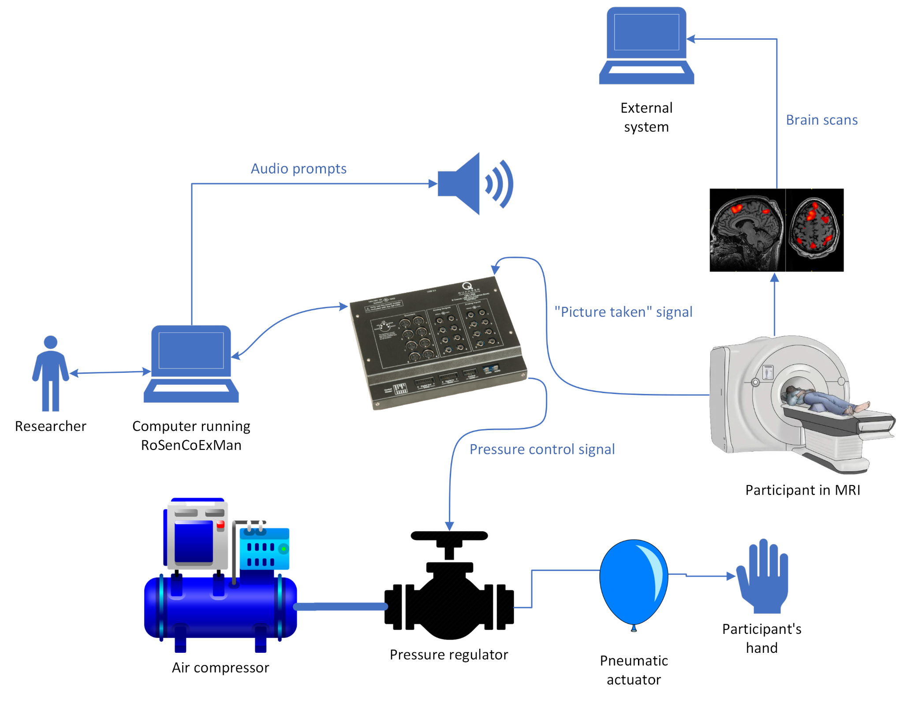
Physical setup

Slide 10
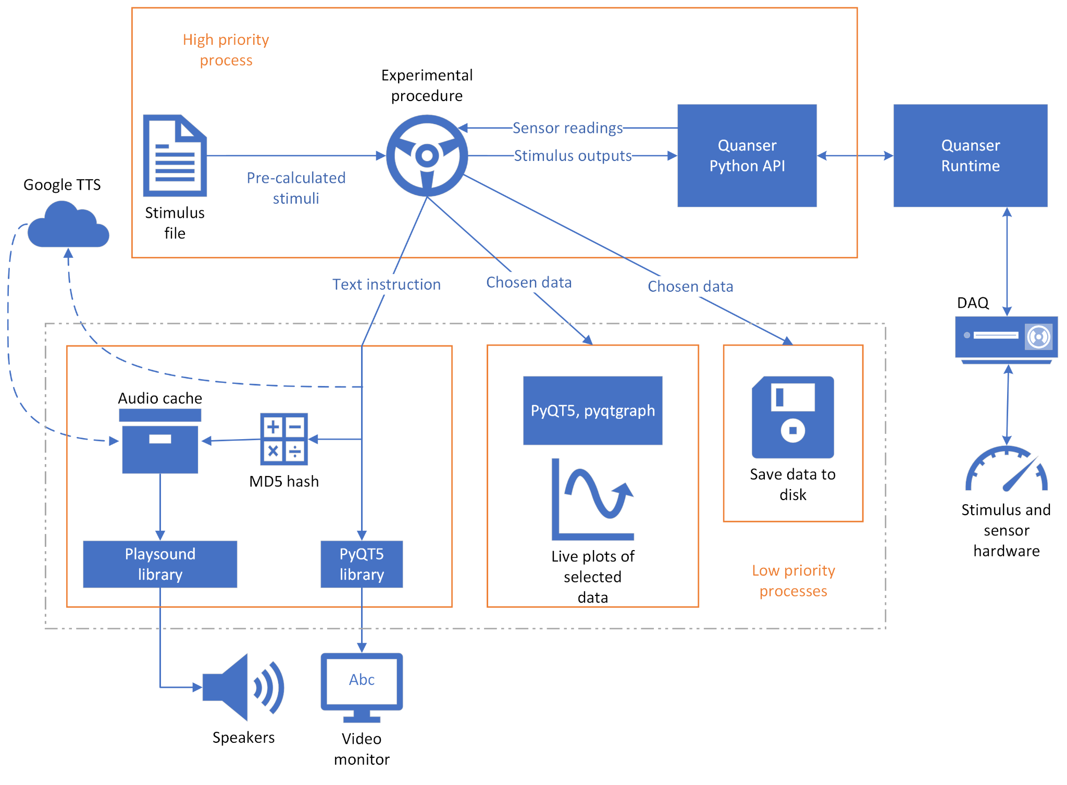
Software
Architecture

Slide 11
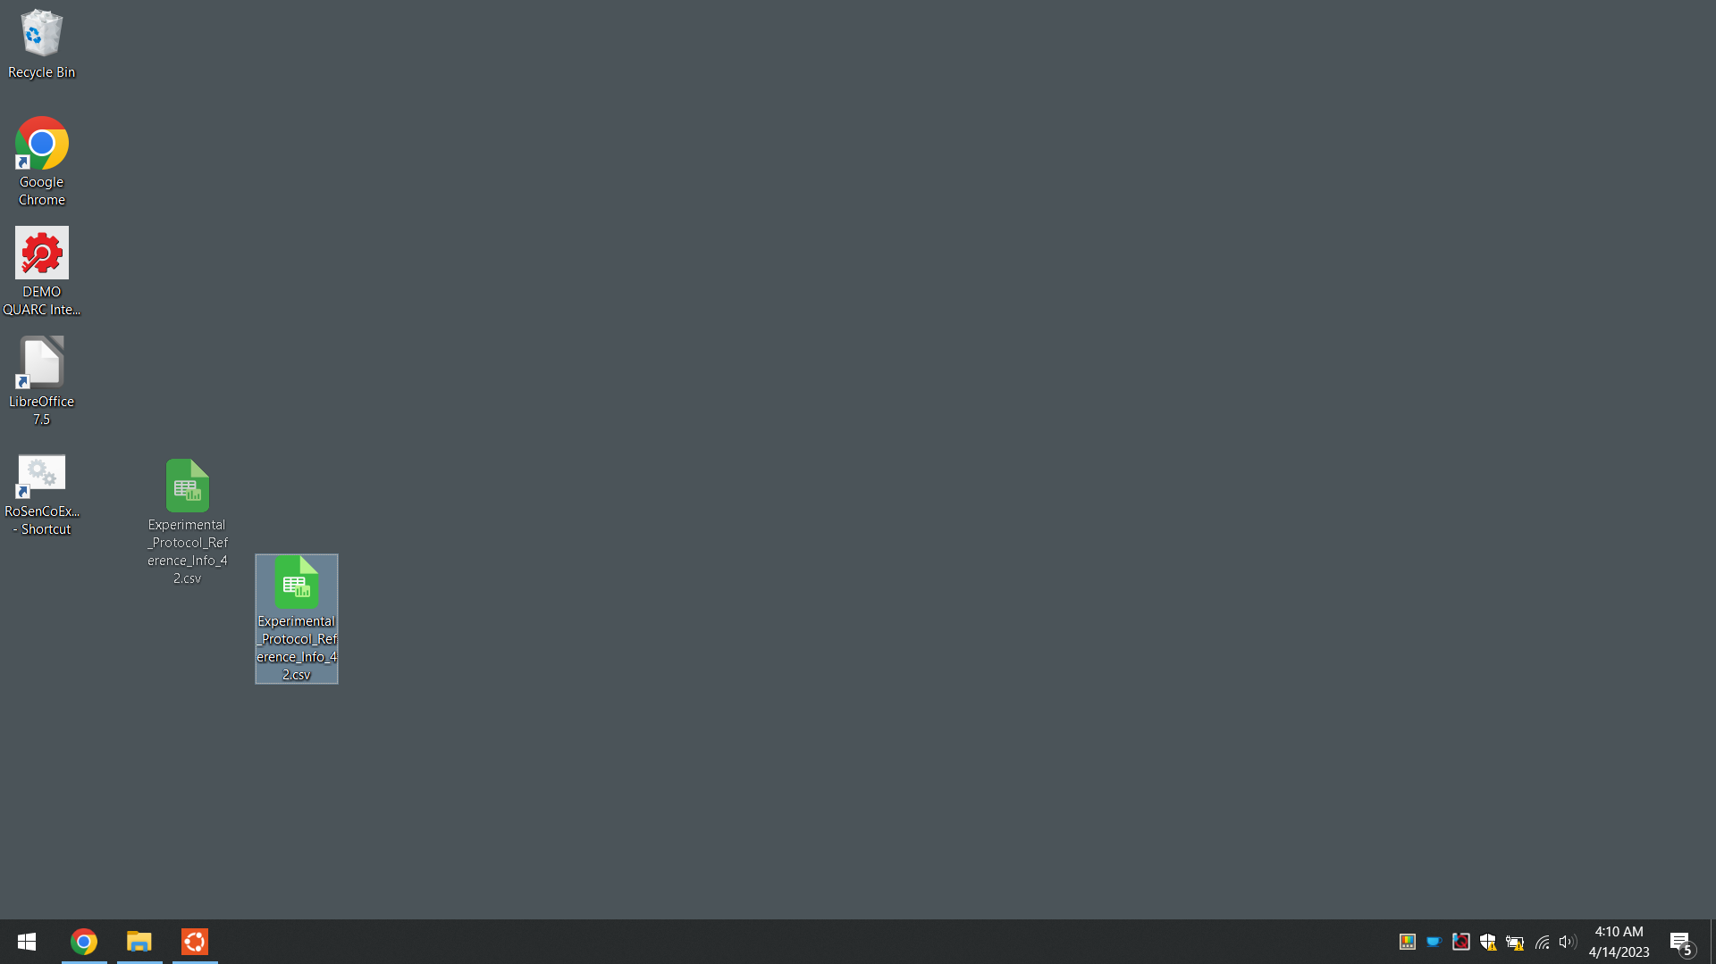

Slide 12
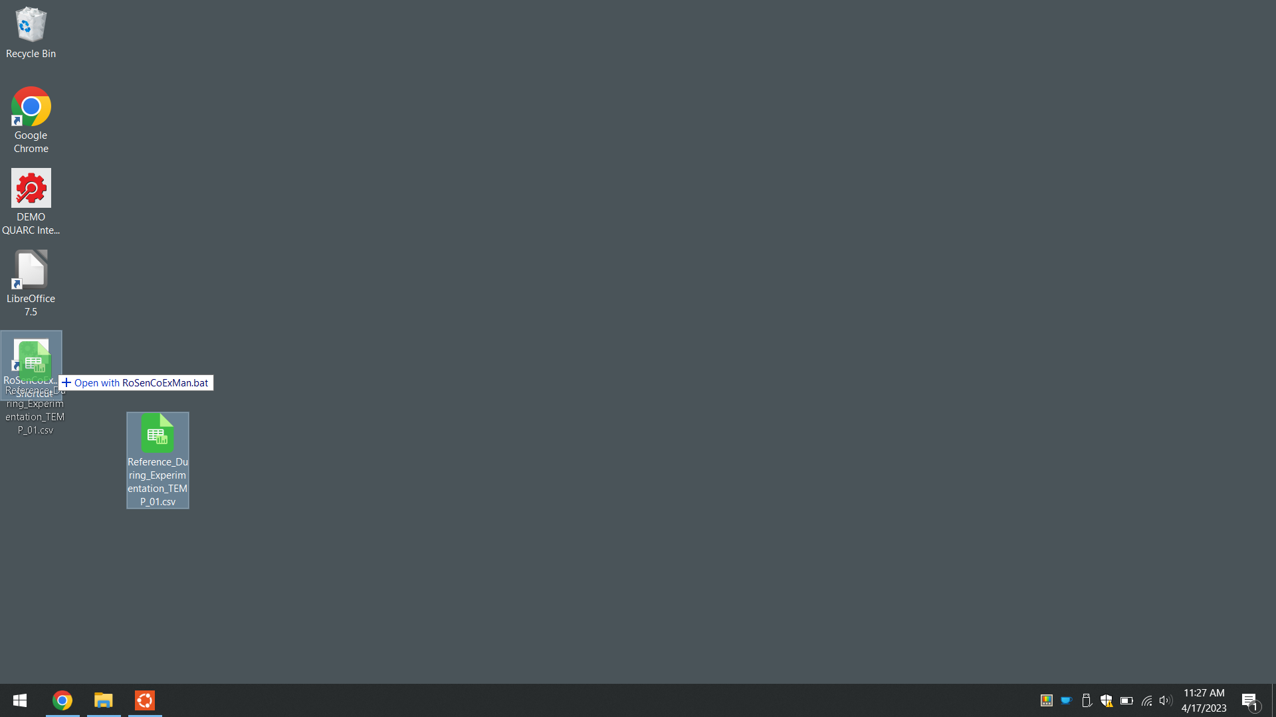

Slide 13
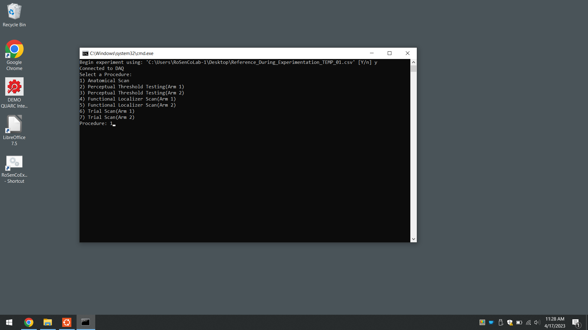

Slide 14
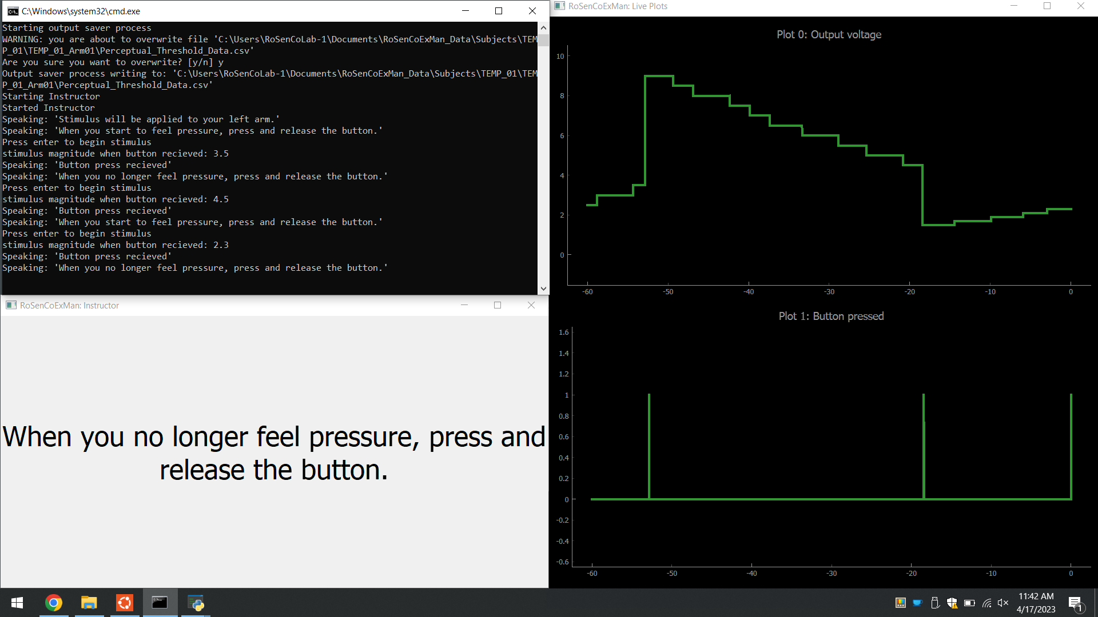

Slide 15

Text to speech
Initially selected Mozilla TTS as the text-to-speech engine
Produces fairly natural-sounding results
Generation is done locally, so no internet required
Uses a ~300MB model
Dependency conflict with the live-plotting library

Slide 16

Text to speech cont.
Pivoted to gTTS
Wrapper for calls to Google Translate’s tts
Sounds even better
Much faster than Mozilla TTS
Requires internet at time of generation, but results are cached
No dependency conflict!

Slide 17
Performance
The data input/output needs to run at 1000Hz to 4000Hz.
  Currently running at 1600Hz.
Simple reading and writing uses 8% of the period, leaving plenty of time for experiment logic.
Currently, most “expensive” experimental procedure takes about 30%
Time-sharing OSs have inherent non-determinism.
  Not an issue because DAQ hardware reads samples exactly on time, and buffers them.

Slide 18
Future work
Integration of GUI created by other student teams this semester.
More advanced visuals for planned interactive experiments.

Slide 19
Acknowledgements
Dr. Fox
Dr. Gurari
Anna Feldbush
Grants
  Department of Biomedical Engineering and Mechanics Start-up Funds, Virginia Tech
  Institute for Critical Technology and Applied Science Junior Faculty Program, Virginia Tech

Slide 20
Image credits
[1] https://github.com/mozilla/TTS
[2] https://commons.wikimedia.org/wiki/File:Google_Translate_logo.svg

